Slide 1

Intrusion Detection System (IDS)
Esad Engin IŞIK 22011602
Emir Kerem ÖZTÜRK 20011613
Şeyda Şeyma BALCI 21011617
Atahan UZ 21011019

Slide 2
What is IDS?
Definition
An Intrusion Detection System (IDS) is a security tool used to monitor network traffic for suspicious activity and potential threats.
Multiple types of IDS
Host-based
Network-based
Hybrid
Active and Passive monitoring of the Network

Slide 3
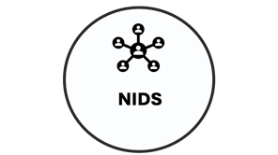
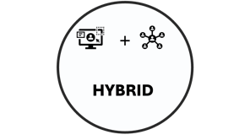

Types of Intrusion Detection Systems

Slide 4

HIDS

Slide 5
Host Intrusion Detection System (HIDS)
Works independently on each separate device.
Most common areaOnly monitors and reacts to the malicious activity that is happening on the device that HIDS is set up.
Works by comparing files to how they were before and after detecting malicious activity on the device.
s of use:
Databases: Monitors database activities.
Endpoints: Laptops, desktops and mobile devices.
Virtual Machines and Cloud
Servers: Web servers.

Slide 6

NIDS

Slide 7
Network Intrusion Detection System (NIDS)
Works for the entire Networks traffic.
Key features include; Signature and Anomaly based detection and real time alerts.
Works by capturing data packets as they travel across the network, analyzing them and detecting patterns or anomalies that suggest malicious activities.
Most common areas of use:
Data Centers
Enterprise Networks
Critical Infrastructure

Slide 8

HYBRID

Slide 9
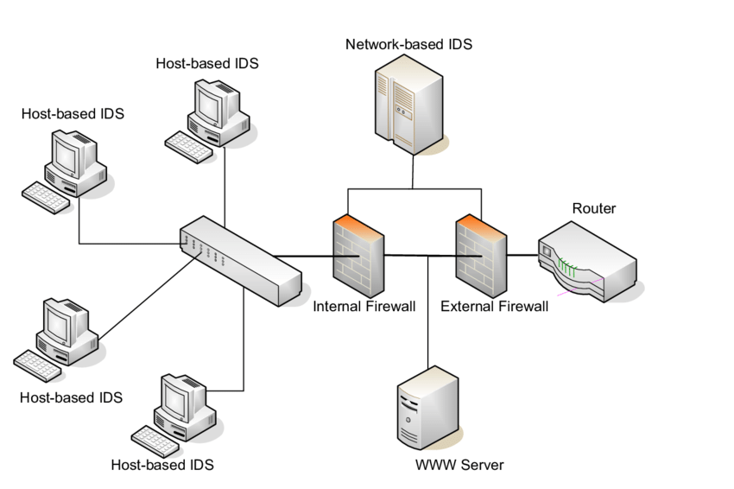
Hybrid IDS
Works by combining both HIDS and NIDS types into one.
Most common areas of use:
Government and Military.
Educational Institutions.
Large Enterprises.

Slide 10
How does it work?
IDS monitors the computer network to detect malicious activity.
Analyzes the data in the network traffic and searches for patterns and signs of irregular behavior in the network.
IDS compares the suspicious activity to a set of rules.
If the suspicious activity matches these set of rules, an alarm is rang and the system admin is alerted.

Slide 11
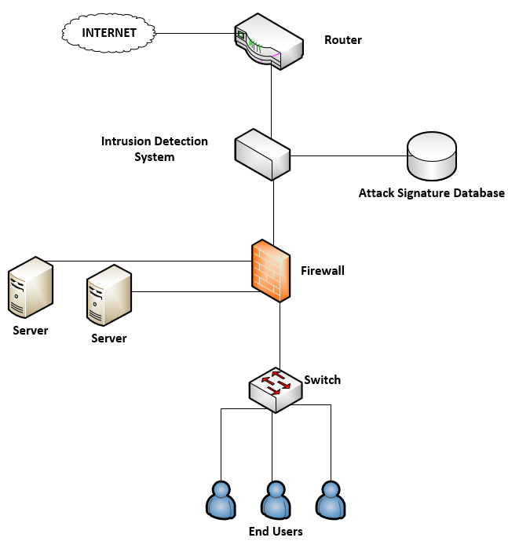
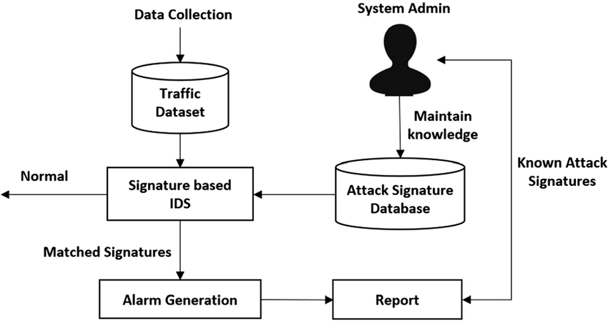
Methods
Signature-based Method
Anomaly-based Method

Slide 12
Signature-based Method
Signature-based NIDS monitors packages inside of a Network. Pre-determined attack patterns are known as signatures.
Example: Checks the spesific byte patterns of a network traffic.
Signature-based IDS is a very effective method but, when an unknown attack is happening on the Network it doesn’t recognise it.

Slide 13
Anomaly-based Method
Anomaly-based NIDS monitors network traffic and compares it with a baseline. This baseline decides what is «accepted» for that network.
Malicious codes constantly get better therefore this method uses machine learning to create a trustful activity model. If the activity doesn’t fit the model, it’s reported as suspicious.

Slide 14
Intrusion Detection System Evasion Techniques
Types of IDS evasion techniques:
Fragmentation: Dividing big packets into smaller ones to make the malware harder to detect.
Encryption: Even though the default use is to protect private data, it is also used to hide malicious data.
Traffic Obfuscation: Making the message more complicated to interpret.
Coordinated, low-bandwidth attacks: Multiple attackers attacking a network with coordination in low-bandwidth to overwhelm the IDS.

Slide 15
Placement of IDS
Ideal placement for an IDS depends on the spesific network. But there are two main approaches.
IDS behind the Firewall:
Firewall is the first filter, dealing with most of the unwanted data. IDS gets to focus only on the internal threats. Potential disadvantage would be that if the firewall fails, IDS couls be reached by the unwanted data.
IDS beyond the Firewall: IDS is the first filter, we get to identify loud noise from the internet and threats before they reach the firewall, it also reduces network load by stopping them outside. An IDS in this position monitors layers 4 through 7 of the OSI model using Signature-based NIDS.
IDS within the Network:
Exposes the attacks within the Network. It is the least used approach.

Slide 16
Benefits
IDS provides in depth defense for a network.
Can detect external hackers, as well as, internal network-based attacks.
Improves the networks performance.
It’s easy to integrate into a network of any size.
Gives administrators the ability to learn and quantify attacks by monitoring the network, and generating reports about the attacks.
Provides an additional layer of protection to a network on top of the Firewall.
It is a self sufficient system that doesn’t need anyone to oversee.
Helps reduce the potential costs that data breaches and security incidents would cause by early detection of threats.

Slide 17
Problems
The main weakness of IDSs are:
(False positive: adds to the unwanted noise of the internet.)
(False negative: IDS doesn’t recognize a threat and deems it trustworthy.)
Has difficulty monitoring busy networks.
Requires to monitor the network full-time.
Finds it difficult to deal with encrypted network traffic.
If the suspicious data is complex and massive it takes time to analyze.

Slide 18
THANKS ☺

