Slide 1
S-72.245 Transmission Methods in
Telecommunication Systems (4 cr)
Transmission Channels

Slide 2
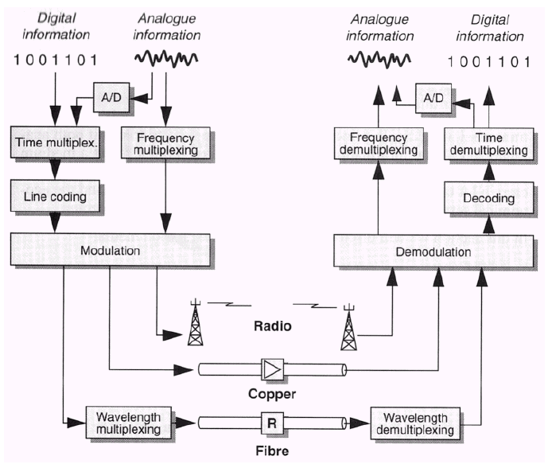
Agenda today
Characterizing channels
  linearity
  non-linearity
  time-variability
Measuring channels
Overview to some channels
  wired channels
    coaxial cables
    twisted cables
  wireless cellular channel
    large-scale path loss
    small scale modeling, e.g
      delay spread
      coherence bandwidth
      Doppler spread
Analog and digital transmission in various channels [8]

Slide 3
Communication channels and medium
A physical medium is an inherent part of a communications system
  Wires (copper, optical fibers) , wireless radio spectra
Communications systems include electronic or optical devices that are part of the transmission path followed by a signal
  Equalizers, amplifiers, signal conditioners (regenerators)
  Medium determines only part of channels behavior. The other part is determined how transmitter and receiver are connected to the medium
  Therefore, by telecommunication channel we refer to the combined end-to-end physical medium and attached devices
Often term “filter” refers to a channel, especially in the context of a specific mathematical model for the channel. This is due to the fact that all telecommunication channels can be modeled as filters. Their parameters can be
  deterministic
  random
  time variable
  linear/non-linear

Slide 4





Guided and unguided medium
Medium convoys message by electromagnetic waves
  wireless/wired (medium)
  baseband/carrier wave (transmission band)
  digital/analog (message format)
In free space information propagates at
Wireless: easy deployment, radio spectra sets capacity limit. Attenuation as function of distance d follows n(f)=2..5 (cellular ch.)
Wired: more capacity by setting extra wires (may be complicated, costly, time consuming). Attenuation as function of frequency follows
, where k(f) is the attenuation parameter, yelding
Therefore, in general, wireless systems may maintain signal energy longer that wired systems. However, actual received power depends greatly on transmission parameters
(omni-directional radiation)

Slide 5
Selecting the medium/media
What is amount of traffic to be distributed?
What is the cost we can afford?
What is the interference environment?
Is mechanical robustness adequate?
Point-to-point or networking usage?
Capability to transfer power (for instance for repeaters)?
Often the first selection is done between
  Wired
  Wireless
Often one can consider if digital or analog message is to be transmitted
  analog PSTN takes 300-3400 kHz
  digital PCM takes 64 kbit/s
  digital, encoded GSM speech only 13 kbit/s
  what is the adequate compression level?

Slide 6





Channels parameters
Characterized by
  attenuation , transfer function
  impedance , matching
  bandwidth , data rate
Transmission impairments change channel’s effective properties
  system internal/external interference
    cross-talk - leakage power from other users
    channel may introduce inter-symbolic interference (ISI)
    channel may absorb interference from other sources
    wideband noise
  distortion, linear (uncompensated transfer function)/nonlinear (non-linearity in circuit elements)
Channel parameters are a function of frequency, transmission length, temperature ...

Slide 7



Data rate limits
Data rate depends on: channel bandwidth, the number of levels in transmitted signal and channel SNR (received signal power)
For an L level signal with theoretical sinc-pulse signaling transmitted maximum bit rate is (Nyqvist bit rate)
There is absolute maximum of information capacity that can be transmitted in a channel. This is called as (Shannon’s) channel capacity
Example: A transmission channel has the bandwidth
and SNR = 63. Find the approproate bit rate and number of signal levels. Solution: Theoretical maximum bit rate is
In practise, a smaller bit rate can be achieved. Assume

Slide 8


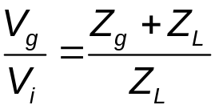
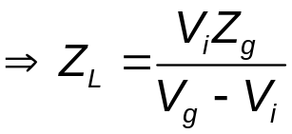


Measuring channels
Parameters of greater interest are transfer function and impedance. Transfer function can be measured by
  launching white noise (in the frequency range to be measured) to the channel (frequency response)
  Launching impulse to the channel (theoretical). In practice, short, limited amplitude pulse will do (impulse response)
  Launching sweeping tone(s) to the channel (frequency response)
Impedance can be measured by measuring voltage across the load in the input/output port:
Transfer characteristics of nonlinear channels can be deducted from generated extra frequency components (we will discuss this soon with non-linearity)

Slide 9
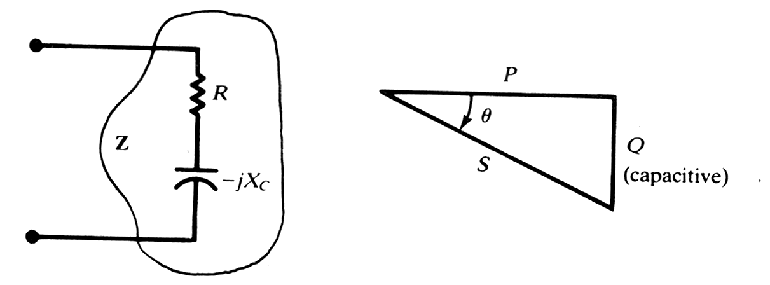
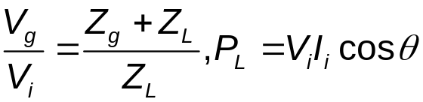
Impedance matching
Example: a capacitive loading impedance;
What is the respective, optimum generator
impedance Z_{g}?
Often (as with coaxial cables) channel interfaces must be impedance matched to maximize power transfer and to avoid power reflections
In applying power to a transmission channel (or a circuit) source and loading impedances must be complex conjugates in order to maximize power dissipated in the load
Perfect match means efficiency of 50%
Setting impedances Z_{g} and Z_{L} to fulfill
this condition is called impedance matching
R
X
Z
Impedance triangle

Slide 10

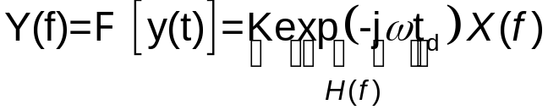





Linear channels [1]
Linear channels have the output that is input signal multiplied by a constant and delayed by a finite delay:
due to the fact that system output is also
Therefore, for linear systems
Linear distortion can be
  amplitude distortion:
  delay distortion:
Solving above gives phase delay, defined by
In distortionless channel all Fourier-components retain their relative phase positions while propagating in channel

Slide 11


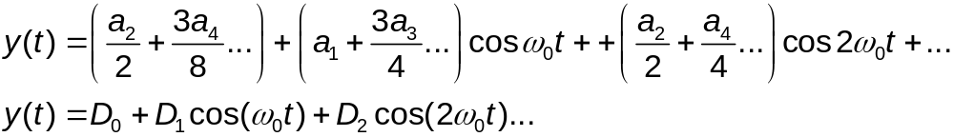

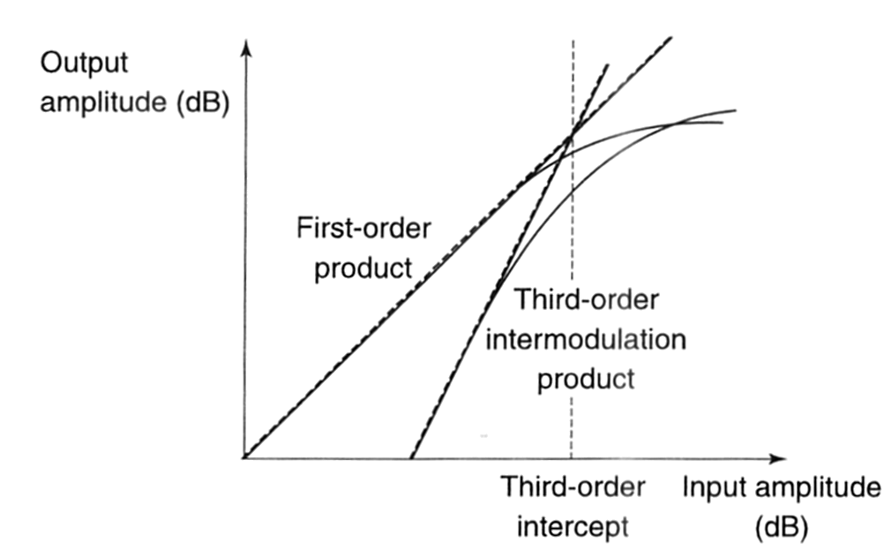

Nonlinear channels[1]
System non-linearity means that its transfer characteristic is nonlinear
For non-linear channels output is
Assume sinusoidal input , then
where D_{n}:s are the distortion coefficients
n:rth-order distortion [%] is determined with respect of the fundamental frequency:
Assume that the input is
3rd order intercept [1,p.55] occurs* where
This is easy to measure and is used
to characterize nonlinear systems
3:rd order intercept [1]
*See the prove in supplementary material (A. Burr: Modulation and Coding)

Slide 12
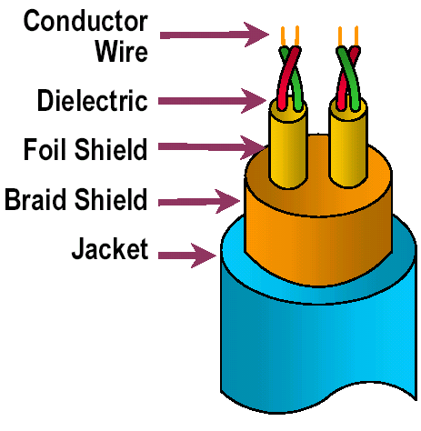
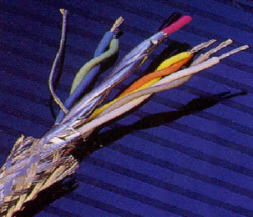
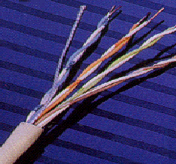
Wireline channels: Twisted pair
Comes in two flavors: Shielded (STP) / Unshielded (UTP)
Twisting reduces interference, and crosstalk (antenna-behavior)
Applications
  Connects data and especially PSTN local loop analog links (Intra-building telephone from wiring closet to desktop )
  In old installations, loading coils added to improve quality in 3 kHz band, resulting more attenuation at higher frequencies (ADSL )
  STP used especially in high-speed transmission as in token ring-networks
structure
STP-cable
UTP-cable
larger attenuation
higher rates
more expensive
more sensitive to interference
easy to install and work with
example: 10BaseT Ethernet

Slide 13
Twisted pair - UTP categories in LANs
Category 1: mainly used to carry voice (telephone wiring prior to 1980). Not certified to carry data of any type.
Category 2: used to carry data at rates up to 4Mbps. Popular for older Token-passing ring LANs using 4Mbps specs (IEEE 802.5). Rated bandwidth 1 MHz.
Category 3: known as voice grade. Used primarily in older Ethernet 10base-T LANs (IEEE 802.3). Certified to carry 10Mbps data. 16Mhz. 3-4 twists/feet.
Category 4: primarily used for token-based or 10Base-T. 20MHz.
Category 5: most popular Ethernet cabling category. Capable of carrying data at rates up to 100 Mbps (Fast Ethernet, IEEE 802.3u) and used for 100 base-T and 10base-T networks. Rated to 100 MHz. 3-4 twists/inch.

Slide 14
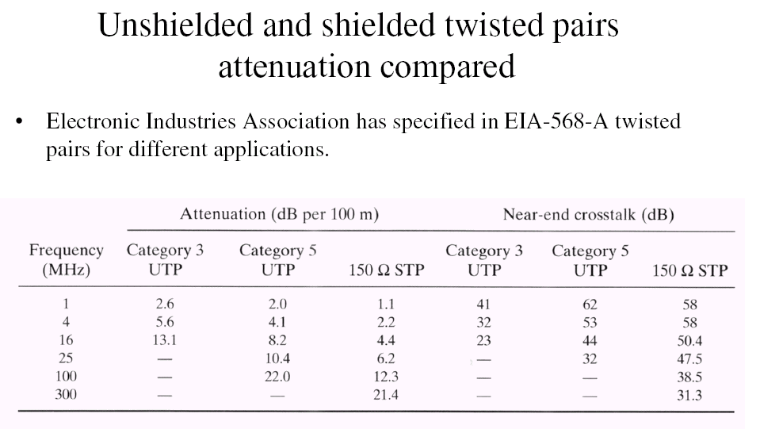

Slide 15
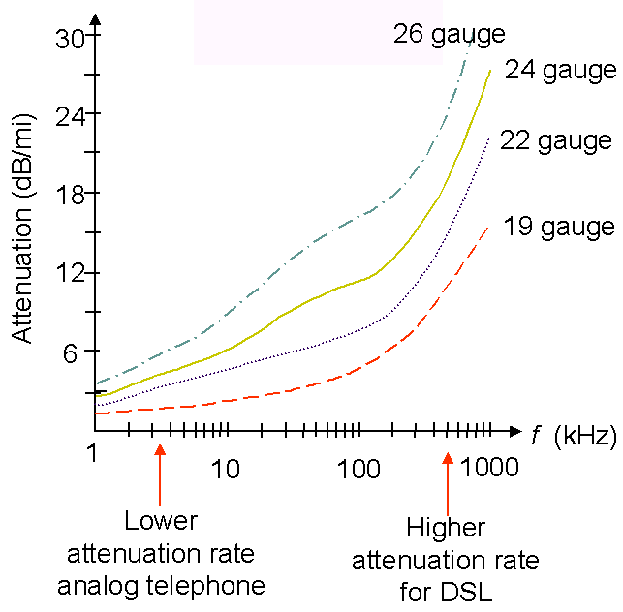
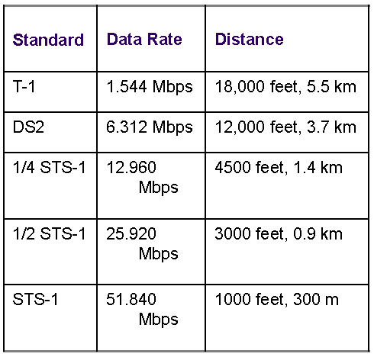
Twisted pair - application examples [6]
Comes in different wire
thickness,
e.g. 0.016 inch (24 gauge)
The longer the cable, the
smaller the bandwidth
DS-1
DS-2
Twisted cable attenuations
DS-1,DS2: Digital Signal 1,2
Synchronous Digital Hierarchy (SDH) levels
STS-1: Synchronous Transport Signal level-1,
Synchronous Optical Network’s (SONET) physical
level signal
Data rates & distances for 24-gauge twisted pair

Slide 16
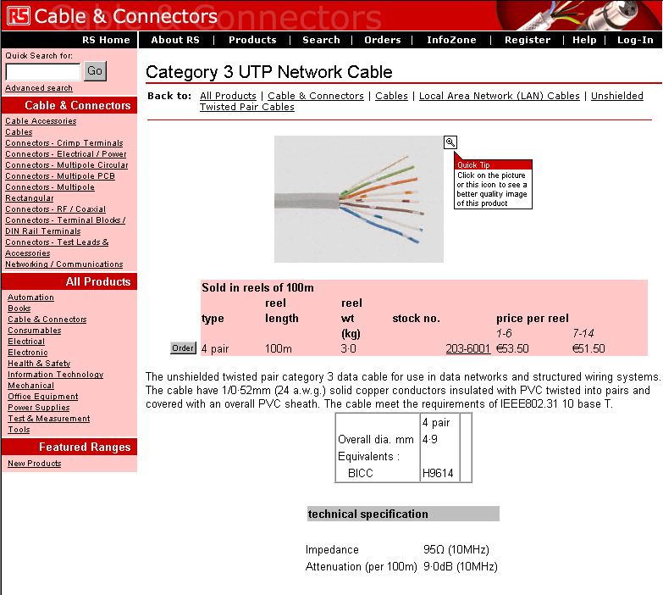
www.yleiselektroniikka.fi

Slide 17
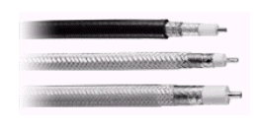

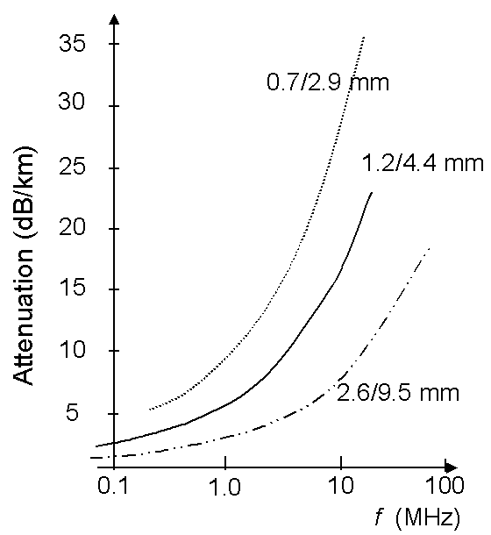
Wireline channels: Coaxial cables
Mechanics
  Cylindrical braided outer conductor surrounds insulated inner wire conductor
Properties
  Well shielded structure -> immunity to external noise
  High bandwidth, up to Ghz-range (distance/model)
Applications
  CATV (Cable TV networks)
  Ethernet LANs
  Earlier a backbone of PSTN
practical structures
Center conductor (copper)
Dielectric material
Braided outer conductor (metal mesh)
Outer cover

Slide 18
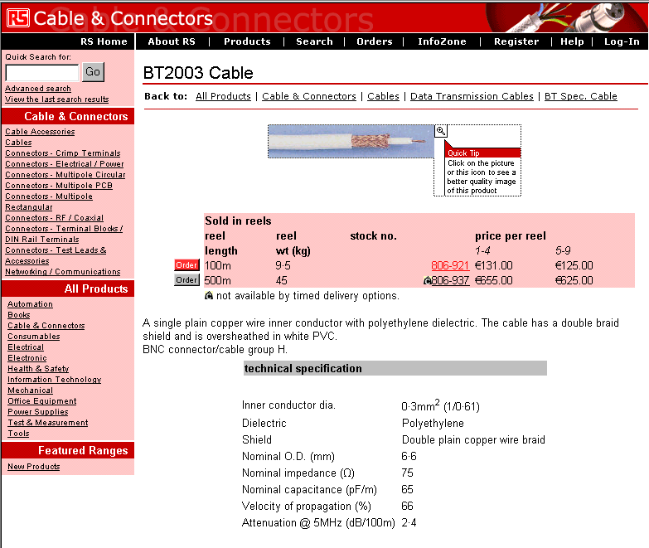

Slide 19
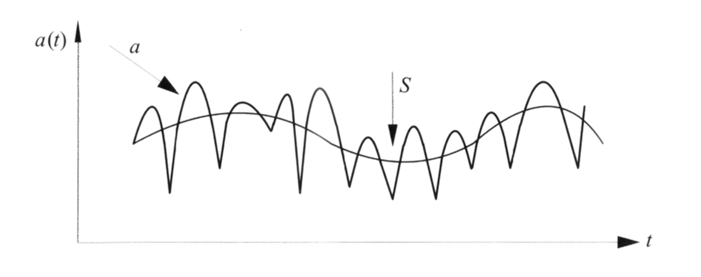
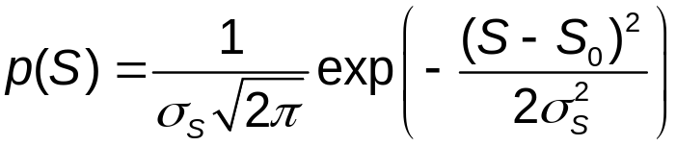

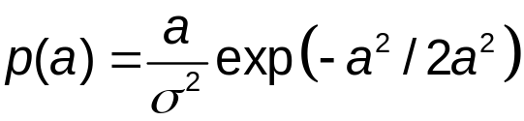
Slow (S) and fast fading (a) in cellular channel
Fluctuation of received power in cellular channel [4]
Received power fluctuations can be modeled to consist of:
  Shadow fading, slow rate, local averaged signal power component has a Gaussian distribution (in dB) (Caused by larger obstacles between TX and RX)
  Rayleigh/Rice fading, high rate component due to various sources of multipath. Rayleigh distribution (non-line of sight path) is defined as
  high rate Doppler shifts
(global, average power)

Slide 20
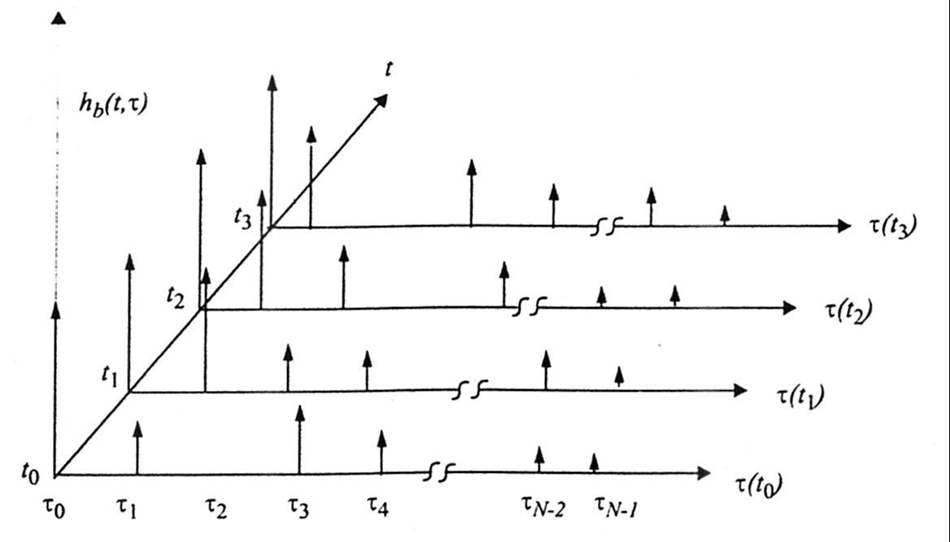
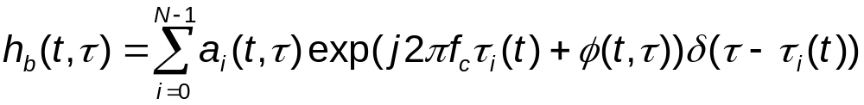
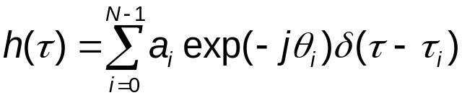
Wideband Channel Impulse
Response [7]
The time variable channel impulse response is
For time invariant channels each impulse response is the same or has the same statistics and then

Slide 21
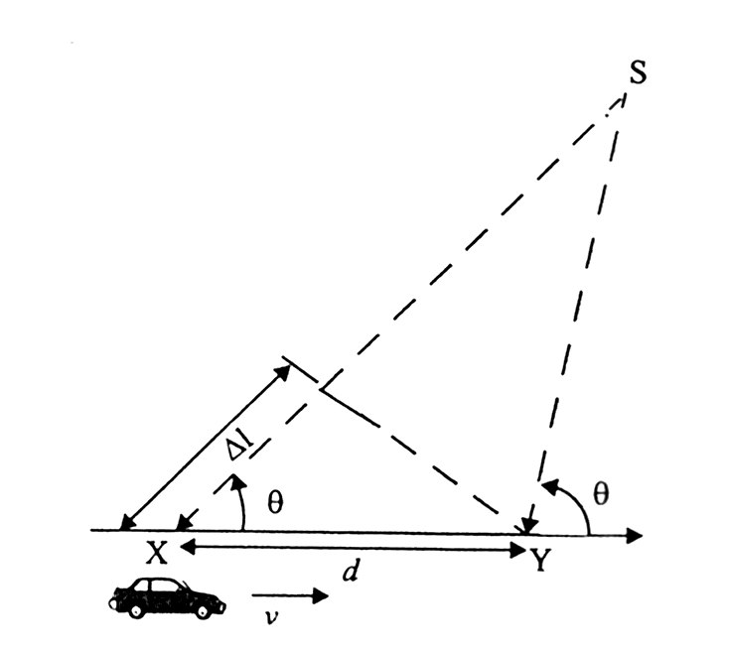

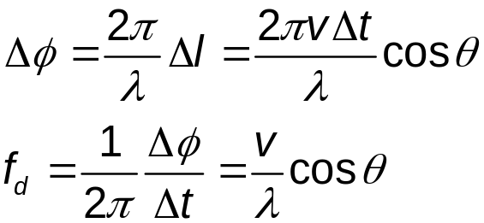
Doppler bandwidth
Multipath created small-scale fading effects
  rapid changes in signal strength due to movement and/or time
  random frequency modulation due to Doppler
  shifts on different multipath propagation paths
  time dispersion due to multipath propagation delay
The difference in path lengths to X & Y from
source S is
The phase change between locations X & Y
is then
*
Doppler effect [7]
*
Angular frequency is the derivative of angular phase
see also slides of frequency modulator later

Slide 22
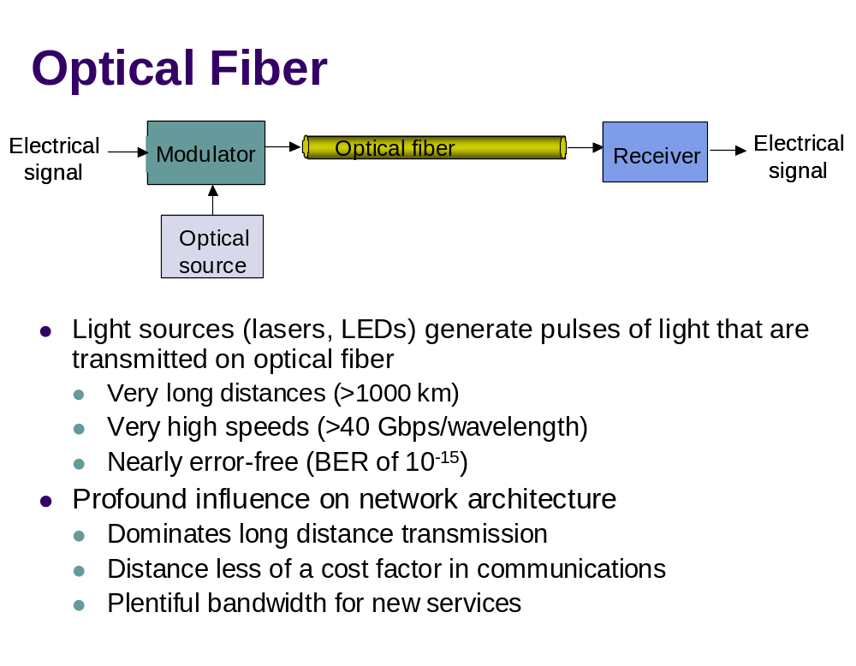
ref [6]

Slide 23
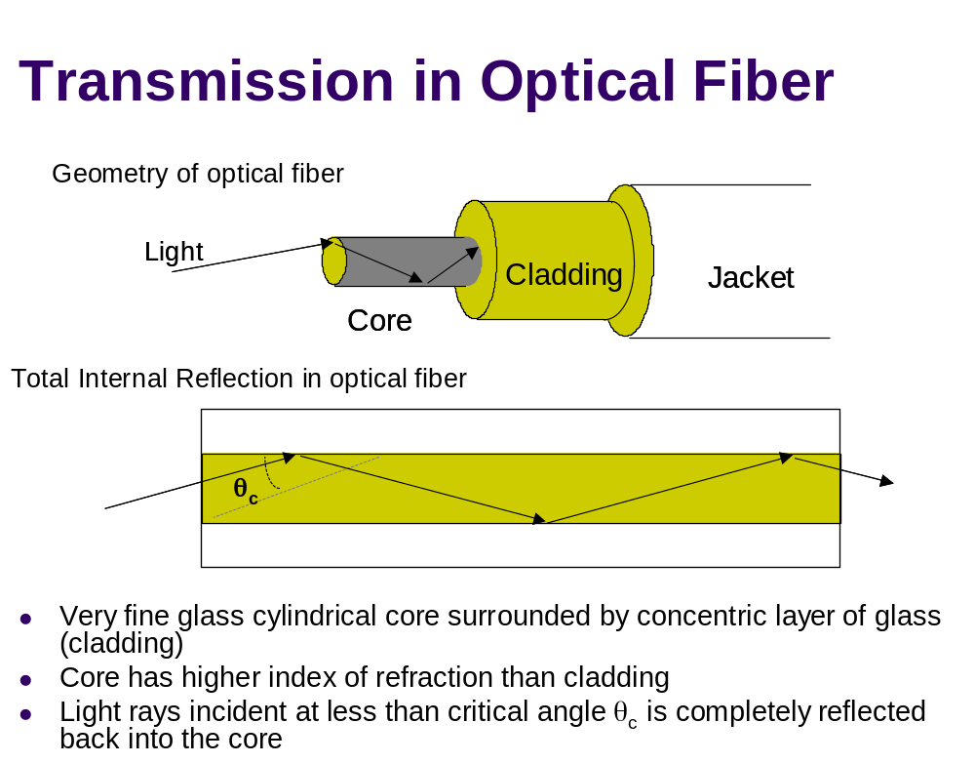
ref [6]

Slide 24
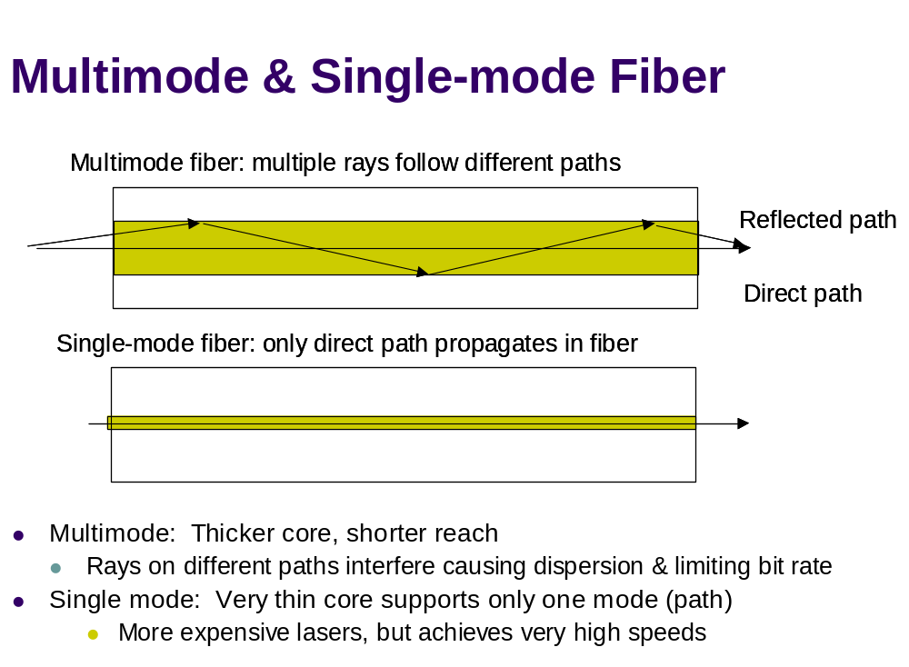
ref [6]

Slide 25
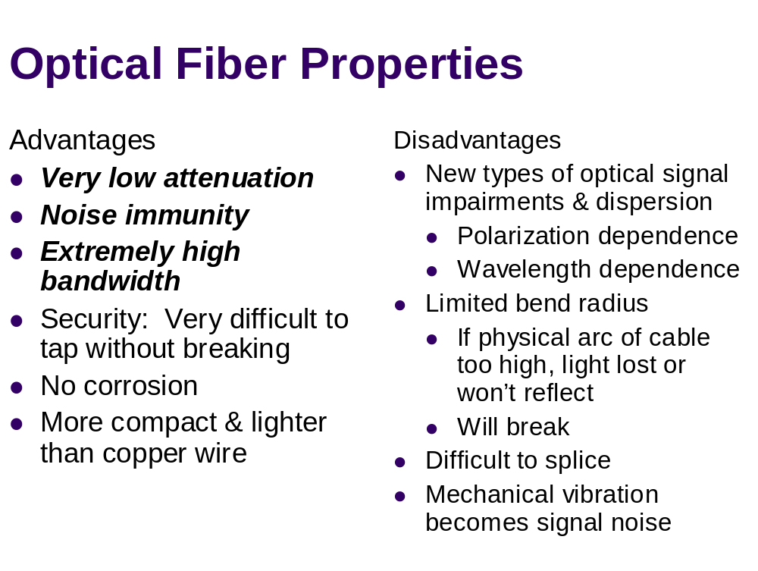
ref [6]

Slide 26
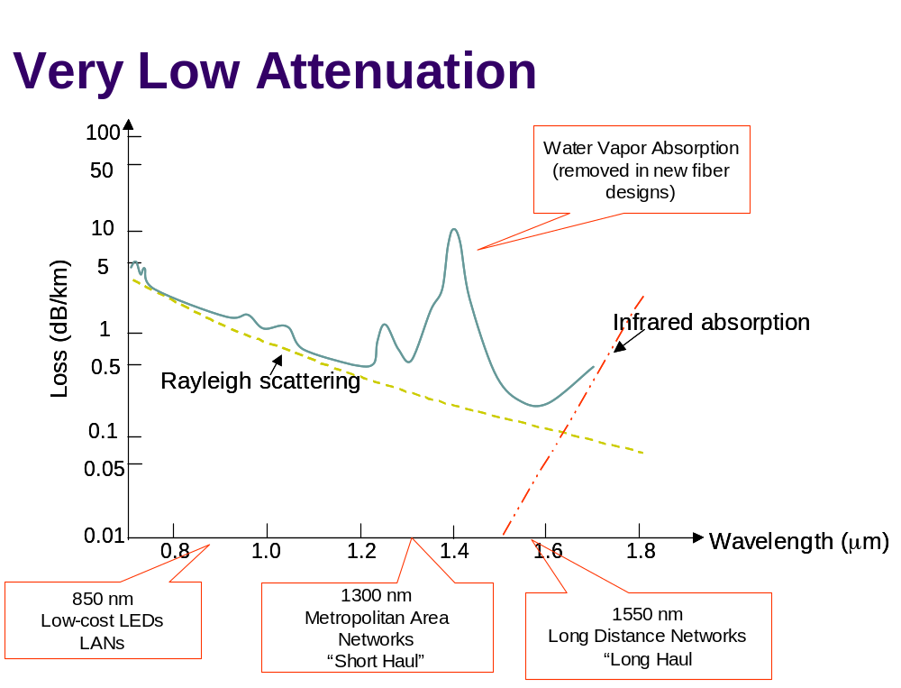
ref [6]

Slide 27
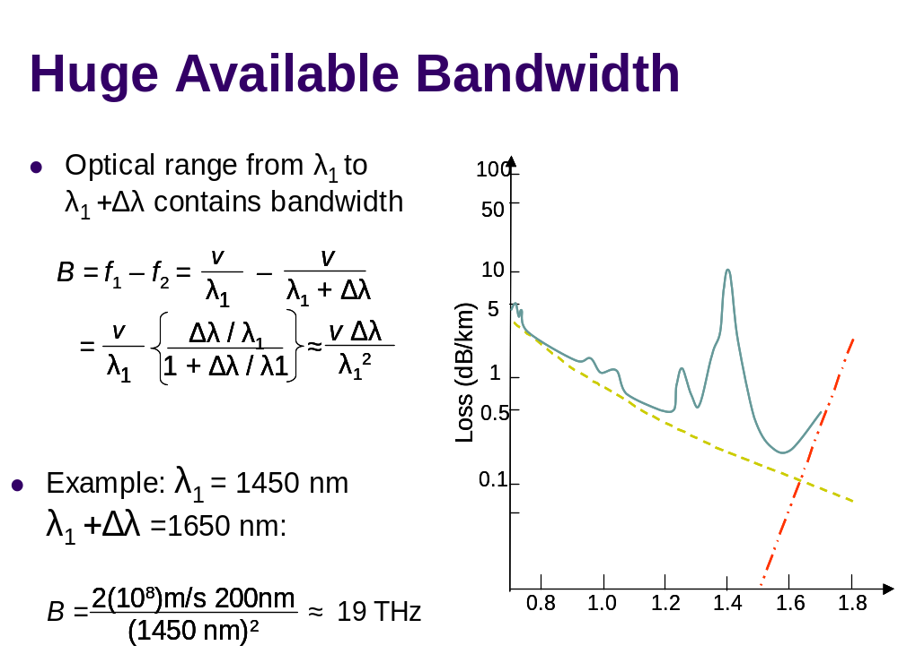
ref [6]

Slide 28
References
1 A. Burr: Modulation & Coding
2 A.B. Carlson: Communication Systems (4th ed)
3 S.J. Halme:Televiestintäjärjestelmät (isbn 951 672 238 5)
4 Ahlin, Zhanders: Principles of Wireless Communications
5 W. Stallings: Wireless Communications and Networks
6 A. Leon-Garcia, I. Widjaja: Communication Networks (extracts from instructors slide set)
7 T. Rappaport: Wireless Communications, Prentice Hall
8 Telia, Ericsson: Understanding Telecommunications, Student Litterature

