Slide 1
Event Driven Architecture & Kafka
1

Slide 2
1 Why Event Driven Architecture?
2

Slide 3
Traditional Approach:
3

Slide 4

Event Driven Approach:
4

Slide 5
Traditional Vs Event Driven Approach
* Targeted
* Conversational
* Transient
* Scalable
* Event Log
* Permanent
5

Slide 6
Why Event Driven Architecture ?
* Realtime Processing
* Extensive Streaming
* Pluggable Microservices
6

Slide 7
2 What is Event Driven Architecture?
7

Slide 8
Event Driven Architecture
* Event-driven architecture refers to a system of loosely coupled microservices that exchange information between each other through the production and consumption of events.
* enables events to be ingested into the event driven ecosystem and then broadcast out to whichever services are interested in receiving them
8

Slide 9
Events
* “A significant change in state”
* Immutable (cannot be changed or deleted)
* Ordered in sequence of their creation
* published by a service and Consumed by service(s)
9

Slide 10

10

Slide 11
Benefits
* Availability
* Easily Rollback
* Transactions
* Stores Intent
11

Slide 12
Drawbacks
* Consistency
* Less Control
* Hidden Flow
* Migration (to Req-Res)
12

Slide 13
3 Spring Cloud Stream with Kafka Binder
13

Slide 14

Spring Cloud Stream
* Spring cloud stream is a framework that will handle the implementation of message Broker
14

Slide 15
Spring Cloud Stream Application types:
* Source
* Sink
* Processor
15

Slide 16
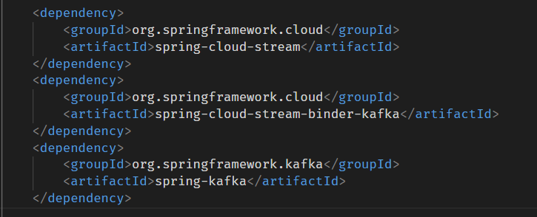
16

Slide 17
# Source:
It will publish the event to the message broker
17

Slide 18
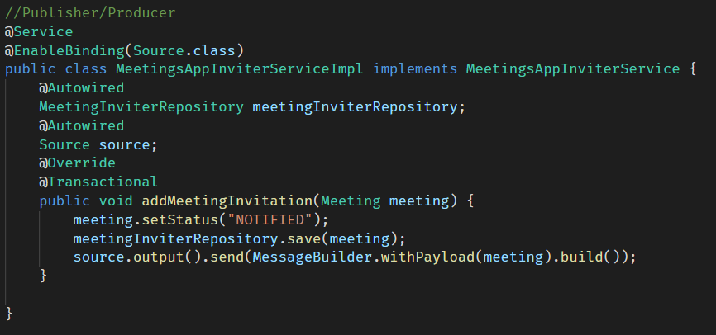
18

Slide 19
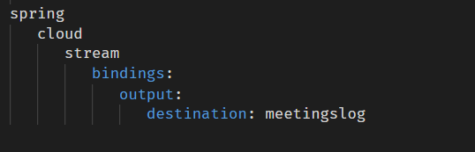
19

Slide 20
# Sink:
It will consume the event from the message broker
20

Slide 21
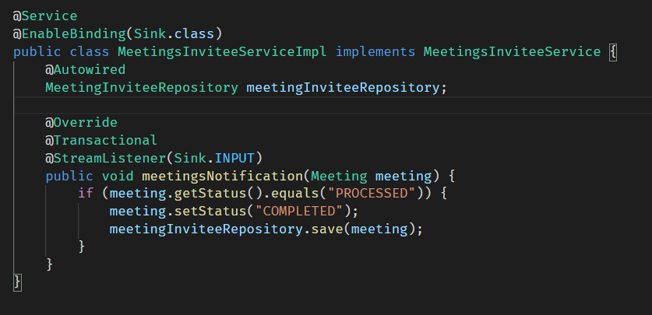
21

Slide 22
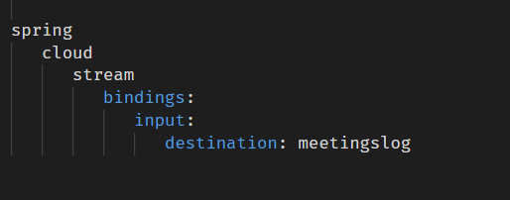
22

Slide 23
# Source+Sink:
It will publish+subscribe the event from the message broker
23

Slide 24
24

Slide 25
25

Slide 26
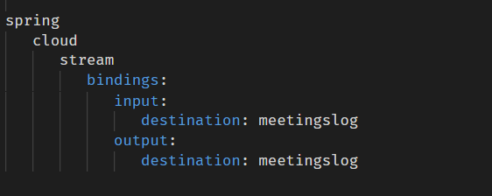
26

Slide 27
#
*
27

