Slide 1

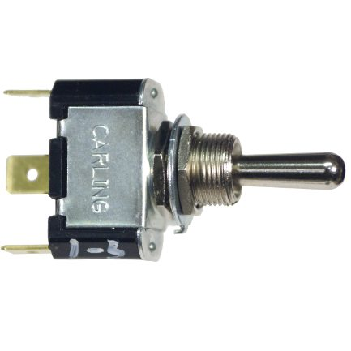
Extending MSFS with hardware cockpit components
Minimal code for a single ON/OFF switch
(not a HID device based solution)
Gábor Hraskó
December 2020

Slide 2
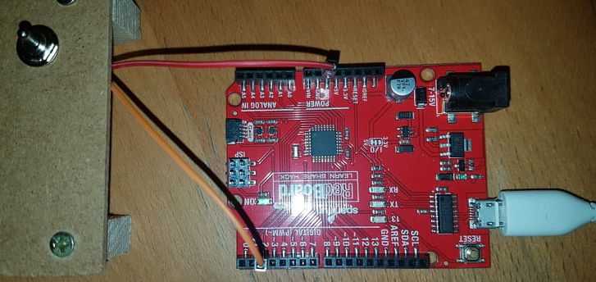

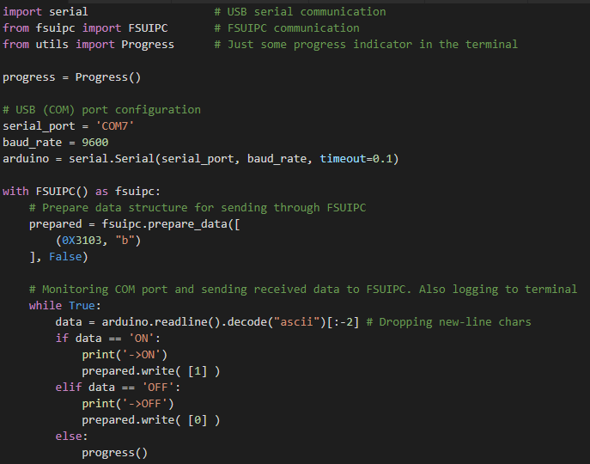

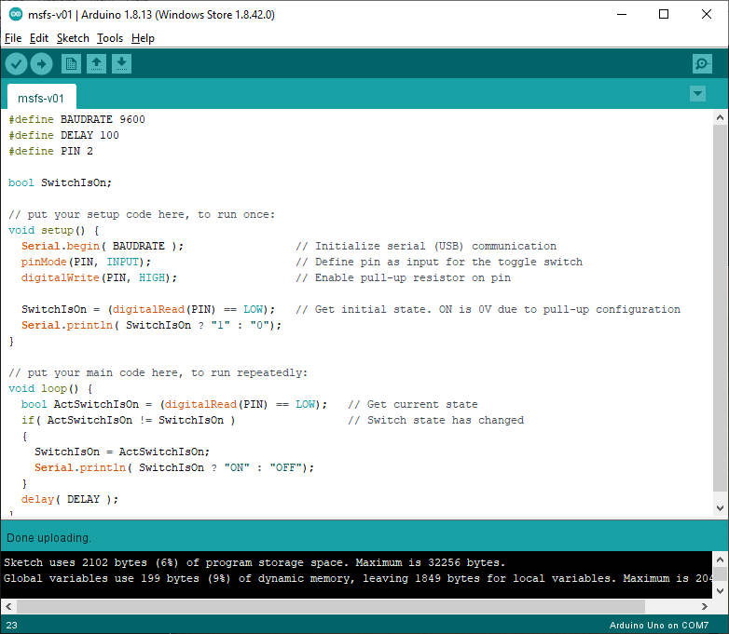

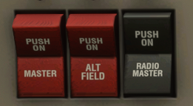

ON-OFF switch for controlling Radio Master switch in MSFS 2020
Arduino compatible card
Windows 10 PC
Arduino program (C++) in Arduino IDE
Python 3.5+ program on the PC
(pyserial and fsuipc libs)
FSUIPC 7
(free version)
MSFS 2020

Slide 3
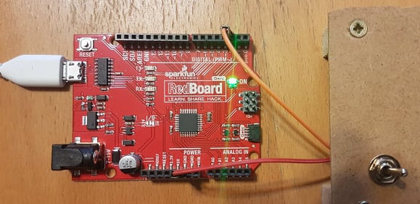
Arduino UNO compatible board with a single ON-OFF switch
Pin 2
ON-OFF switch connections:
GND
Digital pin 2
GND

Slide 4
C++ program for the board developped and deployed in Arduino IDE
You might have to download and install the Windows driver of the board. For my SparkFun RedBoard Qwiic the driver can be found here: https://learn.sparkfun.com/tutorials/how-to-install-ch340-drivers
The COM port number for the USB connection can be found in Windows Device Manager / Ports and it is also displayed at the bottom-left corner of the Arduino IDE window.
#define BAUDRATE 9600
#define DELAY 100
#define PIN 2
#define PIN 13
bool SwitchIsOn;
// put your setup code here, to run once:
void setup() {
Serial.begin( BAUDRATE ); // Initialize serial (USB) communication
pinMode(PIN, INPUT); // Define pin as input for the toggle switch
digitalWrite(PIN, HIGH); // Enable pull-up resistor on pin
SwitchIsOn = (digitalRead(PIN) == LOW); // Get initial state. ON is 0V due to pull-up configuration
Serial.println( SwitchIsOn ? "1" : "0");
}
// put your main code here, to run repeatedly:
void loop() {
bool ActSwitchIsOn = (digitalRead(PIN) == LOW); // Get current state
if( ActSwitchIsOn != SwitchIsOn ) // Switch state has changed
{
SwitchIsOn = ActSwitchIsOn;
Serial.println( SwitchIsOn ? "ON" : "OFF"); // Sending the state via USB (COM)
digitalWrite(LEDPIN, SwitchIsOn ? HIGH : LOW); // Display status on the on-board LED
}
delay( DELAY );
}

Slide 5
Python 3 program as USB – FSUIPC connector on the PC
C:\> cd \venvs
C:\venvs> py -m venv msfs
C:\venvs> cd msfs
C:\venvs\msfs> Scripts\activate
(msfs) C:\venvs\msfs> python -m pip install --upgrade pip
(msfs) C:\venvs\msfs> pip install pyserial
(msfs) C:\venvs\msfs> pip install fsuipc
import serial # USB serial communication
from fsuipc import FSUIPC # FSUIPC communication
# USB (COM) port configuration
serial_port = 'COM7'
baud_rate = 9600
arduino = serial.Serial(serial_port, baud_rate, timeout=0.1)
with FSUIPC() as fsuipc:
# Prepare data structure for sending through FSUIPC
prepared = fsuipc.prepare_data([
(0X3103, "b")
], False)
# Monitoring COM port and sending received data to FSUIPC. Also logging to terminal
while True:
data = arduino.readline().decode("ascii")[:-2] # Dropping new-line chars
if data == 'ON':
print('->ON')
prepared.write( [1] )
elif data == 'OFF':
print('->OFF')
prepared.write( [0] )
Comments:
Setting up python virtual environment with the two required libs
Card is connected via COM7
FSUIPC offset of avionics switch is 0x3103, type is 8 bit unsigned
FSUIPC functions expect array inputs even if we have a single value, so we pass the parameters as a 1-member arrays
Logging to stdio

Slide 6

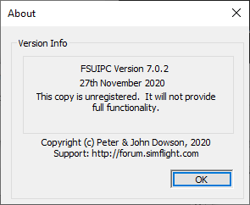
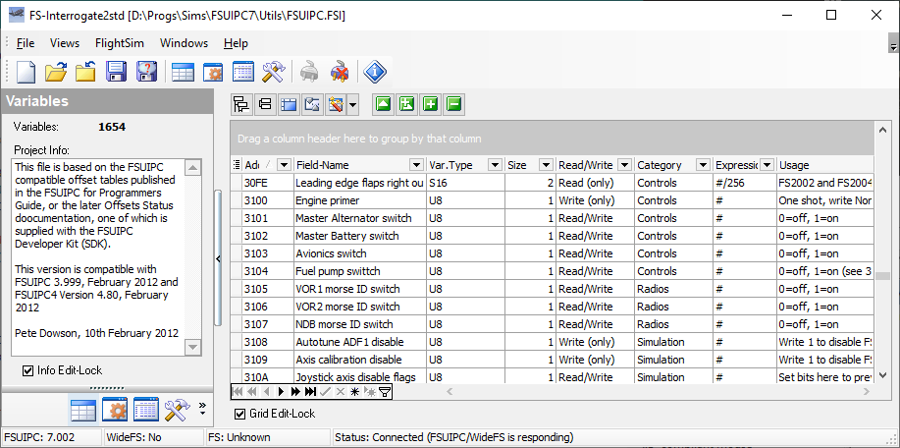
Connecting to MS Flight Simulator via FSUIPC 7 (free version)
Download FSUIPC 7 from the author Pete Dowson’s page
(http://www.fsuipc.com/) and run FSUIPC7.exe.
You might use FS-Interrogate from the package’s Utils folder to check FS variable offsets and value types.

Slide 7
References and links
Arduino boards: https://www.arduino.cc/en/Main/Products
Sparkfun board used in this eyample: https://www.sparkfun.com/products/15123
Sparkfun PC drivers: https://learn.sparkfun.com/tutorials/how-to-install-ch340-drivers
Arduino programming language reference: https://www.arduino.cc/reference/en/
Python pyserial library: https://pypi.org/project/pyserial/
Python FSUIPC library: https://pypi.org/project/fsuipc/
FSUIPC: http://www.fsuipc.com/
Microsoft Flight Simulator: https://www.flightsimulator.com/

