Slide 1
DEGAiN TRAINING COURSE - MODULE 1
Bacterial Recombination
From Biology to Bioinformatics
Odion O. Ikhimiukor
21 July 2026

Slide 2
Learning Objectives for this session
Define recombination and the vocabulary used to describe it
Explain how and why bacteria exchange and rearrange DNA
Use Bioinformatic tools to detect and mask recombinant regions in a dataset
Visualize and estimate recombinational parameters affecting DEC lineages

Slide 3
What we will cover in this training
1 . Lecture
CLASS 1
CLASS 2
Introduction to bacterial recombination
Overview of Bioinformatic Tools.
2 . Hands-on
Practical Sessions

Slide 4
CLASS 1
Introduction to bacterial recombination

Slide 5



First, how does bacteria acquire foreign DNA…..
Horizontal Gene Transfer (HGT)
Transformation
Conjugation
Transduction
Bacterium takes up naked DNA from the environment.
Direct cell-to-cell contact
Phage-mediated DNA transfer.
Burmeister 2015, PMID: 26224621
…and then what? HGT gets you foreign DNA. Recombination may swap it into the chromosome.
5

Slide 6
What is bacterial recombination?
Recombination = the process by which a stretch of DNA in one bacterium is replaced by, or joined to, DNA from another source, producing a new combination of genetic material not present in either parent alone.
The result is a mosaic genome: different regions have different ancestral histories.
Not the same as mutation
Mutation changes DNA one base at a time, gradually.
Recombination moves whole blocks of DNA in a single event so it can change tens to hundreds of positions at once.

Slide 7
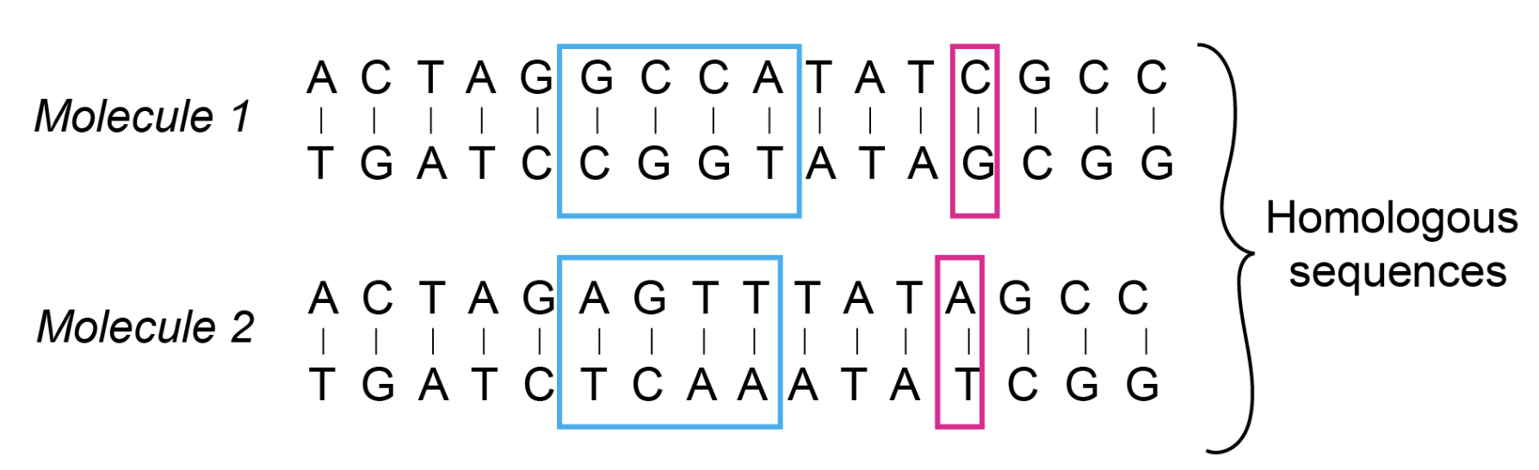
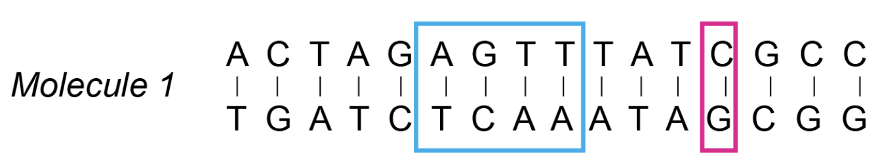
Types of recombination
Homologous
NEEDS SIMILARITY
Exchange between near-identical sequences.
The dominant force reshaping the bacterial core genomes
Chakravarty, goldbio.com
***When bioinformaticians say 'recombination' in phylogenetics, they almost always mean the homologous kind.***

Slide 8
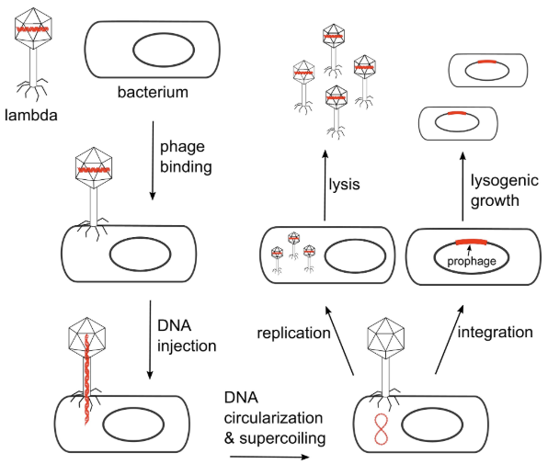
Types of recombination (contd.)
Site-specific
DEFINED SITES
Occurs at specific short recognition sequences, catalysed by dedicated recombinases (e.g., phage integration, integrons).
Duyne and Landy, 2024: PMID:38372210

Slide 9
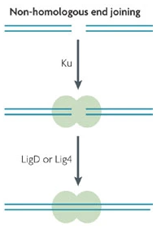
Types of recombination (contd.)
Illegitimate / NHEJ
LITTLE/NO SIMILARITY
Joining of largely unrelated sequences. Rarer, often mediated by transposons or error-prone repair.
NHEJ – Non-homologous end joining

Slide 10
What recombination does to a phylogeny
Raw tree vs. Recombination-masked tree
• Branches containing many recombination events become artificially long.
• Tree topology can be wrong: isolates cluster by shared imports, not ancestry.
• Molecular clock signal is corrupted: dating analyses (BEAST, BactDating) drift.
• Ancestral state reconstruction on affected regions is unreliable.
raw
after masking
Donor ancestry
Red = branches inflated by recombination SNPs. After masking, the clonal signal emerges.
AAAAAAAAAAABBBBBBBBBBBBBBBCCCCCCCCCCCCC
Original ancestry
Original ancestry

Slide 11
Why does it happen?
1
Repair damaged DNA
2
Acquire new functions
3
Generate diversity
4
Purge harmful mutations
Bacterial Evolution

Slide 12
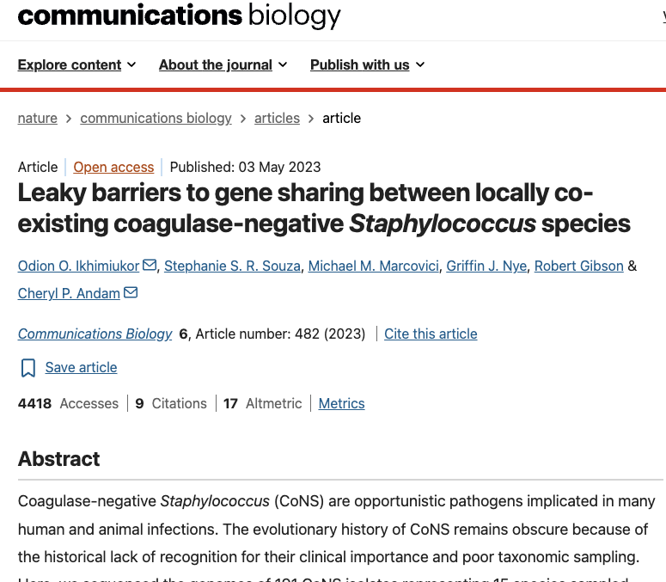
Identify Host-donor gene sharing relationship

Slide 13
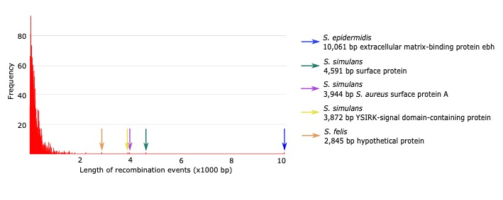
Micro- and macro-recombination in Coagulase Negative S. aureus (CoNS)
1882 recombination events
Median 242 bp

Slide 14
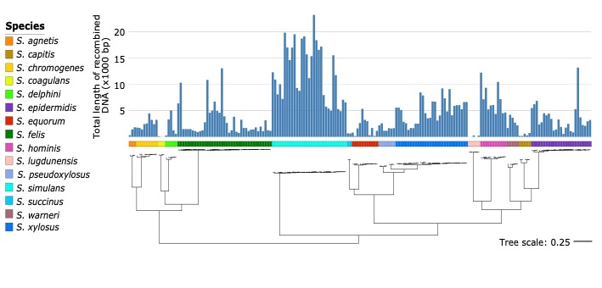
Varying rates of recombination

Slide 15
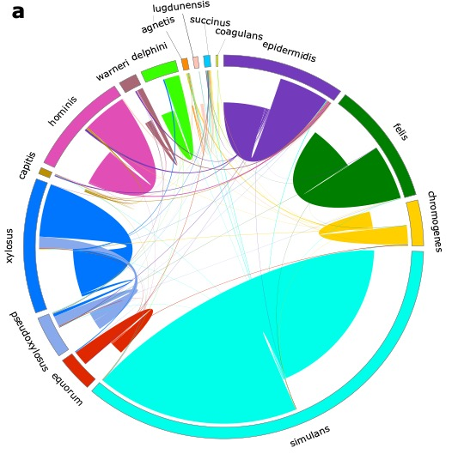
Leaky barriers to DNA recombination
Partner bias:
pseudoxylosus + xylosus
epidermidis + hominis

Slide 16
CLASS 2
Overview of Bioinformatics Tools

Slide 17
A branch's SNPs along the genome
sparse = point mutation
dense block = recombination
Job of the Recombination detection tool:
find those blocks and set them aside.

Slide 18

No bioinformatics tool / workflow is universally considered "most correct."

Slide 19
Bioinformatics Workflow
Reads
FASTQ
Snippy
Core / clean
alignment
Gubbins
Phandango / R
map to reference,
call variants
snippy-core →
clean_full_aln
mask
recombination
View/Estimate recombination parameters
Reference
FASTA
MASH
Find best reference genome

Slide 20
What is a reference genome?
A single, high-quality, fully-assembled genome chosen to represent a species or lineage.
It provides a fixed coordinate system: 'position 452,113' means something only relative to a reference.
What makes a good reference?
CLOSENESS
COMPLETENESS
QUALITY & ANNOTATION
FITNESS FOR PURPOSE
Sources:
RefSeq / GenBank,
Curated type strains
Closed genome from your own study.
Rule of thumb: as close as possible, as complete as possible, as is appropriate to the question.

Slide 21
finding a reference genome: MASH
https://github.com/marbl/Mash
Calculates genome distances in a fraction of a second.
No alignment needed.
Genome
Hash k-mers
Keep smallest hashes (sketch -s)
break into k-mers
(k = 21 default)
each k-mer → a number
the MinHash sketch
(s = 1000 default)
Compare two sketches
Shared hashes estimate the Jaccard index J (fraction of k-mers in common). Mash converts that to a distance:
J = Shared sketch / Total Sketch
D = −(1/k) · ln[ 2J / (1 + J) ]
J = Jaccard similarity
D = Mash distance
6

Slide 22
SNIPPY: Reference-based variant calling & alignment
https://github.com/tseemann/snippy
Given a reference genome and reads from one isolate, Snippy chains standard tools to find high-confidence differences.
Snippy-core combines per-isolate results into a whole-genome alignment across all samples.
BWA-MEM
FreeBayes
Filter
SnpEff
Map reads to the
reference genome
Call variants with
haploid settings
Min depth, quality &
variant fraction
Annotate the effect
of each variant
Key output:
core.full.aln - the full alignment with every position for all samples.
clean.full.aln - tidies odd characters → N

Slide 23
GUBBINS
Gubbins = Genealogies Unbiased By recomBinations In Nucleotide Sequences.
1
2
3
4
5
Build a starting tree
Reconstruct ancestors
Scan each branch
Mask recombination
Rebuild the tree
from the remaining clonal SNPs
from the current alignment
infer sequences at internal nodes; assign SNPs to each branch
find regions where SNP density is far above expectation
remove those blocks from the alignment
↻ Repeat until the tree and the recombination predictions stop changing (convergence)
The final tree's branch lengths reflect clonal (point-mutation) divergence only — a fairer basis for dating and transmission analysis.

Slide 24
Output from GUBBINS
1. Recombination-masked tree (…final_tree.tre)
2. Filtered SNP alignment (…filtered_polymorphic_sites.fasta)
3. Predicted recombination regions (…recombination_predictions.gff)
4. Per-branch statistics. A .csv file containing:
Total SNPs
SNPs Outside Recombinations
SNPs Inside Recombinations
Bases in Recombinations (incl / excl gaps)
Cumulative Bases in Recombinations
Genome Length
Number of Recombination Blocks
r/m
rho/theta

Slide 25
r/m vs rho/theta
r / m
rho / theta
SNPs from recombination ÷ SNPs from mutation
recombination events ÷ point-mutation events
Measures IMPACT on diversity
How much of the sequence variation was imported vs. mutated in place.
r/m > 1 → recombination adds more variation than mutation.
Measures FREQUENCY / rate
How often recombination happens relative to mutation.
Counts events, ignoring how many SNPs each one brought.
r/m ÷ rho/theta ≈ average number of SNPs imported per recombination event
A lineage can recombine rarely (low rho/theta) yet still be reshaped a lot (high r/m) if each event imports a large block.

Slide 26
Recombination masking tools
Feature | Gubbins | ClonalFrameML | Verticall
Input | Whole-genome alignment | Whole-genome alignment + phylogenetic tree | Pairwise genome comparisons (assemblies)
Main approach | Detects clusters of SNPs inconsistent with vertical inheritance | Explicit evolutionary model of mutation and recombination | Detects regions of unusually high sequence divergence between genome pairs
Requires tree? | Builds and iteratively updates one | Yes (user supplies one) | No
Output | Recombination blocks, filtered alignment, tree | Recombination events, evolutionary parameters | Pairwise recombinant and vertically inherited regions
Scalability | Very good (hundreds to thousands of genomes) | Good (hundreds) | Excellent

Slide 27
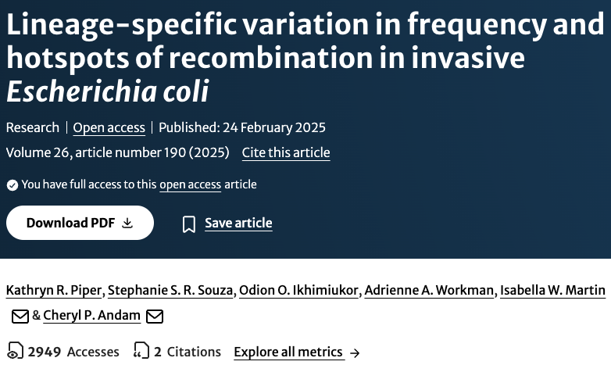
Identify Lineage specific recombination events in invasive E. coli

Slide 28
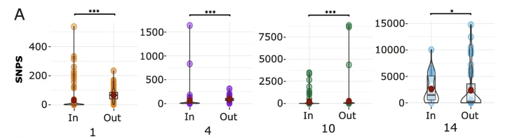
Number of base substitutions reconstructed onto the branch that fall within (In) and outside (Out) a predicted recombination for each sequence cluster.

Slide 29
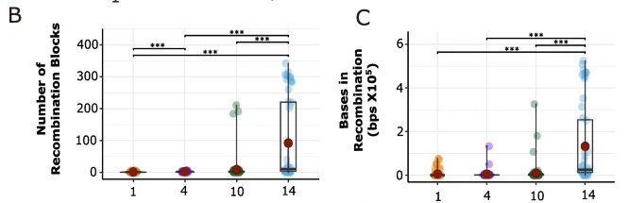
Total number of recombination blocks reconstructed onto the branch.
Bases in recombinations refers to the total length of all recombination events reconstructed onto a branch

Slide 30
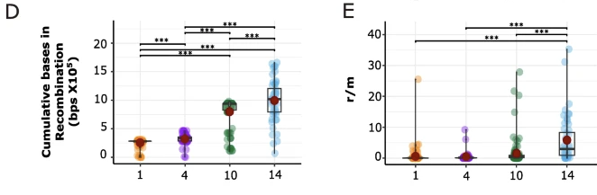
Cumulative bases in recombinations refers to the total number of bases in the alignment affected by recombination on a branch and its ancestors
The value r/m is the ratio of probabilities that a given site was altered through recombination and mutation. It gives a measure of the relative impact of recombination (r) and mutation (m) on the variation accumulated on the branch.

Slide 31
Practical Session 1

