Slide 1
E.S.C.
Logan Johnson

Slide 2
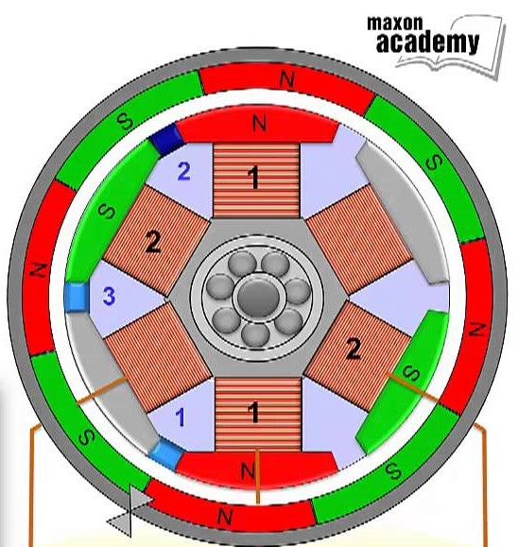
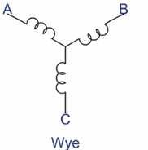
Motor Basics
Magnetic Fields cause motion
Wye Configuration
Current flow determines pole orientation
2 - Phases “On” at a time

Slide 3
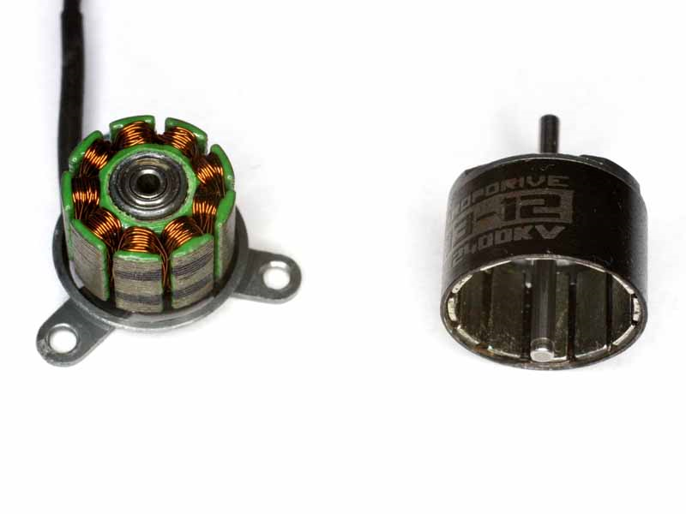
BLDC (Brushless “D.C.” ) Motors
What do ESCs drive?
3 - Phases
6 Phase Combinations
Brushless (Electronically Switched)
Varieties (Outrunner, Sensorless)

Slide 4
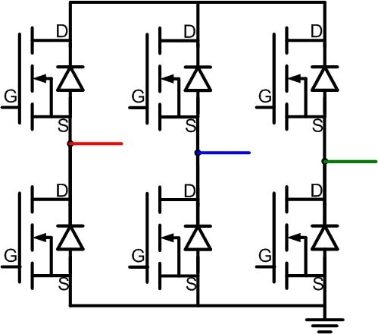
Inverter Circuit
High side/Low side
Typically MOSFETs
PWM Control
Can get HOT

Slide 5
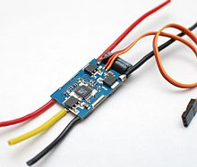
E.S.C. (Electronic Speed Controller)
Can handle High current
Typically consists of :
Microcontroller
MOSFETs
Gate Drivers
Capacitor banks
Linear Voltage regulators
Op-amps

Slide 6
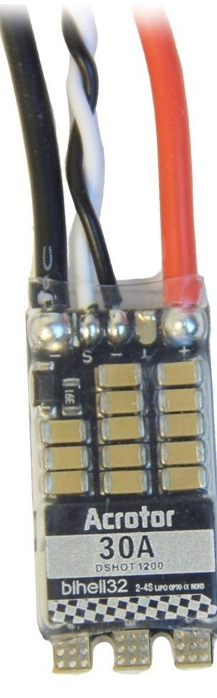
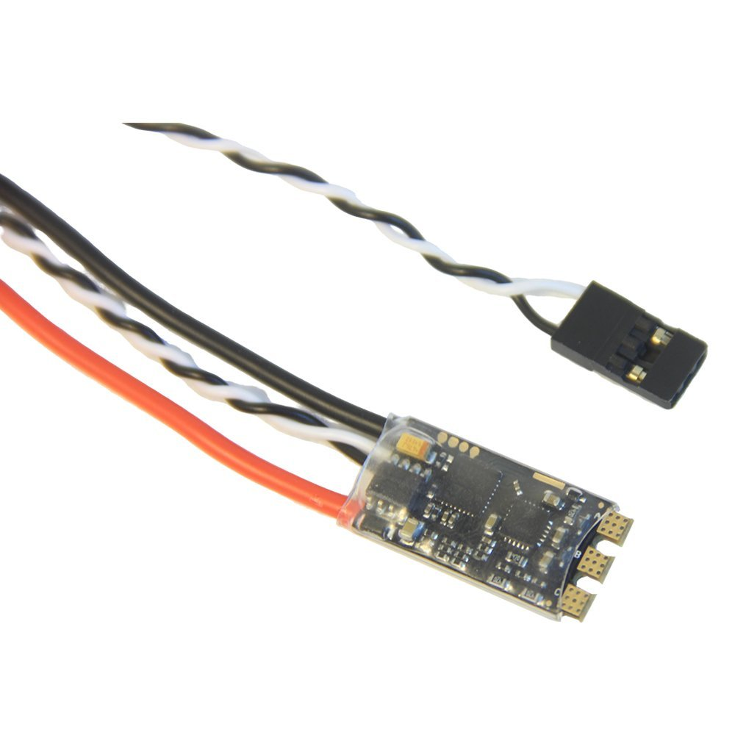
My ESCs
Microcontroller
STM32F051K86
ARM Cortex-M0
48 MHZ
Several Timer outputs up to 11
BLHeli_32 Firmware
Fortior Gate Driver IC
Rated for 30A Continuous
D-Shot, OneShot, PWM Communication

Slide 7
Questions?
Thank You!

