Slide 1
HyperKernel在RISC-V的移植与CPU结合验证(g09)
秦岳 2015011333
陈宇 2015011343

Slide 2
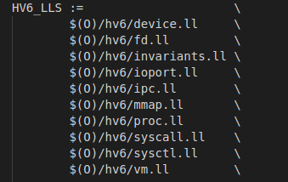
验证流程
源码
hv6.ll
hv6.py
spec
验证

Slide 3
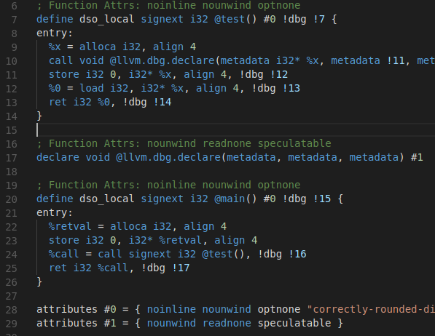
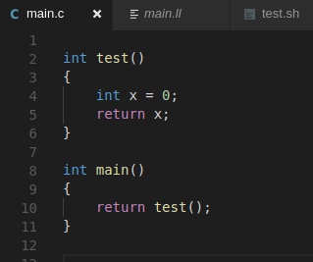
使用riscv相关clang/llvm工具：失败

Slide 4
决定采用x86下的相关工具

Slide 5
14/50：直接跑
sys_map_pml4 | 512
sys_map_page_desc | 512
sys_map_proc | 512
sys_map_dev | 512
sys_map_file | 512
sys_alloc_pdpt | 512
sys_alloc_pd | 512
sys_alloc_pt | 512
sys_alloc_frame | 512
sys_copy_frame | 0
sys_protect_frame | 512
sys_free_pdpt | 512
sys_free_pd | 512
sys_free_pt | 512
sys_free_frame | 512
sys_reclaim_page | 0
clone_proc | 512
sys_set_proc_name | 512

Slide 6
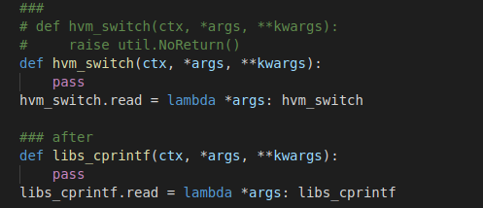
30/50：在spec中修改/添加函数定义
clone_proc | 0 | -> | libs_cprintf
sys_set_proc_name | 0 | -> | libs_cprintf
sys_set_runnable | 0
switch_proc | 0 | -> | hvm_switch
sys_kill | 0
sys_reap | 0
sys_reparent | 0
send_proc | 0
recv_proc | 0
reply_wait_proc | 0 | -> | libs_cprintf
call_proc | 0 | -> | libs_cprintf
sys_create | 0 | -> | libs_cprintf
sys_close | 0 | -> | libs_cprintf
sys_dup | 0 | -> | libs_cprintf
sys_dup2 | 0 | -> | libs_cprintf
sys_lseek | 0 | -> | libs_cprintf
sys_map_pcipage | 512
sys_alloc_iommu_root | 0 | -> | libs_cprintf

Slide 7
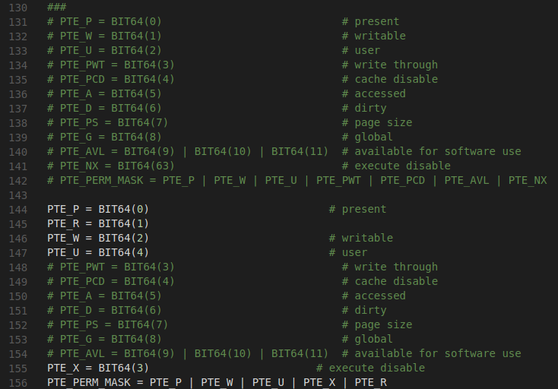
38/50：在spec中修改页表标识位
sys_map_pml4 | 0 | -> | PTE
sys_map_page_desc | 0 | -> | PTE
sys_map_proc | 0 | -> | PTE
sys_map_dev | 0 | -> | PTE
sys_map_file | 0 | -> | PTE
sys_alloc_pdpt | 512
sys_alloc_pd | 512
sys_alloc_pt | 512
sys_alloc_frame | 0 | -> | PTE
sys_copy_frame | 0
sys_protect_frame | 512

Slide 8
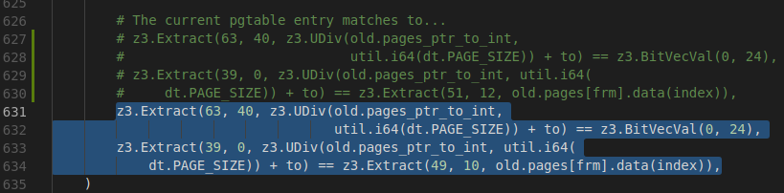
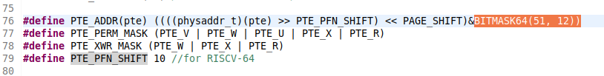
43/50：修改spec的相关页表，修改hv6相关页表函数
sys_alloc_frame | 0 | -> | PTE
sys_copy_frame | 0
sys_protect_frame | 0 | -> | spec&mmu | mask
sys_free_pdpt | 0 | -> | spec&mmu | mask
sys_free_pd | 0 | -> | spec&mmu | mask
sys_free_pt | 0 | -> | spec&mmu | mask
sys_free_frame | 0 | -> | spec&mmu | mask
sys_reclaim_page | 0

Slide 9

46/50：增加spec中对于XWR标志位的约束
sys_map_file | 0 | -> | PTE
sys_alloc_pdpt | 0 | -> | PTE_XWR_MASK
sys_alloc_pd | 0 | -> | PTE_XWR_MASK
sys_alloc_pt | 0 | -> | PTE_XWR_MASK
sys_alloc_frame | 0 | -> | PTE

Slide 10

50/50：修改spec中iommu的页表标识位
sys_map_pcipage | 0 | -> | PTE
sys_alloc_iommu_root | 0 | -> | libs_cprintf
sys_alloc_iommu_pdpt | 0 | -> | DMAR_PTE_W
sys_alloc_iommu_pd | 0 | -> | DMAR_PTE_W
sys_alloc_iommu_pt | 0 | -> | DMAR_PTE_W
sys_alloc_iommu_frame | 0 | -> | DMAR_PTE_W
sys_map_iommu_frame | 0 | -> | PTE

Slide 11
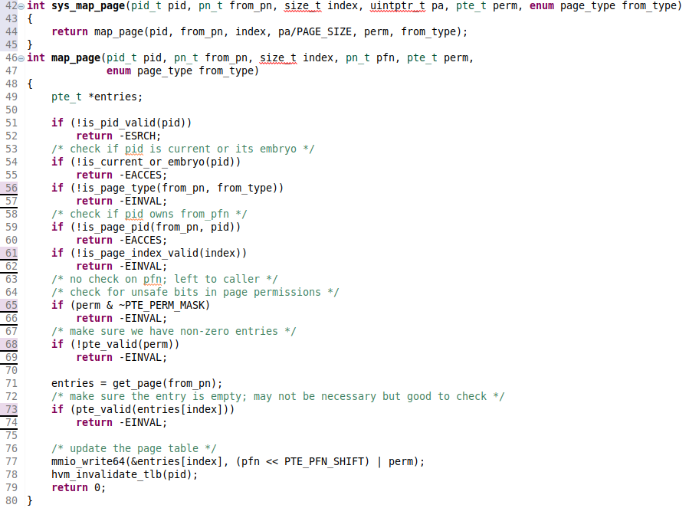
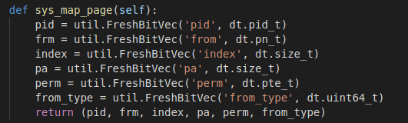
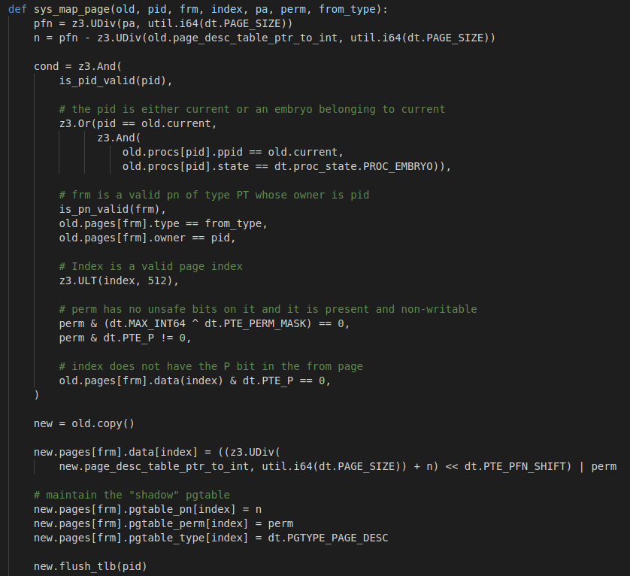
51/50：在spec中添加新系统调用的约束

Slide 12
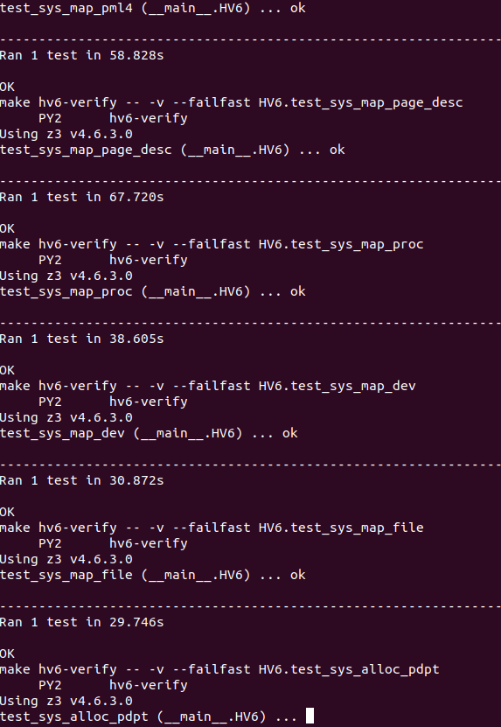

Slide 13
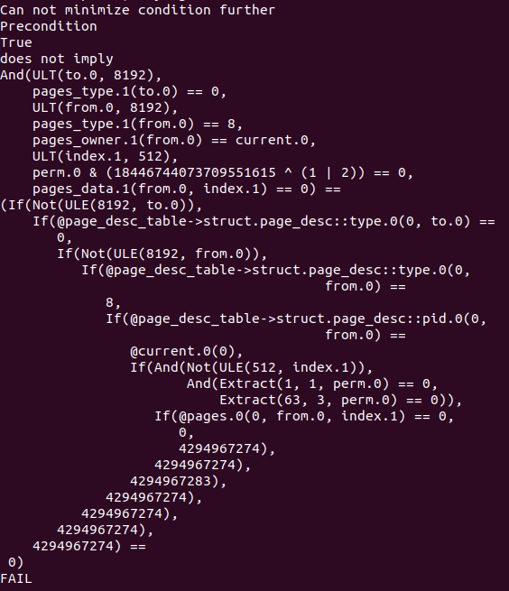
吐槽：错误信息极不友善

Slide 14
吐槽：错误信息极不友善
调试方式：二分删除spec和hv6的代码
但是不是任何时候都有效

