Slide 1
Epitope Background
HLA antibodies are specific for epitopes of HLA molecules
The International Registry of Antibody-Defined HLA Epitopes (Epitope Registry) curates a list of consensus HLA epitopes [1]
The Epitope Registry exposes their epitope database via a HTML web application that includes a sophisticated filtering mechanism for returning mismatched epitopes
Inferring antibody specificity for a particular epitope from a panel of single antigen bead results is cognitively challenging
[1] Duquesnoy, R. J., Marrari, M., Mulder, A., L. C. D. Da Mata Sousa, Silva, A. S., & Monte, S. J. (2014). First report on the antibody verification of HLA-ABC epitopes recorded in the website-based HLA Epitope Registry. Tissue Antigens, 83(6), 391-400.
Notes:
Acknowledgements to Dr. Howie Gebel at Emory University School of Medicine.

Slide 2
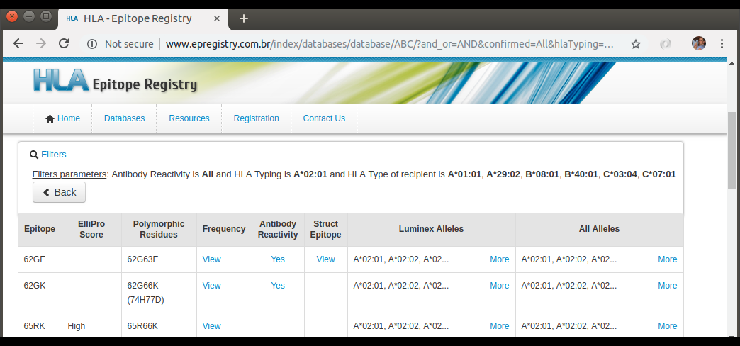
Sophisticated Filtering for Mismatched Epitopes
[1] http://www.epregistry.com.br/index/databases/database/ABC
Notes:
- The epitope filtering mechanism in the Epitope Registry is excellent. You provide it with (a) an allele for which you are interested in assessing for donor/recipient mismatches and (b) the recipient’s HLA type, and the Epitope Registry instantly returns a list of mismatched epitopes.
- Iteratively using this filtering mechanism with multiple positive single antigen bead results from a single antigen bead panel to infer which epitopes may be reactive with antibodies is cognitively difficult: the relationship between positive beads and epitopes is many-to-many and extremely tedious to keep track of.

Slide 3
Epitope Heuristic Example
= positive bead
Notional 5-bead Single Antigen Bead Panel
= negative bead
X
= rep. epitope
Bead #5 Epitopes
Bead #1 Epitopes
Bead #3 Epitopes
A
C
Bead #2 Epitopes
Bead #4 Epitopes
B
E
D
The presence of an antibody specific for epitope "E" is inferred because all of the beads with epitope "E" are positive (and all of the beads without epitope "E" are negative).
Notes:
My first exposure this heuristic was in conversation with Dr. Howie Gebel in the HLA laboratory at Emory University Hospital.

Slide 4
Epitope Heuristic
Infer the presence of an antibody specific for an epitope if…
all single antigen beads bearing the epitope are positive
-AND-
all single antigen beads not bearing the epitope are negative

Slide 5
Epitope Heuristic Example
= positive bead
Notional 5-bead Single Antigen Bead Panel
= negative bead
X
= rep. epitope
Bead #5 Epitopes
Bead #1 Epitopes
Bead #3 Epitopes
A
C
Bead #2 Epitopes
Bead #4 Epitopes
B
E
D
The presence of an antibody specific for epitope “B" is not inferred because bead #3 is positive but does not include the epitope. This is restrictive since it requires a single-antibody solution.
Notes:
Requiring a single-antibody solution rules out the possibility of the system considering a solution that, say, involved an antibody to epitope B and an antibody to epitope C.

Slide 6
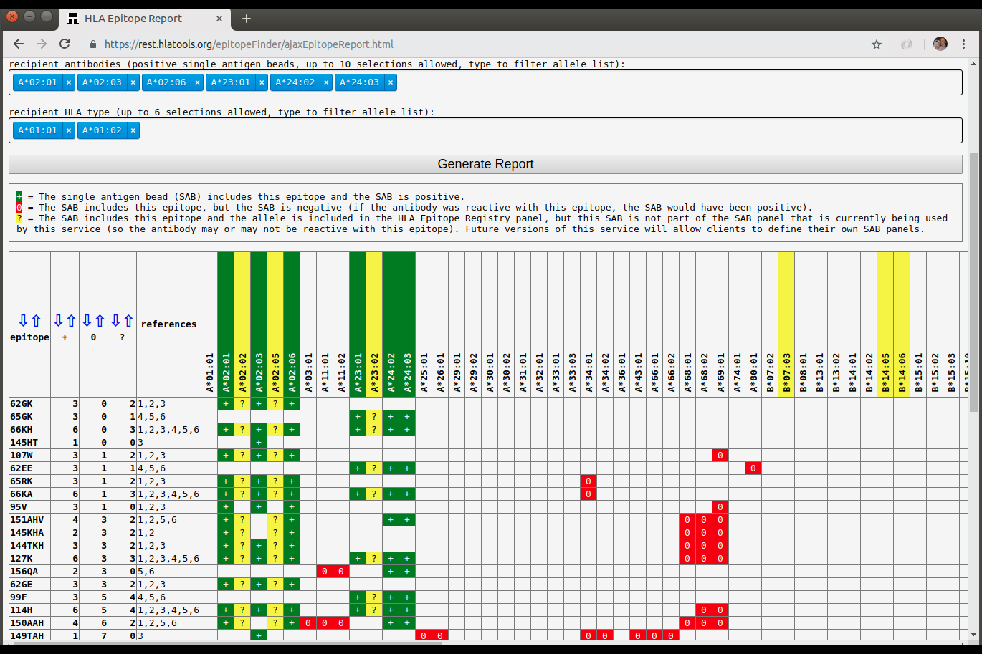
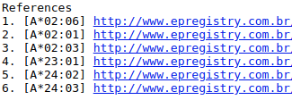
Epitope Report
Notes:
Note that there are at least two solutions: 66KH -OR- 62GK and 65GK.

Slide 7
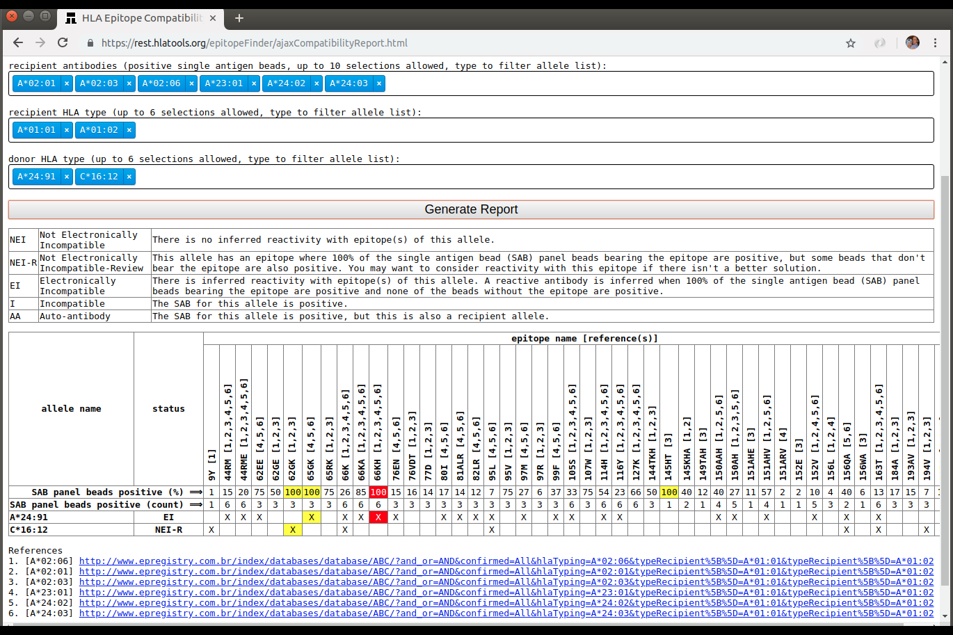
Compatibility Report
Notes:
Note that there are at least two solutions: 66KH -OR- 62GK and 65GK.
The 66KH solution is favored, since it is the single-antibody solution.

