Slide 1
Hot Topic: Analytics & Algorithms Web Service-based Clinical Decision Support
Geoffrey H. Smith, MD
Assistant Professor of Pathology
Emory University School of Medicine

Slide 2
DISCLOSURES
I have no financial relationships with commercial interests to disclose
My presentation does/does not include discussion of off-label or investigational use.

Slide 3
Learning Objectives
Develop a working definition of Clinical Decision Support and Web Services.
Describe some examples of heuristic decision making algorithms in HLA donor-recipient matching.
Propose a web service-based technical architecture for an HLA donor-recipient matching clinical decision support application.

Slide 4
PREAMBLE

Slide 5
Survey Question
Which of the following is a Hypertext Transfer Protocol (HTTP) request method [1]?
GET
GIMME’
IT’S MINE
RETRIEVE
[1] Internet RFC 2616: Hypertext Transfer Protocol -- HTTP/1.1, https://www.w3.org/Protocols/rfc2616/rfc2616.html.

Slide 6
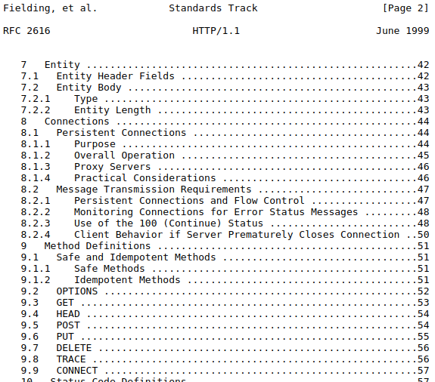
Survey Question
Which of the following is a Hypertext Transfer Protocol (HTTP) request method [1]?
GET
GIMME’
IT’S MINE
RETRIEVE
[1] Internet RFC 2616: Hypertext Transfer Protocol -- HTTP/1.1, https://www.w3.org/Protocols/rfc2616/rfc2616.html.

Slide 7
www.cnn.com (home page)
HTTP GET requests required to render CNN home page | ~400
number of those request that are HTTP GET web service requests | ~40
Web services are likely already a big part of your life as a consumer of Internet services.

Slide 8
CLINICAL DECISION SUPPORT

Slide 9
Clinical Decision Support
Clinical decision support (CDS) provides clinicians, staff, patients or other individuals with knowledge and person-specific information, intelligently filtered or presented at appropriate times, to enhance health and health care. [1]
Clinical Decision Support ≠ Clinical Decision Making
[1] Clinical Decision Support, https://www.healthit.gov/topic/safety/clinical-decision-support.

Slide 10
Examples of Clinical Decision Support
Drug – drug allergy alerts
Teratogenic drug alerts in reproductive age women
Laboratory test recommendations (e.g, overdue HbA1c in diabetic patient, PT/INR in warfarin patient)
CPOE order sets (e.g., Cerner Millennium “PowerPlans”)
CPOE duplicate order alerts
CPOE test utilization alerts (e.g., are you sure you really want to order a 1,25-dihydroxy vitamin D level?)
CPOE = Computerized Physician Order Entry

Slide 11
5 “Rights” of Clinical Decision Support [1]
The right information
To the right person
In the right intervention forma
Through the right channel
At the right time in the workflow
[1] Osheroff et al., Improving Outcomes with Clinical Decision Support: An Implementer's Guide, HIMSS Publishing, 2012.

