Slide 1
Hot Topic: Analytics & Algorithms Web Service-based Clinical Decision Support
Geoffrey H. Smith, MD
Assistant Professor of Pathology
Emory University School of Medicine

Slide 2
DISCLOSURES
I have no financial relationships with commercial interests to disclose
My presentation does/does not include discussion of off-label or investigational use.

Slide 3
Learning Objectives
Develop a working definition of Clinical Decision Support and Web Services.
Describe some examples of heuristic decision making algorithms in HLA donor-recipient matching.
Propose a web service-based technical architecture for an HLA donor-recipient matching clinical decision support application.

Slide 4
Conclusion
Enterprise Clinical System
FHIR Resources
(clinical knowledge)
HLA Resources
(biomedical knowledge)
REST web
services
REST web services
Clinical Decision Support functionality
FHIR = Fast Healthcare Interoperability Resource (an HL7 standard)

Slide 5
PREAMBLE

Slide 6
Survey Question
Which of the following is a Hypertext Transfer Protocol (HTTP) request method [1]?
GET
GIMME’
IT’S MINE
RETRIEVE
[1] Internet RFC 2616: Hypertext Transfer Protocol -- HTTP/1.1, https://www.w3.org/Protocols/rfc2616/rfc2616.html.

Slide 7
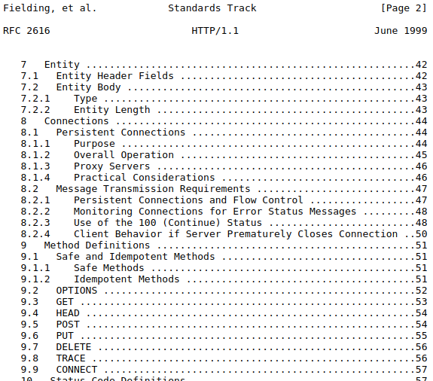
Survey Question
Which of the following is a Hypertext Transfer Protocol (HTTP) request method [1]?
GET
GIMME’
IT’S MINE
RETRIEVE
[1] Internet RFC 2616: Hypertext Transfer Protocol -- HTTP/1.1, https://www.w3.org/Protocols/rfc2616/rfc2616.html.

Slide 8
www.cnn.com (home page)
HTTP GET requests required to render CNN home page | ~400
number of those request that are web service requests | ~40
Web services are likely already a big part of your life as a consumer of internet services.
Notes:
Even if you don’t want them to be (e.g., advertising, tracking).

Slide 9
CLINICAL DECISION SUPPORT

Slide 10
Clinical Decision Support
Clinical decision support (CDS) provides clinicians, staff, patients or other individuals with knowledge and person-specific information, intelligently filtered or presented at appropriate times, to enhance health and health care. [1]
Clinical Decision Support ≠ Clinical Decision Making
[1] Clinical Decision Support, https://www.healthit.gov/topic/safety/clinical-decision-support.

Slide 11
Common Examples of CDS
Drug – drug allergy alerts
Teratogenic drug alerts in reproductive age women
Laboratory test recommendations (e.g, overdue HbA1c in diabetic patient, overdue PT/INR in warfarin patient)
CPOE order sets (e.g., Cerner Millennium “PowerPlans”)
CPOE duplicate order alerts
CPOE test utilization alerts (e.g., are you sure you really want to order a 1,25-dihydroxy vitamin D level?)
CPOE = Computerized Physician Order Entry

Slide 12
5 “Rights” of Clinical Decision Support [1]
The right information
To the right person
In the right intervention format
Through the right channel
At the right time in the workflow
[1] Osheroff et al., Improving Outcomes with Clinical Decision Support: An Implementer's Guide, HIMSS Publishing, 2012.

Slide 13
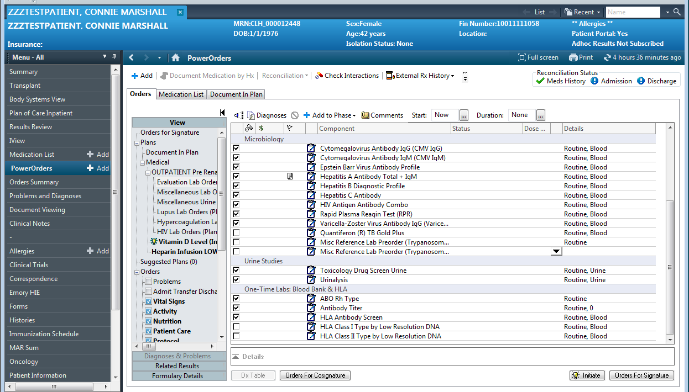
Notes:
Representative CPOE order set in Cerner Millennium PowerChart.

Slide 14
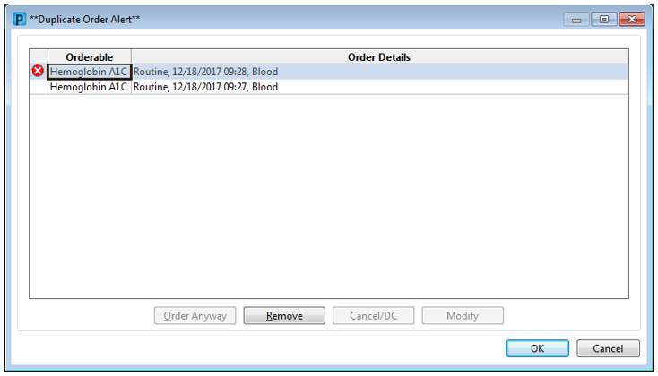
Notes:
Representative non-overridable CPOE duplicate order alert in Cerner Millennium PowerChart. This was perceived as clinical decision making by MPC and is now overridable. CDS implemented this way also contributes to alert fatigue.

Slide 15
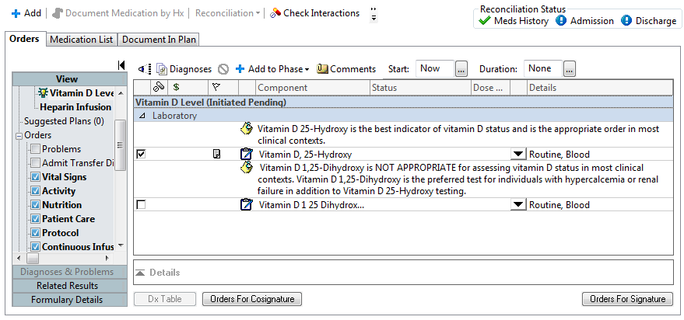
Notes:
Representative laboratory test utilization guidance implemented as notes in an order set. Additionally, the undesirable Vitamin D 1 25 Dihydroxy order is not selected by default. This intervention was not popular with physicians, because orders only accessible in order sets are not easily placed in some contexts like so-called “quick-orders pages” and “favorite orders lists.”

Slide 16
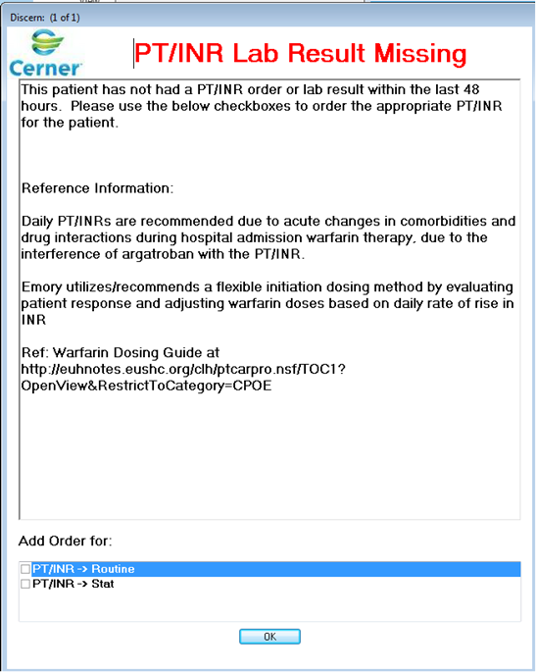
Notes:
Representative example of a rules-based ordering alert that is triggered when warfarin is ordered on a patient without a recent PT/INR. In this case, the rule is implemented in Cerner Millennium Discern.

Slide 17
How do we get out-of-the box CDS?
in-the box CDS
in-and-out-of-the-box CDS
EMR Feature Set
“the box”
EMR Feature Set
“the box”
Clinical Decision Support functionality
Clinical Decision Support functionality
More specifically, how do we get out-of-the-box CDS functionality while still respecting the 5 rights?

Slide 18
REST WEB SERVICES

Slide 19
Web Page Request (in English)
client
wide area data network
server
send me an HTML document
OK, here's your HTML document
time
time

Slide 20
Web Page Request (in HTTP)
client
wide area data network
server
REQUEST: HTTP GET /document.html
RESPONSE: HTTP 200, <html>blah, blah</html>‡
time
‡The HTML document in the response payload represents both the content and the presentation.
time

Slide 21
Web Service Request (in English)
client
wide area data network
server
send me the information for a resource
OK, here’s the JSON* representation of the resource
time
*JavaScript Object Notation (JSON)
time

Slide 22
Web Service Request (in HTTP)
client
wide area data network
server
REQUEST: HTTP GET /alleles/HLA-DPB1*01:01:01:01
RESPONSE: HTTP 200, {alleleName: HLA-DPB1*…}‡
time
‡The JSON response payload is pure content without any presentation.
time

Slide 23
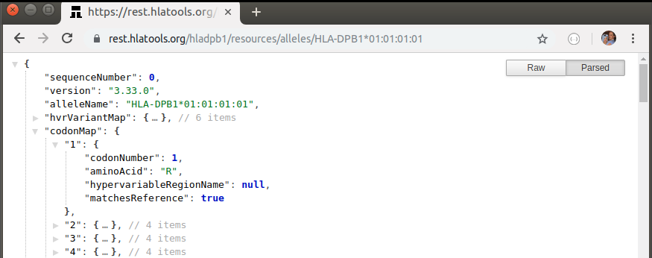
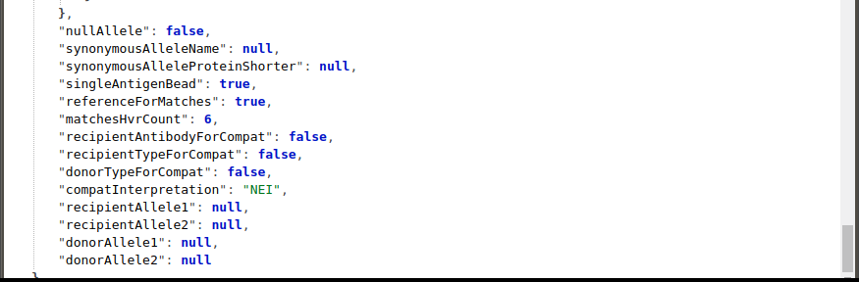
Web Services Return JSON‡
Provider: rest.hlatools.org
Resource Name: alleles
Resource ID: HLA-DPB1*01:01:01:01
JSON = JavaScript Object Notation
‡Web services usually return JSON.

Slide 24
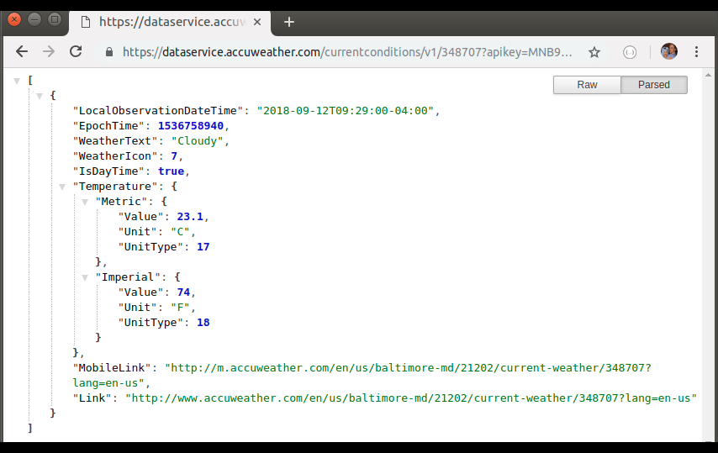
Web Services Return JSON‡
Provider: dataservice.accuweather.com
Resource Name: currentConditions
Resource ID: 348707 (Baltimore)
JSON = JavaScript Object Notation
‡Web services usually return JSON.

Slide 25
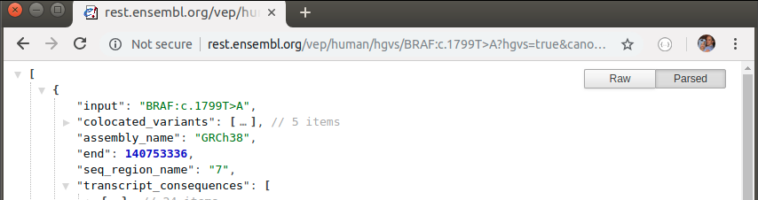
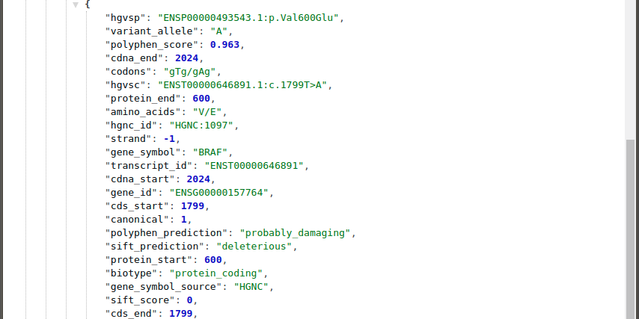
Web Services Return JSON‡
Provider: rest.ensembl.org
Resource Name: /vep/human/hgvs
Resource ID: BRAF:c.1799T>A
JSON = JavaScript Object Notation
‡Web services usually return JSON.

