Slide 1
Hot Topic: Analytics & Algorithms Web Service-based Clinical Decision Support
Geoffrey H. Smith, MD
Assistant Professor of Pathology
Emory University School of Medicine

Slide 2
DISCLOSURES
I have no financial relationships with commercial interests to disclose
My presentation does/does not include discussion of off-label or investigational use.

Slide 3
Learning Objectives
Develop a working definition of Clinical Decision Support and Web Services.
Describe some examples of heuristic decision making algorithms in HLA donor-recipient matching.
Propose a web service-based technical architecture for an HLA donor-recipient matching clinical decision support application.

Slide 4
Conclusion
Enterprise Clinical System
FHIR Resources
(clinical knowledge)
HLA Resources
(biomedical knowledge)
REST web
services
REST web services
HLA Clinical Decision Support functionality
REST = REpresentational State Transfer
FHIR = Fast Healthcare Interoperability Resource (an HL7 standard)
Notes:
- One possible observation here is that we have a lot of electronically accessible biomedical databases. But, arguably, we do not always have robust service layers around those biomedical databases that facilitate electronica interoperability and distributed computing.

Slide 5
SURVEY

Slide 6
Survey Question
Which of the following is a Hypertext Transfer Protocol (HTTP) request method [1]?
GET
GIMME’
IT’S MINE
RETRIEVE
[1] Internet RFC 2616: Hypertext Transfer Protocol -- HTTP/1.1. https://www.w3.org/Protocols/rfc2616/rfc2616.html.

Slide 7
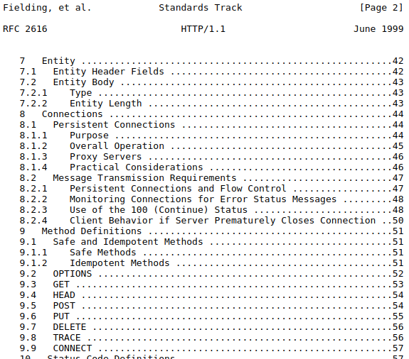
Survey Question
Which of the following is a Hypertext Transfer Protocol (HTTP) request method [1]?
GET
GIMME’
IT’S MINE
RETRIEVE
[1] Internet RFC 2616: Hypertext Transfer Protocol -- HTTP/1.1, https://www.w3.org/Protocols/rfc2616/rfc2616.html.

Slide 8
www.cnn.com (home page)
HTTP GET requests required to render CNN home page | ~400
number of those request that are web service requests | ~40
Web services are likely already a big part of your life as a consumer of internet services.
Notes:
- Web services are in-play even if you don’t want them to be (e.g., advertising, tracking).

Slide 9
CLINICAL DECISION SUPPORT

Slide 10
Clinical Decision Support
Clinical decision support (CDS) provides clinicians, staff, patients or other individuals with knowledge and person-specific information, intelligently filtered or presented at appropriate times, to enhance health and health care. [1]
Clinical Decision Support ≠ Clinical Decision Making
[1] Clinical Decision Support. https://www.healthit.gov/topic/safety/clinical-decision-support.

Slide 11
Common Examples of CDS
Drug – drug allergy alerts
Teratogenic drug alerts in reproductive age women
Laboratory test recommendations (e.g, overdue HbA1c in diabetic patient, overdue PT/INR in warfarin patient)
CPOE order sets (e.g., Cerner Millennium “PowerPlans”)
CPOE duplicate order alerts
CPOE test utilization alerts (e.g., are you sure you really want to order a 1,25-dihydroxy vitamin D level?)
CPOE = Computerized Physician Order Entry

Slide 12
5 “Rights” of Clinical Decision Support [1]
The right information
To the right person
In the right intervention format
Through the right channel
At the right time in the workflow
[1] Osheroff et al. Improving Outcomes with Clinical Decision Support: An Implementer's Guide. HIMSS Publishing. 2012.
Notes:
The latter four (4) rights suggest that the enterprise’s electronic medical record (e.g., Cerner, EPIC), where our health care providers now spend most of their time, has an important role in clinical decision support.
Although there are numerous web sites and applications that can facilitate good clinical decision making, those services may not respect the latter four (4) rights.
As laboratorians, I think we also need to consider that the traditional static CLIA-compliant laboratory report may limit the clinical utility of our increasingly sophisticated laboratory testing modalities (e.g., next generation sequencing panels).

Slide 13
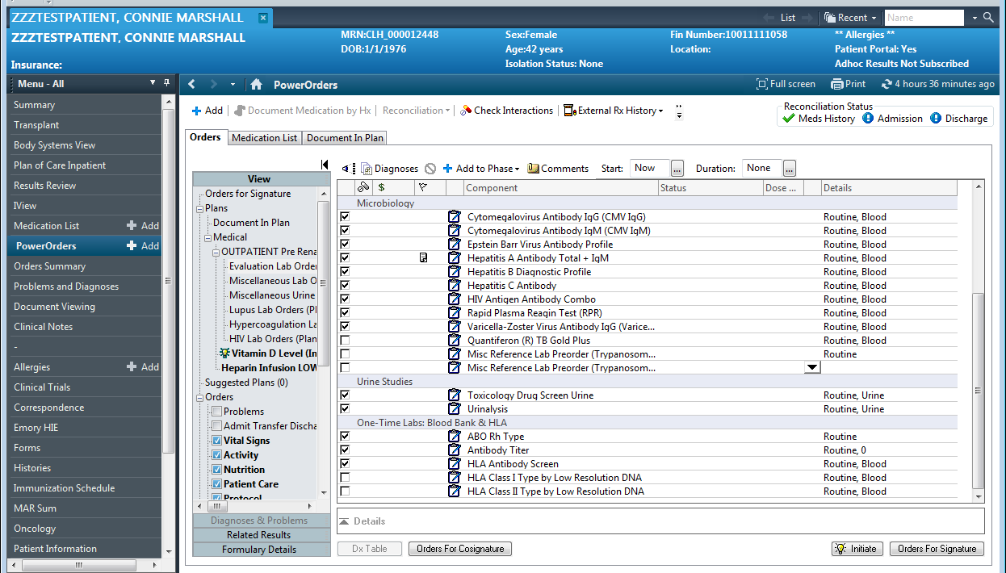
Notes:
Representative CPOE order set in Cerner Millennium PowerChart.

Slide 14
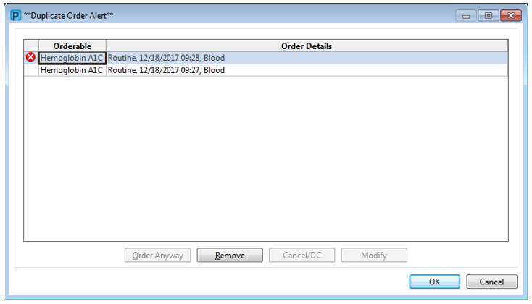
Notes:
Representative non-overridable CPOE duplicate order alert in Cerner Millennium PowerChart. This was perceived as clinical decision making by MPC and is now overridable. CDS implemented this way also contributes to alert fatigue.

Slide 15
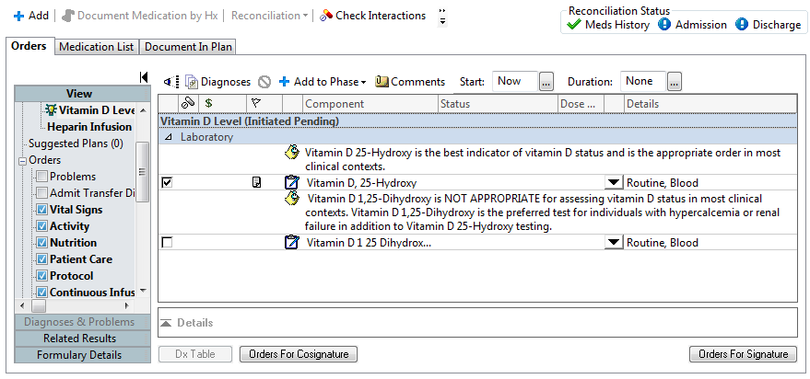
Notes:
- Representative laboratory test utilization guidance implemented as notes in an order set. Additionally, the undesirable Vitamin D 1 25 Dihydroxy order is not selected by default. This intervention was not popular with physicians, because orders only accessible in order sets are not easily placed in some contexts like so-called “quick-orders pages” and “favorite orders lists.”

Slide 16
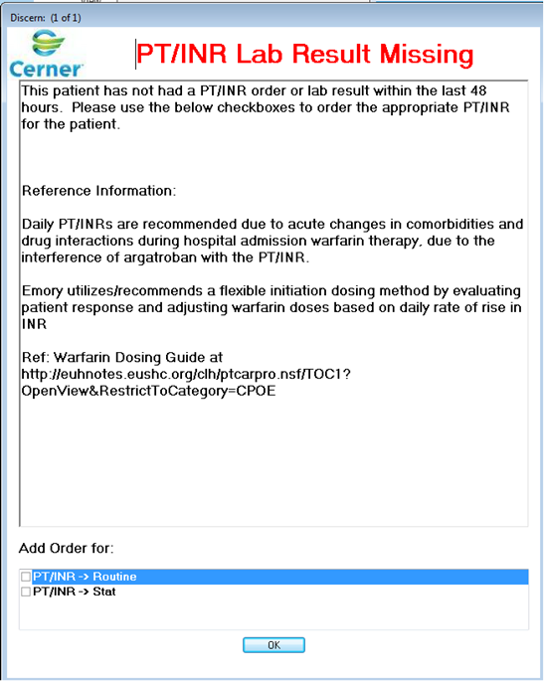
Notes:
- Representative example of a rules-based ordering alert that is triggered when warfarin is ordered on a patient without a recent PT/INR. In this case, the rule is implemented in Cerner Millennium Discern.

Slide 17
How do we get out-of-the box CDS?
in-the box CDS
in-and-out-of-the-box CDS
EMR Feature Set
“the box”
EMR Feature Set
“the box”
Clinical Decision Support functionality
Clinical Decision Support functionality
More specifically, how do we get out-of-the-box CDS functionality while still respecting the 5 rights?

Slide 18
REST WEB SERVICES

Slide 19
Web Page Request (in English)
client
wide area data network
server
send me an HTML document
OK, here's your HTML document
time
time

Slide 20
Web Page Request (in HTTP)
client
wide area data network
server
REQUEST: HTTP GET /document.html
RESPONSE: HTTP 200, <html>blah, blah</html>‡
time
‡The HTML document in the response payload represents both the content and the presentation.
time

Slide 21
Web Service Request (in English)
client
wide area data network
server
send me the information for a resource
OK, here’s the JSON* representation of the resource
time
*JavaScript Object Notation (JSON)
time

Slide 22
Web Service Request (in HTTP)
client
wide area data network
server
REQUEST: HTTP GET /alleles/HLA-DPB1*01:01:01:01
RESPONSE: HTTP 200, {alleleName: HLA-DPB1*…}‡
time
‡The JSON response payload is pure content without any presentation.
time

Slide 23
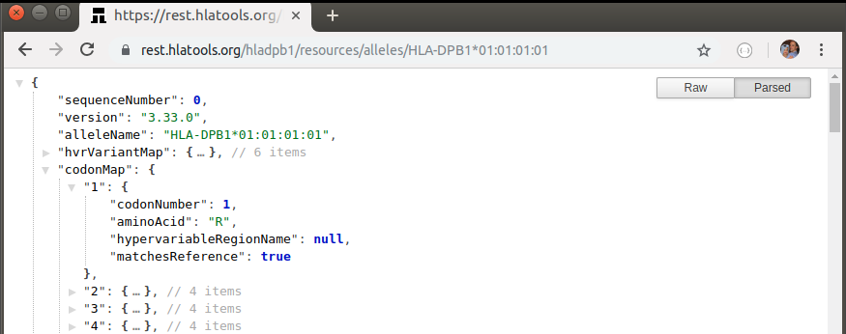
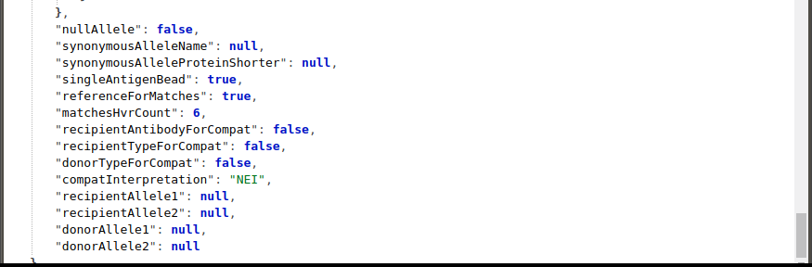
Web Service Endpoints Return JSON‡ Responses
Provider: rest.hlatools.org
Method: GET
Resource Name: alleles
Resource ID: HLA-DPB1*01:01:01:01
JSON = JavaScript Object Notation
‡Web services usually return JSON, other formats are possible.

Slide 24
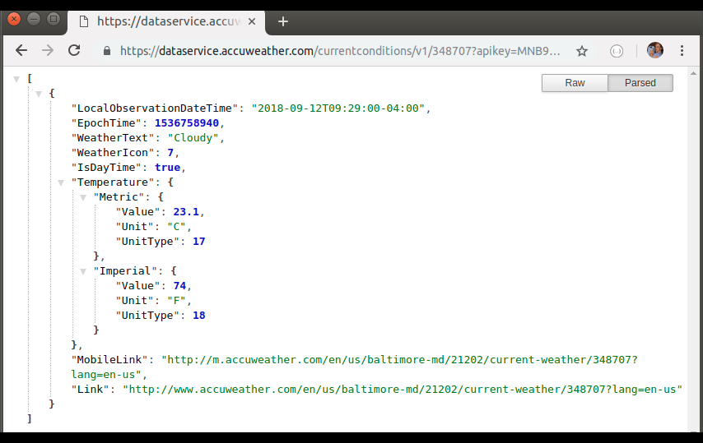
Web Service Endpoints Return JSON‡ Responses
Provider: dataservice.accuweather.com
Method: GET
Resource Name: currentConditions
Resource ID: 348707 (Baltimore)
JSON = JavaScript Object Notation
‡Web services usually return JSON, other formats are possible.

Slide 25
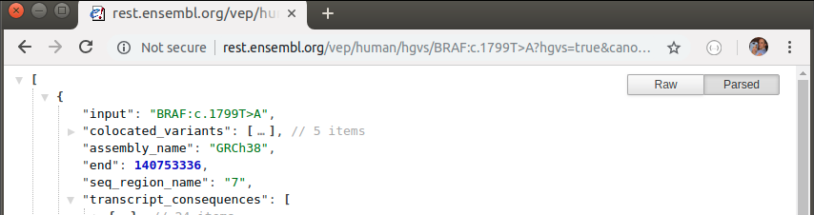
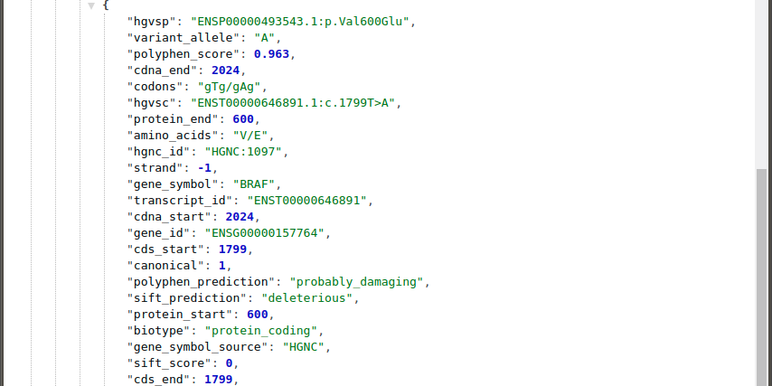
Web Service Endpoints Return JSON‡ Responses
Provider: rest.ensembl.org
Method: GET
Resource Name: vep/human/hgvs
Resource ID: BRAF:c.1799T>A
JSON = JavaScript Object Notation
‡Web services usually return JSON, other formats are possible.

Slide 26
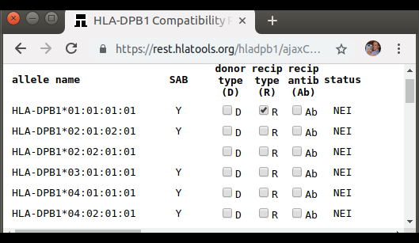
Web Service Endpoints Accept JSON‡ Requests
click
PUT /hladpb1/resources/alleles/HLA-DPB1*01:01:01:01
Host: rest.hlatools.org
{
alleleName: "HLA-DPB1*01:01:01:01",
donorTypeForCompat:false,
recipientTypeForCompat:true,
recipientAntibodyForCompat:false,
…
}
JSON = JavaScript Object Notation
‡Web services usually return JSON, other formats are possible.
Notes:
A key point is that we are transferring REPRESENTATIONS of the resources between the client and server. This is likely one of the bases for the name of the REST architectural style.
HTTP request methods commonly used with REST include GET (read), POST (create), PUT (update), DELETE (delete).

Slide 27
REST Web Services are Widely Supported
REST client libraries are available for almost any technology platform:
Thin web clients (i.e., JavaScript applications in web browsers)
Fat desktop applications (e.g., Java, .NET)
Mobile applications (e.g., Java, Swift)
Scripting languages (e.g., Python, Perl)
Analytical tools (e.g., R)
HTTP is well understood by software engineers, both on the client and server side (28 year old tech)
HTTP works well on high-latency wide area data networks (i.e, the internet)
REST web services leverage well-established HTTP security mechanisms (e.g., HTTPS, OAuth)
Notes:
Another factor that makes REST compelling is that our client devices typically have oodles of excess compute capacity, memory, and network bandwidth. Operations that would have previously not been possible to perform efficiently on the client tier (e.g., sorting, caching) are now trivial to perform on the client tier.
REST lowers the complexity bar for interoperability in distributed computing by riding on the coat-tails of a ubiquitous application-layer protocol that works great on a wide area network: HTTP. It reduces the repertoire of possible interactions between clients and servers relative to traditional “chatty” SQL-based client/server architectures by limiting the number of access paths to a finite set of well-defined “resources.” In my experience, it seems most appropriate in applications which are heavy on reads, light on writes, and where the transactions are short and simple. Notably, I believe that clinical decision support frequently falls into this category.

Slide 28
REST Web Services are Emerging for Clinical Data
HL7 Fast Healthcare Interoperability Resources (FHIR) defines a set of REST web services resources for clinical medicine
Enterprise clinical system vendors have implemented FHIR endpoints:
Cerner Corporation: Cerner Ignite APIs for Millennium
EPIC Systems Corporation: Open.epic
Both patient-facing and provider-facing use cases are envisioned
Notes:
HL7 version 2 is still the dominant specification for electronic interoperability in health care, although it is very dated and essentially only defines “flat” files that have to be exchanged using essentially ad-hoc mechanisms.
Mainstream vendors are implementing FHIR endpoints in their enterprise systems and also curating “app store”-like collections of approved applications.
The fact that the commercial vendors are implementing this specification is hugely significant. Some previous HL7 specifications have not been widely adopted (too bloated?).

Slide 29
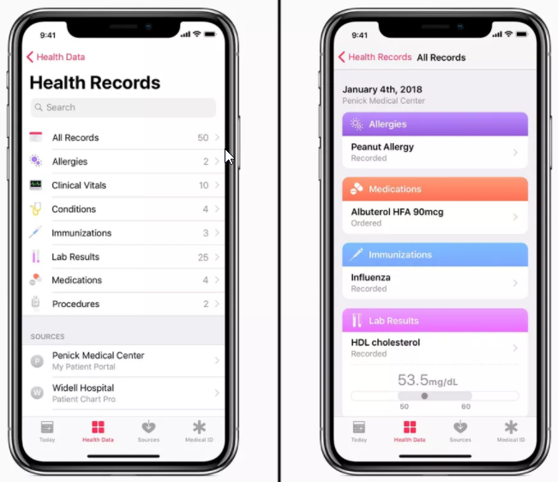
HL7 Fast Healthcare Interoperability Resources (FHIR)
Patient
Practitioner
Allergy
Problem
Observation (e.g., HLA laboratory results)
.
.
.
https://www.idahopress.com/news/local/st-luke-s-patients-can-get-medical-records-on-apple. July 17, 2018.
Notes:
The “observation” resource includes lab results. In our system, most HLA laboratory results are maintained as structured results in our electronic medical record and would be easily accessible via the FHIR Obervation resource.
Apple Health uses FHIR. This is probably the canonical patient-facing FHIR application.

Slide 30
HEURISTIC ALGORITHM AS A REST WEB SERVICE EXAMPLE #1: Electronic Compatibility Assessment using HLA-DPB1 Hypervariable Regions (Google Cloud deployment) https://rest.hlatools.org/hladpb1 (source code) https://github.com/ghsmith/hladpb1

Slide 31
DPB1 Background
In 2014 OPTN/UNOS mandated DPB1 typing for deceased donors. This becomes effective in 2016.
IMGT/HLA Allele Database Version 3.33.0 (2018-07-11) includes 1,108 DPB1 alleles but less than 30 DPB1 alleles are represented by single antigen bead products. [1]
Compatibility of donor alleles not represented by a single antigen bead cannot be easily determined.
[1] IPD-IMGT/HLA. https://www.ebi.ac.uk/ipd/imgt/hla.

Slide 32
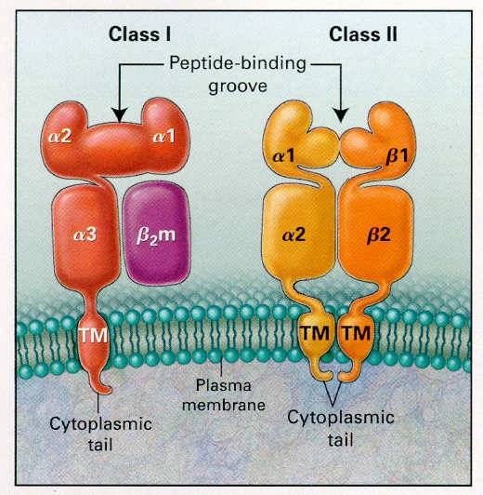
DPB1 Structure
DR
DQ
DP
Alleles are named sequentially independent of sequence homology, so no structural relationships are conveyed by allele names.
Exon 2
Exon 3
Klein J. and Sato A. NEJM 343;702-709. 2000.
Notes:
HLA-DPB belongs to the HLA class II beta chain paralogues.

Slide 33
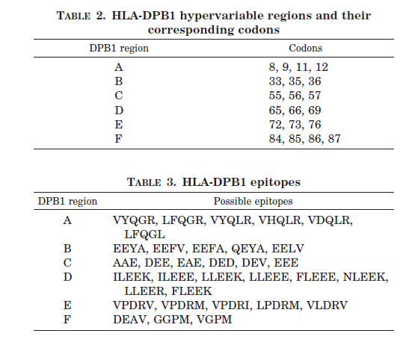
DPB1 Hypervariable Regions
Multiple publications have demonstrated that six (6) hypervariable regions account for the majority of antibody reactivity against DPB1 alleles. [1-4]
[1] Billen, et al. Tissue Antigens 75:278, 2009.
[2] Piazza. Transplantation 82:242, 2006.
[3] Arnold ML, et al. Tissue Antigens 65:370, 2005.
[4] Laux, et al. Transplantation 75:1527, 2003.
Laux, et al. Transplantation 75:1527, 2003.
Notes:
Acknowledgements to Dr. Bob Bray at Emory University School of Medicine.

Slide 34
Full Citations from Previous Slide
[1] Billen, E. V., Christiaans, M. H., Doxiadis, I. I., Voorter, C. E., & Berg-Loonen, E. M. (2010). HLA-DP antibodies before and after renal transplantation. Tissue Antigens, 75(3), 278-285.
[2] Piazza, A., Poggi, E., Ozzella, G., Borrelli, L., Scornajenghi, K., Monaco, P., Tisone, G., & Adorno, D. (2006). Anti Hla-Dp Antibodies And Graft Failure In Kidney Transplantation. Transplantation, 82(Suppl 2), 242.
[3] Arnold, M., Pei, R., Spriewald, B., & Wassmuth, R. (2005). Anti-HLA class II antibodies in kidney retransplant patients. Tissue Antigens, 65(4), 370-378.
[4] Laux, G., Mansmann, U., Deufel, A., Opelz, G., & Mytilineos, J. (2003). A new epitope-based HLA-DPB matching approach for cadaver kidney retransplants. Transplantation, 75(9), 1527-1532.
Notes:
Acknowledgements to Dr. Bob Bray at Emory University School of Medicine.

Slide 35
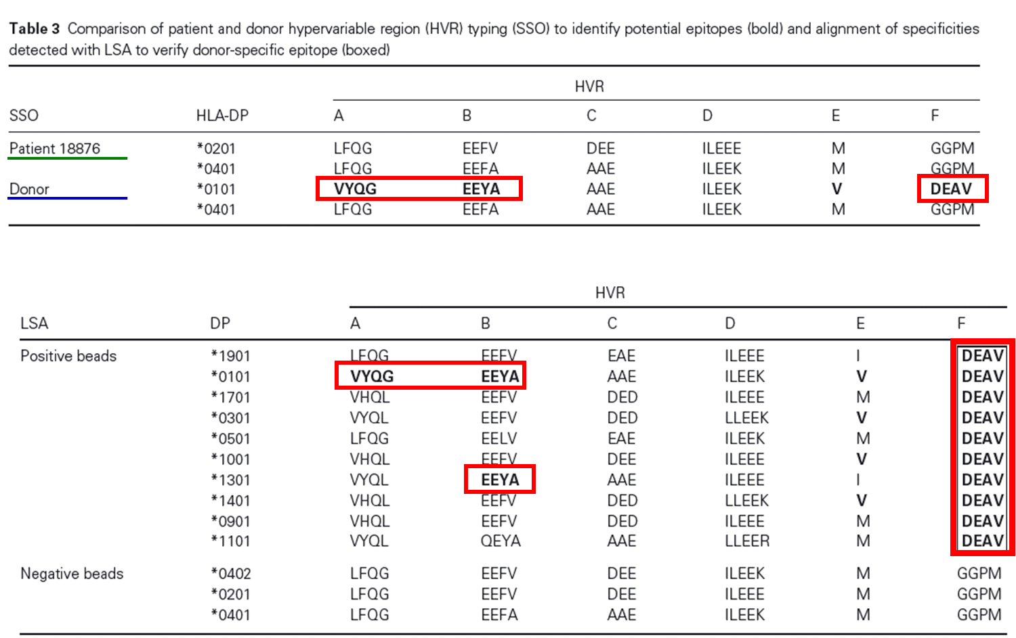
DPB1 Heuristic
If all single antigen beads bearing a particular hypervariable region epitope are positive, then infer there is an antibody specific for that epitope.
Billen, et al. Tissue Antigens 75:278, 2009.
Notes:
Some detail is omitted here. For example, allowances for recipient HLA type should be made (i.e., don’t infer the presence of an autoantibody).
My first exposure this heuristic was in conversation with Dr. Bob Bray in the HLA laboratory at Emory University Hospital.
What would this heuristic look like implemented as a REST web service?

Slide 36
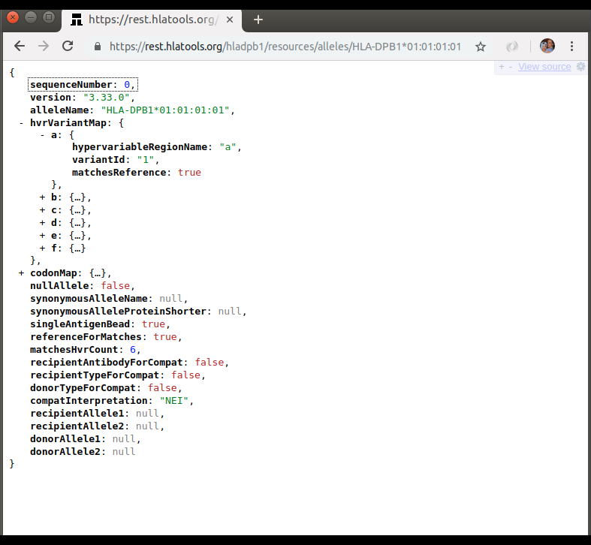
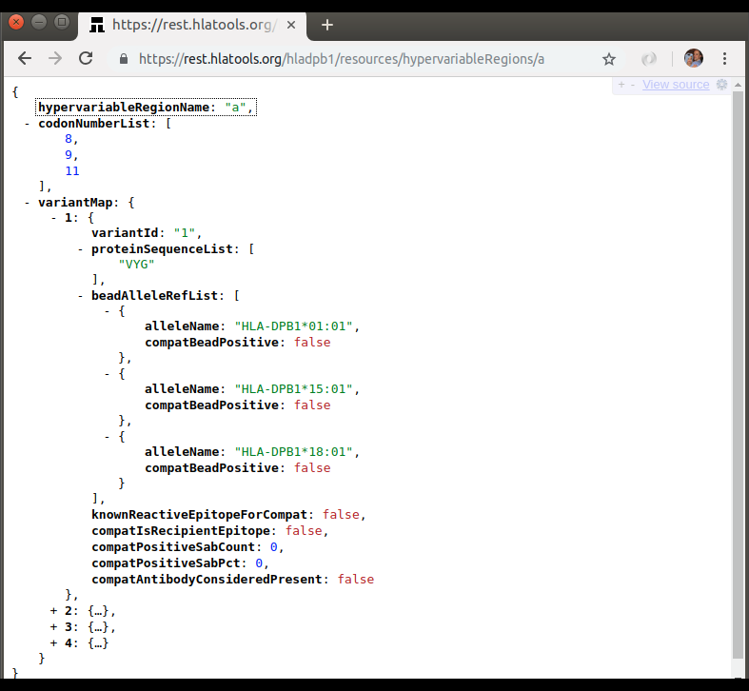
DPB1 REST Web Services Resources
Resource Name: alleles
Resource ID: HLA-DPB1*01:01:01:01
Resource Name: hypervariableRegions
Resource ID: a
Notes:
The service layer is implemented as a Java web application.
The “alleles” resource is loaded from an XML representation of the IMGT/HLA database.
The “hypervariableRegions” resource is loaded from a locally (Emory University) created XML database.
Only two (2) resources are required to implement the clinical decision support heuristic.

Slide 37
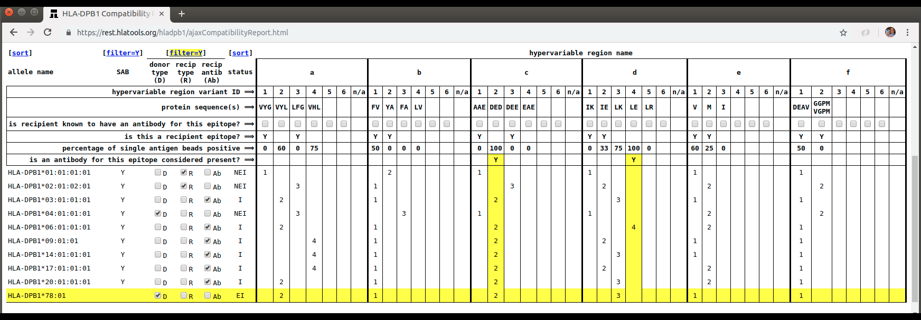

DPB1 REST Web Services Demonstration HTML5 Application
Candidate type: DPB1*01:01, *02:01 Donor phenotype: DPB1*04:01, *78:01
Candidate’s unacceptable antibody profile: DPB1*03, *06, *09, *14, *17, *20
Notes:
This is just a static HTML document with an embedded JavaScript program. My child in fifth grade is writing HTML documents like this.
This application is just fluff to demonstrate that the REST web services may have utility. As a stand-alone application it does not respect the latter four (4) rights of clinical decision support.
The author of an application like this would need to know almost nothing about HLA or even how the alleles are represented in the IMGT/HLA database. Most of the HLA domain-specific content has been abstracted in the JSON representation of the data model. The developer can focus on excellent user interface design. No comments from the peanut gallery.

Slide 38
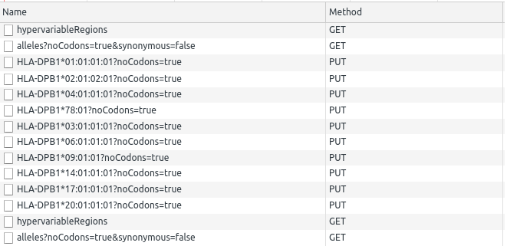
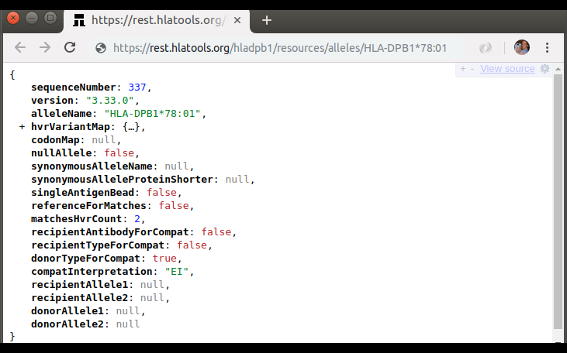
DPB1 REST Web Services Request Sequence
Candidate type: DPB1*01:01, *02:01 Donor phenotype: DPB1*04:01, *78:01
Candidate’s unacceptable antibody profile: DPB1*03, *06, *09, *14, *17, *20
t₀
t₁
load page
t₂
click recip. type
t₃
click recip. type
t₄
click donor type
t₅
click donor type
t₆
click antibody
t₇
click antibody
t₈
click antibody
t₉
click antibody
t₁₀
click antibody
t₁₁
click antibody
t₁₂
t₁₃
display results
time
Notes:
This is just a static HTML document with an embedded JavaScript program. My child in fifth grade is writing HTML documents like this.
This application is just fluff to demonstrate that the REST web services may have utility. As a stand-alone application it does not respect the latter four (4) rights of clinical decision support.
Some of these requests have slightly bulky payloads, but bandwidth is cheap.

Slide 39
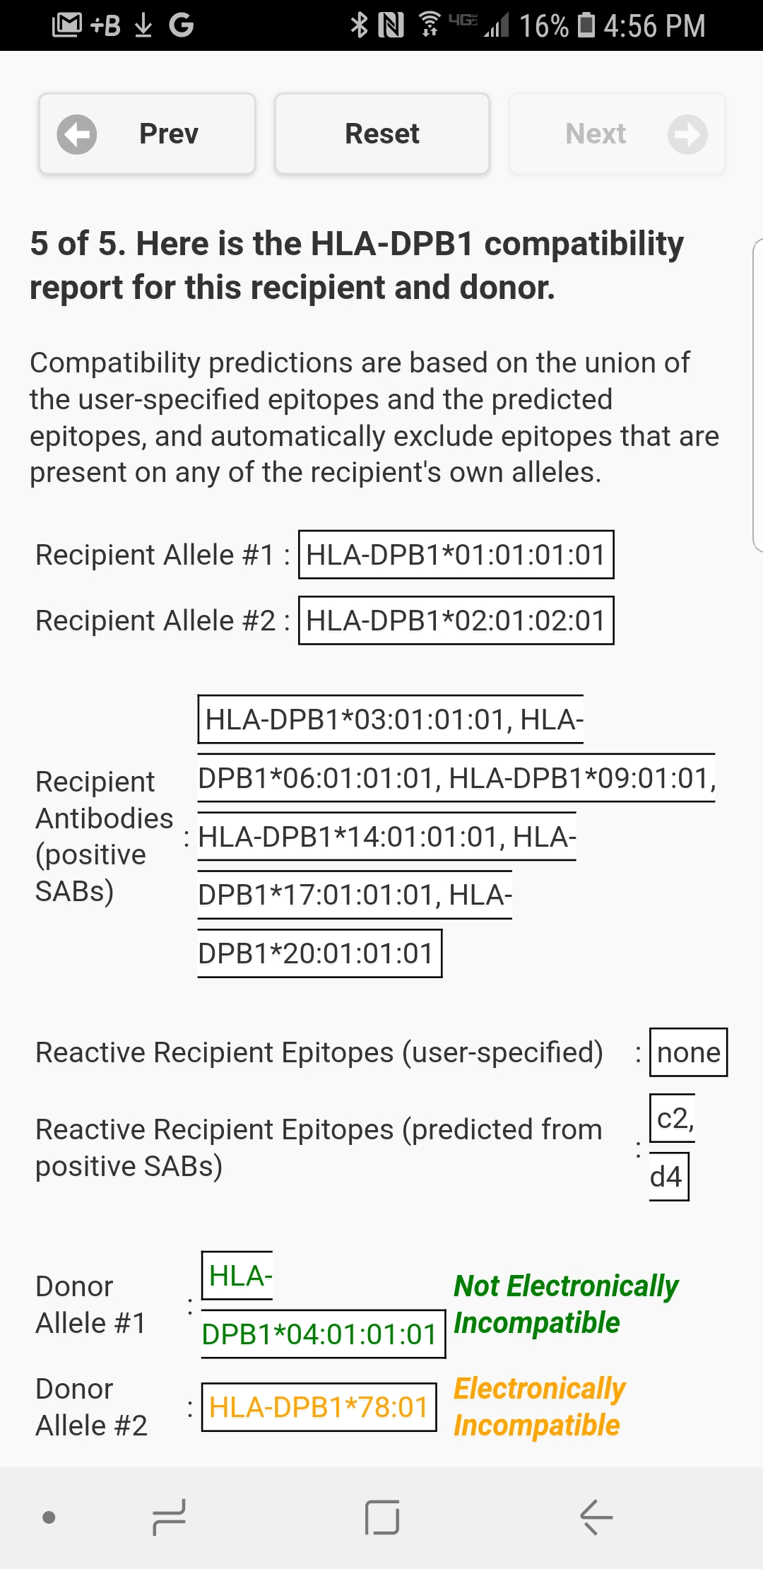
DPB1 REST Web Services Mobile Demonstration Application
Candidate type: DPB1*01:01, *02:01
Donor phenotype: DPB1*04:01, *78:01
Candidate’s unacceptable antibody profile: DPB1*03, *06, *09, *14, *17, *20
Notes:
This is a mobile “wizard” application running on a Samsung Android smart phone. The first four (4) wizard steps where you select the various alleles that represent antibodies and donor/recipient types are not shown.
This is only to demonstrate how universally consumable REST web services are. The request sequence is identical to the request sequence used from the

Slide 40
HEURISTIC ALGORITHM AS A REST WEB SERVICE EXAMPLE #2: Electronic Compatibility Assessment using Epitope Registry Epitopes (Google Cloud deployment) not publicly accessible (source code) https://github.com/ghsmith/epitopeFinder
Notes:
https://rest.hlatools.org/epitopeFinder has been removed from slide pending review of this usage with the Epitope Registry.

Slide 41
Epitope Background
HLA antibodies are specific for epitopes of HLA molecules
The International Registry of Antibody-Defined HLA Epitopes (Epitope Registry) curates a list of consensus HLA epitopes [1]
The Epitope Registry exposes their epitope database via a HTML web application that includes a sophisticated filtering mechanism for returning mismatched epitopes
Inferring antibody specificity for a particular epitope from a panel of single antigen bead results is cognitively challenging
[1] Duquesnoy, R. J., Marrari, M., Mulder, A., L. C. D. Da Mata Sousa, Silva, A. S., & Monte, S. J. (2014). First report on the antibody verification of HLA-ABC epitopes recorded in the website-based HLA Epitope Registry. Tissue Antigens, 83(6), 391-400.
Notes:
Acknowledgements to Dr. Howie Gebel at Emory University School of Medicine.

Slide 42
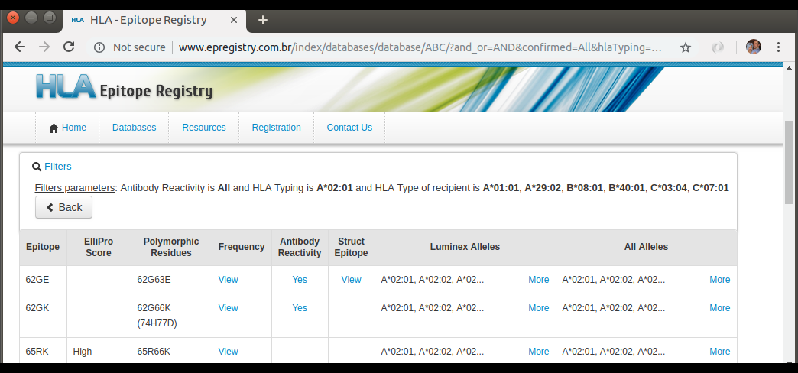
Sophisticated Filtering for Mismatched Epitopes
[1] http://www.epregistry.com.br/index/databases/database/ABC
Notes:
- The epitope filtering mechanism in the Epitope Registry is excellent. You provide it with (a) an allele for which you are interested in assessing for donor/recipient mismatches and (b) the recipient’s HLA type, and the Epitope Registry instantly returns a list of mismatched epitopes.
- Iteratively using this filtering mechanism with multiple positive single antigen bead results from a single antigen bead panel to infer which epitopes may be reactive with antibodies is cognitively difficult: the relationship between positive beads and epitopes is many-to-many and extremely tedious to keep track of.

Slide 43
Epitope Heuristic Example
= positive bead
= negative bead
Notional 5-bead Single Antigen Bead Panel
X
= rep. epitope
Bead #5 Epitopes
Bead #1 Epitopes
Bead #3 Epitopes
A
C
Bead #2 Epitopes
Bead #4 Epitopes
B
E
D
The presence of an antibody specific for epitope "E" is inferred because all of the beads with epitope "E" are positive (and all of the beads without epitope "E" are negative).
Notes:
My first exposure this heuristic was in conversation with Dr. Howie Gebel in the HLA laboratory at Emory University Hospital.

Slide 44
Epitope Heuristic
Infer the presence of an antibody specific for an epitope if…
all single antigen beads with a particular epitope are positive
-AND-
all single antigen beads without the epitope are negative

Slide 45
Epitope Heuristic Example
= positive bead
= negative bead
Notional 5-bead Single Antigen Bead Panel
X
= rep. epitope
Bead #5 Epitopes
Bead #1 Epitopes
Bead #3 Epitopes
A
C
Bead #2 Epitopes
Bead #4 Epitopes
B
E
D
The presence of an antibody specific for epitope “B" is not inferred because bead #3 is positive but does not include the epitope. This is restrictive since it requires a single-antibody solution.
Notes:
Requiring a single-antibody solution rules out the possibility of the system considering a solution that, say, involved an antibody to epitope B and an antibody to epitope C.

