Slide 1
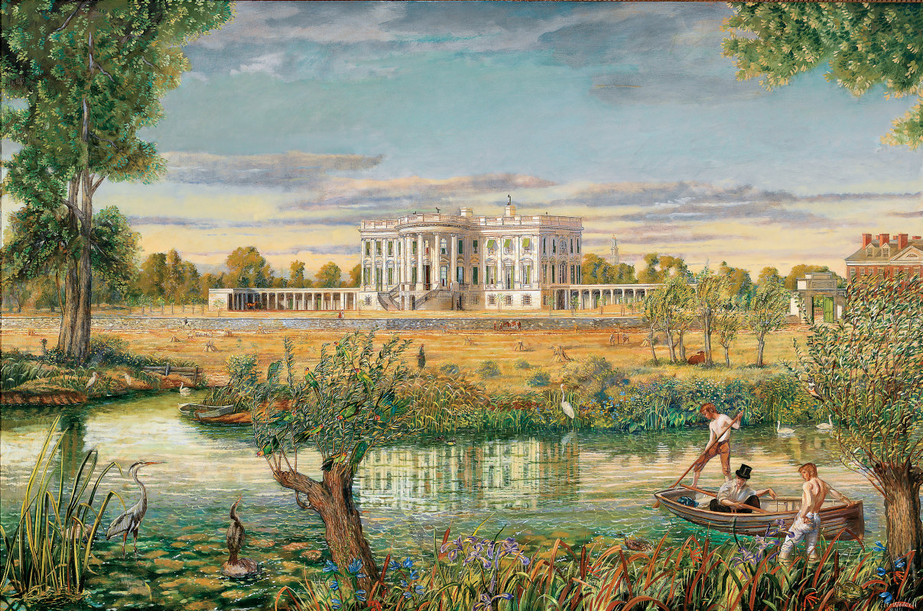
Unit 1: Foundations of American Democracy
15-20% of
exam

Slide 2
Key Vocabulary
Government: the institutions and processes through which public policies are made for society
Politics: the way groups of people make decisions, share power, and manage resources as a society
Natural rights: rights given to everyone in a state of nature before governments arise
Social contract: a form of government where the people consent to being governed by a sovereign
Republicanism: the power resides in the people, who elect representatives to govern them

Slide 3
Key Vocabulary (Continued)
Democratic theory: democracy is a form of government that places ultimate political authority in the hands of people
  Direct democracy: citizens debate and vote directly on laws
  Representative democracy: people elect representatives to govern them and to make laws and set policies; essentially an indirect democracy
Elite theory: a relatively small, cohesive elite class makes all important decisions rather than the will of the people
Pluralist theory: the argument that representative democracies are based on group interest that protect the individual’s interest by representing him/her to the government
Federalism: a system of government that divides power between a central government and the states

Slide 4
Key Vocabulary (Continued)
Block grants: A fixed sum of money given by the national government to a state or local government for broadly defined purposes.
  Examples: Mental Health Block Grant, Social Services Block Grant
Categorical grants: Federal funds given to state and local governments for narrow, specific purposes.
  Examples: Medicaid, Head Start, National School Lunch Program
Grants-in-Aid: Funds given by the national government to state and local governments to pay for specific public programs or projects.
  Examples: Interstate Highway Construction Grants

Slide 5
Key Vocabulary (Continued)
Federal mandates: Rules or orders set by the national government requiring states, local governments, or private groups to take specific actions or follow strict standards.
  Examples: Clean Air Act, Americans with Disabilities Act
Revenue sharing: A fiscal arrangement where a higher level of government allocates a portion of its tax revenues to lower-level state or local governments with few restrictions on how the funds are spent.
  Examples: American Rescue Plan Act, U.S. General Revenue Sharing Program

Slide 6
Key Documents
Declaration of Independence
Articles of Confederation
Gettysburg Address
Federalist No. 10
Federalist No. 51
Brutus No. 1
The United States Constitution
Marbury v. Madison
Federalist No. 39
McCulloch v. Maryland
United States v. Lopez

Slide 7
Disclaimer
The following slides simply summarize the key documents in the AP® United States Government and Politics curriculum. You should always read the actual documents for more specific details and facts, using the slides/notes as a supplementary guide.

Slide 8
Declaration of Independence
Paragraph 1 → reasons for severing ties to British rule
Paragraph 2 → colonists’ belief of the fundamental purpose of government → inalienable rights of “life, liberty, and the pursuit of happiness.”
Paragraphs 3-29 → colonists’ grievances towards King George III, who ruled over them → common grievances include standing army, taxation without consent, cutting of trade with rest of the world
Paragraphs 30-32 → concluding paragraphs declaring the united colonies free from British rule and allegiance to the British crown → signers pledge their lives, fortune, and sacred honor in support of the Declaration.

Slide 9
Key Takeaways
Declaration of Independence paid homage to Enlightenment ideals.
  “Life, liberty, pursuit of happiness” and social contract theory heavily inspired by John Locke’s works
Separated American ties to British rule
Established a new form of republican government: one that derives its powers from the consent of the people

Slide 10
MCQ Practice
The Declaration of Independence cites specific reasons for separating from British rule, including the British imposing taxes and maintaining a standing army without consent. Which of the following principles or ideas would these grievances be most related to?
Natural rights such as life, liberty, and property.
The authority to create a centralized military among the colonies.
The incorporation of checks and balances among the branches of government.
Concurrent powers allowing the colonies to draft their own laws.
STOP

Slide 11
Articles of Confederation
Drafted after Declaration of Independence and came into force in 1781
First body of law for the newly formed nation
Purpose was to preserve the independence and sovereignty of the thirteen states
SUMMARY:
  Article I: Named the country as “The United States of America.”
  Article II: Provides that states retain sovereignty not delegated to the national government.
  Article III: Creates a “league of friendship” between states for defense and security.
  Article IV: Protects equal treatment and freedom of movement for citizens.
  Article V: Allocates one vote in Congress for each state.
  Article VI: Gives the national government the power to declare war.
  Article VII: Gives states the power to assign military ranks.
  Article VIII: Expenditures by the United States will be paid with funds raised by state legislatures.

Slide 12
Articles of Confederation
SUMMARY
  Article IX: Gives Congress the power to declare war and peace, appoint tribunals for crimes on the seas, regulate the post office, appoint a president, and request regulations from states. Nine states are required to consent to declare war.
  Article X: Allows a “committee of the states” to exercise the powers of Congress when Congress is not in session.
  Article XI: Provides that Canada may join the Union.
  Article XII: Provides that the Confederation accept the war debt.
  Article XIII: Provides that amendments require the approval of all thirteen states.

Slide 13
Key Takeaways
PROS
  Provides significant freedom to states, preventing them from being under the rule of a tyrannical government.
  Each state is given equal representation in Congress, with one vote per state, honoring the founding principle that “all men are created equal.”
CONS
  Does not allow Congress to collect taxes, meaning government cannot be funded easily.
  No executive power to enforce laws passed by Congress.
  Changing the Articles of Confederation requires the consent of all 13 states (which is nearly impossible to achieve).
WHY DID THE ARTICLES OF CONFEDERATION FAIL?
  Created a weak central government that was unable to collect taxes or force states to pay off its debts from the Revolutionary War.
  No federal power (a.k.a. a president) to enforce laws passed by Congress or a federal court system to handle disputes between states.
  Changing the Articles of Confederation was nearly impossible, requiring the approval of all thirteen states.

Slide 14
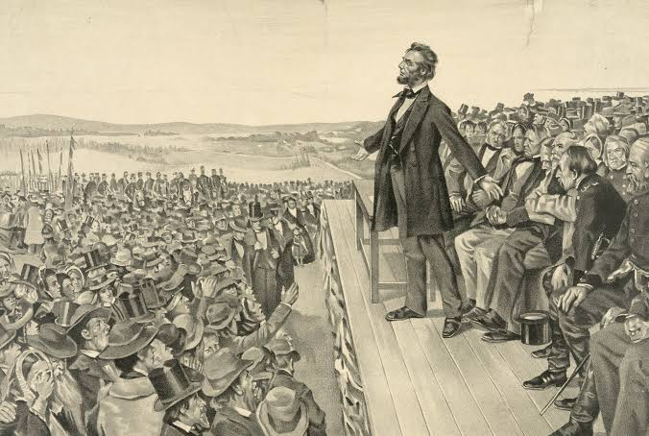
The Gettysburg Address
Nearly a century later, during the midst of the Civil War, Abraham Lincoln delivered a speech that tied the Union’s battle back to our nation’s founding ideals…

Slide 15
The Gettysburg Address
Delivered to dedicate a military cemetery for Union soldiers during the Civil War.
In the address, Lincoln alludes to the Declaration of Independence’s ideals of a nation where all men are created equal.
Described the Civil War as a test of whether a nation founded on and dedicated to these ideals would survive.
Called for a “new birth of freedom.”
“The government of the people, by the people, for the people, shall not perish from the earth.”

Slide 16
Key Takeaways
The Gettysburg Address demonstrates the foundational ideals in the Declaration of Independence being put to the test.
Lincoln reminds the audience of the ideals the nation was founded on, and advocates fighting for them.

Slide 17
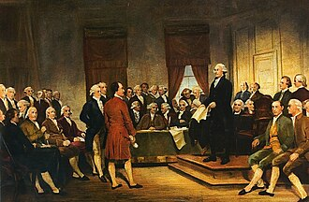
The Federalists vs. The Anti-Federalists
Dissatisfaction with the Articles of Confederation led to a strong desire for reform within the American government…

Slide 18
Federalist No. 10
James Madison describes the problem of faction.
  A faction is an organized political group that opposes the rights of other citizens.
  Can lead to majoritarianism (one faction with a majority dominates and suppresses others)
How to “cure” factions?
  Removing liberty (“the air to the fire”)
  Make everyone have the same interests, passions, and motives.
The methods described above for curing factions are impossible and impractical in a nation where everyone is entitled to natural rights.

Slide 19
Federalist No. 10
Madison’s solution?
A large federal republic!
WHY?
  A large federal republic allows for a variety of political interests and factions, which prevents one faction from becoming too strong.

Slide 20
Federalist No. 51
James Madison argues for a stronger federal government.
  If all humans were “angels”, there would be no need for government.
  If humans were governed by “angels”, there would be no need for a system of checks and balances.
Madison proposes separation of powers and checks and balances.
  Legislative, judicial, and executive branches
  Each branch imposes limits on one another if a branch becomes too powerful.
  Legislative branch is inherently predominant, requiring additional limits.

Slide 21
Brutus No. 1
Author acknowledges limitations of Articles of Confederation
But… the Constitution is NOT the solution to these limitations.
In a large nation, the Constitutional republic cannot represent the interests of its people.
Necessary and proper clause
  Allows federal government to exercise unprecedented power over states and citizens.
Commerce clause
  Destroys state sovereignty and gives central government unprecedented power.

Slide 22
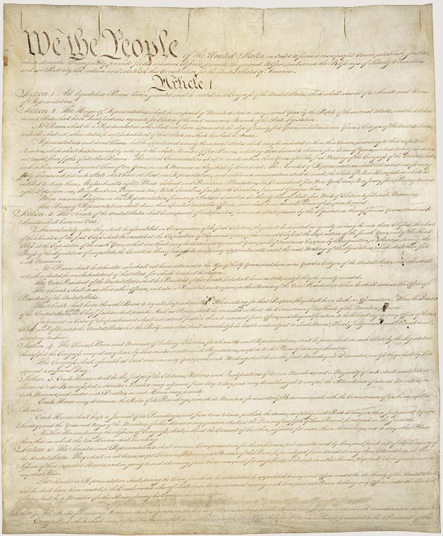
The Constitution
The Federalists were triumphant, albeit with several compromises made to appeal to the Anti-Federalists…

Slide 23
The Constitution
Article I: Creates a bicameral legislature, establishes requirements for serving in the House of Representatives and Senate, lists expressed powers of Congress, and allows for implied powers (necessary and proper clause).
Article II: Creates the presidency, establishes requirements for office, lists the expressed powers of the executive.
Article III: Creates a Supreme Court and provides that Congress may establish lower federal courts.
Article IV: Sets forth the relationship between states.
Article V: Establishes the process for amending the Constitution.

Slide 24
The Constitution
Article VI: Establishes that the Constitution, federal laws, and treaties are the supreme law of the land (supremacy clause)
Article VII: Describes how the Constitution will be ratified.

Slide 25
Constitutional Amendments
Below are key amendments to the United States Constitution you MUST know about for the AP® exam.
  Amendment I: Congress cannot make any laws restricting freedom of speech or press.
  Amendment II: The right for a “well regulated militia” to bear arms shall not be infringed.
  Amendment IV: People are protected from unreasonable searches and seizures by the government.
  Amendment X: Grants states powers not explicitly prohibited by the Constitution or exclusively reserved for the federal government.

Slide 26
Constitutional Amendments
  Amendment XIII: Abolished slavery and involuntary servitude nationwide except as a punishment for crime.
  Amendment XIV: Defined national citizenship and provided each person equal protection under the law.
  Amendment XIX: Guarantees that the right to vote in the United States cannot be denied on account of sex.
  Amendment XXII: Limits an elected president to two presidential terms.
  Amendment XXV: Sets the rules for presidential succession and disability.

Slide 27
MCQ Practice
Which of the following is a correct comparison between the United States Constitution and the Articles of Confederation?
 | United States Constitution | Articles of Confederation
(A) | Favored strong national government | Favored a federal system
(B) | Granted Congress the power to levy taxes | Granted states alone the power to levy taxes
(C) | Required approval by three-fourths of Congress for a constitutional amendment | Required unanimity of Congress to amend
(D) | Granted Congress the power to declare war | Granted Congress the power to regulate trade
STOP

Slide 28
Federalist No. 39
The Constitution establishes a republic because the people elect representatives to create and administer laws.
The Constitution establishes both a federal and national government.
  Ratification of the Constitution is dependent on three-fourths of state legislatures approving it → federal
  House of Representatives are directly elected by the people → national

Slide 29
Unit 1 SCOTUS cases
Marbury v. Madison, McCulloch v. Maryland, united states v. Lopez

Slide 30
Marbury v. Madison
Facts of the case: Marbury attempted to sue SCOTUS into delivering his commission, which Thomas Jefferson instructed his Secretary of State James Madison not to hand it over.
Holding: SCOTUS ruled that although Marbury had a legal right to the commission, the Judiciary Act that Marbury utilized for the case was unconstitutional because it expanded the court’s original jurisdiction beyond what Article III of the Constitution allowed.
Significance: Because the ruling declared an act of Congress void, the case established the principle of judiciary review.

Slide 31
McCulloch v. Maryland
Facts of the case: Congress chartered the Second Bank of the United States in 1816. In 1818, Maryland passed legislation to tax the bank. James McCulloch, the cashier of the Baltimore branch of the bank, refused to pay the taxes. Maryland’s appeals court asserted that the Second Bank was unconstitutional because the Constitution did not explicitly allow the federal government to charter a bank.
Holding: SCOTUS unanimously ruled that Maryland could not tax the bank because it was an asset of the national government used to execute constitutional powers outlined in the necessary and proper clause. Because the Constitution grants the government the power to tax and declare war, Congress has an implied power to charter a bank.
Significance: The case allowed the national government to exercise implied powers that were supreme over state laws.

Slide 32
United States v. Lopez
Facts of the case: Alfonzo Lopez, a high school senior in San Antonio, TX, carried a concealed weapon on campus. Federal agents charged Lopez for violating the Gun Free School Zones Act of 1990, which forbids firearm possession on school property.
Holding: SCOTUS ruled in favor of Lopez because in Jones & Laughlin Steel, the Court already warned about the limitations of the Commerce Clause. The Gun Free School Zones Act was not related to interstate commerce. If the act were to be upheld, Congress could become tyrannical as they could regulate all activities that could lead to violent crime, regardless of their relation to interstate commerce.

Slide 33

United States v. Lopez
Dissenting opinions: The presence of guns in schools has been statistically proven to undermine education. Because global competition has increased the importance of education, the presence of guns has a chain effect on commerce in the form of decreased education and therefore worker productivity.
Significance: This case limits Congressional power under the Commerce Clause such that the clause cannot be extended to non-economic and local activities solely due to indirect effects on the national economy. It also reinforced the Tenth Amendment, which limits the power of the federal government.

Slide 34
MCQ Practice
The case United States v. Lopez (1995) struck down the Gun-Free School Zones Act because
It violated Fourth Amendment protections against unwarranted searches.
Congress exceeded its authority in the use of the commerce clause.
The Second Amendment is a right incorporated to the states.
Students retain their First Amendment rights while attending schools.
STOP

