Slide 1
ART FIBER SYSTEMS CHALLENGE / NATIONAL AI HACKATHON 2026
AFS Assessment
Assistant
From a customer enquiry to a
reviewable first feasibility experiment.
SOURCE-GROUNDED
EXPERT-REVIEWABLE
EXPLICIT UNCERTAINTY
PROJECT TEAM
Eisa Atif • Marie Habermann • Atfan Deshmukh • Akshdeep Singh
Naumanurrahman Shaikmujeeburrahman
github.com/ght007/SchubKI • 18 October 2026
01 / 14
Notes:
PRESENTATION TIMING: 15 seconds
SPEAKER NOTES
Introduce the project as an assistant for an AFS expert’s first customer discussion. Name the five contributors; do not imply individual roles that have not been supplied. The assistant supports technical screening and experiment design, rather than replacing expert judgment.
SOURCES AND EVIDENCE
User-provided contributor names; README introduction; challenge brief p.1. The organiser is SchubKI; no separate formal team name was supplied.

Slide 2
01 / CUSTOMER PROBLEM
The first decision is what to test.
A process goal is not yet a spectroscopy specification.
Clarify the problem
THE CUSTOMER KNOWS
Extract requirements and ask the missing questions that change the decision.
“We need to monitor
moisture or
contamination.”
Propose a sensing concept
Recommend methods, spectral range and a high-level probe concept, with sources.
Still unknown: target range, sample optics, references, installation and success criteria.
Plan the first experiment
Make uncertainty, practical comparisons and the decision basis explicit.
Challenge brief pp.1–2; README §§1–2
02 / 14
Notes:
PRESENTATION TIMING: 20 seconds
SPEAKER NOTES
Start with the challenge’s industrial customer: the desired process variable is known, but the measurement concept is not. Explain the three outputs: clarify, propose, and design a useful first test. The displayed customer sentence is an illustrative condensation of the challenge, not a logged customer quote.
SOURCES AND EVIDENCE
Challenge brief pp.1–2: six requested outputs and minimal requirements. README §§1–2.

Slide 3
02 / SYSTEM ARCHITECTURE
A fixed pipeline keeps reasoning reviewable.
Language models read and explain; explicit code checks constraints, evidence and confidence.
LLM language
Deterministic code
Checks + one repair
01
02
03
04
Read the enquiry
Rules + coverage
Retrieve evidence
Test premises
Facts, unknowns and premises
Method, fiber and scope checks
BM25 + dense → RRF → MMR
Supported, contradicted or unknown
05
06
07
08
Draft the report
Verify claims
Quality gate
Confidence + coach
Fast model or Council drafts
Quotes, numbers and client facts
16 checks; at most one repair
Signals, caps and follow-up needs
Browser + live SSE • Python / FastAPI / Pydantic • Groq • Supabase + local SQLite fallback
README §§3–8, 21; backend/app/engine/pipeline.py
03 / 14
Notes:
PRESENTATION TIMING: 35 seconds
SPEAKER NOTES
Walk through the fixed stages without reading every box. The pipeline deliberately does not depend on an agent choosing whether to verify. Explain that Council is optional: multiple models draft and cross-judge, but deterministic gates still run. Supabase is the main database only when configured; SQLite is local storage and offline fallback. Source files and a built index remain prerequisites for a functional run.
SOURCES AND EVIDENCE
README §§3–8 and 21. docs/frontend-integration.md: processing, data retention, accounts. Current engine and database implementation. Older architecture.md describes a SQLite-only baseline; this slide reflects the newer conditional Supabase implementation.

Slide 4
03 / USE OF AFS MATERIALS
AFS knowledge becomes checkable evidence.
The source, page, quote and evidence scope travel with the recommendation.
95
curated evidence cards
35
sourced screening rules
16
report quality checks
Evidence with different scopes
Page → quote → claim → verification
S01 + table
Method principles, applications, limitations
S02
Company slides, fibers, bands and AFS paths
Ingest refuses evidence cards whose quotes cannot be found on their cited pages.
S03 / S04
In-vitro proof of concept / laboratory work
S05 / S06
Business and laboratory context
A laboratory or in-vitro result does not establish deployment or clinical readiness.
data/kb/claims.jsonl; rules.yaml; README §§5–7, 21
04 / 14
Notes:
PRESENTATION TIMING: 25 seconds
SPEAKER NOTES
Use the three counts as implementation counts, not performance claims. The repository contains 95 evidence cards and 35 rules; the quality gate defines 16 checks. Explain the hierarchy of evidence scopes. The S02 slide deck is image-based and has a curated transcription. Raw source documents must be available for ingestion and quote verification.
SOURCES AND EVIDENCE
Counts checked directly in current claims.jsonl and rules.yaml. README §§5–7, 21; quality.py. Source descriptions cross-checked against the supplied original presentation, pp.3–4. Original S01–S05 PDFs are not present in this cloud checkout, so source quotations were not independently reverified for this slide.

Slide 5
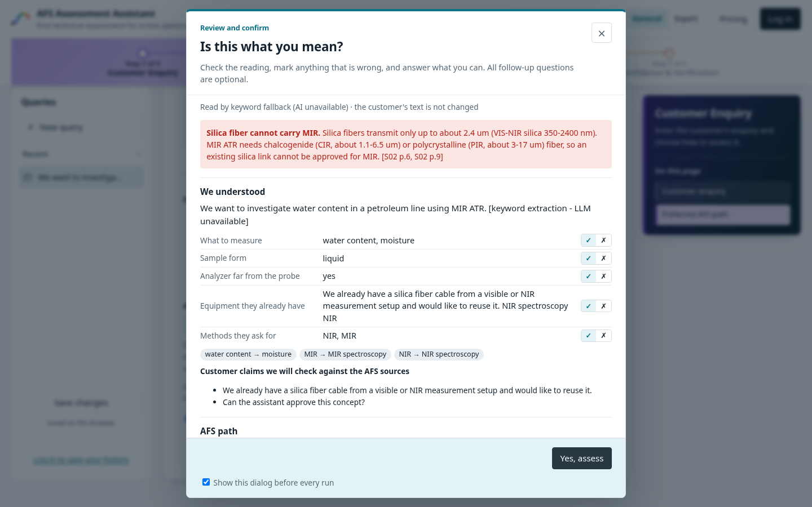
04 / PRODUCT EXPERIENCE • DEMO
Review once. Assess with the expert in control.
General: Customer Enquiry → Result Assessment → Confidence and Verification
1 Enter the enquiry
Instant pre-check highlights vague facts and early constraints.
2 Confirm the reading
A dialog contains optional follow-ups. “Yes, assess” submits the answers.
3 Inspect the result
Review the 11-section report, citations, confidence and exported plan.
Current feature_dialog UI; docs/frontend-integration.md; illustrated replay using stored H04
05 / 14
Notes:
PRESENTATION TIMING: 65 seconds, including a 60-second live demo
SPEAKER NOTES
Live demo script (Fast mode): 0–10s enter or load H04; 10–25s show the reading dialog, the silica/MIR warning, and one follow-up question; 25–45s select Yes, assess and open the resulting recommendation; 45–60s click a citation, inspect verification and show the feasibility plan. Close/Escape returns to editing; there is no skip button. If remote model latency prevents a five-minute presentation, open the stored run and clearly identify it as a replay. Expert view adds Process Information and Coach; General has three tabs. The screenshot is a current-frontend replay using rule-based reading and the archived H04 result, not evidence of a fresh model run or of currently configured external services.
SOURCES AND EVIDENCE
docs/frontend-integration.md and current frontend code, feature_dialog @18e4f84. UI screenshots captured from real frontend code with fixture API responses; result data taken from outputs/H04.json.

Slide 6
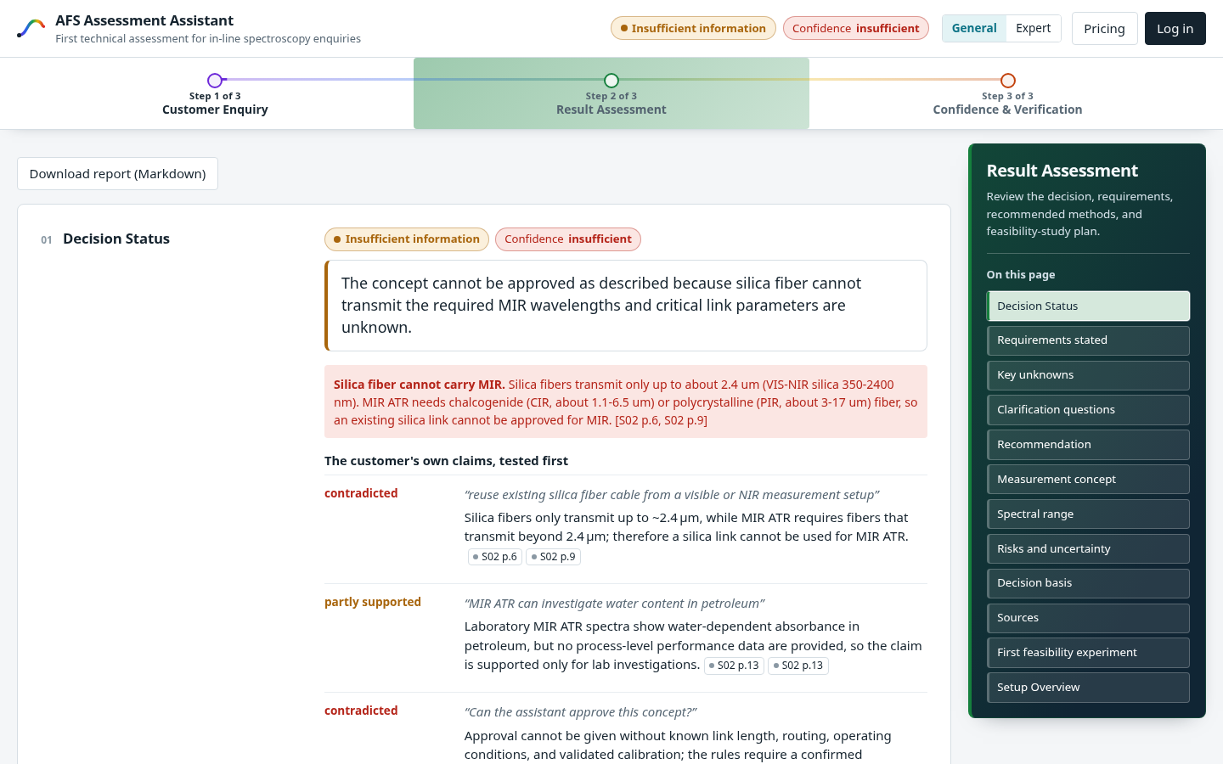
05 / EXAMPLE RECOMMENDATION
H04: the requested MIR setup cannot be approved.
Water in a petroleum line; analyzer in another building; an existing VIS/NIR silica cable.
The assessment
Silica is incompatible with the requested MIR wavelengths.
Unknown: link length, routing and operating conditions.
First test: an IR-compatible link and alternative sensing concepts.
STORED H04 RESULT • INSUFFICIENT INFORMATION
outputs/H04.json; supplied presentation p.5; AFS reference S02 pp.6, 9, 13 via curated KB
06 / 14
Notes:
PRESENTATION TIMING: 30 seconds
SPEAKER NOTES
Read the concept, then the refusal: the customer’s existing asset does not match the requested spectral region, and critical installation data is missing. This is a recommendation to investigate, not approval of an engineered system. The reference to silica and MIR is drawn from the curated AFS evidence; do not present the old model report as fully verified. Its verification defects are intentionally shown on slide 8.
SOURCES AND EVIDENCE
H04 exact scenario in eval/cases/final_cases.yaml. Stored outputs/H04.json, report headline and feasibility plan. S02 pp.6/9 fiber references and p.13 water-in-petroleum reference as represented in repository evidence cards; original S02 PDF was not available for a fresh page check.

Slide 7
06 / FIRST FEASIBILITY EXPERIMENT
A useful recommendation ends with a test.
H04 example: a bench comparison before a remote process installation.
Samples
Reference
Comparison
Decision basis
Water-spiked petroleum spanning relevant process states.
Independent water measurements, such as Karl Fischer.
MIR ATR and alternatives; test the effect of link length.
Client-agreed error, signal and robustness criteria.
Path A
Path B
Path C
AFS lab trial
Chemometric model for process automation
Multispectral system for the R&D laboratory
Spectral sensor solution for process monitoring
outputs/H04.json, feasibility_plan; challenge brief pp.1–2; AFS pathway via README / S02 p.20
07 / 14
Notes:
PRESENTATION TIMING: 30 seconds
SPEAKER NOTES
Show that the output is an experiment plan rather than a product catalog answer. Use representative samples, independent references, same-sample comparisons and success criteria agreed with the customer. The H04 archive specifically proposes water-spiked petroleum, Karl Fischer references and increasing link length. The AFS pathways are options after evidence from the lab trial; this slide does not claim that all three are already suitable for H04.
SOURCES AND EVIDENCE
Stored H04 report feasibility_plan and pathway. README §§5, 7, 21; S02 p.20 path descriptions in curated materials. Challenge brief requires a simple practical feasibility-study plan. No sample counts, detection limits or accuracy targets have been invented.

Slide 8
07 / VERIFICATION AND UNCERTAINTY
A plausible report can still contain a bad citation.
Verification is visible evidence for review—not a guarantee that every recommendation is correct.
Stored run
H01
H04
A REAL FLAG IN STORED H04
Claim checks¹
10 / 10
2 / 7
spectral_range[1]
Unsupported numbers
0
1
Unverified:
S12 p.7 does not exist
Quality checks
14 / 16
14 / 16
Confidence
Low
Insufficient
¹ App metric includes verified/fuzzy claims. Two stored examples, not an aggregate benchmark.
One repair round is allowed. Remaining warnings stay visible for expert review.
Stored Fast runs outputs/H01.json and outputs/H04.json (17 Oct 2026); README §§7, 21
08 / 14
Notes:
PRESENTATION TIMING: 30 seconds
SPEAKER NOTES
Make the limitations visible rather than overstating performance. The archive has an H01 run with 10/10 sourced statements counted verified and an H04 run with 2/7; both score 14/16 on the quality gate. H04 includes a nonexistent S12 citation and one unsupported number. The overall confidence is insufficient. These are stored runs dated 17 October 2026, not results of a new evaluation. The app metric counts verified/fuzzy statements. A citation check is not an expert validation of the scientific claim. Do not repeat the old deck’s claims that 60 tests passed or all 21 cases passed; those claims were not established by the available artifacts.
SOURCES AND EVIDENCE
Exact metrics and flag read from outputs/H01.json and outputs/H04.json. README §§7,21 explains metric definitions. Supplied old presentation p.7 provides context, but the archive values are the primary evidence.

Slide 9
08 / LIMITATIONS AND NEXT STEPS
Clear boundaries make the assistant useful.
A first technical assessment supports the next conversation and the next experiment.
No measured spectra
Curated knowledge
Model and runtime limits
Accuracy and detection limits cannot be predicted from the supplied documents.
Next: collect trial spectra, compare models and validate on independent samples.
Rules are conservative; unusual wording or missing sources can limit coverage.
Next: expert-approved source additions and feedback-informed cards and rules.
A model can mis-cite; Council agreement is not independent validation and can be slow.
Next: visible verification, Fast-mode demos and broader independent evaluation.
README §§19–21; supplied presentation p.8; current code and integration guide
09 / 14
Notes:
PRESENTATION TIMING: 25 seconds
SPEAKER NOTES
Name the scientific and system boundaries in plain language. No laboratory spectra were supplied, so there is no defensible predictive accuracy claim. More documents do not automatically mean approved rules; experts curate them. LLM citations can still fail and runtime quotas affect latency. Near-term work is to use measured spectra and expert feedback, not to claim production or clinical readiness from a prototype.
SOURCES AND EVIDENCE
README §§19–21. Original presentation p.8. Current knowledge-base editor supports registered readable documents with validation/versioning; it does not remove the need for expert review.

Slide 10
09 / PROJECT TEAM
Better first conversations. Checkable next steps.
AFS Assessment Assistant
Eisa Atif
Marie Habermann
Atfan Deshmukh
Akshdeep Singh
Naumanurrahman Shaikmujeeburrahman
Source-grounded recommendations • Explicit uncertainty • Practical feasibility experiments
Project credits supplied by the team • github.com/ght007/SchubKI
10 / 14
Notes:
PRESENTATION TIMING: 15 seconds
SPEAKER NOTES
Thank the jury and credit every contributor exactly as supplied: Eisa Atif, Marie Habermann, Atfan Deshmukh, Akshdeep Singh, and Naumanurrahman Shaikmujeeburrahman. Do not assign roles or hierarchy. End the main presentation here. Slides 11–14 are backup slides and submission handoff material; they are not part of the five-minute talk.
SOURCES AND EVIDENCE
User-provided contributor names. Main-slide timings total 290 seconds, including the demo.

Slide 11
APPENDIX A / JURY RUBRIC
The deck maps to every evaluation criterion.
Weights reproduced from the official challenge brief; no jury score is claimed.
Criterion
Weight
Evidence in the main presentation
Technical quality
30%
Constraint-aware method and probe concept; H04 example (3, 6).
Use of AFS knowledge
20%
Scoped corpus, citations and source checks (4, 8).
Feasibility-study plan
15%
Samples, references, comparisons and decision basis (7).
Clarification & uncertainty
15%
Review dialog, missing facts and computed confidence (5, 8, 9).
Explainability
10%
Auditable pipeline and visible verification defects (3, 8).
Prototype & presentation
10%
Current UI, timed demo and reproducible repository (5).
Challenge brief p.2; submission form pp.2–4
11 / 14
Notes:
PRESENTATION TIMING: Backup slide; omit from the timed talk
SPEAKER NOTES
Use this only for questions about alignment to the challenge. This is an evidence mapping, not a scoring result. It covers all six criteria, summing to 100%. The presentation and demo are planned to fit in the five-minute requirement.
SOURCES AND EVIDENCE
Official challenge brief p.2: criterion weights 30/20/15/15/10/10. Submission form pp.3–4 requires architecture, examples, feasibility plans, limitations and a prototype demonstration.

Slide 12
APPENDIX B / STRUCTURED OUTPUT
One assessment, eleven review sections.
The page and Markdown export share the same outline; Setup Overview is separate.
01
Decision Status
07
Spectral range
02
Requirements stated
08
Risks and uncertainty
03
Key unknowns
09
Decision basis
04
Clarification questions
10
Sources
05
Recommendation
11
First feasibility experiment
06
Measurement concept
Separate Setup Overview diagrams illustrate the proposed Path A / B / C systems.
docs/frontend-integration.md; backend/app/render/outline.py; current result presenter
12 / 14
Notes:
PRESENTATION TIMING: Backup slide; omit from the timed talk
SPEAKER NOTES
This is the current shared frontend/backend section contract. The final heading is First feasibility experiment; Setup Overview appears separately after the 11 sections in the current frontend. Feasibility lists are numbered once; pre-existing numeric markers are stripped only for display/export, without modifying stored steps.
SOURCES AND EVIDENCE
docs/frontend-integration.md: Result Assessment outline. backend/app/render/outline.py SECTIONS. frontend/js/components/assessment-outline.js. These supersede older README preview and prototype wording.

Slide 13
APPENDIX C / SUBMISSION HANDOFF
A complete submission needs more than slides.
Checklist from the supplied form. Listed items are requirements, not a claim of submission.
Required item
Handoff / check before submitting
Public repository
Code, setup, models/tools, material-loading instructions and architecture. Verify public access.
Six generated answers
Publish H01–H06, unedited and without case-specific hard-coding.
Accessible slide PDF
Use the companion PDF; publish it with access for the jury.
Video: max. 5 minutes
Demonstrate questions, methods, sources and the experiment; explain limits and architecture.
All five team members
Enter all names and their registered emails in the same order; credits are on slides 1 and 10.
Checkout check: only H01 and H04 output pairs are present. Complete and verify the remaining four before submission.
Submission form pp.1–4; deadline stated there: 18 Oct 2026, 23:59 CEST
13 / 14
Notes:
PRESENTATION TIMING: Submission handoff only; omit from the timed talk
SPEAKER NOTES
The supplied submission form says the final deadline is 18 October 2026 at 23:59 CEST. It requires unrestricted public access to source code, the six assistant-generated H01–H06 answers, slide PDF and a maximum-five-minute video, plus every participant’s registered name/email in matching order. Missing repository access leads to disqualification; missing slides/video access scores zero for the relevant criterion. These are requirements stated in the attached form, not actions taken by this assistant. This checkout has H01/H04 JSON and Markdown outputs only; H02/H03/H05/H06 must be produced by the assistant and published. No video, public access check or form submission has been performed. Source PDFs must also be supplied to reproduce ingest; adding the three uploaded PDFs to this presentation work does not populate the application’s required S01–S05 corpus.
SOURCES AND EVIDENCE
Submission form pp.1–4. Filesystem inventory of outputs/ at feature_dialog @18e4f84. No output files were edited or fabricated for the submission.

Slide 14
APPENDIX D / SOURCES AND TRACEABILITY
Built from the supplied materials and current code.
Current repository: ght007/SchubKI • feature_dialog @18e4f84
1 Official challenge brief
AI-based molecular media analysis by process-spectroscopy in-line.pdf, pp.1–3.
2 Submission requirements
Art Fiber Systems: AI Assistant for In-line Spectroscopy Solution Design.pdf, pp.1–4.
3 Earlier project presentation
AFS_Assistant_Presentation.pdf, 8 pages; used as background, with claims checked.
4 Project documentation
README.md and docs/frontend-integration.md: approach, UI, evaluation, limits and storage.
5 Implementation and evidence
Current pipeline, presenter and render code; data/kb/claims.jsonl and rules.yaml.
6 Stored examples
outputs/H01.json and H04.json, created 17 Oct 2026; screenshots replay those archived data.
Reproduce through the repository README with the required raw AFS documents. Slides alone do not establish runtime readiness.
Prepared 18 October 2026 • Source details are also recorded in each slide’s speaker notes
14 / 14
Notes:
PRESENTATION TIMING: Backup / reference slide
SPEAKER NOTES
Review methodology: all three attached PDFs were text-extracted and reviewed; the original deck was visually inspected. Repository documentation was checked against current frontend and rendering code, KB counts and stored H01/H04 results. Stale README top-level preview/four-tab wording and unsubstantiated old-deck aggregate test claims were not carried forward. UI screenshots run the actual frontend with mocked API responses: rule-only reading plus archived H04 result. Original raw S01–S05 PDFs were absent, so technical source-page statements here are attributed to the repository’s curated evidence, not a new independent page verification. The PowerPoint uses editable text/shapes with image screenshots, and includes sources and timing notes. No contributors’ emails or roles were supplied or invented.
SOURCES AND EVIDENCE
All sources listed on this slide. Repository URL: https://github.com/ght007/SchubKI. Source branch current at deck creation: feature_dialog @18e4f84. Main talk timings: 15+20+35+25+65+30+30+30+25+15 = 290 seconds.

