Slide 1
ART FIBER SYSTEMS CHALLENGE · NATIONAL AI HACKATHON 2026
AFS Assessment Assistant
A reviewable first experiment
for in-line spectroscopy.
Six final cases. Visible evidence. Explicit uncertainty.
6
4
16
FINAL CASES
FEATURE DEMOS
QUALITY CHECKS
Eisa Atif · Marie Habermann · Atfan Deshmukh · Akshdeep Singh
Naumanurrahman Shaikmujeeburrahman
github.com/ght007/SchubKI • Results review, 18 October 2026
01 / 13
Notes:
TIMING: 10 seconds
PRESENTER SCRIPT
Our assistant turns enquiries into reviewable spectroscopy experiments. Here are six final-case results and four working features: clarification, evidence review, the Coach, and knowledge expansion.
EVIDENCE & REPRODUCTION
README; current code at 40dd40b; official challenge brief pp.1–3; user-supplied team names.
LIMITS / DEMO DETAIL
All five names are credited equally; no individual roles have been invented. The deck updates both supplied drafts. Main talk totals 260 seconds, leaving 40 seconds for transitions within five minutes.

Slide 2
EVALUATION DESIGN
Six cases test technical decisions.
The challenge is whether the next technical step is justified.
H01 · Calibration transfer
H02 · Optical geometry
H03 · Selectivity
New API blend: revalidate the NIR model.
Clear whey and opaque milk need different interfaces.
Sensitivity alone does not establish selectivity.
H04 · Fiber compatibility
H05 · Undefined target
H06 · Evidence scope
An existing silica link cannot be approved for MIR.
Clarification needed; Council remains provisional.
An in-vitro kidney study does not establish surgical readiness.
JUDGING WEIGHTS
Technical 30%
AFS knowledge 20%
Feasibility 15%
Clarification 15%
Explainability 10%
Prototype 10%
Official final-case inputs H01–H06; challenge rubric p.3
02 / 13
Notes:
TIMING: 20 seconds
PRESENTER SCRIPT
The evaluation uses all six official final scenarios. They test calibration transfer, optical geometry, selectivity, fiber physics, an undefined target, and the scope of research evidence. These are decision tests, not a presentation of measurement accuracy. The feature demos connect directly to the weighted judging criteria shown here.
EVIDENCE & REPRODUCTION
customer_scenarios_for_final_evaluation.txt from materials.zip; challenge brief p.3; six archived H01–H06 Council answers.
LIMITS / DEMO DETAIL
H01–H04 archived runs include extra path answers. H05 still receives a provisional status despite an undefined target; this is a reported evaluation gap, not a pass.

Slide 3
SAVED COUNCIL RESULTS
Useful output, with measurable grounding gaps.
Six archived final answers · three model drafts · automatic checks after generation
35 / 44
source checks verified
4
unsupported-number flags
0 / 6
high-confidence outputs
Case
Source checks
Checks passed
Number flags
Confidence
Decision status
H01
6/8
15/16
0
Low
Provisional
H02
9/10
12/16
1
Insufficient
Provisional
H03
5/5
15/16
0
Low
Provisional
H04
7/10
15/16
0
Insufficient
Provisional
H05
3/3
13/16
3
Insufficient
Provisional
H06
5/8
12/16
0
Insufficient
Outside scope
Automatic checks are not expert accuracy scores. Quote matching covers only selected report fields.
origin/presentation@807609d · resultAssessments/H01–H06_council.md
03 / 13
Notes:
TIMING: 35 seconds
PRESENTER SCRIPT
Here are the actual saved Council results, before showing the demos. Thirty-five of forty-four counted source checks verify. Four unsupported-number flags remain, and none of the six reports claims high confidence. The check totals range from twelve to fifteen out of sixteen. H06 is outside scope, as it should be. H05 still says provisional despite the undefined target. We treat these as inspectable results and remaining defects, rather than claiming a perfect score.
EVIDENCE & REPRODUCTION
evaluation/council_archive_audit.json; archived Markdown from origin/presentation@807609d. Ratios are from each report’s own verification totals; 35/44 = 79.5%.
LIMITS / DEMO DETAIL
These are stored Council outputs, not fresh paid LLM runs. Some include expert path answers, so they cannot be compared as controlled paired trials with the unanswered offline baseline. Quality checks include heuristic rules, can produce false positives, and do not cover every sentence or prove semantic correctness. There is no jury score or spectral prediction benchmark.

Slide 4
HOW THE ASSESSMENT WORKS
LLMs draft. Code checks the decision.
A structured pipeline keeps sources, assumptions, proposals and uncertainty visible.
01
02
03
04
Read + clarify
Rules + retrieval
Draft + review
Gate + explain
Structured requirements
and missing facts
AFS claims, sources
and physical constraints
Fast or Council mode;
check and repair
Computed confidence;
report and Coach
95
35
16
curated claim cards
sourced rules
quality checks
FastAPI + Pydantic / Groq models / native JavaScript UI / SQLite or Supabase
README; docs/frontend-integration.md; backend/app/engine/{pipeline,verify,quality,confidence}.py
04 / 13
Notes:
TIMING: 20 seconds
PRESENTER SCRIPT
The model interprets the enquiry and drafts an assessment. Code applies sourced rules, retrieves evidence, checks claims and numbers, and computes confidence. Council adds multiple drafts and review. The starting knowledge base has ninety-five claim cards and thirty-five rules; the report has sixteen quality checks.
EVIDENCE & REPRODUCTION
README; docs/frontend-integration.md; backend/app modules pipeline, understand, rules, retrieve, report, verify, quality, confidence, coach, whatif; data/kb. Snapshot 40dd40b.
LIMITS / DEMO DETAIL
Source inventory: six supplied AFS sources, 65 PDF pages, 275 index records; a separately registered three-page business brief brings the complete initial test index to 68 pages / 281 records. Cards and rules are curated, not all automatically learned. Council uses three model endpoints from two model families; agreement is not three independent experiments.

Slide 5
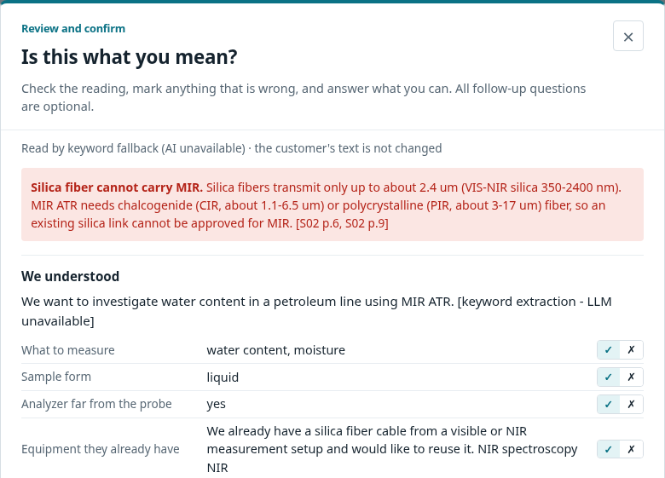
DEMO 01 · CLARIFICATION
Confirm the reading before assessing.
Show what the assistant understood, then ask what would change the recommendation.
Ask the decision questions
Sample optics
Clear, turbid or opaque — does it change?
Required range
What range and smallest change matter?
Independent reference
Which reference method provides calibration values?
REVIEW → YES, ASSESS · CLARIFICATION 15%
Actual UI, local rule-only demo · H04 · intake / understand / reading-review dialog
05 / 13
Notes:
TIMING: 25 seconds
PRESENTER SCRIPT
Start with the enquiry review. The assistant exposes its reading and the customer’s own claims, including the silica-to-MIR conflict. The user can correct facts and answer the questions that matter before selecting Yes, assess. The original enquiry stays visible; answers are recorded separately. This makes clarification part of the workflow instead of burying it after a confident recommendation.
EVIDENCE & REPRODUCTION
assets/clarification-review.png and clarification-questions.png; real browser and unmodified local API. Run 990e8459a5, generated from official H04 input, LLM_MOCK=1, hashing embeddings, SQLite.
LIMITS / DEMO DETAIL
Screenshots are actual local rule-only behavior, not the saved Council run on slide 3. Optional answers do not imply that missing information has been supplied. The dialog has Yes, assess and return/close behavior; no skip button or every-run checkbox is advertised.

Slide 6
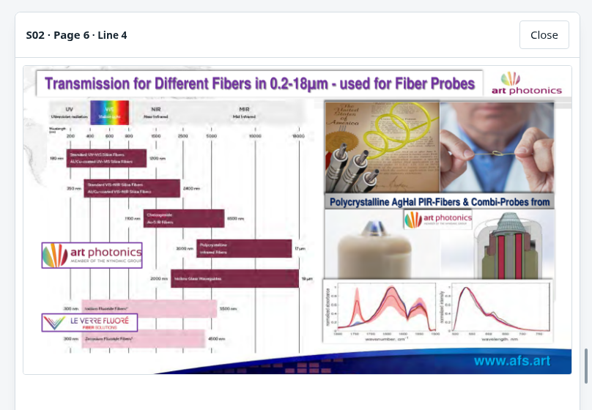
DEMO 02 · EVIDENCE REVIEW
Open the source that changes the decision.
H04: MIR ATR may be investigated; the existing silica link cannot be approved.
The physical constraint
Silica: VIS / NIR
MIR: a different fiber system
Remote link: confirm with AFS
A lab application is evidence to investigate — not approval of this installation.
ACTUAL PDF PANE · SOURCE PAGE SHOWN BESIDE THE REPORT
Actual evidence pane: S02 p.6 · related fiber data p.9 · petroleum application p.13
06 / 13
Notes:
TIMING: 30 seconds
PRESENTER SCRIPT
Click a citation to open the PDF alongside the report. Here, S02 page six gives the fiber transmission ranges. The central result is physical: the existing silica cable cannot simply carry the requested MIR signal. A new infrared fiber and the actual route require confirmation. S02 page thirteen supports investigating water in petroleum in the lab; it does not establish a validated remote process installation.
EVIDENCE & REPRODUCTION
Actual screenshot assets/evidence-split.png, cropped to enlarge the unchanged PDF pane. Supplied S02_Process_Control_Slides, pp.6,9,13; manual image transcription in data/kb/s02_notes.md and curated claim cards.
LIMITS / DEMO DETAIL
The UI supports a draggable split and starts at 50/50; the app header hides while the PDF is open. The source page is image-based, so curated transcription is an additional verification dependency. The saved Council H04 output cites S11 p.13 in some sections; S11 is not in the committed source registry. That gap is disclosed on slide 10. Wavelength ranges describe source specifications, not a promised installation distance or detection limit.

Slide 7
FEASIBILITY · 15%
Turn the recommendation into a testable comparison.
H04 example · a proposed experiment, not a claim of achieved sensor performance
01 · Samples
02 · Independent reference
Representative petroleum; vary water content and process conditions.
Measure water with a suitable reference, e.g. Karl Fischer.
03 · Compare concepts
04 · Decide with the client
NIR on the silica link vs MIR ATR with a confirmed IR link.
Use held-out samples; judge error, robustness and installation constraints.
Agree the target range, reference uncertainty and acceptance limits before validation.
H04 Council §11, condensed for presentation; S02 p.13; acceptance criteria require the customer
07 / 13
Notes:
TIMING: 25 seconds
PRESENTER SCRIPT
Use representative samples and an independent water reference such as Karl Fischer. Compare NIR on the existing silica link with MIR ATR only if an infrared link is confirmed. Validate on held-out samples against customer-agreed error, robustness and installation constraints. The acceptance limits must come from the customer, rather than an arbitrary R-squared threshold.
EVIDENCE & REPRODUCTION
Archived H04 Council report §11, compressed and edited as a presentation example; supplied S02 p.13 shows lab petroleum spectra, not process accuracy. The complete saved Council answer remains unedited in its original archive.
LIMITS / DEMO DETAIL
This is a proposed feasibility plan; no experiment has been performed here. The Council plan uses the illustrative source range 0.1–2.0% and its decision basis includes R² > 0.95; neither is an established client requirement. The fresh keyword fallback also introduces irrelevant formulation-reuse steps in H04. Those are limitations rather than examples to reproduce in the recommended plan.

Slide 8
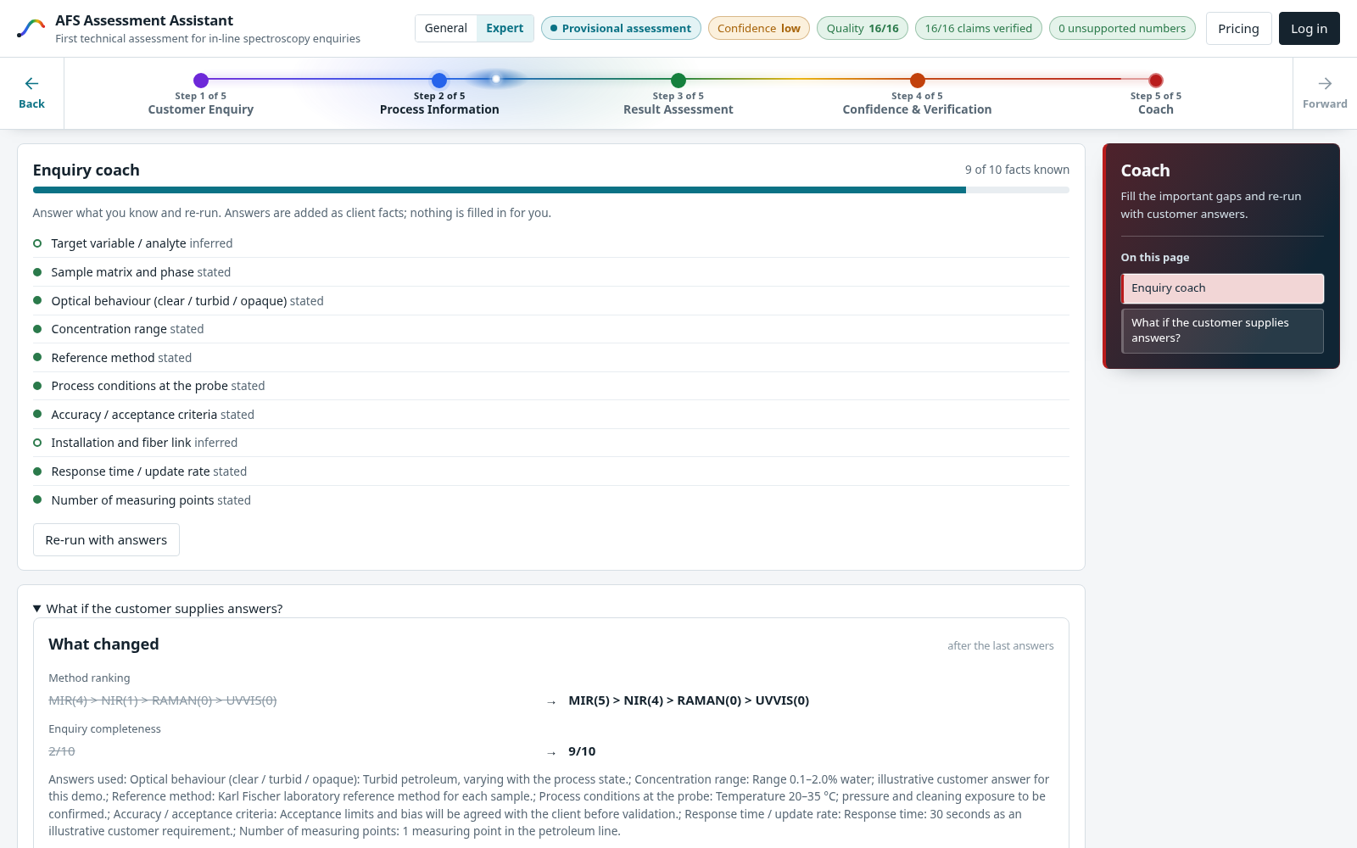
DEMO 03 · COACH + WHAT-IF
More answers improve completeness.
The Coach shows what changed; confidence still reflects physical constraints.
INFORMATION COMPLETENESS
2 / 10 → 9 / 10
CONFIDENCE
LOW → LOW
The silica/MIR blocker remains.
The parent run and change summary remain visible.
Actual local H04 demo · 990e8459a5 → c36bf79f5c · illustrative customer answers
08 / 13
Notes:
TIMING: 25 seconds
PRESENTER SCRIPT
In this real Coach re-run, we add illustrative customer answers about optical behavior, a reference method, operating conditions and acceptance criteria. Completeness moves from two to nine of ten. Confidence stays low because answering questions does not repair the silica-to-MIR incompatibility. The re-run retains its parent and shows a comparison, so the expert can see what changed.
EVIDENCE & REPRODUCTION
evaluation/coach_after.json; evaluation/demo_evidence.json; actual screenshot coach-after.png. Before run 990e8459a5; after c36bf79f5c. Diff: completeness 2/10→9/10; MIR and NIR screening scores change; low confidence remains.
LIMITS / DEMO DETAIL
The seven entered answers are explicitly illustrative and are not final evaluation-case ground truth. Rule-only, hashing, SQLite. Completeness is a ten-field information checklist, not measured scientific correctness. The checker marks some information as stated based on answer text; customer confirmation remains necessary.

Slide 9
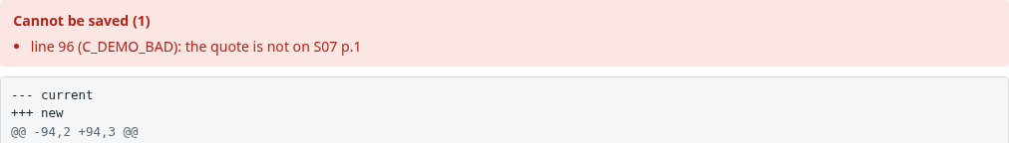
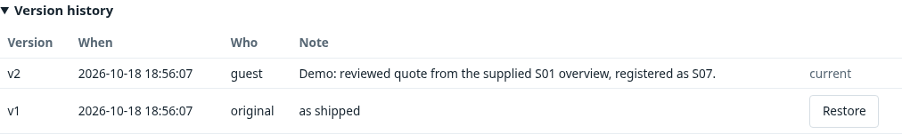
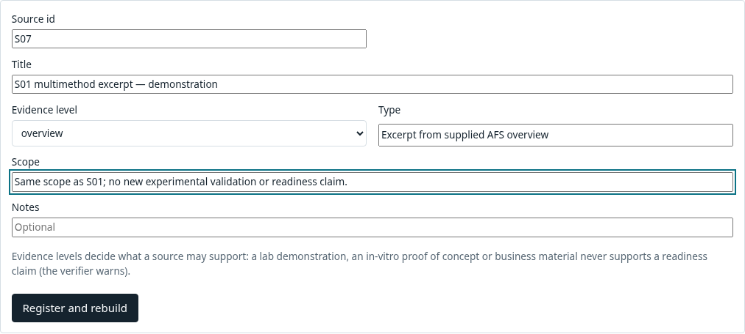
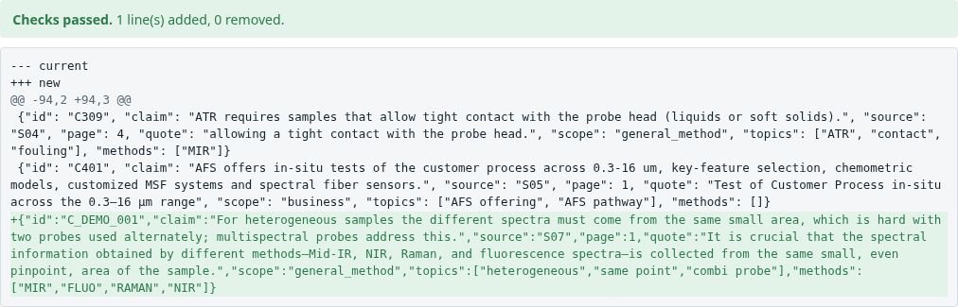
DEMO 04 · KNOWLEDGE-BASE EXPANSION
New knowledge must survive a source check.
Register → validate the quote → save a version → rebuild the index
01 Upload + scope
02 Check + diff
03 Version + rebuild
281 → 283
+1 document excerpt
+1 verified claim card
The excerpt reuses supplied S01 evidence. Expansion does not create new scientific validation.
Actual KB Editor and local API · isolated S01 excerpt demo · 281 → 283 records
09 / 13
Notes:
TIMING: 30 seconds
PRESENTER SCRIPT
The knowledge base can grow through the actual editor. We upload a short excerpt from supplied S01, register its source and evidence scope, and try an invented quotation. Validation rejects it. An exact quotation passes, and saving creates a version with a human comment before rebuilding the index. The isolated index grows from two hundred eighty-one to two hundred eighty-three records: one document chunk and one claim card.
EVIDENCE & REPRODUCTION
assets/kb-register.png, kb-rejected-quote.png, kb-validated-diff.png and kb-version-history.png; evaluation/demo_evidence.json; backend/app/kb/files.py, api/kb_admin.py and kb/ingest.py. Source S07 is a demonstration excerpt of S01 p.8. claims.jsonl version 2.
LIMITS / DEMO DETAIL
This demonstrates controlled expansion, not autonomous science or automatic rule learning. The card keeps S01’s overview scope. Rejected quotation is absent from the uploaded page. Local KB_EDIT=open and guest attribution are demo-only; the project includes authenticated owner/admin controls for deployed settings. The demo changed only scratch files outside the repository and did not write to Supabase.

Slide 10
EVALUATION FINDINGS
Three priorities before stronger performance claims.
The prototype exposes failure signals; some checks still miss or misclassify claims.
Ground every section
Tighten decision gates
Expert validation
H02 + H05: 4 number flags.
H04: S11 absent from registry.
An R² threshold escapes the number counter.
H05: undefined target still provisional.
Negation and units can trigger false warnings.
Keywords can overreach.
No spectra or prediction labels.
No proven detection limit.
Council traces: 72–189 s; use a prepared run for the demo.
Fresh regression evidence: 21 runs completed · 7/7 adversarial expectations · 81 tests passed
Rule-only / hashing baseline; 20 PostgreSQL tests skipped. These are software checks, not Council accuracy.
Council archive audit; verify.py / quality.py; fresh 21-case rule-only baseline
10 / 13
Notes:
TIMING: 30 seconds
PRESENTER SCRIPT
Three priorities remain. Verify every report section: an R-squared threshold escapes the number checker, and H04 cites S11, absent from the committed registry. Tighten the undefined-target gate and reduce heuristic false warnings. Validate usefulness with experts and samples. Separately, fresh offline checks completed twenty-one runs, met seven adversarial expectations, and passed eighty-one tests. Those establish regression coverage; model quality still needs expert evaluation.
EVIDENCE & REPRODUCTION
Council audit: H02 one number flag, H05 three; H04 S11 and R² >0.95; H05 provisional. Fresh baseline: 6 final + 8 dev + 7 adversarial; pytest 81 passed, 20 skipped, 2 warnings. Current snapshot 40dd40b.
LIMITS / DEMO DETAIL
Saved Council trace durations 72.289–188.733 seconds, median 141.4535 s; includes cached calls/failures/fallbacks, not a controlled latency benchmark. Some H06 flags arise around negated readiness language; do not treat every heuristic flag as a confirmed scientific error. The rule-only fallback’s quote checks can pass even when its plan includes irrelevant formulation steps in H04. No spectra, reference labels or expert ratings were supplied for quantitative sensor-performance validation.

Slide 11
RESULT
Make the next experiment reviewable.
01
02
03
Clarify
Inspect
Test
What is actually required?
Which source supports it?
What experiment resolves it?
Working prototype. Inspectable results. Clear validation gaps.
Eisa Atif · Marie Habermann · Atfan Deshmukh · Akshdeep Singh
Naumanurrahman Shaikmujeeburrahman
AFS Assessment Assistant • github.com/ght007/SchubKI
11 / 13
Notes:
TIMING: 10 seconds
PRESENTER SCRIPT
Clarify the request, inspect the evidence, and agree the next experiment. Our working prototype makes both its recommendations and its remaining validation gaps visible. Thank you.
EVIDENCE & REPRODUCTION
Repository ght007/SchubKI; current code, captured demos and archived final outputs. Team names supplied by the user.
LIMITS / DEMO DETAIL
End the main talk here at approximately 4 minutes 20 seconds. The following two slides are backup material for questions.

Slide 12
APPENDIX A · EVALUATION PROTOCOL
Different checks answer different questions.
Keep mechanical regression checks separate from stored Council behavior.
Evidence
Conditions
Observed result
What it does not prove
Council archive
6 saved final reports
35/44 checks; 4 number flags
Not fresh; not expert accuracy
Fresh pipeline
21 cases; rule-only / hashing
21 completed; 7/7 adversarial
Not a new LLM benchmark
Verifier totals
Same 21 offline cases
179/179 counted checks
Not semantic correctness
Software suite
SQLite; supplied corpus
81 pass; 20 PG skips
No PostgreSQL claim
Feature demos
Real local UI + API
Coach 2→9; KB +2 records
Illustrative customer answers
Code: 40dd40b · Council archive: 807609d · No case-specific code changes
Mock evaluation: LLM_MOCK=1 · EMBED_BACKEND=hashing · DB_BACKEND=sqlite
Reproducible artefacts: evaluation/baseline_summary.json, council_archive_audit.json, pytest.xml
12 / 13
Notes:
TIMING: 0 seconds (appendix; outside main talk)
PRESENTER SCRIPT
If asked about evaluation rigor, use this slide to explain which claim each evidence set supports. The Council archive shows actual model-generated final answers. The fresh deterministic baseline checks the current pipeline and guard behavior without spending LLM calls. Tests cover software behavior; the UI captures prove workflows. None is a measured spectral prediction result.
EVIDENCE & REPRODUCTION
evaluation/run_baseline.py calls the unchanged application pipeline with official H01–H06, eval/cases/dev_cases.yaml and eval/cases/adversarial_cases.yaml, using the existing check_expect helper. pytest.xml records full-suite outcome. See accompanying Evaluation_Audit.md for commands, per-case metrics and limitations.
LIMITS / DEMO DETAIL
The full source registry is needed for the suite. Supplied challenge brief was restored in the isolated raw corpus under its already-registered name, resolving a source-missing setup failure before the final suite run. 20 account/database variants require AUTH_TEST_PG_URL and were skipped. Two pre-existing deprecation warnings remain. The 179/179 count is exact-quote checking of selected typed fields, not all assertions or independent fact validation.

Slide 13
APPENDIX B · PROVENANCE
Evidence scope travels with the claim.
Sources define what may be concluded, not just what may be cited.
Source
Evidence boundary
Used pages / form
S01 · Multispectral Laboratory
Overview; method selection and sample optics
pp.5–10, 16–18
S02 · Process-Control slides
Company slides; fibers, lab petroleum, solution paths
pp.6, 9, 13, 20
S03 · LED kidney study
In-vitro proof of concept; not clinical readiness
pp.1, 14
S04 · MIR + fluorescence
Laboratory/model-tissue demonstration
6-page paper
S05 / S06 · flyer + link
Business context; not performance validation
Flyer / lab link
Basis: README + frontend integration + pipeline/UI/KB/evaluation code; supplied drafts; official rubric.
Saved Council answers are preserved unedited. Presentation examples are labelled when condensed.
Supplied AFS corpus, official challenge documents, repository and unedited Council archive
13 / 13
Notes:
TIMING: 0 seconds (appendix; outside main talk)
PRESENTER SCRIPT
Use this source map when asked about AFS knowledge. Overview material supports screening; company slides show the relevant fiber and application examples; the kidney and combined-method papers remain within their laboratory scope. Flyers and links are business context, not a detection-limit or readiness claim.
EVIDENCE & REPRODUCTION
Reviewed current repository snapshot 40dd40b, including README.md and docs/frontend-integration.md; AST inventory of 126 source/doc/config files (14,820 lines); all core pipeline, UI, KB and evaluation paths. Both supplied presentation drafts and the submission/challenge documents were read. Sources are the materials.zip versions and supplied PDFs.
LIMITS / DEMO DETAIL
Document instructions were treated as challenge context; no hackathon form was submitted and no third-party messages were sent. Source PDFs are not redistributed in the presentation package. Embedded slide notes retain precise context, demo conditions and limits. Old draft claims of perfect tests or missing final answers have been replaced with the current auditable findings.

