Slide 1
AFS FIBERWISE
JURY PRESENTATION / 01
AFS Fiberwise
First technical assessment for
in-line spectroscopy
AFS evidence for a reviewable first experiment
TEAM
Akshdeep Singh Atfan Deshmukh Eisa Atif
Marie Habermann Naumanurrahman Shaikmujeeburrahman
github.com/ght007/SchubKI
Notes:
Sources and context:
Reconstructed as editable text and vector elements from the revised jury PDF. Original AFS figures remain embedded images. Repository snapshot bf818a9.
Repository: https://github.com/ght007/SchubKI

Slide 2
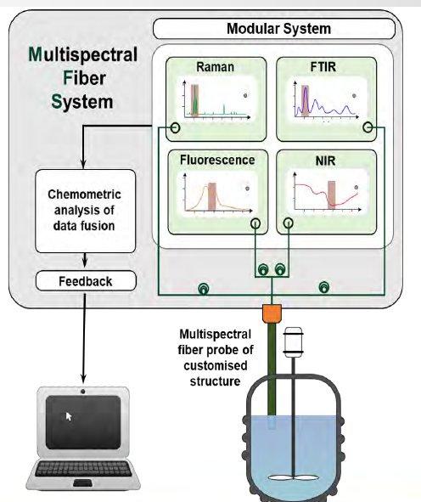
AFS FIBERWISE
JURY PRESENTATION / 02
The first customer discussion
The assistant proposes an investigation for an AFS expert to review.
01
Customer enquiry
Target, material, process conditions and existing equipment.
02
Confirm the reading
Confirm extracted facts and correct misreadings.
03
Technical assessment
Review methods, evidence and a first experiment.
04
Expert follow-up
Add customer answers and compare the revised assessment.
AFS multispectral laboratory concept
Source: S02, slide 5
Sources: challenge brief p.1; S02 slide 20. Workflow: frontend/js/app.js.
Notes:
Sources and context: Sources: challenge brief p.1; S02 slide 20. Workflow: frontend/js/app.js.
Reconstructed as editable text and vector elements from the revised jury PDF. Original AFS figures remain embedded images. Repository snapshot bf818a9.
Repository: https://github.com/ght007/SchubKI

Slide 3
AFS FIBERWISE
JURY PRESENTATION / 03
System architecture
Rules handle the physics. Models handle language. Code checks the drafted report.
0 / CODE
1 / LLM
2 / CODE
3 / CODE
4 / LLM
Pre-check
Extract
Rules engine
Retrieval
Premise check
EN / DE glossary
Facts, unknowns
35 sourced rules
BM25 + embeddings
Checks customer
Early warnings
Client premises
Fiber range, scores
RRF, MMR
assumptions
5 / LLM
6 / CODE
7 / CODE
8 / CODE
OUTPUT
Report
Verifier
Quality gate
Confidence
Assessment
11 sections or
Quotes, numbers
16 code checks
Computed signals
Citations and
Council drafts
Evidence scope
Optional LLM repair
Coach and what-if
reviewable findings
Knowledge base: 95 verbatim evidence cards, 35 sourced rules, method profiles, fibers and bands
Orange border: model stage. Code runs the checks. Optional repair and Coach also use a model.
Adapted from AFS Fiberwise - Video Intro, slide 2. Implementation: engine/pipeline.py, precheck.py and confidence.py.
Notes:
Sources and context: Adapted from AFS Fiberwise - Video Intro, slide 2. Implementation: engine/pipeline.py, precheck.py and confidence.py.
Reconstructed as editable text and vector elements from the revised jury PDF. Original AFS figures remain embedded images. Repository snapshot bf818a9.
Repository: https://github.com/ght007/SchubKI

Slide 4
AFS FIBERWISE
JURY PRESENTATION / 04
AFS materials become inspectable evidence
Page references and evidence scope stay attached to the knowledge.
95
35
16
curated evidence cards
general sourced rules
quality checks
S01 + comparison table
Methods, interfaces, calibration and application examples.
S02 process-control slides
Fiber transmission, analyte bands, sensor concepts and A/B/C pathways.
S03 + S04 research papers
Laboratory evidence with explicit limits on readiness claims.
S05 + S06 business
Company and laboratory context only.
context
S02 uses a labelled slide transcription. Ingest checks evidence-card quotes.
Sources: data/kb/claims.jsonl, rules.yaml and sources.json.
Notes:
Sources and context: Sources: data/kb/claims.jsonl, rules.yaml and sources.json.
Reconstructed as editable text and vector elements from the revised jury PDF. Original AFS figures remain embedded images. Repository snapshot bf818a9.
Repository: https://github.com/ght007/SchubKI

Slide 5
AFS FIBERWISE
JURY PRESENTATION / 05
Verification supports expert review
Statement types and checks expose uncertainty.
Four statement types
Checks after drafting
Client fact
What the customer actually said.
Citation and scope
Quote presence, missing pages and readiness language.
Sourced claim
A claim with a source, page and
Numbers and client facts
quote.
Heuristic checks against supplied text and evidence.
Assumption
An unconfirmed interpretation.
Quality and repair
Proposal
An experiment or design to
16 checks, with at most one model repair attempt.
investigate.
Confidence uses information, evidence and scope signals, with rule caps and verification penalties.
A matching quote does not prove that the full scientific conclusion is correct.
Code: engine/verify.py, quality.py and confidence.py. Citation counts cover selected report fields.
Notes:
Sources and context: Code: engine/verify.py, quality.py and confidence.py. Citation counts cover selected report fields.
Reconstructed as editable text and vector elements from the revised jury PDF. Original AFS figures remain embedded images. Repository snapshot bf818a9.
Repository: https://github.com/ght007/SchubKI

Slide 6
AFS FIBERWISE
JURY PRESENTATION / 06
Example: a new pharmaceutical formulation
H01 asks whether adding Raman can preserve an existing NIR calibration after the formulation changes.
Customer premise (paraphrased)
Assessment finding
“Adding Raman will keep
our old calibration valid.”
Adding Raman does not validate the old
model for a new formulation.
Methods worth testing
NIR diffuse reflection as the baseline, with Raman as a comparison.
Decision-changing
What changed in the blend? Which reference values and acceptance criteria
questions
are available?
Archived H01: provisional assessment, low confidence. The report stage used a rule-based fallback.
Archived H01 output. Technical basis: S01 pp.5, 8-10 and 14-15.
Notes:
Sources and context: Archived H01 output. Technical basis: S01 pp.5, 8-10 and 14-15.
Reconstructed as editable text and vector elements from the revised jury PDF. Original AFS figures remain embedded images. Repository snapshot bf818a9.
Repository: https://github.com/ght007/SchubKI

Slide 7
AFS FIBERWISE
JURY PRESENTATION / 07
A first feasibility experiment
The first experiment tests whether calibration reuse is justified.
01
Representative samples
Cover the new API / excipient range and relevant physical variation.
02
Independent reference values
Pair each sample spectrum with a suitable laboratory measurement.
03
Controlled comparison
Test the old NIR model first. Compare a new NIR model with Raman or fused data if justified.
04
Independent validation
Evaluate held-out batches or runs against client-agreed error and bias.
Decision: retain, rebuild or reject calibration reuse using the experimental evidence.
Based on the stored H01 plan. Acceptance criteria remain client-agreed; no spectra were supplied.
Notes:
Sources and context: Based on the stored H01 plan. Acceptance criteria remain client-agreed; no spectra were supplied.
Reconstructed as editable text and vector elements from the revised jury PDF. Original AFS figures remain embedded images. Repository snapshot bf818a9.
Repository: https://github.com/ght007/SchubKI

Slide 8
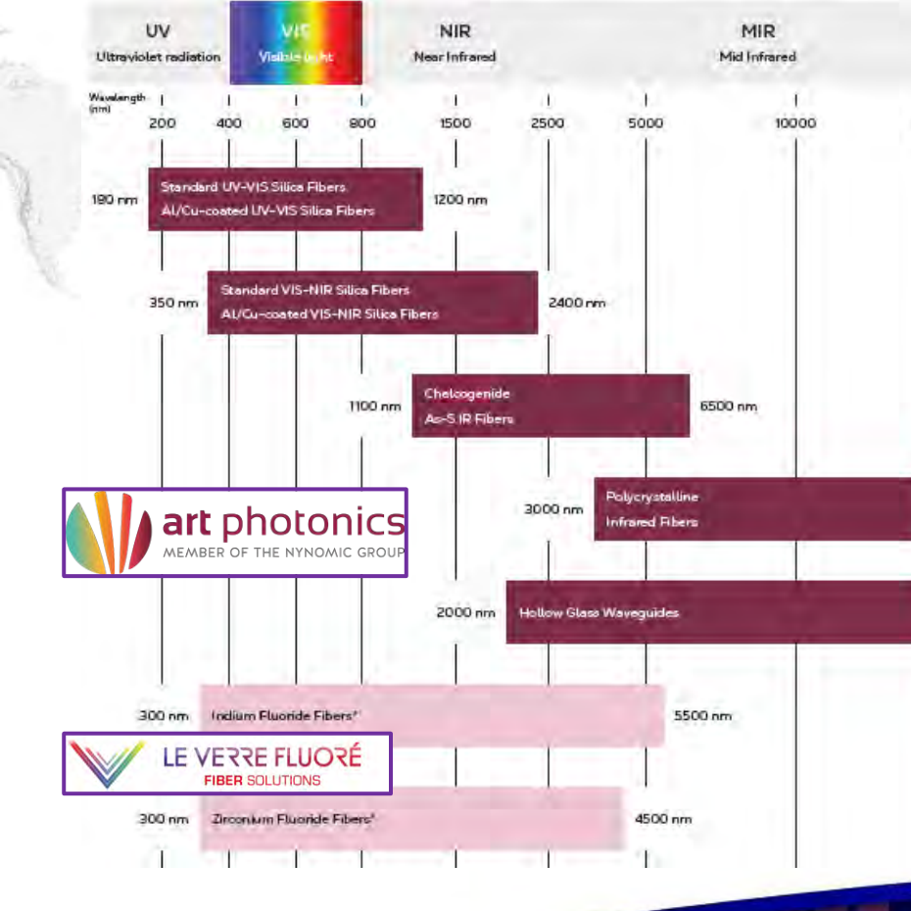
AFS FIBERWISE
JURY PRESENTATION / 08
Example: the existing fiber blocks the MIR concept
H04 asks to reuse a visible/NIR silica cable for remote MIR ATR measurements of water in petroleum.
The central finding
The existing silica link
cannot support the proposed
MIR measurement.
Next questions: link length, routing, process
conditions, target range and reference
measurements.
Next experiment: compare a compatible MIR setup on
representative samples before approving a remote
link.
S02 slide 6, cropped fiber transmission chart
Archived H04 also flags 2/7 sourced claims verified and one unsupported number. Expert review is still required.
Archived H04 output. Fiber chart: art photonics, supplied S02 slide 6.
Notes:
Sources and context: Archived H04 output. Fiber chart: art photonics, supplied S02 slide 6.
Reconstructed as editable text and vector elements from the revised jury PDF. Original AFS figures remain embedded images. Repository snapshot bf818a9.
Repository: https://github.com/ght007/SchubKI

Slide 9
AFS FIBERWISE
JURY PRESENTATION / 09
AFS pathways follow the investigation
Optional pathway preferences are checked against sourced rules.
Lab trials establish useful features before solution selection.
A
B
C
Chemometric model
Customized MSF system
Dedicated spectral sensors
Translate spectra into process
Equip the customer’s R&D
Develop a dedicated sensor after
measurements for automation.
laboratory.
lab validation.
A preference is context. The analysis can return “premature”, “conflicts” or “undecided”.
Path definitions: S02 slide 20. Code: engine/paths.py. AFS and the customer confirm the solution.
Notes:
Sources and context: Path definitions: S02 slide 20. Code: engine/paths.py. AFS and the customer confirm the solution.
Reconstructed as editable text and vector elements from the revised jury PDF. Original AFS figures remain embedded images. Repository snapshot bf818a9.
Repository: https://github.com/ght007/SchubKI

Slide 10
AFS FIBERWISE
JURY PRESENTATION / 10
Current limits and the expert’s role
The prototype structures the first decision. Real samples determine analytical performance.
No measured spectra
Accuracy and detection limits remain unproven for the customer’s
process.
Heuristic safeguards
Rule scores and confidence are design signals, not calibrated probabilities.
Incomplete verification
Quote checks do not prove conclusions. Citation counts cover selected
fields.
Model and service failures
Retries and labelled fallbacks help when model calls fail.
Expert review and feasibility studies guide the next step.
Repository:
github.com/ght007/SchubKI
/ Reviewed snapshot bf818a9 / 18 October 2026
Notes:
Sources and context: Repository: github.com/ght007/SchubKI / Reviewed snapshot bf818a9 / 18 October 2026
Reconstructed as editable text and vector elements from the revised jury PDF. Original AFS figures remain embedded images. Repository snapshot bf818a9.
Repository: https://github.com/ght007/SchubKI

Slide 11
AFS FIBERWISE
APPENDIX / 11
Saved-run evidence and evaluation scope
These are reported artifact metrics, not independently measured scientific accuracy.
Archived run | Quality checks | Sourced claims | Unsupported numbers
H01 formulation | 14 / 16 | 10 / 10 | 0
H04 silica / MIR | 14 / 16 | 2 / 7 | 1
What the artifacts demonstrate
What they do not establish
H01 retains a labelled rule-based draft after a model
The reviewed snapshot contains two final-case
failure. H04 exposes citation and numeric failures
outputs and six adversarial outputs. It does not
rather than presenting a clean verification result.
establish completion of H01-H06 or expert-validated
performance.
Evidence: outputs/H01.json, H04.json and outputs/adversarial at snapshot bf818a9. H01: H1 fail / U2 warn. H04: G1 and G2 fail.
Notes:
Sources and context: Evidence: outputs/H01.json, H04.json and outputs/adversarial at snapshot bf818a9. H01: H1 fail / U2 warn. H04: G1 and G2 fail.
Reconstructed as editable text and vector elements from the revised jury PDF. Original AFS figures remain embedded images. Repository snapshot bf818a9.
Repository: https://github.com/ght007/SchubKI

Slide 12
AFS FIBERWISE
APPENDIX / 12
Sources and reproducibility
Public source code and traceable materials support jury review.
Implementation
github.com/ght007/SchubKI
Snapshot bf818a9, inspected on 18 October 2026.
Core files
engine/pipeline.py, paths.py, verify.py and confidence.py
kb/retrieve.py, kb/store.py and data/kb/*
AFS evidence
S01: methods and calibration, pp.5-10 and 14-18
S02: fiber chart, slide 6; lab concept, slide 5; pathways, slide 20
Evidence scope
S03: LED kidney study, in-vitro proof of concept
S04: combined MIR / fluorescence probe, laboratory demonstration
Reproduction: Python 3.12, requirements.txt, registered AFS source files, ingest and local app startup. Groq requires a
private API key.
The repository README documents setup. The original AFS documents retain their owners’ rights.
Challenge context: AI Assistant for In-line Spectroscopy Solution Design brief, pp.1-2; opening presentation, p.22.
Notes:
Sources and context: Challenge context: AI Assistant for In-line Spectroscopy Solution Design brief, pp.1-2; opening presentation, p.22.
Reconstructed as editable text and vector elements from the revised jury PDF. Original AFS figures remain embedded images. Repository snapshot bf818a9.
Repository: https://github.com/ght007/SchubKI

