Slide 1
Operating Systems:
Scheduling

Slide 2
Kernel
Controls execution of processes by allowing their creation, termination, suspension, communication
Schedules processes fairly for execution on CPU
CPU executes a process
Kernel suspends process when time quantum elapses
Kernel schedules another process to execute
Kernel later reschedules the suspended process

Slide 3
Basic Operations on Processes
Basic operations on processes are implemented by kernel primitives
Maintain the state of the operating system
These primitives are indivisible, protected by “busy-wait” type of locks

Slide 4
Basic Operations on Processes
create - Establish a new process
Assign a new unique PID to the process
Allocate memory to the process for all elements of process image, including private user address space and stack; the values can possibly from from the parent process; set up any linkages, and then allocate space for PCB
Create a new process control block corresponding to PID and add it to process table, initialize different values in there such as parent PID, list of children (initialized to null), program counter (set to program entry point), system stack pointer (set to define the process stack boundaries)

Slide 5
Basic Operations on Processes
create - Establish a new process
Initial CPU state, typically initialized as Ready or Ready, suspend
Add the process id of new process to list of children of the creating process
Assign initial priority
Initial priority of the process may be greater than the parents
Fill out accounting information and limits
Add the process to the ready list

Slide 6
Basic Operations on Processes
suspend - Change process state to suspended
A process may suspend only its descendants
May include cascaded suspension
Stop the process if process is in running state and save the state of the processor in PCB
If process is already in blocked state, leave it blocked, else change to ready
If need be, call scheduler to schedule the processor to some other process

Slide 7
Basic Operations on Processes
activate - Change process state to active
Change one of the descendant processes to ready state
Add the process to the ready list
destroy - Remove one or more processes
Cascaded destruction possible
Only descendant processes may be destroyed
If the process to be killed is running, stop execution
Free all resources currently allocated to process
Remove PCB associated with killed process

Slide 8
Basic Operations on Processes
change_priority - Set a new priority for the process
Change priority in the PCB
Move process to a different queue to reflect priority change

Slide 9

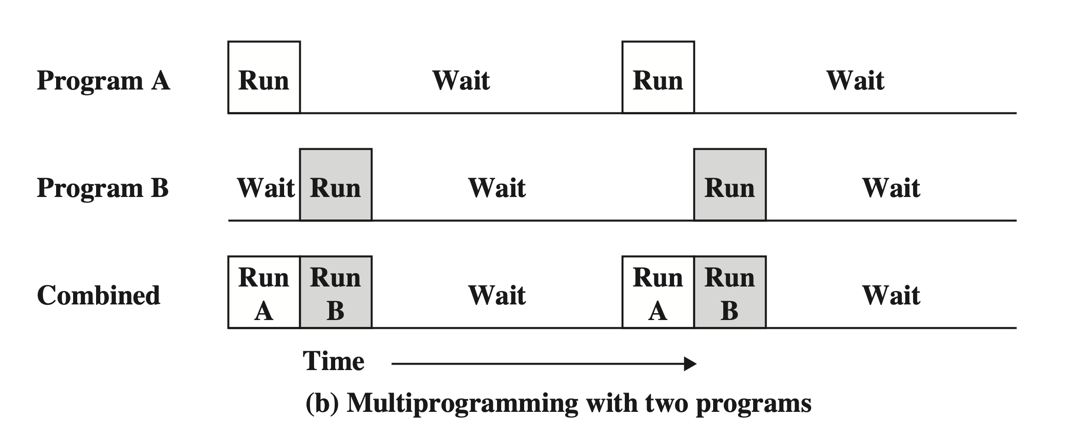
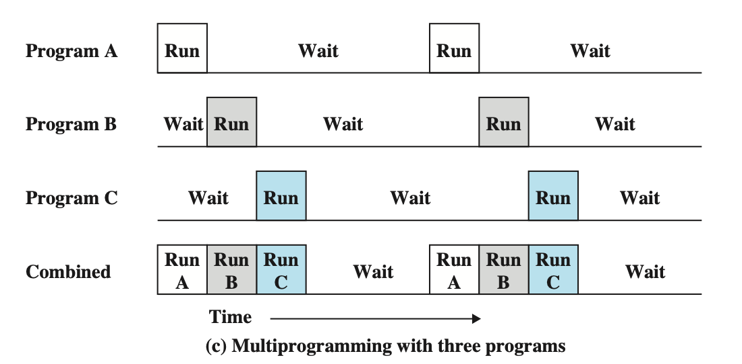
Organization of Schedulers
What is the objective of multitasking?
Maximize CPU utilization and increase throughput

Slide 10
Organization of Schedulers
Each entering process goes into job queue. Processes in job queue:
Reside in mass storage
Await allocation of main memory
If residing in main memory and awaiting CPU time
Kept in ready queue
If waiting for allocation of a certain I/O device
Reside in device queue

Slide 11
Organization of Schedulers
So what is a scheduler?
Concerned with deciding a policy about which process to be dispatched
After selection, loads process state or dispatches
Process selection based on a scheduling algorithm

Slide 12
Organization of Schedulers
Can have Autonomous or Shared scheduling
Shared scheduler
Scheduler is invoked by a function call as a side effect of kernel operation
Kernel and scheduler are potentially contained in the address space of all processes and execute as part of the process

Slide 13
Organization of Schedulers
Autonomous scheduler
Scheduler (and possibly kernel) are centralized
Scheduler is considered a separate process running autonomously
Continuously polls system for work or can be driven by wakeup signals
Which is preferred?

Slide 14
Organization of Schedulers
Autonomous scheduling:
Preferable in multiprocessor systems as master/slave configuration
One cpu can be permanently dedicated to scheduling, kernel and other supervisory activities such as I/O and program loading
OS is clearly separated from user processes
How does scheduler get dispatched?
Solved by transferring control to the scheduler whenever a process is blocked or awakened

Slide 15
Organization of Schedulers
Linux scheduler
Autonomous scheduler
Runs between any two other processes
Serves as a dummy process that runs when no other process is ready

Slide 16
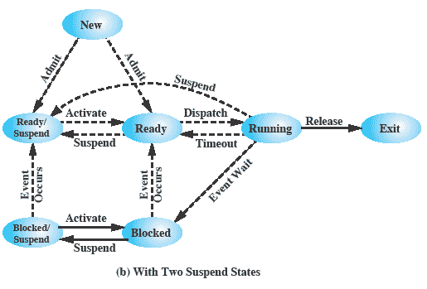
Process states

Slide 17
Schedulers
Long-term scheduler
Selects processes from job queue
Loads the selected processes into memory for execution
Updates teh ready queue
Controls the degree of multiprogramming (number of procs in memory)
Not executed as frequently as short-term scheduler
Should generate a good mix of CPU-bound and I/O bound processes
May not be present in some systems (like time-sharing systems)

Slide 18
Schedulers
Short-term scheduler
Selects processes from ready queue
Allocates CPU to the selected process
Dispatches the process
Executed frequently (very few milliseconds, like 10 msec)
Must make a decision quickly, so be very fast

Slide 19
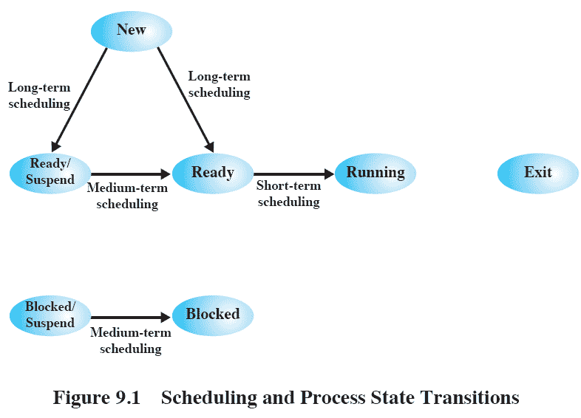
Schedulers

Slide 20
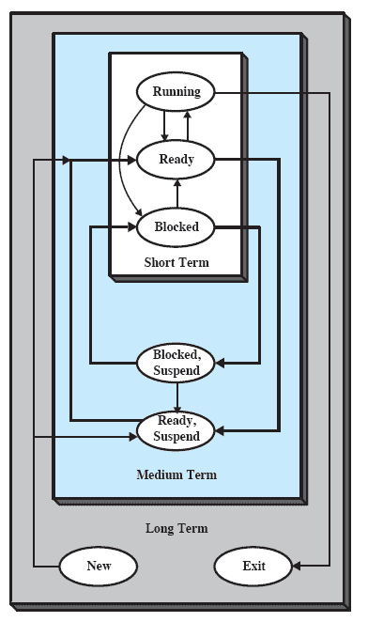
Schedulers

Slide 21
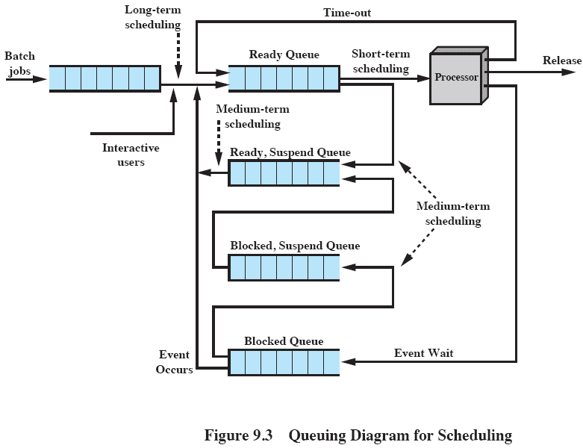
Schedulers

Slide 22
Schedulers
Major task of any operating system
Allocate ready processes to available processors
Scheduler decides process to run first based on scheduling algorithm
Two components of a scheduler
Process scheduling
Decision making policies to determine order in which active processes compute for use of CPu
Process dispatch
Actual binding of selected process to the CPU

Slide 23
Process Scheduling
Desirable features of a scheduling algorithm
Fairness: Make sure each process gets its fair share of CPU and that no process starves
Efficiency: Keep the CPU busy 100% of the time
Response time: Minimize response time for interactive users
Turnaround: Minimize the time batch users must wait for output
Throughput: Maximize the number of jobs processed per hour

Slide 24
Process Scheduling
Desirable features of a scheduling algorithm
Predictability: A job should run in same time and have same cost
Balance resources: Keep resources of the system busy
Enforcing priorities: Higher priority processes should be favored

Slide 25
Process Scheduling
Types of scheduling
Preemptive
Temporarily suspend the logically runnable processes
More expensive in terms of CPU time
Can be caused by:
Interrupt
Trap
Supervisor call
Nonpreemptive
Run the process to completion

Slide 26
Process Scheduling
Universal Scheduler: specified in terms of the following concepts
Decision mode
Select the process to be assigned to the CPU
Priority function
Applied to all processes in the ready queue to determine current priority
Arbitration rule
Applied to select a process in case two processes are found with the same current priority

Slide 27
Process Scheduling
Decision mode
When (time) to select a process for execution
Preemptive and nonpreemptive decisions
Selection of a process occurs when:
A new process arrives
An existing process terminates
A waiting process changes state to ready
A running process changes state to waiting (I/O) or ready (INT)
Every q seconds (quantum)
Priority of a ready process exceeds priority of running process

Slide 28
Process Scheduling
Decision mode:
Selective preemption
Uses a bit pair (up,vp)
up set if p may preempt another process
vp set if p may be preempted by another process

Slide 29
Process Scheduling
Priority function
Defines priority of a ready process using parameters associated with process
Memory requirements are important due to swapping overhead
Smaller memory means less swapping overhead
Smaller memory also means can service more processes
Attained service time
Total time when the process is in the running state
Real time in system
Total actual time the process spends in the system since arrival

Slide 30
Process Scheduling
Priority function
Total service time
Total CPU time consumed by process during lifetime
Equals attained service time when process terminates
Higher priority for shorter processes
Preferential treatment of shorter processes reduces average time a process spends in system

Slide 31
Process Scheduling
Priority function
External priorities
Differentiate between classes of user and system processes
Interactive processes should have higher priority
Batch processes should have lower priority
Account for resource utilization

Slide 32
Process Scheduling
Priority function
Timeliness
Dependent upon the urgency of a task and deadlines
System load
Maintain good response time during heavy load
Reduce swapping overhead by larger quanta of time

Slide 33
Process Scheduling
Arbitration rule
Random choice
Round robin (cyclic ordering)
Chronological ordering (FIFO)
Time-Based Scheduling Algorithms
May be independent of required service time

Slide 34
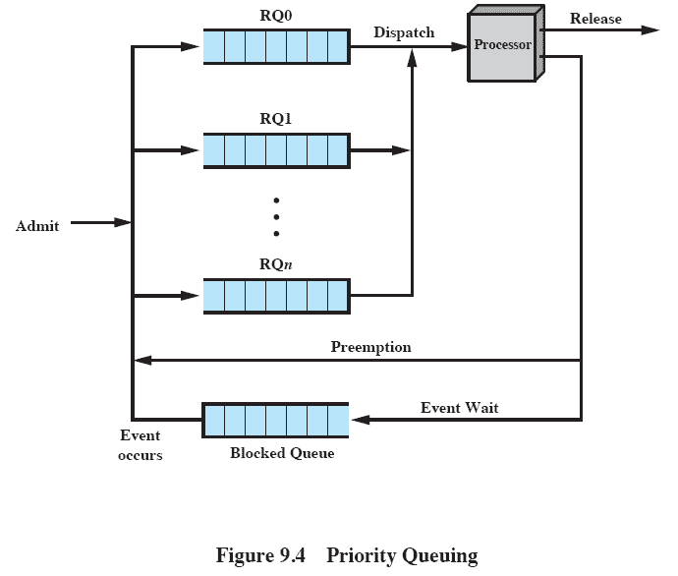
Priority Queuing

Slide 35
First-Come-First-Served
Also called FIFO or strict queueing
Nonpreemptive decision mode
Upon process creation, link its PCB to rear of FIFO queue
Scheduler allocates CPU to the process at the front of FIFO queue

Slide 36
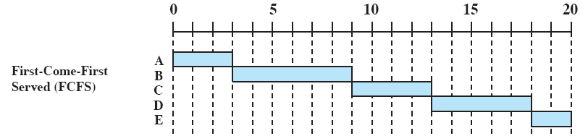
FIFO scheduling

Slide 37
FIFO scheduling

Slide 38
FIFO Scheduling
Tends to fair CPU-bound processes compared to I/O bound processes
Due to non-preemptive nature
If CPU bound process is in wait state when I/O bound process initiates I/O, CPU goes idle
Inefficient use of both CPU and I/O devices

Slide 39
Shortest Job Next Scheduling
Associate length of next CPU burst with each process
Assign process with shortest CPU burst requirement to the CPU
Nonpreemptive scheduling
Specially suitable for batch processing or longterm scheduling
Ties broken by FIFI scheduling

Slide 40
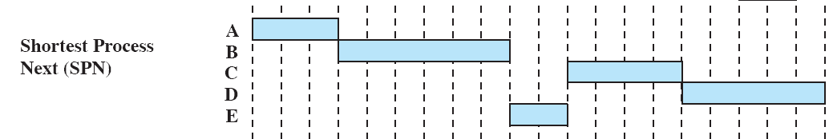
Shortest Job Next Scheduling

Slide 41
Shortest Job Next Scheduling
Priority function P(t) = 1/t
Provably optimal scheduling
Least average waiting time
Moving a short job before a long one decreases the waiting time for short job more than it increases waiting time for longer proc
Difficult in practice to determine length of CPU burst

Slide 42
Shortest Remaining Time First
Preemptive version of shortest job next scheduling
Preemptive in nature (only at arrival time)
Highest priority to process that needs least time to complete
Priority function P(t) = a - t, where a is arrival time

Slide 43
Shortest Job Next Scheduling

Slide 44
Round-Robin Scheduling
Preemptive in nature, based on fixed time quanta q
Reduces penalty that short jobs suffer with FIFO
Generate clock interrupts at periodic intervals
Time quantum between 10 and 100 milliseconds
Each process gets a slice of time before preemption
All user processes treated to be at same priority

Slide 45
Round-Robin Scheduling
Ready queue treated as circular
New processes added to the rear of ready queue
Preempted processes added to the rear of the ready queue
Scheduler pricks up a process form head of queue and dispatches it with a timer interrupt set after the time quantum
CPU burst < q means process releases CPU voluntarily
Timer interrupt results in context switch and process put at rear of queue
No process is allocated CPU time for more than 1 quantum in a row

Slide 46
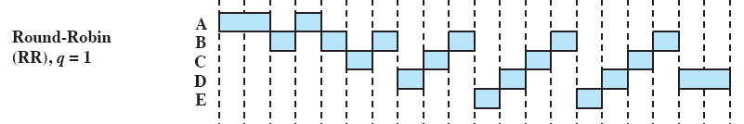
Round-Robin Scheduling

Slide 47
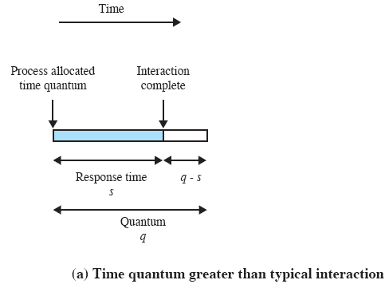
Round-Robin Scheduling

Slide 48
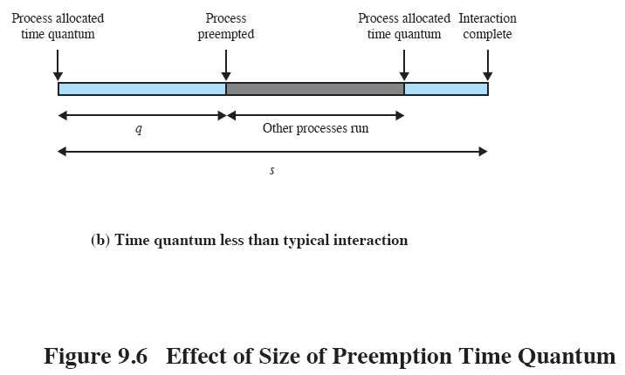
Round-Robin Scheduling

Slide 49
Round-Robin Scheduling
One drawback is generally I/O bound processes have shorter process burst
Than a CPU bound process
Why?
So processor-bound processes tend to receive unfair amount of processor time
Can add an auxiliary queue of processes that were blocked on I/O
Take from that in preference to normal queue

Slide 50
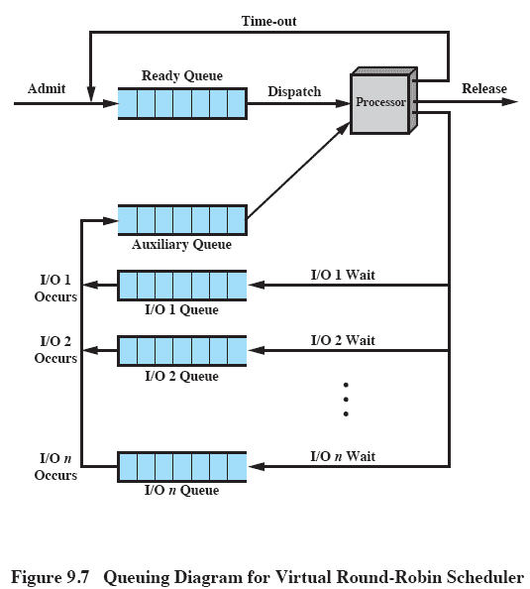
Round-Robin Scheduling

Slide 51
Round-Robin Scheduling
If n processes in ready queue, and q is time quantum, each gets 1/n of CPU time in chunks of at most q time units
Each process waits no longer than (n-1)q time units for next quantum
Performance depends heavily on size of time quantum
Large time quantum means essentially FIFO
Small time quantum means large context switching overhead
Rule of thumb is 80% of CPU bursts should be shorter than time q

Slide 52
Multilevel Feedback Queue
Most general CPU scheduling algorithm
Prefers shorter jobs by penalizing jobs that use too much CPU time
Using dynamically computed priority
Background
Make a distinction between foreground (interactive) and batch processes
Separate queues for different types of processes, with process priority being defined by what queue it is in
Separates processes with different CPU burst requirements

Slide 53
Multilevel Feedback Queue
Too much CPU time means lower priority
I/O bound and interactive processes means higher priority
n different priority levels: ∏1 ... ∏n
Each process may not receive more than T∏ time units at priority ∏
Let T∏ = 2^{n-∏}Tn, where Tn is the maximum time on highest priority queue at level n
Each process will spend Tn at priority n and time 2^{i}Tn at priority n-i, 1 <= i <= n
Process may remain at lowest priority level for infinite time

Slide 54
Multilevel Feedback Queue
CPU always serves highest priority queue
That has processes in it ready for execution
Can result in starvation. How?
Variation:
Aging to prevent starvation

Slide 55
Examples
Process | Arrival Time | Service Time
A | 0 | 3
B | 2 | 6
C | 4 | 4
D | 6 | 5
E | 8 | 2

Slide 56
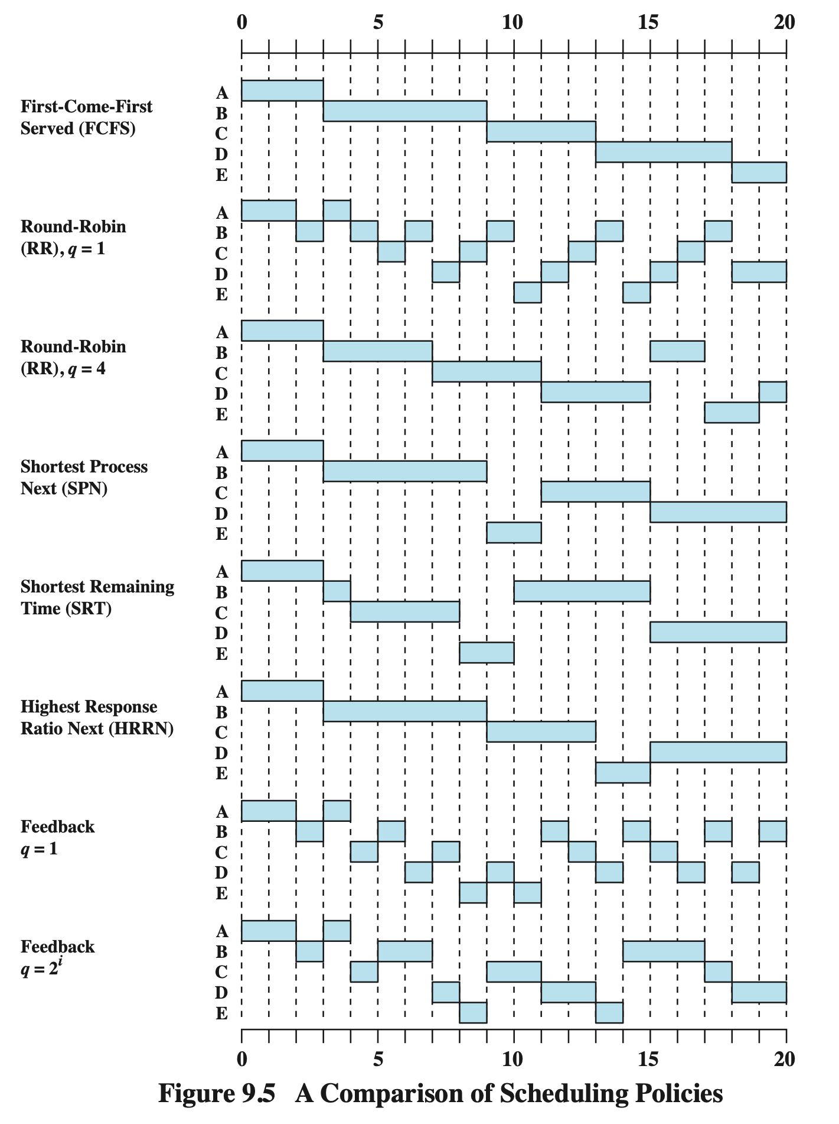

Slide 57
Scheduling policy in Linux
Linux objectives include:
Fast process response time
Good throughput for background jobs
Avoidance of process starvation
Reconcile the needs of low and high priority processes
Based on time sharing
Several processes run in time-multiplexing mode, where users take turns

Slide 58
Multilevel Feedback Queue
Process priority is dynamic
Scheduler keeps track of what the processes are doing and adjust their priorities
Processes that do not get CPU for a long time will have priority boosted by dynamically increasing their priority
Processes that run a long time are penalized by decreasing priority

Slide 59
Linux Scheduling
Process classification
Interactive process
Interact constantly with users
Waiting for keypresses or mouse operations
When user input, need to respond quickly
Typical delay between 50-150ms
Variance of delay should be bounded or will seem erratic

Slide 60
Linux Scheduling
Batch processes
No user interaction
Run in the background
Need not be very responsive and hence, are penalized by scheduler
May be I/O-bound or CPU-bound
Real-time processes
Stringent scheduling requirements
Should never be blocked by lower priority processes
Short guaranteed response time with minimum variance

Slide 61
Linux Scheduling
Linux scheduling pre-2.6
At every process switch:
Kernel scanned list of ready processes
Computes their priorities
Selects the one with highest priority
Expensive algorithm if list of ready processes is large

Slide 62
Linux Scheduling
Linux Scheduling Post-2.6
Designed to scale well with number of ready processes
Selects process to run in constant time
Independent of the number of processes in ready queue
Designed to scale well with number of processors
Each processor has its own runqueue
Does a better job distinguishing between interactive and batch process

Slide 63
Linux Scheduling
Scheduler always finds a process to be executed
There is always at least one runnable process
Always swapper with PID 0
Executes only when CPU cannot execute any other process
Every CPU in multiprocessor system has its own swapper

Slide 64
Linux Processes
Linux scheduler
Assigns priority in range of 0 to 139
140 different lists in runqueue structure
Process descriptor linked into list of runnable processes with same priority
On multiprocessor systems, each CPU has its own runqueue

Slide 65
Linux Scheduling
Every Linux process scheduled according to its scheduling class
SCHED_FIFO: A FIFO real-time process
When scheduler assigns CPU to the process, it leaves the process descriptor in its current position in runqueue
If no other higher priority runnable real-time process, current process uses CPU as long as it needs even if there are other runnable real-time processes at same priority
SCHED_RR: A round robin real-time process
When a scheduler assigns CPU to the process, it leaves the process descriptor at the tail of runqueue
Ensures a faire assignment of CPU time to all SCHED_RR real-time processes with same priority

Slide 66
Linux Scheduling
SCHED_NORMAL: Conventional time-shared process
Scheduling of a conventional process
Each conventional process has its own static priority
Static priority used by scheduler to rate process with respect to other conventional processes in system
Static priority in range 100(highest) to 139(lowest)
New process inherits static priority of its parent
Can change with using nice(2) or setpriority(3c)

Slide 67

Linux Scheduling
Have an adjustable time quanta based on CPU use
Qb time quantum in ms
Based on its static priority Ps
Higher the static priority (lower its numerical value), longer the base quantum

Slide 68
Linux Scheduling
Dynamic priority Pd and average sleep time
Ranges from 100 (highest) to 139 (lowest)
Actual priority used by scheduler to select a new process to run
b is a bonus value ranging from 0 to 10
b < 5 is a penalty to lower Pd
b > 5 raises Pd
b depends on past history of the process
Related to average sleep time
Pd = max(100, min(Ps - b + 5, 139))

Slide 69
Linux Scheduling
Average sleep time
Given by average number of nanoseconds spent by process in sleep state
Sleeping in TASK_INTERRUPTIBLE state contributes to average sleep time in a different way from sleeping in TASK_UNINTERRUPTIBLE
Average sleep time decreases while process is running
Can never become larger than 1s

Slide 70
Linux Scheduling
Average sleeptime is also used to differentiate between batch/interactive
Interactive if it satisfies either of these equivalent statements
Pd <= 3 * Ps / 4 + 28
or
b - 5 >= Ps / 4 - 28

Slide 71
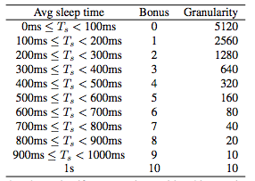
Average sleep time

Slide 72
Linux Scheduling
Interactive delta Δi
Given by Ps / 4 - 28
Easier for higher priority processes to become interactive
A process with 100 priority is considered interactive if b > 2
Or average sleep time > 200ms
Process with 139 priority is never considered interactive
b is always less than 100
Process with priority of 120 becomes interactive as soon as average sleeptime exceeds 700ms

Slide 73
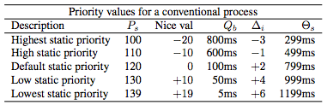
Linux Scheduling
Sleep threshold Θs

Slide 74
Linux Scheduling
Scheduling of real-time processes
Real-time priority ranges from 1 (highest) to 99 (lowest)
Scheduler always favors higher priority runnable process over a lower priority one
Real-time processes always considered active
If there are several real-time runnable processes at same priority, scheduler chooses the process that occurs first in the corresponding list of local CPU’s runqueue

Slide 75
Linux Scheduling
Active and expired processes
processes with higher Ps get larger slice of CPU time but they should not completely lock out processes with lower Ps
Process starvation is avoided by scheduling a lower priority process whose time quantum has not been exhausted when a higher priority process finishes its quantum
Active processes:
Runnable processes that have not exhausted their time quantum and are allowed to run
Expired processes:
Runnable processes that have exhausted their time quantum and are forbidden to run until all active processes expire

Slide 76
runqueue
struct runqueue {
spinlock_t lock; /* spin lock which protects this
runqueue */
unsigned long nr_running; /* number of runnable tasks */
unsigned long nr_switches; /* number of contextswitches */
unsigned long expired_timestamp; /* time of last array swap */
unsigned long nr_uninterruptible; /* number of tasks in
uinterruptible sleep */
struct task_struct *curr; /* this processor's currently
running task */
struct task_struct *idle; /* this processor's idle task */
struct mm_struct *prev_mm; /* mm_struct of last running task
*/
struct prio_array *active; /* pointer to the active priority
array */
struct prio_array *expired; /* pointer to the expired
priority array */
struct prio_array arrays[2]; /* the actual priority arrays */
int prev_cpu_load[NR_CPUS];/* load on each processor */
struct task_struct *migration_thread; /* the migration thread on this
processor */
struct list_head migration_queue; /* the migration queue for this
processor */
atomic_t nr_iowait; /* number of tasks waiting on I/O
*/
}

Slide 77
Linux Scheduling
Data structures used by scheduler
runqueue
Each CPU has its own runqueue
Every runnable process in system belongs to exactly one runqueue
Runnable processes may migrate from one runqueue to another
ie: Move to another CPU

Slide 78
Linux Scheduling
runqueue cont.
each structure also contains two arrays of 140 doubly linked list heads
One list corresponding to each priority (0-139)
arrays[0] contains expired processes
arrays[1] contains active processes
Role of each of these swaps periodically
arrays[0] holds active processes, arrays[1] holds expired processes

Slide 79
Linux Processes
Linux process information cont.
tasks->prev field of init_task points to the tasks field of process descriptor inserted last in the list
Entire process list is scanned by following macro:
#define for_each_process(p) \
for (p = &init_task; \
(p = list_entry((p)->tasks.next,struct task_struct,tasks))\
!= &init_task; )

Slide 80
Linux Processes
Lists of TASK_RUNNING processes
When looking for a new process to run on CPU, kernel has to consider only runnable processes
Processes in TASK_RUNNING state
Early Linux versions put all runnable processes in the same list called runqueue
Scheduler speedup is achieved by splitting runqueue into many lists of runnable processes
One list per priority

Slide 81
Linux Processes
runqueue implemented through prio_array_t
Inserting a process p into the runqueue:
struct prio_array_t {
int nr_active; // Number of active processes
unsigned long bitmap[5] // Priority bitmap; set if corresponding
// priority list is not empty
struct list_head queue[140]; // head of each priority list
}
list_add_tail ( &p->run_list, &array->queue[p->prio] );
_set_bit ( p->prio, array->bitmap);
array->nr_active++;
p->array = array;

Slide 82
Linux Scheduling
Allocating time slices to children
Both parent and child get half the number of ticks left to the parent
Done to prevent children from getting unlimited amount of CPU time
Parent creates a child that runs the same code and kills itself
If creation rate is adjusted properly, child can get full quantum before parent’s quantum expires
Continuing this process allows infinite time to single process family
Also prevents single process from using excessive time
By starting several processes in background

Slide 83
Linux Scheduling
Each cpu in multi-core system has its own set of queues
What happens if one queue gets long?
Necessary to do load-balancing
Load-balancing
Find busiest run-queue
Grab processes from one of the priority arrays
Actually prefers the expired array, as has been out of system awhile
Likely not in cache

Slide 84
Scheduling done!
Any questions?

