Slide 1
Operating Systems:
Resource Management

Slide 2
Deadlocks
Law passed by Kansas Legislature in early 20th century:
Neil Groundwater has the following to say about working with Unix at Bell Labs in 1972:
“When two trains approach each other at a crossing, both shall come to a full stop and neither shall start upon again until the other has gone.”
“ ... the terminals on the development machine were in a common room ... when one wanted to use the line printer. There was no spooling or lockout. pr myfile > /dev/p was how you sent your listing to the printer. If two users sent output to the printer at the same time, their outputs were interspersed. Whoever shouted, “line printer!” first owned the queue.”

Slide 3
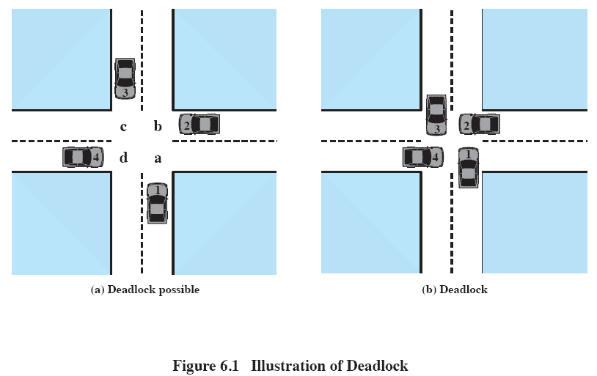
Deadlocks

Slide 4
Deadlocks
Permanent blocking of a set of processes that either compete for system resources or communicate with each other
Several processes may compete for a finite set of resources
Processes request resources and if a resource is not available, enter a wait state
Requested resources may be held by other waiting processes
Require divine intervention to get out of this problem

Slide 5
Deadlocks
A significant problem in real systems, because there is no efficient solution in the general case
Deadlock problem is more important because of increasing use of multiprocessor systems
real-time systems, life support, vehicle monitoring, multicore utilization, grid processing
Important in answering the question about whether or when a process will complete

Slide 6
Deadlocks
Deadlocks can occur with
Serially reusable (SR) resources - printer, tape drive, memory
A finite set of identical units, with the number of units constant
Can be used safely by only one process at a time and are not depleted by that use
Units acquired by processes, used, and released later for use by other processes
A process may release a unit only if it has previously acquired it
Examples include processors, memory, devices, files, databases, and semaphores

Slide 7
Deadlocks
Deadlocks can also occur with:
Consumable resources like messages
Resource gets created dynamically and may be destroyed after use
Typically no limit on the number of consumable resources of a specific type
Examples are messages, signals, interrupts, and information in I/O buffers

Slide 8
Examples of Deadlocks
Reusable resources
File sharing
Consider two processes p1 and p2
They update a file F and require a scratch tape during the updating
Only one tape drive T available
T and F are serially reusable resources, and can be used only by exclusive access

Slide 9
Examples of Deadlocks
Reusable resources
p2 needs T immediately prior to updating
request operation
Blocks the process requesting the resource
Puts the process on the wait queue
The process remains blocked until requested resource is available
If the resource is available, the process is granted exclusive access to it

Slide 10
Examples of Deadlocks
Reusable resource
release operation
Returns the resource being released to the system
Wakes up the process waiting for the resource, if any
p1 can block on T holding F while p2 can block on F holding T

Slide 11
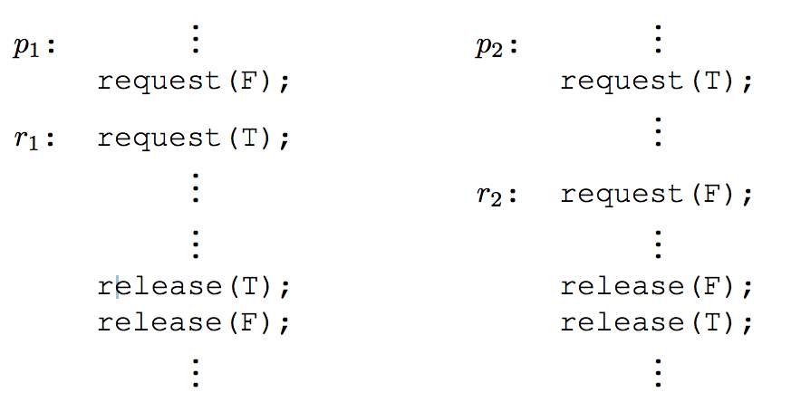
Examples of Deadlocks

Slide 12
Examples of Deadlocks
Single resource sharing
A single SR resource, such as memory M, with m allocation units shared by n processes p1, p2, ..., pn, 2 <= m <= n
Suppose sequence of operations is as follows:
Deadlock due to no memory being available and existing processes request more memory
Fairly common cause of deadlock
m1 = malloc ( 1024 );
m2 = malloc ( 1024 );
...
free ( m1 );
free ( m2 );

Slide 13
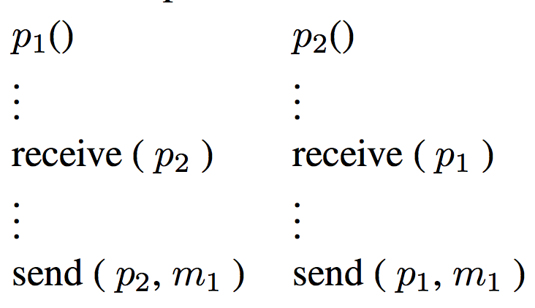
Examples of Deadlocks
Consumable resources
Deadlock with messages
Have a pair of processes p1 and p2
Each process receives a message from other process and then sends a message to the other process
Deadlock with blocking receive

Slide 14
Examples of Deadlocks
Locking in Database Systems
Locking required to preserve integrity and consistency of databases with random request patterns
Problem when two records to be updated by two different processes are locked
Deadlocking by nefarious users
void deadlock( task ) {
wait ( event );
} /* deadlock */

Slide 15
Examples of Deadlocks
Effective Deadlocks
Milder form of indefinite postponement of processes competing for a resource
Exemplified by Shortest Job Next Scheduling
If many small processes come in, large job never gets any time

Slide 16
Examples of Deadlocks
Deadlocks in Unix
Possible deadlock condition that cannot be detected
Number of processes limited by the number of available entries in process table
If process table is full, fork system call fails
Process can try and wait random time before trying fork again
Example:
10 processes create 12 children each
100 entries in process table
Each process has already created 9 children
No more space in process table, so deadlock

Slide 17
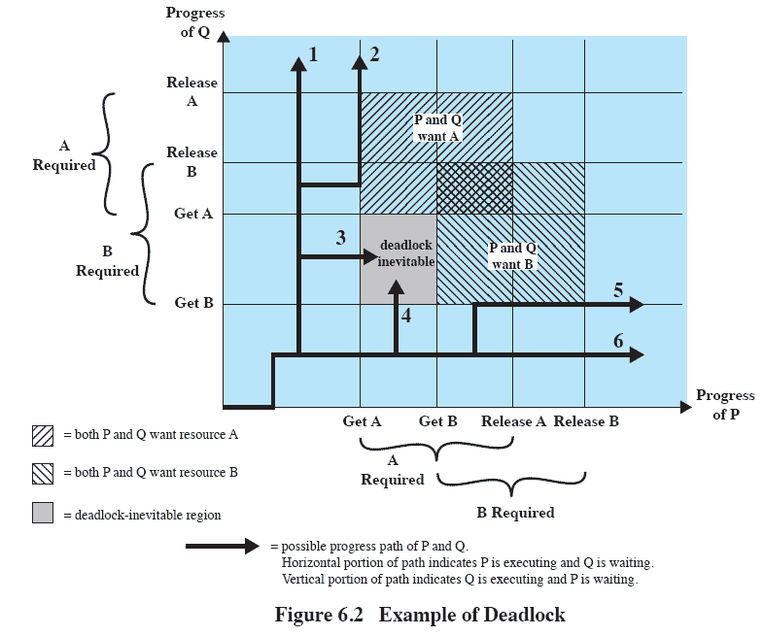
Examples of Deadlocks

Slide 18
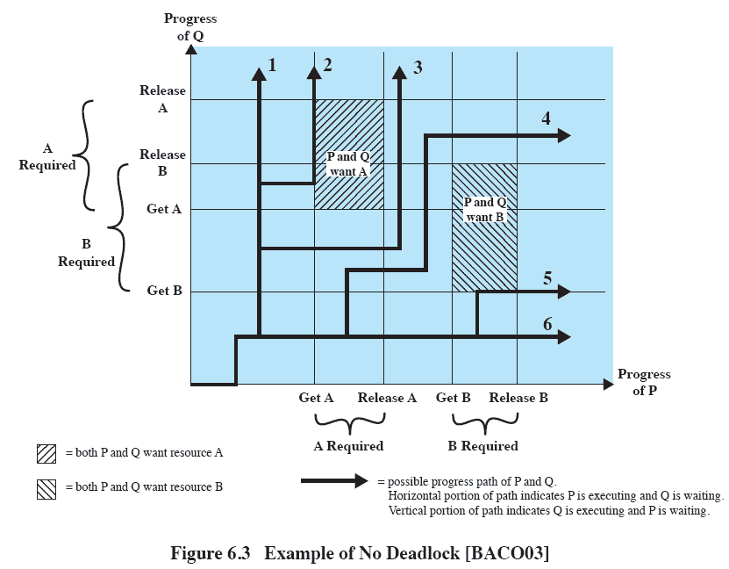
Examples of Deadlocks

Slide 19
Deadlocks Problem Characterization
Deadlock Detection
Process resource graphs
Deadlock Recovery
What is “best” way of recovering from a deadlock
Deadlock Prevention
Not allowing a deadlock to happen

Slide 20
Resource Allocation Graph
Directed graph to describe state of the system of resources and processes
Set of vertices V consisting of
Set of processes P = P1, P2, ...
Process nodes are represented as circles
Set of resource types R = R1, R2, ...
Resource nodes represented as squares with a dot representing each instance of the resource
Resource types with multiple instances could be I/O devices allocated by a resource management module

Slide 21
Resource Allocation Graph
Set of edges E
Request edge
Directed edge from Pi to Rj
Denoted by Pi → Rj
Pi has requested an instance of Rj and is currently waiting for that resource
Assignment edge
Directed edge from Rj to Pi
Denoted by Rj → Pi
An instance of Rj has been allocated to Pi

Slide 22
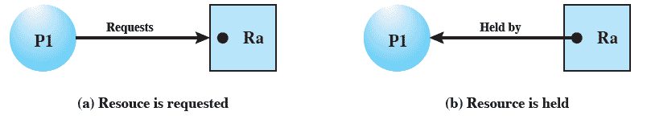
Resource Allocation Graph

Slide 23
Resource Allocation Graph
No cycles in the graph means no deadlock
Cycle in the graph means could be a deadlock
If not multiple instances
Each process involved in a cycle is deadlocked
Cycle in the resource graph is necessary and sufficient condition for existence of a deadlock
If a graph contains several instances of a resource type, a cycle is not a sufficient condition for a deadlock but it is a necessary condition

Slide 24
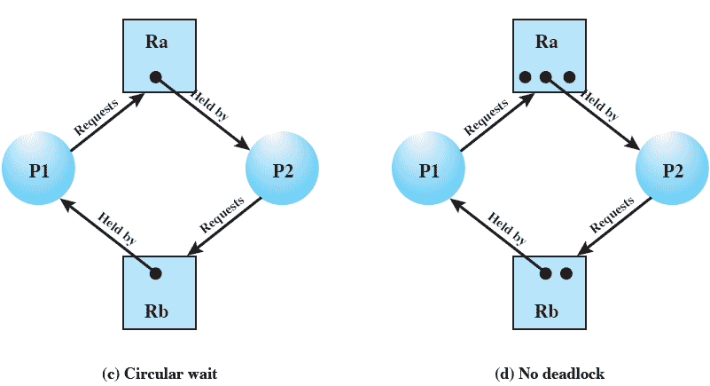
Resource Allocation Graph

Slide 25
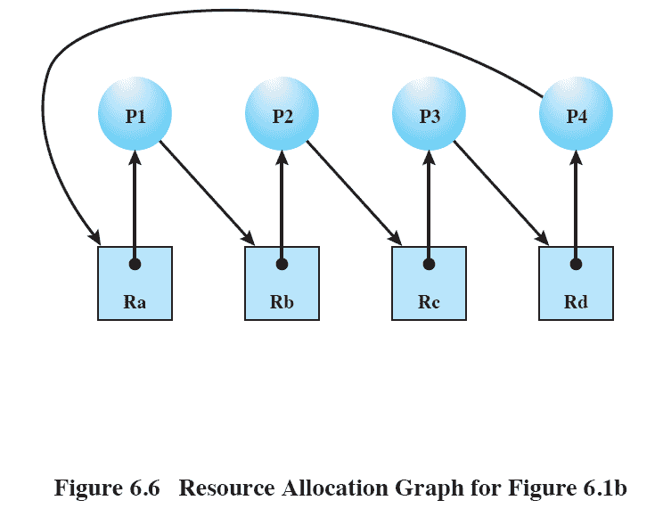
Resource Allocation Graph

Slide 26
Deadlock Characterization
Four necessary and sufficient conditions for deadlock
Mutual Exclusion
Only one process may use a resource at a time
At least one resource must be held in a non-sharable mode
Hold and wait
Existence of a process holding at least one resource and waiting to acquire additional resources currently held by other processes
No preemption
Resources cannot be preempted by system
Circular wait
Processes waiting for resources held by other waiting processes

Slide 27
Deadlock Detection
Do not restrict process actions or limit resource access
If resources are available, satisfy requests
Periodically detect circular wait condition
Using a deadlock detection algorithm

Slide 28
Deadlock Detection
Simulate the most favored execution of each unblocked process
An unblocked process may acquire all the needed resources
Run and then release all the acquired resources
Remain dormant thereafter
Released resources may wake up some previously blocked process
Continue the above steps as long as possible
If any blocked processes remain, they are deadlocked

Slide 29
Deadlock Detection
Reduction of resource graphs
Process blocked if it cannot progress by either of the following operations
Request
Acquisition
Release

Slide 30
Deadlock Detection
Reduction of resource graph
Reduced by a process pi
by removing all edges to and from pi
pi is neither blocked nor isolated node
After reduction, pi becomes an isolated node
Graph is irreducible if it cannot be reduced by any process
Completely reducible if a sequence of reductions deletes all the edges in the graph
Lemma 1. All reduction sequences of a given resource graph lead to the same irreducible graph

Slide 31
Deadlock Detection Algorithm
Algorithm will attempt to reduce our resource graph
Four lists:
Resources requested by each process (Request matrix Q)
Resources allocated to each process (Allocation matrix A)
How many total resources (of each) we have (Resource vector)
How many we have left to allocate (Allocation vector)

Slide 32
Deadlock Detection Algorithm
Algorithm will attempt to reduce our resource graph
Works by looping through process request matrix Q
Attempting to satisfy a request
If able to satisfy, can then release all resources
If unable to clear out request matrix, then we have detected a deadlock
Most favorable scenario did not result in system being able to finish
Only processes left over are guaranteed to result in deadlock
For n processes and m resources, worst case execution time of mn²

Slide 33
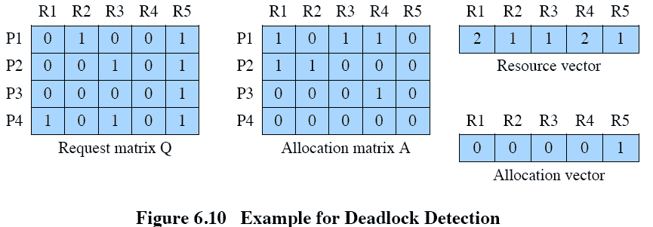
Deadlock Detection Algorithm

Slide 34
Deadlock Detection Algorithm
bool deadlock( const int *available, const int m, const int n, const int *request, const int *allocated) {
int work[m]; // m resources
bool finish[n]; // n processes
for (int i (0); i < m; work[i] = available[i++]);
for (int i (0); i < n; finish[i++]; = false;
int p (0);
for (; p < n; p++) {
if ( finish[p] ) continue;
if (req_lt_avail (request, work, p, m)) {
finish[p] = true;
for (int i (0); i < m; i++)
work[i] += allocated[p*m+i];
p = -1;
}
}
for (p = 0; p < n; p++)
if ( !finish[p] )
break;
return (p != n);
}
bool req_lt_avail(const int *req, const int *avail, const int pnum, const int num_res) {
int i (0);
for (; i < num_res; i++)
if (req[pnum*num_res+i] > avail[i] )
break;
return ( i == num_res );
}

Slide 35
Deadlock Recovery
So we discover system is in a deadlock, how do we recover?
Two ways:
Recovery by process termination
Recovery by resource pre-emption

Slide 36
Process Termination
Abort all deadlocked processes
Most commonly adopted solution
Do we need to abort them all though?
Back up system to a checkpoint
Requires restarting at that point
Requires a system have rollback and restart mechanisms
Will original deadlock reoccur?

Slide 37
Process Termination
Terminate deadlocked processes in systematic way
Keep terminating until no longer in a deadlock
Do deadlock detection at each process termination
Should terminate based on some policy
Process priority, cpu time used and expected usage, number resources taken up, is it interactive or batch?
A few problems:
If a process has open files, termination could lead to invalid files
Same issues with other i/o: Terminated print job, etc

Slide 38
Resource Preemption
Preempt resources from some processes
Allows satisfaction of requests from other processes
Could resolve the deadlock
How do we select a victim?
Need to rollback the state
Starvation could occur
Keep preempting resources from one job and it will never get to finish

Slide 39
Deadlock Prevention
Let us make sure we can never get into a deadlock.
How?
Need to set up our system so we prevent one of the four conditions necessary for deadlock to occur

Slide 40
Deadlock Conditions
Four necessary and sufficient conditions for deadlock
Mutual Exclusion
Only one process may use a resource at a time
At least one resource must be held in a non-sharable mode
Hold and wait
Existence of a process holding at least one resource and waiting to acquire additional resources currently held by other processes
No preemption
Resources cannot be preempted by system
Circular wait
Processes waiting for resources held by other waiting processes

Slide 41
Deadlock Prevention
Require each process to request and acquire all needed resources at once
Eliminates the hold and wait necessary condition of deadlock
Works decently for processes that perform a single burst of activity
Doesn’t require preemption
Serious downsides:
Can delay process initialization
Have to know at the start what resources it will need
Not always possible
Can end up holding on to resources for much longer than it needs to

Slide 42
Deadlock Prevention
Impose a total ordering on all resource types
Intention is to eliminate possibility of circular wait condition
Processes must request resources in order
If several instances are needed, must request all instances at once
Example: Resources R1, R2, ..., R5
Process could request R2 and then R4
Could not request R3 and then R2
Disallows incremental resource requests

Slide 43
Deadlock Prevention
Allow preemption of resources
Eliminates no preemption condition
Different ways to accomplish this:
If process gets denied a resource request, release all resources and must then request them all
If a process requests a resource that is currently held by another, require the other process to release its resources
Only useful if state can be saved and restored easily
Does preemptions that aren’t strictly necessary

Slide 44
Deadlock Avoidance
Deadlock prevention constrains resource requests to prevent deadlock
Prevent at least one of four necessary conditions of deadlock
Leads to inefficient use of resources and inefficient process execution
Deadlock avoidance allows three of the four conditions
Then makes choices to ensure that deadlock point is never reached
Allows more concurrency than prevention does

Slide 45
Deadlock Avoidance
We will discuss two approaches to deadlock avoidance:
Do not start a process if its demands might lead to a deadlock
Do not grant a request if the allocation could lead to deadlock
Dynamically exist the resource allocation status to ensure that no circular wait condition can exist
Requires knowledge of maximum possible claims for each process

Slide 46
Deadlock Avoidance
Called Bankers Algorithm
Banking system that never allocates its available cash such that it can no longer satisfy the needs of all its customers
Examine current state of the system, determine if it is safe
Safe state is where at least one sequence does not result in a deadlock
A safe sequence exists : If execution follows this path, no deadlock
Unsafe state may lead to a deadlock
Unsafe state will not always result in a deadlock

Slide 47
Deadlock Avoidance
Note that it is possible to from a safe state to an unsafe state
Our task:
Detect the possibility of an unsafe state and deny requests even if resources are available

Slide 48
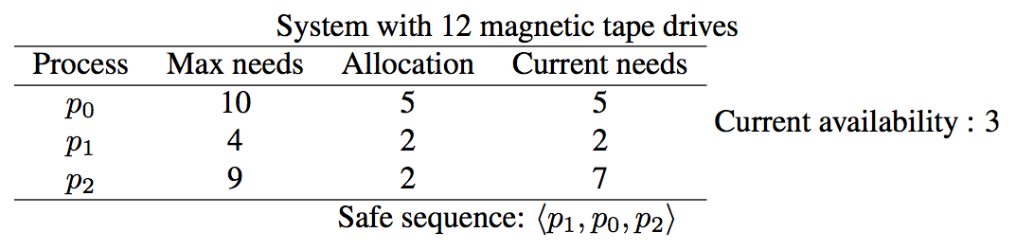
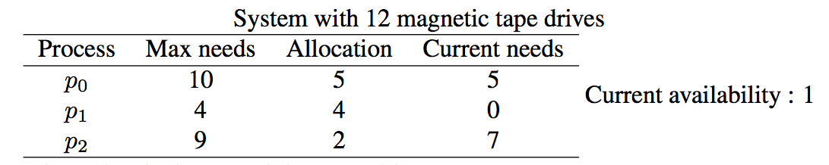
Deadlock Avoidance
p1 acquires 2 more tapes...
Fine, but what if p2 is allowed to request and acquire one more?

Slide 49
Deadlock Avoidance
We need a system state, so as before, m resources and n processes
Resource vector resource[m]
Total resources available in system
Available vector available[m]
Current resources available to be allocated
Maximum claims vector claim[n][m]
Process pi may request at most k instances of resource Rj
Allocation vector alloc[n][m]
Process pi is currently allocated k instances of resource Rj

Slide 50
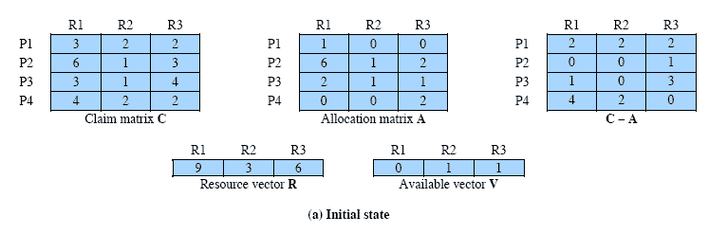
Determination of a Safe State

Slide 51
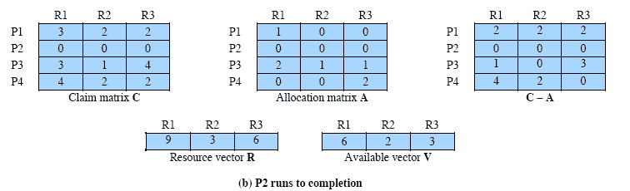
Determination of a Safe State

Slide 52
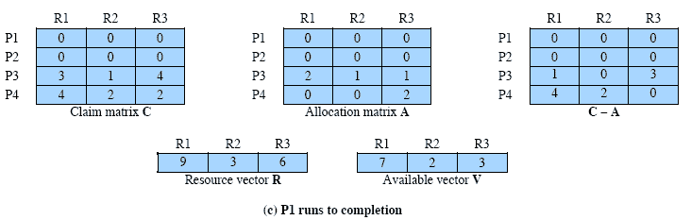
Determination of a Safe State

Slide 53
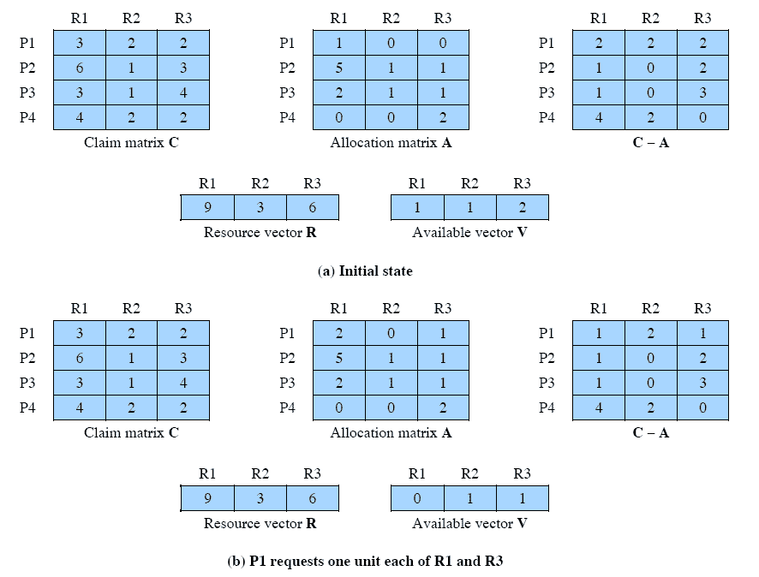
Determining an Unsafe State

Slide 54
Deadlock Avoidance Logic
// global data structures
struct state {
int resource[m];
int available[m];
int claim[n][m];
int alloc[n][m];
}
// resource allocation algorithm
if (alloc[i,*] + request[*] > claim[i,*])
< error >; // total request > claim
else if (request[*] > available[*])
< suspend process >;
else { // simulate allocation
< define newstate by:
alloc[i,*] = alloc[i,*] + request[*];
available[*] = available[*] - request[*] >;
}
if (safe (newstate) )
< carry out allocation >;
else {
< restore original state >;
< suspend process i>;
}

Slide 55
Deadlock Avoidance Logic
boolean safe (state S) {
int currentavail[m];
process rest[<number of processes>]; // list of processes running
currentavail = available;
rest = {all processes};
possible = true;
while (possible) {
<find a process Pk in rest such that
claim[k,*] - alloc[k,*] <= currentavail;>
if (found) { // simulate execution of Pk
currentavail = currentavail + alloc[k,*];
rest = rest - {Pk}; // Remove Pk from list of running processes
}
else
possible = false;
}
return (rest == null);
}

Slide 56
Deadlock Avoidance
Pros:
No preemption necessary
Cons:
Maximum resource requirement must be stated in advance
Processes under consideration must be independent
No synchronization requirements
Fixed number of resources

Slide 57
Integrated Strategies
All strategies have their strengths and weaknesses
In practice must design OS’s that employ different strategies in different situations
One integrated strategy:
Group resources into different resource classes
Use linear ordering between resource classes
Prevents circular wait
Within a specific resource class, use the appropriate algorithm

Slide 58
Integrated Strategies
Possible division of resources into classes:
Swappable space
Blocks of memory on secondary storage for swapping processes
Process resources
Assignable devices like tape drives and files
Main memory
Pages or segments of memory assigned to processes
Internal resources
I/O channels and the like

Slide 59
Integrated Strategies
Strategies for each resource class:
Swappable space
Require all resources be grabbed at once, or deadlock avoidance
Process resources
Avoidance or resource ordering
Main memory
Preemption, when a process is preempted it is just swapped to secondary memory
Internal resources
Resource ordering

Slide 60
End ofResource Management
Any questions?

