Slide 1
Operating Systems:
Memory
Management

Slide 2
Memory Management
“Multitasking without memory management is like having a party in a closet”
“Programs expand to fill the memory that holds them.”

Slide 3
Memory Management
Why talk about memory management?
Process isolation
Automatic allocation and management
Support for modular programming
Protection and access control
Long term storage

Slide 4
What is memory?
Physical viewpoint (RAM)
Physical chip attached to the motherboard
Programmer's viewpoint
Just large array of words (or bytes)
Unique address for each word
Is this correct?
What if compiler uses a register to store a variable?
What if it does not even allocate a variable?
OS viewpoint: Both are wrong

Slide 5
Memory hierarchy managers
OS handles a complex memory hierarchy of memory managers
Heap manager (dynamic memory manager)
"High" level
Supports basic operations with memory blocks
Block allocation, release, changing size of allocated block

Slide 6
Memory hierarchy managers
Virtual memory manager
Lower level than heap manager
Manages virtual address spaces
Abstracts physical addresses, allowing arbitrary addresses to be assigned to memory cells
Allows concurrent processes to be loaded into overlapping memory at different times
Lets us separate processes completely from each other
Requires kernel and memory manager to find location of memory unit

Slide 7
Memory hierarchy managers
Virtual memory manager
Virtual memory
Extension of idea of virtual address space
Any memory cell can reside in both main memory and/or hard disk
Allows for almost unlimited amounts of memory to be allocated
Process allowed 2GB address space on some versions of Windows
Though you might never see it taking up 2GB of RAM

Slide 8
Physical view
Processor does not interact directly with memory or hard disk
Works through memory controller and disk controller
System memory
Based on Dynamic RAM, relatively slow, requires periodic refresh
30 to 80, or even 250 cycles of CPU time
Cache memory
Higher speed memory closer to the CPU
Usually implemented as static RAM (more expensive, faster)
Invisible to programmer

Slide 9
Physical view
Cache memory
Contents cannot be directly read/modified
Cache controller
Manages cache memory instead of CPU
Responsible to accumulate important data and clear out old data
Often integrated into CPU
L1 cache: Near cpu speed, often read in 2-3 cycles
L2 cache: Access times in range of 9-15 cycles
Contains data flushed out of L1 cache (victim cache)

Slide 10
Addresses
Address binding
Binding: Mapping from one address space to another
Program must be loaded into memory before execution
Loading of processes may result in relocation of addresses
Link external references to entry points as needed
User process may reside in any part in memory

Slide 11
Addresses
Programs have symbolic addresses in the source programs
int i = 0;
Compiler binds symbolic addresses to relocatable addresses
Usually assumed to start at 0
Linkage editor (loader) binds relocatable addresses to absolute addresses

Slide 12
Binding
Types
Compile time binding
Binding of absolute addresses by compiler
Possible only if compiler knows where program will be in memory
Load time binding
Needs relocatable code generated by compiler
Final binding delayed until code is loaded
If change of starting address, have to reload code

Slide 13
Binding
Types
Execution time binding
Process may be moved to different addresses during execution
Need to delay binding until code is actually being run
Requires special hardware

Slide 14
Relocation
Compiler works with assumed logical address space when creating object module
Relocation: Adjustment of operand and branch addresses within program to reflect actual address space
Types:
Static relocation
Dynamic relocation

Slide 15
Static Relocation
Static relocation often done through separate linkage editor and loader
Starting address not required to be known
Absolute physical addresses bound only at time of loading
Relocatable physical addresses bound by relocating complete module
Program gets relocated twice
Once for linking and another for loading

Slide 16
Dynamic Relocation
Dynamic relocation: Modules kept on disk in relocatable load format
Binding of physical addresses delayed to the very last possible moment
Every time a storage reference is made
Invisible to all but system programmers
Forms the basis for virtual memory
Permits efficient use of main storage

Slide 17
Dynamic Relocation
What about when a routine needs to call another routine?
Could be out of main memory, have to check
If out of memory, load it
Unused routine is never actually loaded
Can save us on memory requirements for infrequently used code

Slide 18
Memory alignment
When reading from memory, getting the whole block
Not just one (or set of) bytes
Systems can have unaligned loads and unaligned stores
Unaligned stores could overwrite data adjacent to target
Problem can be avoided by extra overhead
Bus error vs segmentation fault

Slide 19
Requirements
Process address space
Processes need to run in a private address space
User mode
Process refers to private stack, data, code areas
Kernel mode
Kernel data and code areas, uses different private stack
Processes may need access to shared address space
Explicit requests like shared memory
Could be done automatically by kernel to reduce memory usage

Slide 20
Requirements
Relocation
Available main memory must be shared amongst processes
Programmer may not know what other programs are resident in memory while their code is executing
Processes get swapped in and out to maximize cpu utilization
These processes may not be swapped back to the same spot in memory (process got relocated to a new part)
Of course all memory references need to be resolved to correct addresses

Slide 21
Requirements
Protection
Processes need to be protected against unwanted interference
Made harder as relocation because a process’s location in memory is unpredictable
Impossible to check absolute addresses at compile time
Have to deal with dynamic memory allocation through pointers
Need to make sure cannot access data or code of OS
Need hardware support to protect processes from interfering with one another

Slide 22
Requirements
Logical organization
Memory needs to have some logical organization (usually linearly)
Programs written as modules that can be written and compiled independently
Sharing
Need the capability for processes and the OS to share memory as needed/required
Could allow each process to access same copy of a program
Rather than needing separate copies

Slide 23
Requirements
Physical Organization
Cannot leave programmer with responsibility to manage memory
Might not have enough memory for program plus data
Programmer does not know how much total space is available.

Slide 24
Memory Management Schemes
Always have a shortage of main memory
Applications grow to fill the memory allocated to them
Might need several active process at once

Slide 25
Memory Management Schemes
Fixed Partitioning
Dynamic Partitioning
Simple Paging
Simple Segmentation
Virtual Memory Paging
Virtual Memory Segmentation

Slide 26
Fixed Partitioning
Simplest memory management scheme for multiprogrammed systems
Divide memory into fixed size partitions, possibly of different size
Fixed at system initialization, cannot be changed during operation

Slide 27
Fixed Partitioning
Single-Partition Allocation
User is provided with a bare machine
User has full control of entire memory space
Clearly not practical, but has many advantages

Slide 28
Fixed Partitioning
Single-Partition Allocation
Advantages:
Maximum flexibility, use memory as you want
Maximum simplicity
Minimum cost, no special hardware

Slide 29
Fixed Partitioning
Single-Partition Allocation
Disadvantages:
No services
OS has no control over interrupts
No mechanism to process system calls or errors
No space to provide multiprogramming

Slide 30
Fixed Partitioning
Two-Partition Allocation
Memory divided into two partitions
Resident operating system
User memory area
OS placed in low memory or high memory depending on location of interrupt vector
OS code and data can be protected by hardware
base-register, limit register

Slide 31
Multiple-Partition Allocation
Multiple-Partition Allocation
Necessary for multiprogrammed systems
Allocates memory to various processes in wait queue to be brought into memory
Simplest scheme:
Divide memory into a large number of fixed-size partitions
One process to each partition
Degree of multiprogramming bounded by number of partitions
Partitions allocated to processes and released upon termination

Slide 32
Multiple-Partition Allocation
Problems:
Program may not fit in a partition
Main memory use is inefficient
Any program, no matter how small, occupies entire partition
Called internal fragmentation

Slide 33
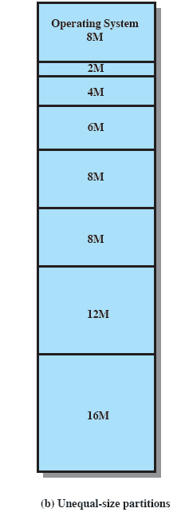
Multiple-Partition Allocation
Can try and solve it with unequal sized partitions
Can fit at least a limited number of larger programs
Smaller programs can be placed in smaller partitions
Less internal fragmentation

Slide 34
Placement Algorithm
How do we determine where processes go?
For equal-sized, no options so trivial
For unequal size
Want to assign them in such a way as to minimize internal fragmentation
Can assign each process to smallest partition within which it can fit
Can even have queues for each partition

Slide 35
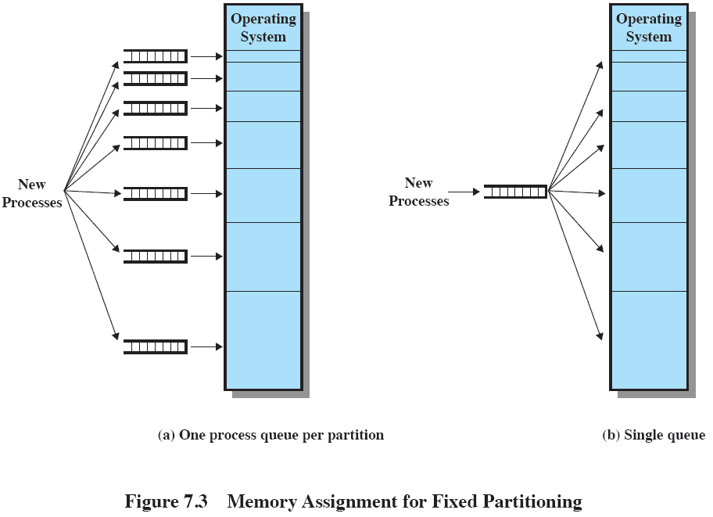
Placement Algorithm

Slide 36
Multiple-Fixed Partition
Still left with some problems
Number of active processes limited by system
Limited by pre-determined number of partitions
Large number of small processes use the space inefficiently
In either fixed or variable length partition methods

Slide 37
Dynamic Partitioning
Variable size partitions
Basic implementation
Keep a table indicating availability of various memory partitions
Any large block of available memory is called a hole
Initially entire memory is identified as one large hole
When a process arrives, allocation table is searched for a large enough hold
If available, that hole is allocated to process

Slide 38
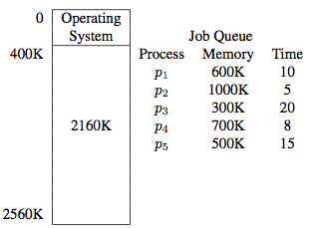
Dynamic Partitioning
Lets look at an example:

Slide 39
Dynamic Partitioning
Will have holes of various sizes scattered throughout the memory
Holes can grow when jobs in adjacent holes are terminated
Holes can also diminish in size if many small jobs are present

Slide 40
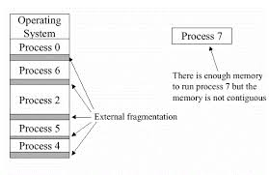
External Fragmentation
Dynamic partitioning often results in fragmentation (External)
Division of main memory into small holes not usable by any process
Enough total memory exists to satisfy request, but is fragmented across many small holes
Caused by mismatch between size of memory request and size of the memory area allocated to satisfy that request
Can cause large jobs to starve

Slide 41
Compaction
One way to handle external fragmentation is with compaction
Move processes so they are contiguous
Shuffle memory contents to place all free memory into one large hole
Only possible if system supports dynamic relocation at exec time
Very CPU-intensive, can break code that works with pointers

Slide 42
Dynamic Partitioning
How does OS decide which free block to allocate to a process?
Many schemes for doing this:
Best-fit
First-fit
Worst-fit
Next-fit
Buddy’s System

Slide 43
Dynamic Partitioning
Best-fit
Allocate the smallest hole that is big enough
Entire list of holes needs to be searched
Or at least keep list of holes sorted by size
Since smallest block is found for process, smallest amount of fragmentation is left
Sounds good, actually worst performer overall!
Not many people will be able to actually use that small hole
Need to do memory compaction more often

Slide 44
Dynamic Partitioning
First-fit
Allocate first hole that is big enough
Scan memory from beginning and choose first available block large enough
Fastest strategy

Slide 45
Dynamic Partitioning
Worst-fit
Allocate largest available hole
Requires sorted order of largest hole to smallest
Creates largest fragment possible
If a process requiring larger memory arrives later, it cannot be put anywhere
Largest hole was already split up and occupied
Poor performer overall

Slide 46
Dynamic Partitioning
Next-fit
Modified version of first fit
Scans memory from location of the last placement

Slide 47
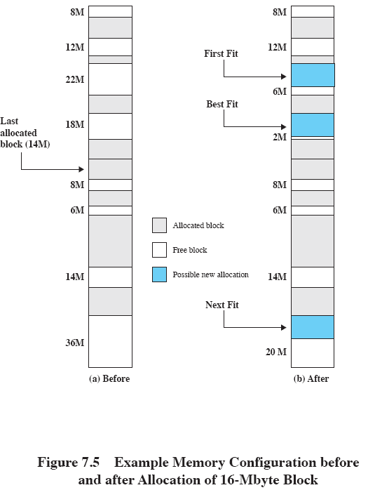
Allocation

Slide 48
Buddy System
Used to resolve external fragmentation
Entire space available treated as single block of 2^{U}
If a request of size s where 2^{U-1} < s <= 2^{U}
Then allocate entire block
Otherwise block is split into two equal buddies
Process continues until smallest block greater than or equal to s is generated

Slide 49
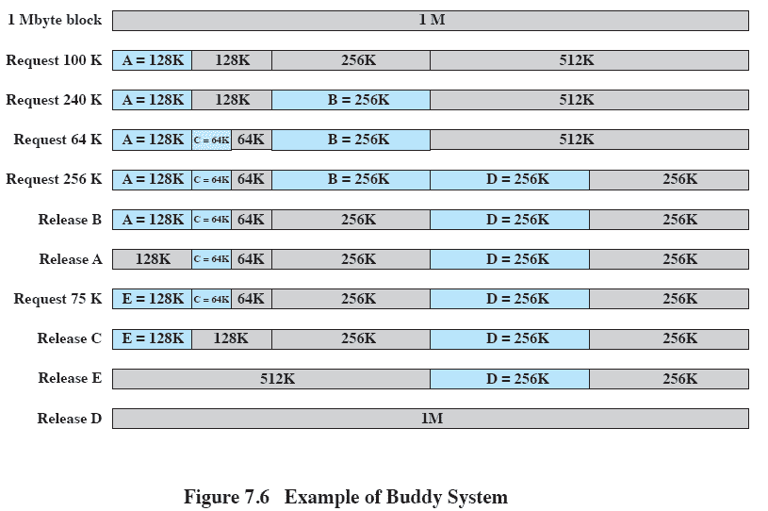
Buddy System

Slide 50
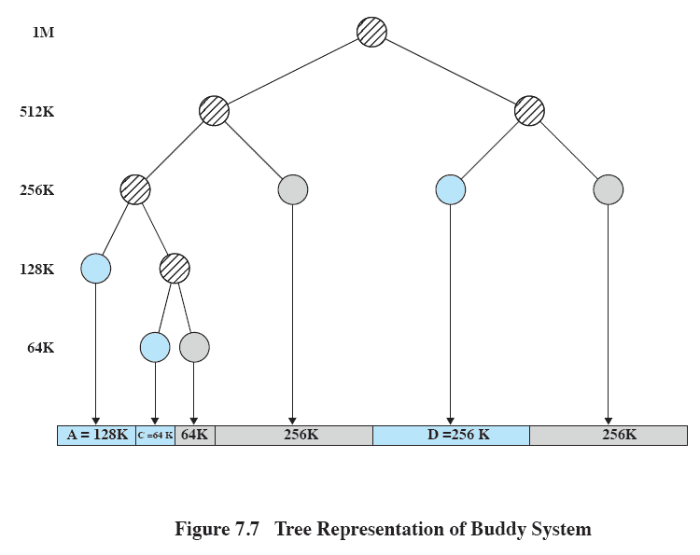
Buddy System

Slide 51
Paging
So far processes have been contiguous in memory
Lets let processes memory be noncontiguous
Paging is one way to do this
Partition memory into small and equal fixed-size chunks
Divide each process into the same size chunks
The chunks of a process are called pages
The chunks of memory are called frames

Slide 52
Paging details
Physical memory divides into page frames
Frames that can hold pages (size of frames 1k or even 8k bytes)
getpagesize(3C) can get it on unix system
Logical memory broken into blocks of same size as page frame size
Called pages
To execute a process, its pages are loaded into frames

Slide 53
Paging details
Every address generated by CPU now divided into two parts
Page number p
Page offset d
Page number used as index into a page table
This table contains base address of where each page is in memory
Page offset defines address of the location within a particular page

Slide 54
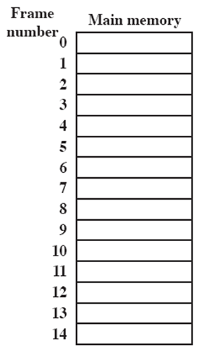
Paging
A.0
A.1
A.2
A.3
D.0
D.1
D.2
C.0
C.1
C.2
C.3
D.3
D.4

Slide 55
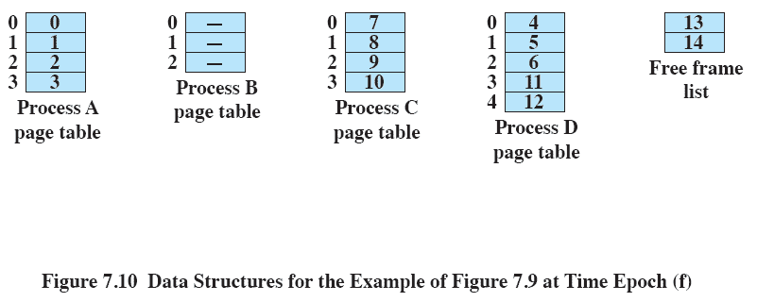
Paging

Slide 56
Paging
No external fragmentation possible!
Internal fragmentation is possible
Average of half a page per process
Paging can allow programs larger than main memory to be executed
Only bring pages into memory when they are needed (demand paging)
Size of a page has tradeoffs
Small page size means more overhead in page table plus more swapping
Large page size has more internal fragmentation

Slide 57
Shared pages
Possible to share common code with paging
Easy way would be to simply have same page in two process’s tables
Must be reentrant (pure code)
Code cannot modify itself and local data of each user must be kept in separate space (separate data pages for each process)
Would have two parts:
Permanent part is the instructions that make up the code
Temporary part contains memory for local variables for use by code
Each execution of permanent part creates a temporary part
activation record for the code

Slide 58
Shared pages
For a function to be classed as reentrant:
All data is allocated on the stack (no global variables)
May not modify its own code
Functions don’t call any other function that is not reentrant
Compilers, text editors, windowing systems, unix kernels all use reentrant code

Slide 59
Segmentation
User often views memory as collection of variable-sized segments
Arrays, functions, procedures, main program
Note no necessary order to these
Length of each segment could also be different
Depending on purpose for each program

Slide 60
Segmentation
Lets divide our programs into segments
Each segment can vary in length
Do have maximum segment length
Address would consider of
A segment number (name)
Segment offset
In some ways similar to dynamic partitioning

Slide 61
Segmentation
Logical address space is considered to be collection of segments
Each with a name and length
Mapping between logical and physical addresses use a segment table
Each entry in segment table is made up of
Segment base
Segment limit
Segment table can be abstracted as array of base-limit register pairs

Slide 62
Segmentation
Segment name/number s:
Used as a index into the segmentation table
Segment offset d:
Added to segment base to produce physical address
Must be between 0 and the segment limit
Attempting to go past this limit results in trap to OS

Slide 63
Sharing
Segments represent a semantically defined portion of a program
Can share these parts, and in fact a bit easier than paging
Why?
Share a particular function between two programs

Slide 64
Fragmentation
Memory allocation becomes a dynamic storage allocation problem
Possibility of external fragmentation
All blocks of memory left are too small to accommodate a segment
Compaction can be used whenever needed
Segmentation relies on relocatable code
External fragmentation is dependent on average size of segments

Slide 65
Logical to physical addresses
Processes see their logical addresses
Must map logical addresses to physical addresses
Trivial for partitioning
For paging or segmentation, must use appropriate table

Slide 66
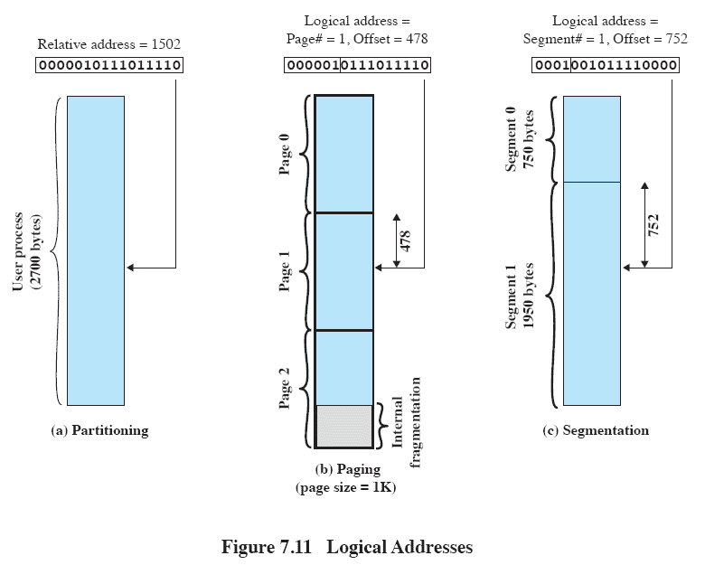
Logical Addresses

Slide 67
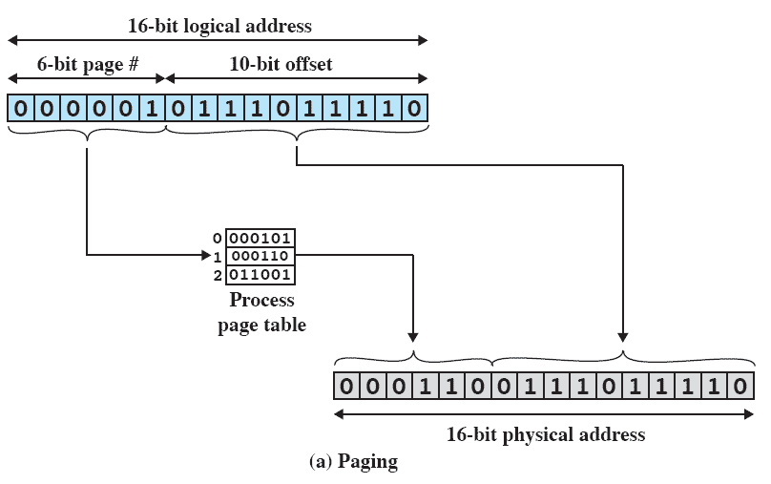
Logical Addresses

Slide 68
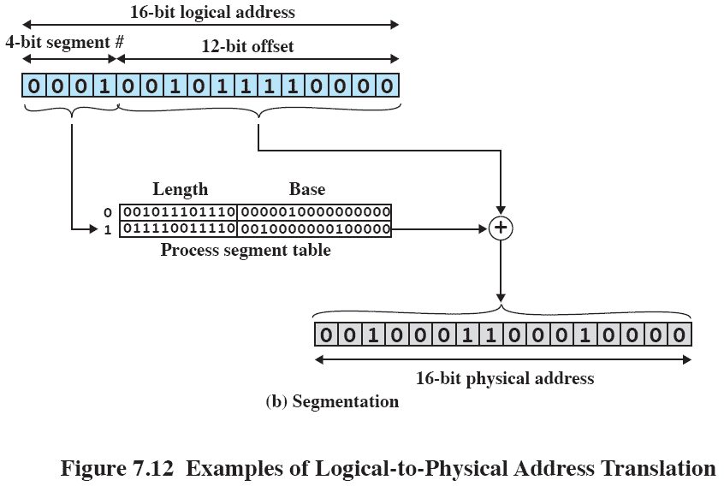
Logical Addresses

Slide 69
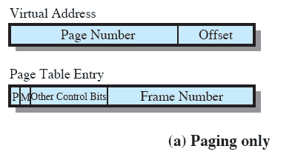
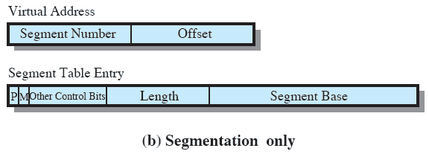
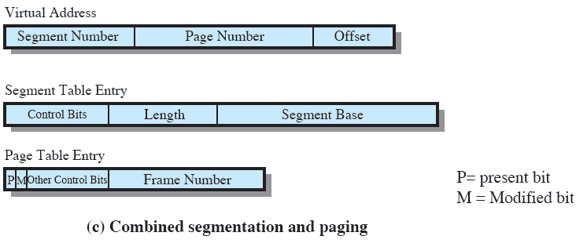
Memory Management Formats

Slide 70
Virtual memory
Memory management has some key points
Memory references are logical addresses dynamically translated into physical addresses at run time
A process can be swapped in and out of main memory, occupying different regions at different times during execution
A process does not need to be contiguous

Slide 71
Virtual memory
If all those conditions are present, then it is not necessary that all pages or all segments of a process be in main memory
As long as next instruction or next data are in memory, execution can proceed
At least for a time

Slide 72
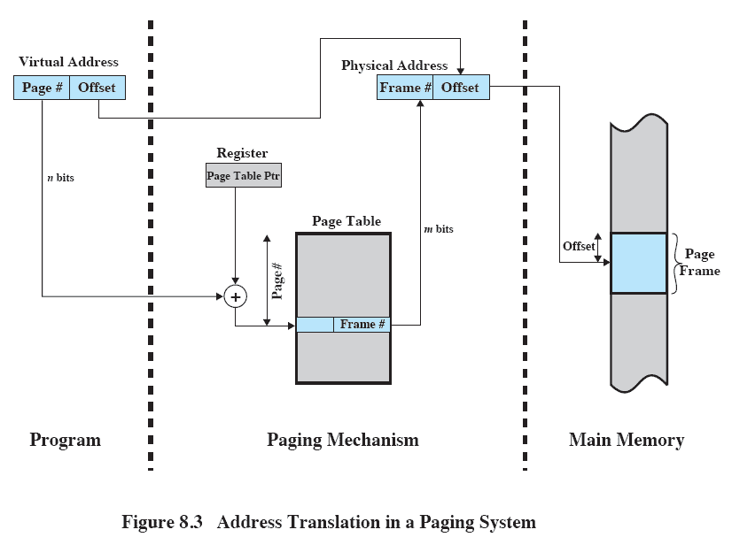
Address Translation

Slide 73
Virtual memory
Process execution in virtual memory:
Operating system brings into main memory a few pieces of a program
Resident set: portion of a process that is in main memory
An interrupt is generated when addresses is needed that is not in main memory
Operating system places that process in a blocked state

Slide 74
Virtual memory
Piece of process that contains the logical address is brought into main memory
Operating system issues a disk I/O read request
Another process is dispatched to run while this I/O takes place
An interrupt is issued when disk I/O completes
System then places the process back into Ready state

Slide 75
Implication of virtual memory
More processes can be maintained in main memory
We only load some of the pieces of each
With so many processes in main memory, it is likely at least one process will always be in Ready state
A process may be larger than main memory

Slide 76
Real and Virtual Memory
Real memory
Main memory, the actual RAM
Virtual memory
Memory on disk
Allows for effective multiprogramming and relieves the user of tight constraints of main memory

Slide 77
Thrashing
A state in which the system spends most of its time swapping pieces rather than executing instructions
To avoid this, operating system needs to try and guess which pieces are least likely to be used in the future
Guess should probably be based on recent history
Why?

Slide 78
Replacement Policy
Need to reduce thrashing by using a replacement policy
When all frames in main memory are occupied, need to bring in new page
Replacement policy determines which page is replaced

Slide 79
Replacement Policy
Which page is replaced?
Page removed should be page least likely to be referenced in future
Principle of locality
Most replacement policies predict future behavior based on past behavior

Slide 80
Replacement Policy
Frame locking : Additional complication we must allow
If frame is locked, it may not be replaced
Kernel of operating system
Key control structures
I/O buffers
Would need a lock bit with each frame

Slide 81
Replacement Policy
Some basic algorithms used to handle page replacement
Optimal
Least recently used (LRU)
First-in-first-out (FIFO)
Clock

Slide 82
Examples
To go over examples, consider a page address stream formed by executing the program
2 3 2 1 5 2 4 5 3 2 5 2
First page reference is 2, second page referenced is 3, and so on
Optimal policy
Selects for replacement page for which time to next reference is the longest
Requires perfect knowledge of future events

Slide 83
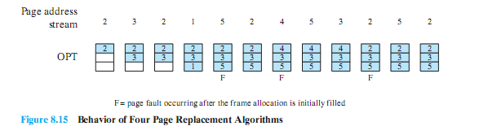
Optimal Policy
3 page faults after frame allocation has been filled

Slide 84
Least Recently Used Policy
LRU replaces page that has not been referenced for longest time
By principle of locality, should be page least likely to be referenced
Expensive to implement
One approach is to tag each page with time of last reference
Requires expensive overhead each time a page is accessed

Slide 85
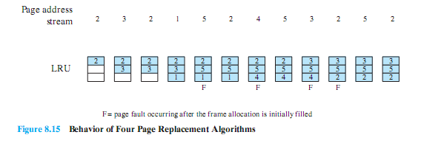
LRU Policy
4 page faults after frame allocation has been filled

Slide 86
First in, First out
FIFO treats page frames allocated to a process as a circular buffer
Pages are removed in round-robin style
Very simple to implement
Page that has been in memory the longest is replaced
These pages may be needed again very soon though
For example, if used over and over for a long time
Which can be quite likely under some situations

Slide 87
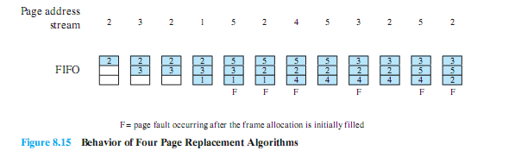
FIFO Policy
6 page faults after frame allocation has been filled
LRU recognized that pages 2 and 5 are referenced more frequently

Slide 88
Second-Chance
Main problem with LRU is that it is expensive to implement
Lets try and “approximate” LRU
Use additional bit called a “use bit”
When page is first loaded in memory or referenced, use bit is set to 1
When it is time to replace a page, OS scans set flipping all 1’s to 0’s
First frame encountered with use bit already set to 0 is replaced
Also called Clock policy

Slide 89
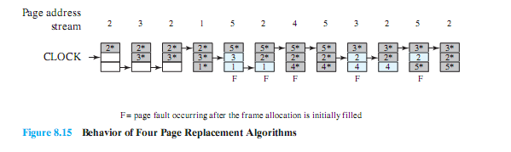
Clock Policy
5 page faults after frame allocation has been filled
Clock policy protected 2 and 5

Slide 90
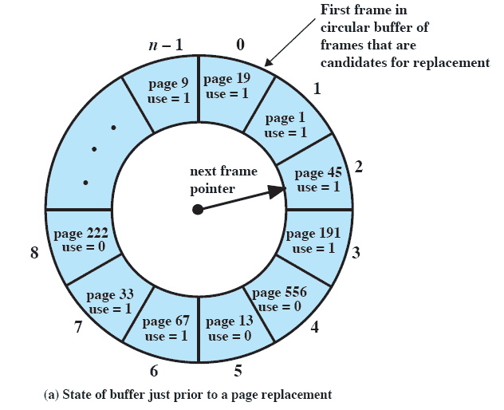
Clock Policy

Slide 91
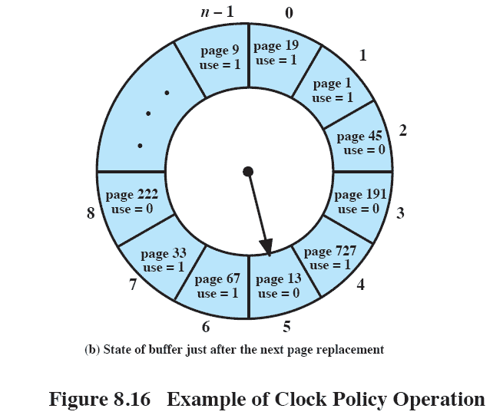
Clock Policy

Slide 92
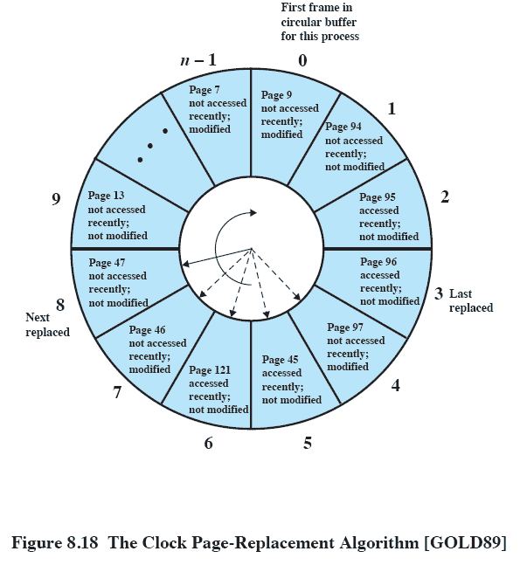
Clock Policy

Slide 93
Additional-Reference-Bits
Can try to do something with a bit more accuracy
Keep 8-bit byte for each page in page table
At regular intervals, shift the reference bits by one
This register contains history of page references for last 8 time periods
Page with lowest number is the LRU page
11000100 used more recently than 01110111
Numbers not guaranteed to be unique
Is this a problem?

Slide 94
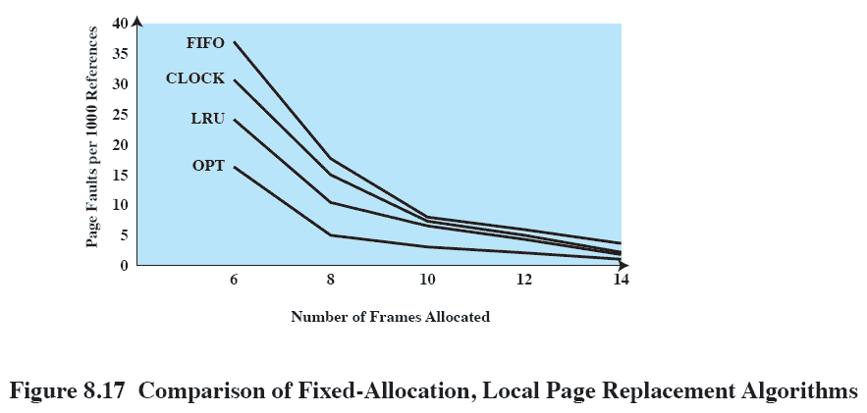
Comparison

Slide 95
Space Concerns
Often think of simple page table
One page table per process
Is this really practical?
Suppose using 32-bit addresses, half for OS, half for user space
Number of pages in a user process is 2^32 / pagesize
If pagesize is 2^10, 2^22 page table entries per process

Slide 96
Hierarchical Page Tables
Still only one page table per process, just only load parts being used
Two-level page table consisting of:
Root page table (essentially page directory)
Each entry points to a small page table
Individual page tßables, each of which points to a portion of total virtual address space

Slide 97
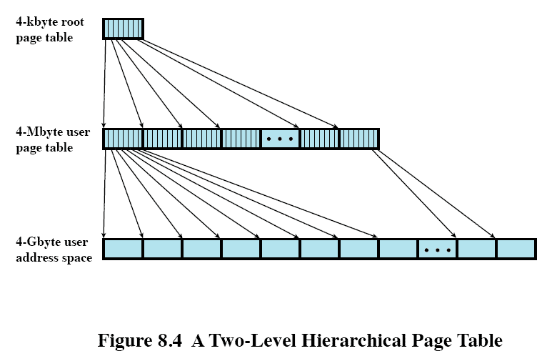
Hierarchical Page Tables

Slide 98
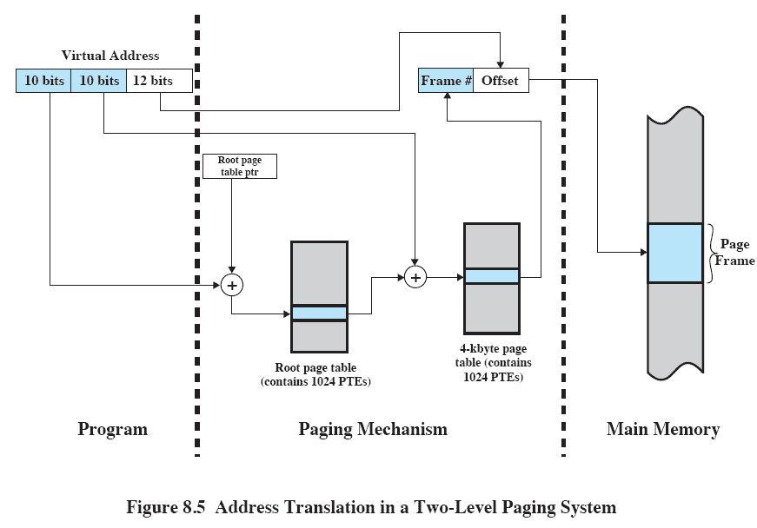
Hierarchical Page Tables

Slide 99
Translation Lookaside Buffer (TLB)
Each virtual memory reference can cause two physical memory accesses
One to fetch page table entry
Another to fetch the data
Naive implementation would cause this to double execution time
To deal with this, special high-speed cache
Translation lookaside buffer
TLB is a cache, so can be implemented with direct or associative caching

Slide 100
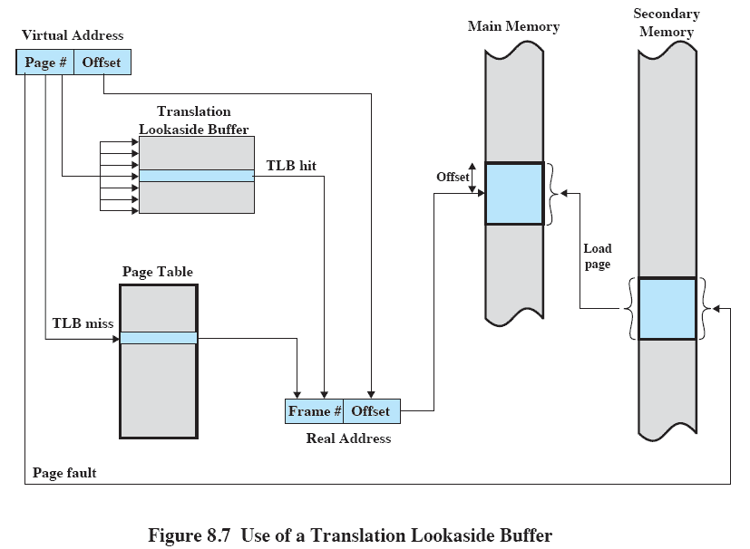
Using the TLB

Slide 101
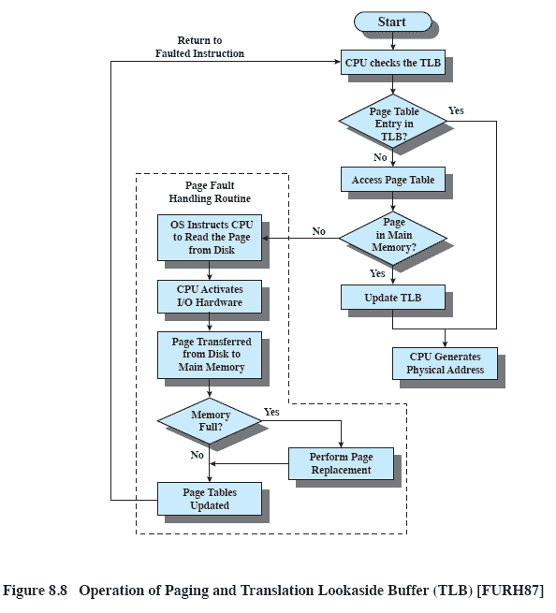
TLB Operation

Slide 102
Resident set management
When new process comes into system, OS must decide how many pages to bring into main memory
Smaller this is, more processes can reside in memory
Larger it is, less page faults (with upper limit at some point)
This size can be fixed
Processes always have the same number of frames allocated to it
Page to be replaced is chosen from its resident set
Varied
Allow the max number of frames to a process to vary over time

Slide 103
Segmentation Fault
When a program tries to access memory it should not have access to
Generated in two ways:
When program tries to read or write memory not allocated to it
When writing memory that can only be read
Generates SIGSEGV signal (usually 11)

Slide 104
Segmentation Fault
Things that could throw a SIGSEGV:
Using uninitialized pointer
De-referencing a NULL pointer
Trying to access memory program does not have privileges for
Accessing array out of bounds
Trying to access memory which has already been freed

Slide 105
Bus Error
When a process tries to access memory that CPU cannot physically address
Generated when program attempts to use an invalid address
Usually caused by alignment issues
Generates SIGBUS signal (usually 10)

Slide 106
Bus Error
Things that could throw a SIGBUS:
Process tries to access specific physical memory address which is not valid
Invalid pointer is dereferenced
Unaligned multi-byte access
Often multi-byte access must be aligned by bytes
Require that longs be accessed at byte 0,4,8,12,16, so on
Trying to read byte 3 or 5 would generate a SIGBUS

Slide 107
Paged Segmentation
Can we combine paging and segmentation?
User address space broken up into segments
Each segment broken up into number of fixed-size pages
Each size of a main memory frame

Slide 108
Paging and Segmentation
Under paged segmentation, different visibility
Segmentation visible to programmer
Paging is only visible to OS

Slide 109
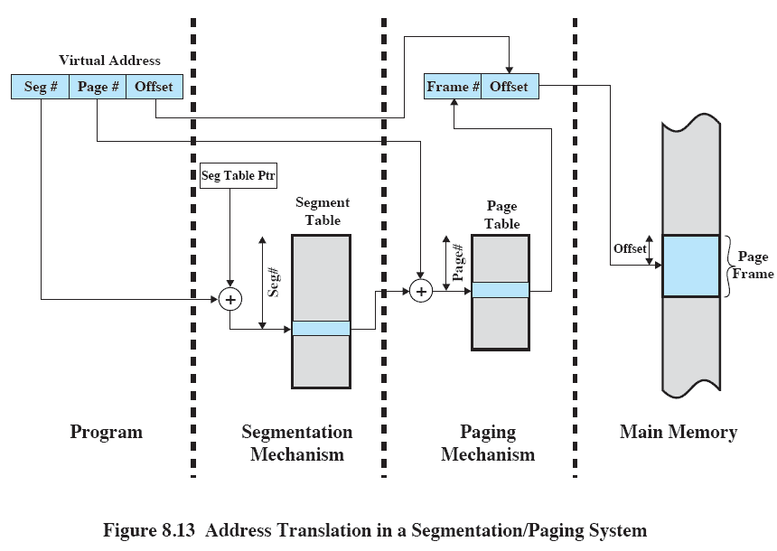
Paging and Segmentation

Slide 110
Inverted Page Tables
Lets solve the size of our page tables in another way
With just one entry for each frame of physical memory
A problem!
More than one virtual address could map to that location
Called Inverted Page Table
Indexes page table entries by frame number, not by virtual page number

Slide 111
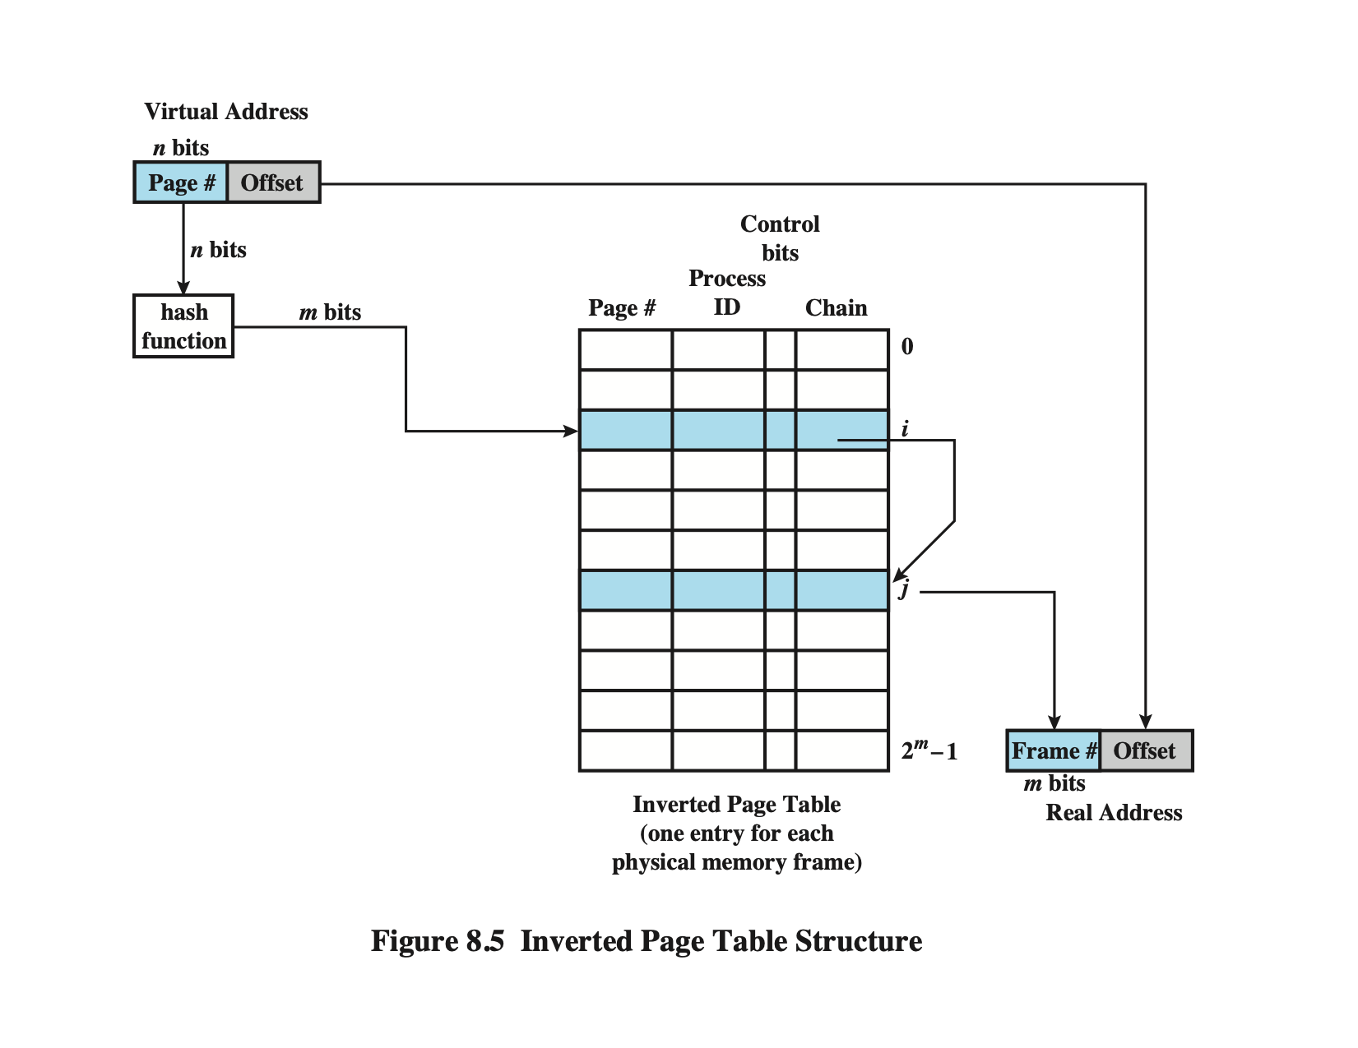
Inverted Page Table

Slide 112
Demand Paging
Demand paging only brings pages into main memory when a reference is made
What happens at the start of processes?
Can we possibly change this exploiting principle of locality?

Slide 113
Prepaging
Lets bring in pages other than the one demanded by page fault
How does this help us? How can we be sure pages will be used?
Exploit the characteristics of secondary storage devices
If pages of a process are stored contiguously in secondary memory, efficient to bring in a number of pages at one time
Ineffective if extra pages are not referenced

Slide 114
End on memory management!
Any questions?

