Slide 1
Operating Systems: Concepts

Slide 2
Operating System
        Exploits the hardware resources of one or more processors
        Provides a set of services to system users
        Manages secondary memory and I/O devices

Slide 3
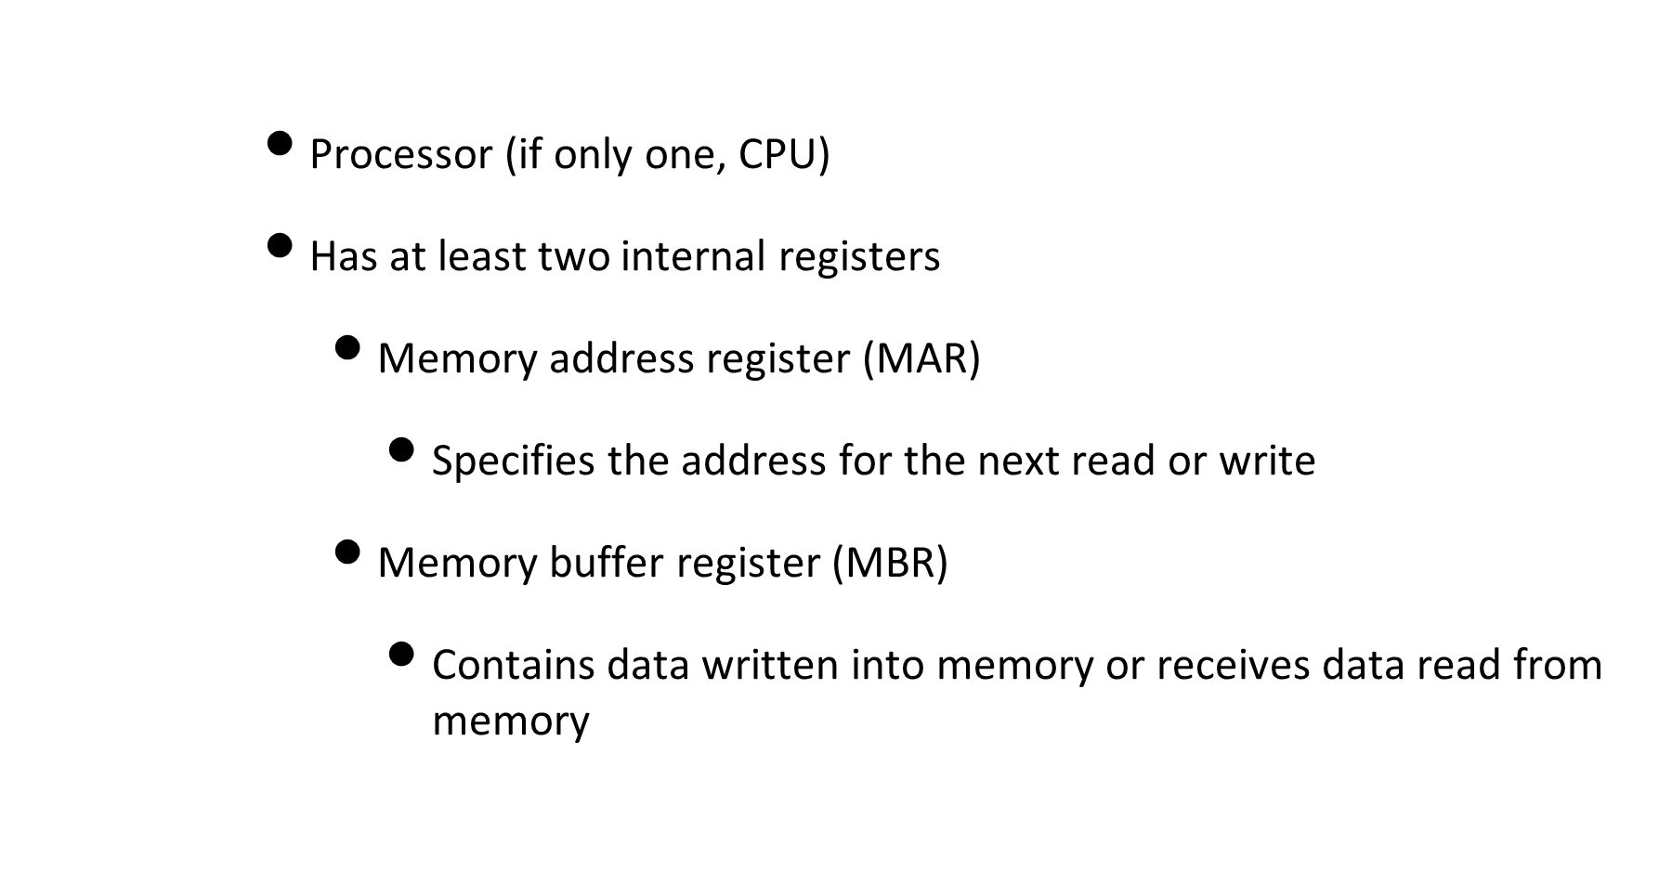
Basic elements

Slide 4
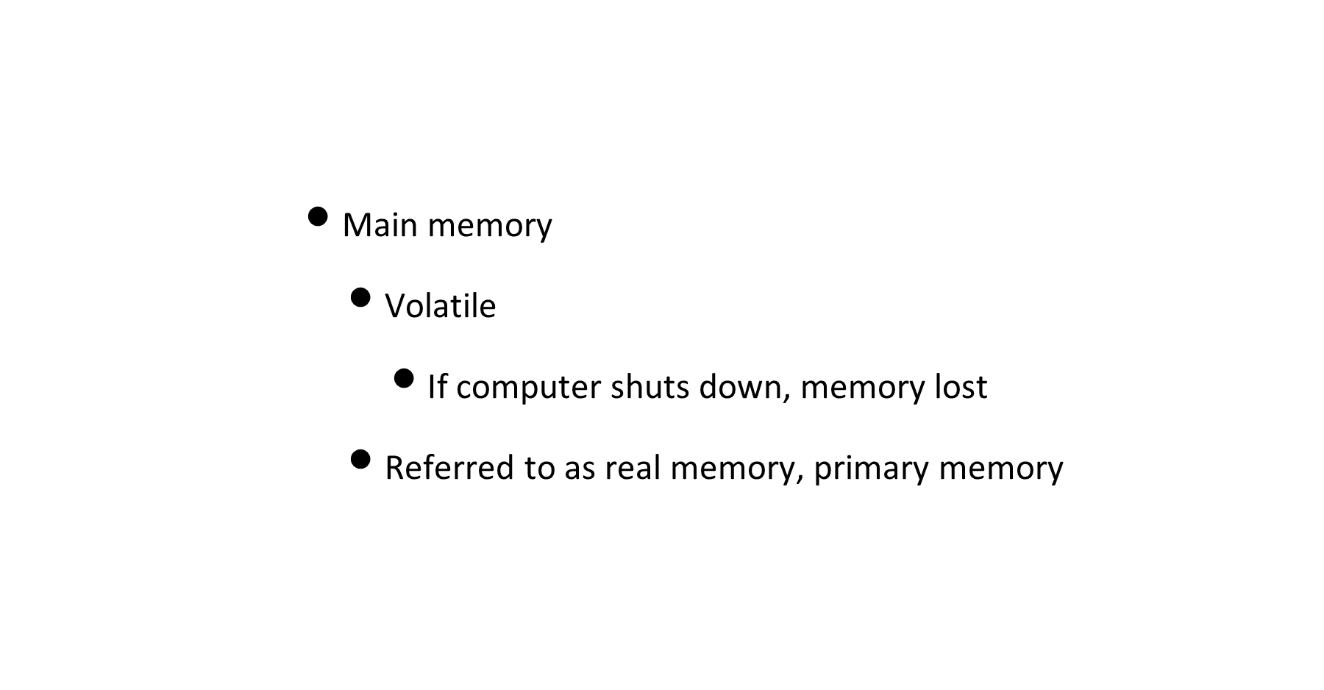
Basic elements

Slide 5
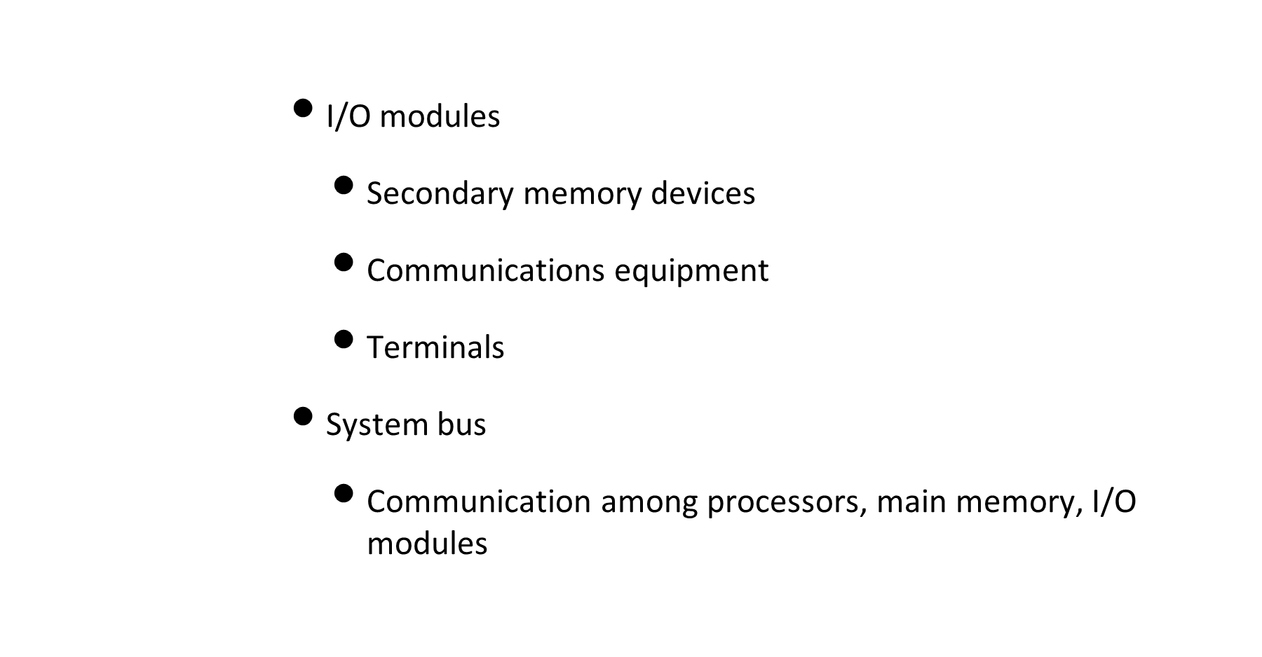
Basic elements

Slide 6
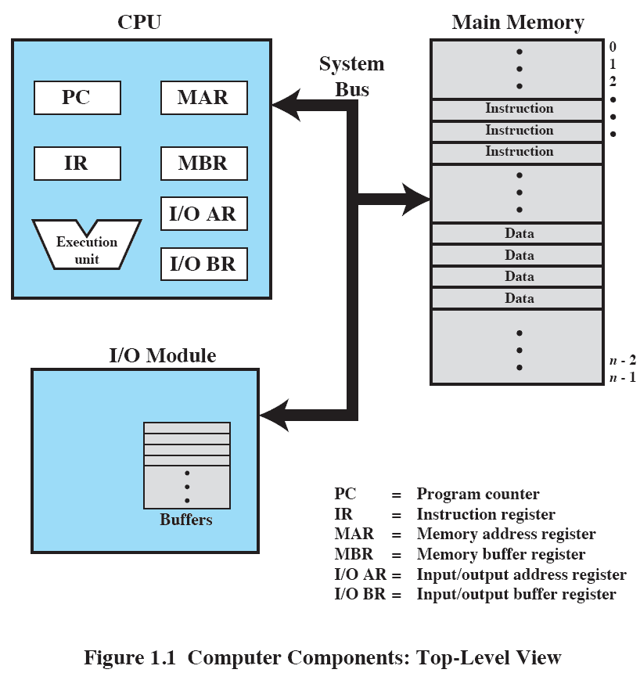
Computer Components
Top-Level view

Slide 7
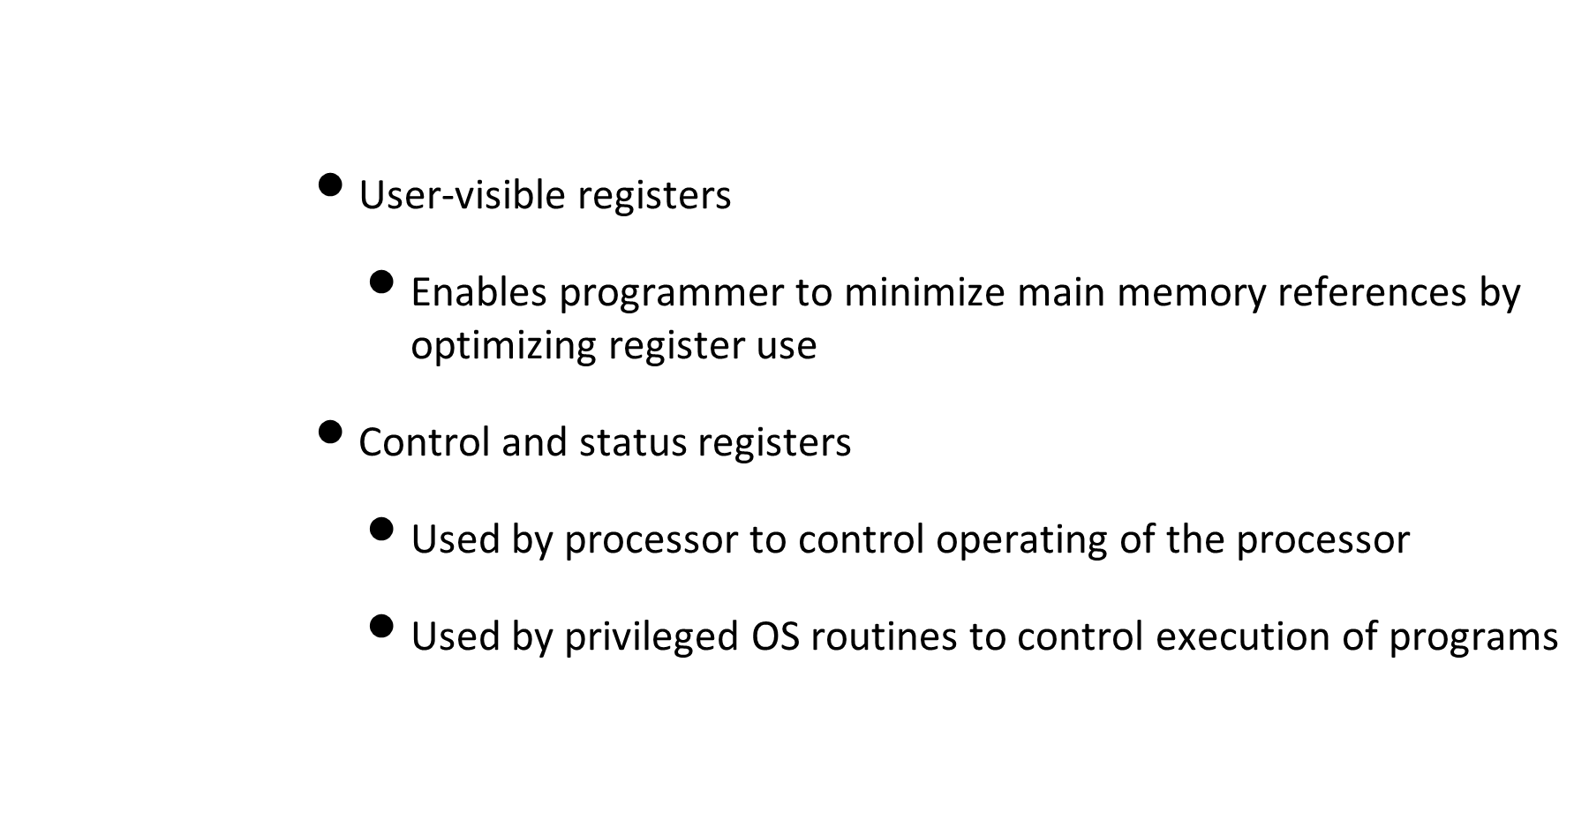
Processor registers

Slide 8
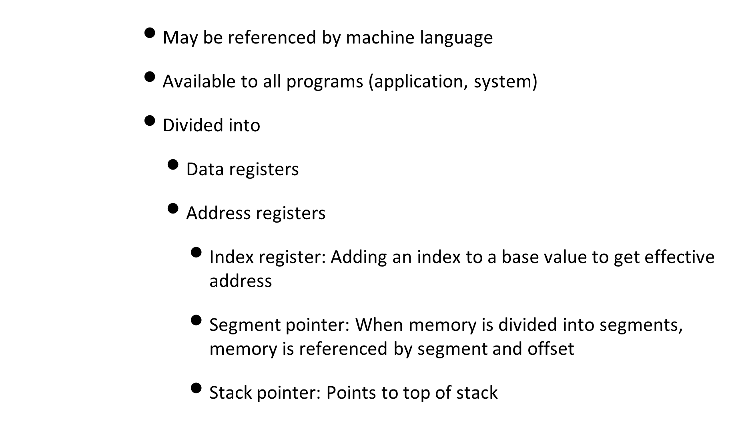
User-Visible registers

Slide 9
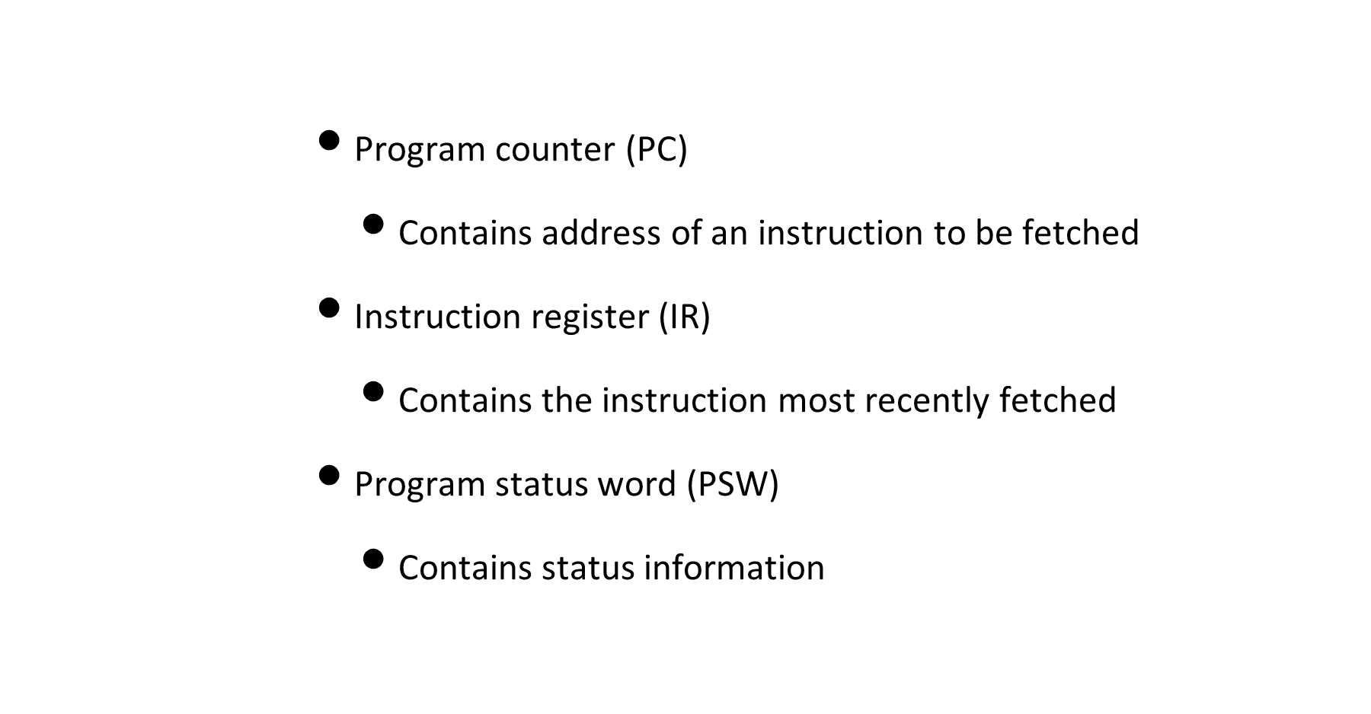
Control and Status registers

Slide 10
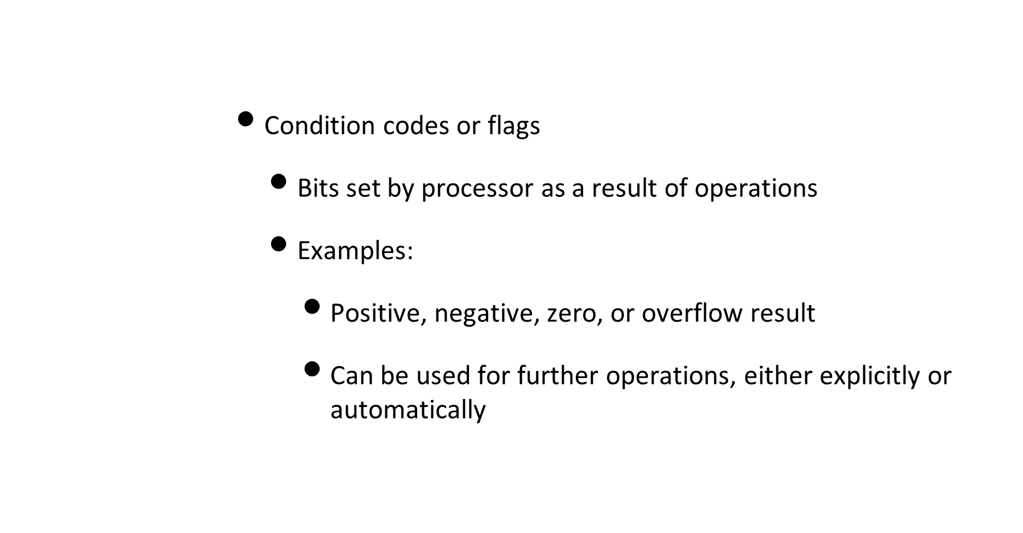
Control and Status registers

Slide 11
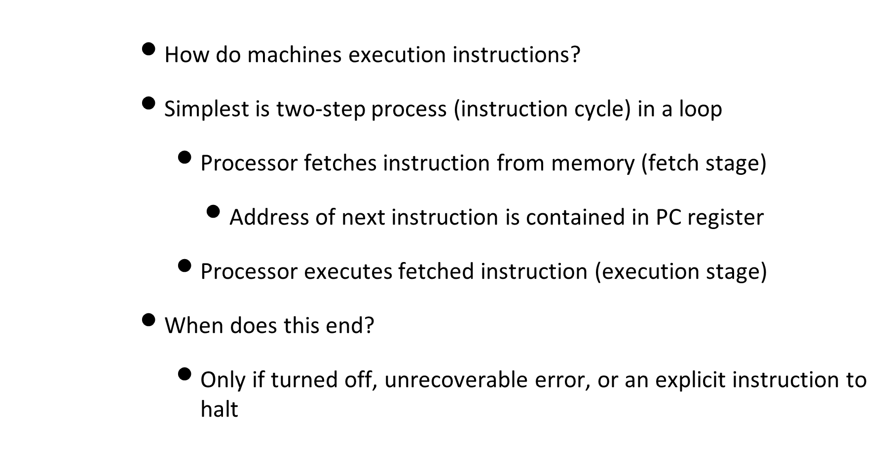
Instruction Execution

Slide 12
Instruction Execution
      Fetched instruction is loaded into instruction register (IR)
      Processor decodes instruction and performs the action
      Usually can be classified into these categories
        Processor-memory - Data transfer from processor to memory
        Processor-I/O - Transfer to I/O module or device (peripheral)
        Data processing - Arithmetic or logic operation on data
        Control - Alter the sequence of instructions
      One instruction can also combine several of these

Slide 13
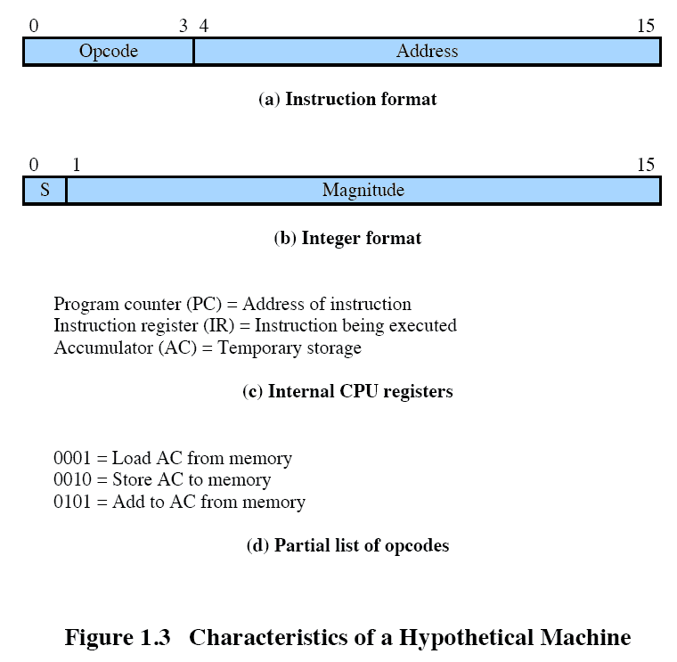
Instruction Execution

Slide 14
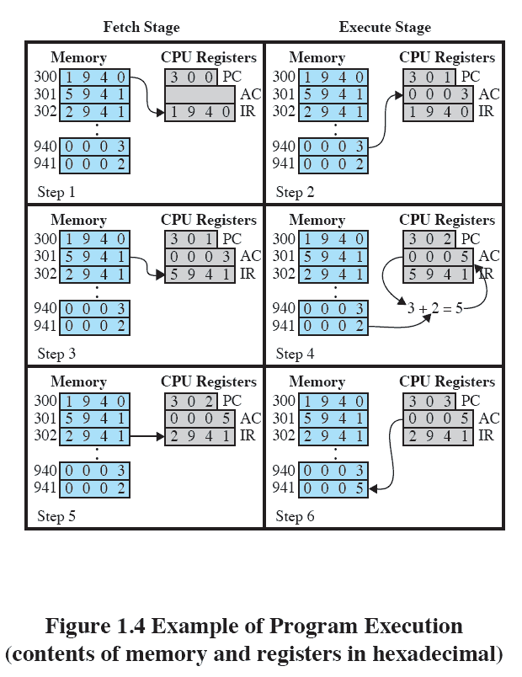
Instruction Execution

Slide 15
Interrupts
      Interrupts are a mechanism to interrupt normal sequence of a processor
        Event that alters the sequence of instructions executed by CPU
        Correspond with electrical signals generated by hardware circuits (in and out of the CPU)
      Help to improve CPU utilization
        Consider typical CPU working at 3 GHZ, or 3x10^9 ips
        Typical HDD will have rotation of 7200RPM, half a track in 4ms
        Could have executed 12million instructions in that time

Slide 16
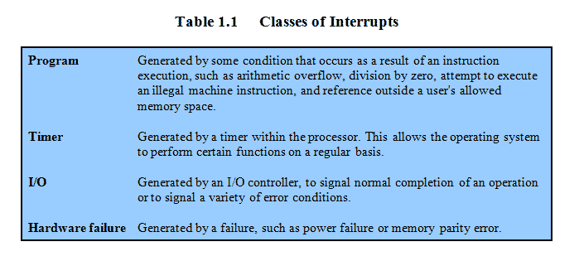
Classes of interrupts

Slide 17
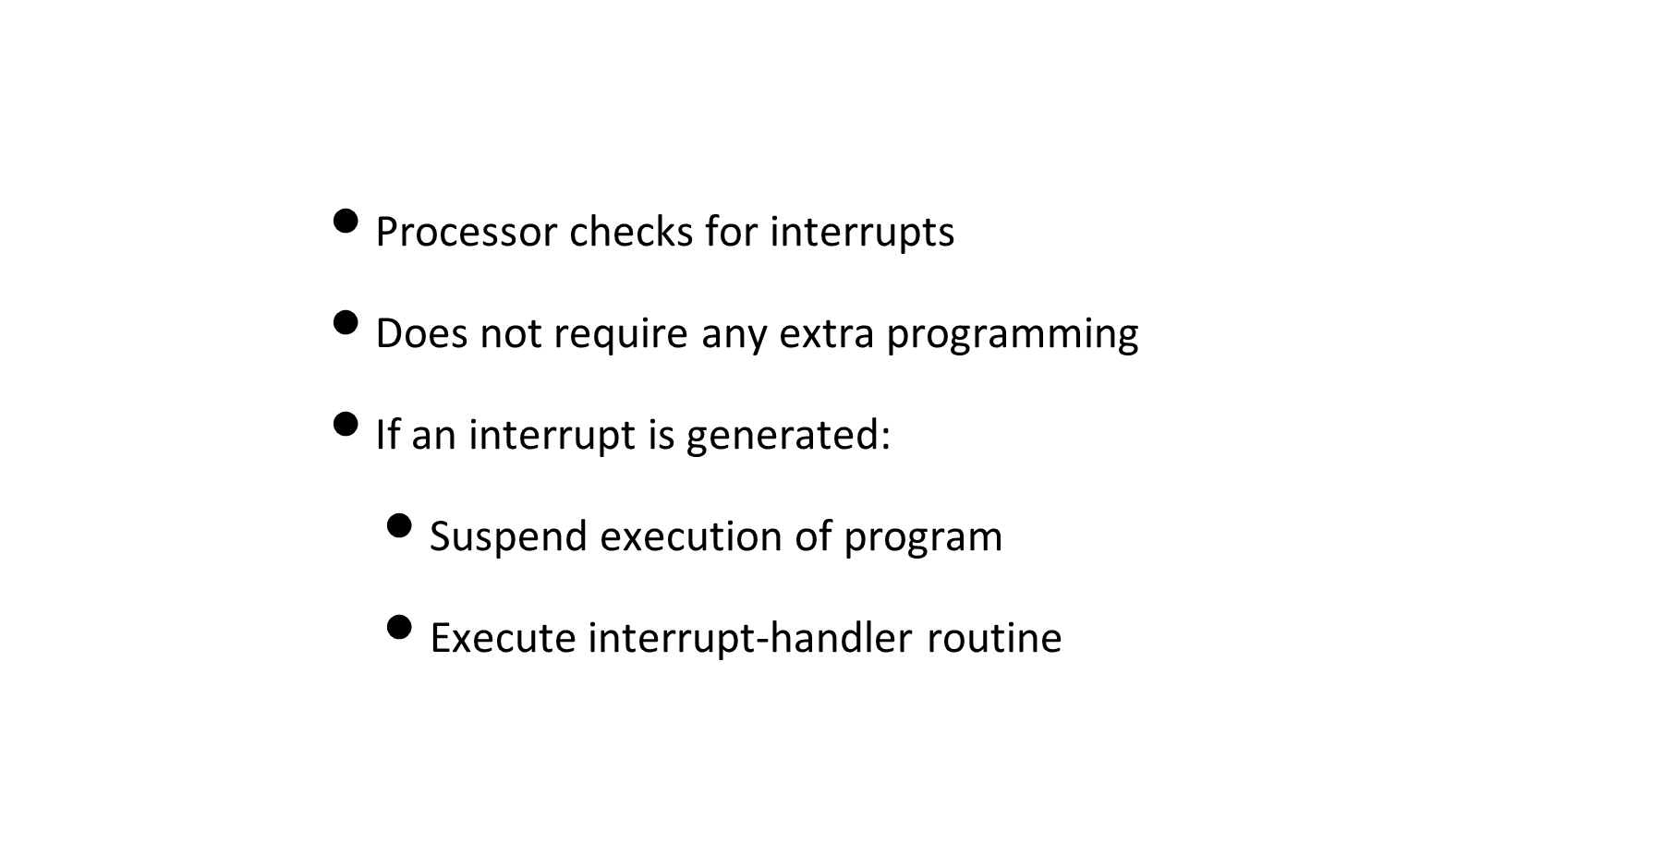
Interrupt Stage

Slide 18
Types of interrupts
      Synchronous interrupts/Exceptions
        Produced by CPU control unit
        Control unit issues them only after terminating execution of instruction
      Asynchronous interrupts
        Generated by other hardware devices at arbitrary times
        No respect to CPU clock signals

Slide 19
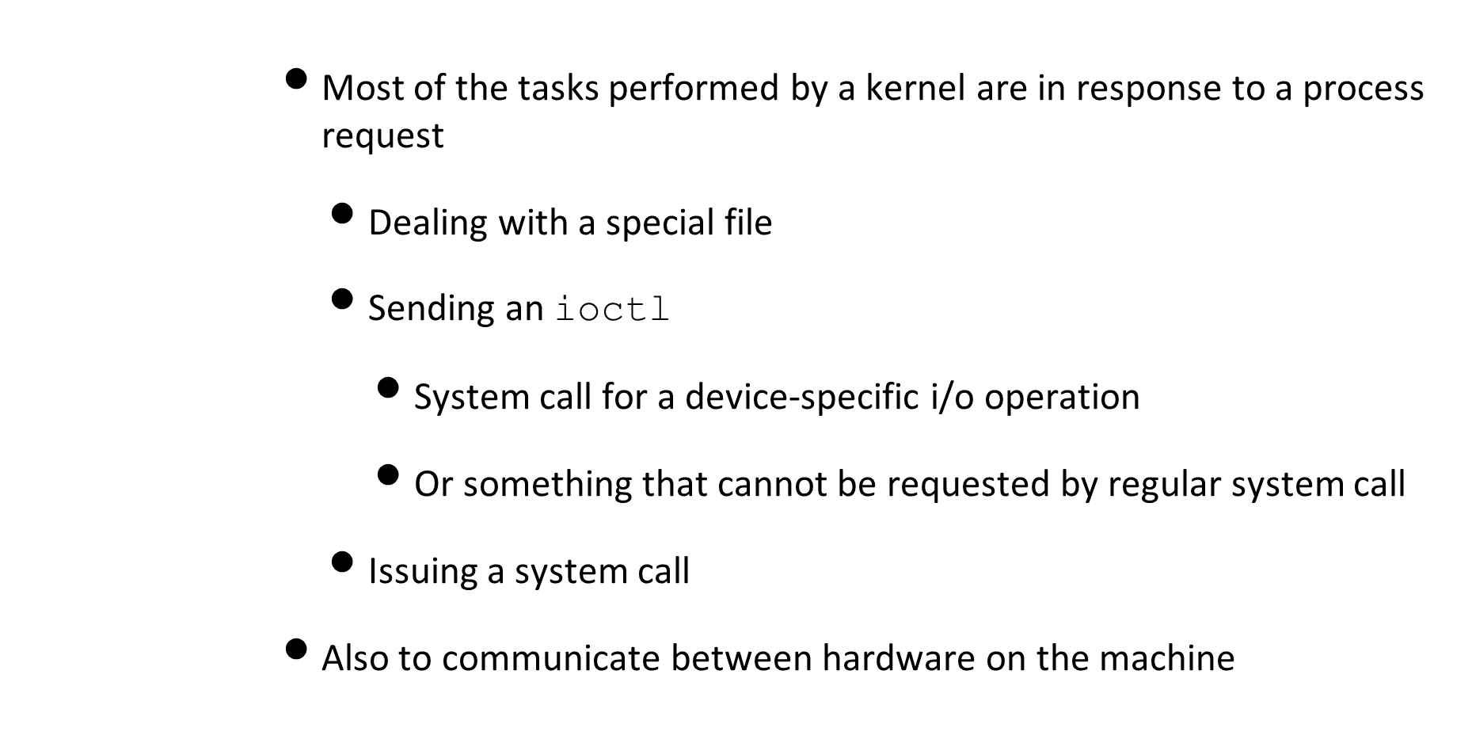
Kernel tasks

Slide 20
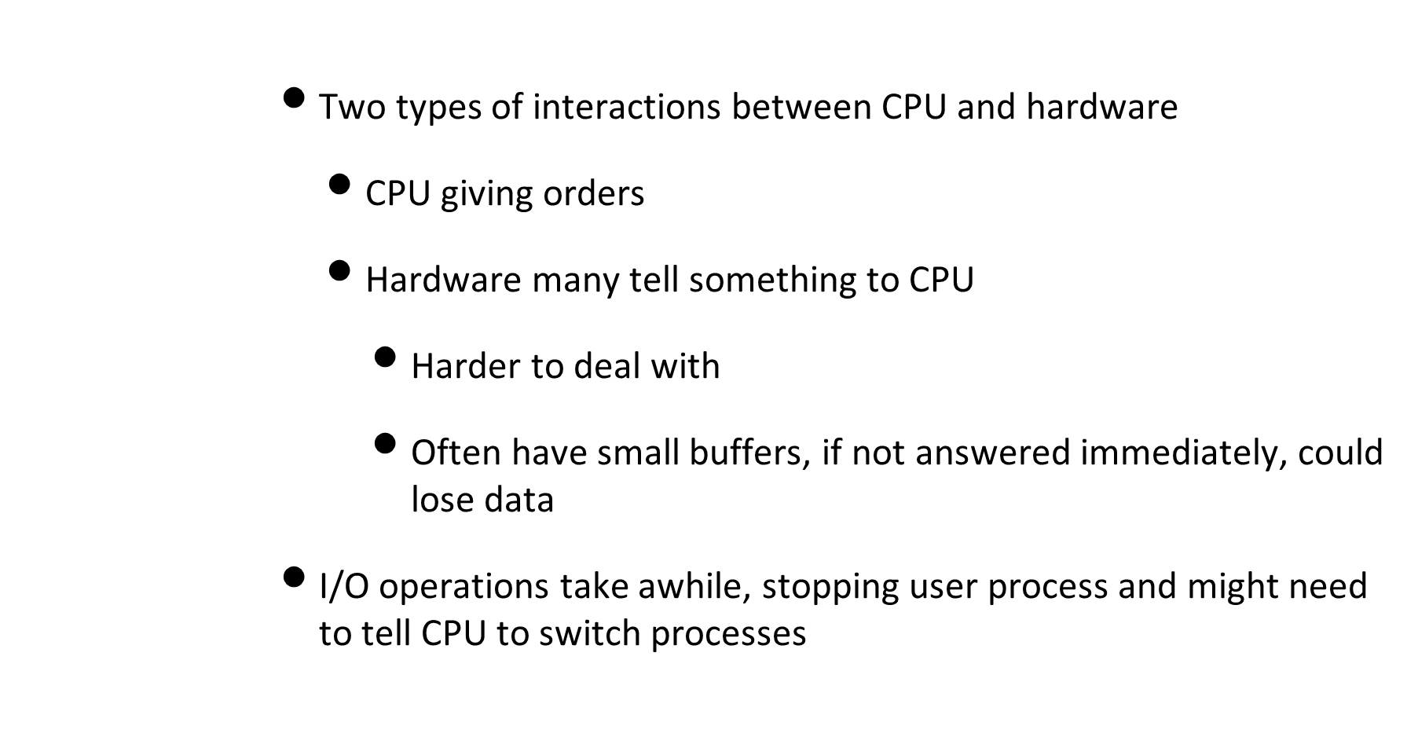
CPU interactions

Slide 21
Interrupts and execution cycle
      Remember we have synch or asynchronous execution of instructions and I/O
      When ext. device is ready, I/O module sends interrupt request to CPU
      CPU responds by suspending current process, branches to int. handler
        Will return after processing request
      Interrupt could occur at any point in programs execution
        Might not depend on any instruction
      User code will not need any special code to deal with this. CPU and OS handle it

Slide 22
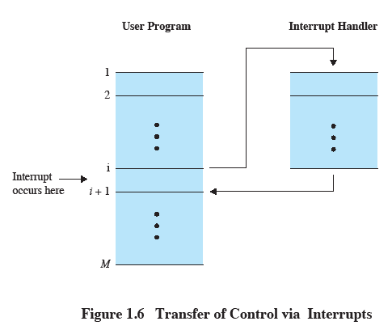
Transfer of Control via Interrupts

Slide 23
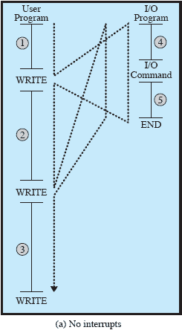
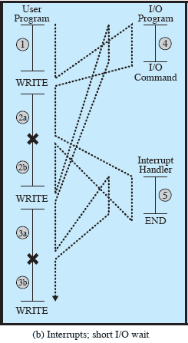
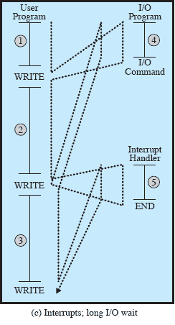
Program flow of control

Slide 24
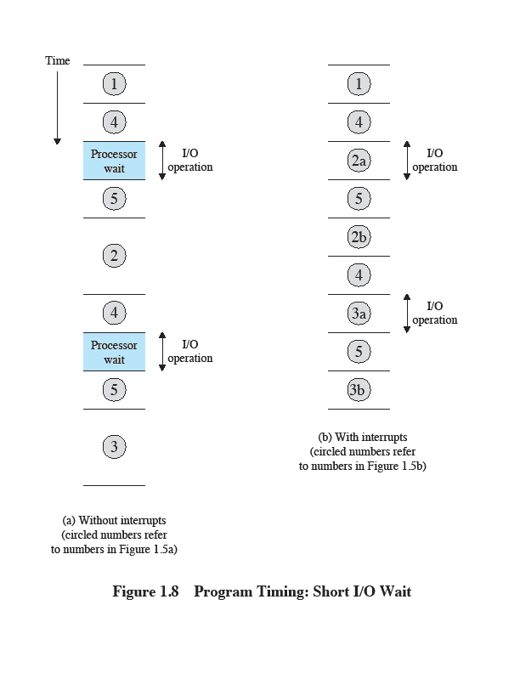
Short I/O wait

Slide 25
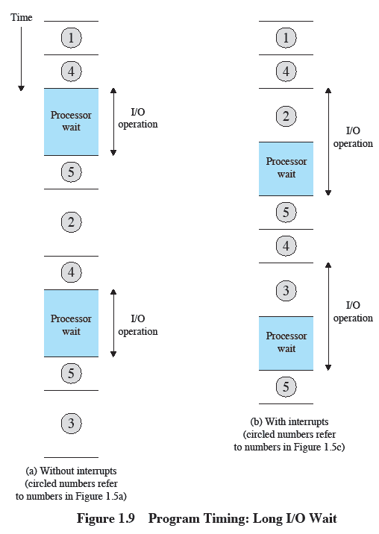
Interrupts

Slide 26
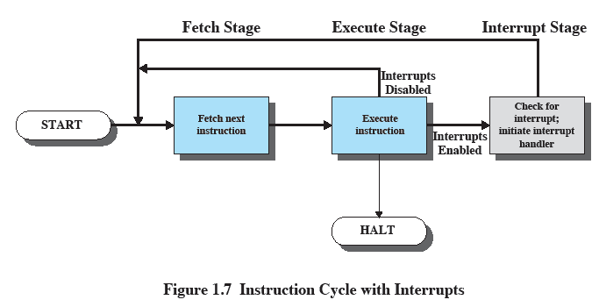
Instruction Cycle with Interrupts

Slide 27
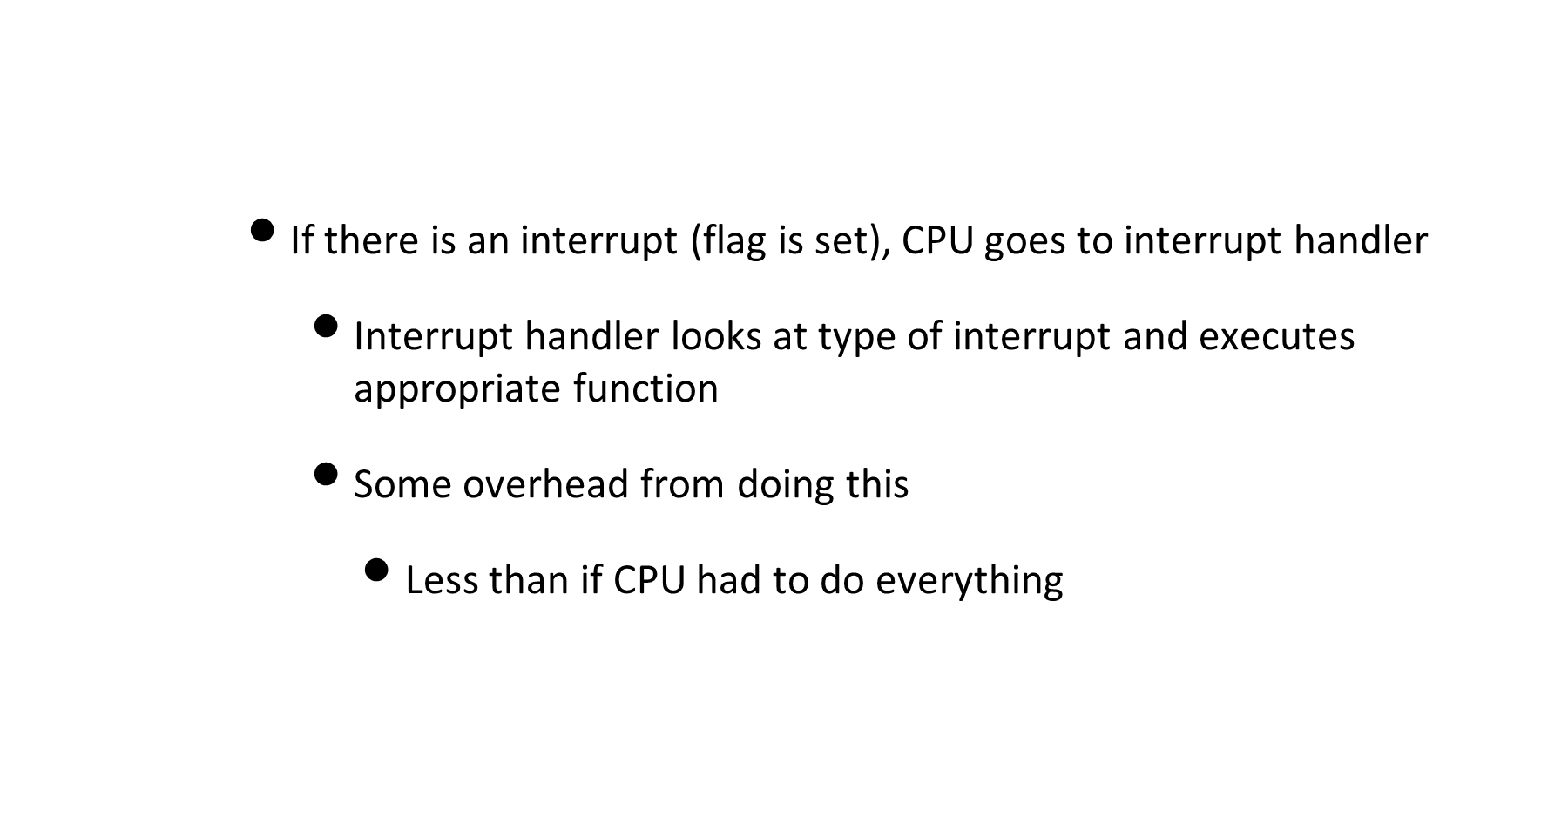
Interrupt process

Slide 28
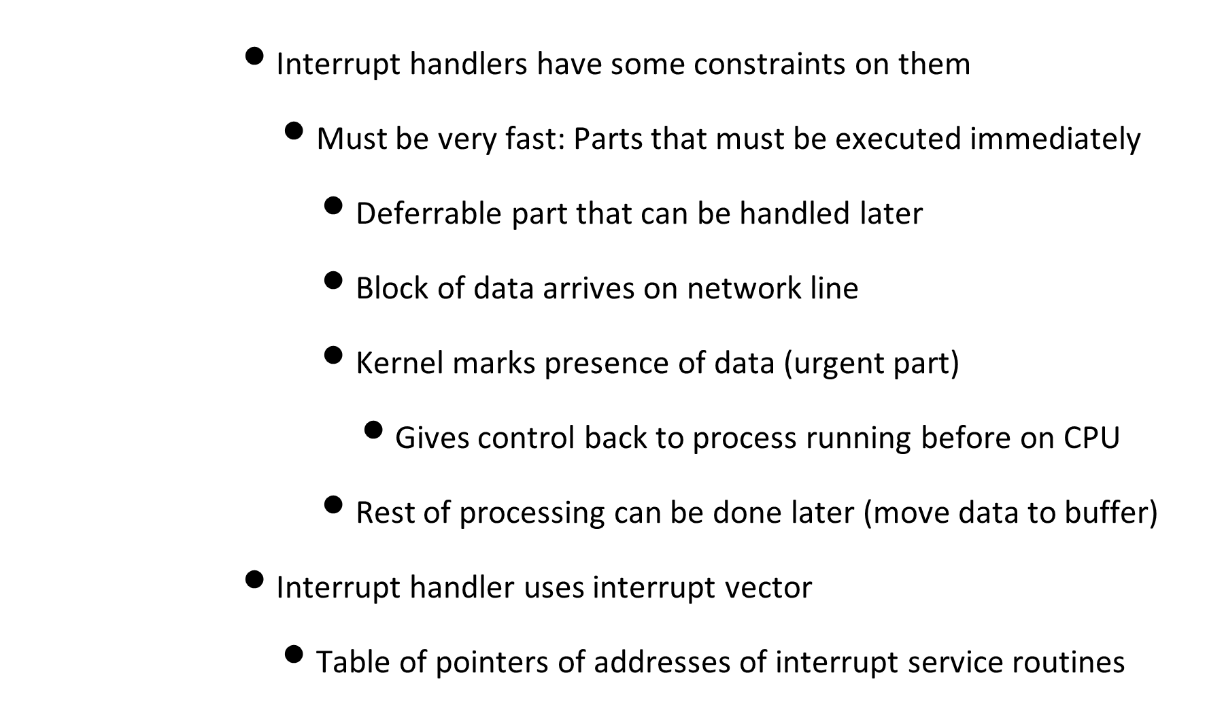
Interrupt constraints

Slide 29
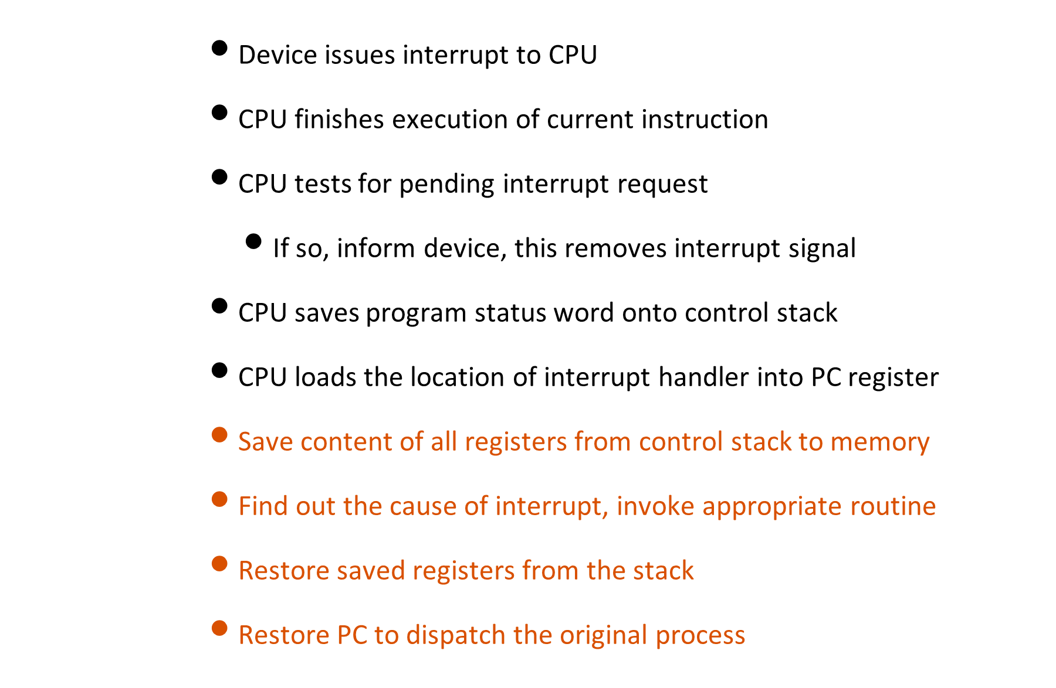
Interrupt processing

Slide 30
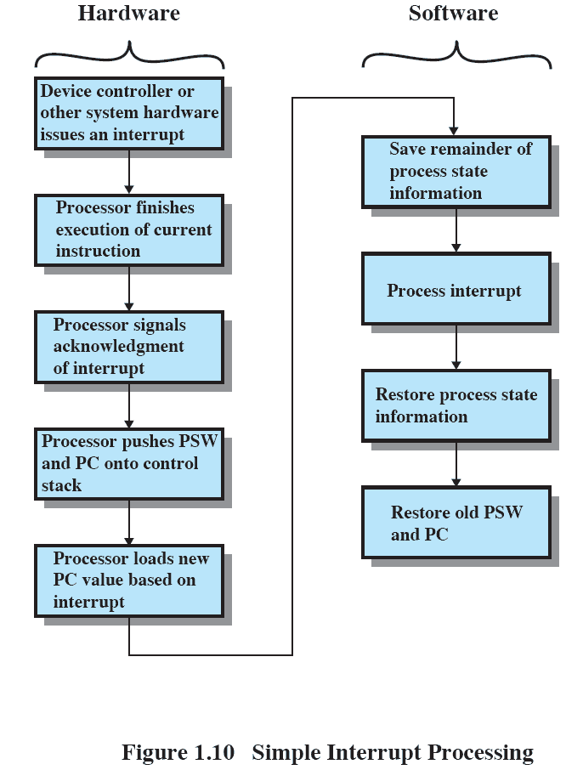
Interrupt Processing

Slide 31
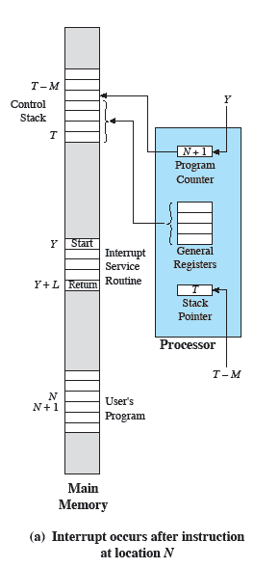
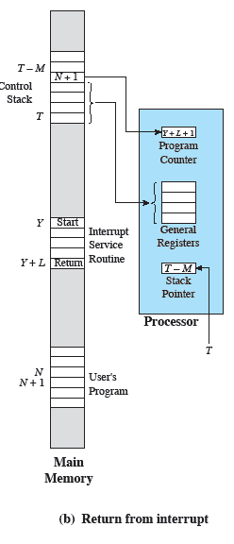
Machine state for interrupts

Slide 32
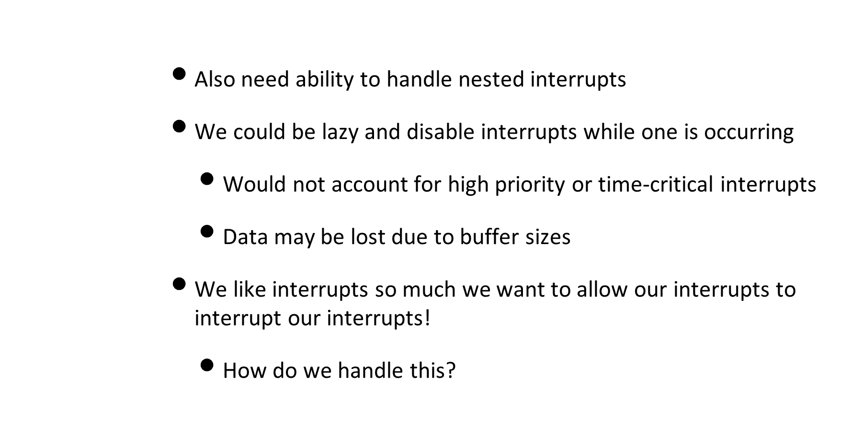
Multiple interrupts

Slide 33
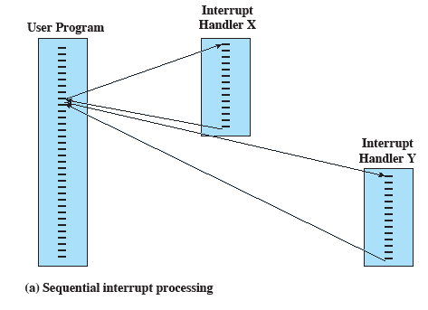
Sequential Interrupt Processing

Slide 34
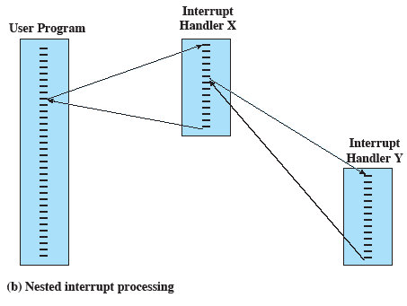
Nested Interrupt Processing

Slide 35
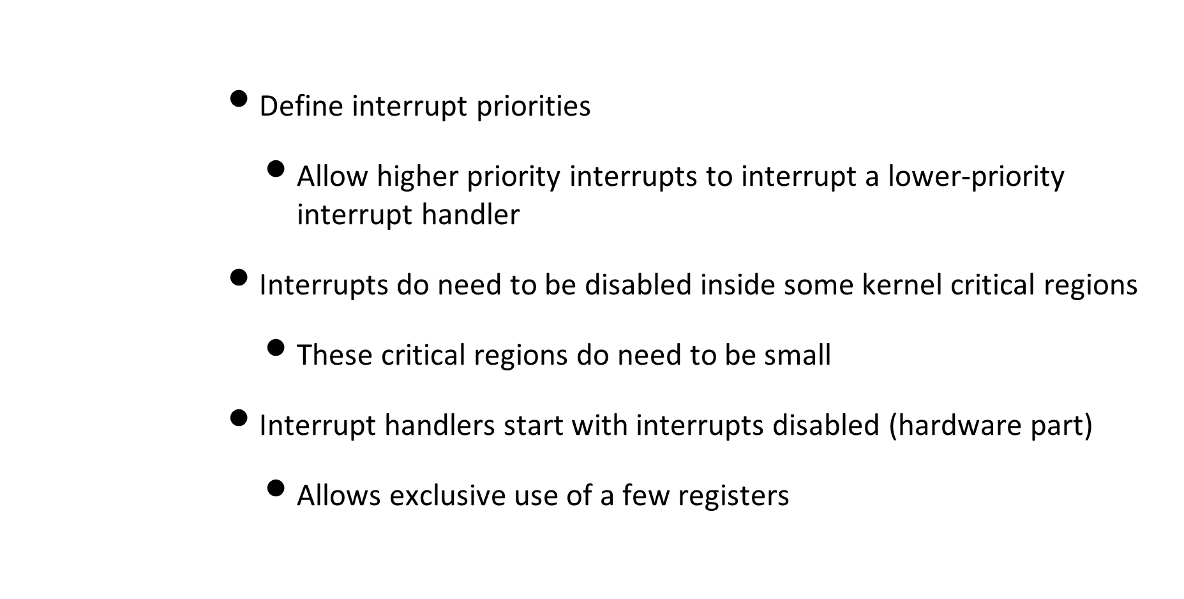
Multiple interrupts

Slide 36
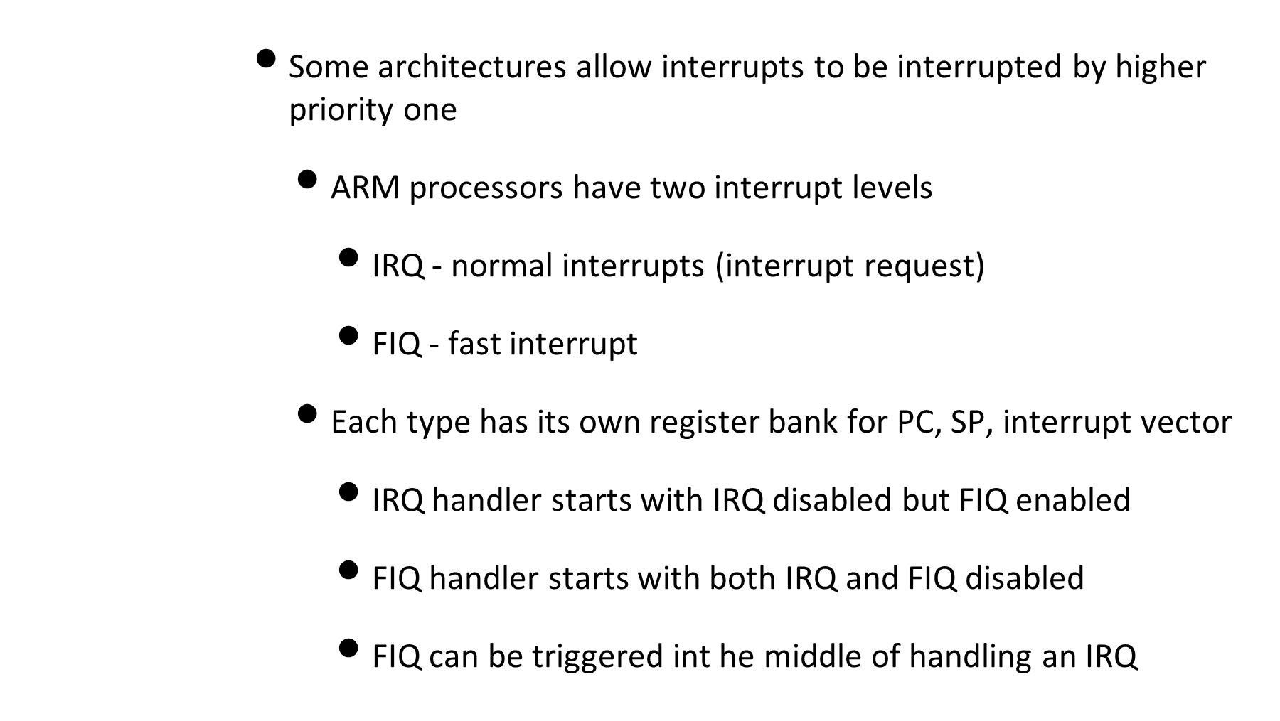
Multiple interrupts

Slide 37
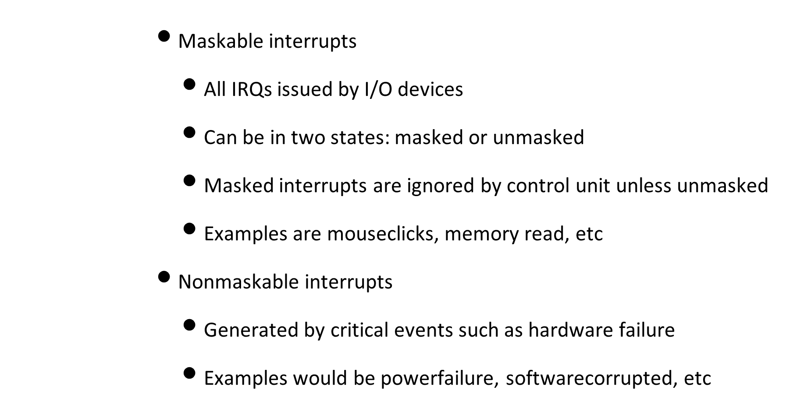
Types of interrupts

Slide 38
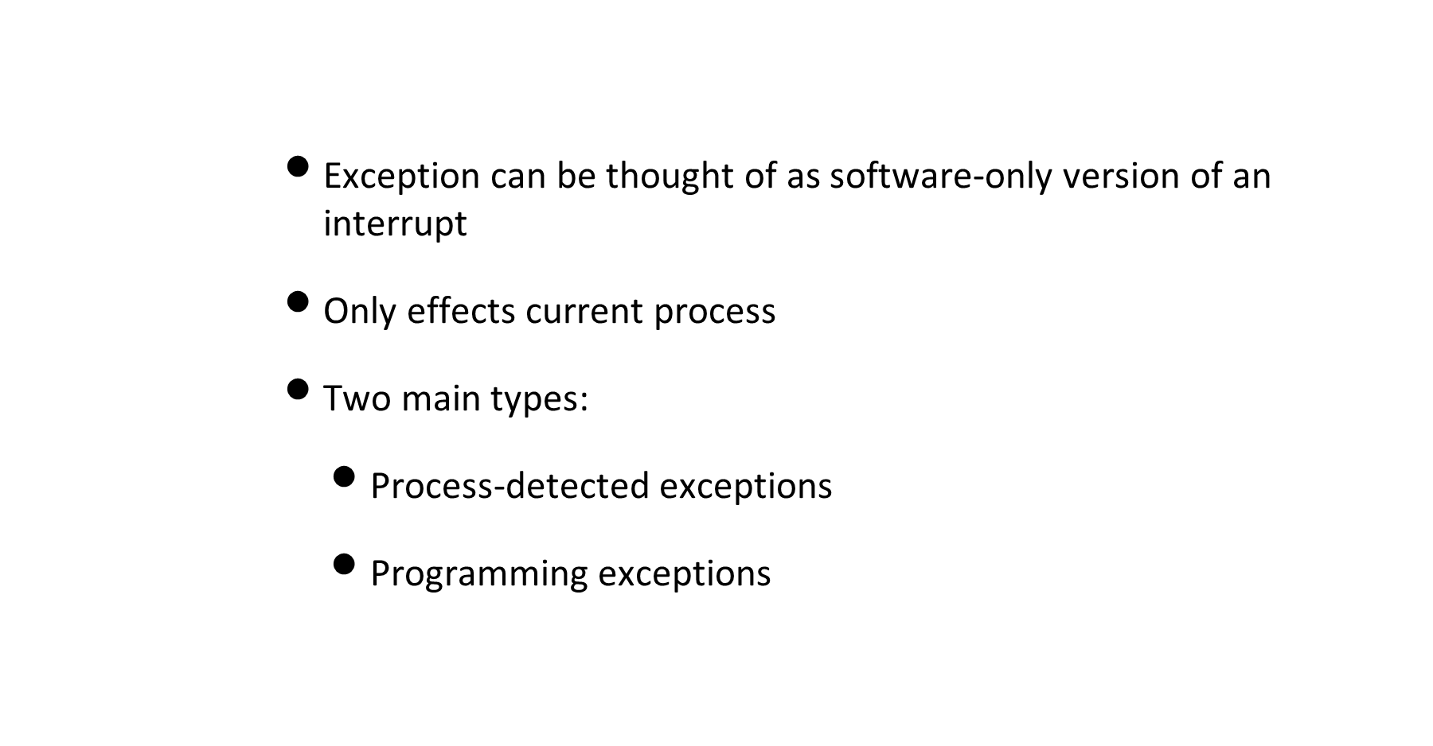
Exceptions vs Interrupts

Slide 39
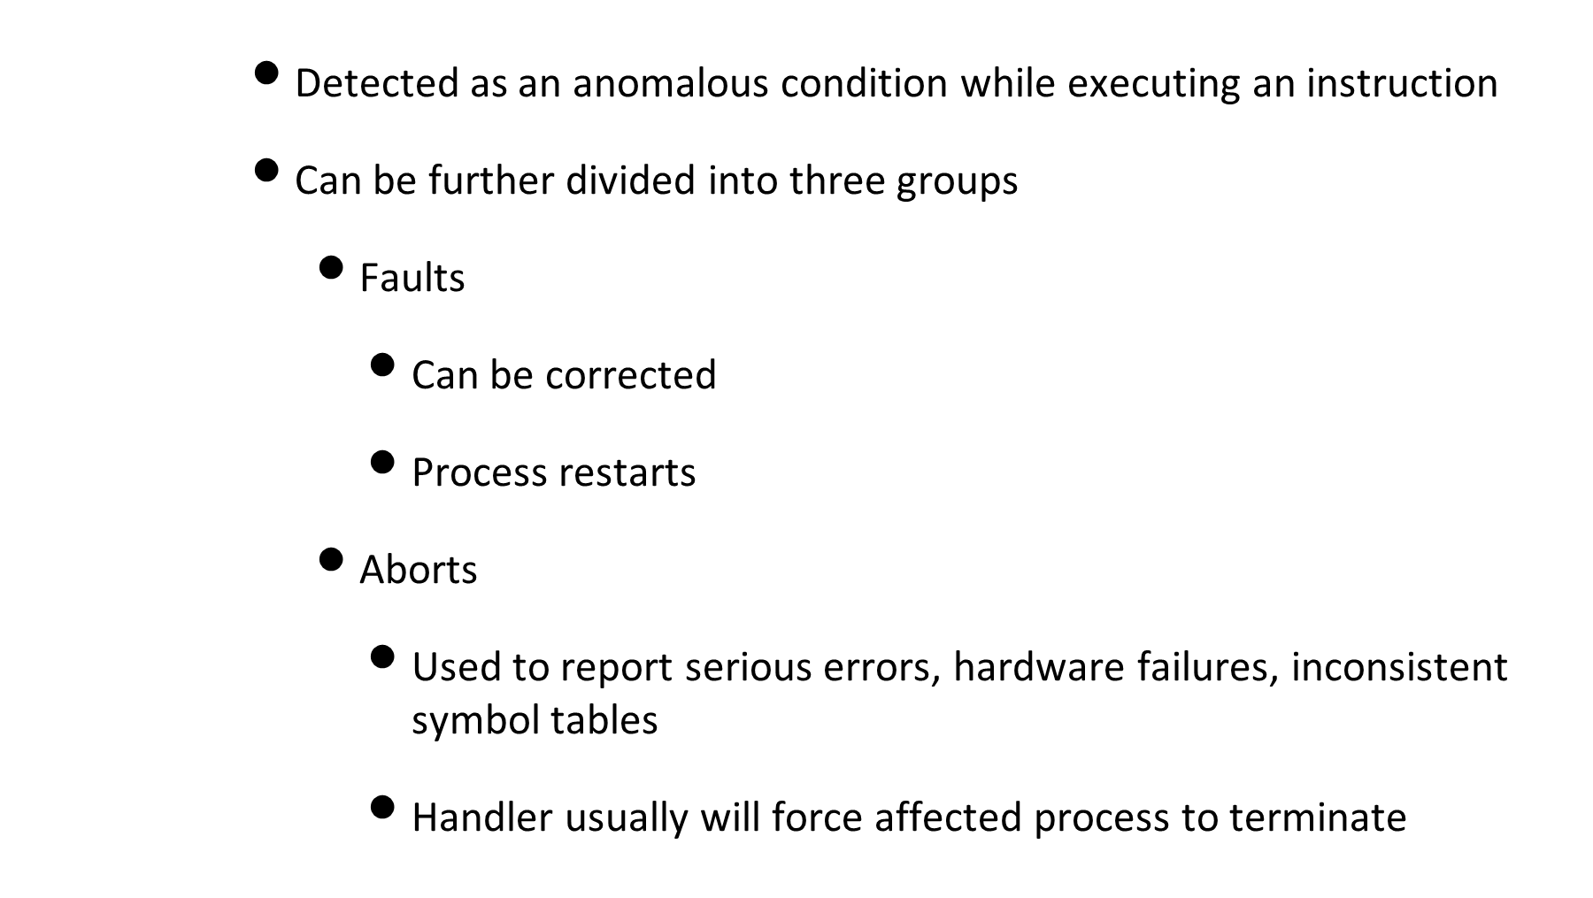
Process-detected exceptions

Slide 40
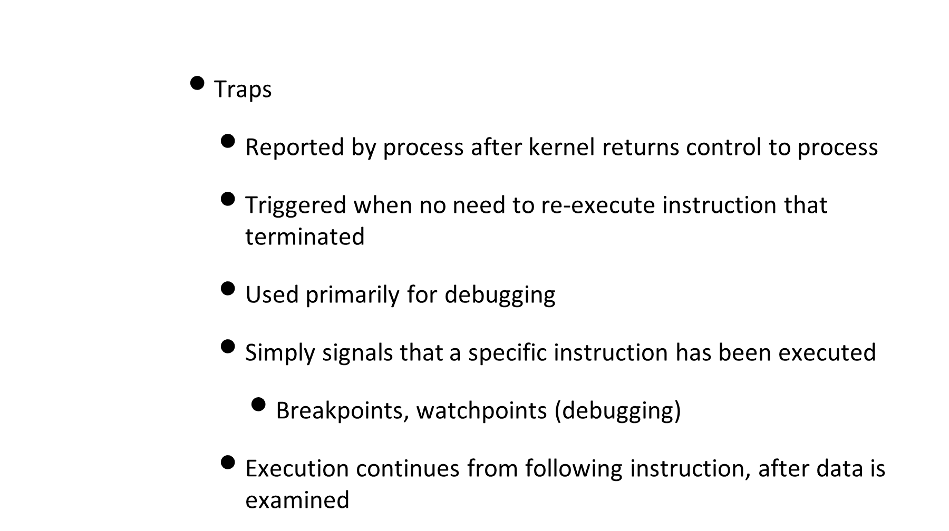
Process-detected exceptions

Slide 41
Programming exceptions
        Occurs at request of programmer
        Handled by control unit as traps, that is software interrupts
        Used to implement system calls and to notify debugger of specific event

Slide 42
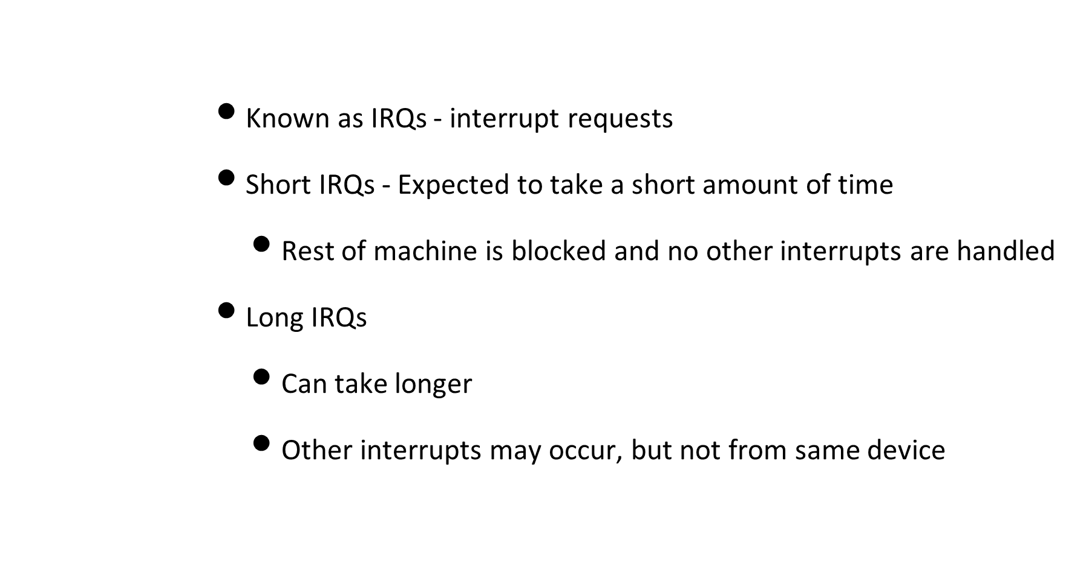
Interrupts in Linux

Slide 43
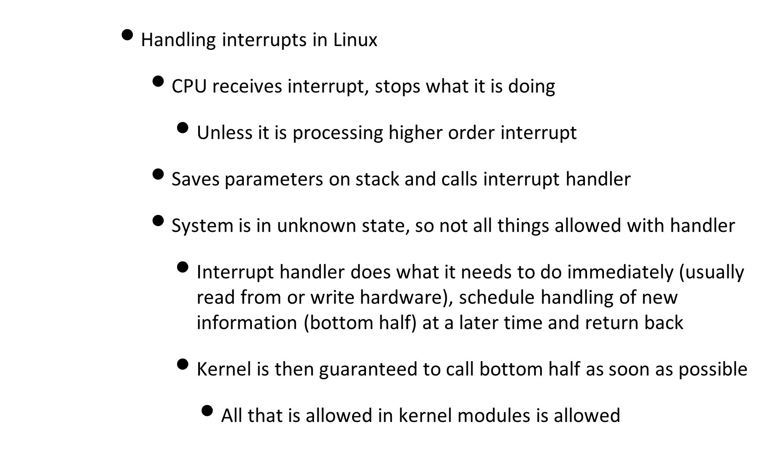
Interrupts in Linux

Slide 44
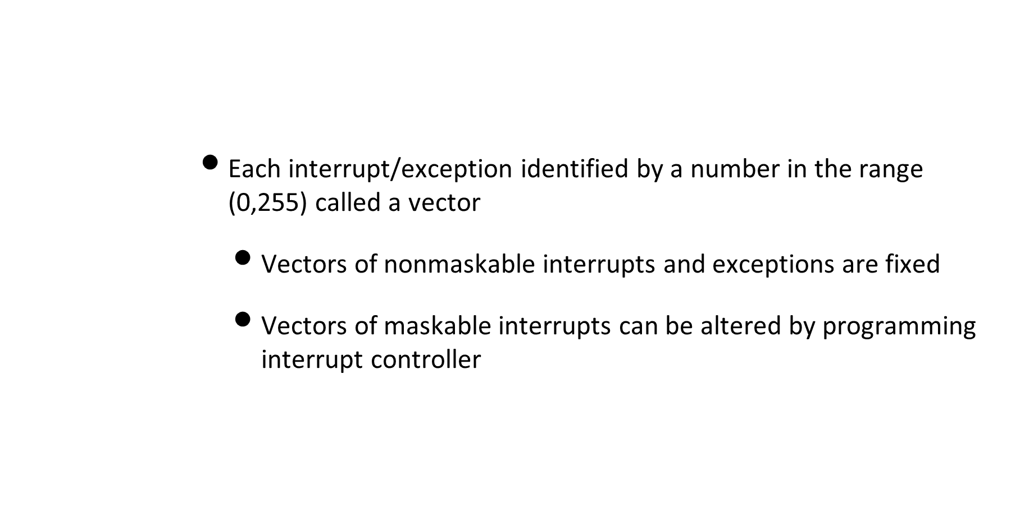
Interrupts in Linux

Slide 45
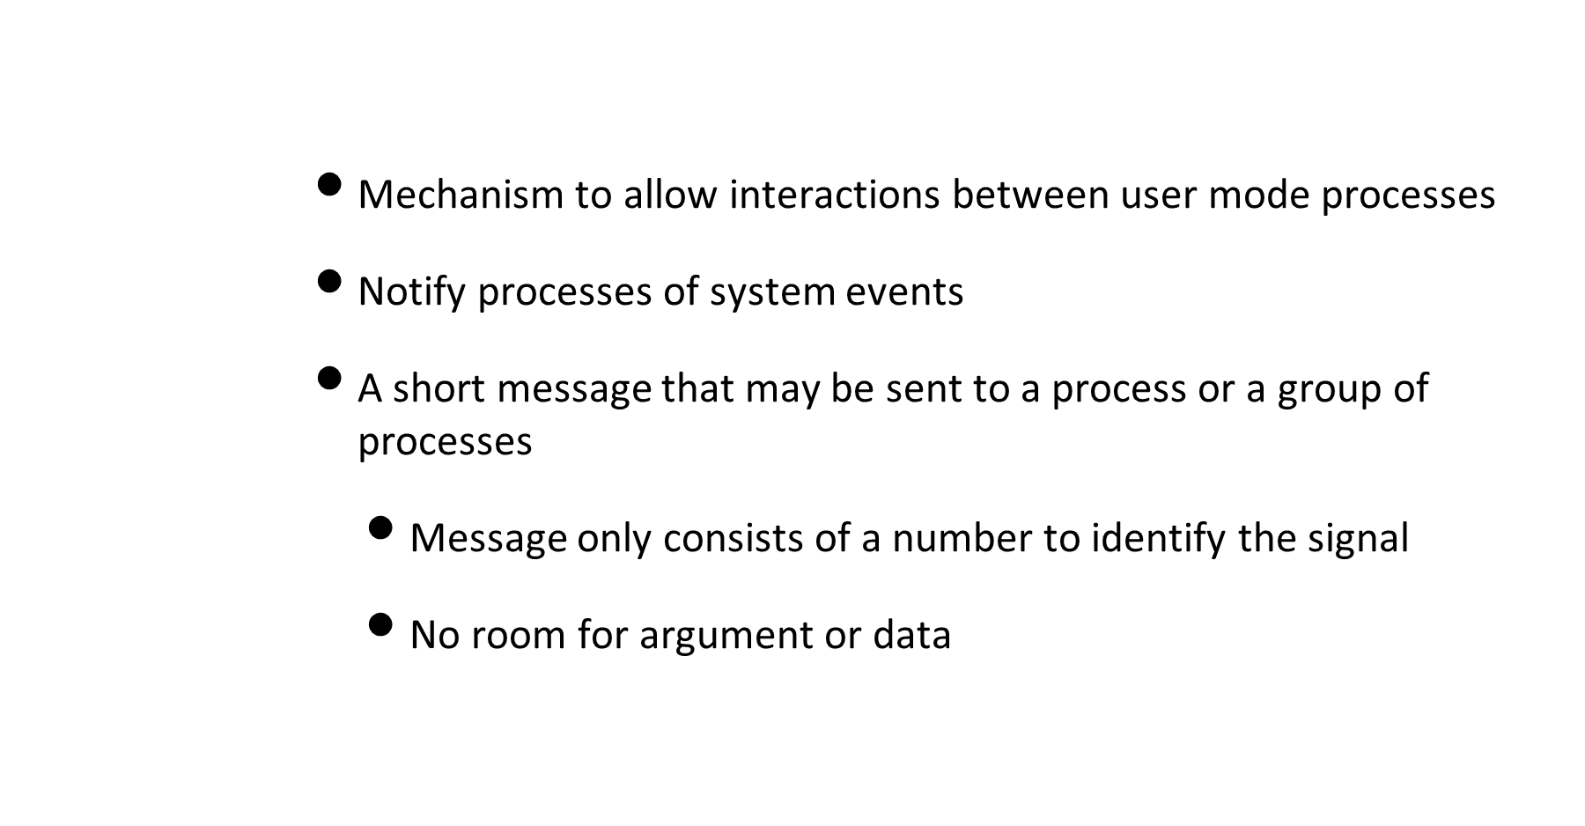
Signals

Slide 46
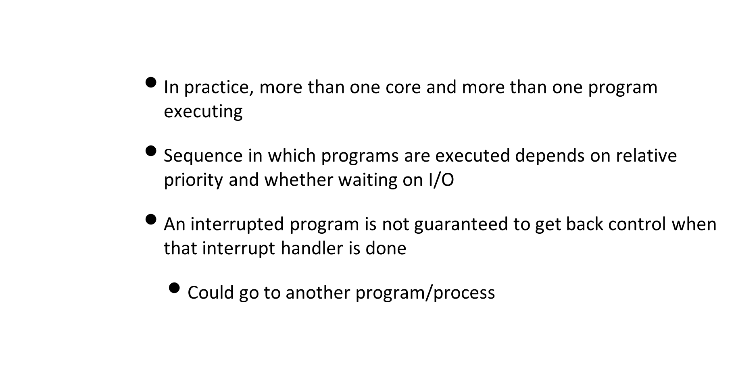
Multiprogramming concerns

Slide 47
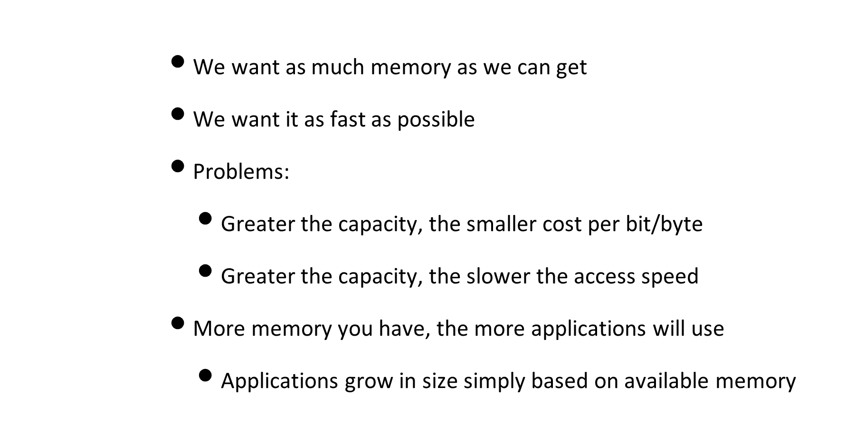
Memory Hierarchy

Slide 48
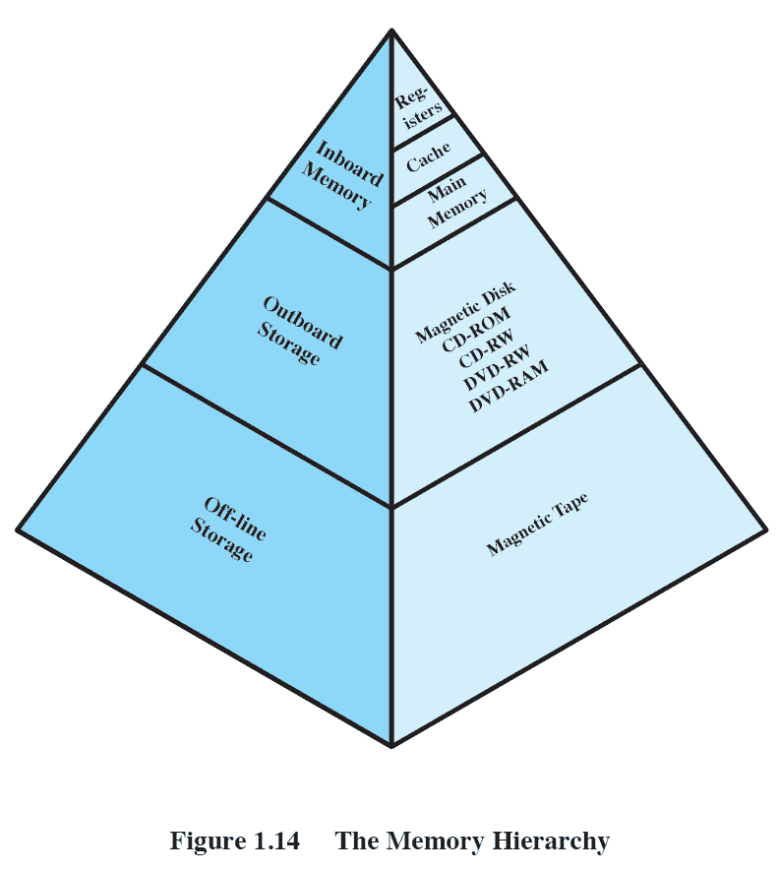
Memory Hierarchy

Slide 49
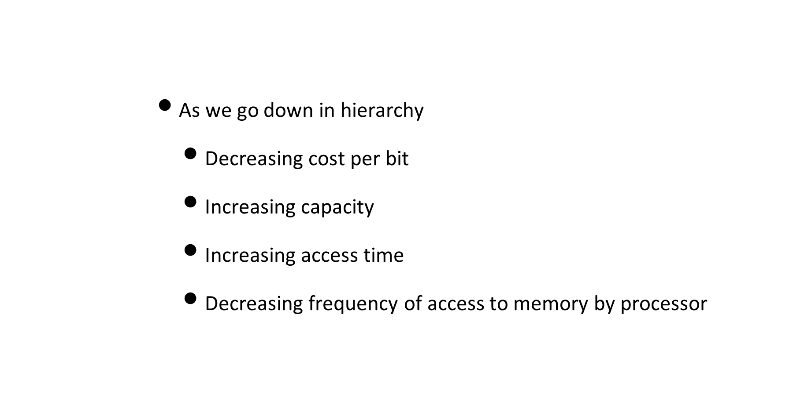
Memory Hierarchy

Slide 50
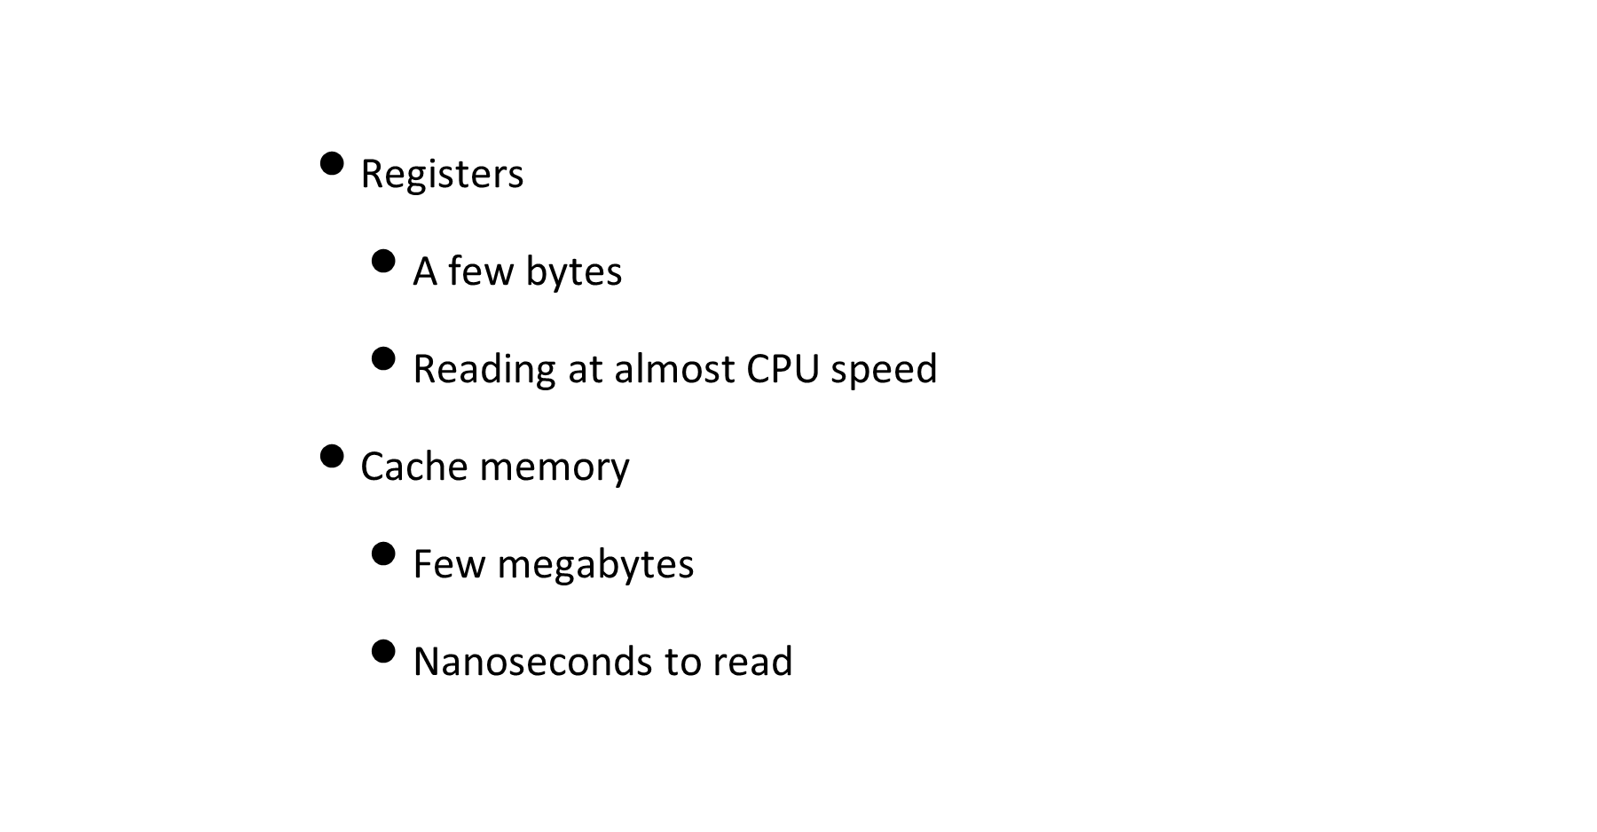
Memory Hierarchy

Slide 51
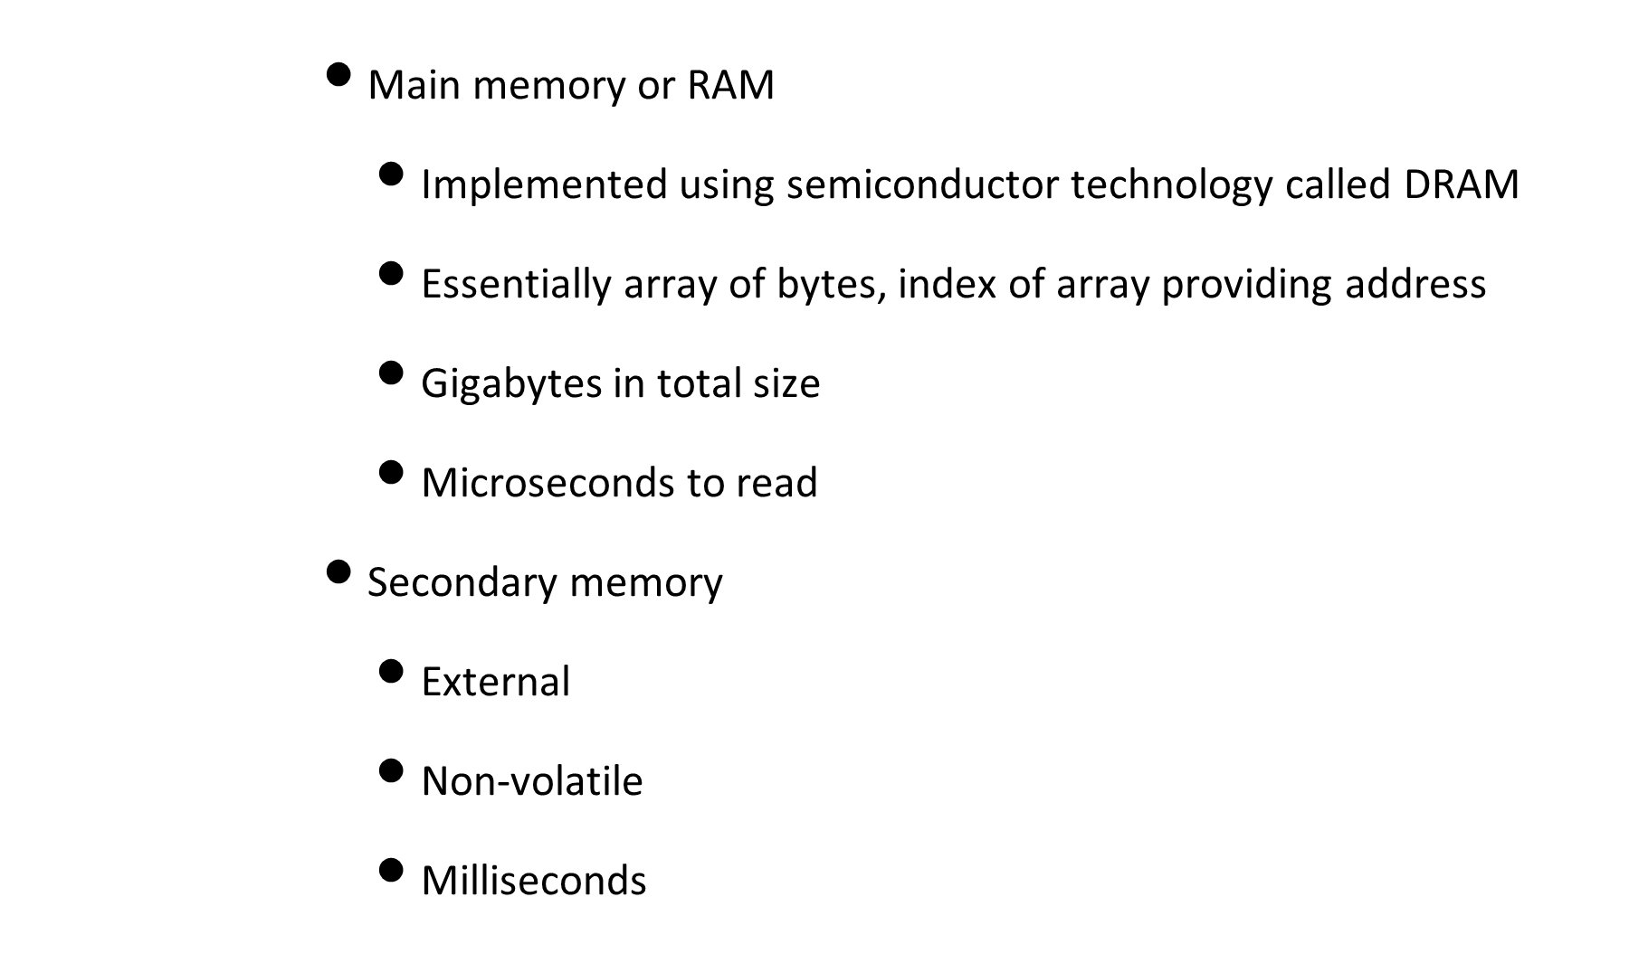
Memory Hierarchy

Slide 52
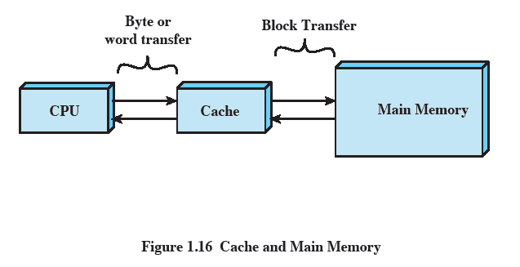
Memory Hierarchy
      Ideal would be to have large amounts of register or cache memory
        Impractical
      In practice, can almost get the best of both worlds
        Almost always use fast memory
        Only rarely require the use of slower memory

Slide 53
Memory Hierarchy
      Use hierarchical memory to transfer data from lower memory M2 (away from CPU) to higher memory M1 (close to CPU) when needed
        Smaller/expensive/faster memory supplemented by larger/cheaper/slower memory
      Only works if we can mostly use the faster memory

Slide 54
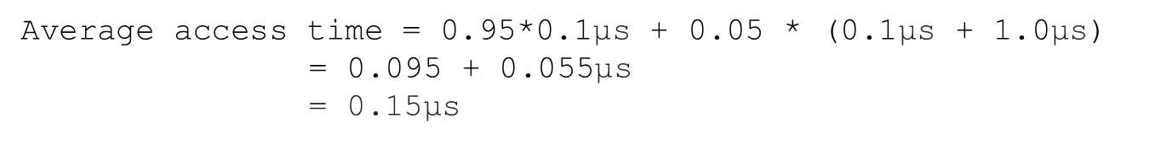
Hit ratio and access time
      Hit ratio H is fraction of accesses that are in faster memory
      Higher H, better the more likely we use the faster memory
      Consider two levels of access with 0.1 and 1.0 microseconds respectively
        Hit rate of 0.95
T1 is access time in smaller/faster memory
T2 is access time of larger/slower memory
Average access time T is
T = H*T1 + (1-H)*(T1 + T2)
= T1 + (1-H)T2

Slide 55
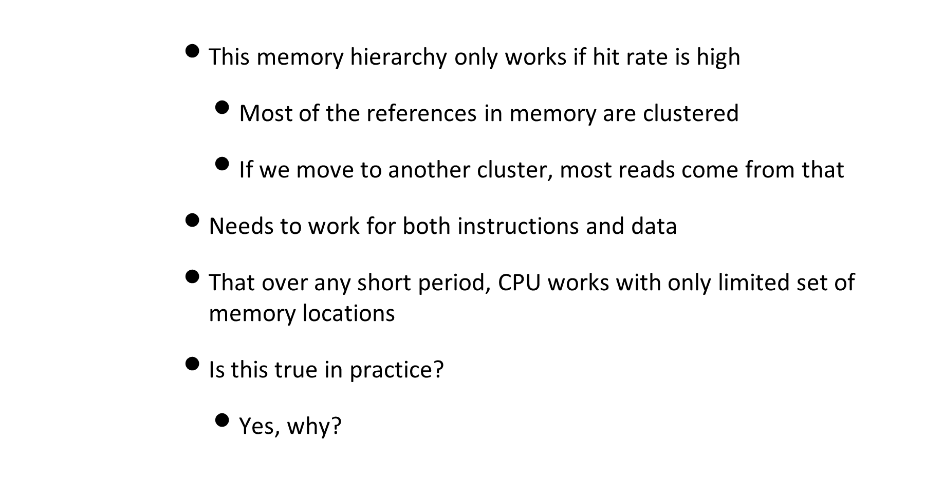
Locality of reference

Slide 56

Locality of reference

Slide 57

Locality of reference

Slide 58
Locality of reference
      Temporal locality
        The more recently it was used, more likely it will be used in the future
        Access locations that have been used most recently
        Executing same instructions repeatedly in a loop (function calls)

Slide 59

Memory hierarchy

Slide 60
Cache memory
      Use of very fast memory designed to contain data for fast access by CPU
        Often not directly visible by the system
      Used to temporarily hold data for transfer between main memory and registers
        Exploits temporal locality
      Transfers blocks of data from memory to cache
        Exploiting locality of reference

Slide 61

Cache/Main-memory Structure

Slide 62

Cache Read Operation

Slide 63
Cache principles
      Cache size
        Even small caches help significantly with performance
      Block size
        Unit of data exchanged between cache and main memory
        Larger sizes yield more hits until probability of using newly fetched data becomes less than the probability of reusing data that has to be moved out of cache

Slide 64

Cache principles

Slide 65
Disk Cache
      Same ideas extended to secondary memory
        Designate a portion of main memory for disk read/write
      Improves performance in several ways:
        Clustering disk writes, as fewer large data transfers instead of many small ones
        Data destined for disk can be read back before it is written

Slide 66

Memory management

Slide 67

Memory bandwidth

Slide 68

Memory management

Slide 69

Multiprocessor organization

Slide 70

Multiprocessor organization

Slide 71

Multiprocessor organization

Slide 72

Multiprocessor organization

Slide 73

Multiprocessor organization

Slide 74

Multiprocessor organization

Slide 75

Cloud computing

Slide 76

Cloud computing

Slide 77

Operating System concepts

Slide 78
Operating System concepts
      Process cont.
        Program initializes first two segments
        Process may even modify instructions but more commonly data
      Process context
        All the metadata about the process
        Terminal, open files, register contents
        Recorded in process table

Slide 79
Operating System concepts
      Process cont.
        Process may acquire resources (more memory, files) not present in the program
        Child and parent processes
        Communication between processes through messages
        Process id, UID (user), GID (group)

Slide 80

Operating System concepts

Slide 81
Operating System concepts
      Files
        Services of file management system to hide disk/tape specifics
        System calls for file management
        Directory to group files together
        Organized as a hierarchical tree
        Root directory
        Path name
        Path name separator

Slide 82

Operating System concepts

Slide 83
System calls
        Interface between user program and operating system
        Set of extended instructions provided by the operating system
        Applied to various software objects like processes and files
        Invoked by user programs to communicate with kernel and request services
        Access routines in the kernel that do work for you

Slide 84

System calls

Slide 85
System calls
      Library functions corresponding to each system call
        Machine registers to hold parameters of system call
        Trap instruction (protected procedure call) to start OS
        Hide details from trap and make call look like ordinary procedure call
        Return from trap instruction

Slide 86
System calls
      Broadly into six classes
        filesystem (open)
        process (fork)
        scheduling (priocntl)
        IPC (semop)
        Socket/networking (bind)
        Miscellaneous (time)

Slide 87

System calls

Slide 88
Shell
        Unix command interpreter
        User program, not part of kernel
        Supplies prompt, redirection of input/output
        Lets you launch background jobs

Slide 89

Shell

Slide 90

Kernel

Slide 91

Kernel

Slide 92

Kernel

Slide 93

Kernel

Slide 94

Kernel

Slide 95

Kernel vs other processes

Slide 96

Process execution modes

Slide 97

Process execution modes

Slide 98

Operating System Structure

Slide 99

Operating System Structure

Slide 100

Operating System Structure

Slide 101
Micro-kernel architecture
      Traditionally kernels were monolithic
        All one block of code
      Micro-kernel
        Smaller set of operations in a limited form assigned to kernel
        Each OS layer is a relatively independent program
        Interacts with other layers through well-defined/clean interfaces
        Interprocess communication, limited process management and scheduling, some lowlvl I/O
        Other OS services provided by processes, or servers, running in user mode

Slide 102

Micro-kernel architecture

Slide 103


Operating System Structure

Slide 104

Operating System Structure

Slide 105


Operating System Structure

Slide 106

Operating System Structure

Slide 107

Uniprogramming
        Processor must wait for I/O instruction to complete before proceeding
        Simple hardware
        CPU and I/O bound system

Slide 108


Multiprogramming

Slide 109


Multiprogramming

Slide 110

Multiprogramming

Slide 111

Multiprogramming

Slide 112

Multiprogramming

Slide 113

Multitasking

Slide 114

Multiuser systems

Slide 115

Multiuser systems

Slide 116

Multiuser systems

Slide 117

What about the user interface

Slide 118

What about the user interface

Slide 119
Oh so much more coming!
Any questions?

