Slide 1
Operating Systems:
Inter-process Communication

Slide 2
Processes
      Basic concept to build the OS around
        From old IBM mainframe OS to the most modern Windows
        Fundamental task of OS: Process management
      Used to express requirements that OS needs to meet
        Interleave execution of multiple processes, maximize CPU utilization while providing good response time
        Allocate resources to processes using a policy while avoiding deadlocks
        Support IPC and user creation of processes to help structuring applications

Slide 3
Background
      Computer platform
        Collection of hardware resources - CPU, memory, I/O modules, timers, storage devices
      Computer applications
        Developed to perform some task
        Input, processing, output
      Efficient to write applications for a given CPU
        Common routines to access computer resources across platforms
        CPU only provides limited support for multiprogramming, software needs to do most
        Protect resources from other applications

Slide 4
What is a process?
      A program in execution
      Abstraction of a running program
      Entity that can be assigned to and executed on a processor
      Unit of work in a system, characterized by:
        Execution of a sequence of instructions
        A current state
        Associated set of machine instructions

Slide 5
Processes
      Split into two abstractions in modern OS
        Resources ownership (traditional process view)
        Stream of instruction execution (thread)
      Pseudoparallelism, or interleaved instructions
      A process is traced by listing the sequence of instructions that execute for that process

Slide 6
Process elements
      A process is comprised of:
        Program code (possibly shared)
        A set of data
        A number of attributes describing the state of the process

Slide 7
Process elements
      While the process is running, it has a number of elements:
        Identifier
        State
        Priority
        Program counter
        Memory pointers
        Context data (registers, etc)
        I/O status information
        Accounting information

Slide 8
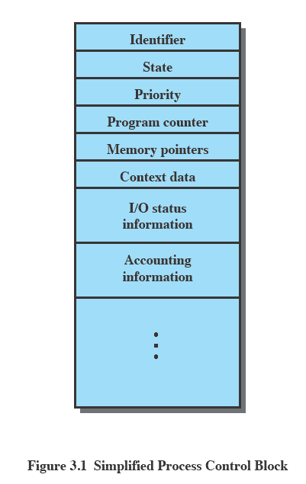
Process Control Block
      Contains process elements
      Created and managed by OS
      Allows support for multiple processes

Slide 9
Trace of the process
      The behavior of an individual process is shown by listing the sequence of instructions that are executed
        This list is called a Trace
      Dispatcher is a small program which switches the processor from one process to another

Slide 10
Concurrent Processes
      Multiprogramming
      Interleaving of traces of different processes characterizes the behavior of the CPU
      Physical resource sharing
        Required due to limited hardware resources
      Logical resource sharing
        Concurrent access to the same resource like files

Slide 11
Concurrent Processes
      Computation speedup
        Break each task into subtasks
        Execute each subtask on separate processing element
      Modularity
        Division of system functions into separate modules
      Convenience
        Perform a number of tasks in parallel
      Real-time requirements for I/O

Slide 12
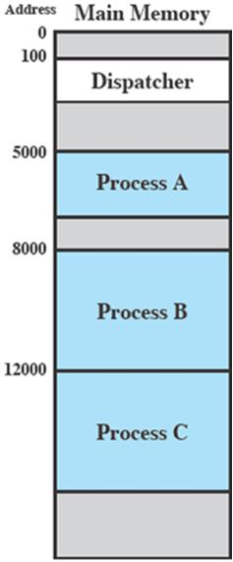
Process Execution
      Consider three processes being executed
      All are in memory (plus dispatcher)
      No virtual memory atm

Slide 13
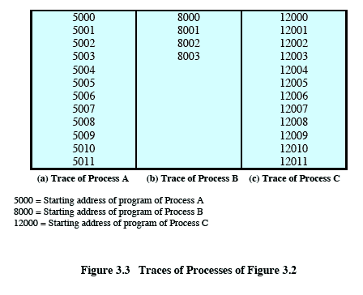
Trace from processes pov
      Each process runs to completion

Slide 14
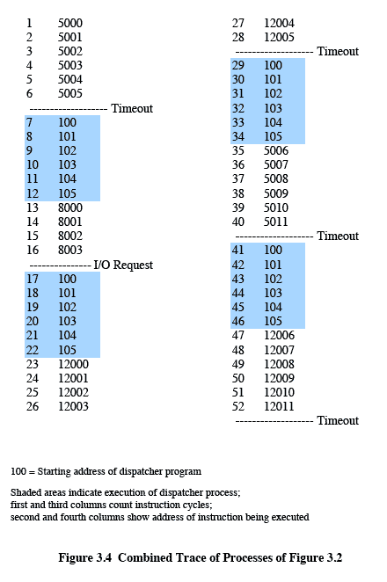
Trace from processes pov
I/O
Timeout
Timeout
Timeout

Slide 15
Process Hierarchies
      Parent-child relationship
        fork system call in Unix
        In older non-multitasking systems such as MS-DOS, parent suspends itself and lets child execute

Slide 16
Process states
      Main topics are:
        How are processes represented and controlled by the OS?
        Process states which characterize the behavior of processes
        Data structures used to manage processes
        Ways in which the OS uses these data structures to control process execution

Slide 17
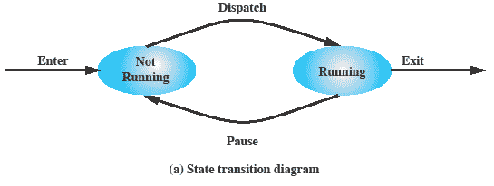
Two-state process Model
      Simplest possible model
      A process is either executing (running state) or it is idle (not running)
      For new process, OS creates a new process control block and brings that process into memory
        Initially in a non-running state

Slide 18
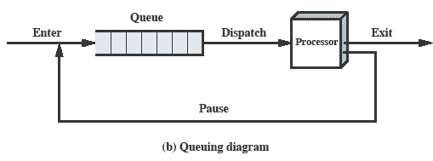
Queuing Diagram
      Processes moved by dispatcher of the OS to the CPU and then back to the queue until the task is completed.

Slide 19
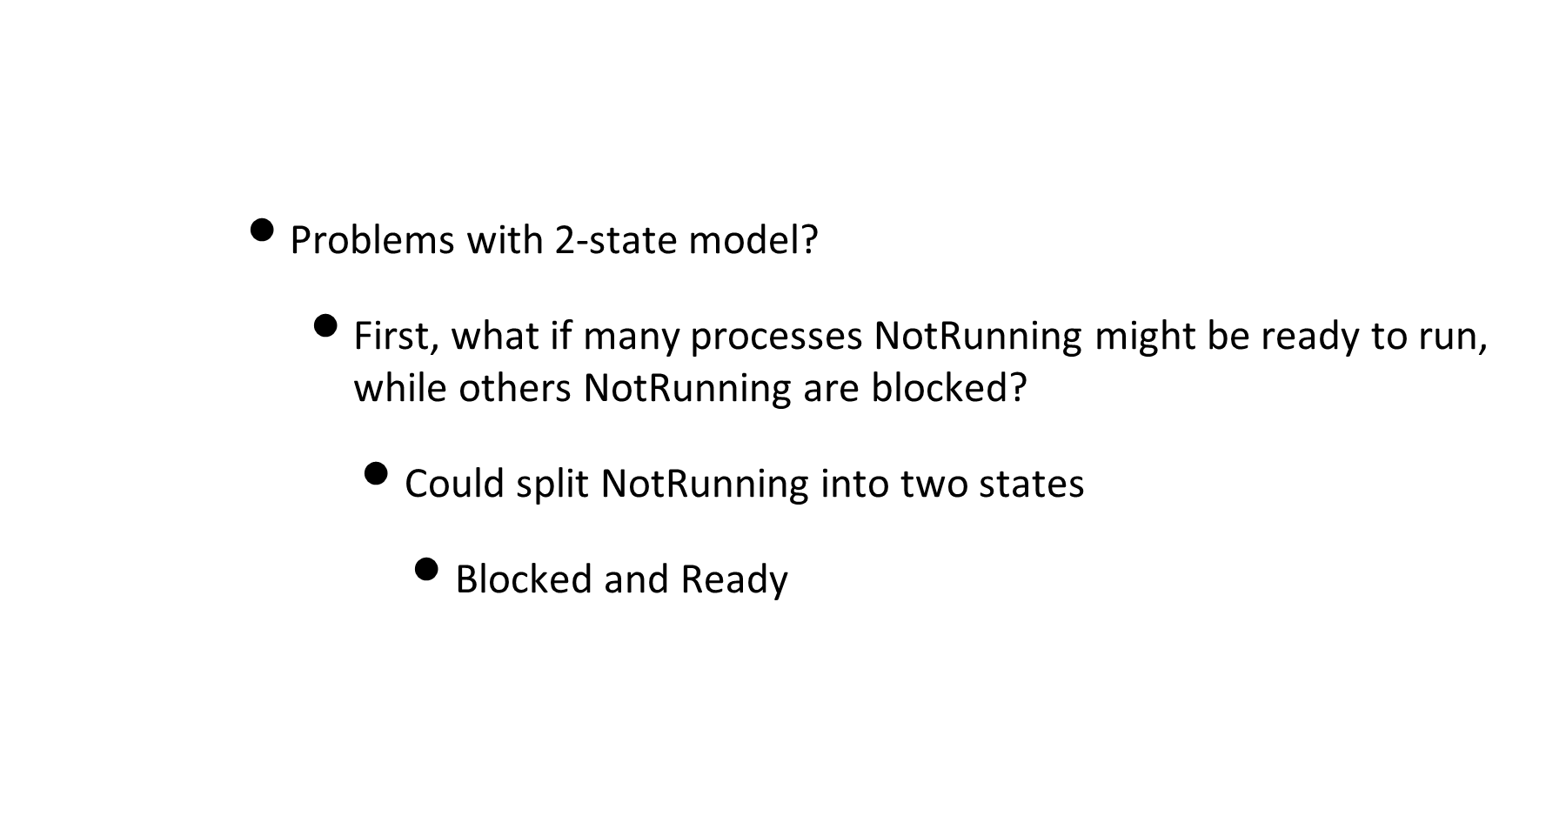
Two-state model

Slide 20
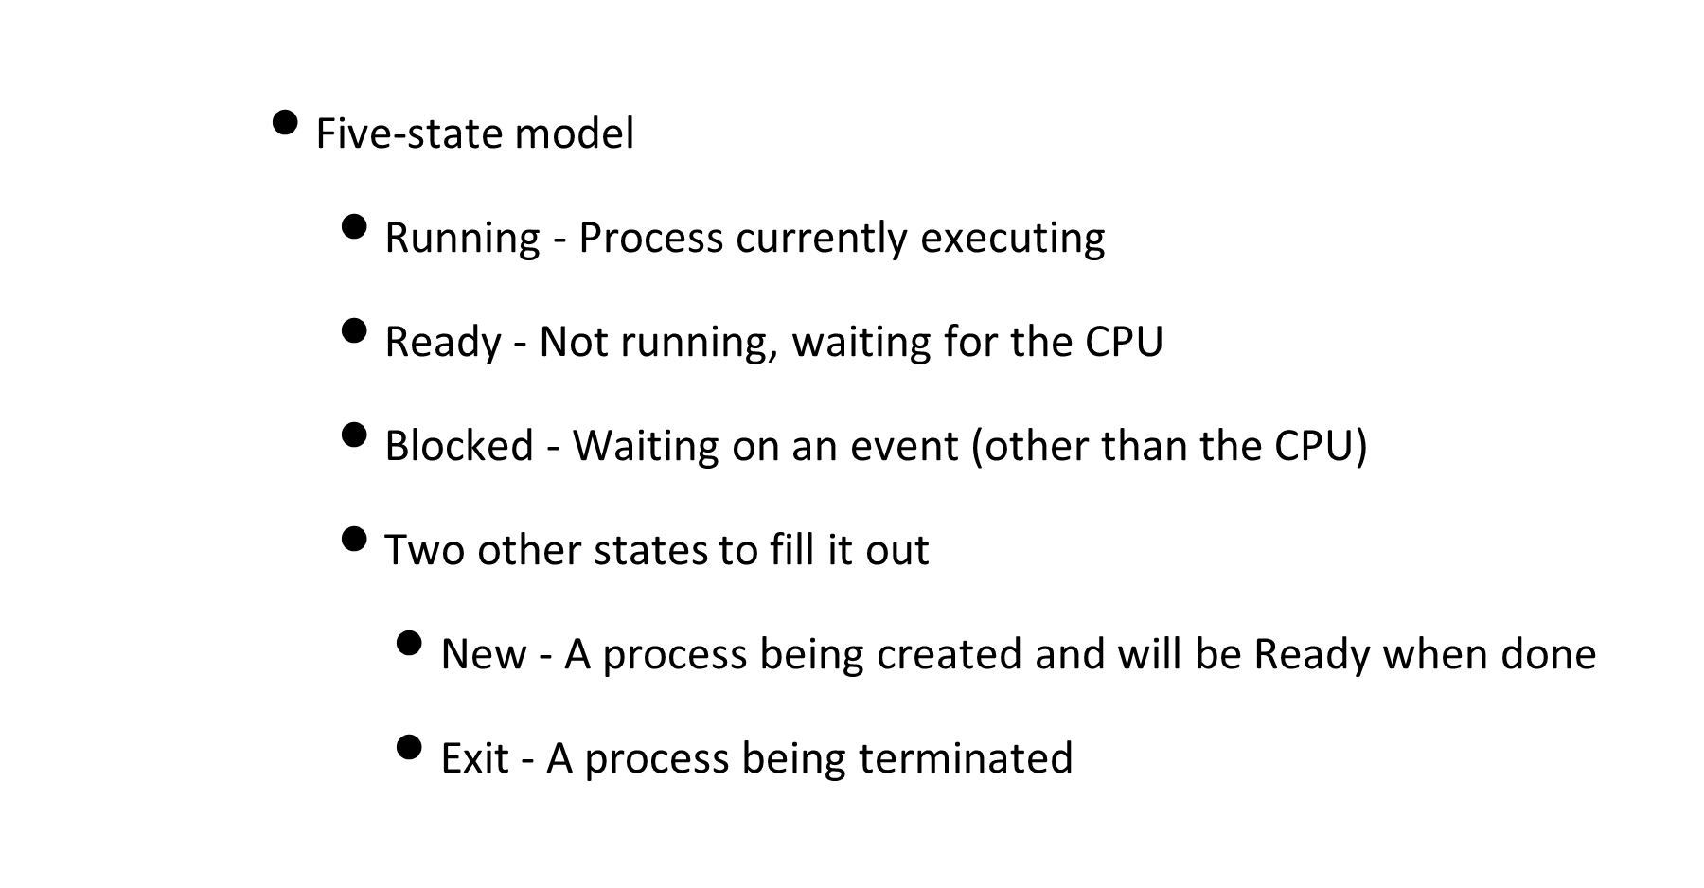
Five-state process Model

Slide 21
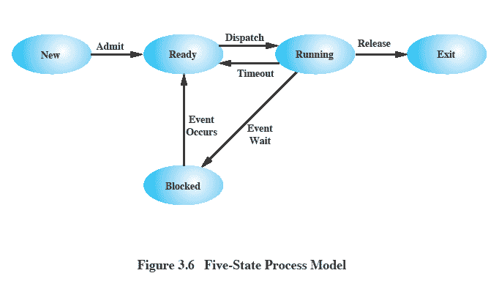
Five-state process Model

Slide 22
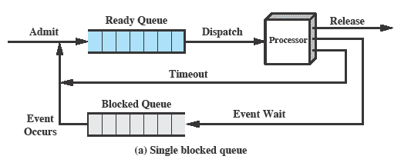
Using Two Queues

Slide 23
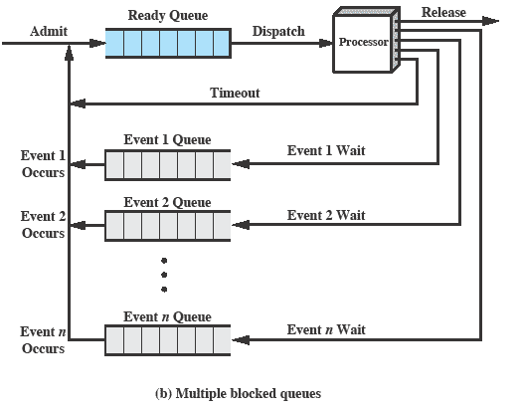
Multiple Blocked Queues

Slide 24
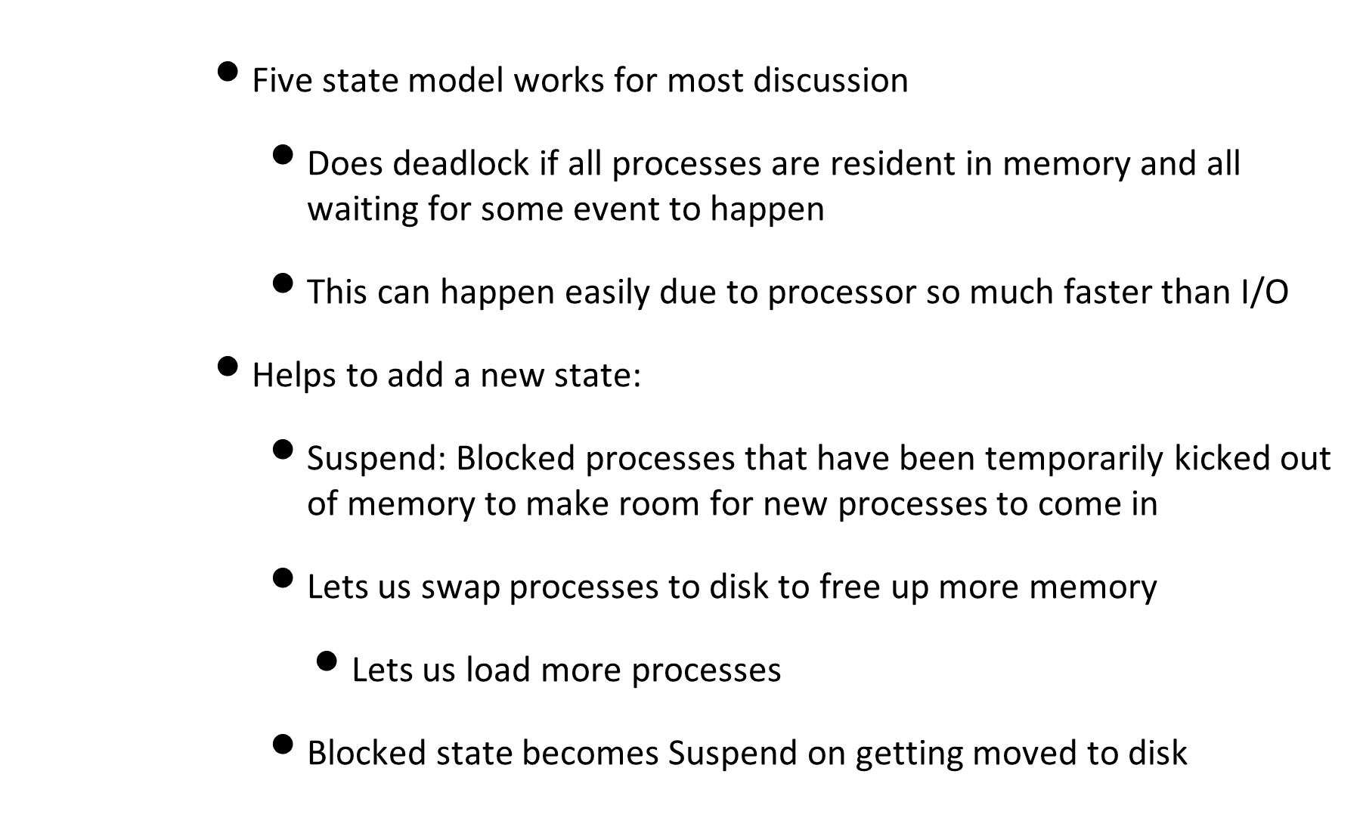
Five-state process Model

Slide 25
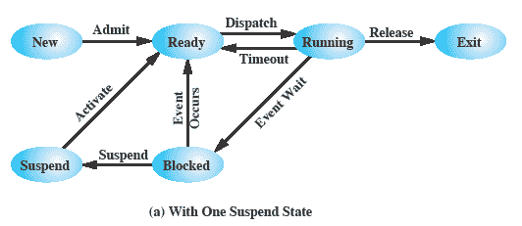
One Suspend State

Slide 26
Two Suspend states
      Useful to split suspend state up
      Which process to grant CPU when current process is swapped out?
        Want preference for a previously suspended process over new process (avoid increasing total load)
        Don’t want to ready a process that will be blocked when loaded
      Need to differentiate between:
        Blocked/Suspend : Blocked on event, put into secondary memory and suspended
        Ready/Suspend: Ready to run if loaded into memory but suspended

Slide 27
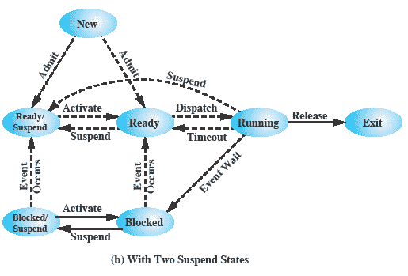
Two Suspend States

Slide 28
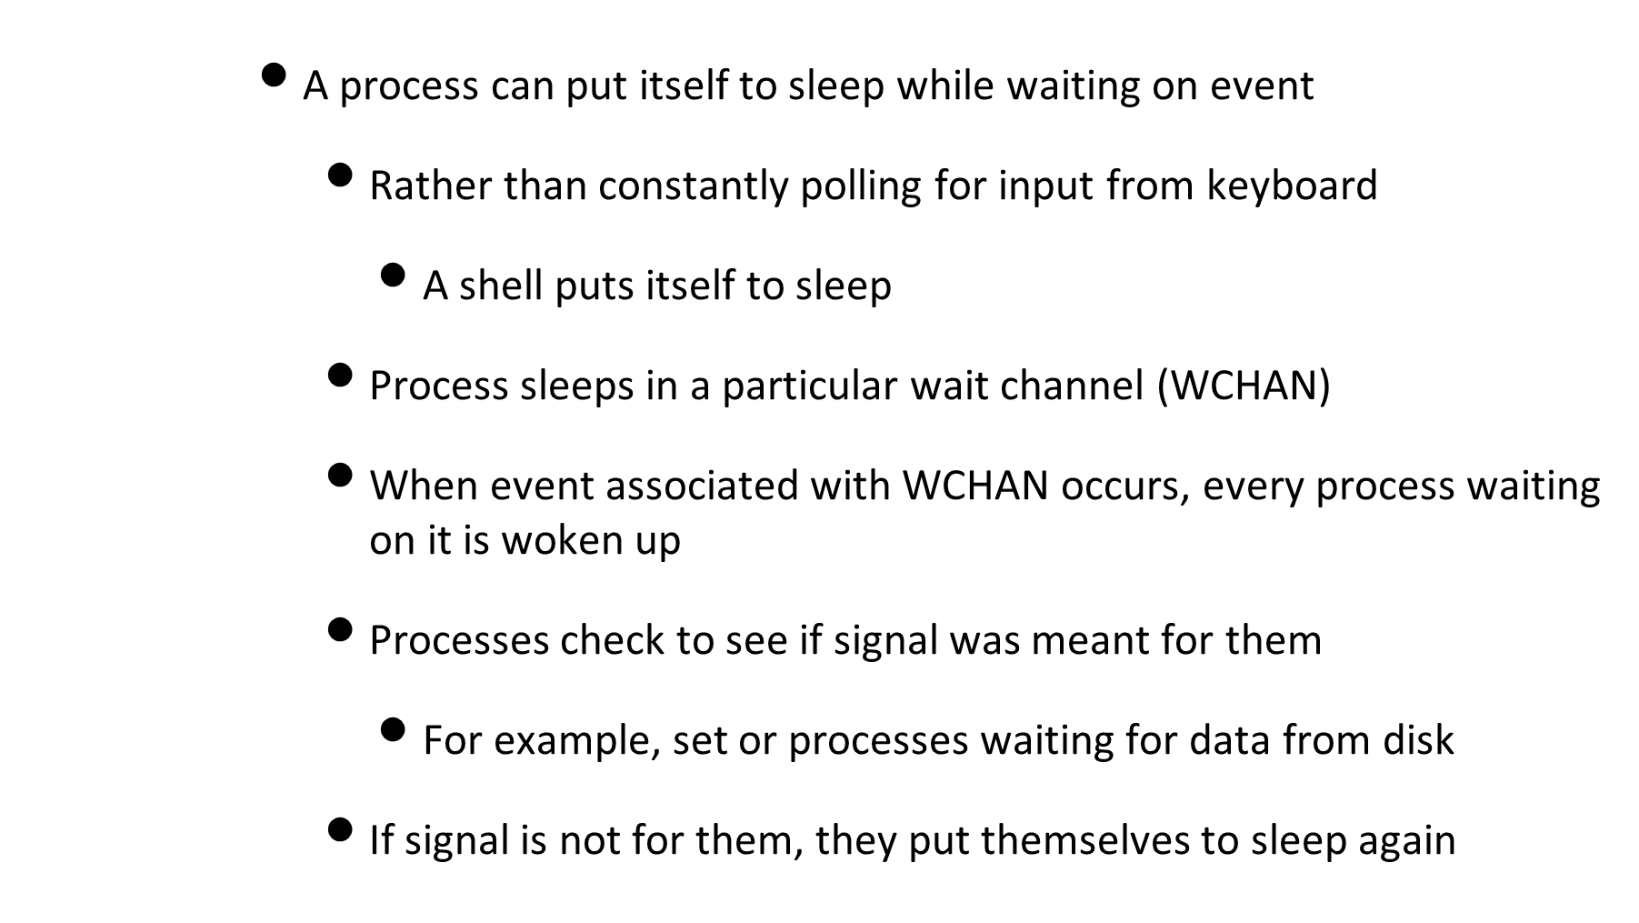
Process sleep state

Slide 29
Thundering Herd
    Imagine large number of processes waiting for an event
    Event happens, all processes woken up in response
    Now a race to lock the resource to themselves
      Remaining ones get put to sleep
    Want to avoid this problem by waking up only one process

Slide 30
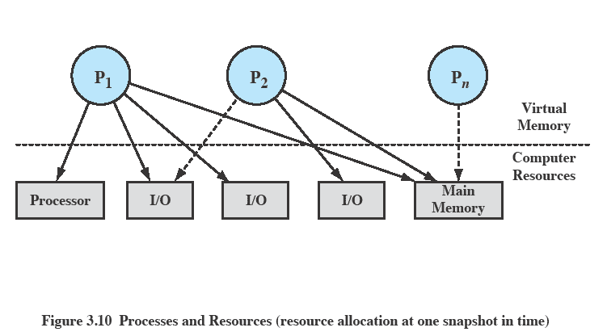
Processes and Resources

Slide 31
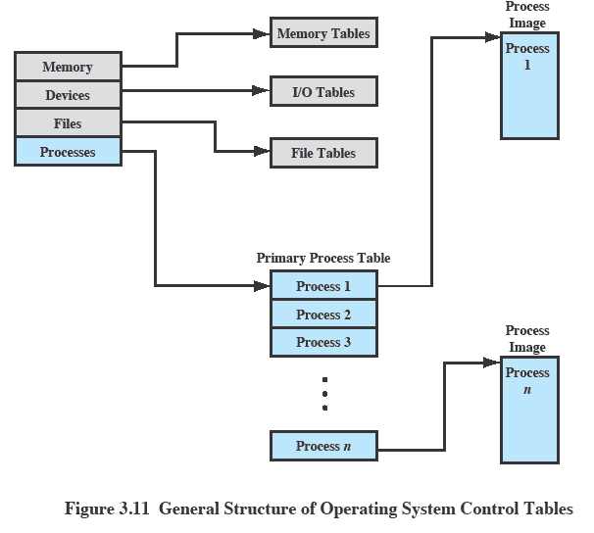
OS Control Tables

Slide 32
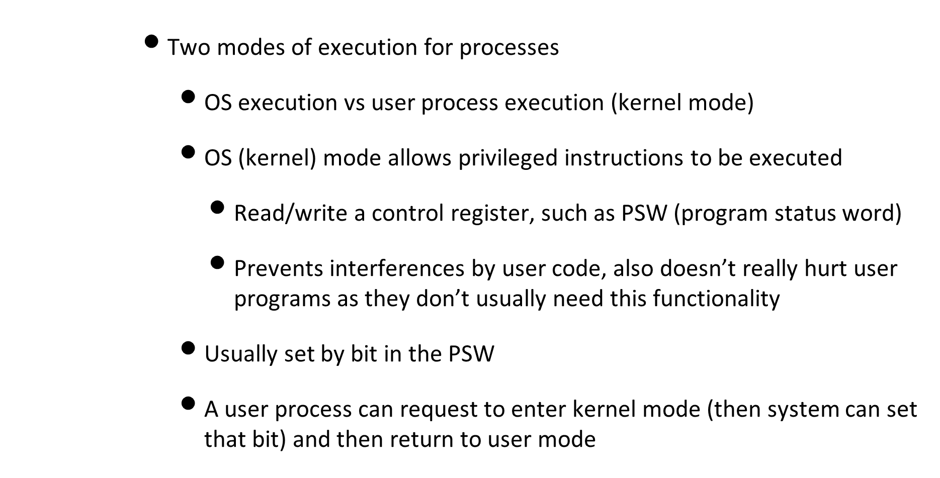
Modes of Execution

Slide 33
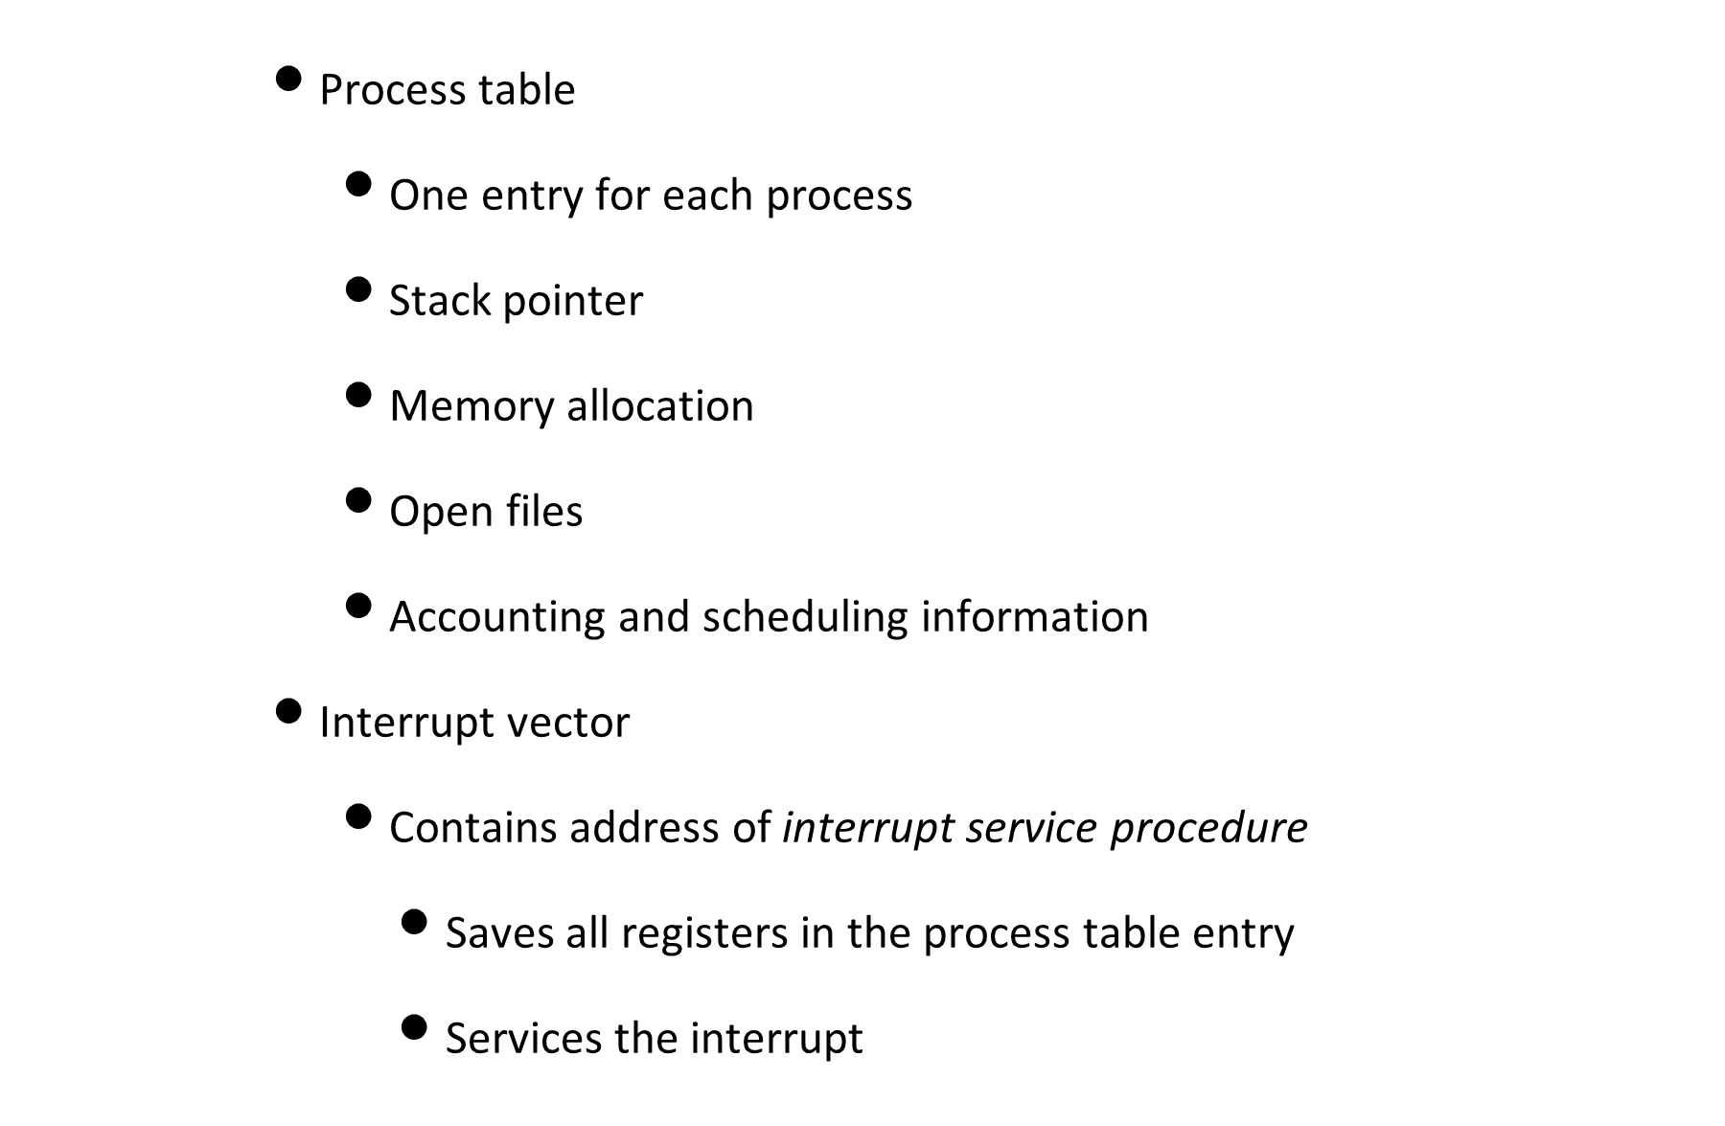
Process Implementation

Slide 34
Process Creation
      Assign a unique PID to process and add this to the system process table that contains one entry for each process
      Allocate space for all elements of process image
        Space for code, data, user stack (Could be set by default or based on parameters when created)
      Allocate resources like CPU time, memory, files with some policy:
        New process obtains resources directly from the OS
        or new process constrained to share resources from a subset of parent process

Slide 35
Process Creation
      Build the data structures that are needed to manage the process
        Especially PCB (Process Control Block)
      Initialization data (input)
      Process execution
        Does parent continue to execute concurrently with children?
        Parent could wait until all its children have terminated

Slide 36
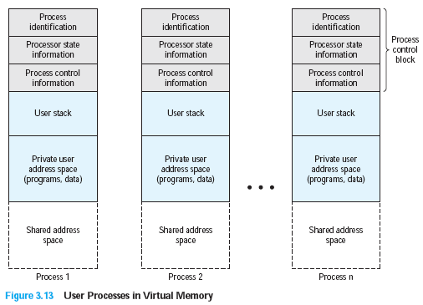
User processes in memory

Slide 37
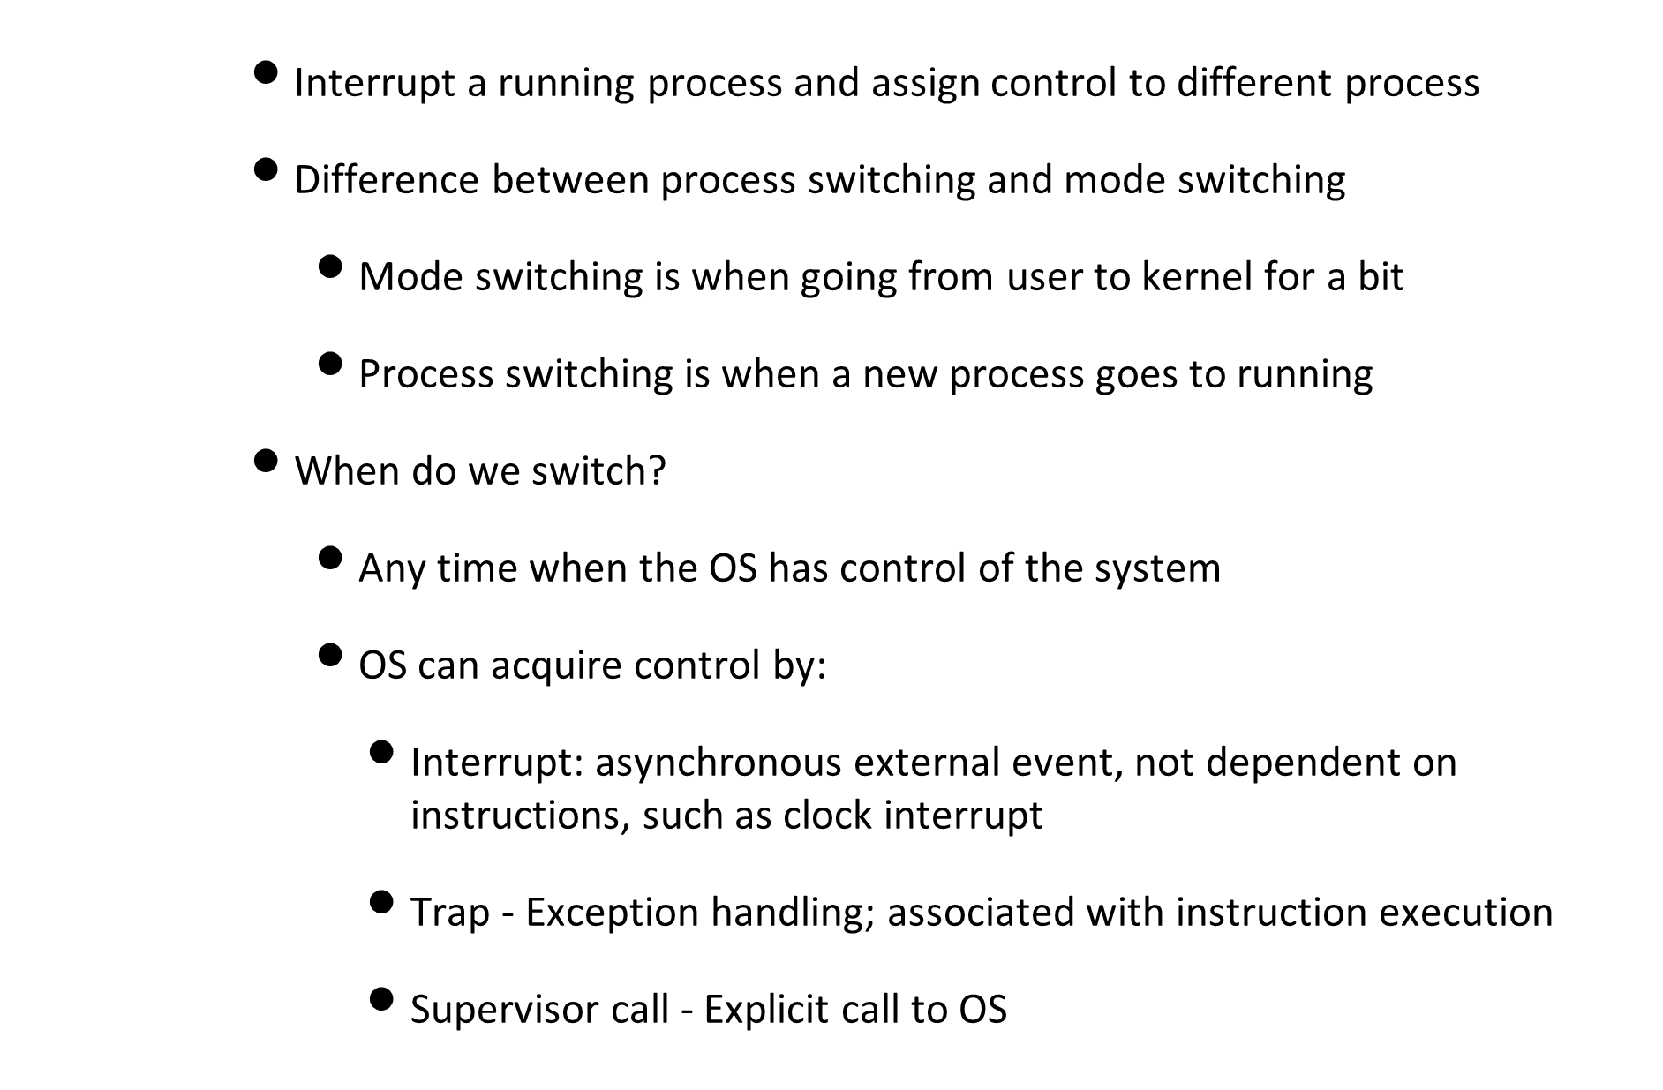
Process switching

Slide 38
Process switching
Mechanism | Cause | Use
Interrupt | External to the execution of the current instruction | Reaction to an asynchronous external event
Trap | Associated with the execution of the current instruction | Handling of an error or an exception condition
Supervisor call | Explicit request | Call to an operating system function
      Mechanisms for interrupting the execution of a process

Slide 39
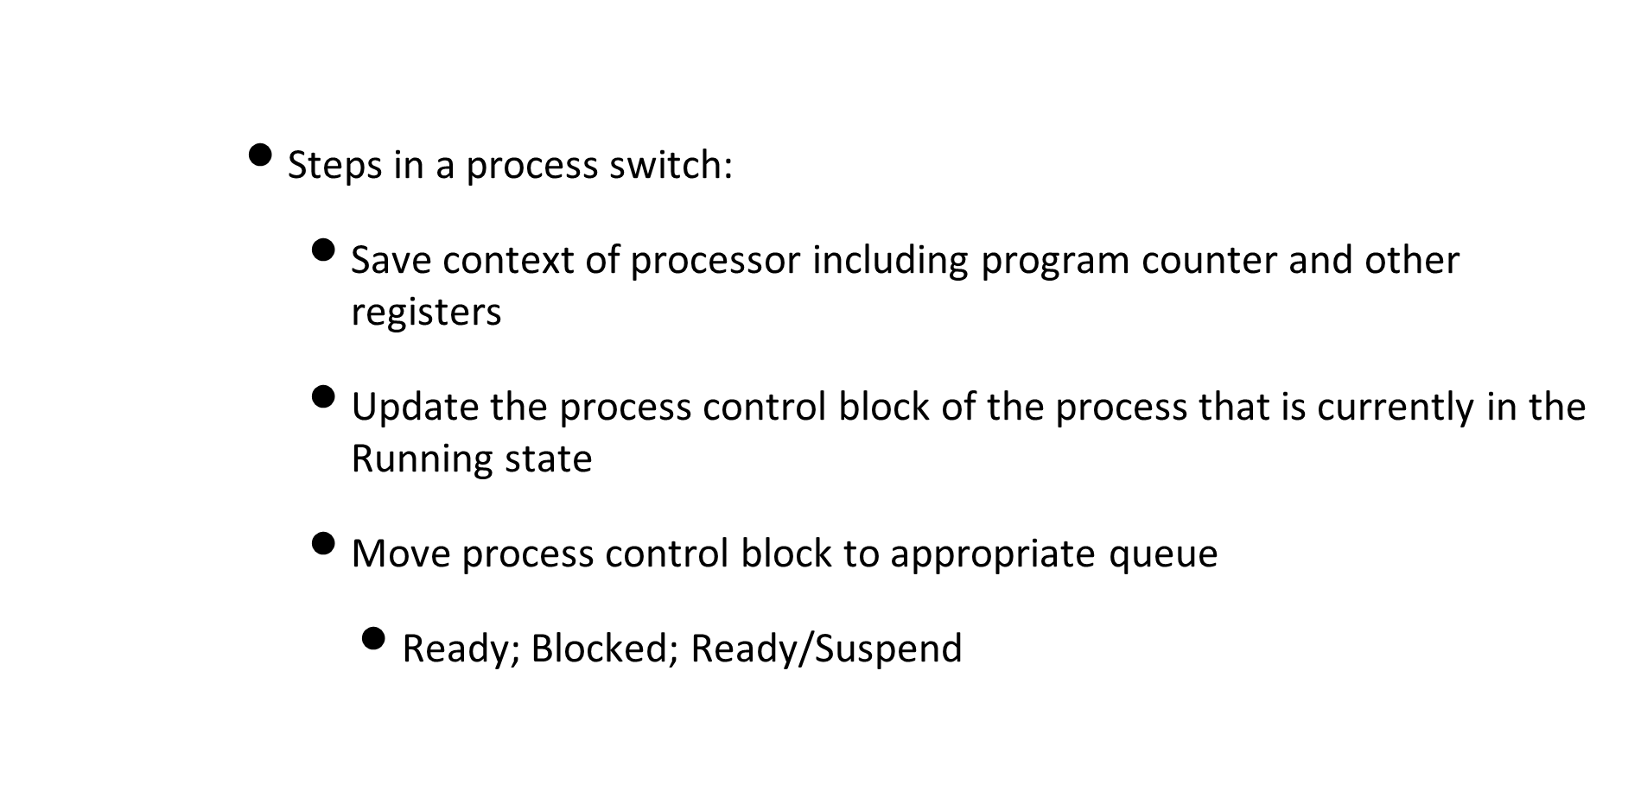
Change of process state

Slide 40
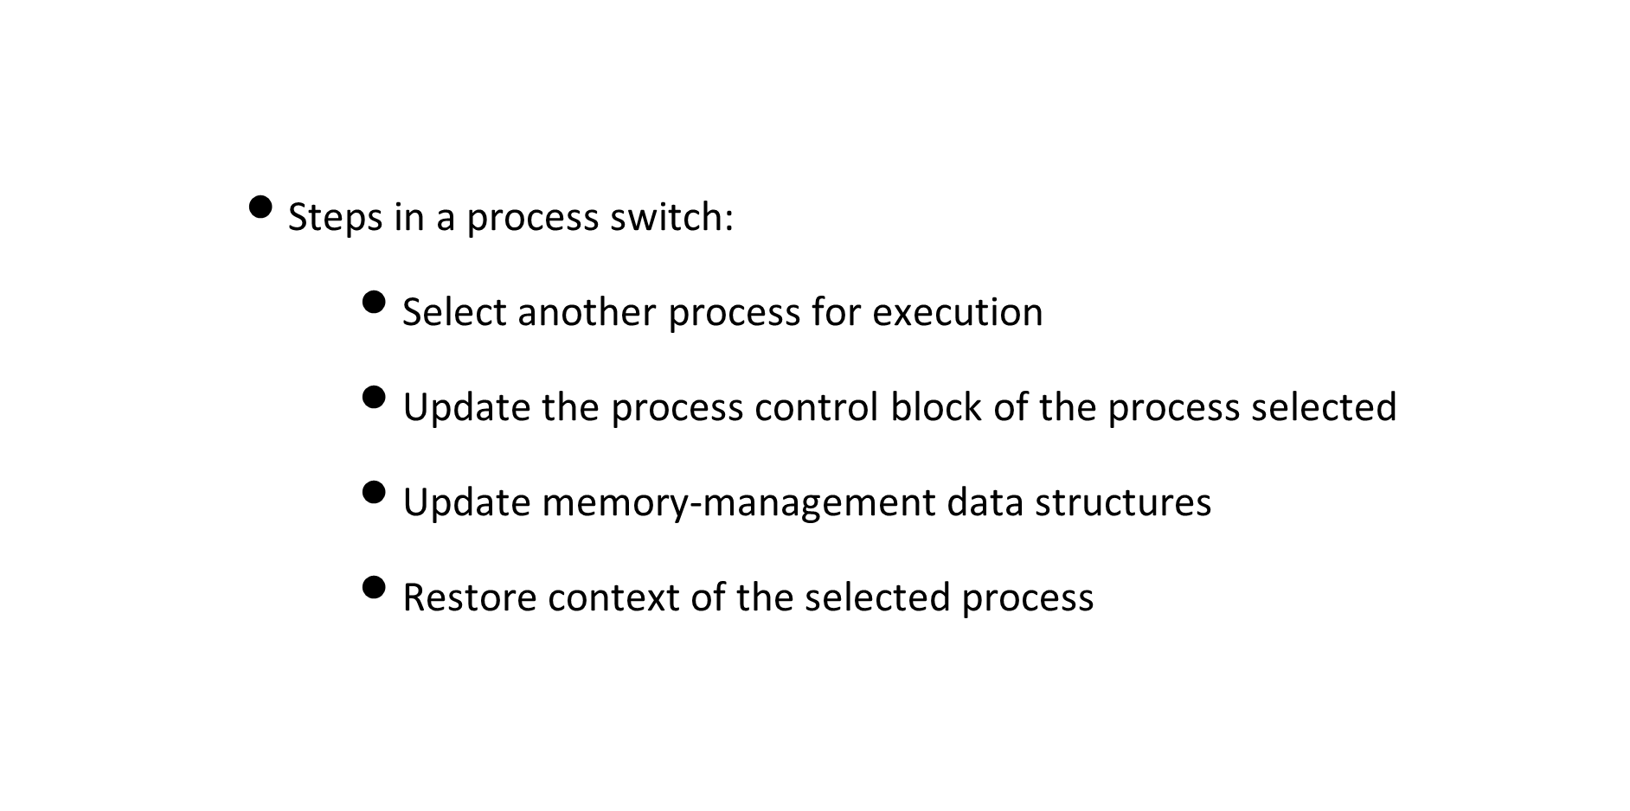
Change of process state

Slide 41
Mode switch
      Anytime that an interrupt happens, could also be a mode switch
      Steps in a mode switch:
        Save context of processor including program counter and other registers
        Do any necessary work
        Restore state of CPU and change PC so old process resumes
      Takes less time than a process switch
      Could switch back to previous process without changing its state
        Without taking it out of running state

Slide 42
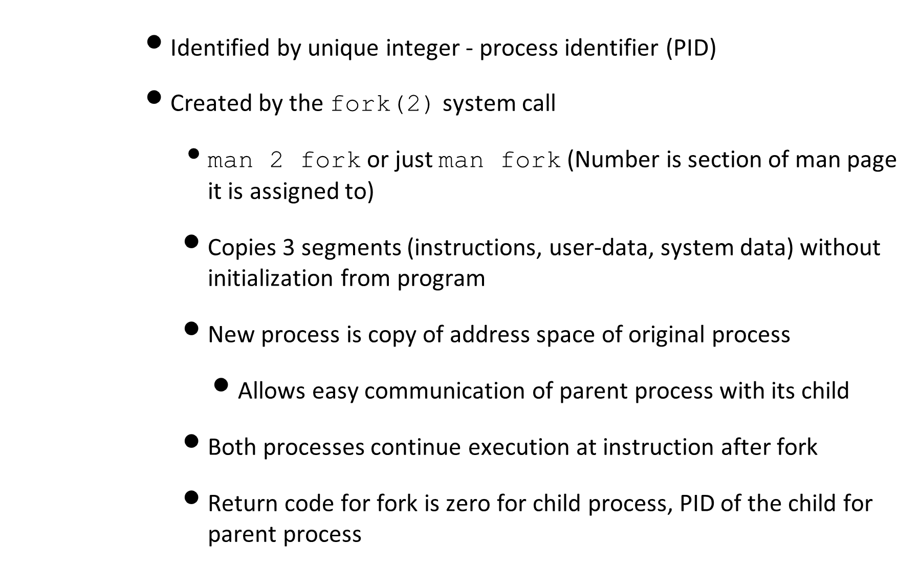
Processes in Unix

Slide 43
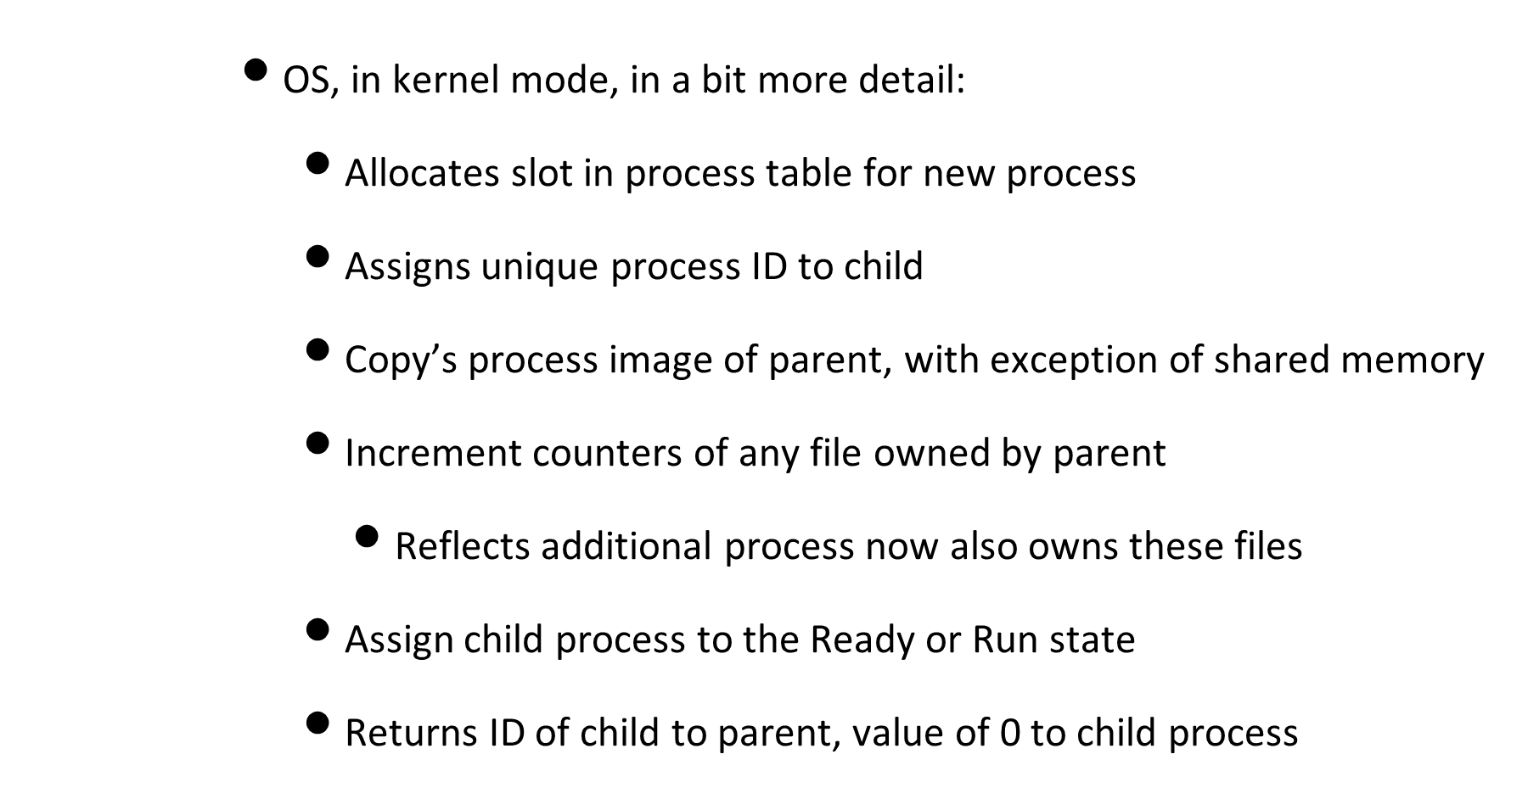
Fork in Unix

Slide 44
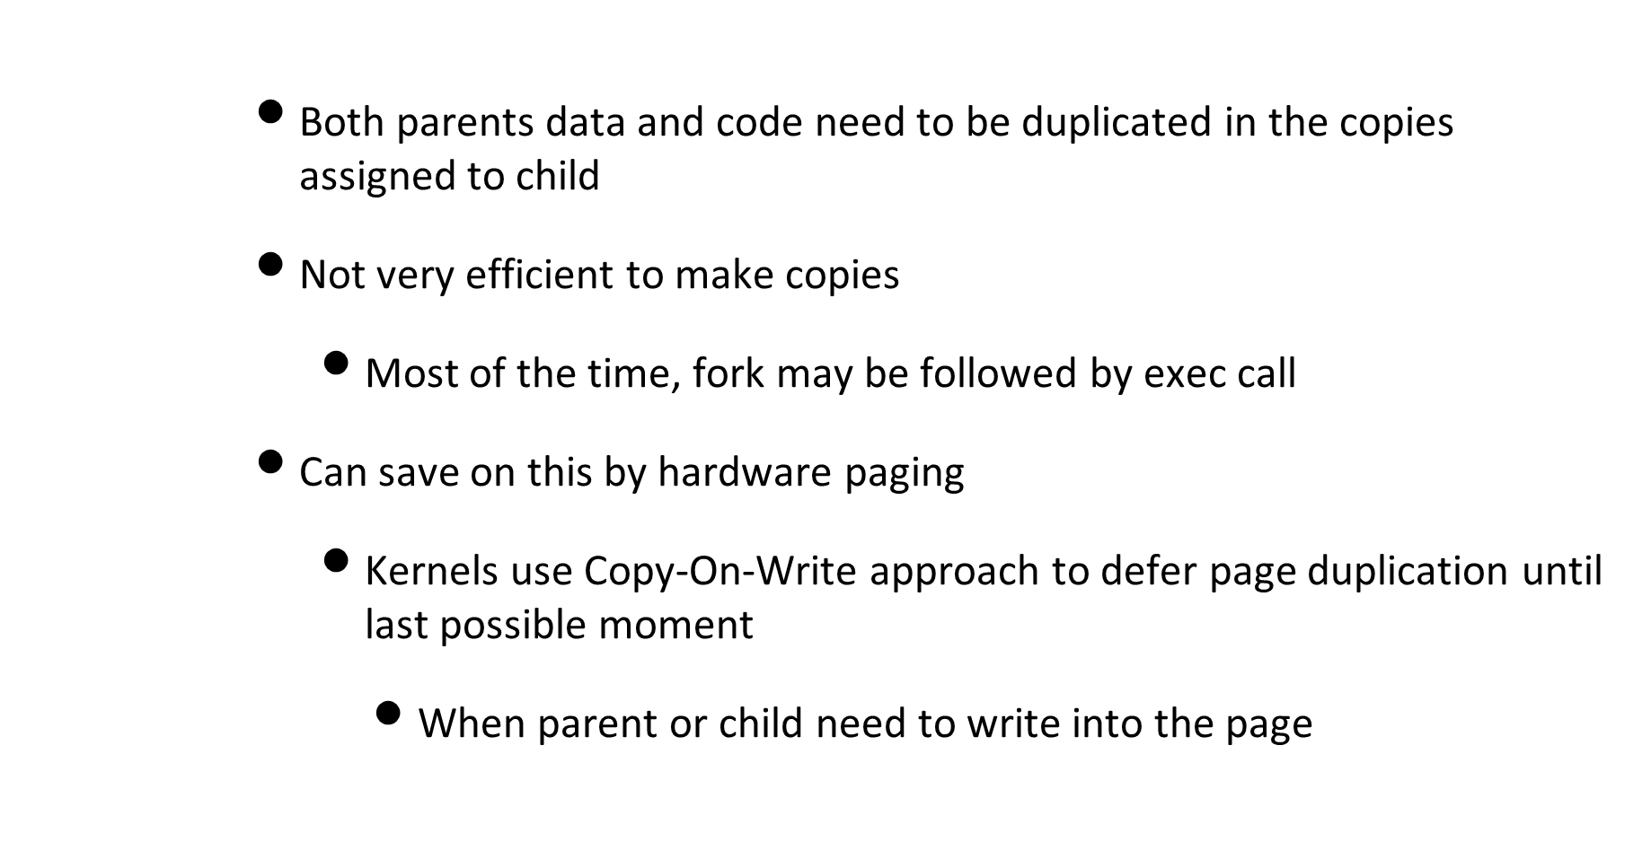
Fork in Unix

Slide 45
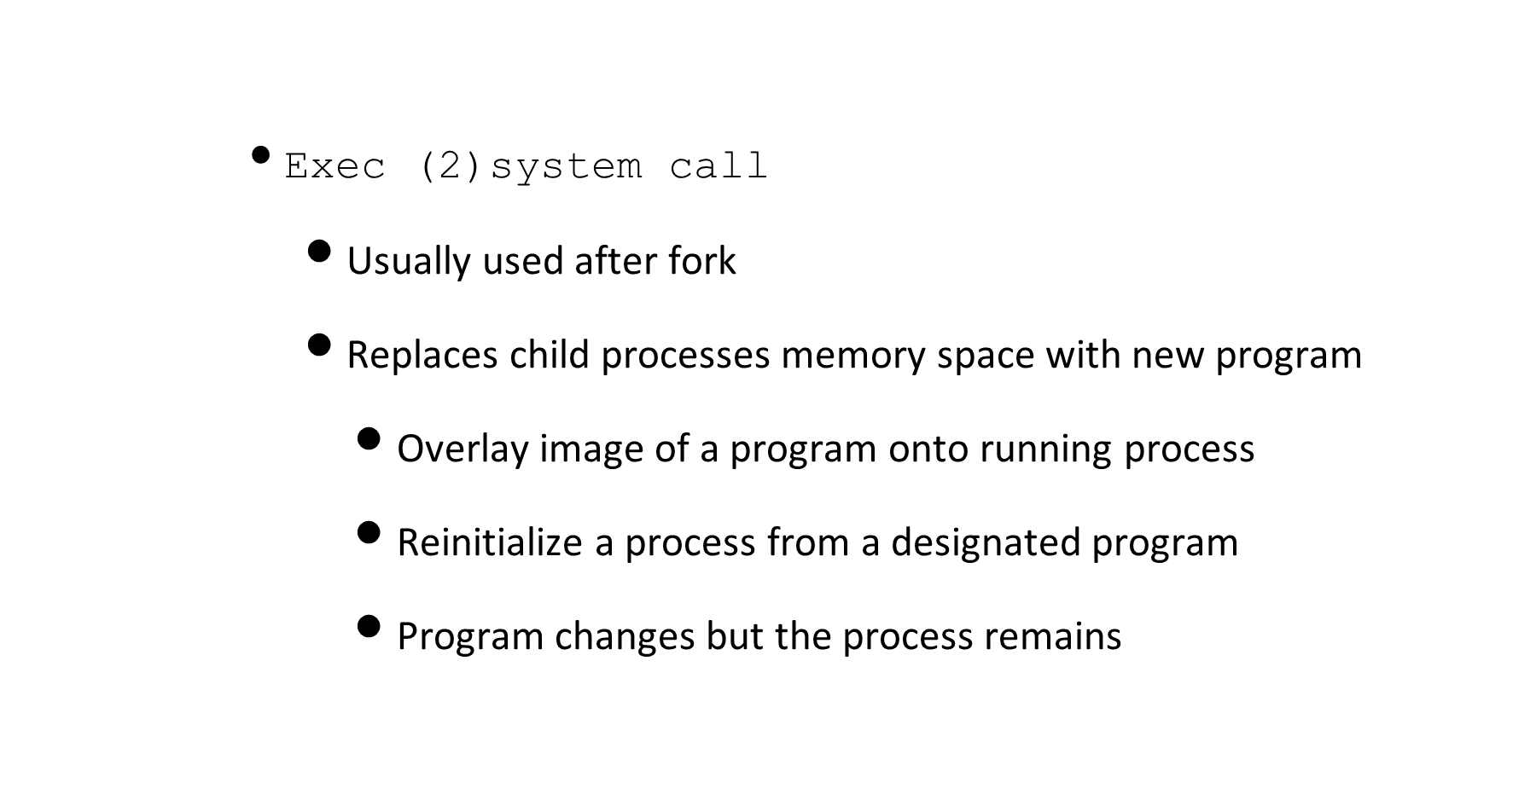
Processes in Unix

Slide 46
Processes in Unix
      exit(2)system call
        Finish executing a process
        Kernel releases resources owned by the process
        All open stdio streams are flushed and closed
        Sends a SIGCHLD signal to parent

Slide 47
Processes in Unix
      wait (2) system call
        Wait for child process to stop or terminate
        Used to synchronize process execution with exit of a previously forked process
      brk (2) system call
        Change amount of space allocated for the calling processes data segment
        Changes location of program break, which defines end of process’s data segment
        Control the size of memory allocated to a process

Slide 48
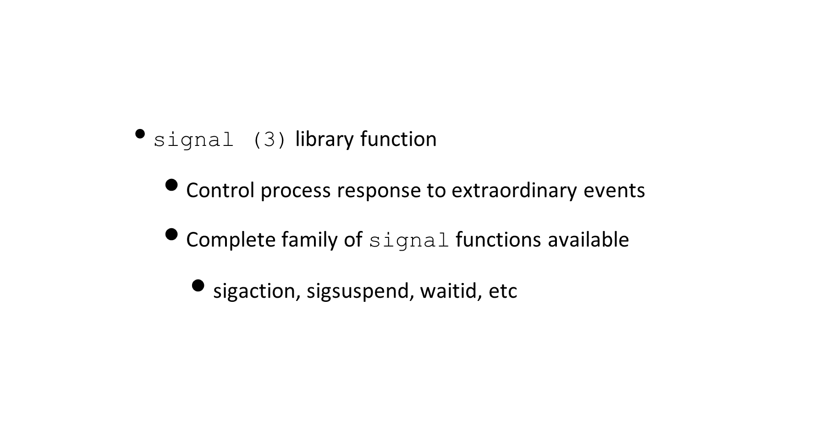
Processes in Unix

Slide 49
Daemons or kernel threads
      Background processes to do useful work on behalf of user
        Sit in machine, doing its task
      Some are privileged processes in Unix
        Run in kernel mode in kernel address space
      Differ in having no stdin or stdout, sleep most of the time
        Communicate with humans through log files

Slide 50
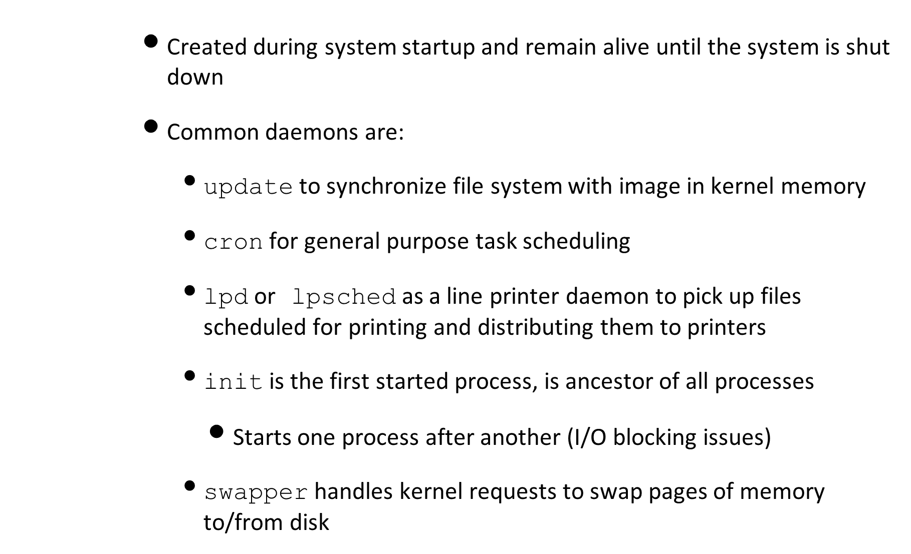
Daemons or kernel threads

Slide 51
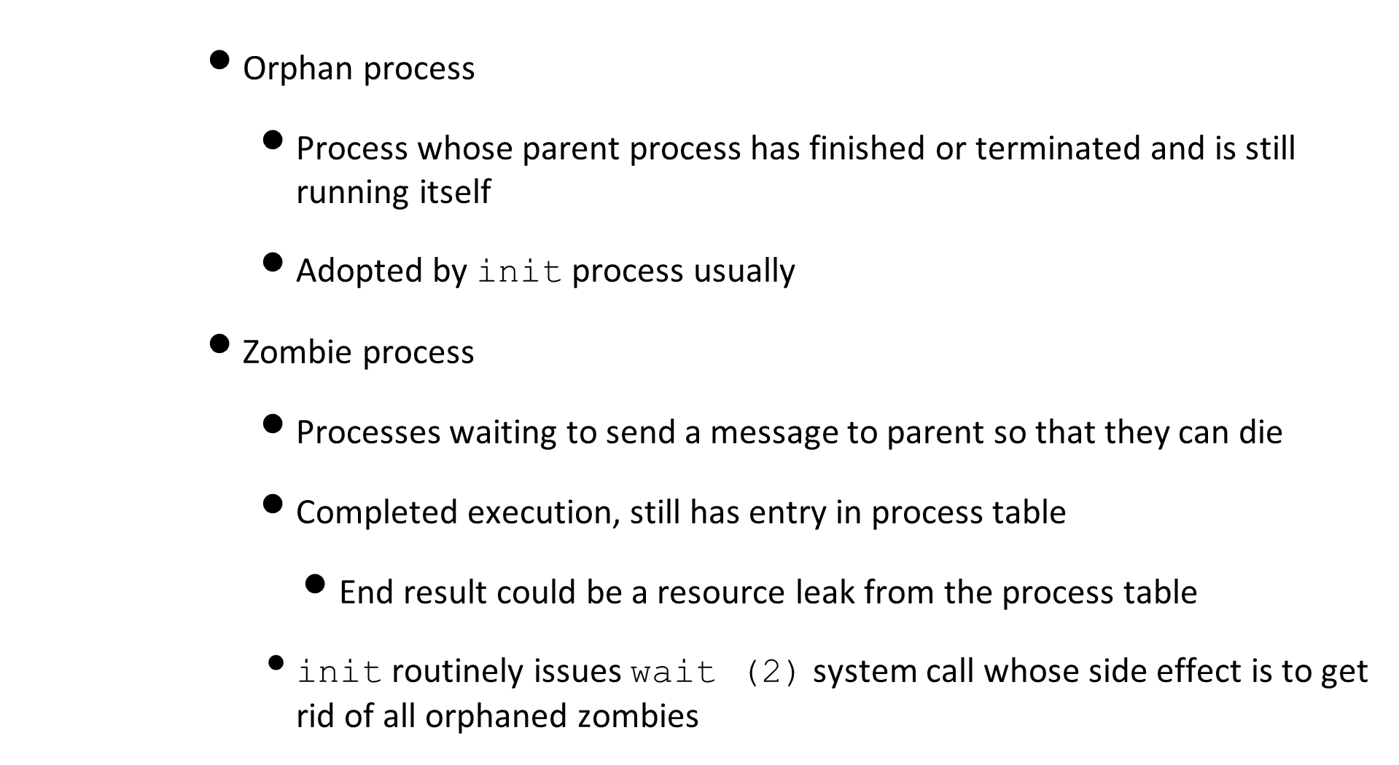
Processes in Unix

Slide 52
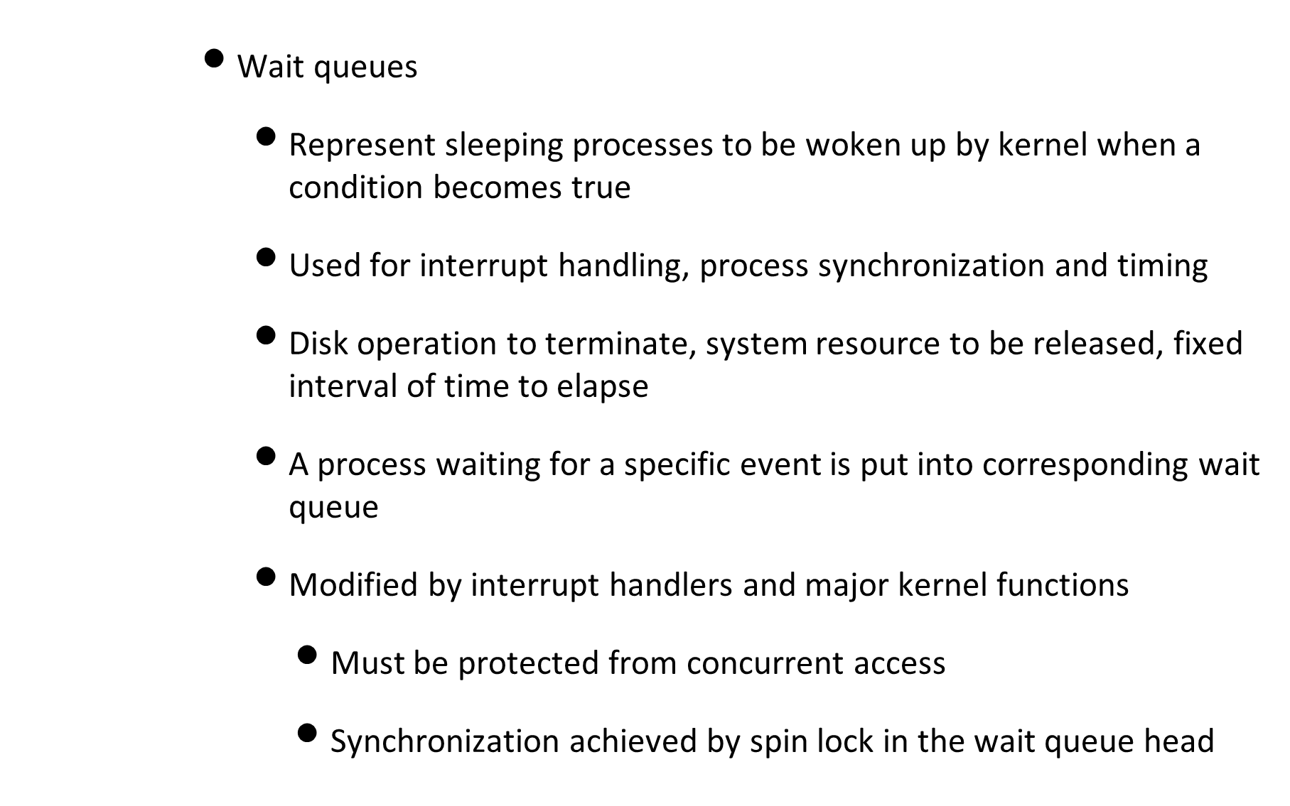
Processes in Unix

Slide 53
Process termination in Unix
      Normal termination
        Process terminates when it executes last statement
        Upon termination, the OS deletes the process
        Process may return data (output) to its parent
      Abnormal termination
        Process terminates by executing library function abort (3c)
        All file streams are closed and other housekeeping performed as defined by signal handler

Slide 54
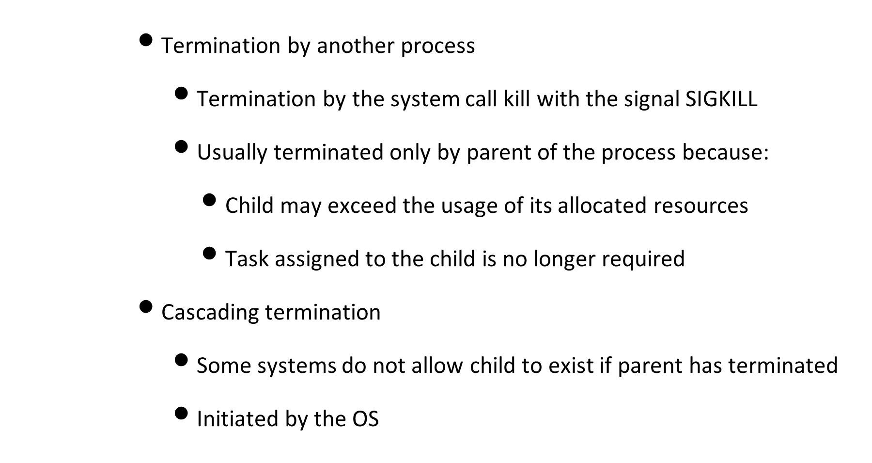
Process termination in Unix

Slide 55
Process termination in Unix
      Process removal (background)
        A process can query the kernel to get execution state of children
        A process can create a child process to perform a specific task and wait to check whether the child has terminated
        Termination code of child tells parent process whether task was completed

Slide 56
Process termination in Unix
      Process removal
        Due to previous design choices, Unix kernel is not allowed to discard data in a PCB right after the process terminates
        Has to wait till parent issues wait that refers to terminated process
        EXIT_ZOMBIE state: Process is technically dead but its descriptor must be saved until parent has received notification
        If parent is dead, the orphan becomes a child of init who destroys zombies by issuing a wait

Slide 57
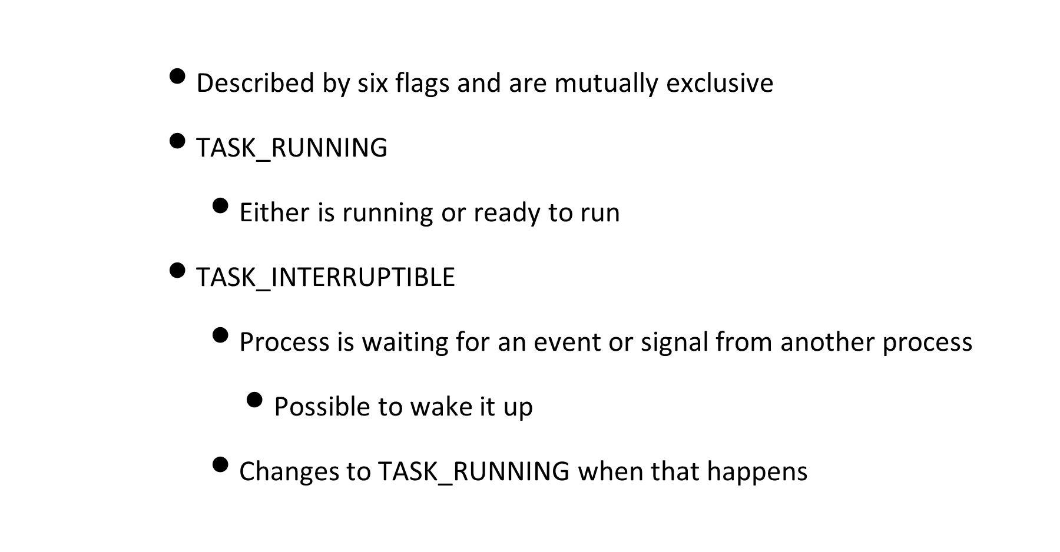
Process states in Linux

Slide 58
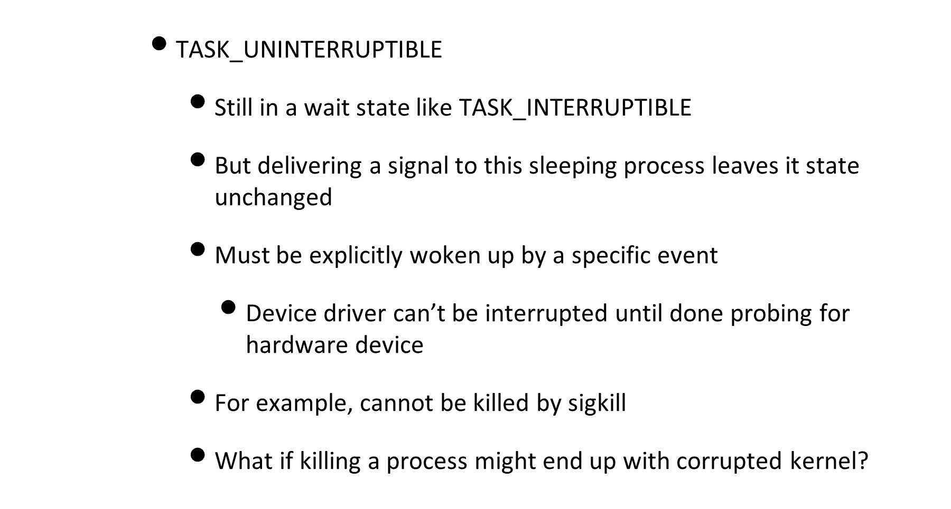
Process states in Linux

Slide 59
Process states in Linux
      TASK_STOPPED
        Process execution is stopped
        Result of receiving a SIGSTOP, SIGTSTP, SIGTTIN, or SIGTTOU
      TASK_TRACED
        Process stopped by a debugger

Slide 60
Process states in Linux
      EXIT_ZOMBIE
        Process finished execution but parent has not yet issued a wait system call
      EXIT_DEAD
        Process being removed after the parent has just issued a wait system call
        Changing state from EXIT_ZOMBIE to EXIT_DEAD avoids race conditions due to other threads of execution that execute wait- like calls on the same process

Slide 61
Processes in MS-DOS
      Created by system call to load a specified binary file
        Loads it into memory and executes it
      Parent is suspended and waits for child to finish execution

Slide 62
Process Control Subsystem in Unix
      Significant part of the Unix kernel
        Along with file system
      Contains three modules
        Interprocess communication
        Scheduler
        Memory management

Slide 63
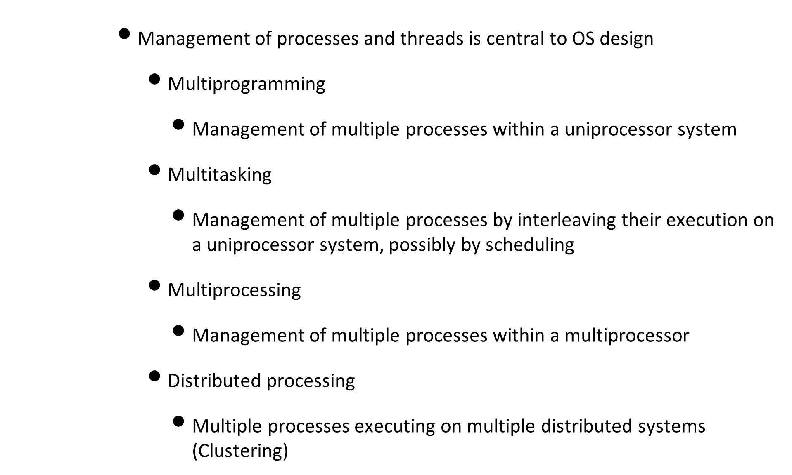
Concurrency

Slide 64
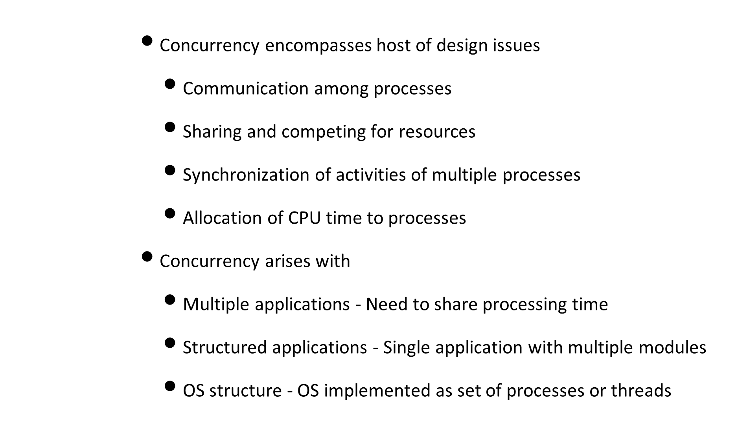
Concurrency

Slide 65
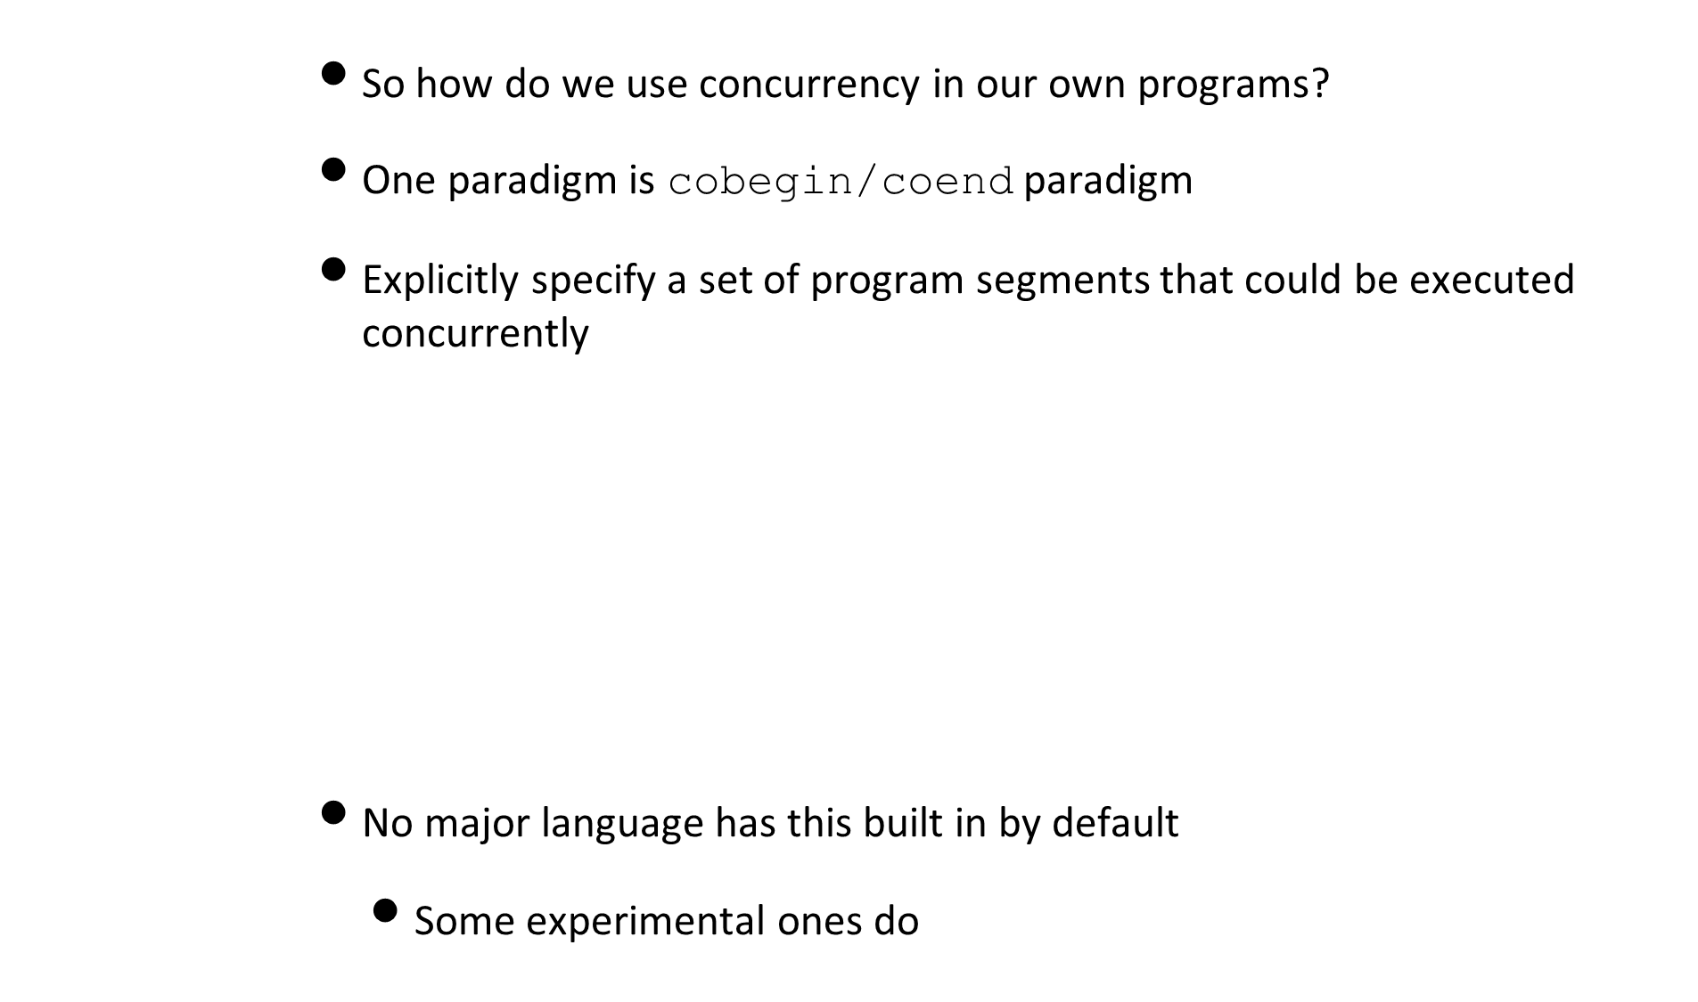
Concurrency
COBEGIN
p_1;
p_2;
...
p_3;
COEND;
cobegin
    t_1 = a + b;
      t_2 = c + d;
      t_3 = e / f;
coend
t_4 = t_1 * t_2;
t+5 = t_4 - t_3;

Slide 66
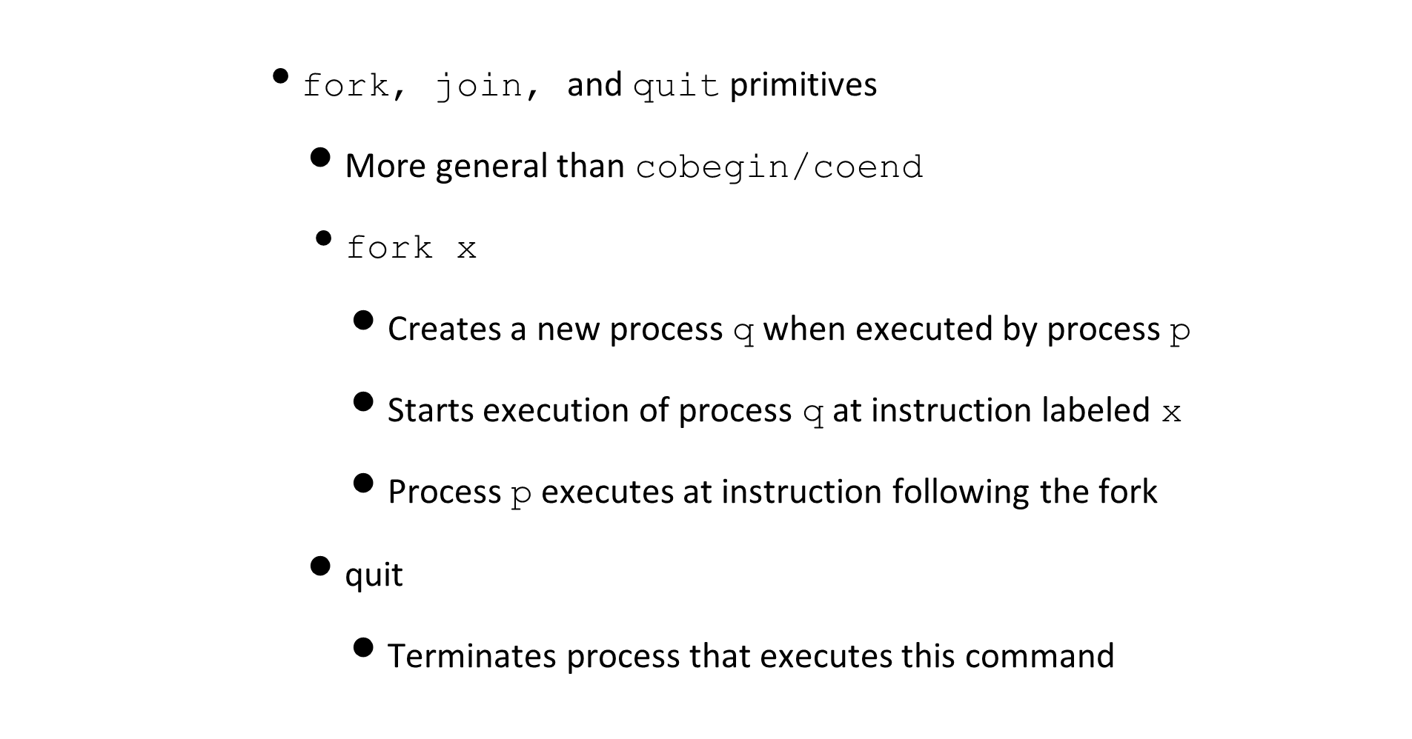
Concurrency

Slide 67
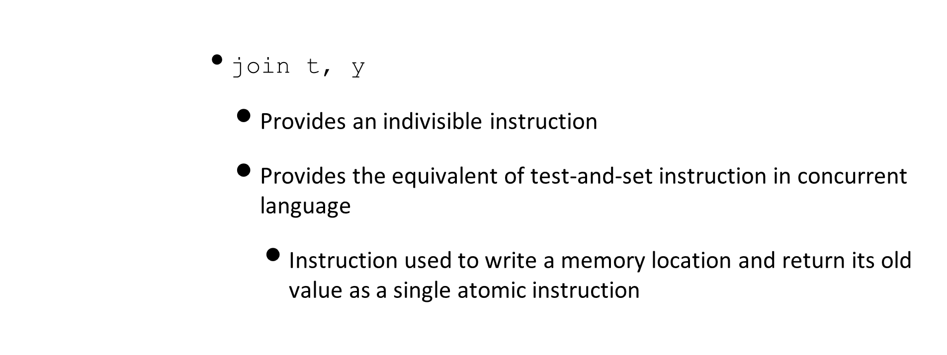
Concurrency
// if old lock is 0, this function ends
// if lock is 1, spin
function Lock(boolean *lock) {
  while (test_and_set(lock) == 1)
  ;
}

Slide 68
Concurrency
        Lets look again at our previous example
  m = 3;
fork p2;
fork p3;
p1 : t1 = a + b; join m, p4; quit;
p2 : t2 = c + d; join m, p4; quit;
p3 : t3 = e / f; join m, p4; quit;
p4 : t4 = t1 * t2;
  t5 = t4 - t3;

Slide 69
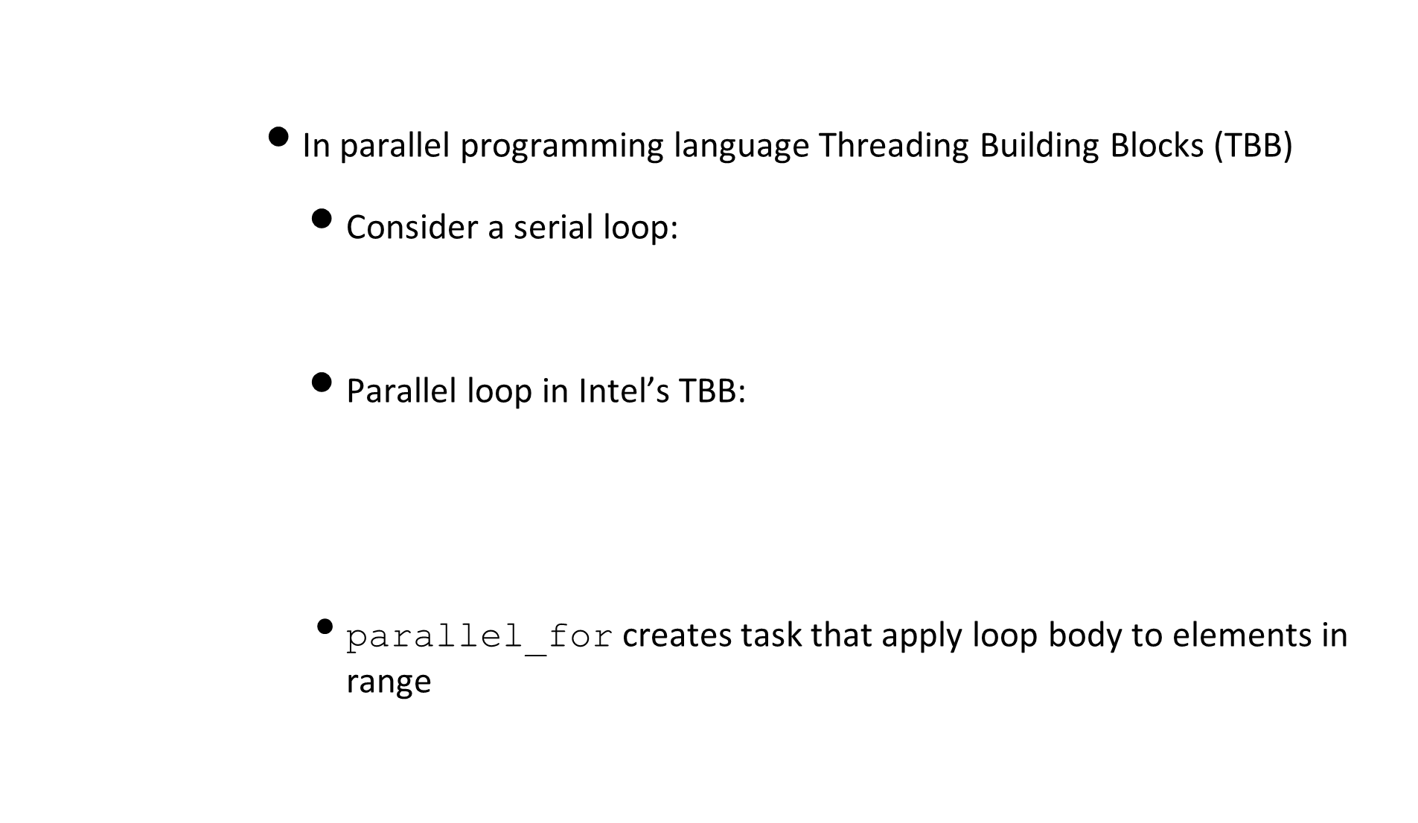
Concurrency
for (int i = 0; i < 10000; i++)
  a[i] = f(i) + g(i);
  tbb::parallel_for ( 0, 10000, [&](int i)
  { a[i] = f(i) + g(i); }
  );

Slide 70
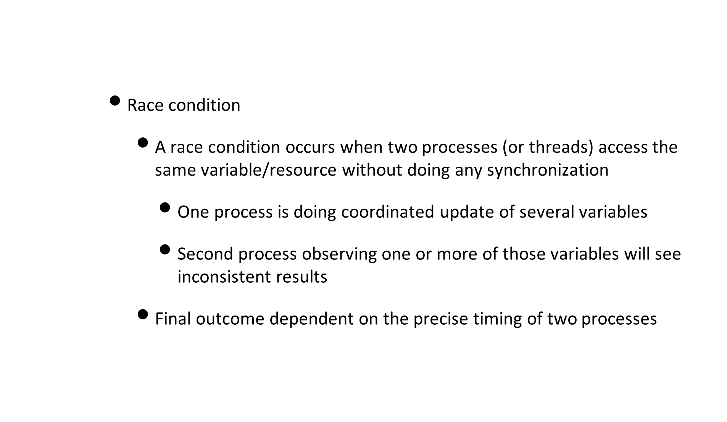
Interprocess Communication

Slide 71
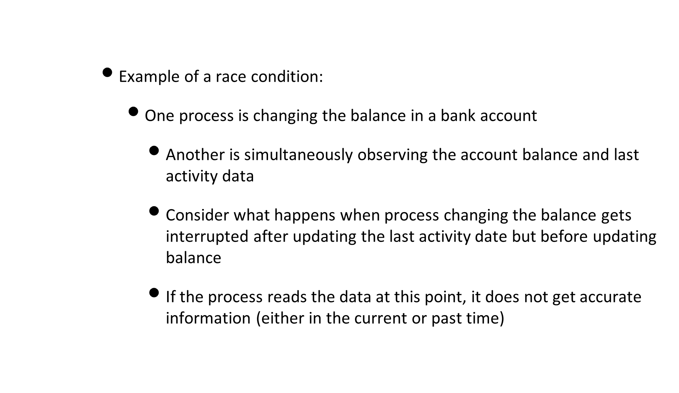
Interprocess Communication

Slide 72
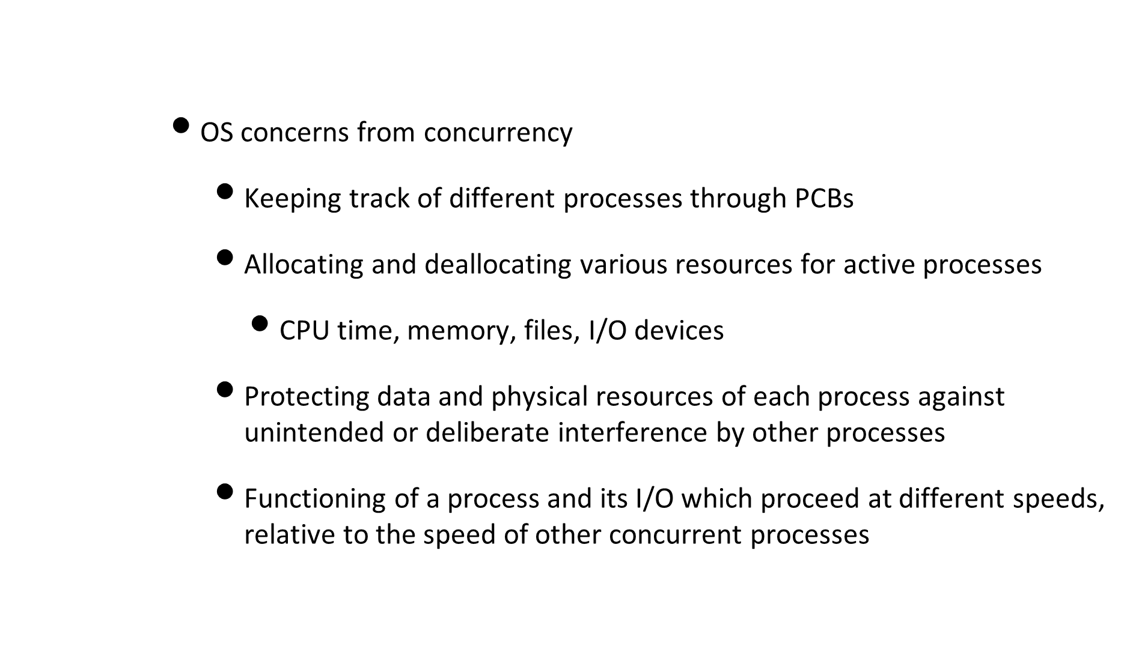
Interprocess Communication

Slide 73
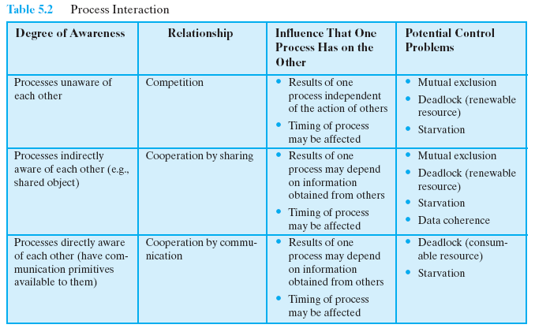
Process interaction

Slide 74
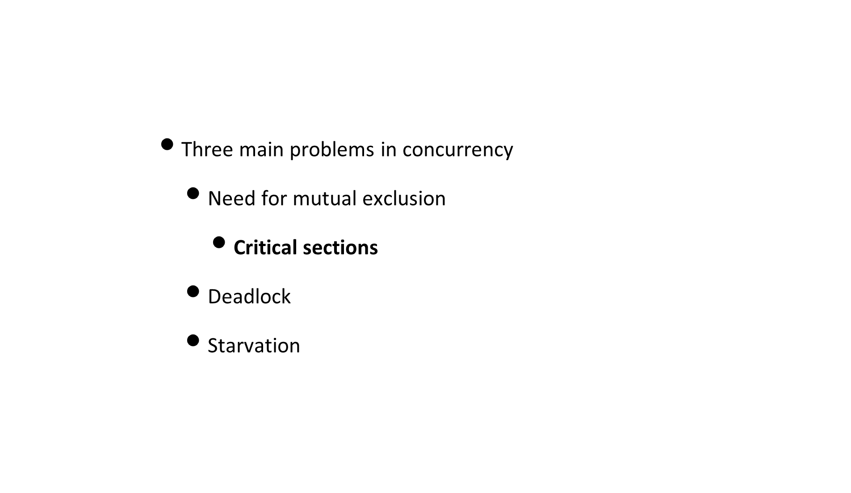
Interprocess Communication

Slide 75
Critical Section Problem
        Section of code that modifies some memory/file/table while assuming its exclusive control
        Mutually exclusive execution in time
        template for each process that involves critical section
        We have to fill in the gaps of ... for entry and exit sections in this template and test the resulting program for compliance with our protocol specified next
  do {
  ... /* entry section; */
  critical_section(); /* Assumed to be present */
  ... /* Exit section */
  remainder_section(); /* Assumed to be present */
  } while ( 1 );

Slide 76
Critical Section Problem
      Design of protocol to be used by processes should cooperate with following constraints:
        Mutual Exclusion - If process pi is executing in critical section, then no other processes can be executing in their critical sections
        Progress - If no process is executing in its critical section, the selection of a process that will be allowed to enter its critical section cannot be postponed
        Bounded waiting - There must exist a bound on the number of times that other processes are allowed to enter their critical sections after a process has made a request to enter its critical section and before that request is granted

Slide 77
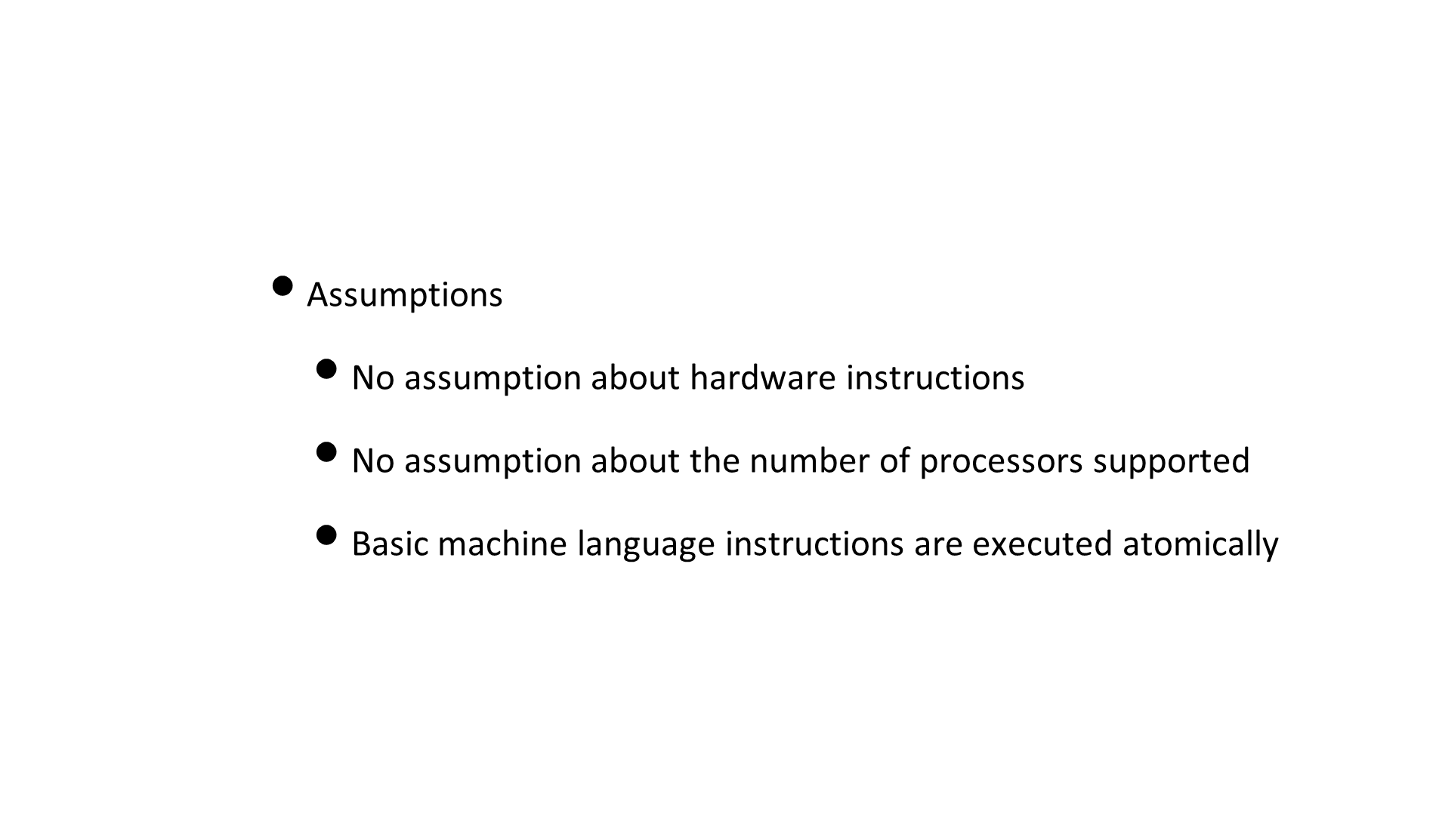
Critical Section Problem

Slide 78
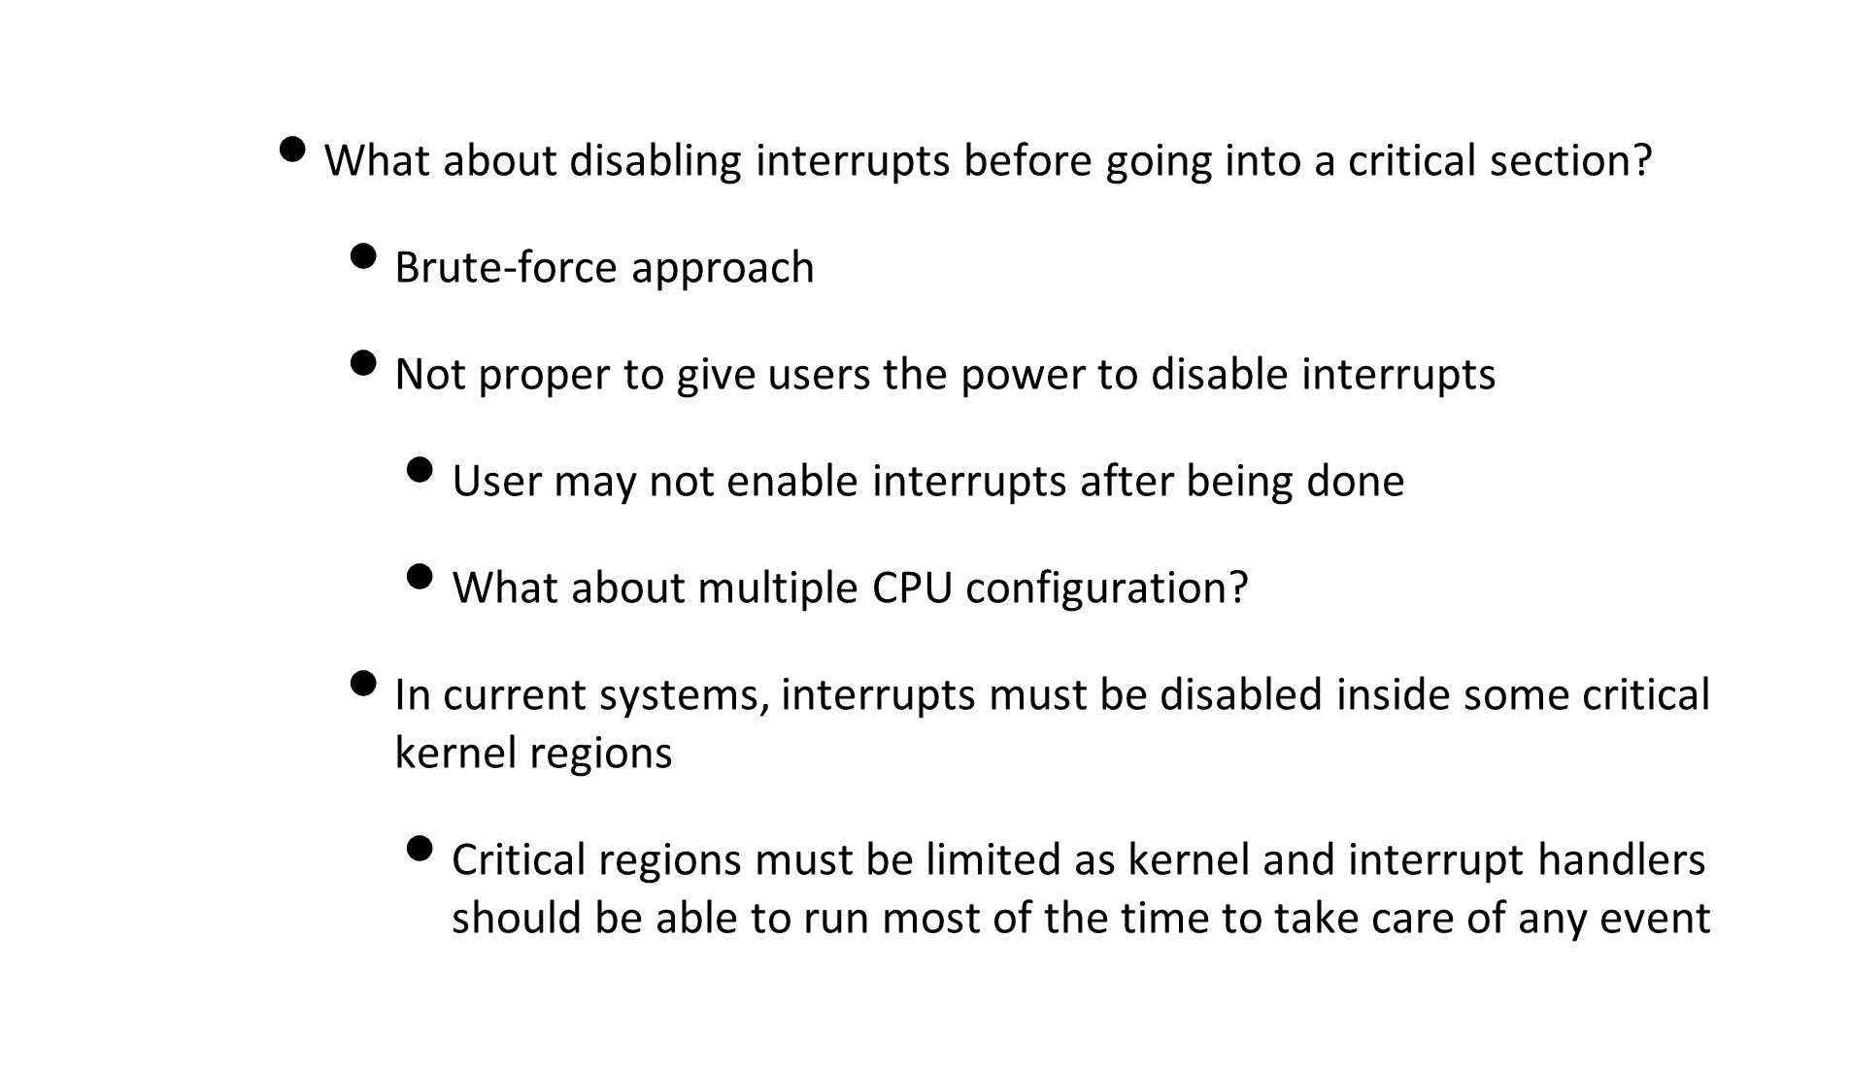
Critical Section Problem

Slide 79
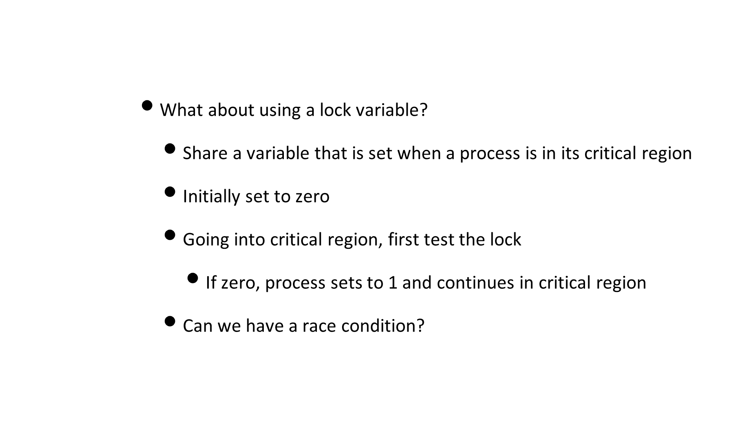
Attempt 1

Slide 80
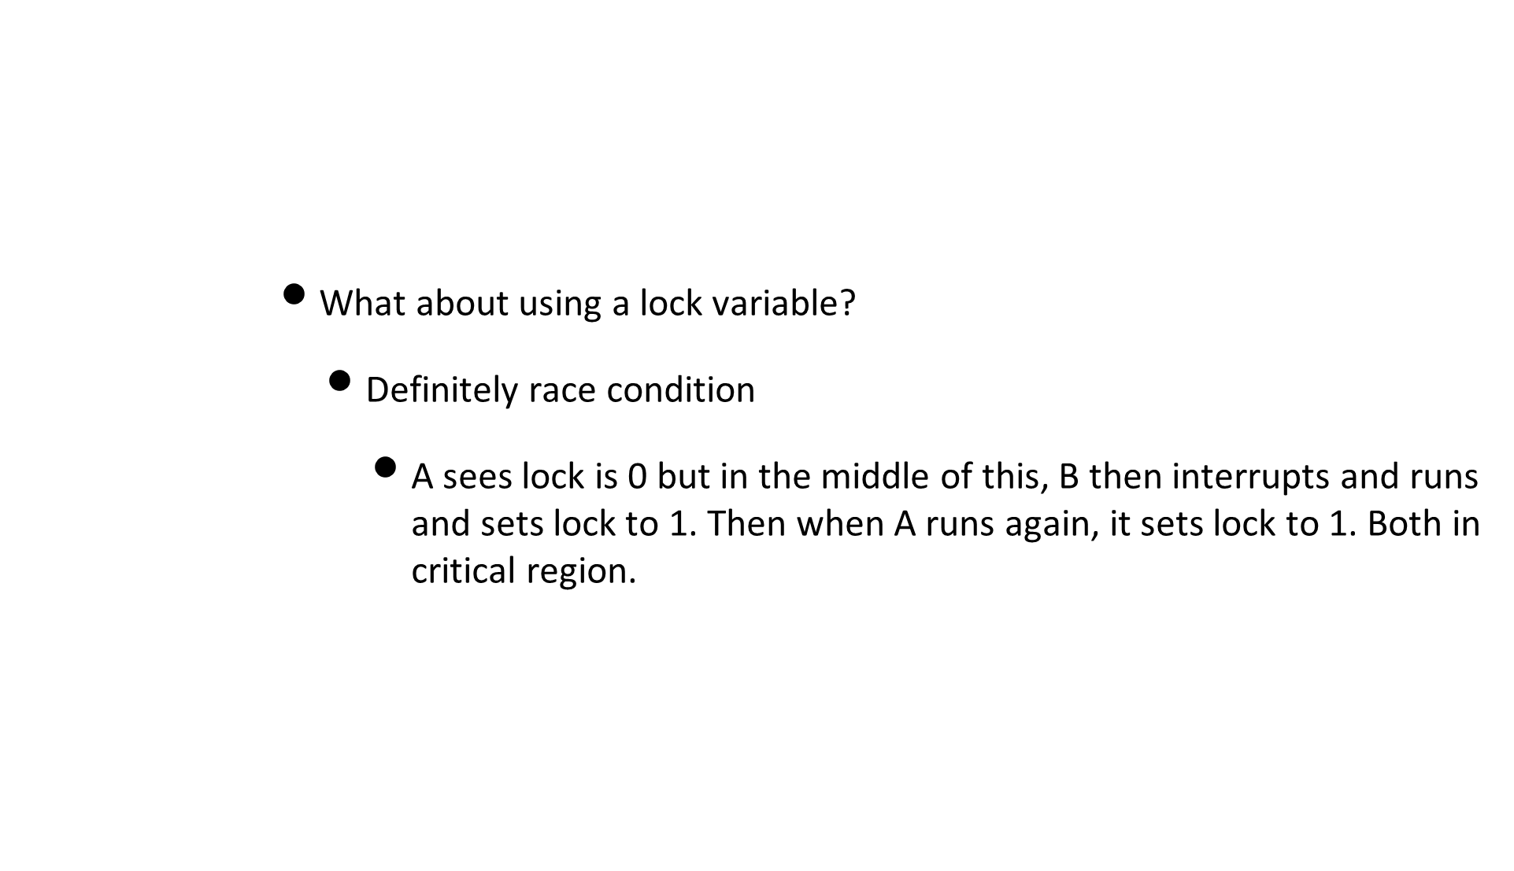
Attempt 1

Slide 81
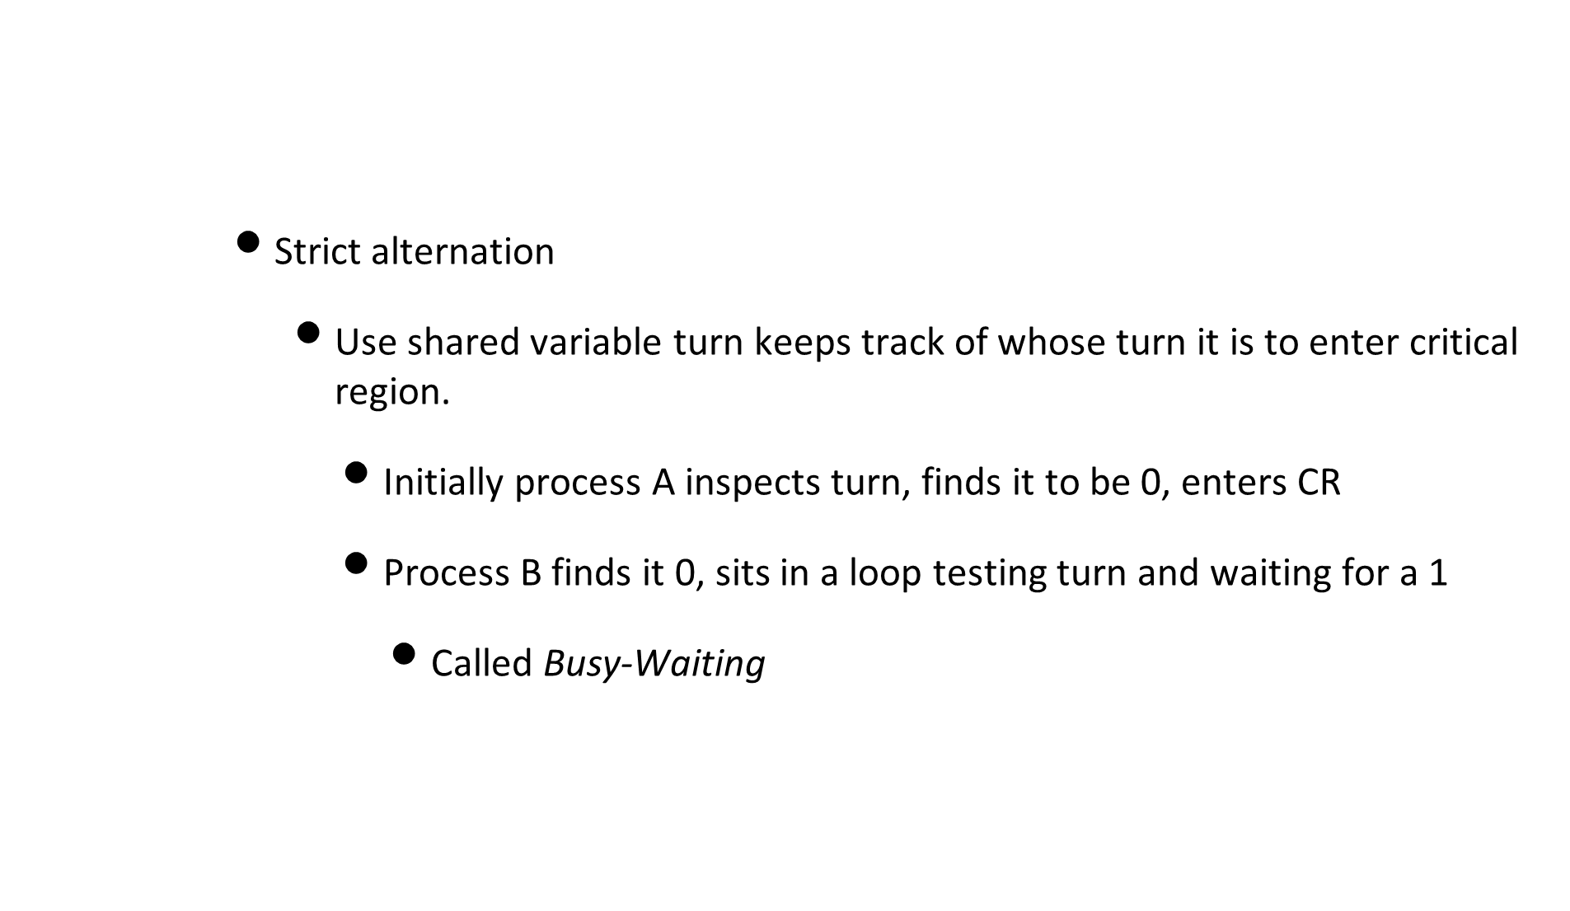
Attempt 2

Slide 82
Attempt 2
      Strict alteration
      Does not satisfy progress requirement
      Does not keep sufficient information about state of each process
  extern int turn; /* Shared variable between both processes*/
  void process( const int me) { /* me can be 0 or 1 */
  int other = 1 - me;
  do {
  while (turn != me); /* Busy wait*/
      critical_section();
      turn = other; /* Release */
      remainder_section();
    }
  }

Slide 83
Attempt 3
      What about the use of a flag vector?
      Does it satisfy mutual exclusion?
  extern int flag[2]; /* Shared variable; one for each process */
  void process ( const int me ) { /* me can be 0 or 1 */
    int other = 1 - me;
  do{
  flag[me] = 1; /* true */
  while ( flag[other] );
  critical_section();
  flag[me] = 0; /* false */
  remainder_section();
  } while ( 1 );
  }

Slide 84

Attempt 3
  Time T0: p0 finds flag[1] set to false
  Time T1: p1 finds flag[0] set to false
  Time T0: p0 sets flag[1] to true, goes in
  Time T1: p1 sets flag[0] to true, goes in

Slide 85

Attempt 3
  Time T0: p0 sets flag[0] to true
  Time T1: p1 sets flag[1] to true

Slide 86

Attempt 4

Slide 87

Attempt 4
  Time T0: p0 sets flag[0] to true // p0 wants in
  Time T1: p1 sets flag[1] to true // p1 wants in
  Time T2: p0 checks flag[1] // Oops, p1 wants in
  Time T3: p1 checks flag[0] // Oops, p0 wants in
  Time T4: p0 sets flag[0] to false // p0 tries to let p1 in
  Time T5: p1 sets flag[1] to false // p1 tries to let p0 in
  Time T6: p0 sets flag[0] to true // p0 wants in again
  Time T7: p1 sets flag[1] to true // p1 wants in again

Slide 88

Attempt 4

Slide 89
Peterson’s solution
      Lets try combining turn and flag!
  extern int flag[2]; /* Shared variable; one for each process */
  extern int turn; /* Shared variable */
  void process ( const int me ) { /* me can be 0 or 1 */
    int other = 1 - me;
  do{
  /* Entry section */
  flag[me] = 1; /* true */
    turn = other /* cede the turn */
  while ( flag[other] && turn == other);
  critical_section();
  flag[me] = 0; /* false */
  remainder_section();
  } while ( 1 );
  }

Slide 90

Peterson’s solution

Slide 91
Peterson’s solution
      Progress
        A process cannot immediately re-enter critical region if the other process has set a flag waiting to go in
      Bounded Waiting
        A process will wait no longer than one turn
        After giving priority to other process, process will run to completion and set its flag to 0, so other can enter critical region
      Only works for 2 processes, can we generalize?
        Filter algorithm

Slide 92
Multiple process solution
    This time, array flag takes one of three values (idle,want-in,in-cs)
  enum state { idle, want_in, in_cs };
  extern int turn;
  extern state flag[n];/*Flag corresponding to each process in shared memory */
  process(const int i ) {
  do {
    do {
  flag[i] = want_in; // Raise my flag
  j = turn; // Set local variable
    // wait until its my turn
  while ( j != i )
  j = ( flag[j] != idle ) ? turn : ( j + 1 ) % n;
  // Declare intention to enter critical section
  flag[i] = in_cs;
  // Check that no one else is in critical section
  for ( j = 0; j < n; j++ )
  if ( ( j != i ) && ( flag[j] == in_cs ) )
  break;
  } while ( ( j < n ) || ( turn != i && flag[turn] != idle ) );
  // Assign turn to self and enter critical section
  turn = i;
  critical_section();
  // Exit section
  j = (turn + 1) % n;
  while (flag[j] == idle)
  j = (j + 1) % n;
  // Assign turn to next waiting process; change own flag to idle
  turn = j; flag[i] = idle;
  remainder_section();
  } while ( 1 );
  }

Slide 93
Multiple processor solution
    pi enters the critical region only if flag[j] != in-cs for all j != i
    turn can be modified only upon entry to and exit from critical section
      First contending process enters its critical section
    Upon exit, successor process is designated to be the one following current process
    Mutual Exclusion?
      pi enters the cr only if flag[j] != in_cs for all j != i
      Only pi can set flag[i] = in_cs
      pi inspects flag[j] only while flag[i] = in_cs

Slide 94
Multiple processor solution
    Progress
      turn can be modified only upon entry to and exit from critical section
      No process is running or exiting critical section so turn remains constant
      First contending process in cyclic ordering (turn, turn+1,..,n-1,0,...,turn-1) enters its critical section
    Bounded Wait
      Upon exit from CS, process must designate its unique successor in the ordering
      Any process waiting to enter CS will do so in at most n-1 turns

Slide 95
Bakery Algorithm
    Each process has unique id and this id assigned in an ordered manner
  extern bool choosing[n]; /* Shared Boolean array */
  extern int number[n]; /* Shared integer array to hold turn number */
  void process_i ( const int i ) /* ith Process */ {
    do
    choosing[i] = true;
    number[i] = 1 + max(number[0], ..., number[n-1]);
    choosing[i] = false;
    for ( int j = 0; j < n; j++ ) {
    while ( choosing[j] ); // Wait if j happens to be choosing
    while ( (number[j] != 0)
    && ( number[j] < number[i] || (number[j] == number[i] && j < i) );
    }
    critical_section();
    number[i] = 0;
    remainder_section();
    while ( 1 );
    }

Slide 96
Bakery Algorithm
    Each process (not in critical region) has a variable that indicates its position in a queue of other processes not in critical region
    Each on trying to get in scans variables of other processes
      Enters critical section only after determining that it is head of the queue
    When process Pi tries to go into CS, sets its turn to one higher than all others
      Then it busy-waits until process j is not in middle of choosing a turn
      Then it busy-waits until Pj’s turn is either 0 or greater than Pi
      Once it goes past all processes like this, it enters CS

Slide 97
Test-and-Set
    Another way is to use synchronization hardware
      Atomic instruction
      Disable/enable interrupts to prevent context switches
    Atomic instruction of test_and_set
      Record the old value AND
      Set the value to indicate availability AND
      Return the old value

Slide 98
Test-and-Set
    Code of test_and_set
    Mutual exclusion with test_and_set
  int test_and_set (int &target) {
  int tmp;
  tmp = target;
  target = 1; /* True*/
    return ( tmp );
  }
  extern bool lock ( false );
  do
  while ( test_and_set ( lock ) );
  critical_section();
  lock = false;
  remainder_section();
  while ( 1 );

Slide 99
Producer/Consumer problem
    General situation
      One or more producers are generating data and placing it in buffers
      A single consumer is taking items out of buffer one at a time
      Only one producer or consumer may access buffer at any one time
    The problem:
      Ensure that the producer can’t add data into full buffer and consumer can’t remove data from empty buffer

Slide 100
Producer/Consumer problem
    Functions that could be used for this problem:
      Assume circular finite buffer b with linear array of elements
Producer | Consumer
while (true) { /* produce item v */ while ((in + 1) % n == out) /* do nothing */; b[in] = v; in = (in + 1) % n } | while (true) { while (in == out) /* do nothing */; w = b[out]; out = (out + 1) % n; /* consume item w */ }

Slide 101
Semaphores
    Want to solve this problem
    We will do this using semaphores
      Integer variable that can only be accessed through two standard atomic operations
        wait(P) and signal(V)
Operation | Semaphore | Dutch | Meaning
Wait | P | proberen | test
Signal | V | verhogen | increment

Slide 102
Semaphores
    Classical definitions for wait and signal are:
    Mutual exclusion implementation with semaphores
    wait ( S ): while (S <= 0);
    S--;
    signal ( S ): S++;
  do
  wait( mutex );
  critical_section();
  signal( mutex );
  remainder_section();
  while ( 1 );

Slide 104
Semaphores
    Also simple matter to enforce synchronization with processes
    Suppose want p1 to complete a task and then p2 to start:
p1 S1; signal( synch);
p2 wait( synch ); S2;

Slide 105
Semaphores
    So how do we actually implement semaphore operations?
    Can use binary semaphores using test_and_set
      As per previous definition
    Implementation with a busy-wait

Slide 106
Binary Semaphore
  class bin_semaphore {
        private:
        bool s; /* Binary semaphore */
        public:
        bin_semaphore() // default constructor
        : s ( false ) {}
        void P () { // sem_wait
        while (test_and_set( s ) );
        }
        void V () { // sem_signal
        s = false;
        }
  };

Slide 107
General semaphore
  class semaphore {
        private:
        bin_semaphore mutex;
        bin_semaphore delay;
        int count;
  public:
  void semaphore ( const int num = 1 ) // Constructor
  : count ( num ) {
  delay.P(); //wait on the delay binary semaphore
  }
  // SemWait
  void P() {
  mutex.P(); // wait on mutex bin sem
  if ( --count < 0) {
  mutex.V(); // signal on mutex bin sem
  delay.P(); // wait on delay bin sem
  }
    else
  mutex.V(); // signal on mutex bin sem
  }
  // SemSignal
  void V() {
  mutex.P(); // wait on mutex bin sem
  if (++count <= 0)
  delay.V(); // signal on delay bin sem
  mutex.V(); // signal on mutex bin sem
  }
  };

Slide 108
Semaphores
    Both of these are busy/waits
      Processes waste CPU cycles while waiting to enter critical sections
      So lets modify wait operation into block operation
        Let process block itself rather than busy-wait
      Modify signal operation into wakeup operation
      Change the state of process from wait to ready

Slide 109
BLock-Wakeup protocol
  // semaphore with block/wait
  class sem_int {
        private:
        int value; // Number of resources
        queue<pid_t> list; // List of processes
  public:
  void sem_int ( const int n = 1 ) // Constructor
  : value ( n ) {
  list = queue<pid_t>( 0 );
  }
  // Sem_wait
  void P() {
  if ( --value < 0) {
  pid_t p = getpid();
  list.enqueue( p ); // enqueue invoking process
  block(p);
  }
  } }
  // Sem_signal
  void V() {
  if (++value <= 0) {
  process p = list.dequeue();
  wakeup( p );
  }
  }
  };

Slide 110
Producer-Consumer solution
  extern semaphore mutex; // To get exclusive access to buffers
  extern semaphore empty ( n ); // Number of available buffer space
  extern semaphore full( 0 ); // Initialized to 0
  void producer() {
  do {
  produce ( item );
  empty.P(); // wait on empty
  mutex.P(); // wait on mutex
  put( item );
  mutex.V(); // signal on mutex
  full.V(); // signal on full
  } while (1);
  }
  void consumer() {
  do {
  full.P(); // wait on full
  mutex.P(); // wait on mutex
  remove ( item );
  mutex.V(); // signal on mutex
  empty.V(); // signal on empty
  consume( item );
  } while ( 1 );
  }

Slide 111
Thundering Herd
    Imagine large number of processes waiting for an event
    Event happens, all processes woken up in response
    Now a race to lock the resource to themselves
      Remaining ones get put to sleep
    Want to avoid this problem by waking up only one process

Slide 112
Event Counters
    Solve the producer-consumer problem without requiring mutual exclusion
    Uses special kind of variable with three operations
      E.read(): Return the current value of E
      E.advance(): Atomically increment E by 1
      E.await(v): Wait until E has a value of v or more
    Event counters always start at 0 and always increase

Slide 113
Producer/Consumer EC
    Can solve Producer/Consumer with event counters
    Both produce a sequence number locally
    For producer:
      Serial number of each thing it has produced
    For consumer:
      Serial number of next item it will consume

Slide 114
Event Counters
  class event_counter {
    int ec; // Event counter
    public:
    event_counter():ec( 0 ) {} // Default constructor
        int read() const { return ( ec ); }
        void advance() { ec++; }
        void await( const int v ) const {while (ec < v); }
        };
  extern event_counter in, out; Shared event counters
  void producer() {
  int sequence (0); // Local to producer
  do {
  produce( item );
    sequence++;
    out.await( sequence - num_buffers);
    put( item );
    in.advance();
  }
  while ( 1 );
  }

Slide 115
Event Counters
  extern event_counter in,out;
  void consumer() {
  int sequence ( 0 ); // Local to consumer
  do {
  sequence++;
  in.await( sequence );
  remove( item);
  out.advance();
  consume(item);
  } while ( 1 );
  }

Slide 116
Semaphores
    Semaphores can be used to solve any traditional synchronization problem
    However, several drawbacks
      Essentially shared global variables, can be accessed anywhere
      No connection between semaphore and data being controlled by sem
      Used both for critical sections (mutual exclusion) and coordination (scheduling)
      No control or guarantee of proper usage
    Can be hard to use and prone to bugs
      Really want programming language support

Slide 117
Monitors
    Semaphores are low-lvl
    A monitor is an attempt to create a high-level synchronization primitive
      Easier to use than semaphores
    A programming construct
      Part of a programming language and not the OS
      Implemented by compiler
        May implement its parts using semaphores

Slide 118

Monitors

Slide 119
Monitors
    Monitors let you do very convenient things
      Lets say you have many linked lists of data
        You could lock the entire set of linked lists with one monitor (lock)
        Lock each linked list with a separate lock
        Lock each element of each linked lists with a separate lock

Slide 120
Monitors
    Very easy to create mutual exclusion around specific things
    Suppose we want to create a counter and not worry about race conditions
  monitor sharedcounter {
  int counter;
  function add() { counter++;}
  function sub() { counter--;}
  init() { counter=0; }
  }

Slide 121
Monitors
    While this easy access to exclusion is nice
      Not only thing that we might want
    For example, in producer/consumer problem
      Producer wants to signal consumer that buffer is no longer empty
    Many times a process might want to signal another based on some condition
      Add condition variables to monitors

Slide 122

Monitors

Slide 123

Dining Philosophers
    5 philosophers sit at a table with bowls of spaghetti
    Each philosopher must think and then eat, alternating
    Can only eat if they have right and left chopsticks
    How to design it so no philosopher starves

Slide 124
Dining philosophers
    Seems easy!
      Think until left fork is available; when it is, pick it up
      Think until right fork is available; when it is, pick it up
      When both forks are held, eat for a fixed amount of time
        Then, put right fork down
        Then, put left fork down
      Repeat

Slide 125
Dining philosophers
    Can deadlock
      State in which each philosopher has picked up fork to left
        Waiting on fork to the right
      Eternally waits for each to release fork
    Can lead to starvation
      One more philosopher that is never ever given both forks
      Everyone else keeps eating, while he starves to death

Slide 126
Solution by monitors
  enum state_type {thinking, hungry, eating}
  class dining_philosophers {
  private:
  state_type state[5]; // State of each philosopher
  condition self[5]; // Condition object for synching
  void test ( int i ) {
  if (( state[ (i + 4 ) % 5] != eating) &&
  ( state[i] == hungry) &&
  ( state[ ( i + 1) % 5] != eating ) ) {
  state[ i ] = eating;
  // no effect on pickup but important to wake up during putdown
  self[i].signal();
  }
  }
  public:
  void dining_philosophers() { // Constructor
  for (int i = 0; i < 5; state[i++] = thinking); }
  void pickup( const int i ) { // i corresponds to phil i
  state[i] = hungry;
  test( i ); // set state to eating only if neighbors not eating
  if (state[i] != eating) // if unable to eat, wait
  self[i].wait();
  }
  void putdown( const int i) // i corresponds to phil i
  state[i] = thinking; // put down chopsticks
  test( ( i+4) % 5); // if R/L is hungry and both are not eating
  test( ( i+1) % 5); // set Rs state to eating and wake it up
  }
  }

Slide 127
Solution by monitors
    Philosopher i must invoke operations pickup and putdown on instance dp of dining_philosophers monitor
    No two neighbors eating simultaneously - no deadlocks
    However, starvation could occur in this example
  dining_philosophers dp;
  dp.pickup(i); // Philosopher i picks up the chopsticks
  ...
  dp.eat(i); // Philosopher i eats (for random amount of time)
  ...
  dp.putdown(i); // Philosopher i puts down the chopsticks

Slide 128
Implementing monitors
    Execution of procedures must be mutually exclusive
    A wait must block the current process on the corresponding condition
    If no process is running in the monitor and some process is waiting, it must be selected
      If more than one waiting process, need some criterion for selecting and deploying one
    Implementation using semaphores
      Semaphore mutex corresponding to the monitor initialized to 1
        Before entry, execute wait(mutex)
        Upon exit, execute signal(mutex)
      Semaphore next to suspend processes unable to enter monitor initialized to zero

Slide 129
Implementing monitors
  Integer variable next_count to count number of processes waiting to enter monitor
  Semaphore x_sem for condition x, initialized to zero
  Integer variable x_num_waiting_procs
  mutex.wait();
  ...
  void proc() { ... } // Body of process
  ...
  if (next_count > 0)
  next.signal();
  else
  mutex.signal();

Slide 130
Implementation of monitors
  class condition {
  int num_waiting_procs; // Processes waiting on this condition
  semaphore sem; // To synchronize processes
  static int next_count; // Processes waiting to enter monitor
  static semaphore next;
  static semaphore mutex;
  public:
  condition() : num_waiting_procs (0), sem (0) // Default const
  void wait() {
  num_waiting_procs++; // # of procs waiting on this condition
  if (next_count > 0 ) // Someone waiting inside monitor?
  next.signal(); // Yes, wake him up
  else
  mutex.signal(); // No, free mutex so others can enter
  sem.wait(); // Start waiting on condition
  num_waiting_procs--; // Wait over, decrement variable
  }
  void signal() {
  if (num_waiting_procs <= 0) // nobody waiting?
  return;
  next_count++; // # of ready processes inside monitor
  sem.signal(); // Send the signal
  next.wait(); // You wait; let signaled process run
  next_count--; // One less process in monitor
  }
  };

Slide 131

Monitors

Slide 132
Advantages over semaphores
      Of course possible to make mistakes with monitors
        Could forget to issue signal after done with a resource
        Other processes hang up waiting for it
      However, all synchronization functions part of monitor
        Easier to verify synching has been done correctly.
      Once monitor is coded correctly, safe no matter how many people access it
      With semaphores, resource access only correct if each process uses them correctly

Slide 133
Message-Based Synchronization
    Process interaction involves two things
      Synchronization (mutual exclusion)
      Communication (information exchange)
    Communication between processes is achieved by:
      Shared memory (semaphores, monitors, CCRs)
        CCR: Concurrency and Coordination Runtime
      Message Systems
        Desirable as they prevent sharing, so less security concerns and also maybe lack of shared memory due to different physical hardware

Slide 134
Message-Based Synchronization
    Communication by passing messages
      Processes communicate without any need for shared variables
      Paradigm of choice for distributed systems, shared memory multiprocessors and uniprocessors
      Two basic communication primitives
      send message:
        send(P, message) : Send a message to process P
      receive message:
        receive(Q, message) : Receive a message from process Q
      Messages passed through a communication link
        Physical or logical link between two processes, set up automatically

Slide 135
Message-Based Synchronization
    Issues that need to be resolved
      Sync vs Asynch communication
        Upon send, does sending process continue or does it wait for it to be accepted by receiving process (synch or blocking communication)
        What happens if receive is issued and no message waiting (block or not block?)
      Implicit vs Explicit Naming
        Does sender specify exactly one receiver or transmit to all other processes
        Does the receiver accept from one or accept from any
  send (p, message) //Send a message to process p
  send (A, message) // Send a message eto mailbox A
  receive (p, message) //Receive a message from process p
  receive (id, message) //Receive a message from any process
  // who’s pid is id
  receive (A, message) // Receive a message from mailbox A

Slide 136
Blocking vs Nonblocking
    Blocking send, blocking receive
      Both are blocked until message is delivered (referred to as rendezvous)
        Allows tight synchronization between processes
      Nonblocking send, nonblocking receive:
        Neither party is required to wait
      Nonblocking send, blocking receive
        Sender can continue, receiver is blocked
        Probably most useful one
    Queues in message passing can be normal queues or priority queues

Slide 137
Message-Based Synchronization
    Producer/Consumer Problem with messages
  void producer () {
  while (1 ) {
  produce ( data );
  send(consumer, data);
  }
  }
  void consumer () {
  while (1 ) {
  receive( producer, data);
  consume( data );
  }
  }

Slide 138
Message-Based Synchronization
    Mutual exclusion with message passing
  /* program mutual exclusion */
  const int n = 5; /* total number of processes */
  void P(int i) {
  message msg;
    while (true) {
  receive (box, msg);
  /* critical section */
  send (box, msg);
  /* remainder */
  }
  }
  void main() {
  create mailbox(box);
  send(box, null);
  parbegin(P(1), P(2), ..., P(n));
  }

Slide 139
Ports and mailboxes
    Can achieve synching of asynch process by embedding a busy-wait loop, with a non-block receive to simulate the effect of implicit naming
      Inefficient solution
    Indirect communication avoids inefficiency of busy-wait
      Make queues holding messages between senders and receivers visible to processes through a mailbox

Slide 140
Message-Based Synchronization
    Mailboxes
      Messages are sent to or taken from a mailbox
      Most general communication facility between n senders and m receivers
      Unique identification for each mailbox
      Process may communicate with another process by a number of different mailboxes
      Two processes may communicate only if they have a shared mailbox

Slide 141
Message-Based Synchronization
    Communication link
      A link is established between a pair of processes only if they share mailbox
      A link may be associated with more than two processes
      Between any pair of processors, may be different links, each corresponding to one mailbox
      A link may be unidirectional or bidirectional

Slide 142
Message-Based Synchronization
      Ports
        In a distributed environment, receive referring to same mailbox may reside on different machine
        Port is a limited form of mailbox associated with only one receiver
        All messages originating with different processes but addressed to the same port are sent to one central place associated with the receiver

Slide 143
Signal and IPC in Unix/Linux
    POSIX standard defines about 20 signals, two of which are user definable
      SIGUSR1, SIGUSR2
    Process can react to signals in two ways
      Ignore the signal
      Asynchronously execute a signal handler
    If process does not specify one of these two, kernel does default action based on number
      Terminate process
      Dump core and terminate process
      Ignore the signal
      Suspend process
      Resume the process if it was stopped

Slide 144
Signal and IPC in Unix
    SIGKILL and SIGSTOP signals cannot be handled directly by the process or ignored
    IPC resources
      Shared memory, semaphores, and message queues
      Acquired by shmget(2), semget(2) and msgget(2)
      Persistent: Must be explicitly deallocated by creator, current owner or root
      msgsnd(2) and msgrcv(2)
      Shared memory
        shmget(2), shmat(2), shmdt(2)

Slide 145
Oh so much more coming!
Any questions?

