Slide 1

Team Name: Team Enigma
Nov 30th – Dec 2nd 2018 | National Incubation Center, Karachi
Challenge Theme: Water Purification at cheaper and efficient cost with Quality check
Team Participant Names:
1. Ghulam Ahmed Bin Saeed (Leader)
2. Muhammad Hamza
3. Zayan Aamir Ali
4. Usama Altaf Zahid
5. Syed Jawwad Mehdi Rizvi
6. Raziuddin Ali Khan
What technologies does your solution leverage?:
Arduino UNO
Water Sensors
pH Sensor
Turbidity sensor
Servo Motor

Slide 2

Civic Tech Hackathon 2018 | Problem-Solution Fit
What is your well-defined solution?
How does your solution mitigate the challenge theme issue?
Abolishes solid waste.
Chlorination, sand and activated charcoal kills bacteria, bad odor and taste.
Fit for consumption.
Determination of water quality and water level in the container.
Chlorination
+ Layer of pure sand and activated charcoal + deionizing filter
Quality testing and water detection
Distribution and cloud data sending
Impure Water
Removal of solid waste

Slide 3

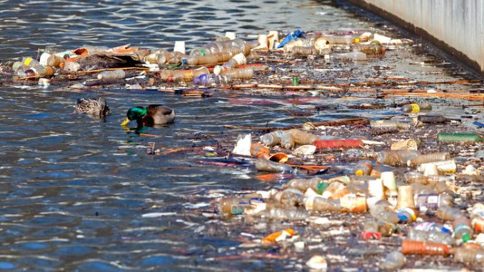
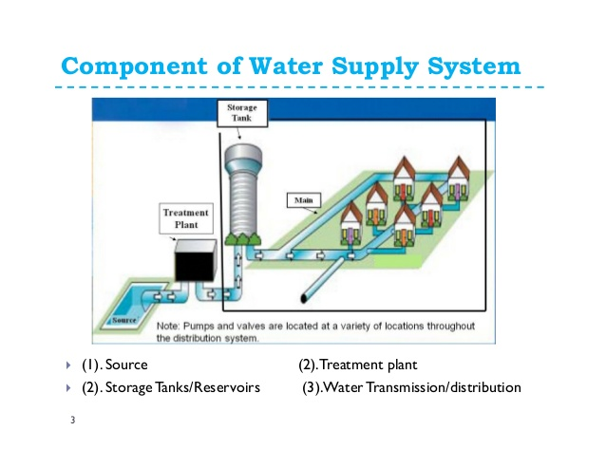
Civic Tech Hackathon 2018 | Potential Impact
Does your application solve a widespread community problem?
Yes! polluted water is a major cause of diseases in Karachi, our application tends to
minimize this concern by means of purification.
Is there any market research on the problem and solution?
According to many researches activated carbon is cheapest and the most efficient
method to purify water, further more it is easy to maintain and is accessible
Research source: https://iaspub.epa.gov/tdb/pages/treatment/treatmentOverview.do?treatmentProcessId=2074826383
Can the solution be scaled easily to actual deployment in the real world?
The solution can easily be implemented in the
real world by identifying the polluted
water reservoirs and treating them by
our method and distributing the water to the
common people

Slide 4
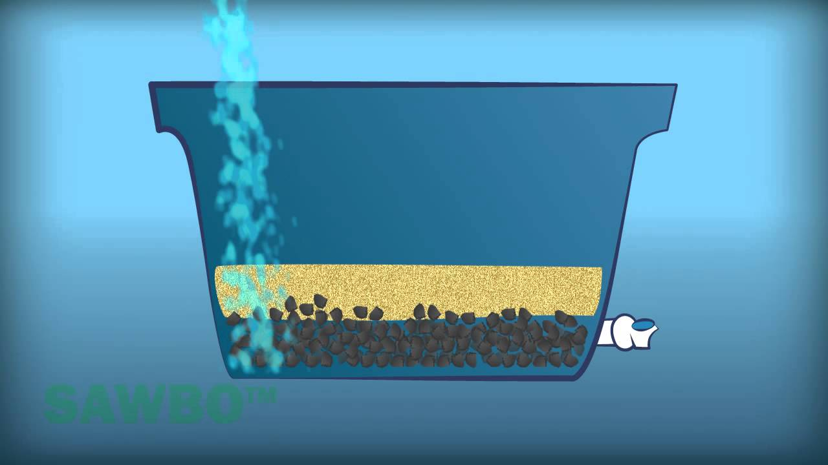
Civic Tech Hackathon 2018 | Novelty & Learning
What is different/novel about your solution?
The thing that makes our solution different that it is cheap and it is able to compete with the RO plants. Moreover not all the people of Karachi can afford RO. So at the main distribution station, the water can be treated with our mentioned method
Has your solution been done before?
The solution hasn’t been used in Pakistan before, although shower filters are available but they do not attract the common man because of its expense.
What about your solutions hasn’t been done before?
Not every problem has been implemented on a large scale because of the
limitations of research in this sector such as the process of cleaning water
through activated carbon in Pakistan on the basis of water quality
and access . However it had been implemented by the removal of
contaminants through ultraviolet radiations.

Slide 5
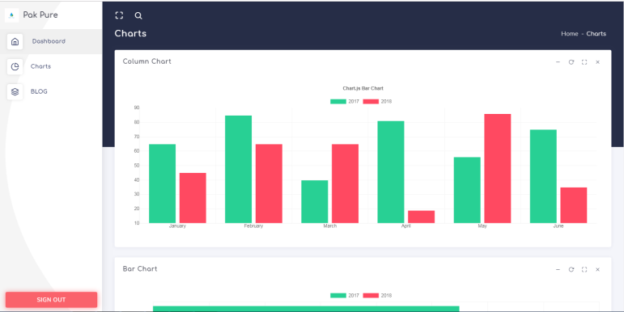
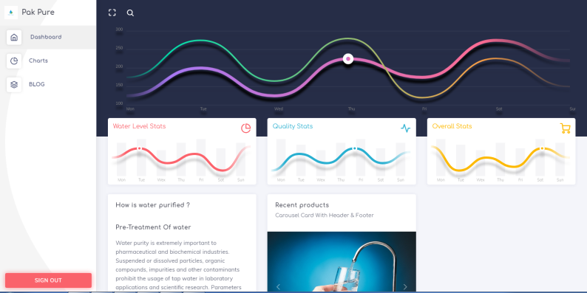
Civic Tech Hackathon 2018 | Prototype
How easy to use is your application?
Our web application will collect the data from the arduino uno and transfer that data to the mobile through ubidot cloud. The user interface is easy to access and friendly which will easily keep track of the water quality which is being transmitted to the slums and the level of water in each container.
Is the user experience elegant and engaging?
The user experience is engaging because the team method is easy to apply and the user does not have to pay the immense amount to achieve the purified water . The purified water can be used not only for household purposes but even for drinking.
Is your prototype demo functional and well-implemented?

Slide 6

Civic Tech Hackathon 2018 | Sustainability
Is your prototype demo functional and well implemented?
The prototype demo is currently not implemented because of the unavailability of the various sensors in Pakistan.
Is your team committed to scaling/deploying your application beyond this hackathon?
Yes, our team will analyze the pros and cons. We will work on the efficiency and improve the system to make it more easy to access.
Will your app be adopted by users (govt/citizens/media) & its usage be sustained over time?
It depends on the approval of our government, in mega cities like a Karachi the government can fund our project to make clean water accessible to the public.
Do you have a business model?
Yes this model can be converted into a revenue model by the ccessibility of more resources and building tanks at the required areas. This setup will be installed only one time and the cost which will be consumed would be of charcoal for every six months and the maintenance cost.

