Slide 1
PREDICTIVE ANALYTICS · COURSE PROJECT
AI-Driven Customer
Churn Prediction for Zara
A comparative study of Logistic Regression and Gradient Boosting on fast-fashion customer data
€27.78 bn
Zara + Zara Home FY2024 sales
218 M
active app users
NO loyalty program
retention by scarcity, not points
01 / 10

Slide 2
01 · The Problem
Why churn prediction matters for Zara
Zara is losing ground in the fast-fashion race.
FY2025 preliminary revenue grew only +3.2% — sharply down from +10.4% in FY2023. Shares dropped 7.5% in March 2025 on the guidance.
Shein reached 50% US fast-fashion market share by late 2022. McKinsey's 2024 survey found 40% of US consumers now shop Shein/Temu.
Retention economics: keeping a customer costs 5-25× less than acquiring one; a 5-pt retention lift raises profits 25-95% (Reichheld, Bain).
27.6%
Churn rate in our dataset
(consistent with 23-31% ecommerce fashion benchmark)
30-40%
Typical apparel return rate
(2-3× non-fashion ecommerce; El Kihal 2025)
None
Zara loyalty programme
— retention must rely on behavioural signals
Zara Customer Churn Prediction · AI-Driven Predictive Analytics
02 / 10

Slide 3
02 · Data
A Zara-style dataset, grounded in public fashion retail
Why synthetic?
Dataset snapshot
Inditex treats transaction data as proprietary. No Zara customer-level dataset exists on Kaggle, UCI, or data.world.
We modelled our dataset on the H&M Personalized Fashion Recommendations Kaggle dataset (31M transactions, 1.37M customers) — the closest public fast-fashion analog.
Feature distributions, churn rate (~28%), return rate (30-40%), and age split (67F/33M) are all calibrated to published benchmarks.
Property | Value
Customers | 10,000
Features | 20 (demographic, RFM, engagement, transactional)
Churn rate | 27.6% (2,756 churners)
Missing values | age (2.4%), email_open_rate (3.8%)
Target | churn ∈ {0, 1}
Analog | H&M Kaggle dataset (31M transactions)
Feature blocks:
Demographics
RFM
Engagement
Transactional
age, gender, country
recency, frequency, monetary
app, email, wishlist
returns, discounts, channel
Zara Customer Churn Prediction · AI-Driven Predictive Analytics
03 / 10

Slide 4
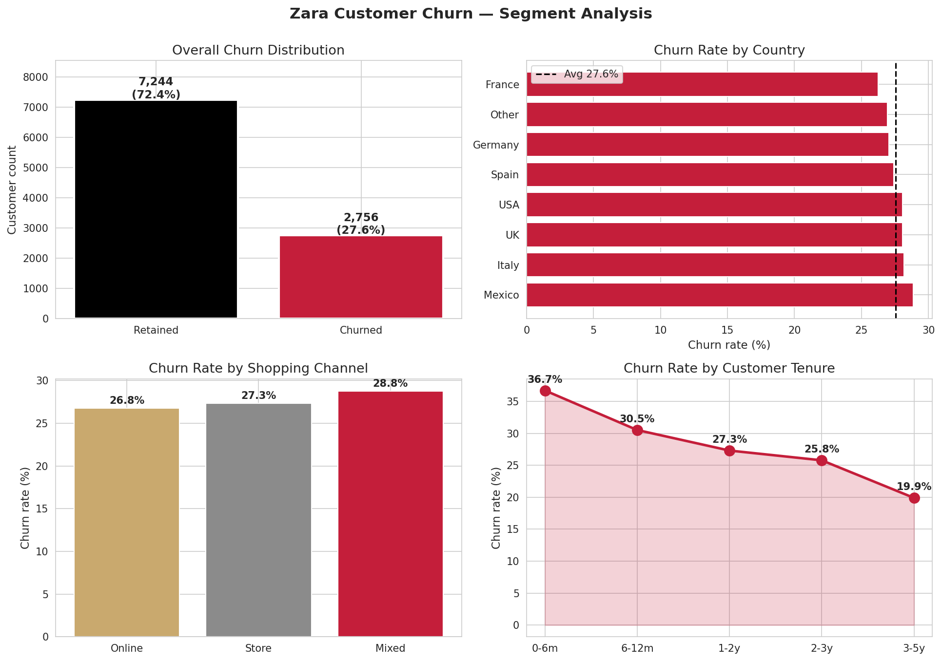
03 · Exploratory Data Analysis
Tenure is the strongest segment signal
Key takeaways
New customers churn 2×
36.7% churn at 0-6 months vs 19.9% at 3-5 years — classic survival bias.
Geography is a weak signal
Churn is 25-29% across all markets; country adds little predictive lift.
Channel is a weak signal
Online 26.8%, store 27.3%, mixed 28.8% — dominated by recency.
Baseline class imbalance
27.6% positive class — use PR-AUC and F1, not accuracy alone.
Zara Customer Churn Prediction · AI-Driven Predictive Analytics
04 / 10

Slide 5
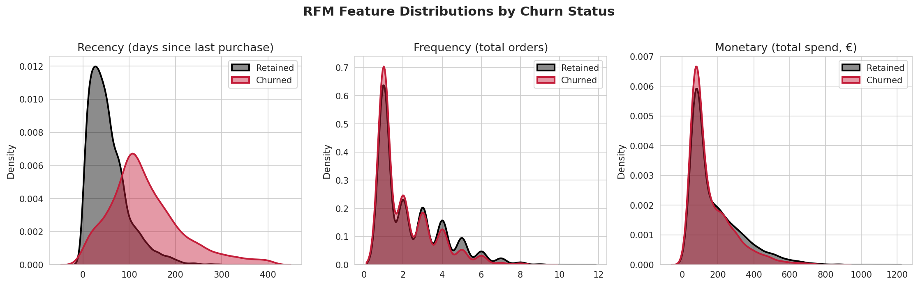
04 · Exploratory Data Analysis
Recency separates churners, frequency and monetary don't
RECENCY
FREQUENCY
MONETARY
Churners cluster around 100+ days, retainers peak at 20-40. This is the single strongest univariate churn signal.
Distributions largely overlap — on its own, order count is not a clean churn separator in fashion retail.
Also heavily overlapping — spend alone does not predict churn; it interacts with recency and returns.
Zara Customer Churn Prediction · AI-Driven Predictive Analytics
05 / 10

Slide 6
05 · Methodology
Two models, one honest comparison
1
2
3
4
5
Clean
Encode
Split
Train
Evaluate
Median/mode imputation
Percentile-cap outliers
z-score numerics (LR)
One-hot categoricals
75/25 train/test
Stratified on churn
LR (balanced)
GB (sample_weight)
Accuracy, F1
ROC-AUC, PR-AUC, 5-fold CV
MODEL 1 · BASELINE
MODEL 2 · ADVANCED
Logistic Regression
Gradient Boosting
Linear, interpretable, fast to train.
Coefficients directly show feature direction.
Config: C=1.0, liblinear, class_weight=balanced, max_iter=2000
Non-linear, captures thresholds and interactions.
Same family as XGBoost — directly comparable.
Config: n_estimators=400, max_depth=5, lr=0.06, subsample=0.8
Zara Customer Churn Prediction · AI-Driven Predictive Analytics
06 / 10

Slide 7
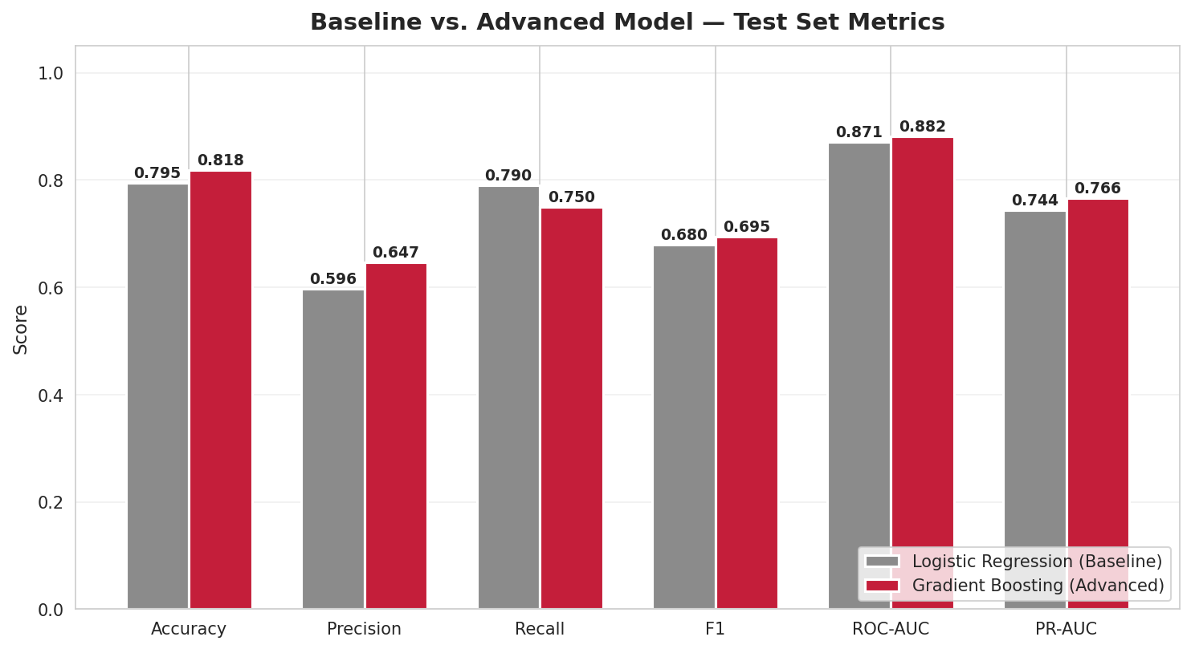
06 · Results
Gradient Boosting wins on 5 of 6 metrics
Metric | LR | GB | Δ
Accuracy | 0.795 | 0.818 | +0.023
Precision | 0.596 | 0.647 | +0.051
Recall | 0.790 | 0.750 | −0.040
F1 | 0.680 | 0.695 | +0.015
ROC-AUC | 0.871 | 0.882 | +0.011
PR-AUC | 0.744 | 0.766 | +0.022
VERDICT
Gradient Boosting is the deployment choice.
Higher precision (+5.1 pts) means fewer wasted retention touches.
Zara Customer Churn Prediction · AI-Driven Predictive Analytics
07 / 10

Slide 8
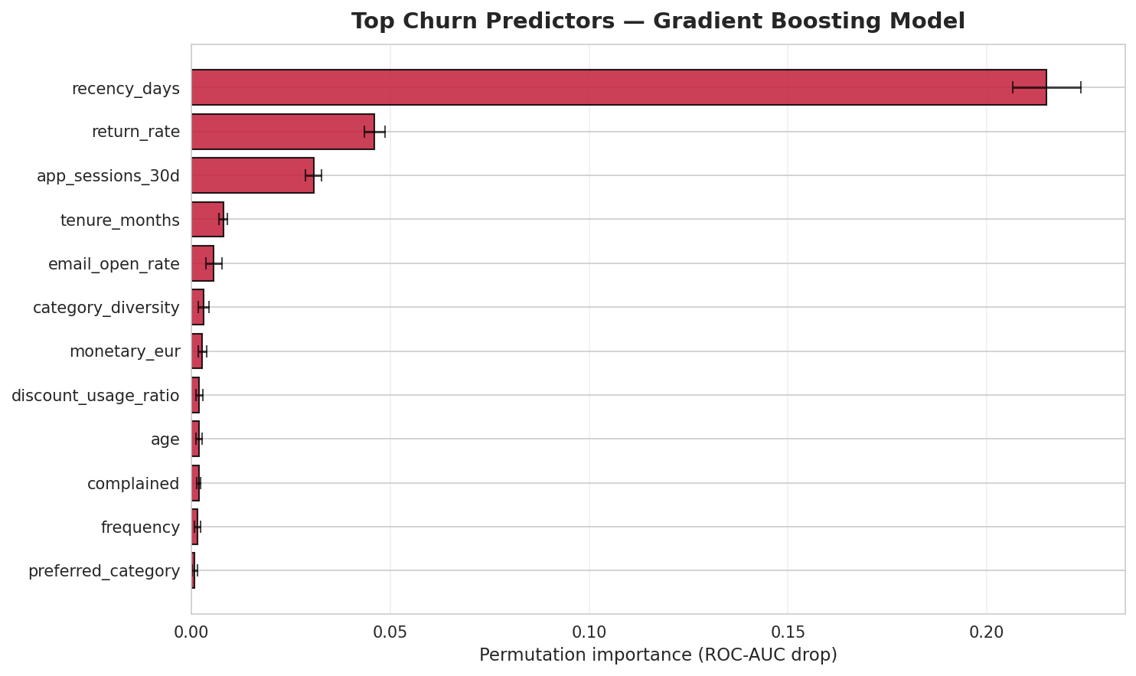
07 · Interpretation
Recency, returns, and app engagement drive churn
Top 3 predictors
1
Recency (days)
0.21 AUC drop when permuted — an order of magnitude ahead. Mirrors Mena et al. (2023) time-varying RFM result.
2
Return rate
0.045 AUC drop. Heavy returners churn — El Kihal et al. (2025) finds return rates rise 48% from a customer's 1st to 10th purchase.
3
App sessions (30d)
0.030 AUC drop. Directly actionable — Zara already has 218M app users and 8.1B annual visits.
Zara Customer Churn Prediction · AI-Driven Predictive Analytics
08 / 10

Slide 9
08 · Recommendations
A 6-part retention playbook for Zara
Mapping churn signals to app-native, scarcity-driven actions — preserving Zara's no-loyalty brand identity.
01
02
03
Daily app churn scoring
Fit personalisation
Scarcity over discount
Score all 218M active users; push notifications to those with p(churn) > 0.6.
Attack return-rate predictor via size-prediction / virtual try-on (Stitch Fix: −30% returns).
Restock alerts and "last-few-in-your-size" instead of price cuts — preserves margin.
04
05
06
Zara Insider tier
Editorial win-back
RFID clienteling
Early-drop access and RFID in-store reserve for top-CLV — status without points.
Klaviyo fashion benchmark: 1.4% reactivation from content-led campaigns.
Feed in-store try-on data into the model; captures signals invisible to e-commerce alone.
Zara Customer Churn Prediction · AI-Driven Predictive Analytics
09 / 10

Slide 10
CONCLUSION
What we built, and what comes next
DELIVERED
LEARNED
NEXT STEPS
End-to-end churn pipeline on 10,000 synthetic Zara customers
Recency alone drives ~80% of predictive signal
Scale to full H&M 31M-transaction Kaggle dataset
Gradient Boosting: ROC-AUC 0.882, F1 0.695, accuracy 81.8%
Return rate is the strongest behavioural churn signal
Upgrade to XGBoost/LightGBM with Optuna Bayesian tuning
Outperformed Logistic Regression baseline on 5 of 6 metrics
App engagement is directly actionable for a no-loyalty brand
Add SHAP values for per-customer explainability
Thank you.
Code, data, plots, and paper in the attached project folder.
10 / 10

