Slide 1
Computer Organization and Assembly Language
Lecture # 01

Slide 2
Why study computer organization?
What are the concern of successful programmers?
  Performance of their programs
What was the main constraints in on computer performance in early development decades?
  The size of the computer’s memory
Advances in computer design and memory have greatly reduced the importance of small memory size
Now programmers care about efficiency of their programs.
But what they need to know about improving efficiency of the programs?
  The understanding of what is below your code
What is below the code/program?
  The knowledge of computer organization

Slide 3
Why study computer organization? (Contd.)
After this course, you will be able to answer the following questions:
  How are programs written in a high-level language translated into machine level?
  How does the hardware execute the resulting program?
  What is the interface between the soft ware and the hardware?
  How does soft ware instruct the hardware to perform needed functions?
  What determines the performance of a program?
  How can a programmer improve the performance?
  What techniques can be used by hardware designers to improve performance and energy efficiency?

Slide 4
Why study computer organization? (Contd.)
Let’s take an example:
Could the following C program be improved?
if (i == j)
f = g + h;
else
f = g – h;

Slide 5
Why study computer organization? (Contd.)
Here's the Assembly code for the given C statements:
  beq $s3, $s4, Add # Branch if i == j (registers $s3 and $s4)
  sub $s0, $s1, $s2 # f = g - h (register $s0 for f, $s1 for g, $s2 for h)
  j Exit # Jump to Exit (optional)
  Add:
  add $s0, $s1, $s2 # f = g + h (register $s0 for f, $s1 for g, $s2 for h)
  Exit:

Slide 6
Why study computer organization? (Contd.)
Explanation:
  beq $s3, $s4, Add: This instruction still checks if i == j are equal.
  sub $s0, $s1, $s2: This instruction is placed after the beq. If the condition is not met (i.e., i != j), the program continues executing instructions sequentially, and this instruction performs the subtraction for the "not equal" case.
  j Exit (optional): This instruction remains to unconditionally jump to Exit if the condition in the beq is true (i.e., i and j are equal). This ensures the program skips the sub instruction for the "equal" case.
  Add:: This label and the following add instruction remain unchanged, handling the "equal" case.

Slide 7
Why study computer organization? (Contd.)
The Assembly code for the same C program but using bne statement:
  bne $s3, $s4, Sub # Branch if i != j (registers $s3 and $s4)
  add $s0, $s1, $s2 # f = g + h (register $s0 for f, $s1 for g, $s2 for h)
  j Exit # Jump to Exit (optional)
  Sub:
  sub $s0, $s1, $s2 # f = g - h (register $s0 for f, $s1 for g, $s2 for h)
  Exit:

Slide 8
Why study computer organization? (Contd.)
Determining which code, using beq or bne, is more efficient depends on the expected distribution of values in the registers being compared. Here's a breakdown of the efficiency considerations:
  Branch Penalty. A branch penalty refers to the performance overhead incurred when executing a branch instruction. It includes
    Pipelining
    Branching and Pipelining:
    The Penalty:
  Code Structure

Slide 9
Why study computer organization? (Contd.)
How it happens?
  Pipelining:
    It divides the execution of instructions into multiple stages like fetching, decoding, execution, memory access, and writing results.
    It allows multiple instructions to be processed simultaneously, potentially improving performance.
  Branching and Pipelining:
    When a branch instruction (e.g., if, else statements) is encountered, the processor needs to determine which path (true or false) to take after the branch condition is evaluated.
    However, in a pipelined processor, the instructions following the branch might already be fetched and partially processed before the branch condition is determined.
  The Penalty:
    If the branch prediction (predicting which path is likely) is incorrect, the fetched instructions become useless, and the processor needs to:
      Flush (discard) these instructions.
      Fetch and start processing instructions from the correct path.
      This flushing and re-fetching process introduces a delay, impacting the overall performance. This delay is the branch penalty.

Slide 10
Why study computer organization? (Contd.)
How Code Structure affects the performance?
  Choosing between beq and bne:
  If the "equal" case is more likely to occur: Using beq can be slightly more efficient because it avoids the branch penalty.
  If the "not equal" case is more likely to occur, and it involves more instructions: Using bne might be beneficial as it avoids the branch penalty in the more frequent and costly scenario.
  Analyze the number of instructions in each branch of the conditional statement. If the "not equal" case involves more instructions, using bne as the first test might be advantageous as it avoids unnecessary branch penalties.

Slide 11
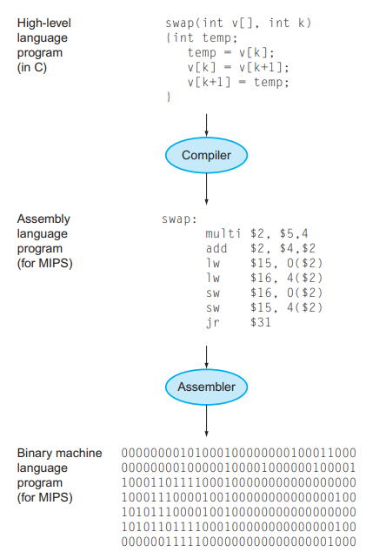
High Level to Machine Level

Slide 12
Measuring Performance
What is the measure of computer performance?
  Time is the measure of computer performance. Program execution time is measured in seconds per program.
What is elapsed time?
  Elapsed time is the total time to complete a task that includes disk accesses, memory accesses, input/output (I/O) activities, operating system overhead—everything.
A processor may work on several programs simultaneously. In such cases, the system may try to optimize throughput rather than attempt to minimize the elapsed time for one program.
  Hence, we often want to distinguish between the elapsed time and the time taken by CPU to execute a program.
What is CPU execution time?
  The time that CPU spends computing for a task and does not include time spent waiting for I/O or running other programs.

Slide 13
Measuring Performance
Computers are constructed using a clock that determines when events take place in the hardware.
  These discrete time intervals are called clock cycles
What is Clock Cycle?
  Designers refer to the length of a clock period both as the time for a complete clock cycle (e.g., 250 picoseconds, or 250 ps)
What is Clock Rate?
  The clock rate (e.g., 4 gigahertz, or 4 GHz), which is the inverse of the clock period

Slide 14


CPU Performance and Its Factors
A simple formula relates the most basic metrics (clock cycles and clock cycle time) to CPU time:
Alternatively, because clock rate and clock cycle time are inverses,

Slide 15
CPU Performance and Its Factors
This formula makes it clear that the hardware designer can improve performance by reducing the number of clock cycles required for a program or the length of the clock cycle.
The designer often faces a trade-off between the number of clock cycles needed for a program and the length of each cycle.
  Many techniques that decrease the number of clock cycles may also increase the clock cycle time.

Slide 16
Example: Improving Performance
A program runs in 10 seconds on computer A, which has a 2 GHz clock. We are trying to help a computer designer build a computer B, which will run this program in 6 seconds. The designer has determined that a substantial increase in the clock rate is possible, but this increase will affect the rest of the CPU design, causing computer B to require 1.2 times as many clock cycles as computer A for this program. What clock rate should we tell the designer to target?

Slide 17
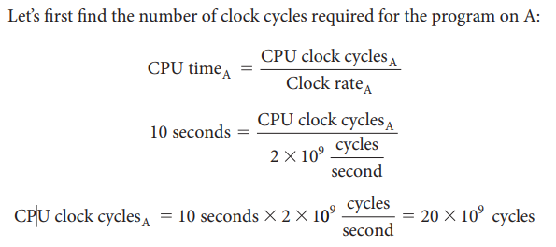
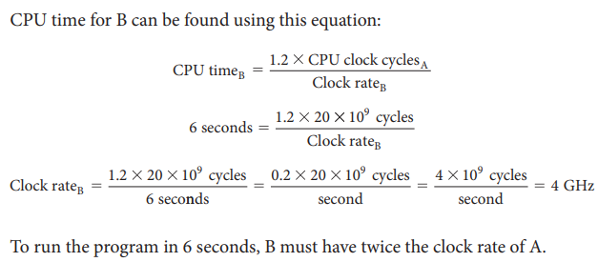
Example: Improving Performance

Slide 18

Instruction Performance
The performance equations above did not include any reference to the number of instructions needed for the program.
However, since the compiler clearly generated instructions to execute, and the computer had to execute the instructions to run the program, the execution time must depend on the number of instructions in a program.
  Then execution time = Number of instructions x Average time per instruction.
  Therefore, the number of clock cycles required for a program can be written as

Slide 19
Instruction Performance
What are clock cycles per instruction?
  It is the average number of clock cycles a processor takes to execute a single instruction and abbreviated as CPI
  A lower CPI indicates that a processor is more efficient, as it can execute instructions in fewer cycles.
What does CPI offer?
  It provides one way of comparing two different implementations of the same instruction set architecture, since the number of instructions executed for a program will, of course, be the same.

Slide 20
Example: Instruction Performance
Suppose we have two implementations of the same instruction set architecture. Computer A has a clock cycle time of 250 ps and a CPI of 2.0 for some program, and computer B has a clock cycle time of 500 ps and a CPI of 1.2 for the same program. Which computer is faster for this program and by how much?

Slide 21
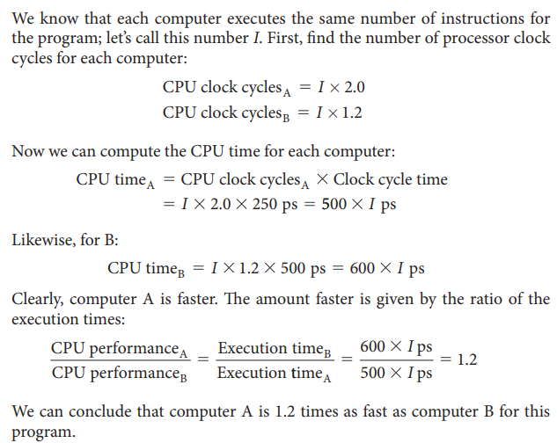
Example: Instruction Performance

Slide 22

The Classic CPU Performance Equation
The basic performance equation in terms of instruction count (the number of instructions executed by the program), CPI, and clock cycle time:
or, since the clock rate is the inverse of clock cycle time:

Slide 23
The Classic CPU Performance Equation
Why this formula is useful?
  Because it separate the three key factors that affect performance.
  We can use this formula to compare two different implementations or to evaluate a design alternative if we know its impact on these three parameters.

Slide 24
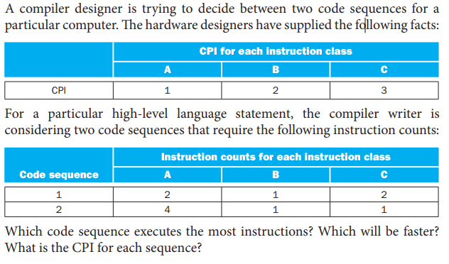
Example: Comparing Code Segments

Slide 25
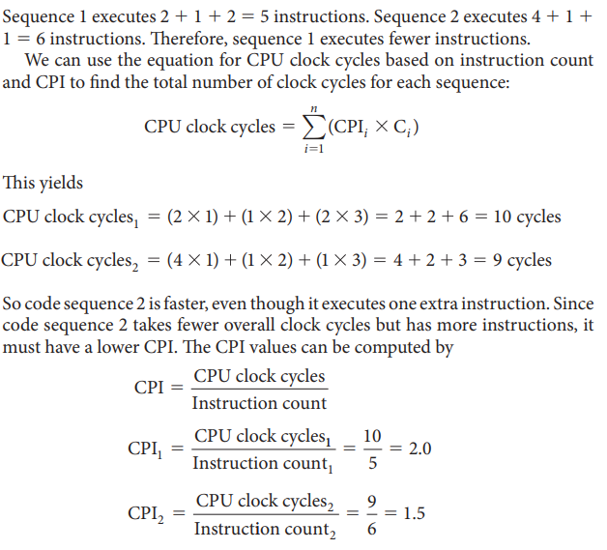
Example: Comparing Code Segments

Slide 26
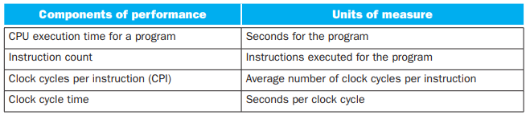
The Classic CPU Performance Equation
Figure shows the basic measurements at different levels in the computer and what is being measured in each case

Slide 27

The Classic CPU Performance Equation
We can see how these factors are combined to yield execution time measured in seconds per program:
Always bear in mind that the only complete and reliable measure of computer performance is time.
For example, changing the instruction set to lower the instruction count may lead to an organization with a slower clock cycle time or higher CPI that off sets the improvement in instruction count.
Similarly, because CPI depends on type of instructions executed, the code that executes the fewest number of instructions may not be the fastest

Slide 28
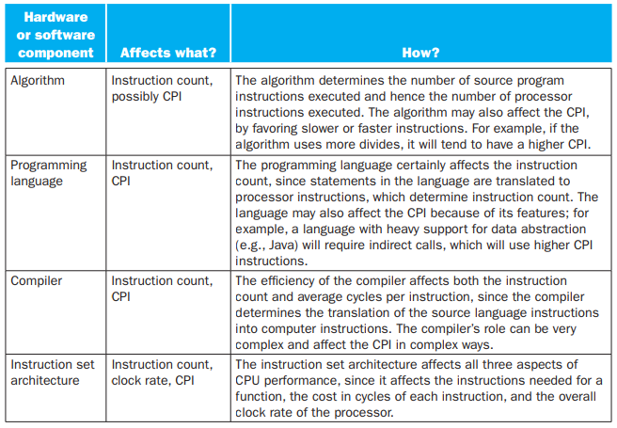
Program Performance
The performance of a program depends on

Slide 29
Elaboration
Although you might expect that the minimum CPI is 1.0, as we’ll see in Chapter 4, some processors fetch and execute multiple instructions per clock cycle.
To reflect that approach, some designers invert CPI to talk about IPC, or instructions per clock cycle. If a processor executes on average 2 instructions per clock cycle, then it has an IPC of 2 and hence a CPI of 0.5.

Slide 30
Elaboration
Although clock cycle time has traditionally been fixed, to save energy or temporarily boost performance, today’s processors can vary their clock rates, so we would need to use the average clock rate for a program.
For example, the Intel Core i7 will temporarily increase clock rate by about 10% until the chip gets too warm. Intel calls this Turbo mode.

