Slide 1
Instructions:
The Language of the Computer
Lecture # 02
Computer Organization and Assembly Language

Slide 2
Computer Instructions
What are the instructions?
  The commands that tell a computer what to do.
  The instructions are written in a programming language, which is a language that a computer can understand.
What is instruction set?
  An instruction set is also known as an instruction set architecture (ISA)
  It is a set of commands that a processor can understand and execute
  These instructions tell the processor what operations to perform, such as arithmetic, data manipulation, and input/output operations
What is specific purpose of ISA?
  The ISA acts as an interface between the hardware and the software, specifying both what the processor is capable of doing as well as how it gets done.
How many ISA we have?
  Common ISAs include x86, ARM, PowerPC, RISC-V and MIPS

Slide 3
Why MIPS Instruction Set?
In this course, we will focus on MIPS architecture and why?
  Its is an elegant example of the instruction sets designed since the 1980s.
Feature | MIPS | ARM | x86 | RISC-V
Complexity | Simpler | More Complex | Most Complex | Moderately Complex
Open Source | Yes | Less Open | Closed Source | Open Source
Focus on Concepts | Strong | Moderate | Weak | Moderate
Documentation | Extensive | Good | Moderate | Growing

Slide 4
Why MIPS Instruction Set? (Contd.)
Why MIPS is often chosen as a base for studying computer architecture over ARM, x86, or RISC-V?
  Simplicity
    MIPS has a simple and regular instruction set architecture (ISA)
    Easier for students to understand the fundamental concepts of computer architecture, like pipelining, caching, and hazard detection
    Its clean design allows focusing on core concepts without the complexities of legacy architectures like x86.
  Open Source
    Its open-source license
    Freely available tools and simulators are crucial for hands-on learning
  Focus on Concepts
    Unlike x86 which has grown complex over time due to backward compatibility, MIPS offers a clean separation between core concepts and implementation details
  Well-Documented
    MIPS has extensive and well-maintained documentation, making it easier for students to learn about the architecture and its features

Slide 5
Operations of the Computer Hardware
Every computer must be able to perform arithmetic.
For Example, the MIPS assembly language notation
  add a, b, c
  It instructs the computer to add the two variables b and c and to put their sum in a
How many operations can be performed in single MIPS instruction?
  Each MIPS arithmetic instruction performs only one operation and must always have exactly three variables.
For example, a = b+c+d+e follows the sequence as given below:
  add a, b, c # The sum of b and c is placed in a
  add a, a, d # The sum of b, c, and d is now in a
  add a, a, e # The sum of b, c, d, and e is now in a
  Thus, it takes three instructions to sum the four variables.

Slide 6
Operands of the Computer Hardware
Where are operands in Assembly language?
  Operands of arithmetic instructions are in limited number of special locations in hardware and called registers
What are registers?
  Registers are high-speed temporary storage units built directly into the central processing unit (CPU)
  They act as the CPU's immediate workspace, holding data and instructions that are currently being processed
What is the size of MIPS registers?
  The size of a register in the MIPS architecture is 32 bits

Slide 7
Operands of the Computer Hardware
Variable in Programming vs Registers
Variables in Programming Languages
  Variables are named storage locations in a program's memory
  The programmer creates variables to store data that the program will use during its execution
  In theory, a programming language can allow for an unlimited number of variables, as long as there's enough memory available to store them.
Registers
  Registers are part of the CPU and serve as the CPU's immediate workspace
  They store data and instructions that are currently being processed
  There are a limited number of registers, typically 32 in MIPS processors.

Slide 8
Operands of the Computer Hardware
What is number of registers are increased?
  A very large number of registers may increase the clock cycle time. Because
  Signal Propagation Delay
    Electronic signals take time to travel within a circuit. With a very large number of registers, the distance that signals need to travel to access specific registers increases. This can lead to a delay in accessing and manipulating data in those registers.
  Decoder Complexity
    The CPU needs circuitry to decode instructions and determine which register holds the required data.
    With a large number of registers, this decoding logic becomes more complex, potentially slowing down the entire process.

Slide 9
Operands of the Computer Hardware
How are registered names in MIPS?
  MIPS convention is to use two-character names following a dollar sign to represent a register
  $s0, $s1, . . . for registers that correspond to variables in C
  $t0, $t1, . . . for temporary registers needed to compile the program

Slide 10
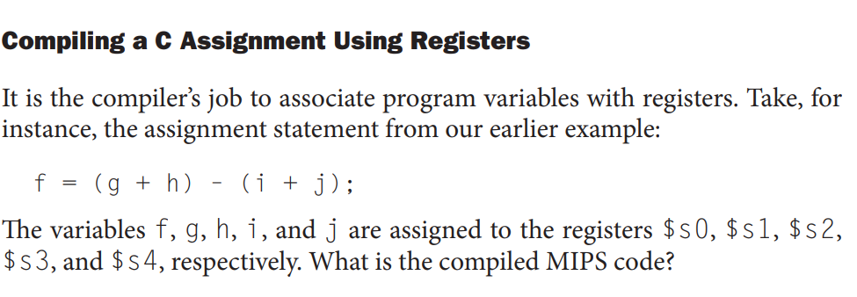
Example:

Slide 11
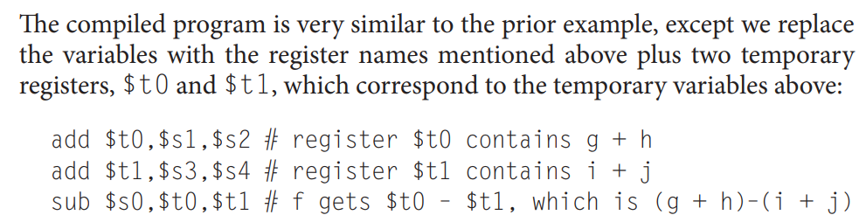
Example

Slide 12
Memory Operands
Programming languages have simple variables that contain single data elements char, int, float, bool.
But there are complex data structures—arrays and structures
  These complex data structures can contain many more data elements than there are registers in a computer
How can a computer represent and access such large structures?
  The processor can keep only a small amount of data in registers
  But computer memory contains billions of data elements
  Hence, data structures (arrays and structures) are kept in memory

Slide 13
Memory Operands
In MIPS, arithmetic operations occur only on registers
But which instructions exchange data between memory and registers?
  Instructions that transfer data between memory and registers are called data transfer instructions
To access a word in memory, the instruction must supply the memory address
What is memory address?
  Memory is just a large, single-dimensional array, with the address acting as the index to that array, starting at 0.

Slide 14
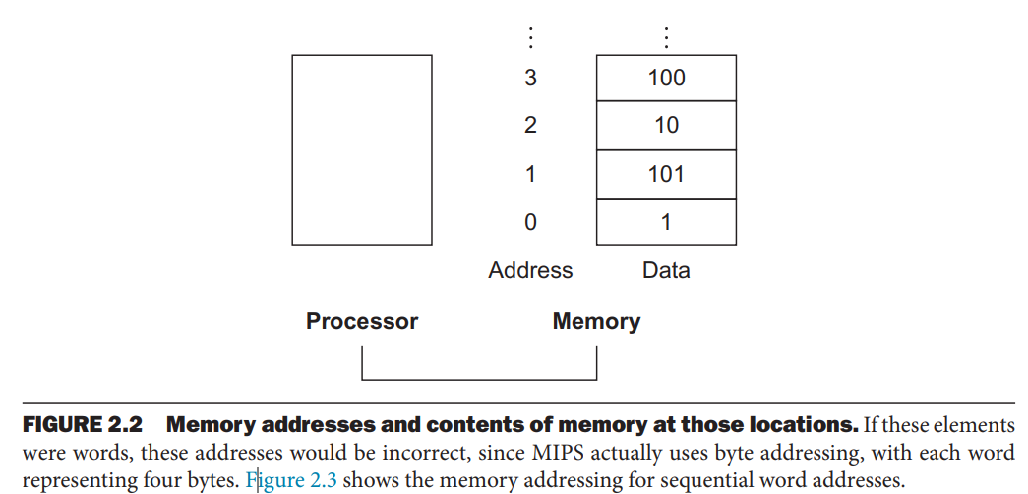
Memory Operands
The address of the third data element is 2
The value of Memory [2] is 10

Slide 15
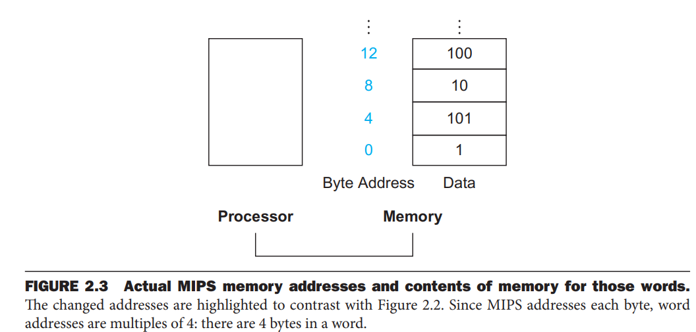
Memory Operands

Slide 16
Memory Operands: Load Word instruction
What instruction is used to copy data from memery to a register?
  Data transfer instruction that copies data from memory to a register is called lw load word instruction
  It load a word (4 bytes) of data from memory into a register
Syntax
lw rt, offset(rs)
  rt: specifies the destination register where the loaded word will be stored
  offset: This is a signed 16-bit integer that represents the memory address relative to the base register (rs).
  rs: specifies the base register that holds the starting memory address. The data will be loaded from address(rs) + offset.

Slide 17
Example: lw Instruction
Let’s assume that A is an array of 100 words and that the compiler has associated the variables g and h with the registers $s1 and $s2 as before.
Let’s also assume that the starting address, or base address, of the array is in $s3.
Compile this C assignment statement:
g = h + A[8];

Slide 18
Example: lw Instruction (Contd.)
One of the operands is in memory which is A[8]
We must first transfer A[8] to a register because add instruction works on two registers add dest, src1, src2
lw $t0,8($s3) # Temporary reg $t0 gets A[8]
  What is destination register?
    rt: the destination register is $t0,8
  What is offset?
    8
  What is base register?
    rs: specifies the base register $s3, represents Array A
ADD can operate on $t0 (which equals A[8]) and $S2
add $s1,$s2,$t0 # g = h + A[8]
Then store the sum in the register $s1

Slide 19
Memory Operand
For arrays and structures, which address is stored in register?
  Starting address of the arrays and structures into the register using the data transfer instructions.
What is meant by word in computer architecture?
  A word is a larger unit of data storage, typically consisting of 4 bytes (32 bits) in many architectures, including MIPS.
What is byte addressable memory?
  The CPU can access and manipulate individual bytes of data in memory
What is word addressable memory?
  The CPU can access and manipulate individual words in memory as show in Figure 2.3
Can the CPU access individual bytes if its word addressable memory?
  If a word address is specified (e.g., the starting address of a word), that address actually corresponds to the memory location of one of the 4 bytes within that word
  This is because the byte-addressable memory allows you to access any of those 4 bytes individually using slight variations of the word address

Slide 20
Memory Operand
What is endianness in computer architecture?
  The order in which bytes are arranged to form a multi-byte data type (like a word) in memory. There are two main conventions: Big-Endian and Litter Endian
What is Big-Endian?
  The most significant byte (MSB) of the data is stored at the lowest memory address. MIPS architecture is indeed big-endian.
What is Little-Endian?
  The least significant byte (LSB) of the data is stored at the lowest memory address.

Slide 21
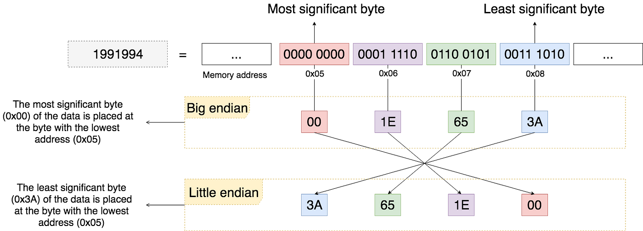

Slide 22
Memory Operand: Store Word
What is a store word instruction:
  The instruction to copies data from a register to memory is called store word instruction
  Its denoted by sw, and is used to store a word (4 bytes) of data from a register into memory
sw rt, offset(rs)
  rt:
    specifies the source register that holds the word (4 bytes) of data to be stored.
    rt can be any of the general-purpose registers in MIPS
  Offset
    This is a signed 16-bit integer that represents the memory address relative to the base register (rs)
  Rs
    specifies the base register that holds the starting memory address
    The data will be stored at address(rs) + offset.

Slide 23
Example: Store Word Instruction
Assume variable h is associated with register $s2 and the base address of the array A is in $s3
What is the MIPS assembly code for the C assignment statement below?
A[12] = h + A[8];

Slide 24
Example: Store Word Instruction
First load data from A[12] into $t0
lw $t0,32($s3) # Temporary reg $t0 gets A[8]
Important Difference: This time we use the proper oﬀset for byte addressing in the load word instruction to select A[8]
Seconldy, add h and $t0
add $t0,$s2,$t0 # Temporary reg $t0 gets h + A[8]
Third, stores the sum into A[12], using 48 (4 *12) as the oﬀset and register $s3 as the base register.
sw $t0,48($s3) # Stores h + A[8] back into A[12]

Slide 25
Signed and Unsigned Numbers
Digital systems can handle both positive and negative numbers.
  int, unsigned int, uint8_t, uint16_t, uint32_t, uint64_t, int8_t, int16_t, int32_t, and int64_t
A signed binary number consists of both sign and magnitude information.
  Sign indicates whether a number is positive or negative
  Magnitude is the value of the number
How many ways to represent Signed integer (whole) numbers?
  Sign-magnitude, 1’s complement, and 2’s complement

Slide 26
Sign and Magnitude Form
What and Where is Sign Bit?
  The left-most bit in a signed binary number
  It tells you whether the number is positive or negative
  A 0 sign bit indicates a positive number
  A 1 sign bit indicates a negative number

Slide 27
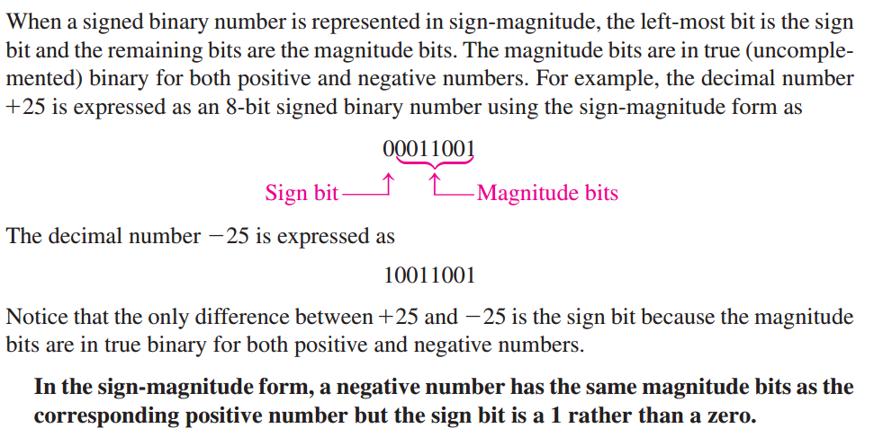
Sign-Magnitude Form

Slide 28
Signed and Unsigned Numbers
What were the shortcomings of sign and magnitude representation?
  It was not obvious where to put the sign bit
  Adders for sign and magnitude may need an extra step to set the sign because we can’t know in advance what the proper sign will be
  A separate sign bit means that sign and magnitude has both a positive and a negative zero, which can lead to problems for inattentive programmers
As a result of these shortcomings, sign and magnitude representation was soon abandoned.

Slide 29
1’s Complement Form
How to represent singed number in 1’s Complement?
  Positive numbers are represented the same way as the positive sign-magnitude numbers.
  Negative numbers are the 1’s complements of the corresponding positive numbers.
What will be 1’s complement of +25 (00011001)?
  -25 is expressed as the 1’s complement of as 11100110
In the 1’s complement form, a negative number is the 1’s complement of the corresponding positive number.

Slide 30
Short Coming of 1’s Complement
The shortcomings of 1's complement representation
Negation
  In 1's complement, negating a positive number is straightforward - you invert all the bits.
  However, negating the minimum negative value (usually represented as all 1's) is problematic.
  Inverting all 1's results in all 0's, which is considered zero in most systems. This creates an ambiguity in representing the most negative number.
Addition and Subtraction
  Adding or subtracting positive numbers using 1's complement involves a straightforward addition process.
  However, handling signed numbers becomes complex.
  1's complement requires an additional step to handle overflow (carry beyond the most significant bit).
  This can complicate arithmetic operations and make them error-prone
Comparison
  Comparing signed numbers in 1's complement is not as intuitive as with 2's complement.
  It requires special handling for negative numbers, making code more complex.
Sign Extension
  When performing arithmetic operations on numbers with different sign extensions (positive or negative), 1's complement requires additional logic to extend the sign bit to all higher-order bits.
  This adds complexity to the hardware design.

Slide 31
2’s Complement Form
How to represent singed number in 2’s Complement?
  Positive numbers are represented same way as in the sign magnitude and 1’s complement forms.
  Negative numbers are the 2’s complements of the corresponding positive numbers.
For example, 2’s complement of +25 (00011001)?
  -25 is by inverting each bit and adding 1, you get -25 = 11100111

Slide 32
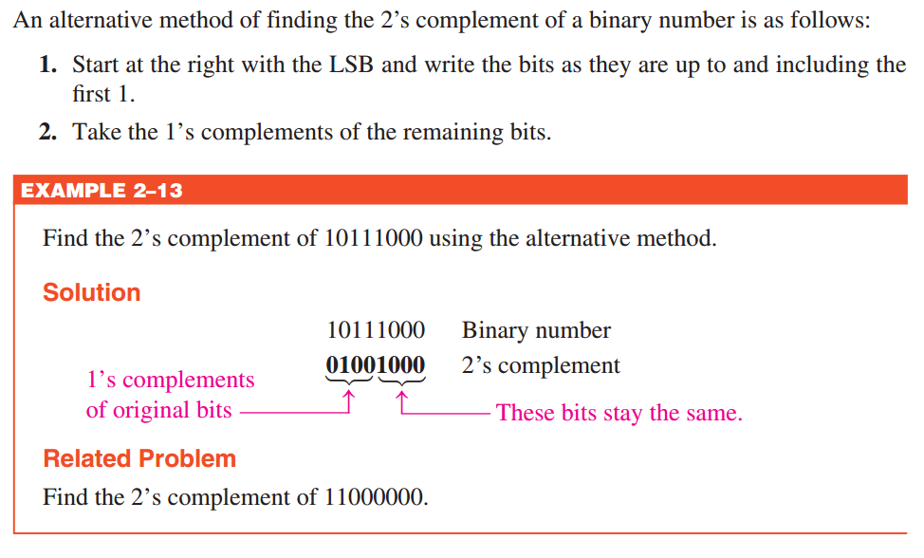

Slide 33
Advantages of 2's Complement:
Simple Negation
  Negating a number is achieved by inverting all the bits and adding 1
  This eliminates the ambiguity of negating the minimum negative value and simplifies the process
Unified Arithmetic
  Both addition and subtraction of signed numbers can be performed using the same addition operation in 2's complement
  Overflow detection is straightforward, making arithmetic logic simpler and more efficient
Intuitive Comparison
  Comparing signed numbers in 2's complement is easier because the sign bit directly indicates the number's positivity or negativity
Sign Extension
  Sign extension in 2's complement involves simply copying the sign bit to all higher-order bits, simplifying hardware design.

Slide 34
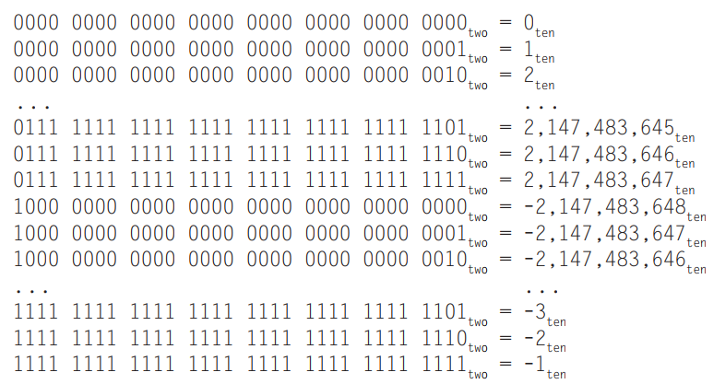
Signed and Unsigned Numbers

Slide 35
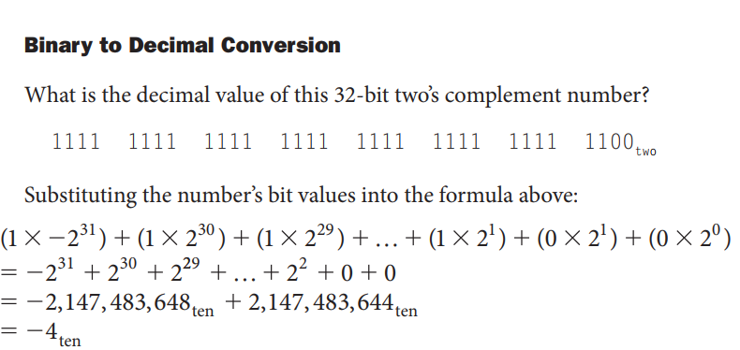

Slide 36
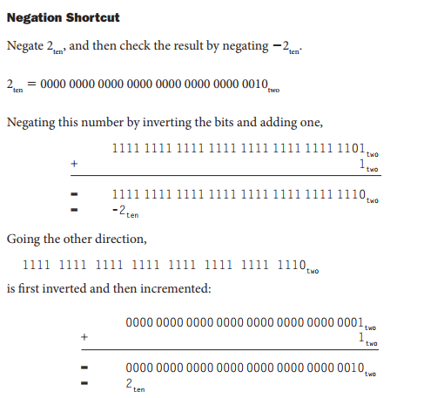

Slide 37
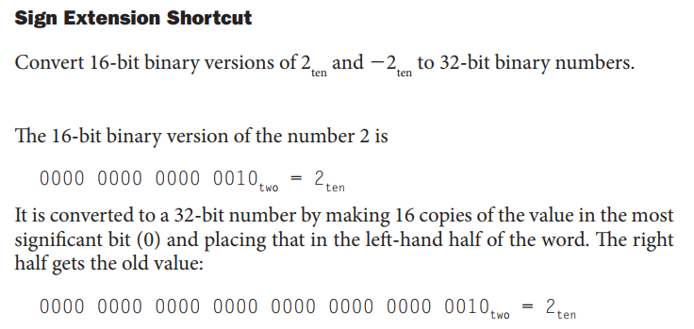

Slide 38
