Slide 1
Instructions: Language of the Computer
Lecture # 07
Computer Organization and Assembly Language

Slide 2
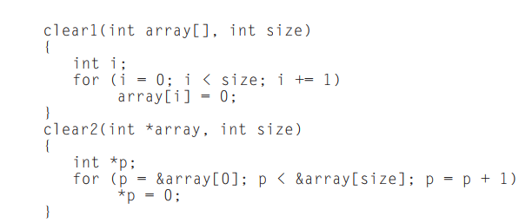
Arrays versus Pointers
This section shows C and MIPS assembly versions of two procedures to clear a sequence of words in memory
  one using array indices
  one using pointers
The purpose of this section is to show how pointers map into MIPS instructions

Slide 3
Array Version
move $t0,$zero
loop1: sll $t1,$t0,2
add $t2,$a0,$t1
sw $zero, 0($t2)
addi $t0,$t0,1
slt $t3,$t0,$a1
bne t3,$zero,loop1
# i = 0
# $t1 = i * 4
# $t2 = address of array[i]
# array[i] = 0
# i = i + 1
# $t3 = (i < size)
# if (i < size) go to loop1

Slide 4
Array Version
In which registers the two parameters array[] and size are stored?
  In the registers $a0 and $a1
Assume that int i is allocated to register $t0
The initialization of i, the first part of the for loop, is straightforward:
move $t0,$zero # i = 0 (register $t0 = 0)

Slide 5
Array Version
To set array[i] to 0 we must first get its address. Start by multiplying i by 4 to get the byte address:
loop1: sll $t1,$t0,2 # $t1 = i * 4
Since the starting address of the array is in a register, we must add it to the index to get the address of array[i] using an add instruction:
add $t2,$a0,$t1 # $t2 = address of array[i]
Finally, we can store 0 in that address:
sw $zero, 0($t2) # array[i] = 0

Slide 6
Array Version
This instruction is the end of the body of the loop, so the next step is to increment i:
addi $t0,$t0,1 # i = i + 1
The loop test checks if i is less than size:
slt $t3,$t0,$a1 # $t3 = (i < size)
bne $t3,$zero,loop1 # if (i < size) go to loop1

Slide 7
Array Version
move $t0,$zero
loop1: sll $t1,$t0,2
add $t2,$a0,$t1
sw $zero, 0($t2
addi $t0,$t0,1
slt $t3,$t0,$a1
bne t3,$zero,loop1
# i = 0
# $t1 = i * 4
# $t2 = address of array[i]
# array[i] = 0
# i = i + 1
# $t3 = (i < size)
# if (i < size) go to loop1

Slide 8
Pointer Version
move $t0,$a0
loop2: sw zero,0($t0)
addi $t0,$t0,4
sll $t1,$a1,2
add $t2,$a0,$t1
slt $t3,$t0,$t2
bne $t3,$zero,loop2
# p = address of array[0]
# Memory[p] = 0
# p = p + 4
# $t1 = size * 4
# $t2 = address of array[size]
# $t3 = (p<&array[size])
# if (p<&array[size]) go to loop2

Slide 9
Pointer Version
The two parameters array and size to the registers $a0 and $a1 and allocates p to register $t0
The code for the second procedure starts with assigning the pointer p to the address of the first element of the array:
move $t0,$a0 # p = address of array[0]
The next code is the body of the for loop, which simply stores 0 into p:
loop2: sw $zero,0($t0) # Memory[p] = 0
This instruction implements the body of the loop, so the next code is the iteration increment, which changes p to point to the next word:
addi $t0,$t0,4 # p = p + 4

Slide 10
Pointer Version
Incrementing a pointer by 1 means moving the pointer to the next sequential object in C
Since p is a pointer to integers, each of which uses 4 bytes, the compiler increments p by 4.
The loop test is next. The first step is calculating the address of the last element of array. Start with multiplying size by 4 to get its byte address:
sll $t1,$a1,2 # $t1 = size * 4
and then we add the product to the starting address of the array to get the address of the first word after the array:
add $t2,$a0,$t1 # $t2 = address of array[size]

Slide 11
Pointer Version
The loop test is simply to see if p is less than the last element of array:
slt $t3,$t0,$t2 # $t3 = (p<&array[size])
bne $t3,$zero,loop2 # if (p<&array[size]) go to loop2

Slide 12
Pointer Version
move $t0,$a0
loop2: sw zero,0($t0)
addi $t0,$t0,4
sll $t1,$a1,2
add $t2,$a0,$t1
slt $t3,$t0,$t2
bne $t3,$zero,loop2
# p = address of array[0]
# Memory[p] = 0
# p = p + 4
# $t1 = size * 4
# $t2 = address of array[size]
# $t3 = (p<&array[size])
# if (p<&array[size]) go to loop2

Slide 13
Pointer Version
Note that this program calculates the address of the end of the array in every iteration of the loop, even though it does not change.
A faster version of the code moves this calculation outside the loop:
move $t0,$a0 # p = address of array[0]
sll $t1,$a1,2 # $t1 = size * 4
add $t2,$a0,$t1 # $t2 = address of array[size]
loop2: sw $zero,0($t0) # Memory[p] = 0
addi $t0,$t0,4 # p = p + 4
slt $t3,$t0,$t2 # $t3 = (p<&array[size])
bne $t3,$zero,loop2 # if (p<&array[size]) go to loop2

Slide 14
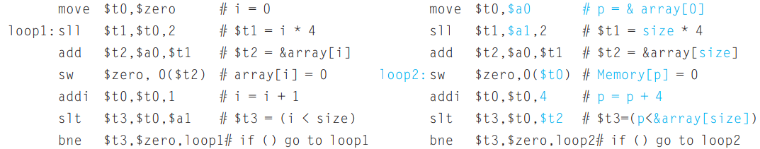
Comparing the Two Versions of Clear
Array version must have the “multiply” and add inside the loop because i is incremented and each address must be recalculated from the new index
Pointer version increments the pointer p directly. The pointer version moves the scaling shift and the array bound addition outside the loop, thereby reducing the instructions executed per iteration from 6 to 4

Slide 15
Comparing the Two Versions of Clear
What is the conclusion?
  This manual optimization corresponds to the compiler optimization of strength reduction (shift instead of multiply) and induction variable elimination (eliminating array address calculations within loops).

