Slide 1
Architecture: PBL Backend (Fix My City API)
DevOps CA2 | Node/Express + MongoDB service, delivered with CI/CD, Ansible, Docker, Kubernetes and Prometheus/Grafana
Application
Delivery
Operations
React frontend
Express API: JWT auth, bcrypt
/health and /metrics endpoints
MongoDB database
GitHub Actions: test, build, deploy
Docker image in GHCR
Kubernetes: 3 replicas, rolling updates
Ansible configures the host
Prometheus scrapes /metrics every 5s
Grafana dashboard
Uptime, latency p95, error rate
Rollback with kubectl rollout undo

Slide 2
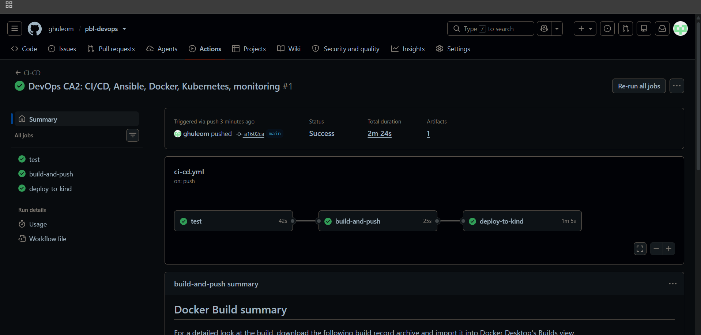
Pipeline flow (GitHub Actions)
Push to main
→
test
npm ci + npm test
→
build-and-push
Docker image to GHCR
→
deploy-to-kind
kubectl apply + rollout
All 3 jobs passed
test: 42s
build-and-push: 25s
deploy-to-kind: 1m 5s
Total: 2m 24s
Workflow: .github/workflows/ci-cd.yml

Slide 3
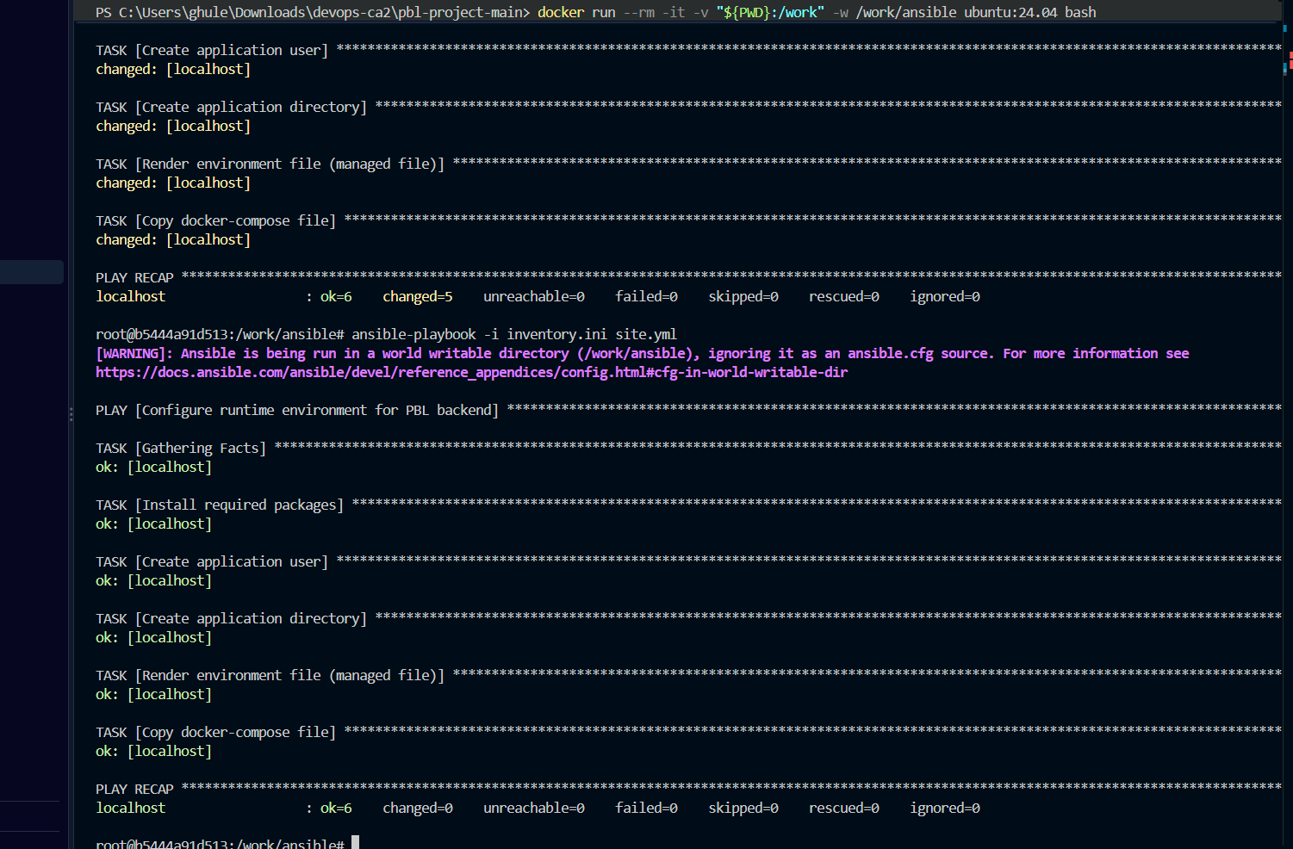
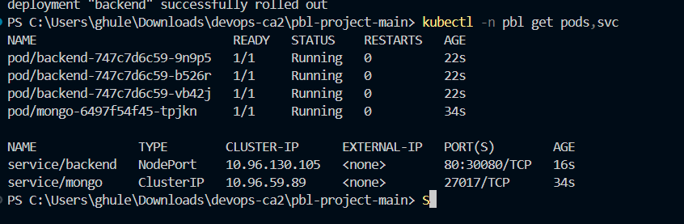
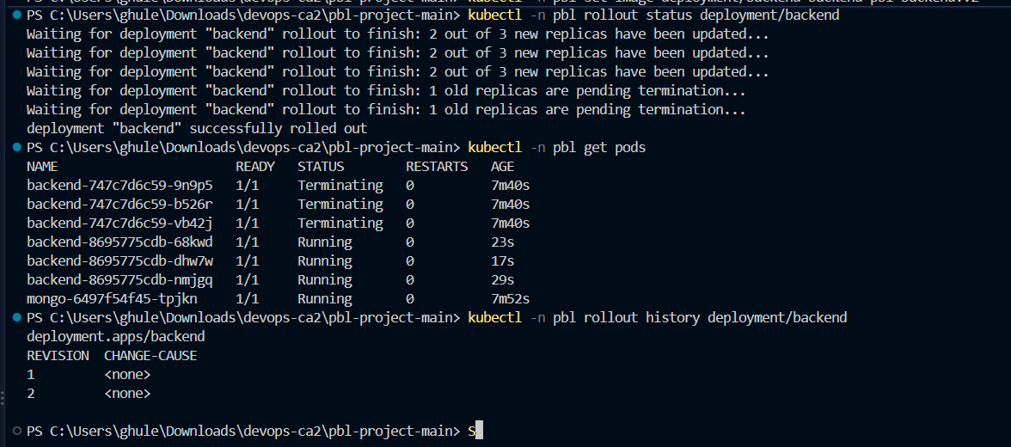
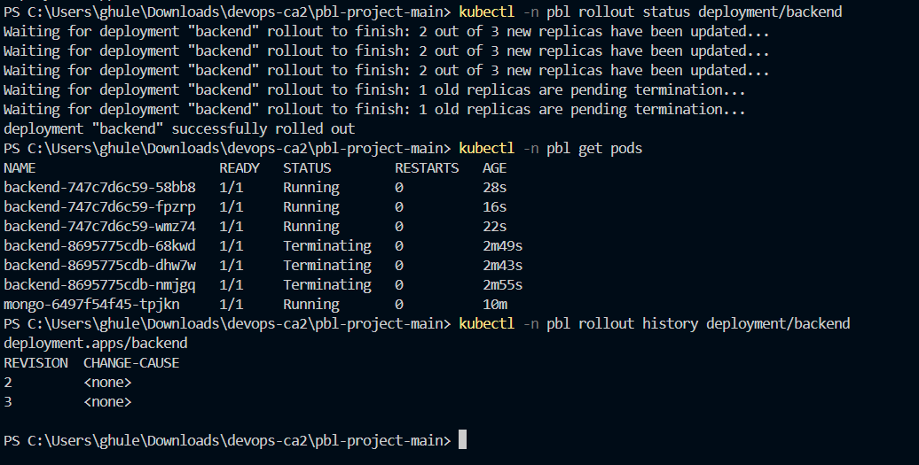
Configuration management, containers and Kubernetes
Ansible: run 1 changed=5, run 2 changed=0 (idempotent)
Kubernetes: 3 backend pods + MongoDB running
Rolling update v1 to v2, zero downtime
Rollback with kubectl rollout undo

Slide 4
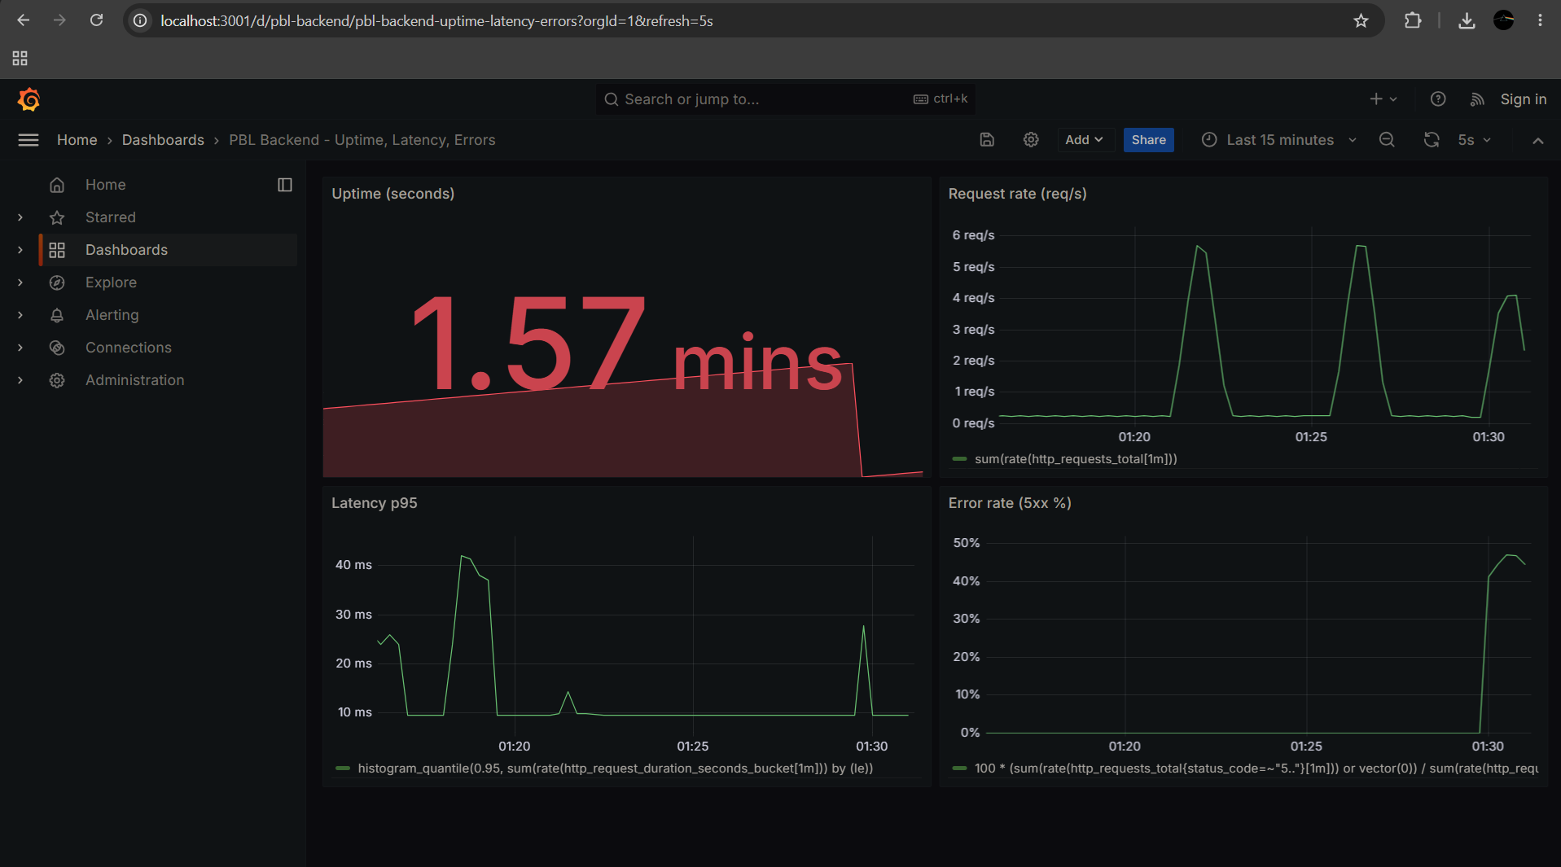
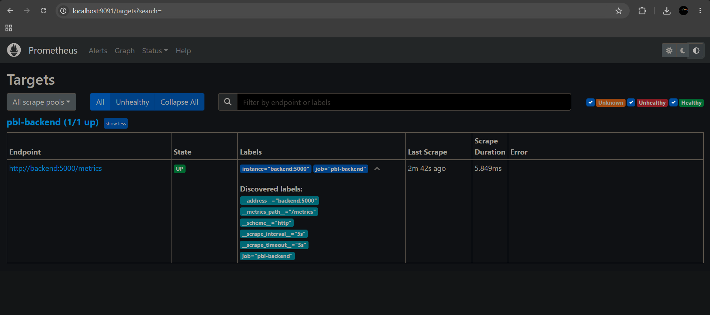
Monitoring with Prometheus and Grafana
Target pbl-backend is UP
Custom metrics: latency histogram and request counter
Error spike generated with a demo /api/error endpoint
Dashboard: uptime, request rate, p95 latency, 5xx error rate

Slide 5
Challenges and lessons learned
Challenges
Lessons learned
Ports 9090 and 8080 blocked, so 9091 and 18080 were used
WSL had no network, so Ansible ran in an Ubuntu container
Grafana error panel had no data until 5xx errors existed
npm test failed on Node 24, script fixed
Secrets kept out of git with .gitignore and a Kubernetes Secret
Readiness probes and maxUnavailable 0 give zero-downtime updates
Rollback is a single command
A histogram and a counter are enough for uptime, latency and errors
Ansible is idempotent: second run changed nothing
Check environment basics first to save time

