Slide 1
OList - Retail Analytics
How OList can manage its Inventory to reduce any unnecessary costs?
Sadanand Ghule
ghulesadanand@gmail.com

Slide 2
The problem
Company
Context
Problem statement
OList is one such e-commerce company that has faced some losses recently
They want to manage their inventory very well so as to reduce any unnecessary costs that they might be bearing.
Need to identify top revenue-generating products and use Market Basket Analysis to identify individual product categories and combinations that can help with sales growth.

Slide 3
Solution
Revenue and Orders by Category
20 Most Ordered Products
Top 20 revenue-generating products
Market Basket Analysis
Key Visualisations

Slide 4
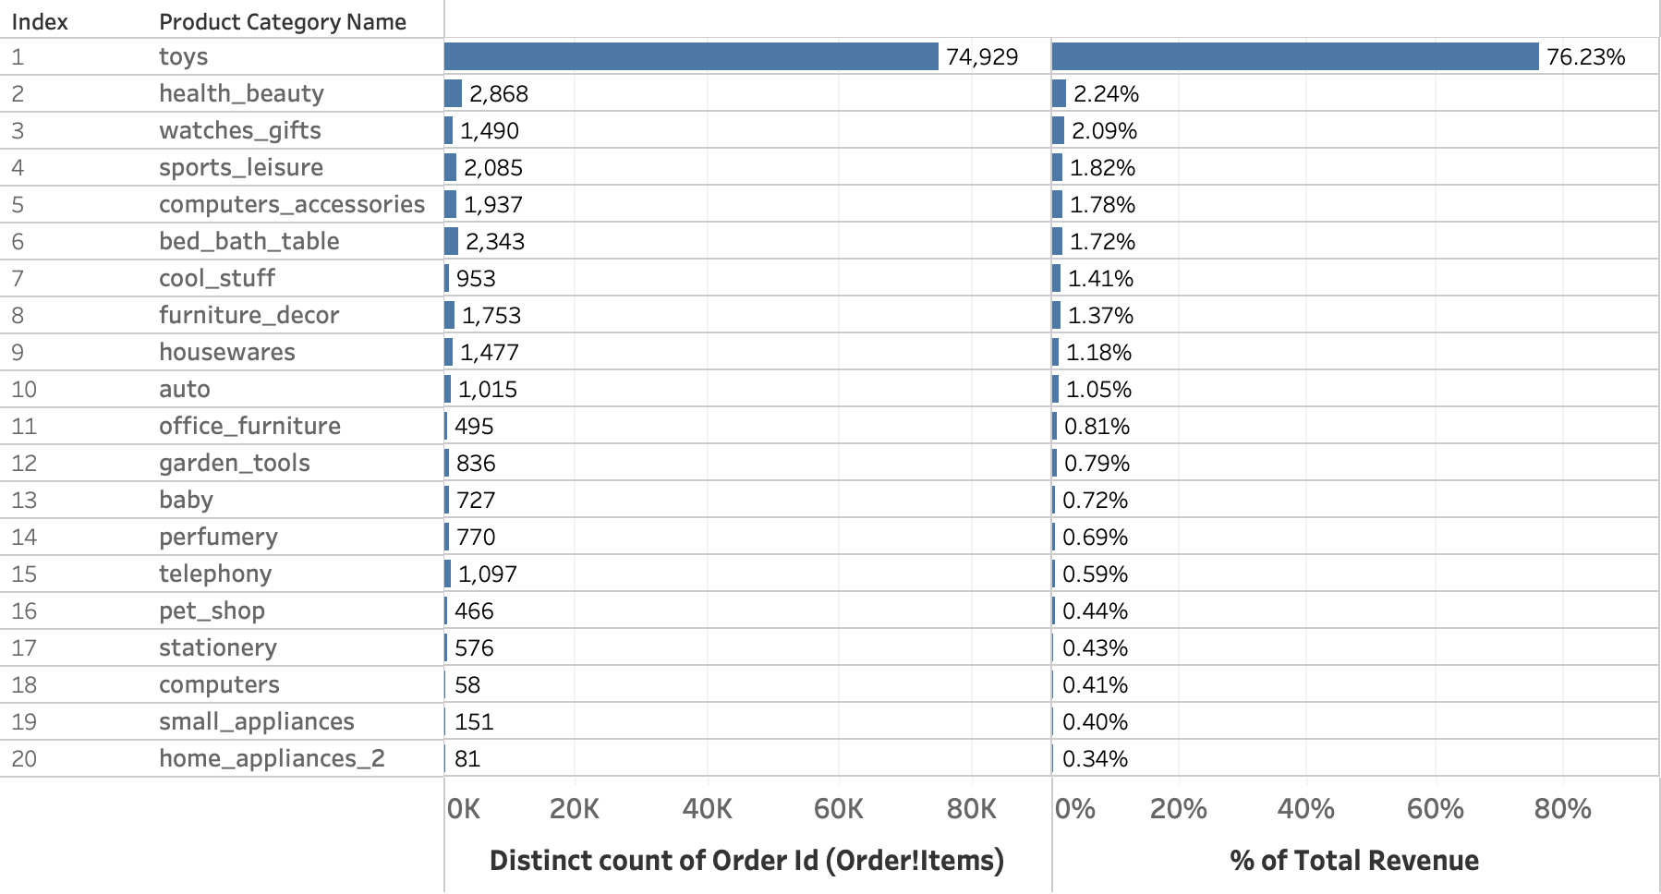
Revenue and Orders by Category

Slide 5
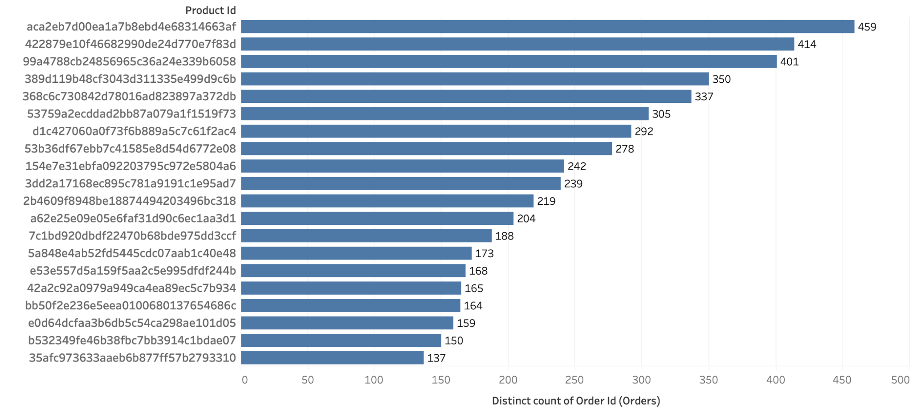
20 Most Ordered Products

Slide 6
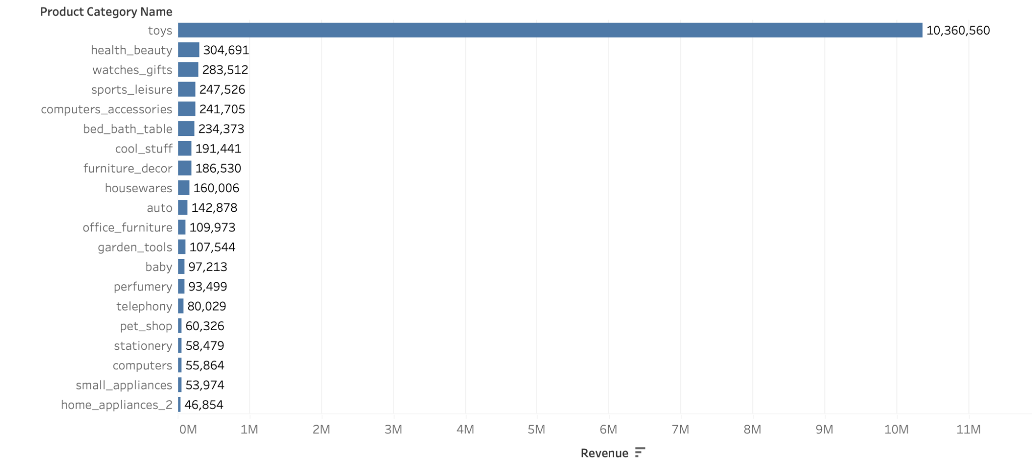
Top 20 revenue-generating products

Slide 7
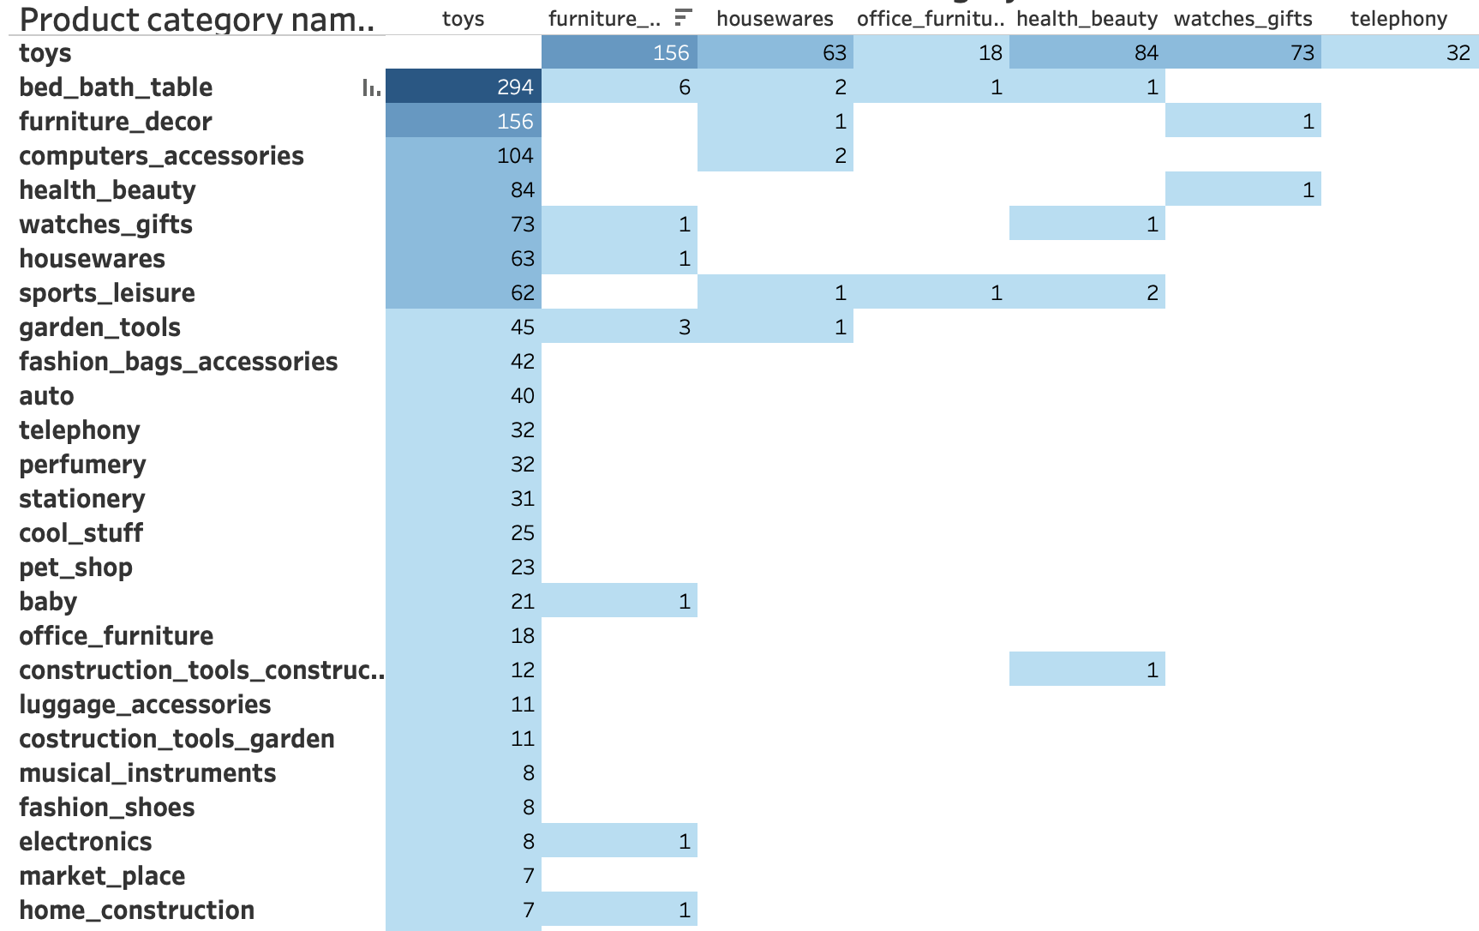
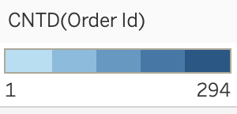
Market Basket Analysis

Slide 8
Toys are most ordered and generate 76.23 % revenue alone
Toys, health_beauty, and watches_gift combined generated 80.56% of the revenues
Key Insights
Top Category
80% orders
80% revenue
5
toys, health_beauty, and bed_bath_table are 80.38% of total orders.

Slide 9
Recommendation
Concentrate on the categories that accounted for more than 80% of total revenue. Always keep them on hand and, if necessary, restock ahead of time.
According to our analysis, customers should be recommended to purchase toys in conjunction with other things that complement them.
Offer discounts on things that work nicely in combination with toys.
Our Target customers are parents and Target consumers are newly born and young children

Slide 10
Summary
The dataset at our disposal is known as "Retail dataset." It is an excel spreadsheet.
The excel file contains five worksheets: orders, order items, customers, payments, and products.
We have a lot of duplicates and null values in our data.
In the jupyter notebook, we filter the values and produce a separate cleaned file.
Following completion of the treatment, the cleaned data was exported to the Retail dataset cleaned excel file with the same sheet names.
Tableau is used for visualising data on various items and product categories, as well as for Market Basket Analysis.
For Market Basket Analysis, we must build a distinct dataset using the original dataset in Excel.
Finally, a market basket analysis for various combinations is performed.

Slide 11
Thankyou
“Knowledge is power in business, and data is the fuel that creates this power“

