Slide 1
PyTorch Introduction
Tutorial by Geoff Hulten

Slide 2
Outline
Part of pytorch vid series
1) how to install (with windows)
2) this video about the basic building blocks
3) simple progression of neural network model structures
4) overview of how to do modeling, with example for Kaggle
5) detailed walk through of model tuning – less on how to use pytorch, more what to do with it.
So for this video talk about hello world with pytorch with a tiny bit of theory behind the elements
1) the components of a pytorch implementation for learning a neural network
2) adding the GPU
3) Moving beyond toy problems and the basics of scaling up

Slide 3
What is PyTorch
Deep learning – lose my PhD
PyTorch
‘a deep learning research platform that provides maximum flexibility and speed’
Lets you set up neural networks in a relatively simple way
Makes it easy to train them by automatically handling lots of the mathy parts of the backpropagation training algorithm
An alternative to TensorFlow
Historically easier to use (may not be as true)
Was #2 for a while, but has a lot of momentum lately, may be the top choice now

Slide 4
Steps for working with PyTorch (hello world style)
Load data
Get the data into PyTorch’s data structures
Set up the model training components
Neural Network structure to use
Loss function
Optimizer
Perform iterations of the back propagation algorithm until you’re happy
Evaluate the model – evaluation is creation

Slide 5
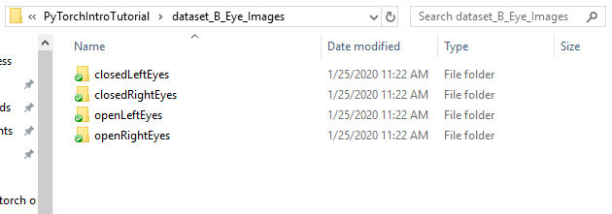
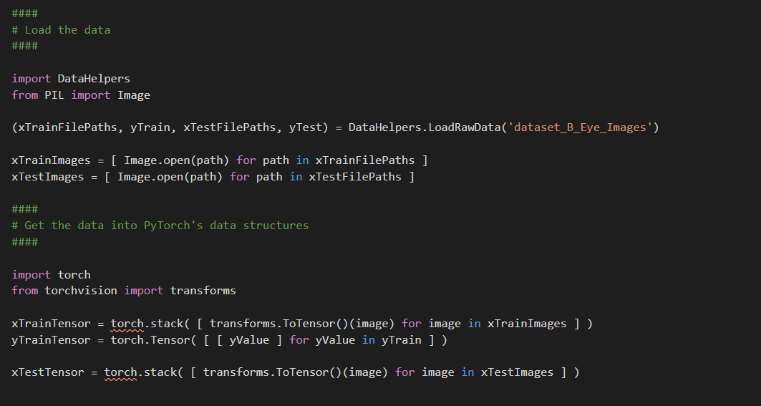
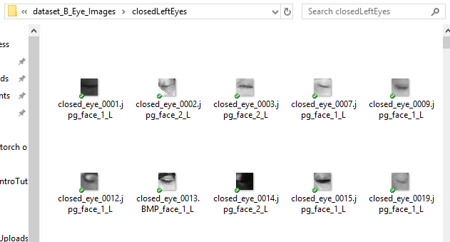
Load Data & PyTorch Structures

Slide 6

Load Data & PyTorch Structures

Slide 7
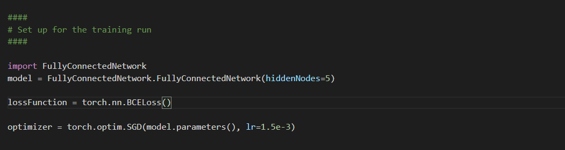

Slide 8





Neural Networks
$$N_{1}$$
$$x_{1}$$ | 1.0
$$x_{2}$$ | 0.5
$$y$$ | 1
$$N_{3}$$
$$\hat{y}=[ the prediciton ]$$
$$N_{2}$$
Input Sample
Hidden Layer
Output Layer

Slide 10
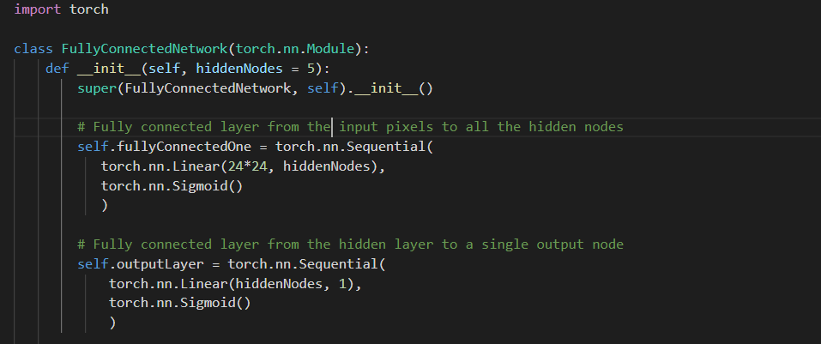
Network Structure in PyTorch
Sigmoid

Slide 11












Forward Propagation
$$Activation_{1}$$
$$=Sigmoid( {1.0 ∗w}_{1−0} +$$
$x_{1} ∗w_{1−1} +$
$x_{2} ∗w_{1−2} )$
$$w_{1−0}$$
$$w_{1−1}$$
$$w_{1−2}$$
$$N_{1}$$
$$x_{1}$$ | 1.0
$$x_{2}$$ | 0.5
$$y$$ | 1
$$w_{3−0}$$
$$w_{3−1}$$
$$w_{3−2}$$
$$N_{3}$$
$$\hat{y}= .82$$
$$Activation_{2}$$
$$output$$
$=Sigmoid({ 1.0 ∗w}_{3−0} +$
${Activation}_{1}∗w_{3−1}+$
${Activation}_{2}∗w_{3−2} )$
$$w_{2−0}$$
$$w_{2−1}$$
$$w_{2−2}$$
$$N_{2}$$
Input Sample
Hidden Layer
Output Layer

Slide 12
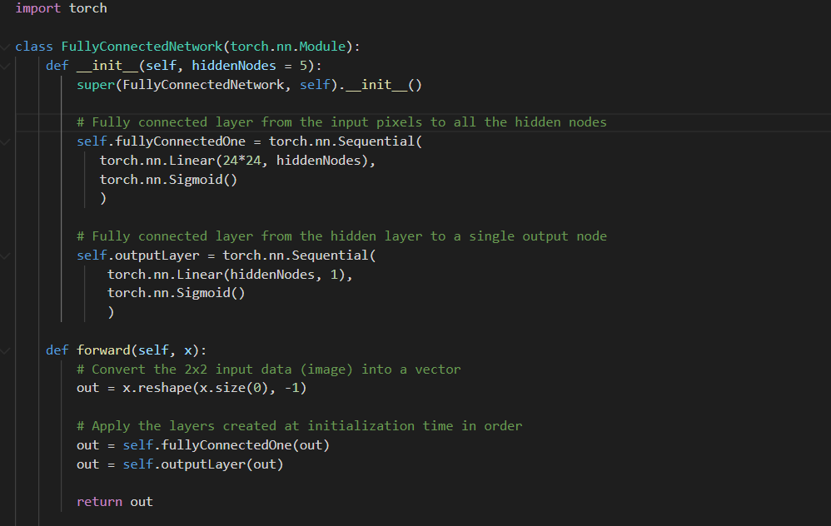

Slide 14





Loss
$$Loss\left(y, \hat{y}\right)=$$
$MSE\left(y, \hat{y}\right)={\left(y −\hat{y}\right)}^{2}$
$$BCE\left(y, \hat{y}\right)=y ∗−\log\left(\hat{y}\right) +$$
$\left(1−y\right) ∗−log(1−\hat{y})$
$$w_{1−0}$$
$$w_{1−1}$$
$$w_{1−2}$$
$$N_{1}$$
$$x_{1}$$ | 1.0
$$x_{2}$$ | 0.5
$$y$$ | 1
$$w_{3−0}$$
$$w_{3−1}$$
$$w_{3−2}$$
$$N_{3}$$
$$\hat{y}= .82$$
1
$Loss\left(y, \hat{y}\right)=$ Loss(1, .82)
$$BCE\left(1, .82\right)=0.086186$$
$$w_{2−0}$$
$$w_{2−1}$$
$$w_{2−2}$$
$$N_{2}$$
Input Sample
Hidden Layer
Output Layer

Slide 15





Backpropagation Algorithm
Forward Propagation
Calculate Loss
Back Propagation
Optimize Weights
$$δ_{N_{1}}$$
~0.5
$$x_{1}$$ | 1.0
$$x_{2}$$ | 0.5
$$y$$ | 1
$$δ_{N_{3}}$$
$$\hat{y}= .82$$
3. Figure out how much each part contributes to the error.
2. Figure out how much error the network makes on the sample:
$$error=y^{^}−y$$
~0.75
$$δ_{N_{2}}$$
4. Step each weight to reduce the error it is contributing to

Slide 16
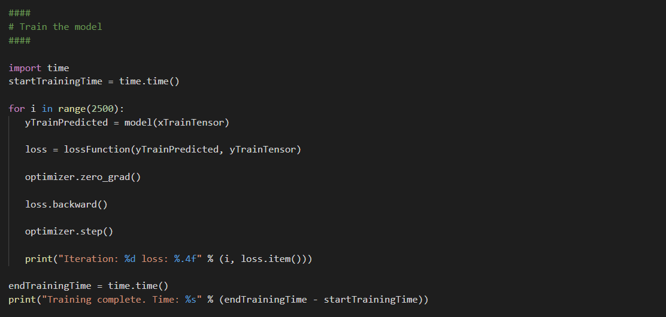
Using Backpropagation in PyTorch
Test for convergence
Extract value from tensor

Slide 17
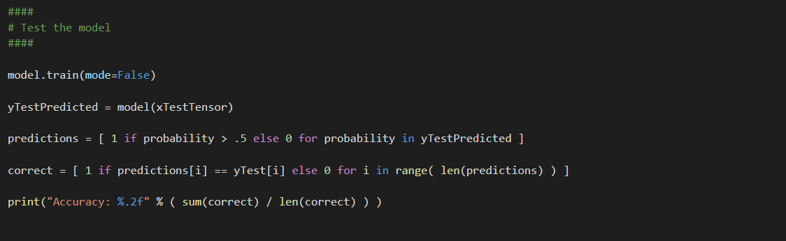
Evaluating the Model

Slide 18
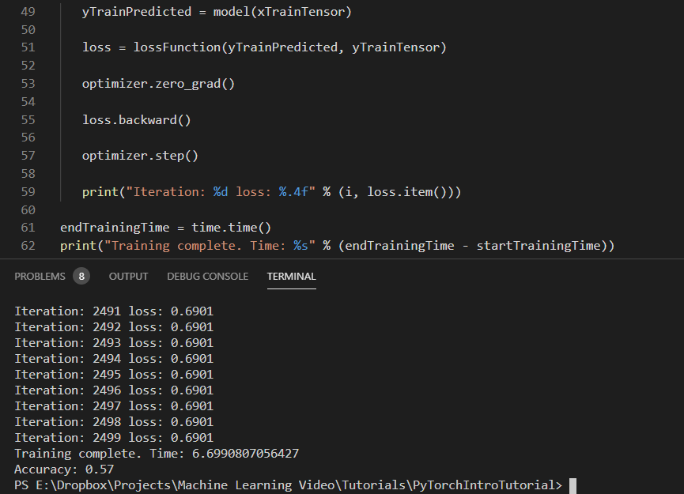
Output of PyTorch ‘Hello World’

Slide 19



PyTorch Modeling Summary
Computer
Load Data
PyTorch Structures
Set up for modeling
Backprop
CPU
Disk
RAM

Slide 20
Adding the GPU
Computer
Graphics Card
Load Data
PyTorch Structures
Set up for modeling
Transfer to GPU RAM
Backprop
CPU
GPU
Backprop
Disk
RAM
RAM
Requires: Nvidia GPU with CUDA Drivers Installed

Slide 21
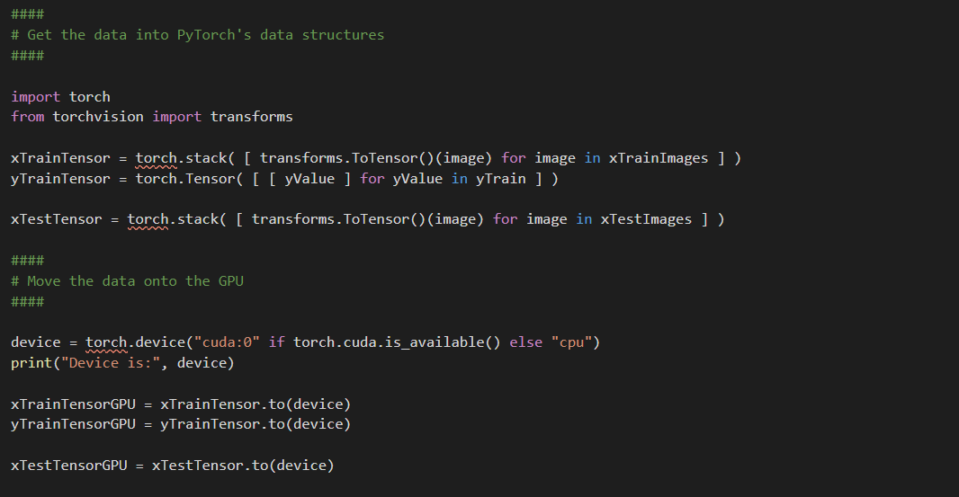
Move Data to Graphics Card RAM

Slide 22
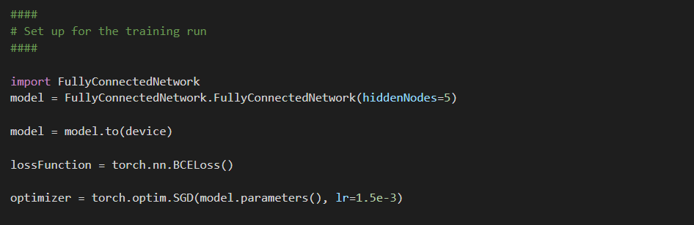
Move Model to Graphics Card RAM

Slide 23
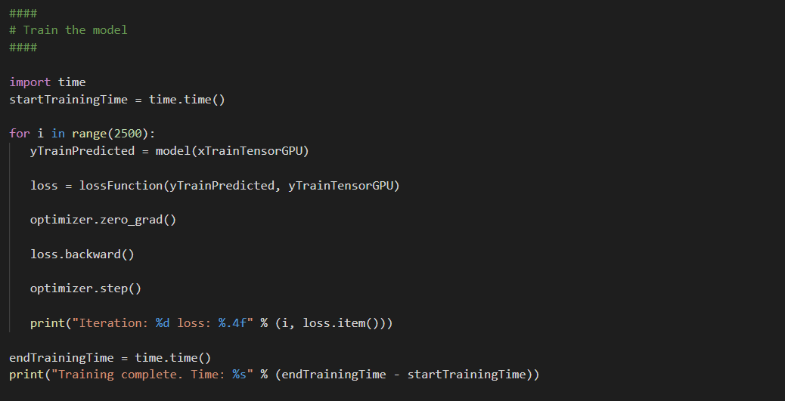
Backprop on GPU
Reference data on GPU
Intermediate results in GPU RAM
loss.item() transfers to CPU for output
Test data to GPU RAM for evaluation

Slide 24
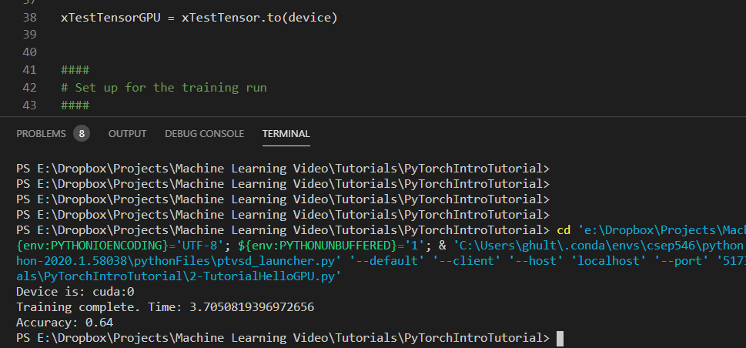
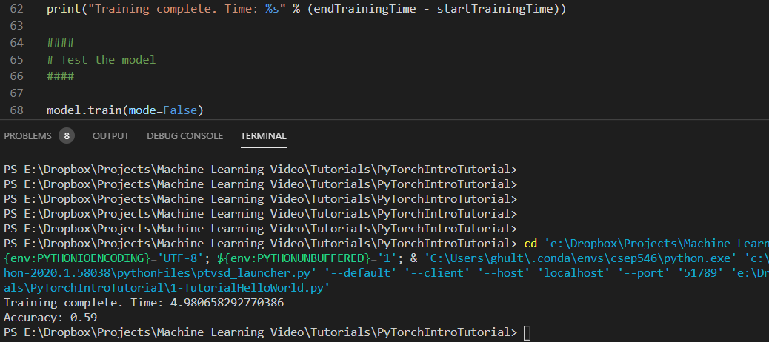
GPU Run
CPU Run
~26% faster (on toy problem)
GPU run more accurate?

Slide 25
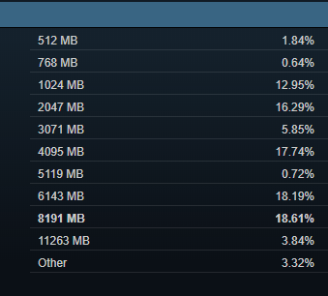
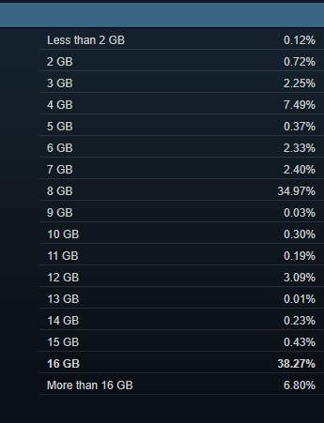
Moving Beyond Toy Problems
Steam GPU RAM Statistics
Steam RAM Statistics
Computer
Graphics Card
DataSet | Size
ImageNet | ~150GB
Open Images Dataset | 500GB compressed
Visual QA | 25GB compressed
Yelp Reviews | ~10GB compressed
CPU
GPU
Data Augmentation…
Disk
RAM
RAM
Model | # Parameters
Our Model | 10
State of art computer vision (2014) | 4 million
State of art NLP (2019) | 100s of millions
Data Size
A few bytes
~8 MB (16 bits per param)
Too big for single GPU

Slide 26
Batching data to GPU
Computer
May augment before transferring to GPU
Graphics Card
Set up Data Iterator
Set up for modeling
Iterate:
* Get batch to GPU
* Backprop
May need to read into
CPU RAM in chunks…
CPU
GPU
Disk
RAM
RAM
Batch: a subset of training data that fits in GPU RAM
Epoch: one complete pass over all the batches that make up the training data

Slide 27
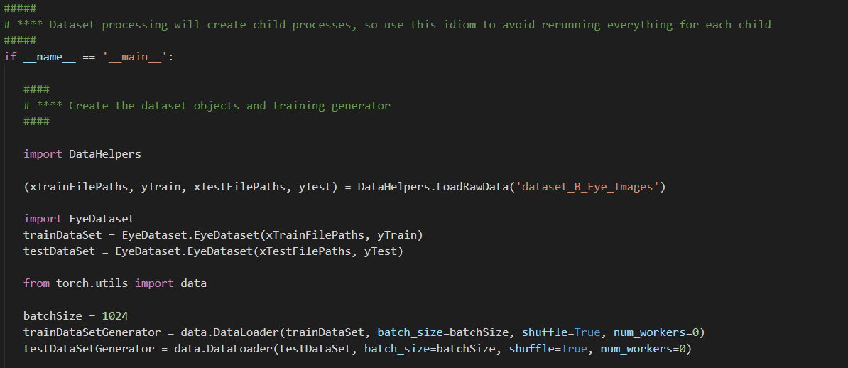
Create the Data Iterator

Slide 28
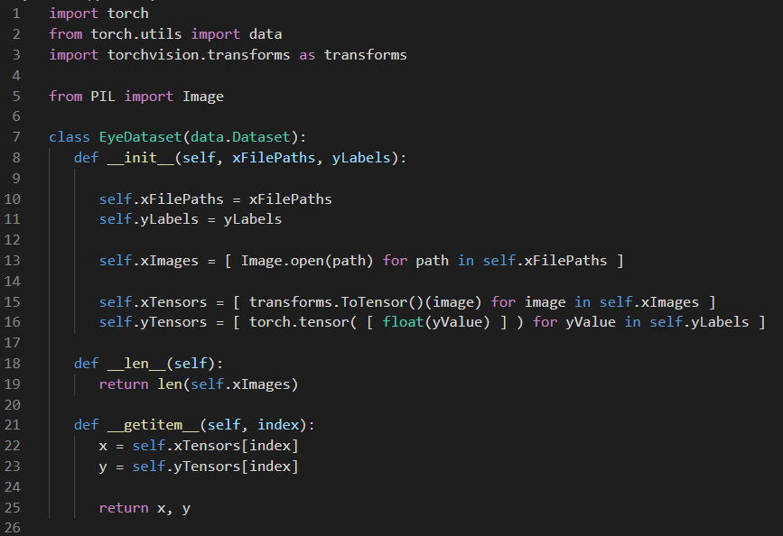
Data Iterator Code
Cache images in CPU RAM
Cache tensors in CPU RAM
Return cached data to build batches

Slide 29
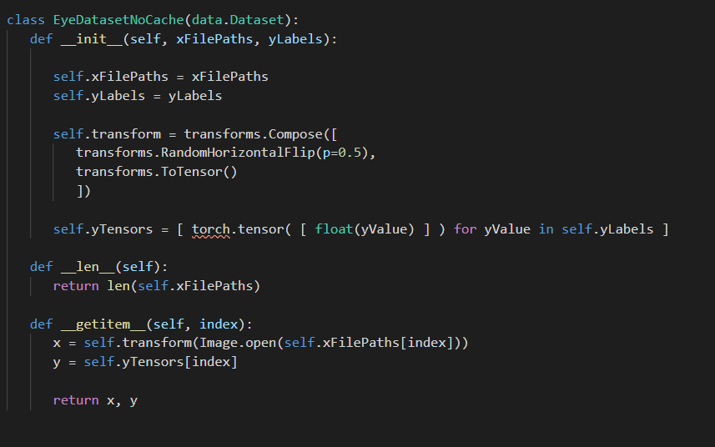
Data Iterator (No Cache)
Transform that augments image and converts to tensor
Loads and processes each image every time it is used in a batch

Slide 30
Create the Data Iterator

Slide 31
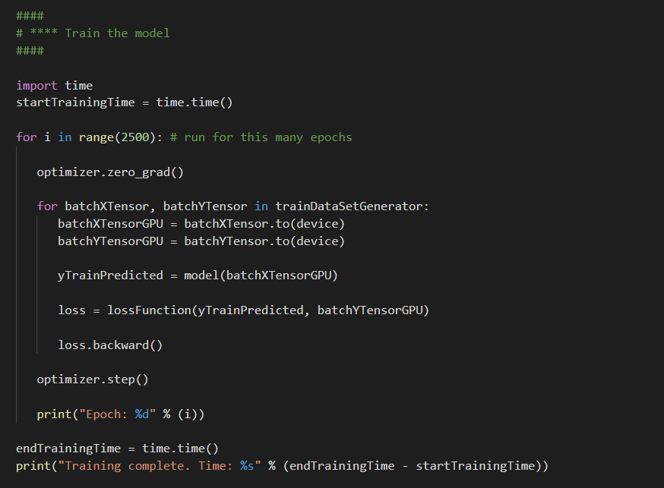
Batched Backprop

Slide 32
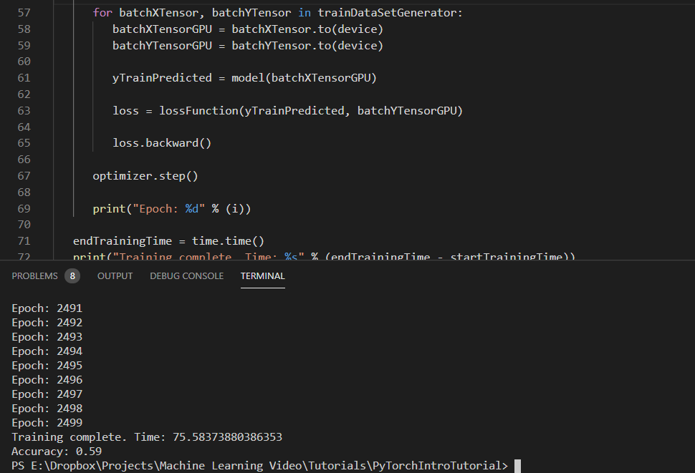
Results of Batched Run
Talk about why it’s slower

Slide 33
Summary
Where to get code
Where to look for more information

