Slide 1
Bayesian Machine Learning to Predict Short-term Course of Eczema Severity
BioMedEng18
07/09/2018
Guillem HURAULT,
Tanaka Group, Department of Bioengineering, Imperial College London
Notes:
Good afternoon and thank you for giving me this opportunity to present my research.
I will be talking about using Bayesian Machine Learning to predict the short-term evolution of eczema severity.

Slide 2
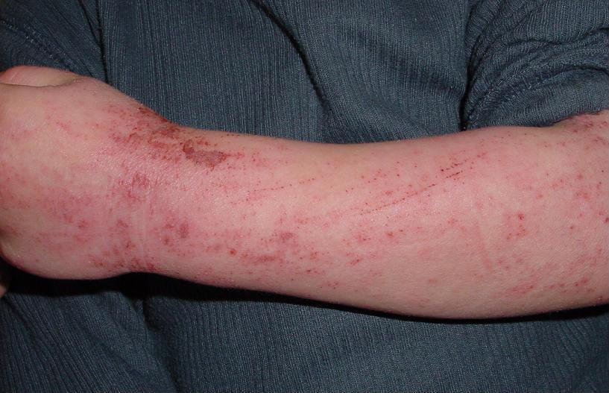
Atopic Dermatitis (AD, eczema)
Chronic disease characterised by a dry and itchy skin
Affects 20% of the paediatric population worldwide
Complex and multi-causal condition
Large variation in disease severity and responses to treatments
Unpredictability in daily fluctuations of AD symptoms (flares)
Notes:
First, eczema, aka Atopic Dermatitis is a skin disease characterised by a dry and itchy skin and affects approximately 20% of the paediatric population worldwide.
AD is a complex and multi-causal condition whose mechanisms are not fully understood yet.
Moreover, there is a large variation in disease severity and response to treatments.
For instance, we cannot predict the daily fluctuations of AD symptoms, aka flares, i.e. periods of exacerbations with a great impact of patients’ quality of life.
By that, I mean that it is difficult to predict when AD flare-ups occur, whether the flare-ups persist or whether they are going to be mild and transient and thus do not require step-up treatments.

Slide 3
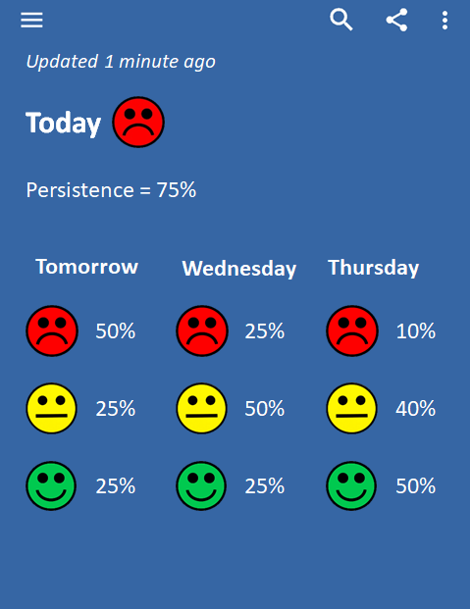
Motivation
Better control of AD symptoms
Making accurate prognoses of the currently available therapies
Understanding the underlying mechanisms of AD pathogenesis
Objectives
Develop a predictive, mechanism-based model of the short-term evolution of AD severity
Notes:
Therefore, one of the main challenge in the field is to better control AD symptoms.
In order to do that, we first need to be able to make accurate prognoses of the currently available therapies.
This could lead to effective intervention, for example by using proactive treatments to prevent a flare from occurring.
Moreover, it is important that these prognoses are interpretable for clinicians and patients, so we need to be able to understand the underlying mechanisms of AD pathogenesis.
So, our aim is to develop a predictive, mechanism-based model of the short-term evolution of AD.
For comparison, we would aim to do something much like weather forecasting but instead of predicting that it will rain the next day with a probability of 50%, we will predict that AD symptoms will improve with a probability of 50%.

Slide 4
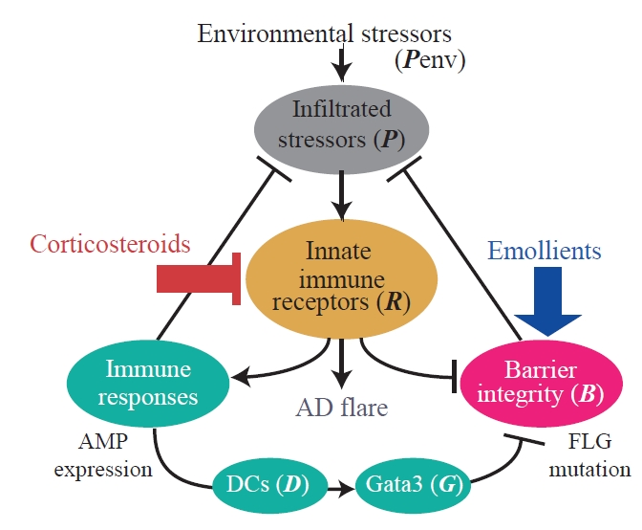
Double-Switch model
System-level understanding of AD
Domínguez-Hüttinger et al., JACI, 2017
Christodoulides et al., Phil. Trans. Roy. Soc., 2017
Notes:
Our group already developed a mechanistic model of AD that describes the dynamic interplay between the skin barrier, environmental stressors and immune responses.
I won’t go into the details of this model in this presentation but our idea was to use this mechanistic understanding of AD pathogenesis as a template for a ML model in order to make interpretable predictions.

Slide 5
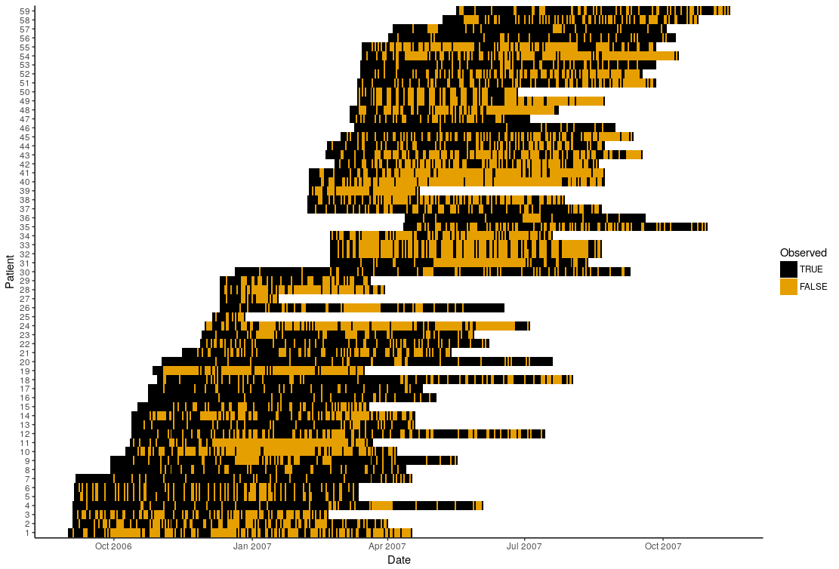
Data
Langan et al., BJD, 2009
60 AD children
6 to 9 months
Daily “bother” & “scratch” score (0-10)
Corticosteroid treatment
Notes:
We used the data from an already published study investigating 60 AD children during 6 to 9 months who received a corticosteroid treatment.
These children recorded daily bother and scratch scores which are respectively the answers to the questions “how much bother did you experience today because of your eczema?” and “how often did you scratch today because of your eczema?”, on a scale from 0 to 10.
One of the main challenge of this dataset, and of many clinical studies is the number of missing values, i.e. children forgetting to record their severity score.
This is challenge since we are dealing with sequential data so we need to take this into account in our approach.
This figure illustrates this problem with on the x-axis the date of the measurement and on the y-axis, patient ID.
Observed values are represented in black and missing in orange, the latter accounting for approximately 30% of the data.

Slide 6
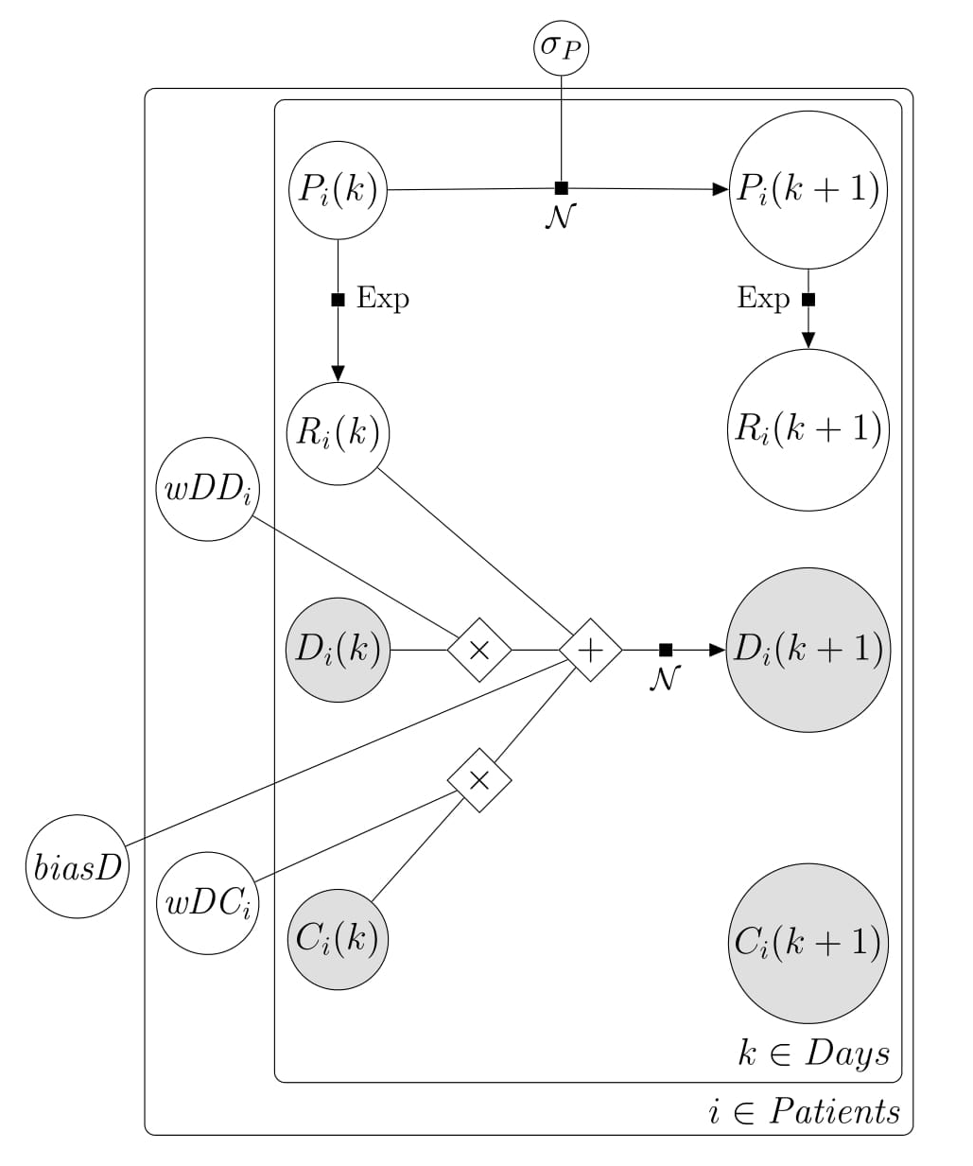
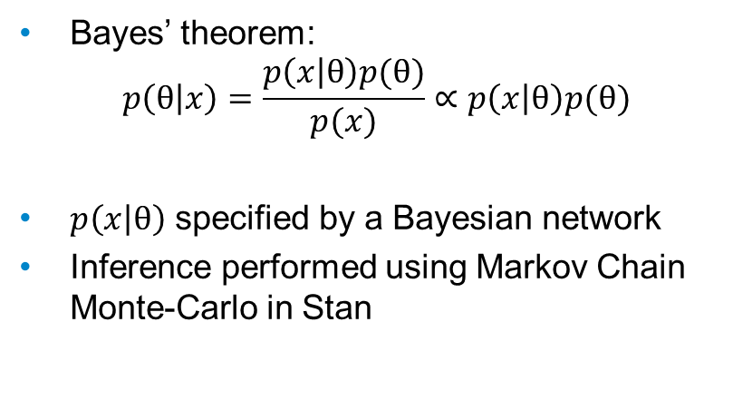
Methods
Bayes’ theorem:
$$p\left(θ | x\right)=\frac{p\left(x | θ\right)p(θ)}{p(x)}∝p\left(x | θ\right)p(θ)$$
$p\left(x | θ\right)$ specified by a Bayesian network
Inference performed using Markov Chain Monte-Carlo in Stan
Unpublished
Notes:
We will specify the double-switch model as a graphical model, more specifically a Bayesian network (figure).
This way, the model is just the joint probability distribution over all parameters of interest so we can compute the likelihood that the data x was generated by the model and update our priors over the parameters p(theta) using Bayes’ theorem from which we derive the posterior distribution p(theta|x), the probability distribution of the parameters given the data.
One way of doing that efficiently is by using Markov Chain Monte-Carlo algorithms and we will use the Hamiltonian Monte-Carlo implemented in Stan.

Slide 7
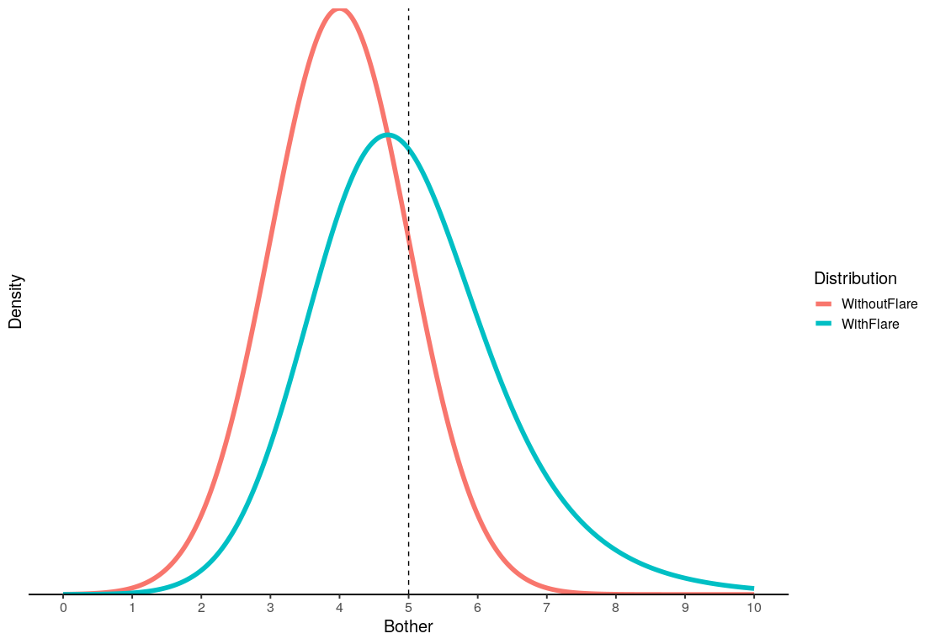
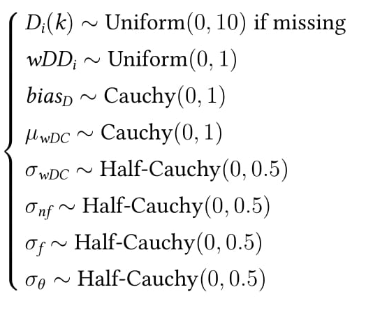
Equation
Autoregressive model
Model
Latent random walk
Flare distribution
Mixed effects
Priors
Notes:
The model is described by this set of equation.
It’s mostly an autoregressive model, meaning that the severity at t+1 depends on the severity at t.
We also model a latent risk P following a random walk, and this risk specifies the flare distribution following an exponential distribution.
What does this mean? If for instance (figure), your bother is 5 out 10 today (dashed line), the probability density function for tomorrow’s severity, if there is no flare is the red curve, meaning that it is very likely that your severity will decrease.
If you have a flare, the risk P will skew the pdf toward higher severity (blue curve)

Slide 8
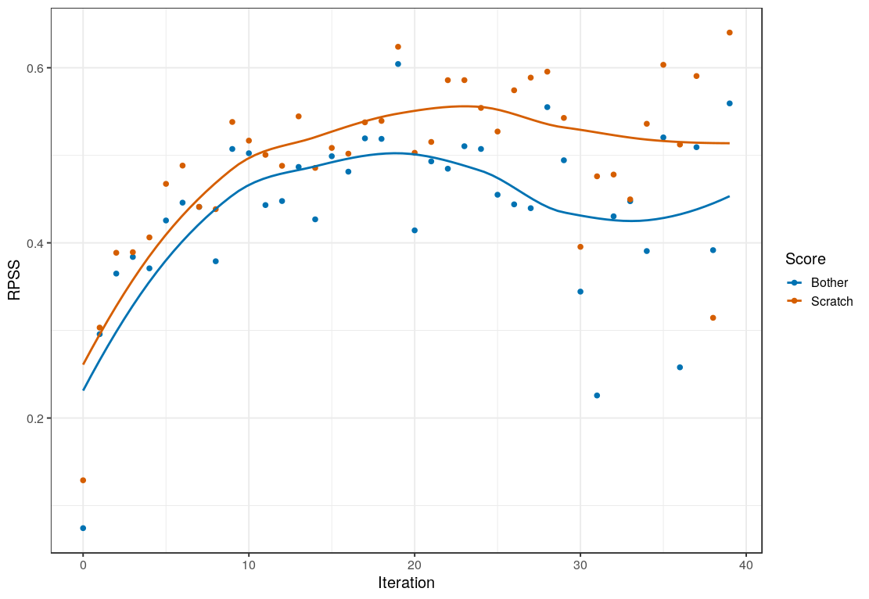
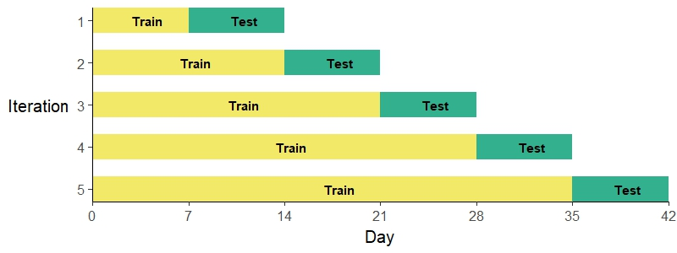
Internal validation
Ranked Probability Skill Score
Accuracy of an ordinal probabilistic forecast
0: guess; 1: perfect
Notes:
So we fitted the data to this model but in order to make sure that it generalises well to unseen data, we internally validate it in this (figure) setting (some people call that forward chaining), meaning that every week we update the model with the data from the past week and make predictions for the following week and so on.
Our main metric to assess the performance of the model was the Ranked Probability Skill Score which measures the accuracy of an ordinal probability forecast with a perfect score of 1 and a score not better than random of 0.
This figure depicts the learning curve of the model, on the x-axis iteration, i.e. each time we update our model and make predictions for the following week, and on the y-axis the RPSS. In blue the learning curve for the bother score and in red the learning curve for the scratch score.
We can see that the model is actually learning something and it performs approximately 50% than random.

Slide 9
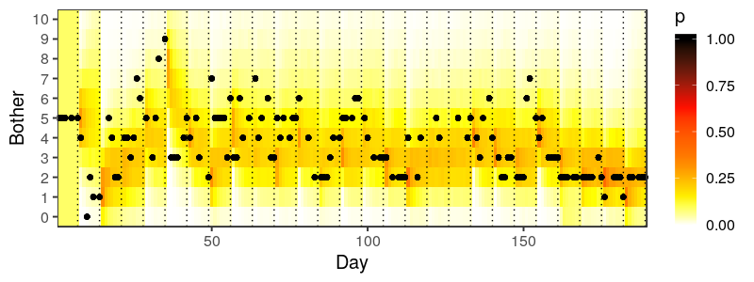
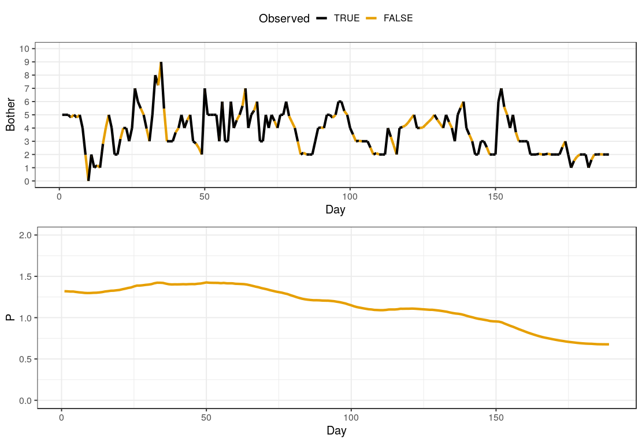
Trajectories
Prediction
Latent “risk”
Notes:
To illustrate this, the top figure represents a prediction plot, with the x-axis representing time and the y-axis the bother score.
Black dots represent the actual score and colour the predicted probabilities.
Moreover, we can infer the latent risk trajectory here, and what it is interesting is that we can see that the risk is decreasing and that the patient is responsive to the treatment, something which is not that obvious when looking at the raw data.

Slide 10
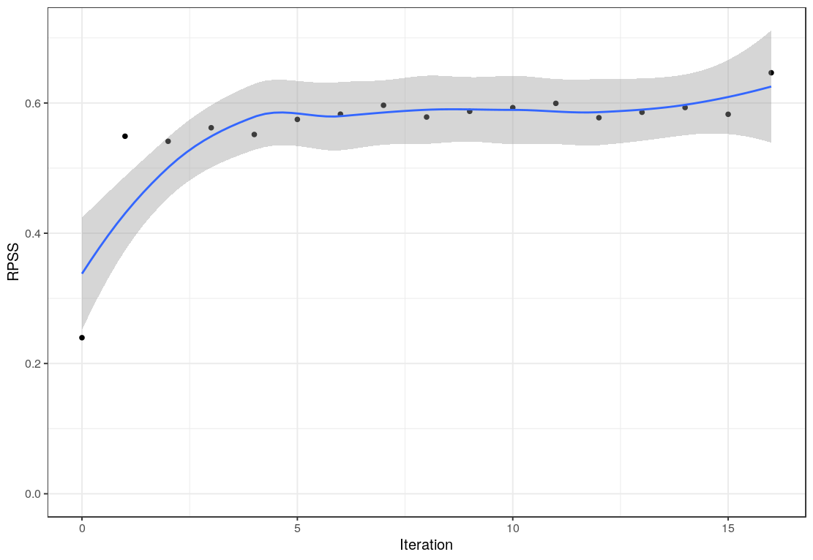
External validation
Thomas et al., BJD, 2008
334 AD patients
16 weeks follow-up
Only 2% missing values
Daily “bother” score (0-10)
Corticosteroid treatment
Notes:
We further performed an external validation of the model to see if it could predict the trajectories of patients from a different clinical study with a larger cohort.
The data includes 334 AD patients receiving a corticosteroid and followed for 16 weeks with a daily recording of the bother score.
One good thing with this dataset is that it has only about 2% missing values, making it particularly suitable for a replication study.
The algorithm is also able to learn and we reach a performance which is 60% better than chance.

Slide 11
Conclusion
Take-home
Developed and validated a mechanism-based model with two datasets
Prediction 50 to 60% better than chance
Next Steps
Extend the model by including type and quantity of treatment, demographics, genetic mutation, etc.
Sequential Monte-Carlo for daily predictions
Notes:
In conclusion, we have managed to develop and internally and externally validate a mechanism-based model with two datasets.
We achieved predictions which are 50 to 60% better than chance.
Future works will consist in extending the model to include several types as well as the quantity of treatment used on a daily basis, demographics data as well as genetic information.
We would also like to implement a Sequential Monte-Carlo algorithm for making daily instead of weekly predictions.

Slide 12

Acknowledgments
Reiko Tanaka (Imperial College London)
Sinead Langan (LSHTM)
Hywel Williams (University of Nottingham)
Kim Thomas (University of Nottingham)
Notes:
Thank you for listening.
I particularly would like to thank…

Slide 13
Appendix

Slide 14
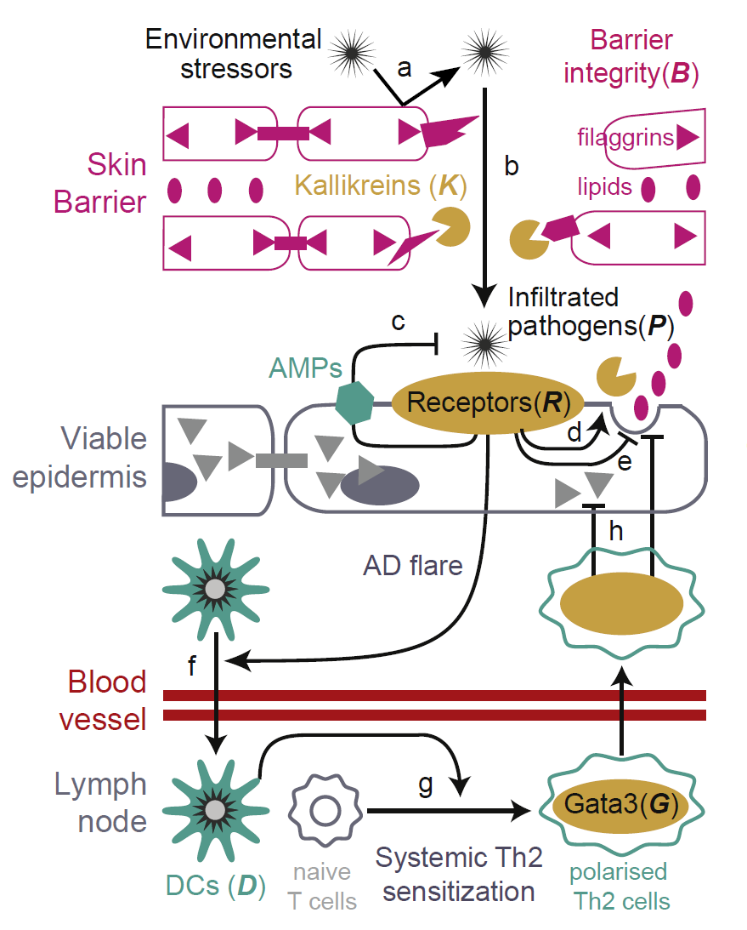
Double-Switch model

Slide 15
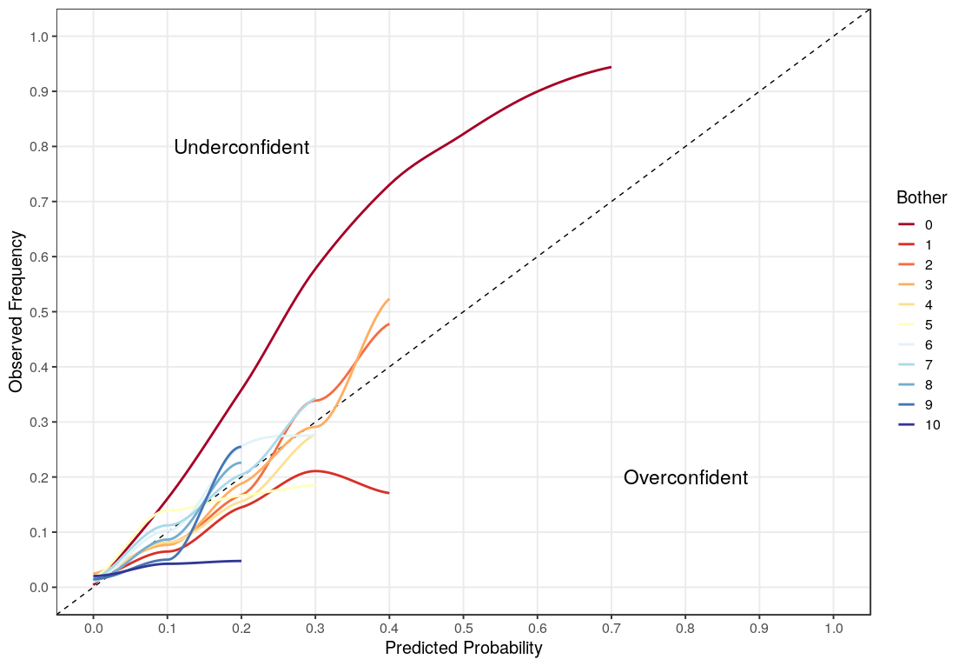
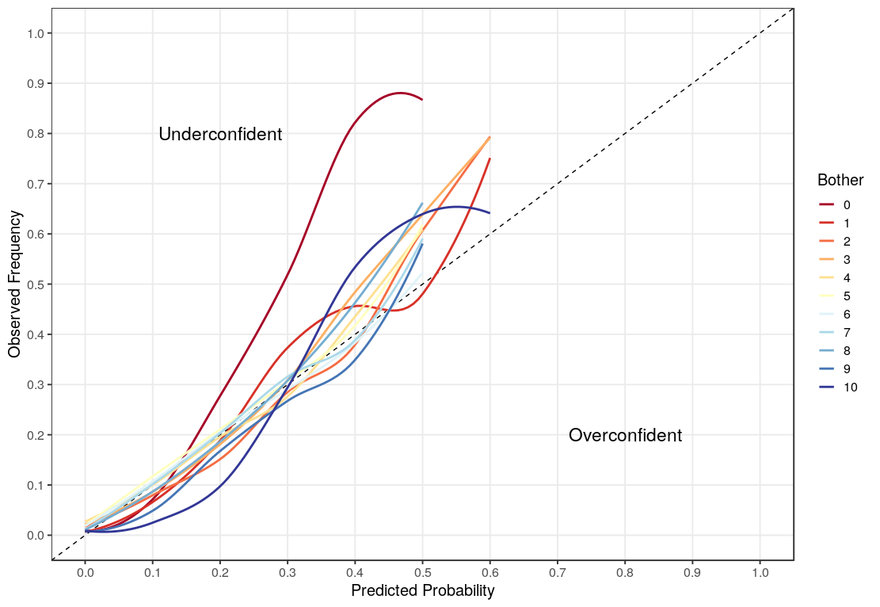
Calibration plot
Flares data
SWET data

Slide 16
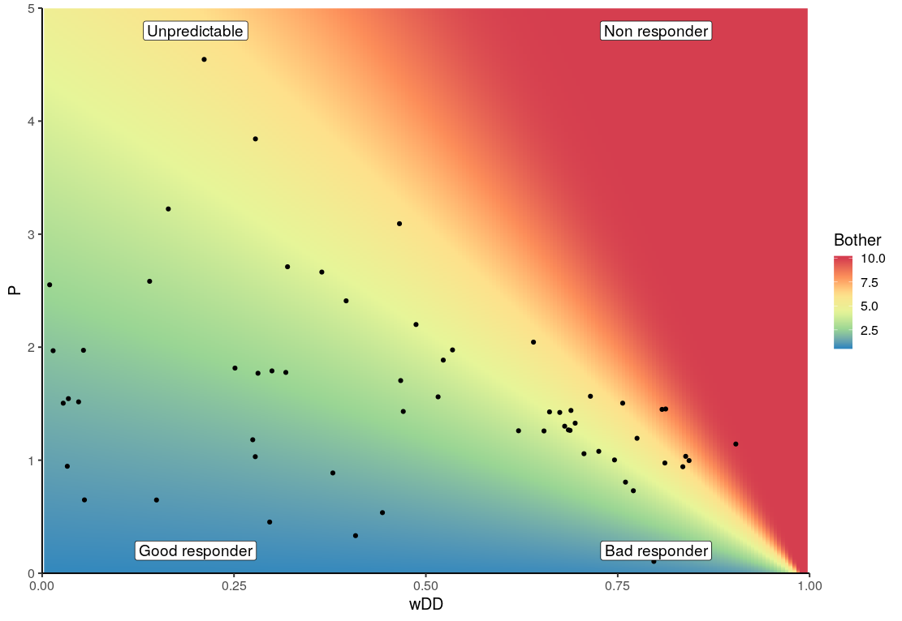
Patient stratification
Expected outcome
Risk
Persistence

Slide 17
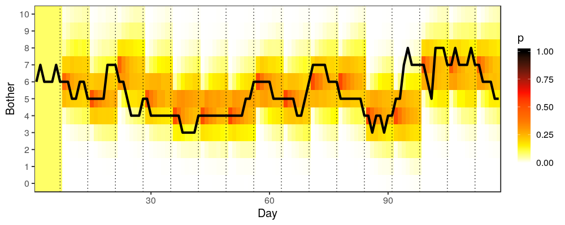
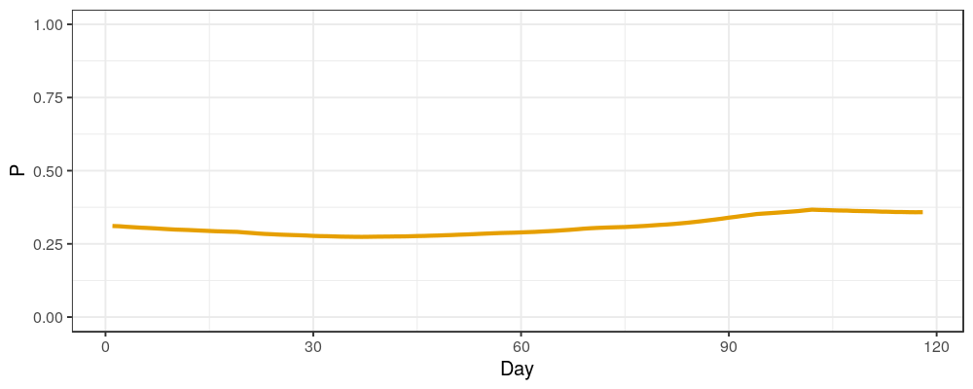
Prediction SWET

Slide 18
Reconstructed data – Flares data

