Slide 1

AI ASSIGNMENT 1
There are 4 Members
Hoang Tan Phat - 1811137
Le Trung Dan - 1810887
To Duy Hung - 1810198
Nguyen Gia Huy - 1810173

Slide 2
Contents
01
02
03
04
N-Puzzle
Sudoku
Using Depth First Search with matrix N = k*k
UsingGenetic Algorithm
Path Finding
Outro
Using A* Algorithm
End of prepresentation

Slide 3
01
N-Puzzle
Using Depth First Search with matrix N = k*k

Slide 4
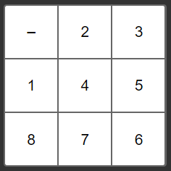
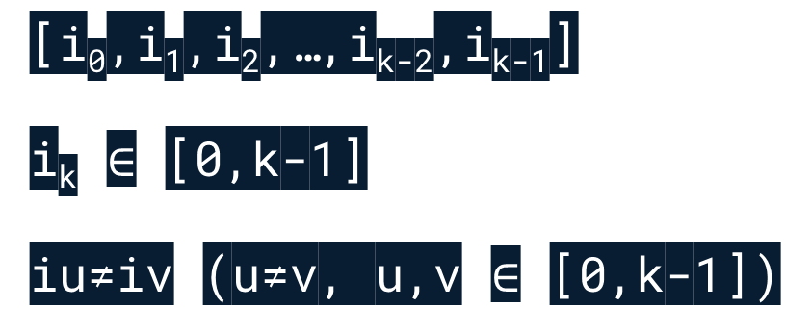
start state
[i₀,i₁,i₂,…,i_{k-2},i_{k-1}]
i_{k} $∈$ [0,k-1]
iu≠iv (u≠v, u,v $∈$ [0,k-1])
0

Slide 5
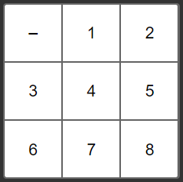
end state
[0,1,2,…,k-2,k-1]
0

Slide 6
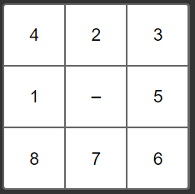
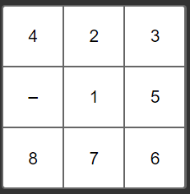
Rules to move
Move left: if 0 is not in the firstcolumn
- Previous state:
[i₀,...,i_{n-2},a,0,i_{n+1},...,i_{k-1}]
- Next state:
[i₀,...,i_{n-2},0,a,i_{n+1},...,i_{k-1}]
0
0

Slide 7
Rules to move
Move right: if 0 is not in the last column
- Previous state:
[i₀,...,i_{n-2},0,a,i_{n+1},...,i_{k-1}]
- Next state:
[i₀,...,i_{n-2},a,0,i_{n+1},...,i_{k-1}]
0
0

Slide 8
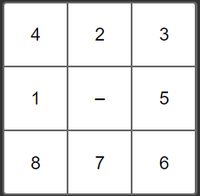
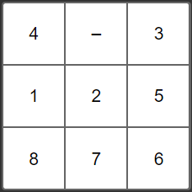
Rules to move
Move up: if 0 is not in the first row
- Previous state:
[i₀,...,i_{n-k},a,...,i_{n},0,...,i_{k-1}]
- Next state:
[i₁,...,i_{n-k},0,...,i_{n},0,...,i_{k-1}]
0
0

Slide 9
Rules to move
Move down: if 0 is not in the last row
- Previous state:
[i₀,...,i_{n},0,...,i_{n+k},a,...,i_{k-1}]
- Next state:
[i₁,...,i_{n},a,...,i_{n+k},0,...,i_{k-1}]
0
0

Slide 10
Rules to move
Move down: if 0 is not in the last row
- Previous state:
[i₀,...,i_{n},0,...,i_{n+k},a,...,i_{k-1}]
- Next state:
[i₁,...,i_{n},a,...,i_{n+k},0,...,i_{k-1}]
0
0

Slide 11
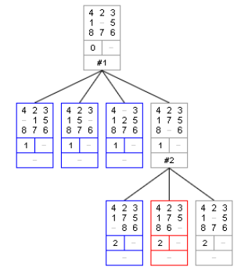
depth first search
—example image—

Slide 12
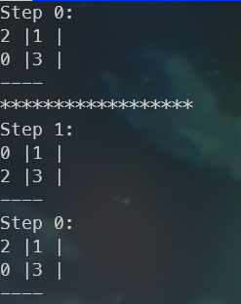
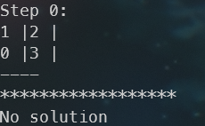
some result
2-Puzzle

Slide 13
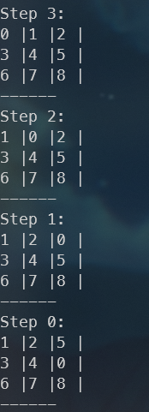
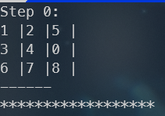
some result
3-Puzzle

Slide 14
02
sudoku
UsingGenetic Algorithm

Slide 15
Genetic algorithms
Initial population
Fitness function
Selection
Crossover
Mutation

Slide 16
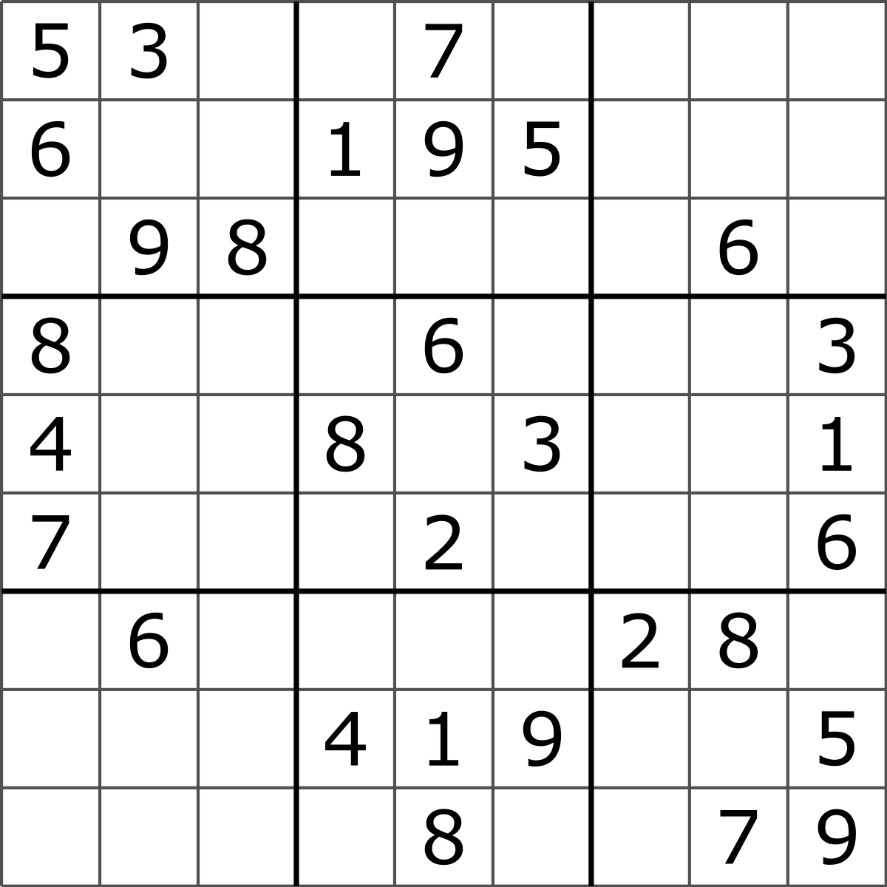
Gene REpresentation
Cell = Gene
Row = Chromosome

Slide 17
Fitness function
Calculate how many unique numbers appear in each row, column and 3x3 sub-grid

Slide 18
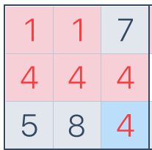

Fitness function Example
fitness = 5
fitness = 6

Slide 19

Fitness function
fitness = 9
This is the best fitness for each row, column, 3x3 grid
If the row-wise, column-wise, and 3x3 sub-grid count is equal 81 (or sum of them equal 243) then the puzzle is solved

Slide 20



CROSSOVER
Uniform Crossover

Slide 21

MUTATION
Random Resetting
If the value selected in each row is a fixed value then don’t randomize it, otherwise insert a random value into it.

Slide 22
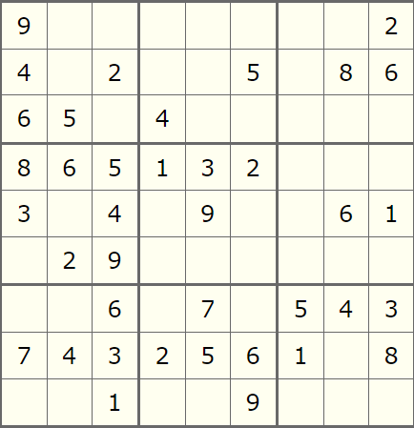
RESULT
INPUT

Slide 23
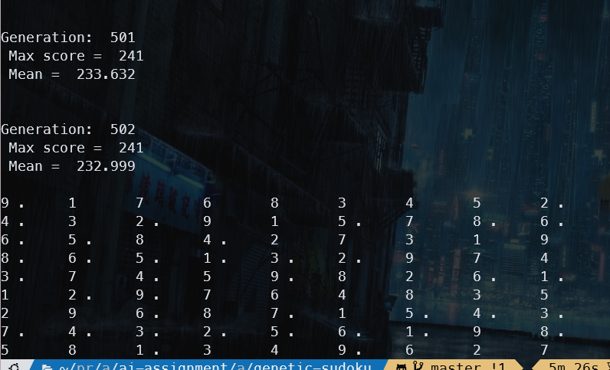
RESULT
OUTPUT
A solution was found at generation 503
The dots (‘.’) marked the fixed cells.

Slide 24
03
Path Finding
Using A* Algorithm

Slide 25
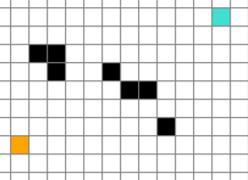
start state
A grid with:
Start point with position: x_start, y_start (orange)
End point with position: x_end, y_end (blue)
Barriers with position List[(x_bar, y_bar)](black)
0

Slide 26
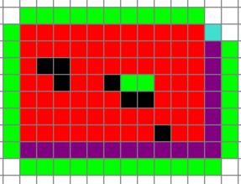
end state
Start point reaches End point:
- x_start = x_end
- y_start = y_end
0

Slide 27
Rules to move
Move left, right, up, down (if the next position do not have barrier)
If start point moves up: (x, y+1)
If start point moves down: (x, y-1)
If start point moves left: (x-1, y)
If start point moves right: (x+1, y)

Slide 28
A* algorithm
At current position, we calculate the cost function: f(x) = h(x) + g(x)
h(x) is the distance from x to end node and for the 4-direction path finding problem:
h(x) = abs(x_{cur}-x_{end}) + abs(y_{cur}-y_{end})
g(x) is the shortest path from start node to x

Slide 29
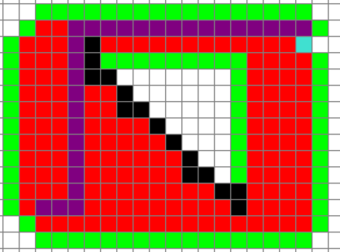
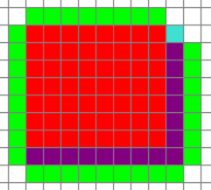
some result
Path finding

Slide 30
04
outro
Thank you for listening!

