Slide 1
Reactive and event-based systems exam
Assignment 3 – Choreographies in ccs and jolie

Slide 2
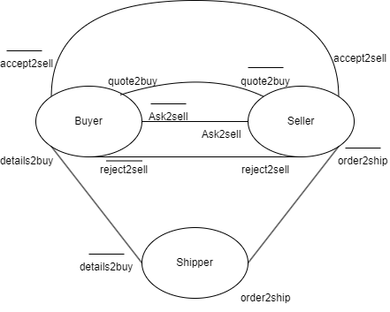
Interface diagrams
Depicts the channels between the participants
Doesn’t say anything about what is exchanged, only the channels

Slide 3
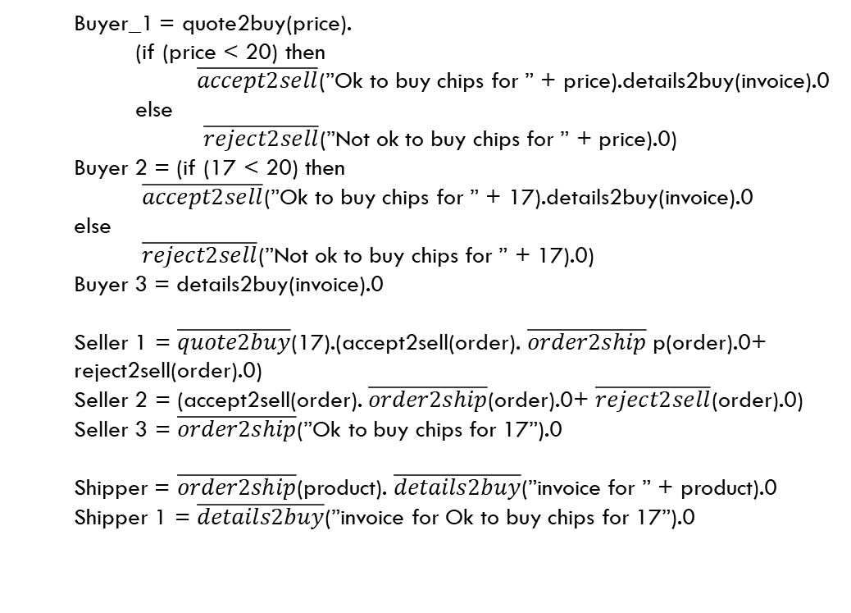
Transition system
S_0 = (Buyer|Seller|Shipper)\Channels
Channels = (Ask2sell, Quote2buy, Details2buy, Accept2sell, Reject2sell, Order2ship)
S_1 = (Buyer_1|Seller_1|Shipper)\Channels
S_2 = (Buyer_2|Seller_2|Shipper)\Channels
S_3 = (Buyer_3|0|Shipper_1)\Channels
S_4 = (Buyer_4|Seller_4|Shipper)\Channels
S_5 = (0|0|0)\Channels
Buyer_1 = quote2buy(price). (if (price < 20) then $\overline{accept2sell}$(”Ok to buy chips for ” + price).details2buy(invoice).0 else
$\overline{reject2sell}$(”Not ok to buy chips for ” + price).0)
Buyer 2 = (if (17 < 20) then $\overline{accept2sell}$(”Ok to buy chips for ” + 17).details2buy(invoice).0 else
$\overline{reject2sell}$(”Not ok to buy chips for ” + 17).0) Buyer 3 = details2buy(invoice).0
Seller 1 = $\overline{quote2buy}$(17).(accept2sell(order). $\overline{order2ship}$p(order).0+ reject2sell(order).0)
Seller 2 = (accept2sell(order). $\overline{order2ship}$(order).0+ $\overline{reject2sell}$(order).0)
Seller 3 = $\overline{order2ship}$(”Ok to buy chips for 17”).0
Shipper = $\overline{order2ship}$(product). $\overline{details2buy}$(”invoice for ” + product).0 Shipper 1 = $\overline{details2buy}$(”invoice for Ok to buy chips for 17”).0
Transitionsystem then becomes: S_0 → S_1 → S_2 → S_3 → S_4 → S_5

Slide 4
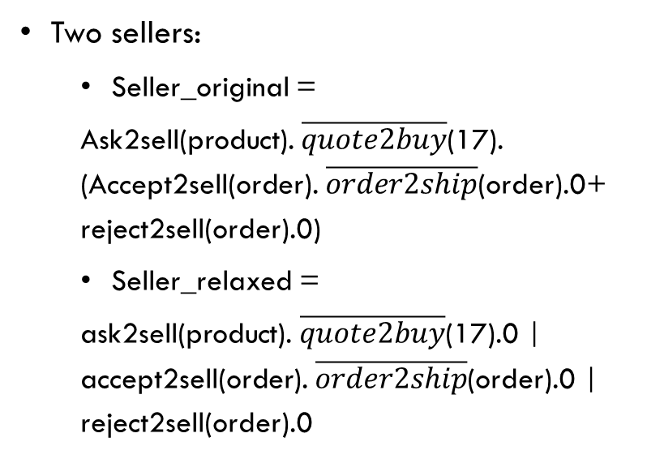
Relaxed seller
Two sellers:
Seller_original =
Ask2sell(product). $\overline{quote2buy}$(17). (Accept2sell(order). $\overline{order2ship}$(order).0+ reject2sell(order).0)
Seller_relaxed =
ask2sell(product). $\overline{quote2buy}$(17).0 | accept2sell(order). $\overline{order2ship}$(order).0 | reject2sell(order).0
Differences:
Relaxed uses concurrent approach
Original more sequential
The difference depends on the buyer. If the buyer’s the same, we can’t see the difference
Sellers are reacting to buyer’s actions.
Essential part is the buyer’s response to the price
Always the same for the fixed price of 17

Slide 5
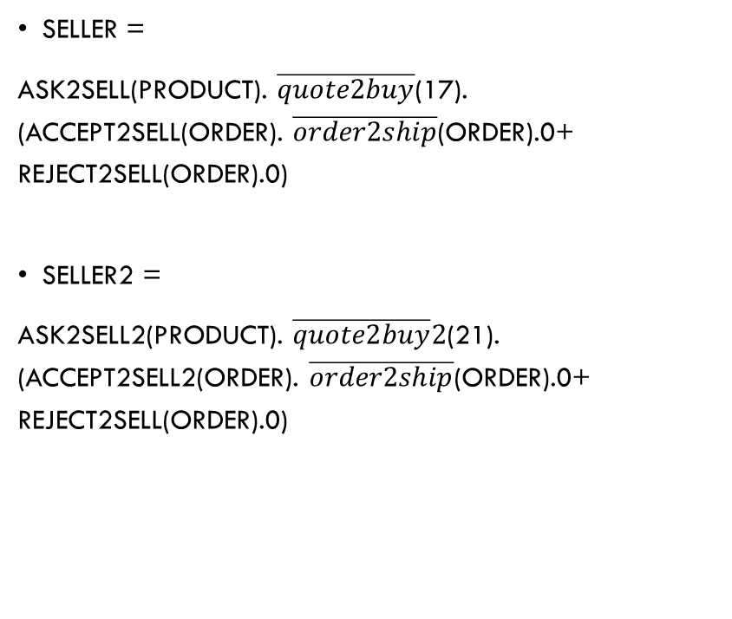
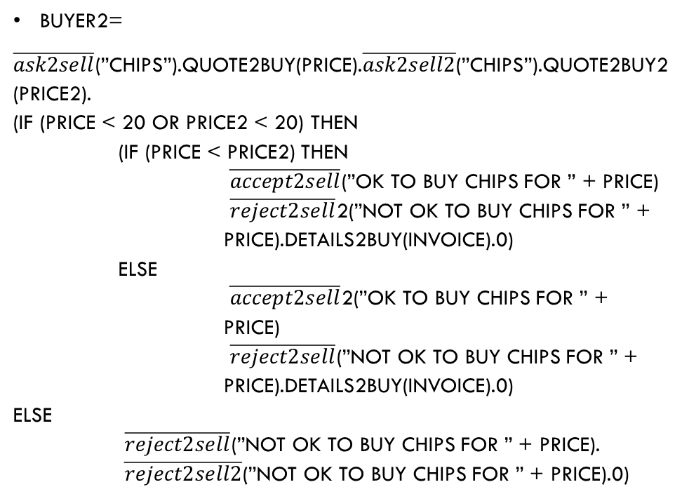
Sequential
Buyer2=
$\overline{ask2sell}$(”chips”).quote2buy(price).$\overline{ask2sell2}$(”chips”).quote2buy2(price2). (if (price < 20 or price2 < 20) then (if (price < price2) then $\overline{accept2sell}$(”Ok to buy chips for ” + price) $\overline{reject2sell}$2(”Not ok to buy chips for ” + price).details2buy(invoice).0) else $\overline{accept2sell}$2(”Ok to buy chips for ” + price) $\overline{reject2sell}$(”Not ok to buy chips for ” + price).details2buy(invoice).0) else $\overline{reject2sell}$(”Not ok to buy chips for ” + price). $\overline{reject2sell2}$(”Not ok to buy chips for ” + price).0)
Seller =
ask2sell(product). $\overline{quote2buy}$(17). (accept2sell(order). $\overline{order2ship}$(order).0+ reject2sell(order).0)
Seller2 =
ask2sell2(product). $\overline{quote2buy}2$(21). (accept2sell2(order). $\overline{order2ship}$(order).0+ reject2sell(order).0)

Slide 6
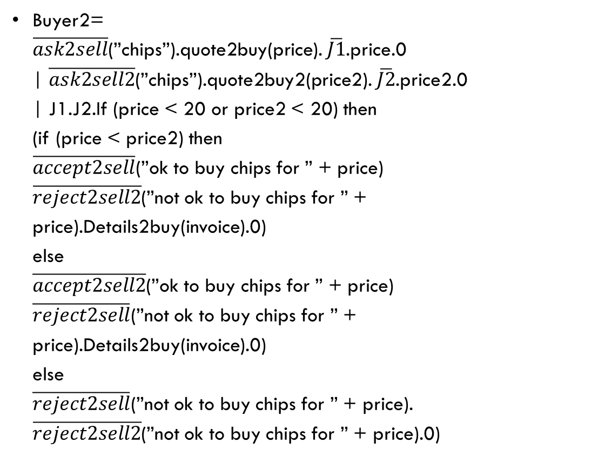
Parallel
Buyer2= $\overline{ask2sell}$(”chips”).quote2buy(price). $\overline{J1}$.price.0 | $\overline{ask2sell2}$(”chips”).quote2buy2(price2). $\overline{J2}$.price2.0 | J1.J2.If (price < 20 or price2 < 20) then (if (price < price2) then $\overline{accept2sell}$(”ok to buy chips for ” + price) $\overline{reject2sell2}$(”not ok to buy chips for ” + price).Details2buy(invoice).0) else $\overline{accept2sell2}$(”ok to buy chips for ” + price) $\overline{reject2sell}$(”not ok to buy chips for ” + price).Details2buy(invoice).0) else $\overline{reject2sell}$(”not ok to buy chips for ” + price). $\overline{reject2sell2}$(”not ok to buy chips for ” + price).0)
Buyer initiates processes simultaneously and checks prices concurrently.
Potentially more efficient solution
We don’t have to wait for price to be checked before we can check price2
Adds complexity
Sequential may be easier to debug

