Slide 1



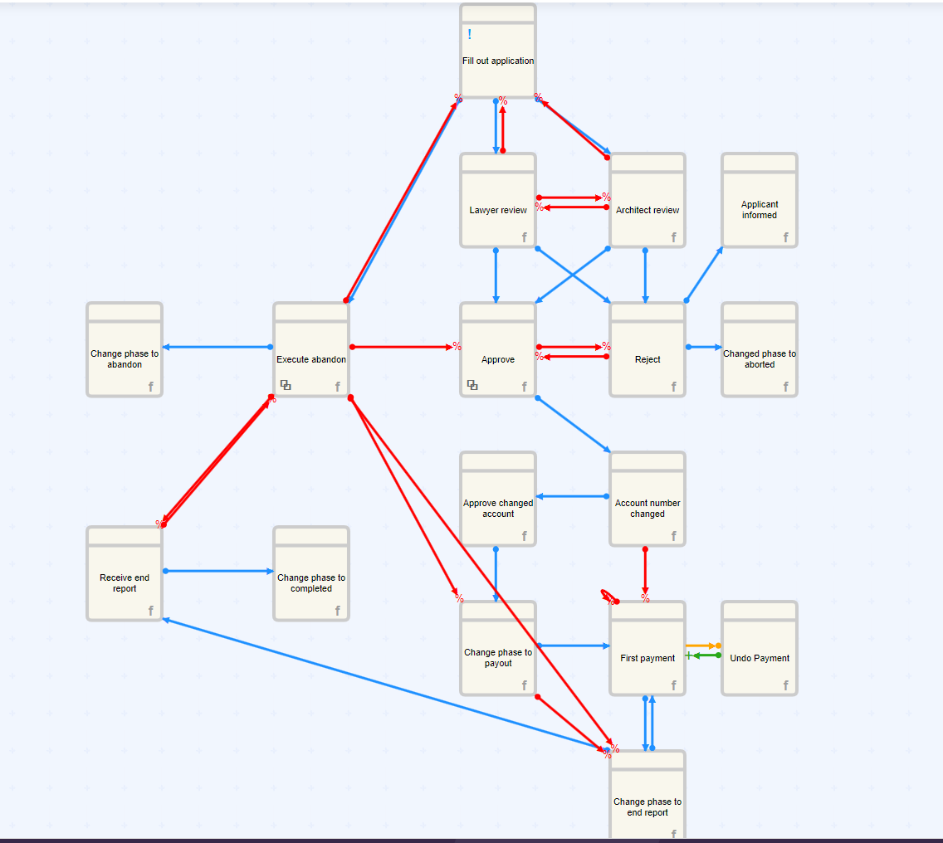
Assignment 1 – Process models and event-based systems
Reactive and event-based systems exam

Slide 2
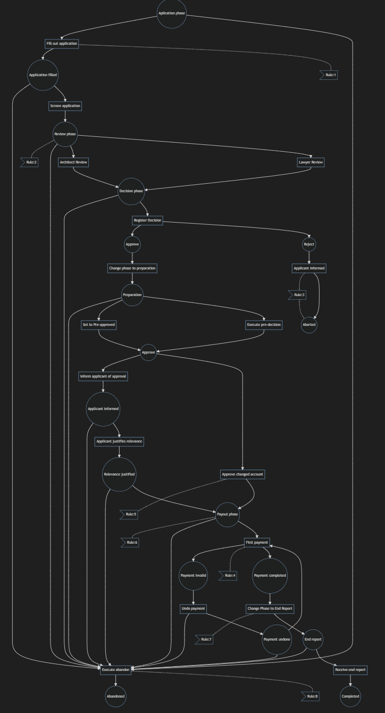
Part 1 – modelling workflows as Petri nets
Activities extracted from the Dreyer’s log
Places – Circles
Transitions – Rectangular
Directed Arcs – Arrows
Striped Lines - Rules

Slide 3
Part 1 – modelling workflows as Petri nets
Is your Petri net live and/or quasi-live?
Is your Petri net bounded and/or safe?
We answered: Bounded
Correct answer: Neither bounded nor safe. First payment has an AND transition to both “payment completed” and “payment invalid”. This can lead to placing unlimited tokens in “payment complete” via the “payment undone” route.
Is your Petri net a WorkFlow net?
We said: Yes
Correct answer: Not strictly, as it has multiple endpoints, where a workflow net typically only has one.

Slide 4
Part 2 – modelling event patterns as DCR graphs
The rules:
Rule 1: Fill out application should always be the first event of the case
Rule 2: Lawyer Review and Architect Review should never occur together
Rule 3: Reject should always eventually be followed by Applicant informed and Change phase to Abort
Rule 4: First payment should only occur once, unless Undo payment is executed afterwards, in which case it may be repeated once
Rule 5: If Account number changed happens, then afterwards Approve changed account needs to be executed before one can execute First payment.
Rule 6: Change Phase to Payout should always eventually be followed by First payment
Rule 7: After Change Phase to Payout has happened, Change Phase to End Report should not happen before we do First Payment. If Change Phase to Payout did not happen then Change Phase to End Report is not restricted by First payment.
Rule 8: Execute Abandon may happen at any time, after it is executed only Change phase to Abandon may happen.

Slide 5
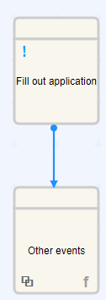
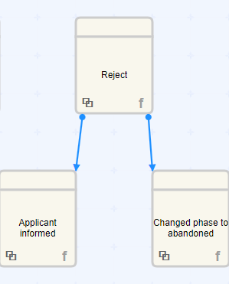
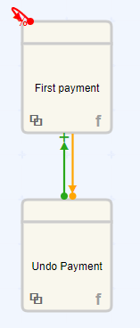
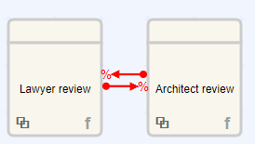
Rule 1
Rule 2
Rule 3
Rule 4
- Doesn’t display that “Fill out application” should be first
- Will never end if it’s pending.

Slide 6
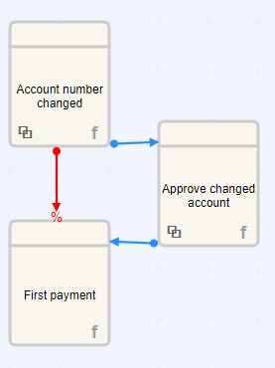
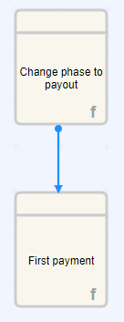
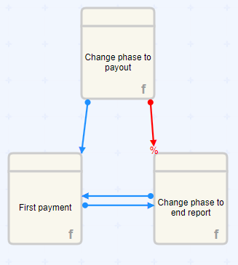
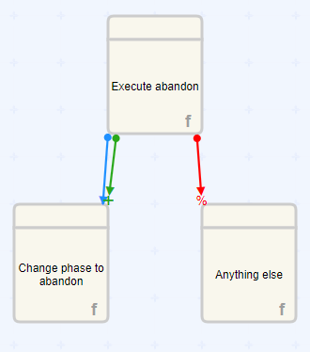
Rule 5
Rule 6
Rule 7
Rule 8
- Once again, we can’t have pending forever.
- Include doesn’t have any effect here, as it’s already enabled
- We never include first payment again after excluding it

Slide 7
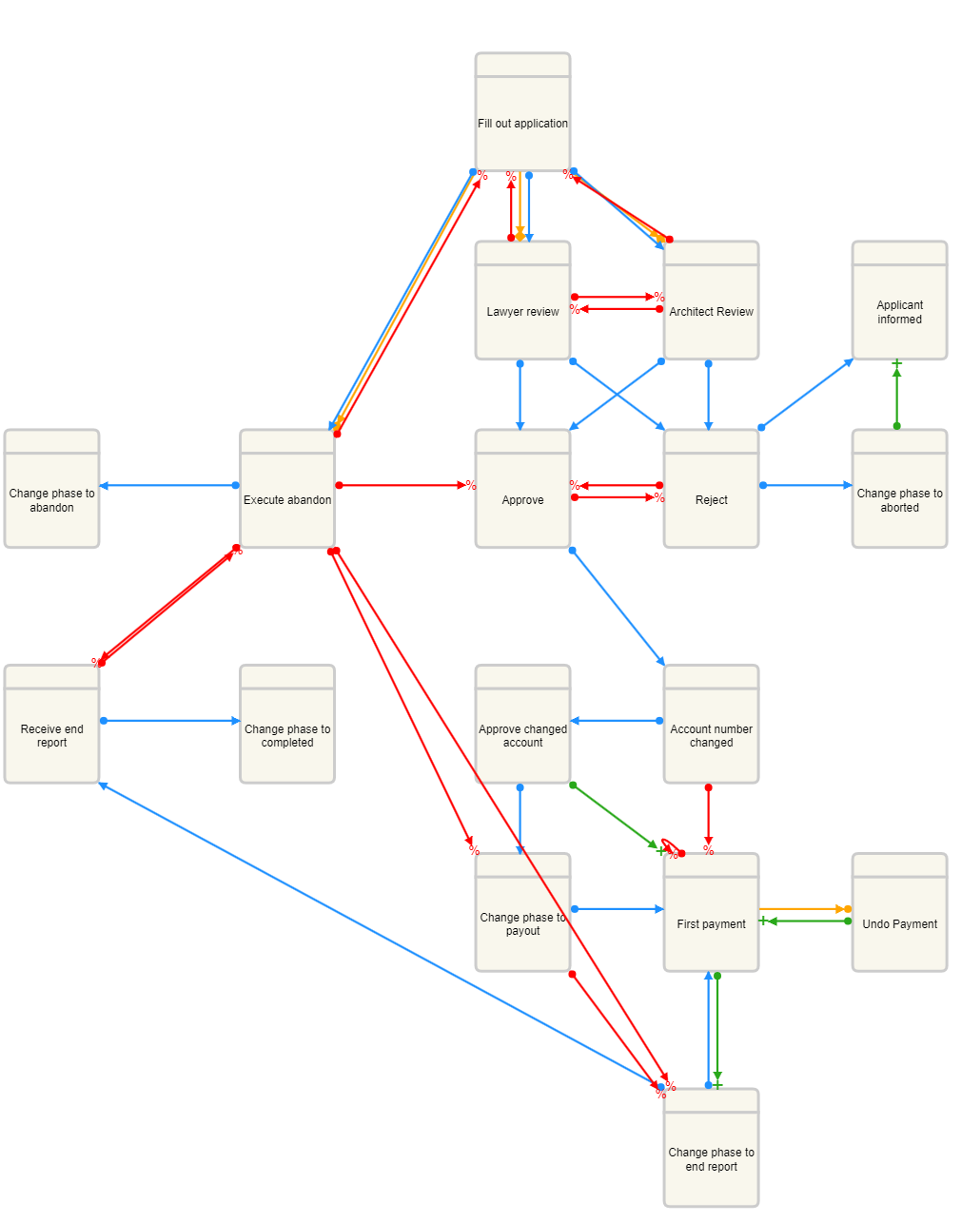
The full graph (new)
Changes:
Fill out application must be first for it to be a valid trace
We include “first payment” again after excluding it
Fix cycle of pendings (rule 7)
Include removed from change phase to abandon

Slide 8
We could’ve used milestone to initialize the “Fill out application” as the starting point.
Model a point in the process that need to be reached before certain events can take place.
DCR graphs and petri nets differ in language and notation
Petri nets use more mathematical notation (places, transitions, tokens and arcs)
DCR graphs depicts events, conditions, responses and milestones.
Both are used to model dynamic systems.

