Slide 1
Reactive and event-based systems exam
Assignment 2 – conformance checking with dcr graphs

Slide 2
Requirements
Take any DCR graph and log as input
Show for each pattern how many traces in the log that satisfy it, and how many do not.
Conformance checker
Used to verify if a set of events recorded in logs satisfies the rules defined in the dcr graph

Slide 3
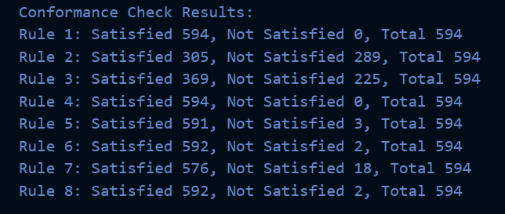
Our implementation
Rules
Hardcoded
Later implemented a parser for dcr graphs
Dreyer’s log
Split it up into activities (ID’s)
Conformance checker
Struggled to implement it, as we only got the parser to work in the last minute
Did the conformance check, but not with the parsed rules from the dcr graph

Slide 4
Parsing dcr graph
Responses relations:
Fill out application --> Execute abandon
Fill out application --> Lawyer review
Fill out application --> Architect Review
Excludes relations:
Execute abandon --% Fill out application
Lawyer review --% Fill out application
Includes relations:
Undo Payment --><> First payment
Approve changed account --><> First payment
Conditions relations:
First payment -->* Undo Payment
Fill out application -->* Execute abandon
Fill out application(0,0,0)
Lawyer Review(0,0,0)
Architect Review(0,0,0)
Change phase to Abandon(0,0,0)
Execute abandon(0,0,0)
Approve(0,0,0)
Reject(0,0,0)
Approve changed account(0,0,0)
Account number changed(0,0,0)
Change Phase to payout(0,0,0)
First payment(0,0,0)
Undo payment(0,0,0)
Change phase to aborted(0,0,0)
Applicant informed(0,0,0)
Change Phase to End Report(0,0,0)
Receive end report(0,0,0)
We managed to parse the xml file into this format
We failed to get it to work with the website provided in the assignment

Slide 5
pseudocode
function checkConformance(dcrGraph, logTraces): // Initialize variables totalTraces = len(logTraces) satisfiedTraces = 0 unsatisfiedTraces = 0 // Iterate over each trace in the log for trace in logTraces: // Reset DCR Graph state for a new trace currentState = dcrGraph.getInitialState() // Iterate over each event in the trace for event in trace: // Check if the event is allowed in the current state if dcrGraph.isEventAllowed(currentState, event): // If allowed, update the state based on the event currentState = dcrGraph.executeEvent(currentState, event) else: // If not allowed, mark the trace as unsatisfied and // break the loop unsatisfiedTraces += 1 break // Check if the trace is fully executed and mark it as satisfied if currentState.isFinalState(): satisfiedTraces += 1
// Output the conformance results print("Conformance Check Results:") print("Total Traces:", totalTraces) print("Satisfied Traces:", satisfiedTraces) print("Unsatisfied Traces:", unsatisfiedTraces)

Slide 6
handtracing
1 means we’ve defined rules for this activity
0 means we haven’t
Assume all activities without rules are valid, since this is open world DCR graph.
Change phase to Board meeting 0 – Valid
Round ends 0 – Valid
Round approved 0 – Valid
Inform application of board review 0 – Valid
Round approved 0 – Valid
Reject 1 – Valid
Applicant informed 1 – Valid
Change phase to Abort 1 - Valid
Fill out application 1 – Valid
Approved to board 0 – Valid
Change phase to Review 0 – Valid
Architect Review 1 – Valid
Architect Review 1 – Valid
Review 0 – Valid
Review 0 – Valid
Architect Review 1 – Valid
Review 0 – Valid
Review 0 – Valid
Lawyer Review 1 – Invalid
(We can't have Lawyer review
after Architect review since they exclude each other)
Register Decision 0 - Valid
We find that both Lawyer review and Architect review occurs, which is against rule 2, which is why this is not a valid trace.

