Slide 1
Reactive and event-based systems exam
Assignment 3 – Choreographies in ccs and jolie

Slide 2
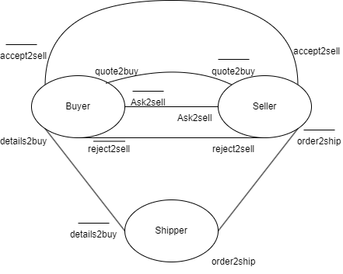
Interface diagrams
Depicts the channels between the participants
Doesn’t say anything about what is exchanged, only the channels

