Slide 1




User Tutorials
SimPEG
Read
Download
Run
Alter

Slide 2
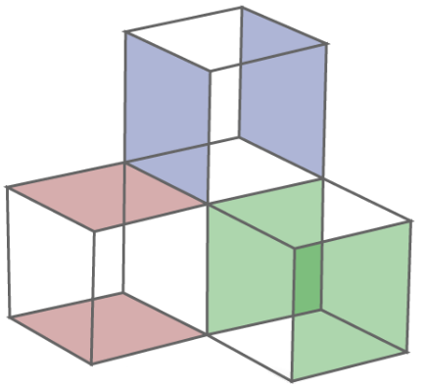


Slide 3
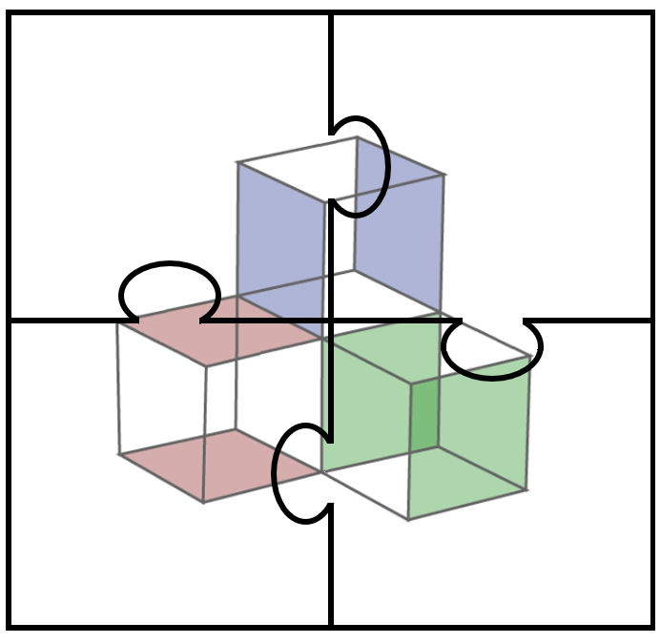

Slide 4

Learning SimPEG
What SimPEG Objects Represent
Creating SimPEG Objects
Suitable
Input Parameters
Using SimPEG Objects

Slide 5
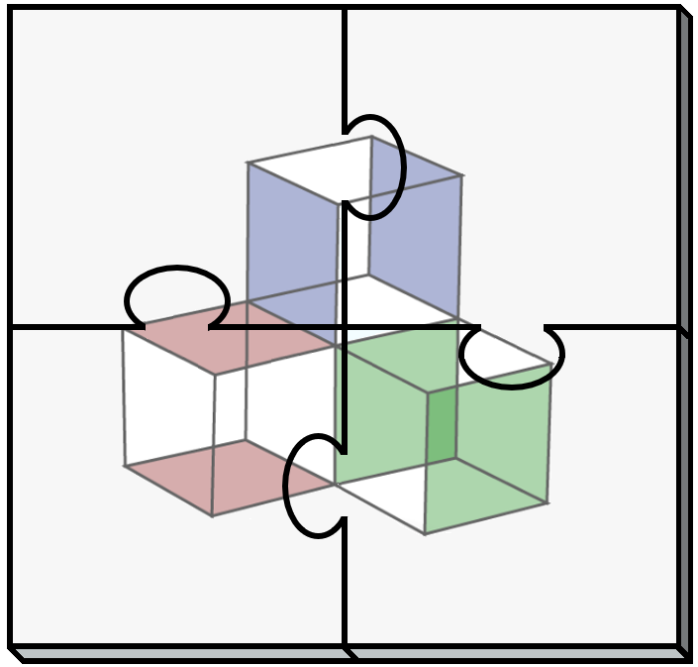
Learning SimPEG
What SimPEG Objects Represent
Creating SimPEG Objects
Suitable
Input Parameters
Using SimPEG Objects

Slide 6
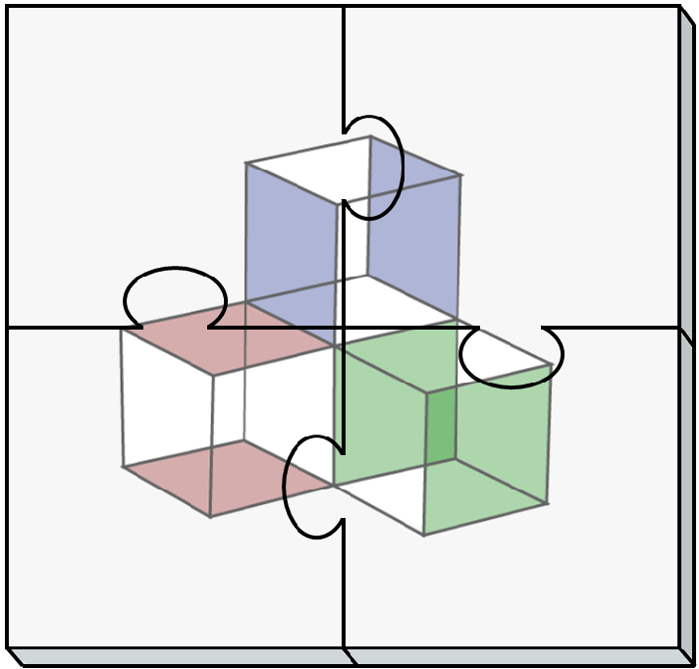
Learning SimPEG
What SimPEG Objects Represent
Creating SimPEG Objects
Suitable
Input Parameters
Using SimPEG Objects

Slide 7









Introductory
Intermediate
Advanced
Light-weight
Moderate
CPU Intensive

