Slide 1

InfoPedia
By: Logan Horn, Cameron Springer,
And Gavin Jett

Slide 2
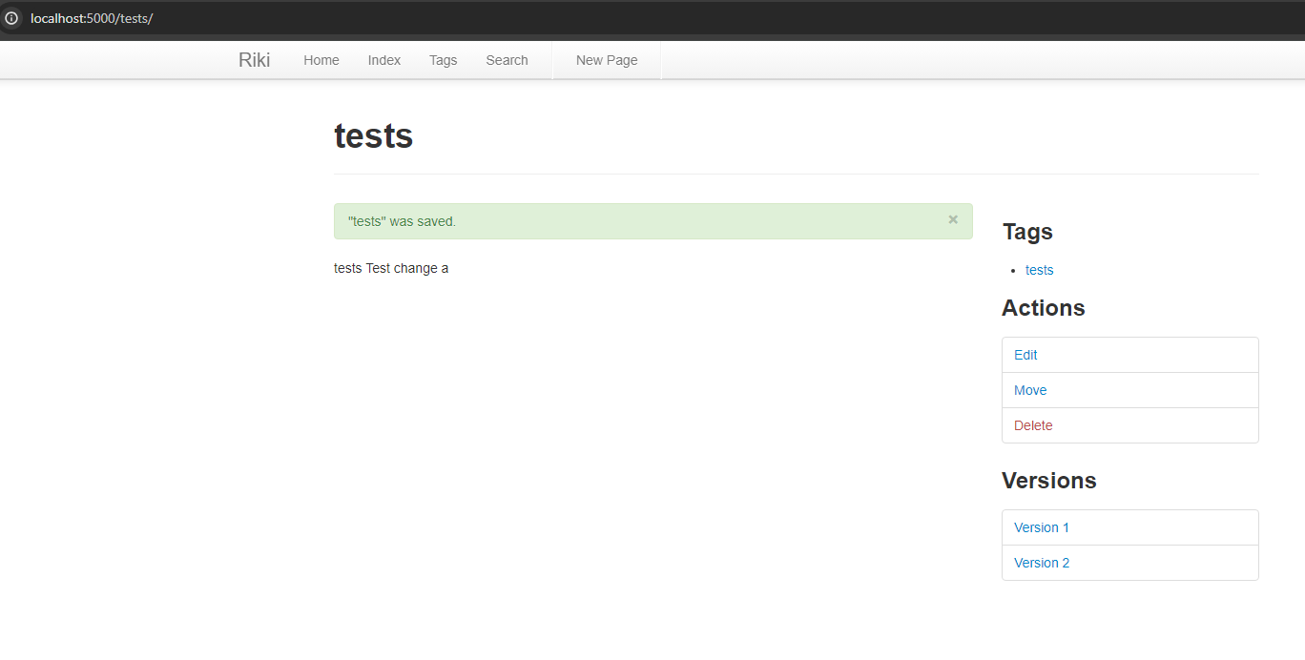
Wiki Version History
This API is designed to allow users to edit their wiki pages, but also allowing them to review older versions.
Whenever a user creates a new page, a new SQLite database entry is entered with version 1.
Any version after version 1 is displayed on the bottom right portion of the screen and is available to view.

Slide 3
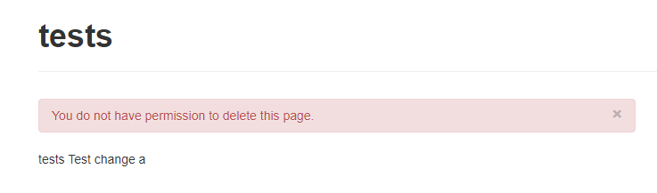
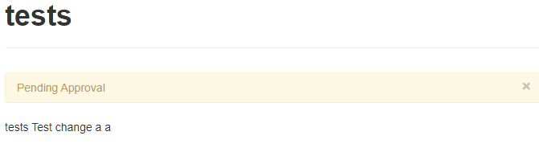
Author/Editor Permissions
Logged in as user "sam":
This API is designed to allow authors to have a tighter control of security and authority over their wiki pages.
Whenever a user creates a wiki page, they are flagged as the author.
If someone is not the author and tries to edit a page, it will send the edit as a request to the author, who can confirm or deny it.
If someone is not the author and tries to delete a page, the system will deny the request and alert the user they do not have permissions.

Slide 4
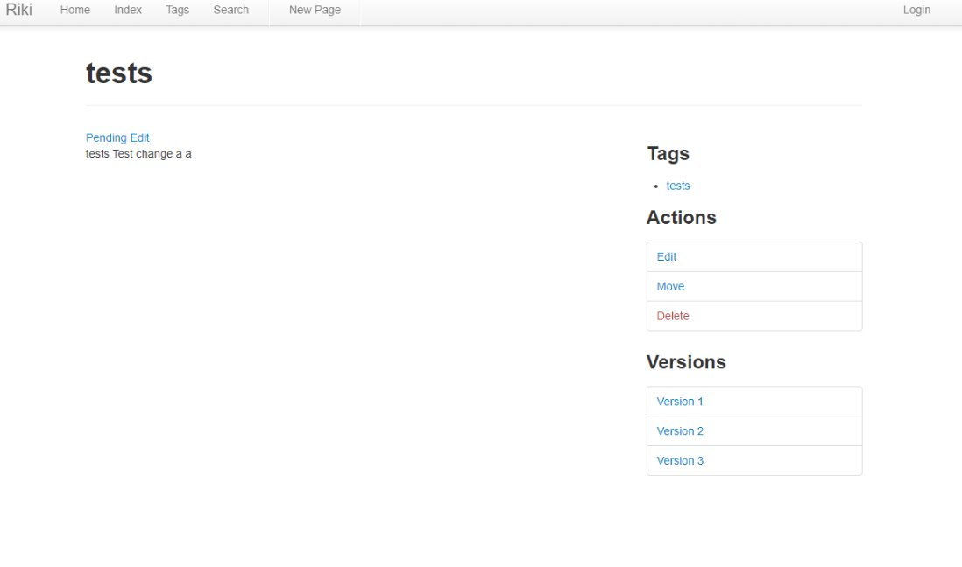

Author Editor/Permissions
Logged in as user "name":

Slide 5
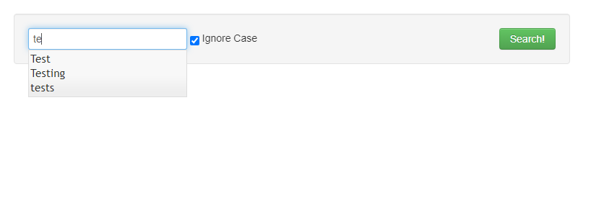
Search Bar Suggestions
This API is designed to help users search quicker and easier.
Whenever you type into the search bar, the dropdown menu will autocomplete and auto-populate the suggestions of available wiki pages.

Slide 6
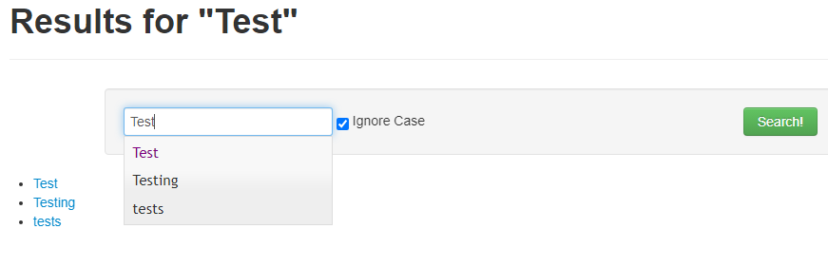
Search Bar Suggestions History
This API is designed to help users find what wiki pages they have been to before.
When a user accesses the search bar, any autocompleted suggestions that have previously been visited will highlight purple.

Slide 7
Requirements
We have 10 requirements and have completed a total of 10 requirements.
We have a burndown rate of 10/10 (100% burndown rate).

Slide 8
Testing
We have discovered 25 unit tests, 4 integration, 4 regression, and 4 acceptance tests.
We have completed 25 unit tests, 4 integration tests, 4 regression tests, and 4 acceptance tests.
We have a burndown rate of 100% on tests.

Slide 9
Lines of Code
We have added 1051 lines of code.

Slide 10
Demo Video

Slide 11
The End
Questions?

