Slide 1
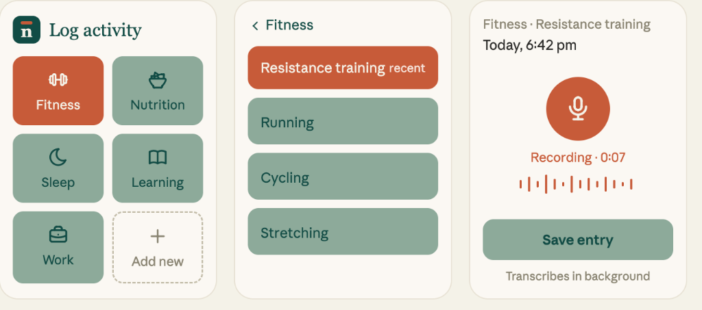
Notare — habit and activity tracker
Category: Habit tracker · Local-first logging with hands-free voice capture and AI insights
User workflow
1
Select
category
2
Choose
activity
3
Record voice
or tap value
4
Automatic
transcription
5
Save to
local DB
Hands-free voice capture
STEP 3 & 4
SPOKEN INPUT
“30 minutes resistance training, upper body workout, felt great.”
AUTOMATED EXTRACTION
30 mins · Fitness · Resistance training
The user records speech while exercising. The Web Speech API transcribes in the background, populates the activity entry, and saves raw text for manual review.
1
2
3
5
4

Slide 2
Technical design
A local-first habit tracking PWA with IndexedDB, cost-optimized delta sync, and serverless AI insights
React 18 PWA
UI, touch gestures,
and Web Speech API
IndexedDB (Dexie)
Local-first database
Instant offline reads & writes
Delta Sync Engine
Syncs changed records
Timestamp diff & tombstoning
Cloud Firestore
Multi-device cloud backup
Firebase Auth protection
Gemini AI Pipeline
Scheduled Cloud Function
Synthesizes community trends
Implementation choices
• Local-first architecture: The app runs 100% offline. All entries and goals save immediately to IndexedDB before any cloud sync.
• Timestamp delta sync: Replaced full-database sync with timestamp queries (updated_at > last_sync_time), reducing Firestore reads by >90%.
• Soft-delete tombstoning: Deletions set deleted_at rather than erasing records immediately, preventing offline deletes from reappearing on sync.
• Zero API keys in client: Gemini calls execute strictly inside a scheduled serverless Cloud Function, keeping API credentials secure.
Development approach
• Developed in Google Antigravity with Gemini and Claude as autonomous pair programmers.
• Claude guided structural refactoring, delta sync reconciliation logic, and offline state management.
• Gemini handled rapid codebase exploration, Cloud Functions integration, and dynamic model discovery.
• Automated regression checks and CI/CD pipelines deployed to Firebase Hosting on each verified push.

