Slide 1
IMAGE RETRIEVAL BASED ON CAPTION
Lecturer:
Thầy Nguyễn Vinh Tiệp
Prepared by:
Nguyễn Đức Hà - 18520689
Nguyễn Trung Hiếu - 18520751
Võ Gia Bảo - 18520502
Trần Lê Duy - 18520674

Slide 2

Table content
Introduction
TF-IDF
Image Retrieval with TF-IDF
Evaluation
Demo

Slide 3
Workflow
Preprocessing text
Query
TF - IDF
Find the similar images base on text/ image description
Similar Images
Ranking
3

Slide 4
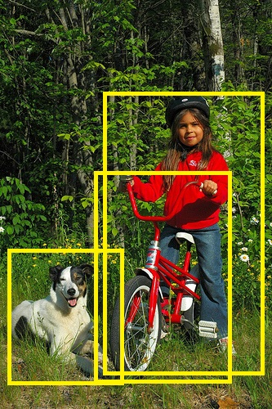
1/ Introduction
- black and white dog lies on the ground next to little girl on red bicycle in the woods
- child in red sweatshirt jeans and black bike helmet and dog pose for picture outdoors
- child is sitting on bike next to her dog
- little girl poses on her bike with her dog in the woods
dog
child
bicycle
4

Slide 5
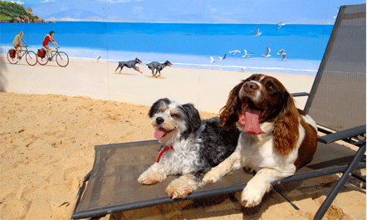
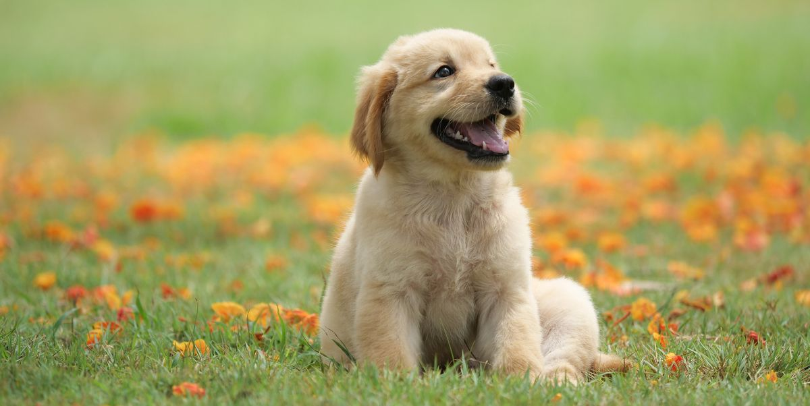
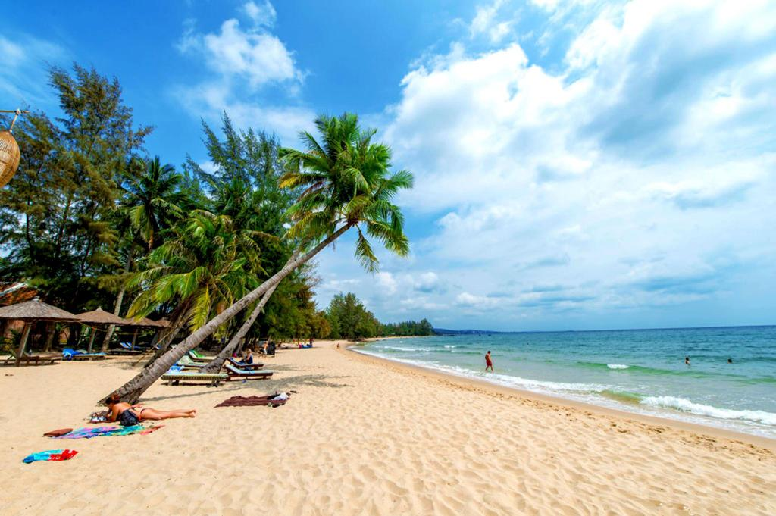

1/ Introduction
Dog | And | Cat | On | Beach
5

Slide 6

1/ Introduction
Input
6

Slide 7
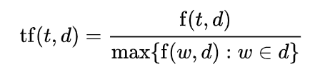
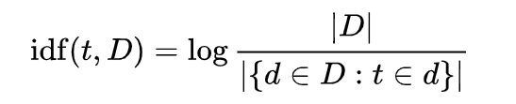
2/ TF-IDF
TF-IDF : Term Frequency – Inverse Document Frequency
TF: Term Frequency
List
TF( , List)= 0.83333334
IDF: Inverse Document Frequency
7

Slide 8
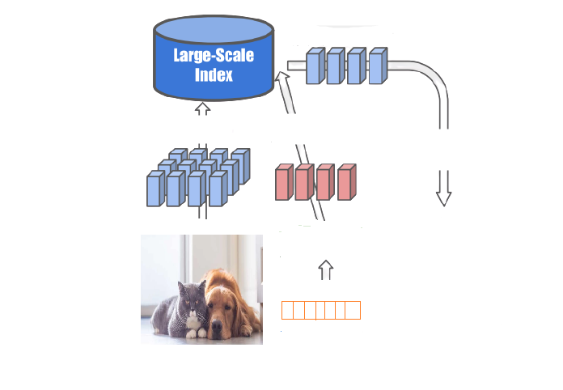
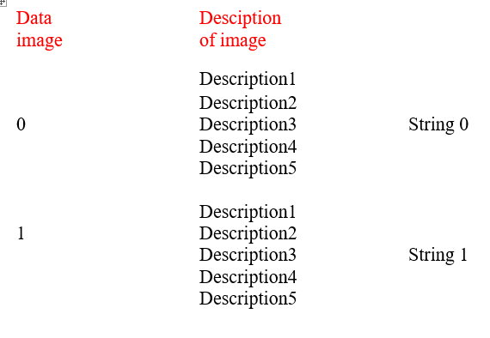
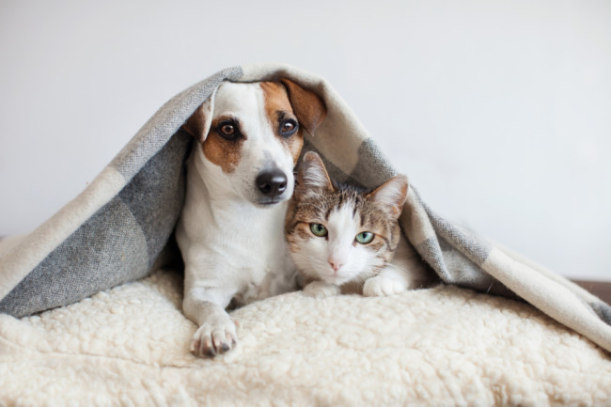
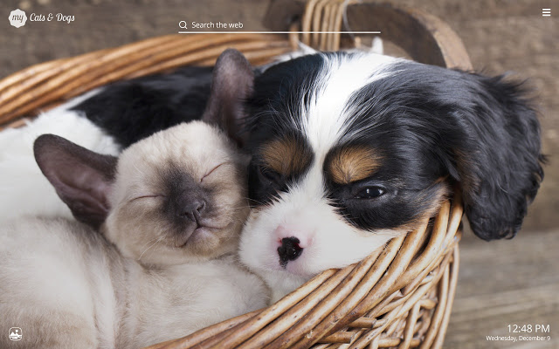
3/ Image retrieval with TF-IDF
key
Index
Query
Database images
Query
8

Slide 9
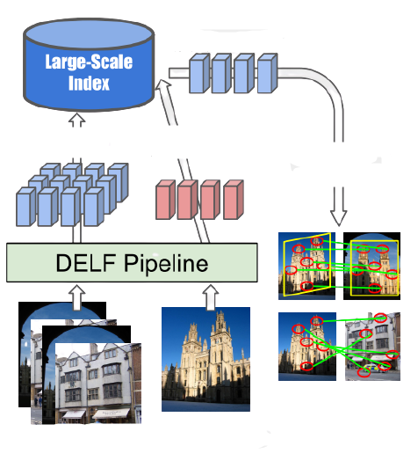
3/ Image retrieval with TF-IDF
Query descriptors
key
Index
Query
TF-IDF
Database images
Key of Image
9

Slide 10
3/ Image retrieval with TF-IDF
key
Ranking
Index
Query
Match Image
Output Images
Database images
10

Slide 11
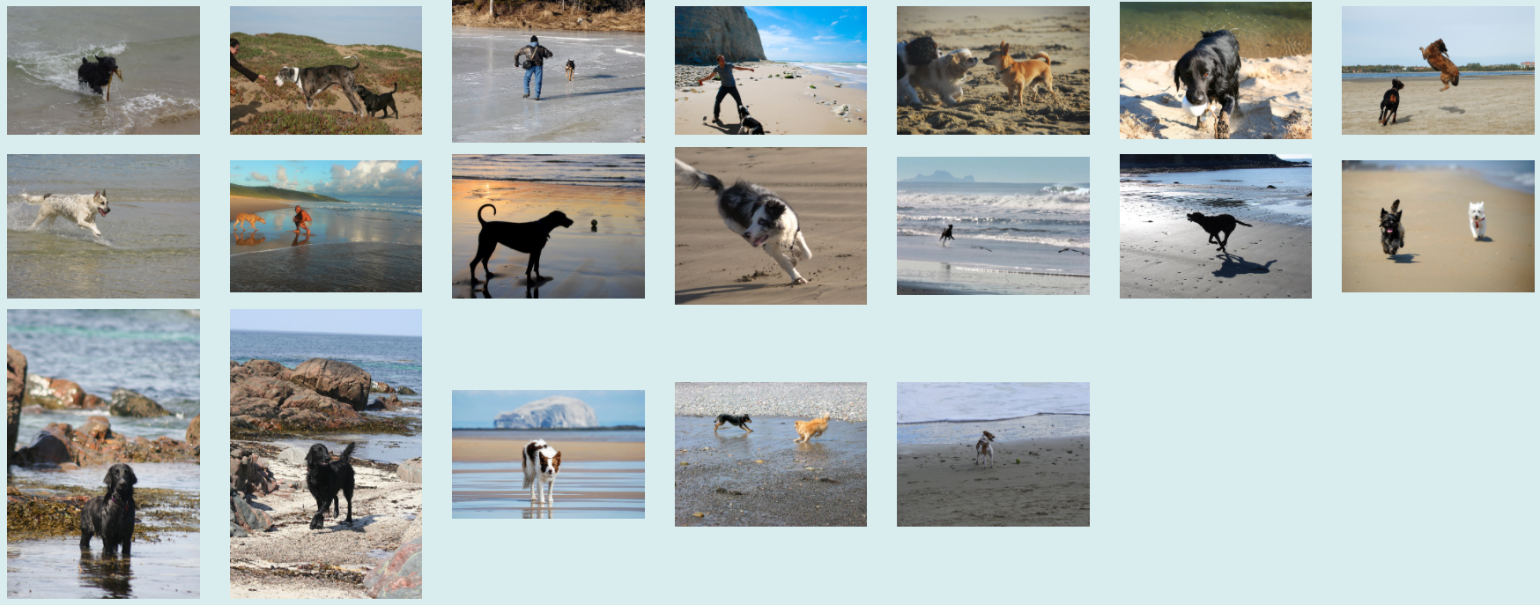
4/ Evaluation
Dog on beach
94%
11

Slide 12
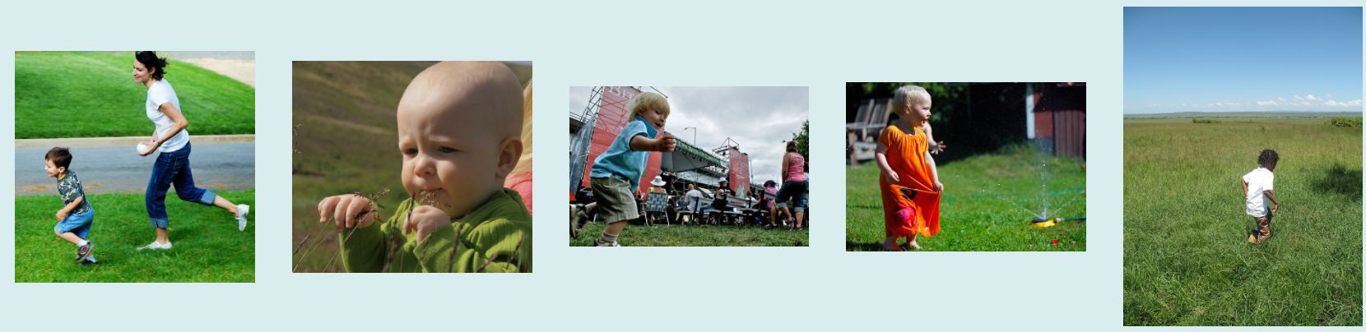
4/ Evaluation
Child on grass
100%
12

Slide 13

13

Slide 14
Thank You
14

