Slide 1
AIR MEASUREMENT
Instructor: Ph.D Do Thanh Nghi
Group members:
Dang Quach Gia Binh B1706973
Nguyen Lam Truc Mai B1706723
Nguyen Thi Bao Thu B1710449

Slide 2
OUTLINE
Module components
Web server
Demonstration
Conclusion

Slide 3
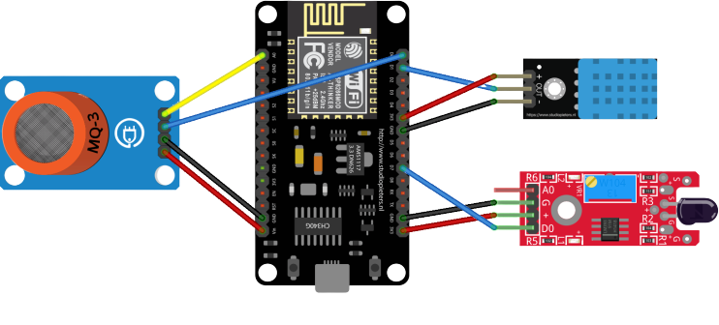
Module components

Slide 4

Web server
HTTP - HyperText Transfer Protocol

Slide 5
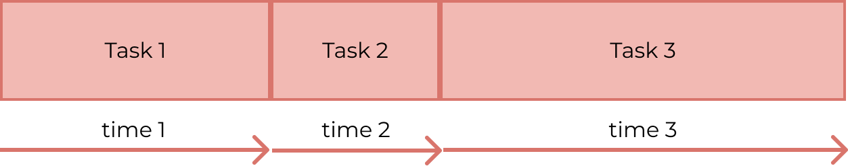
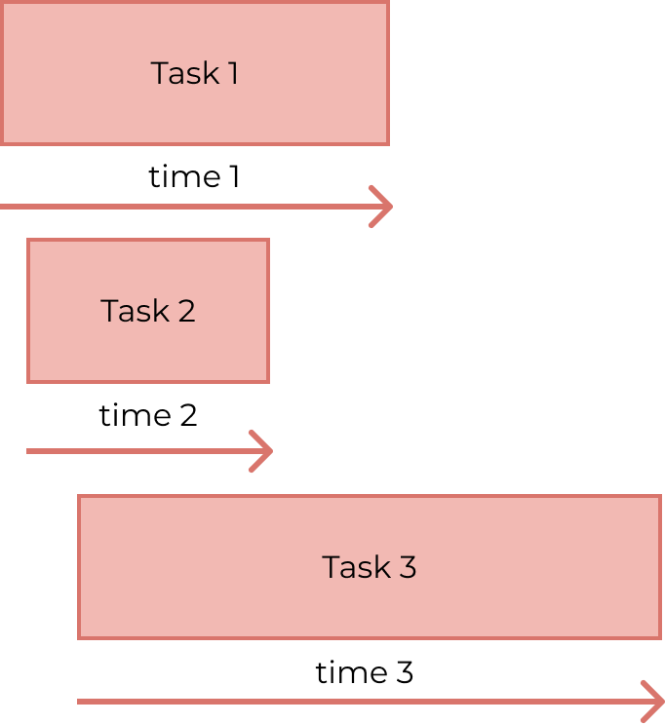
Web server
Synchronous
Asynchronous
Speed
Handle more than 1 connections at 1 time

Slide 6
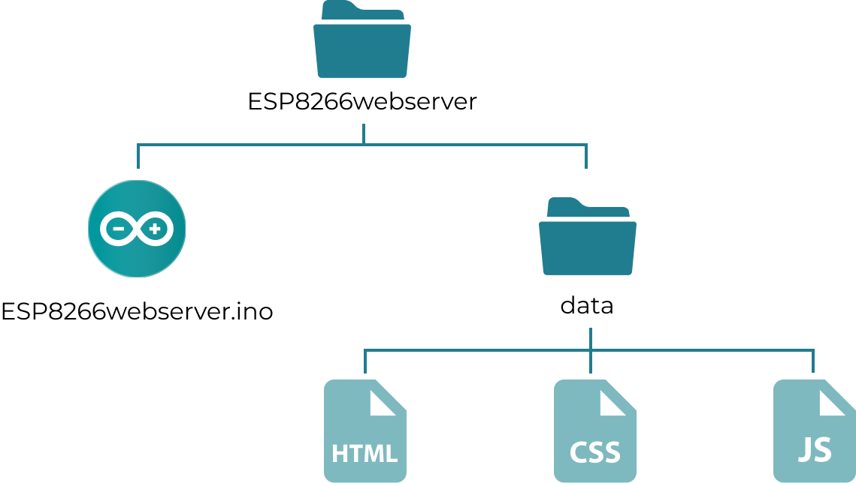
Web server
SPIFFS - Serial Peripheral Interface Flash File System

Slide 7
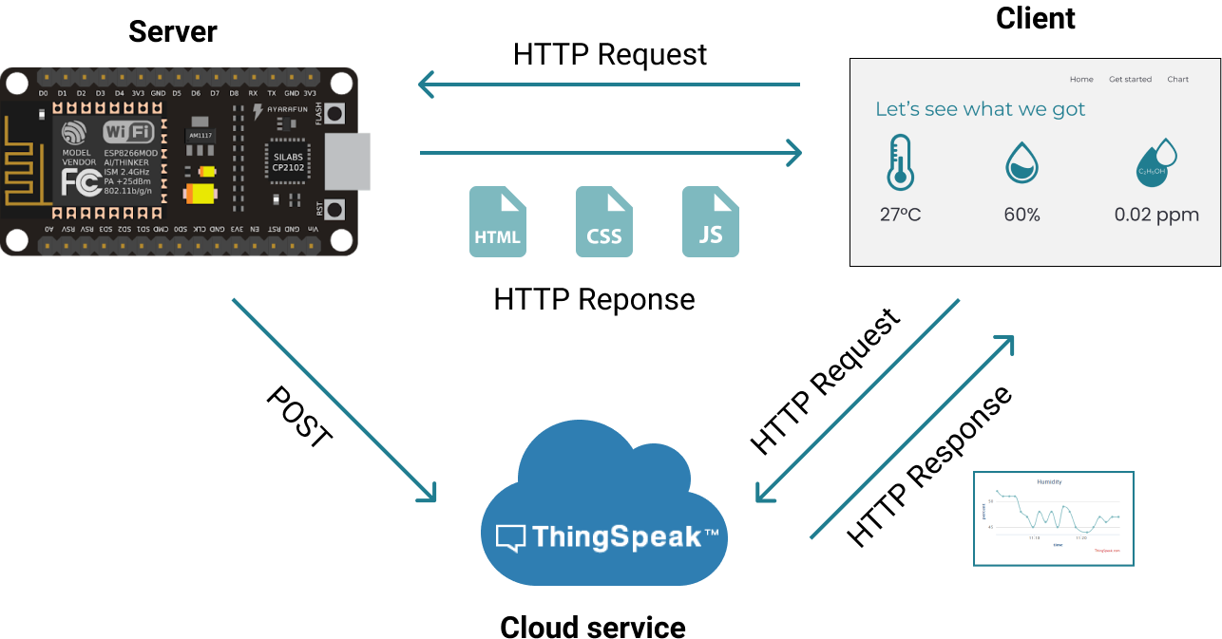
Web server

Slide 8
DEMONSTRATION
Let’s visit our website

Slide 9
Conclusion
High applicability and expandability
Development Strategy
Use an external Webserver
Use an independent power source for ESP8266
Integrate more sensors and other components

Slide 10
THANKS!
Please don’t affair to give any questions

Slide 11
Refereneces

Slide 12
Instructions for use
EDIT IN GOOGLE SLIDES
Click on the button under the presentation preview that says "Use as Google Slides Theme".
You will get a copy of this document on your Google Drive and will be able to edit, add or delete slides.
You have to be signed in to your Google account.
EDIT IN POWERPOINT®
Click on the button under the presentation preview that says "Download as PowerPoint template". You will get a .pptx file that you can edit in PowerPoint.
Remember to download and install the fonts used in this presentation (you’ll find the links to the font files needed in the Presentation design slide)
More info on how to use this template at slidescarnival.com/help-use-presentation-template
This template is free to use under Creative Commons Attribution license. You can keep the Credits slide or mention SlidesCarnival and other resources used in a slide footer.

Slide 13
SlidesCarnival icons are editable shapes. This means that you can:
Resize them without losing quality.
Change fill color and opacity.
Change line color, width and style.
Isn’t that nice? :) Examples:
Find more icons at slidescarnival.com/extra-free-resources-icons-and-maps

Slide 14
Diagrams and infographics

Slide 15
😉
You can also use any emoji as an icon! And of course it resizes without losing quality.
How? Follow Google instructions https://twitter.com/googledocs/status/730087240156643328
✋👆👉👍👤👦👧👨👩👪💃🏃💑❤😂😉😋😒😭👶😸🐟🍒🍔💣📌📖🔨🎃🎈🎨🏈🏰🌏🔌🔑 and many more...

