Slide 1
SCRUM
Đặng Quách Gia Bình – Nguyễn Thị Thúy Duy
Nguyễn Lâm Trúc Mai – Nguyễn Thị Bảo Thư – Huỳnh Ngô Phương Kỷ
Class: CNTT-CLC 1 K43

Slide 2
OUTLINE
Definition
Process
Principles

Slide 3
A framework within which people can address complex adaptive problems, while productively and creatively delivering products of the highest possible value.
[Srumguides.org]

Slide 4
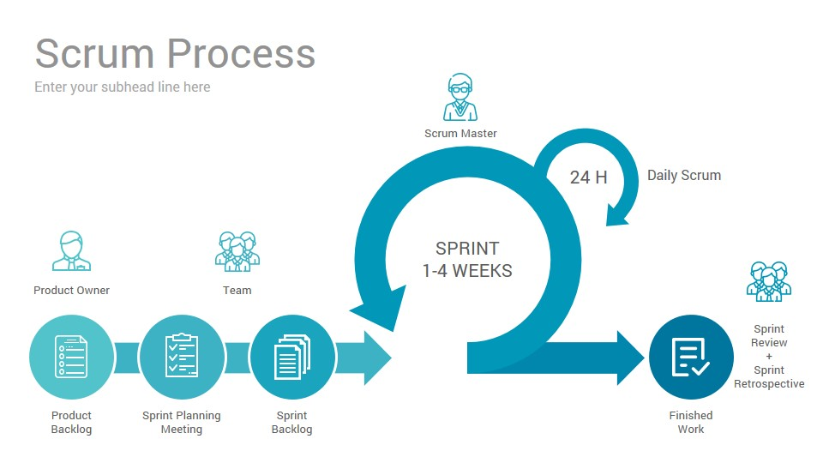

SCRUM PROCESS

Slide 5
PRINCIPLES
Transparency
Adaption
Inspection

Slide 6
Thanks!
Any questions?
Document:
www.srum.org
www.srumguides.org

