Slide 1
LEAP-RE RE4AFAGRI
M-LED
(A «Multi-sectoral Latent Electricity Demand» assessment platform)
An introduction
Place - institution
xth Month 2023

Slide 2
The RE4AFAGRI modelling platform

Slide 3
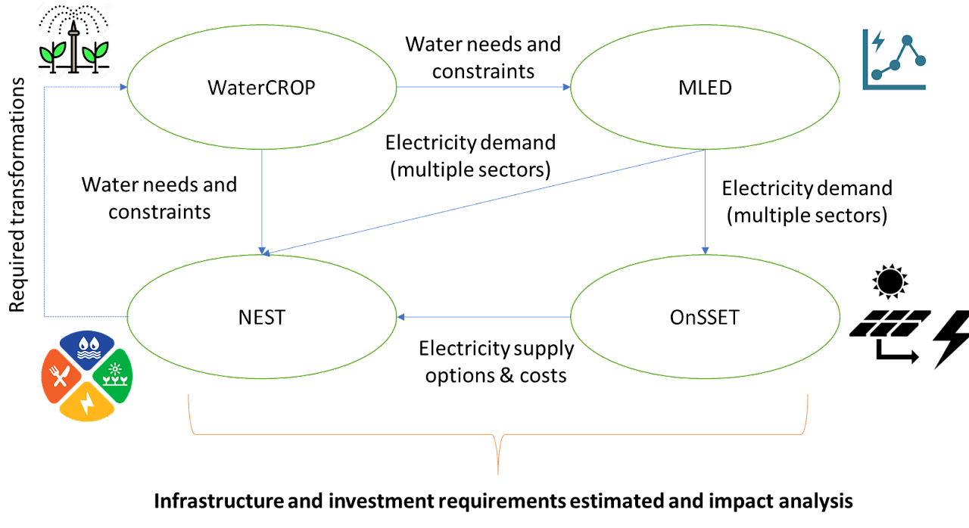
THE RE4AFAGRI modelling platform

Slide 4
Electricity demand
A function of:
Different sectors (residential, industrial, agriculture, social/public services)
Different drivers (population, economic development and growth, infrastructure availability)
Space -> geography, land, urban/rural, climate...
Time -> seasonality

Slide 5
Electricity demand
Tighly connected with:
Water (pumping and supply)
Land-use decisions (agriculture, urbanisation, etc.)
Climate change (adaptation)
...

Slide 6
M-LED
Introduction

Slide 7
M-LED: background
Electricity access gap -> still more than 10% of global population (ESMAP 2021)
Energy demand data is crucial for understanding gap and planning solutions, including in power system planning tools
But how to assess a demand that is currently not existent because there is no electricity access infrastructure…
… which would however be there if electricity access was available?
LATENT DEMAND -> dependent on local socio-economic, environmental, infrastructure characteristics
Three main approaches to estimate it:
Community elicitation through surveys
Empirical evaluation and similarity analysis (e.g. communities that recently got electricity)
Needs-based framework (e.g. Amartya Sen’s capabilities)

Slide 8
Background and Purpose
M-LED: a Multi-sectoral Latent Electricity Demand geospatial data processing platform to estimate electricity demand in communities that live in energy poverty
Main objective: produce spatio-temporally granular estimates of the latent electricity demand in different sectors for entire countries
Contributed to the development: Giacomo Falchetta, Nicolò Stevanato, Davide Mazzoni, Manfred Hafner, Magda Moner-Girona, Paolo Cornali, Su-Min Choi, Francesco Semeria, Emanuela Colombo…
First public “alpha”
Academic paper
Capacity building workshops
Spring 2019
Spring 2021
September 2022
2023
Begin of R&D
Stable, adaptable release

Slide 9
Technical Overview
M-LED methods:
Geospatial data processing algorithms
Appliance-based and needs-driven modelling
Stochastic variations in electricity demand
Scenario logic -> economic, demographic and climate pathways impact on future latent demand
M-LED assumptions:
Discussed with a broad array of stakeholder from different countries of SSA
Field visits to assess current pattern of appliance ownership and use
Literature and needs-driven objectives

Slide 10
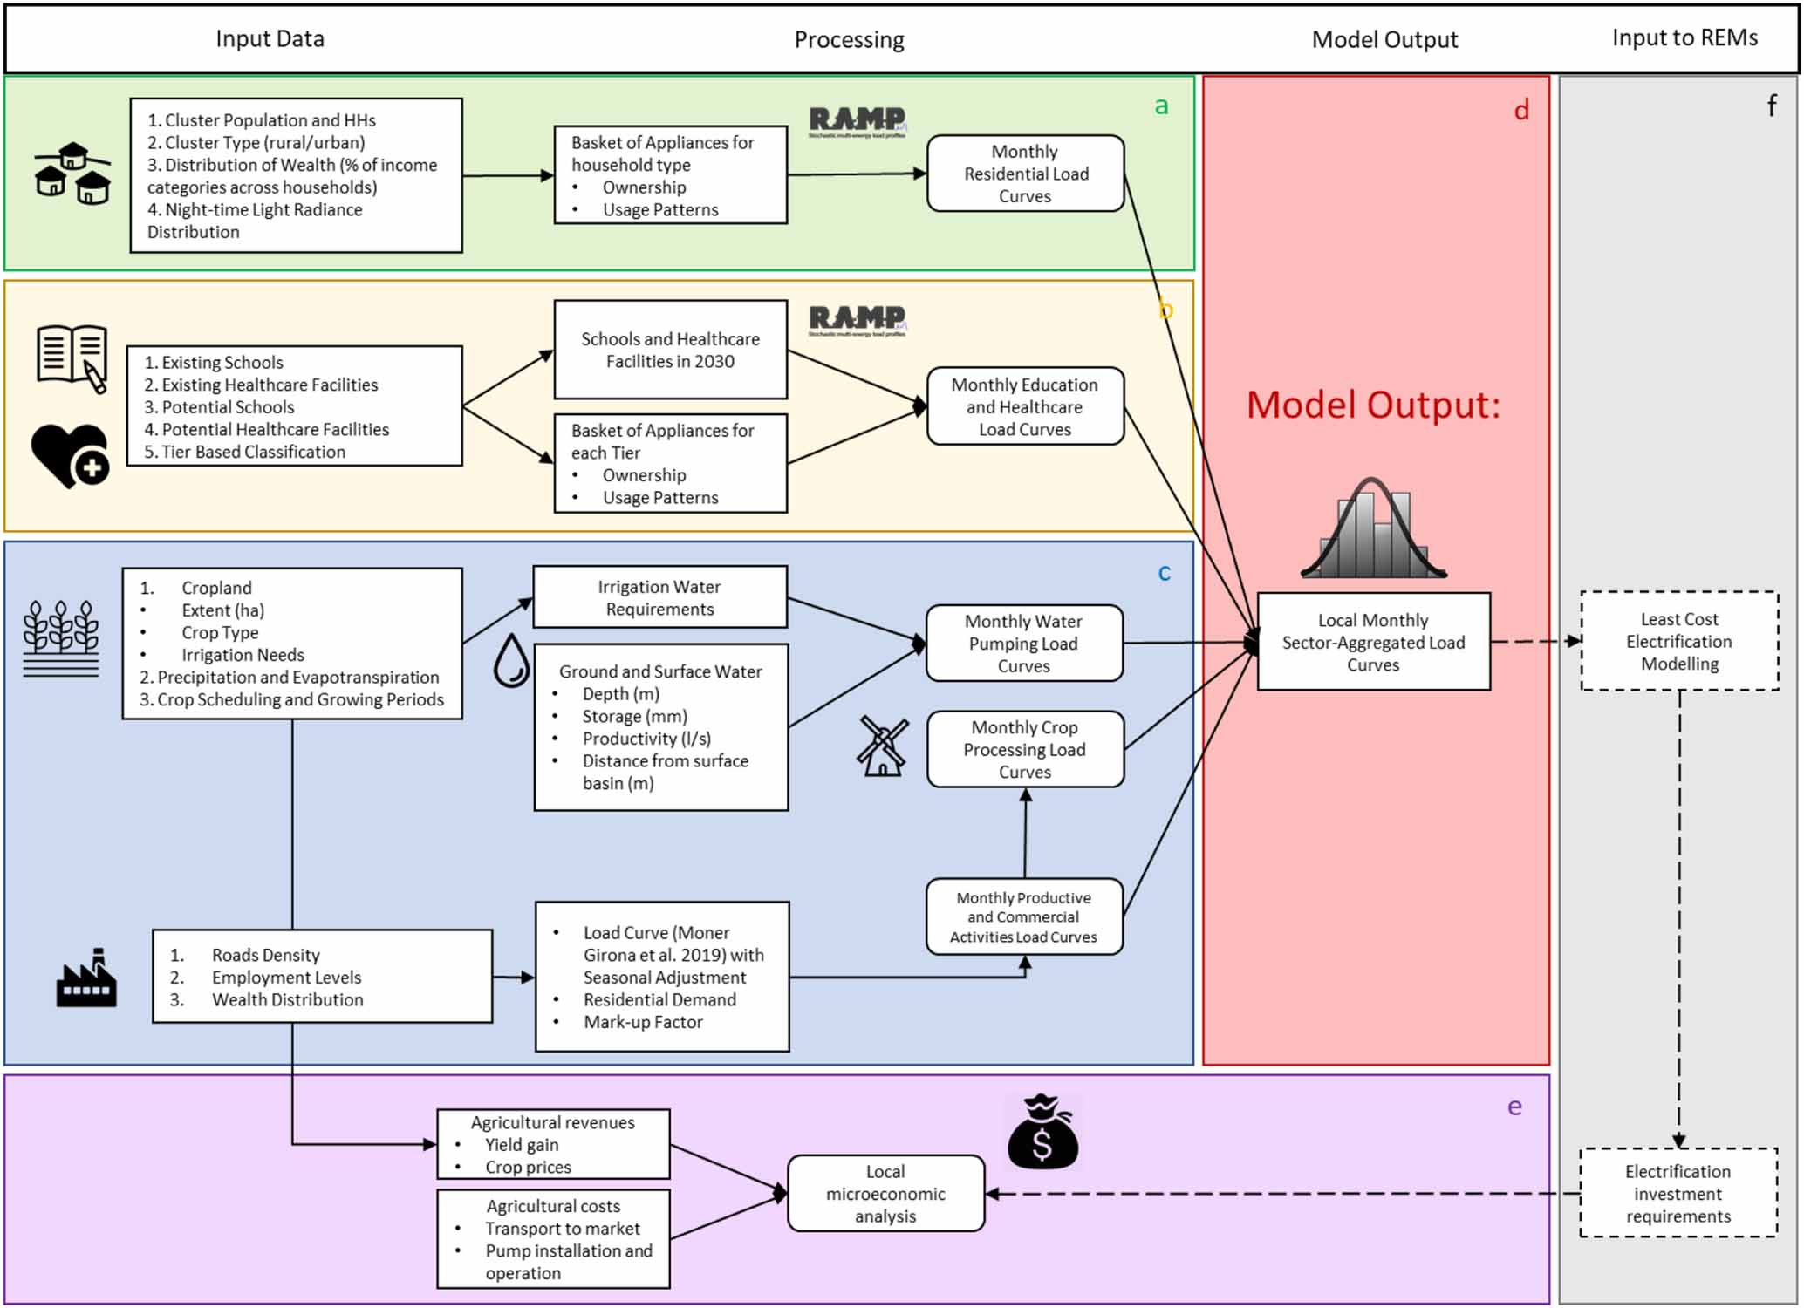
Data Inputs & Outputs
Cluster-based output: clusters encapsulate population settelements and surrounding agricultural land
Electricity demand sectors:
Residential
Irrigation
Crop procesing
SMEs
Healthcare facilities
Schools
Hourly, monthly and yearly demand for each sector -> load curves and seasonality

Slide 11
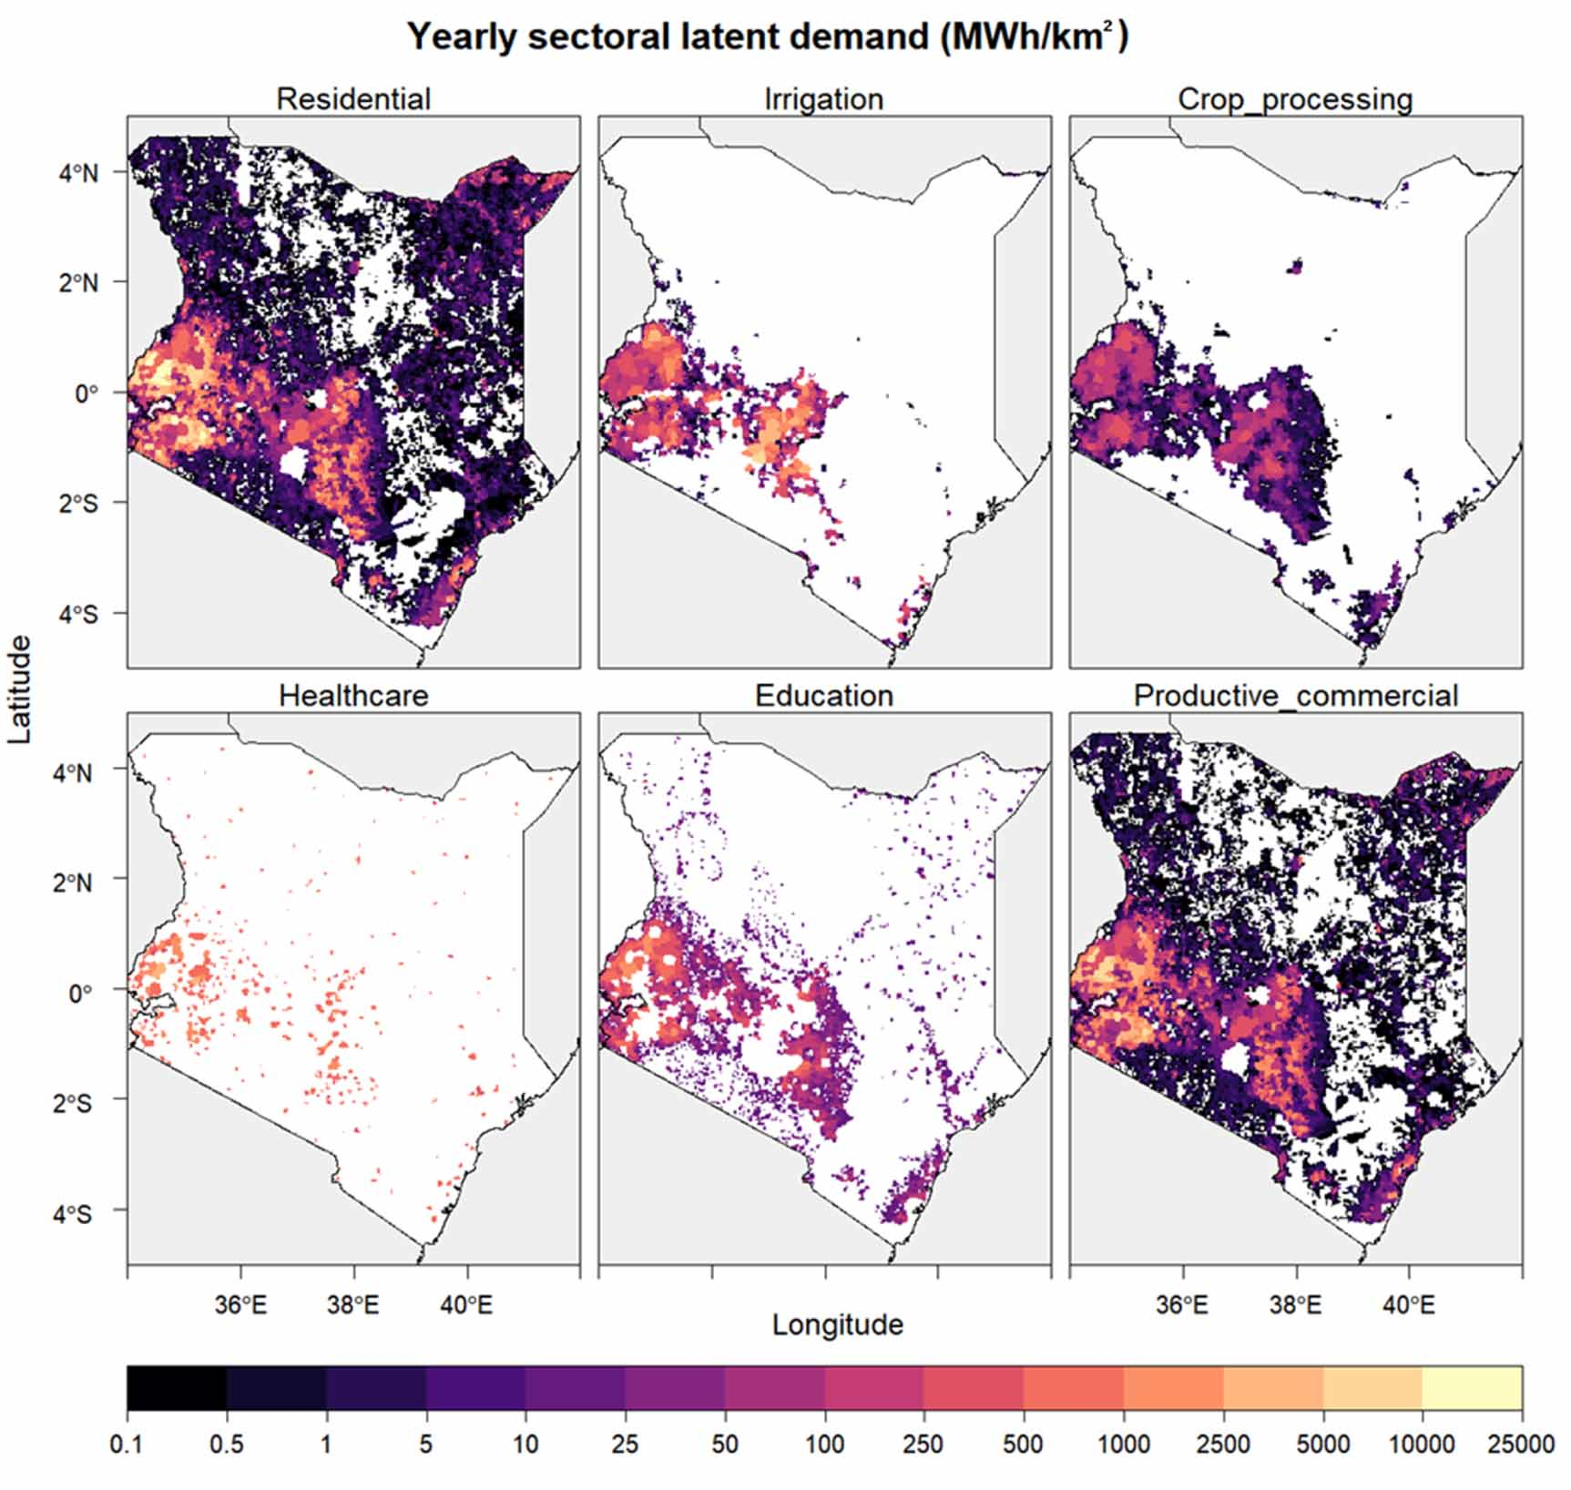
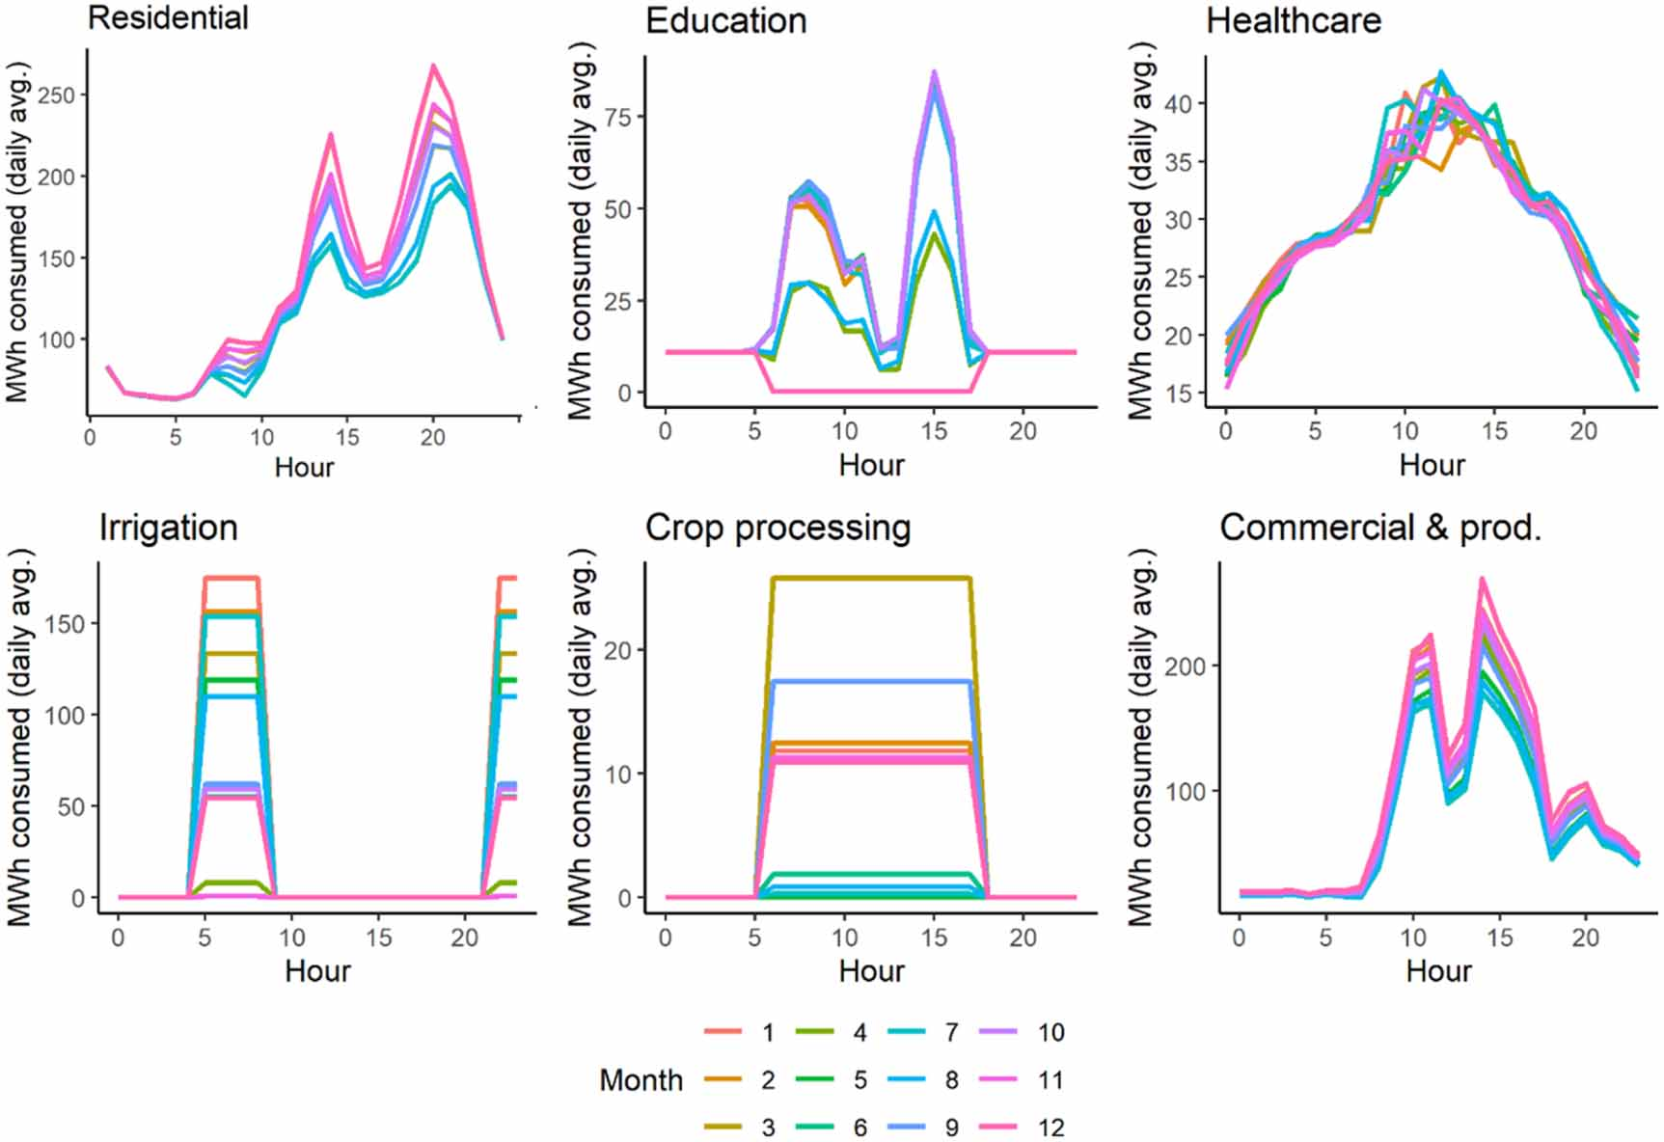
Example outputs

Slide 12
Target Users
Target users:
- Policymakers designing electrification plans
- Private infrastructure developers (solar home systems, solar pumps, mini-grids)
- Researchers and scientists in Africa and elsewhere (capacity building workshops to be held in 2023)
Requirements:
- Current alpha version -> requires coding and modelling proficiency…
- September scheduled release -> much more stable and replicable; less proficiency required to run analysis for custom countries / with custom assumptions
- Moreover -> Development of an accessible output data visualization dashboards for policymakers and private developers in progress!

Slide 13
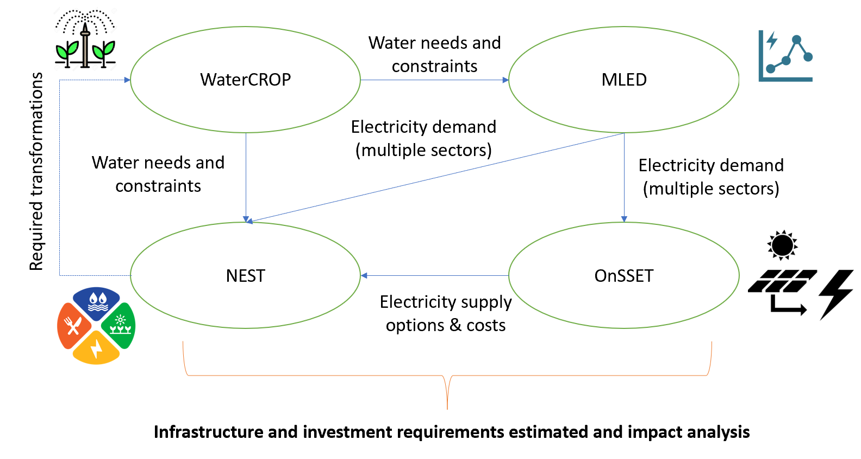
Use Cases
MLED is currently being used in the RE4AFAGRI project in linkage with other energy access – NEXUS tools/models and in cooperation with local stakeholders in Zambia and in Rwanda
Aim -> understand and quantify linkages and requirements along the climate-water-energy-agriculture-development Nexus to support private investment.

Slide 14
Geographic Coverage
M-LED pilot implementation -> Kenya, due to data availability and local contacts to conduct surveys.
Implementation currently in progress -> Zambia and Rwanda in the context of EC-H2020 LEAP-RE project, with direct input from local stakeholder.
Vision -> implementation in larger basket of countries and autonomously by African researchers engaged through capacity building workshops held in 2023.

Slide 15
Complementarity
M-LED output -> perfect match for supply-side electrification assessment tools, e.g. OnSSET, PVGIS, REM…
Moreover, M-LED receives inputs from WaterCROP, a crop evapotranspiration model that suggests the volumes of water to be pumped and supplied to the fields each month to avoid water stress.
Long-standing discussion with OnSSET and EC-JRC PVGIS developers.
Soft-linkages with OnSSET and PVGIS are being carried out for different projects -> e.g. RE4AFAGRI to understand relevance of agricultural demand for electricity supply planning.

Slide 16


Public Access
Github -> source code https://github.com/giacfalk/M-LED
Zenodo -> base package with replication data for Kenya country study https://zenodo.org/record/4741971
Both will be updated in September – December 2022 to a more stable version.

Slide 17
User Training & Support
Documentation -> alpha version under: https://github.com/giacfalk/M-LED/wiki
Documentation to be updated in Q1 2023 with creation of a ReadTheDocs website.
Capacity building workshops -> to happen in the RE4AFAGRI project context during 2023 in different SSA countries / virtually.
Direct support in case of issues -> falchetta@iiasa.ac.at

Slide 18
Future Updates
- Major code and data package update forthcoming in late 2022 -> stability, replicability, ease of access to parameters and assumptions
- Features currently being integrated:
Standalone solar pumps
Local cost-benefit analysis of irrigation expansion
Food security implications of irrigation expansion
Crop processing machinery
- Vision: improve data quality checks with stakeholders and integrate new data products:
M-LED would strongly benefit from high-resolution maps of cropland patches and crop type
Geodatabase of schools would improve precision of social infrastructure modelling

Slide 19
M-LED
Modules

Slide 20
Modules overview
Non-farm SMEs
Residential
Schools and education
Irrigation (pumping)
Mining
Crop processing
Structure of M-LED

Slide 21
M-LED
Software, hardware, and data requirements

Slide 23
M-LED
Running
M-LED

Slide 25
M-LED
Outputs and results visualisation and interpretation

Slide 27
M-LED
Scenarios and assumptions customisation

Slide 29
M-LED
FAQs

Slide 31
M-LED
Typical issues

Slide 33
M-LED
How do I run M-LED for my country / region of interest?

