Slide 1
LEAP-RE RE4AFAGRI
M-LED
(A «Multi-sectoral Latent Electricity Demand» assessment platform)
An introduction
Speaker
Place - institution
xth Month 2023

Slide 2
Background:
the RE4AFAGRI modelling platform

Slide 3
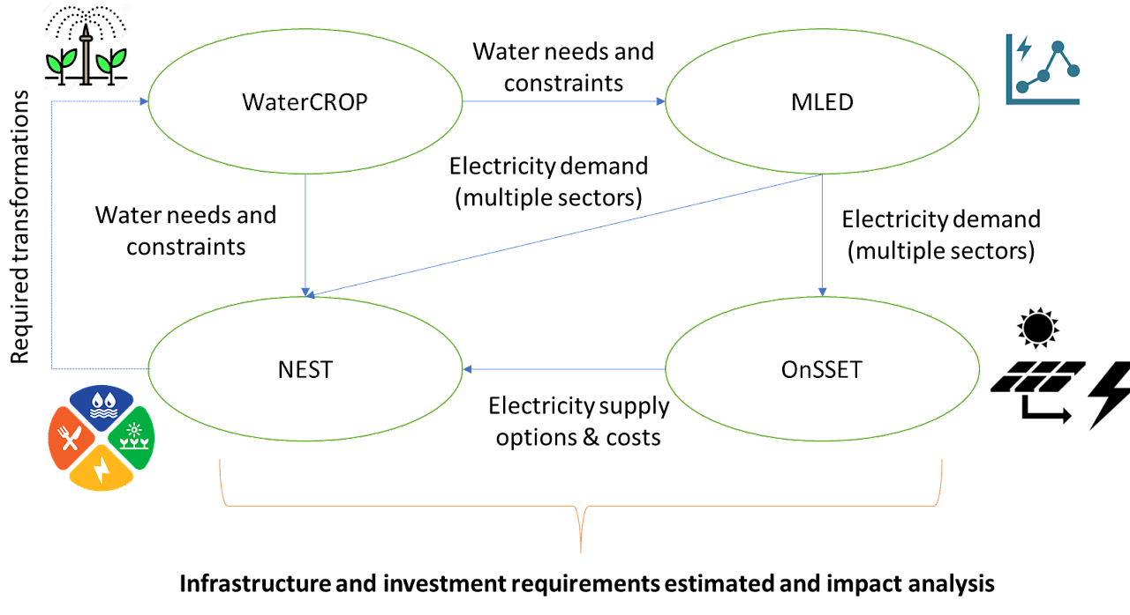
THE RE4AFAGRI modelling platform

Slide 4
M-LED in the RE4AFAGRI modelling platform
M-LED is the energy demand module of the RE4AFAGRI modelling platform

Slide 5
Electricity demand
A function of:
Different sectors (residential, industrial, agriculture, social/public services)
Different drivers (population, economic development and growth, infrastructure availability)
Space -> geography, land, urban/rural, climate...
Time -> seasonality

Slide 6
Electricity demand
Tighly connected with:
Water (pumping and supply)
Land-use decisions (agriculture, urbanisation, etc.)
Climate change (adaptation)
...

Slide 7
M-LED
Introduction

Slide 8
M-LED: background
Electricity access gap -> still more than 10% of global population (ESMAP 2021)
Energy demand data is crucial for understanding gap and planning solutions, including in power system planning tools
But how to assess a demand that is currently not existent because there is no electricity access infrastructure…
… which would however be there if electricity access was available?
LATENT DEMAND -> dependent on local socio-economic, environmental, infrastructure characteristics
Three main approaches to estimate it:
Community elicitation through surveys
Empirical evaluation and similarity analysis (e.g. communities that recently got electricity)
Needs-based framework (e.g. Amartya Sen’s capabilities)

Slide 9
Background and Purpose
M-LED: a Multi-sectoral Latent Electricity Demand geospatial data processing platform to estimate electricity demand in communities that live in energy poverty
Main objective: produce spatio-temporally granular estimates of the latent electricity demand in different sectors for entire countries
Contributed to the development: Giacomo Falchetta, Nicolò Stevanato, Davide Mazzoni, Manfred Hafner, Magda Moner-Girona, Paolo Cornali, Su-Min Choi, Francesco Semeria, Emanuela Colombo…
First public “alpha”
Academic paper
Capacity building workshops
Spring 2019
Spring 2021
September 2022
2023
Begin of R&D
Stable, adaptable release

Slide 10
Technical Overview
M-LED methods:
Geospatial data processing algorithms
Appliance-based and needs-driven modelling
Stochastic variations in electricity demand
Scenario logic -> economic, demographic and climate pathways impact on future latent demand
M-LED assumptions:
Discussed with a broad array of stakeholder from different countries of SSA
Field visits to assess current pattern of appliance ownership and use
Literature and needs-driven objectives

Slide 11
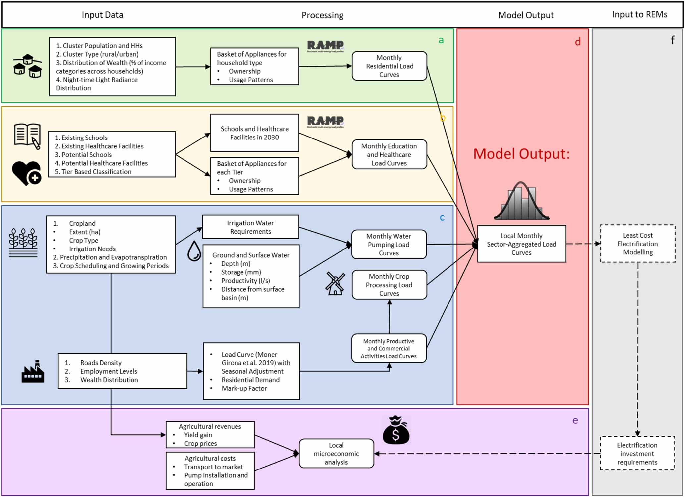
Data Inputs & Outputs
Cluster-based output: clusters encapsulate population settelements and surrounding agricultural land
Electricity demand sectors:
Residential
Irrigation
Crop procesing
SMEs
Healthcare facilities
Schools
Hourly, monthly and yearly demand for each sector -> load curves and seasonality

Slide 12
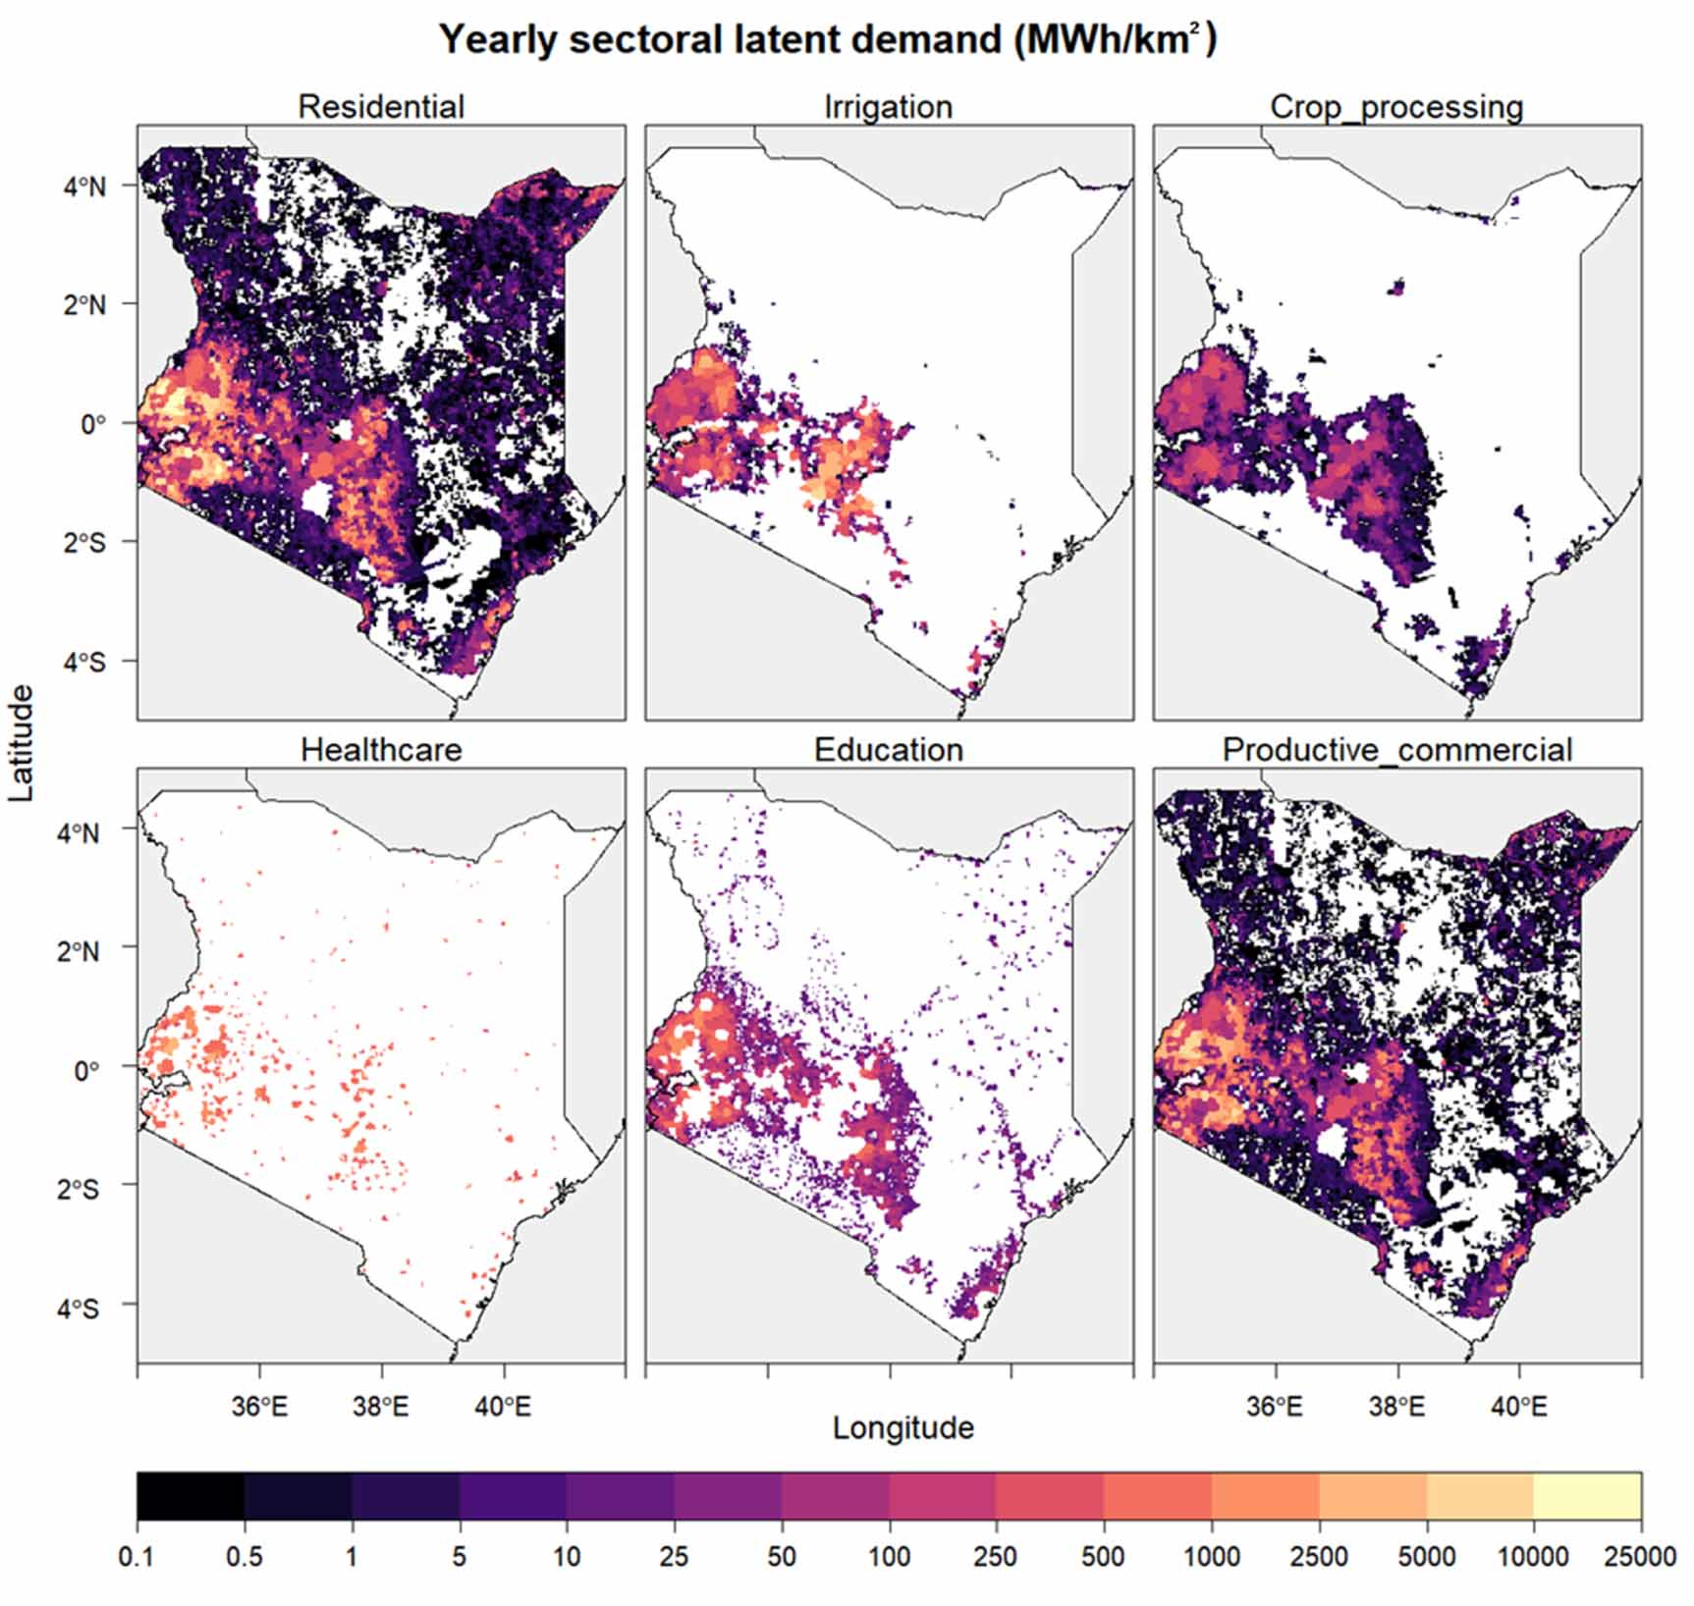
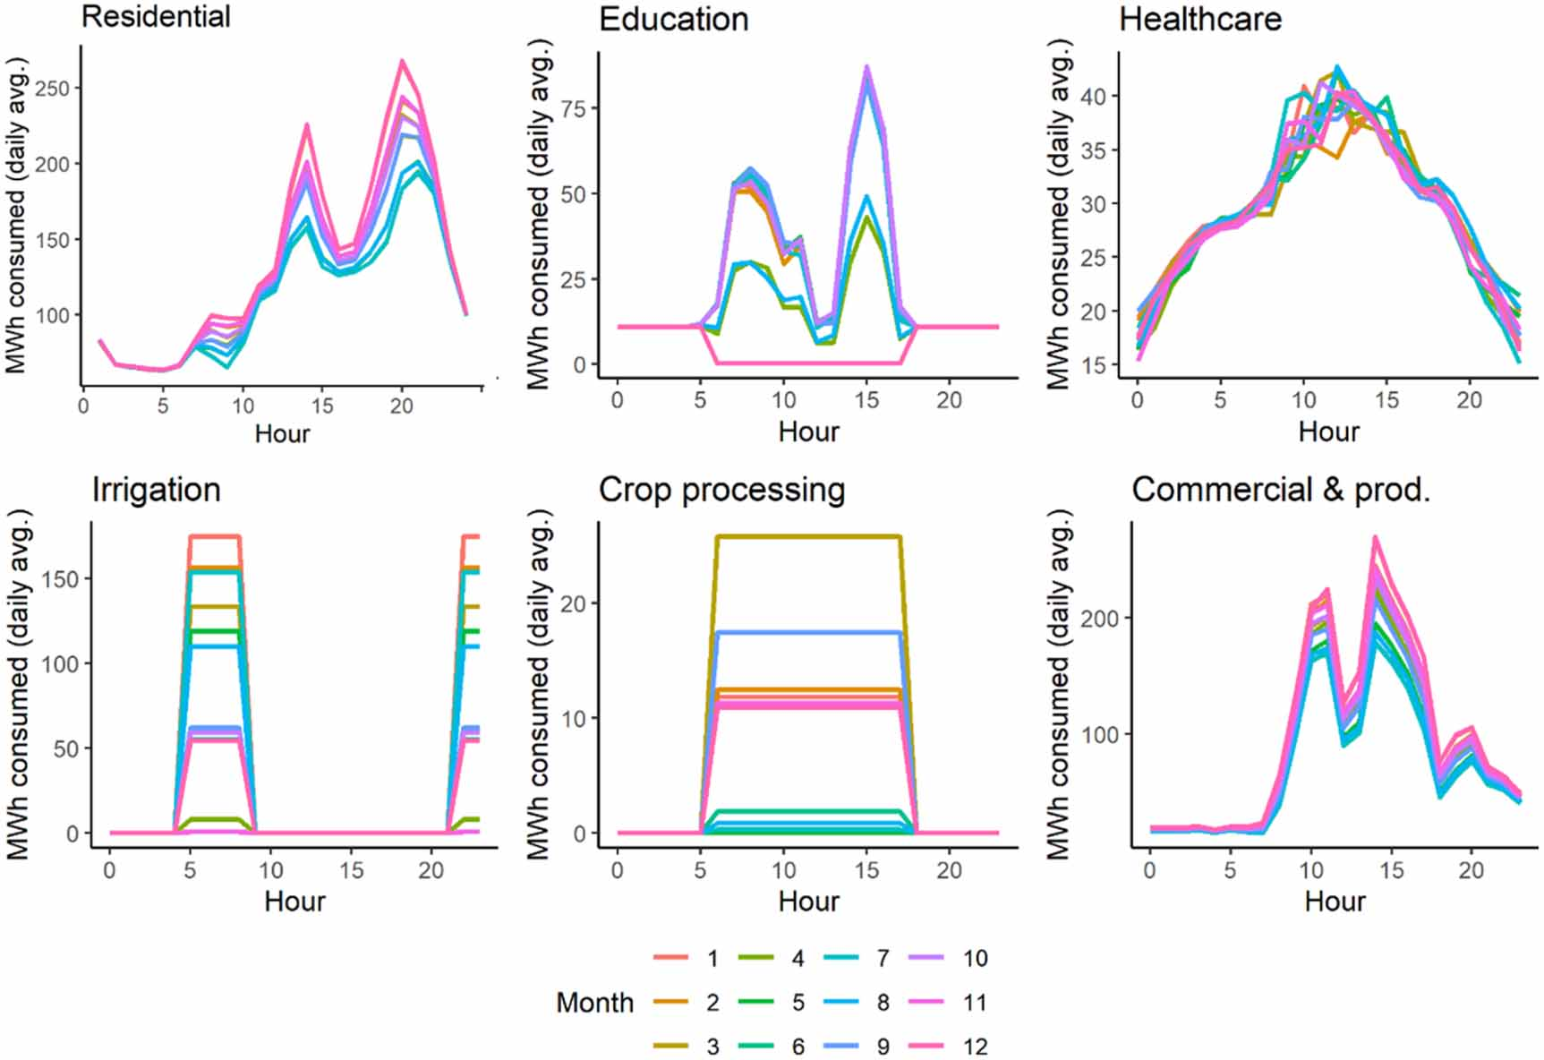
Example outputs

Slide 13
Target Users
Target users:
- Policymakers designing electrification plans
- Private infrastructure developers (solar home systems, solar pumps, mini-grids)
- Researchers and scientists in Africa and elsewhere (capacity building workshops to be held in 2023)
Requirements:
- Current alpha version -> requires coding and modelling proficiency…
- September scheduled release -> much more stable and replicable; less proficiency required to run analysis for custom countries / with custom assumptions
- Moreover -> Development of an accessible output data visualization dashboards for policymakers and private developers in progress!

Slide 14
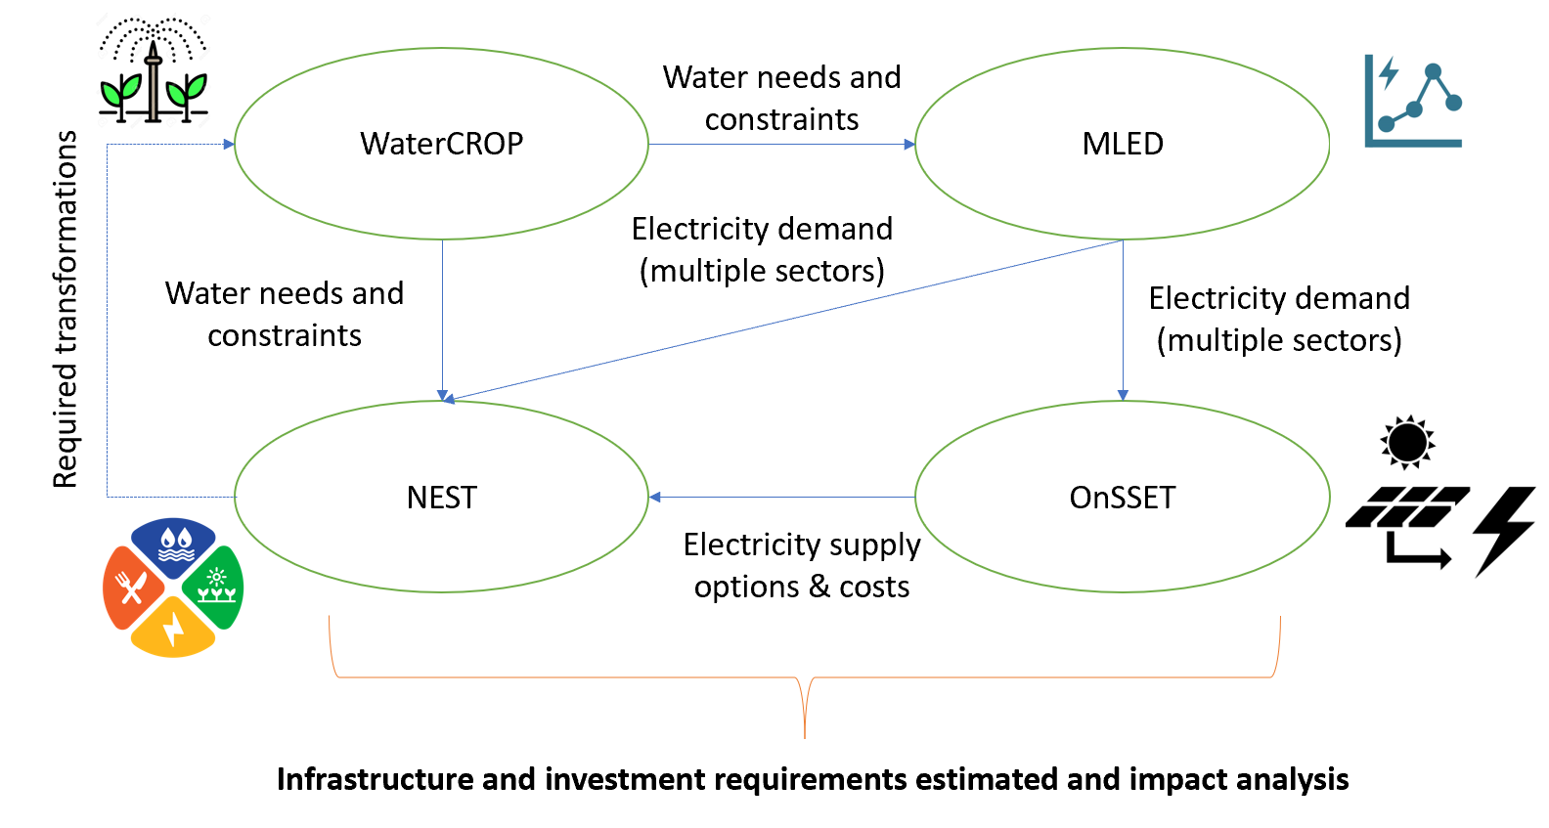
Use Cases
MLED is currently being used in the RE4AFAGRI project in linkage with other energy access – NEXUS tools/models and in cooperation with local stakeholders in Zambia and in Rwanda
Aim -> understand and quantify linkages and requirements along the climate-water-energy-agriculture-development Nexus to support private investment.

Slide 15
Geographic Coverage
M-LED pilot implementation -> Kenya, due to data availability and local contacts to conduct surveys.
Implementation currently in progress -> Zambia and Rwanda in the context of EC-H2020 LEAP-RE project, with direct input from local stakeholder.
Vision -> implementation in larger basket of countries and autonomously by African researchers engaged through capacity building workshops held in 2023.

Slide 16
Complementarity
M-LED output -> perfect match for supply-side electrification assessment tools, e.g. OnSSET, PVGIS, REM…
Moreover, M-LED receives inputs from WaterCROP, a crop evapotranspiration model that suggests the volumes of water to be pumped and supplied to the fields each month to avoid water stress.
Long-standing discussion with OnSSET and EC-JRC PVGIS developers.
Soft-linkages with OnSSET and PVGIS are being carried out for different projects -> e.g. RE4AFAGRI to understand relevance of agricultural demand for electricity supply planning.

Slide 17


Public Access
Github -> source code https://github.com/giacfalk/RE4AFAGRI_platform
Zenodo -> base package with replication data for Kenya country study https://zenodo.org/record/4741971
Both will be updated in September – December 2022 to a more stable version.

Slide 18
User Training & Support
Documentation -> alpha version under: https://github.com/giacfalk/M-LED/wiki
Documentation to be updated in Q1 2023 with creation of a ReadTheDocs website.
Capacity building workshops -> to happen in the RE4AFAGRI project context during 2023 in different SSA countries / virtually.
Direct support in case of issues -> falchetta@iiasa.ac.at

Slide 19
Future Updates
- Major code and data package update forthcoming in late 2022 -> stability, replicability, ease of access to parameters and assumptions
- Features currently being integrated:
Standalone solar pumps
Local cost-benefit analysis of irrigation expansion
Food security implications of irrigation expansion
Crop processing machinery
- Vision: improve data quality checks with stakeholders and integrate new data products:
M-LED would strongly benefit from high-resolution maps of cropland patches and crop type
Geodatabase of schools would improve precision of social infrastructure modelling

Slide 20
M-LED
Modules

Slide 21
Structure of M-LED
Preparation modules
MLED.R -> «homepage» of the model
backend.R -> pre-requirements (software packages, configuration, database donwload) of the model
scenario_xxx.R -> data and parameters specific to the selected run (country, scenario)
electricity_access.R ->
create_clusters_voronoi.R ->

Slide 22
Demand modules: overview
Six sectors are currently represented in M-LED
Residential -> household demand of both household who already benefit from electricity access and of households gaining access to electricity in the future
Non-farm SMEs -> commercial activities and small-scale handcraft
Mining -> heavy industry sector
Crop processing -> agricultural load, post-harvest (e.g. Milling) and cold storage of vegetables
Irrigation -> ground and surface water pumping for crop watering
Schools and education -> social infrastructure demand
Non-farm SMEs
Residential
Schools and education
Irrigation (pumping)
Mining
Crop processing

Slide 23
Preparation modules: MLED.R

Slide 24
Preparation modules: backend.R

Slide 25
Preparation modules: scenario_xxx.R

Slide 26
Preparation modules: electricity_access.R

Slide 27
Preparation modules: create_clusters_voronoi.R

Slide 28
Demand modules: residential.R

Slide 29
Demand modules: crop_module.R and pumping_module.R

Slide 30
Demand modules: mining_module.R

Slide 31
Demand modules: health_education_module.R

Slide 32
Demand modules: crop_processing_catchment_areas.R

Slide 33
Demand modules: other_productive.R

Slide 34
Demand modules: crop_processing.R

Slide 35
Conclusive modules: cleaner.R

Slide 36
M-LED
Software, hardware, and data requirements

Slide 38
M-LED
Running
M-LED

Slide 40
M-LED
Outputs and results visualisation and interpretation

Slide 42
M-LED
Scenarios and assumptions customisation

Slide 44
M-LED
Soft-linkages

Slide 45
THE RE4AFAGRI modelling platform
Receiving inputs
Providing outputs

Slide 46
Input linkages of M-LED
WaterCrop
...

Slide 47
Output linkages of M-LED
OnSSET
...
NEST
...

Slide 48
M-LED
FAQs

Slide 49
FAQs
Q1: What is the running time of M-LED?
A1:
Q2: How much does the M-LED database weight?
A2:

Slide 50
M-LED
Typical issues

Slide 51
Issue 1:
Solution 1:
Issue 2:
Solution 2:

Slide 52
M-LED
How do I run M-LED for my country / region of interest?

Slide 53
Implementation of M-LED in a new region
Look for data. Country specific datasets which are non included in the SSA-wide database of M-LED include:
A
B
C
D
E

Slide 54
Implementation of M-LED in a new region
Discuss with stakeholders. Assumptions (socio-economic, technological, scenario and policy) must be tailored.
A
B
C
D
E

Slide 55
Implementation of M-LED in a new region
Customise parameters in the scenario file. Assumptions (socio-economic, technological, scenario and policy) must be tailored.
A
B
C
D
E

Slide 56
Implementation of M-LED in a new region
Revise RAMP appliance baskets and usage patterns. What type of appliances will newly electrified household and facilities use, and with what patterns?
A
B
C
D
E

Slide 57
M-LED
Contact and help

Slide 58
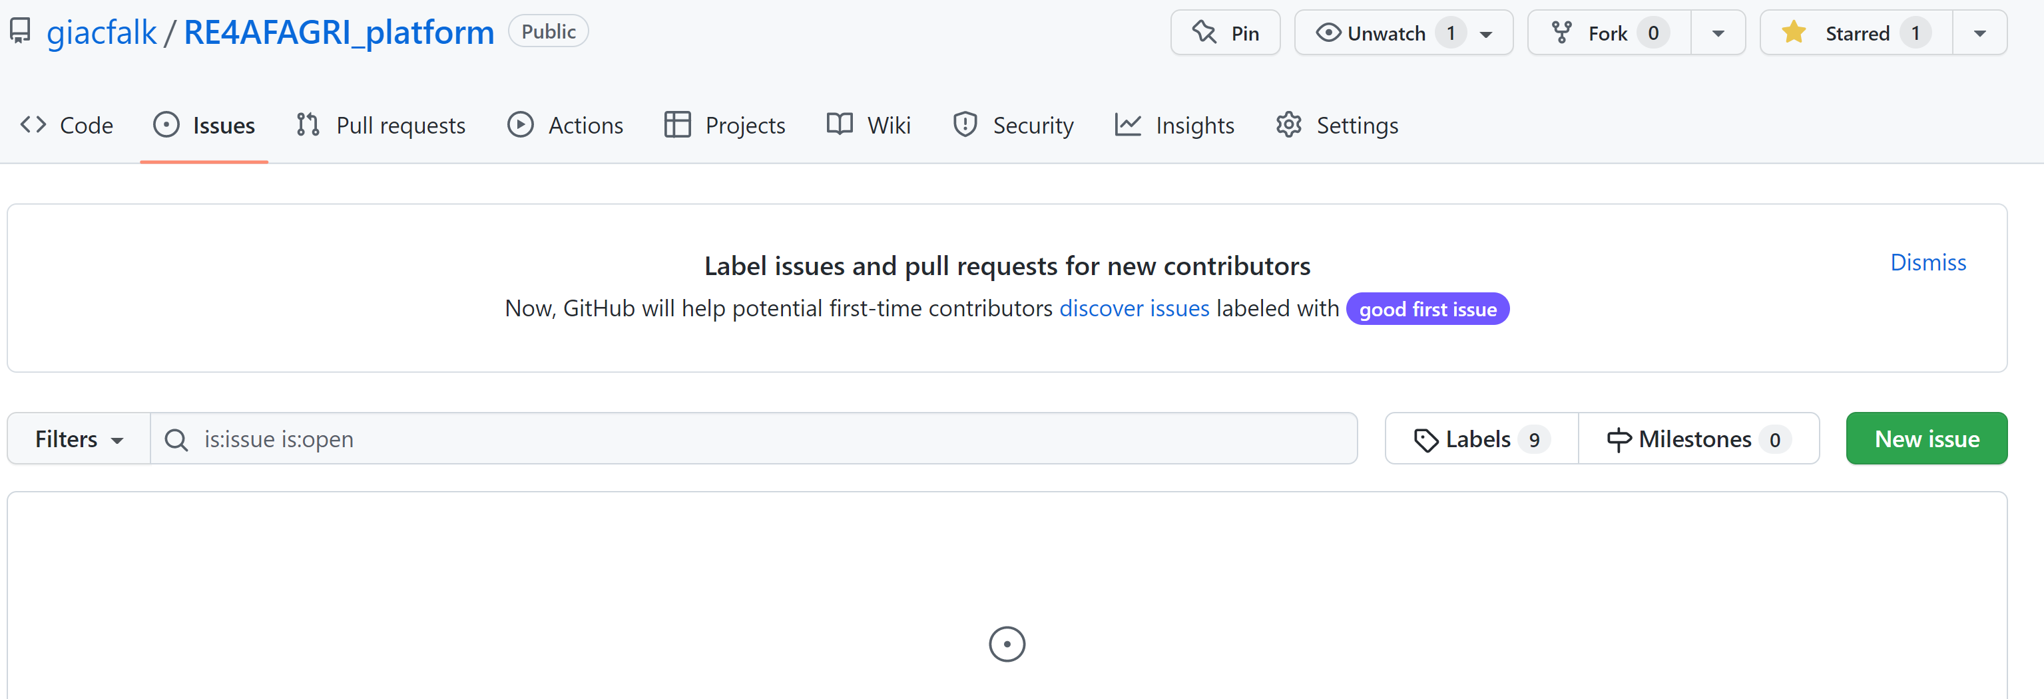
Contact
For other queries and engagement, reach out to:
re4afagri@gmail.com
https://github.com/giacfalk/RE4AFAGRI_platform

Slide 59
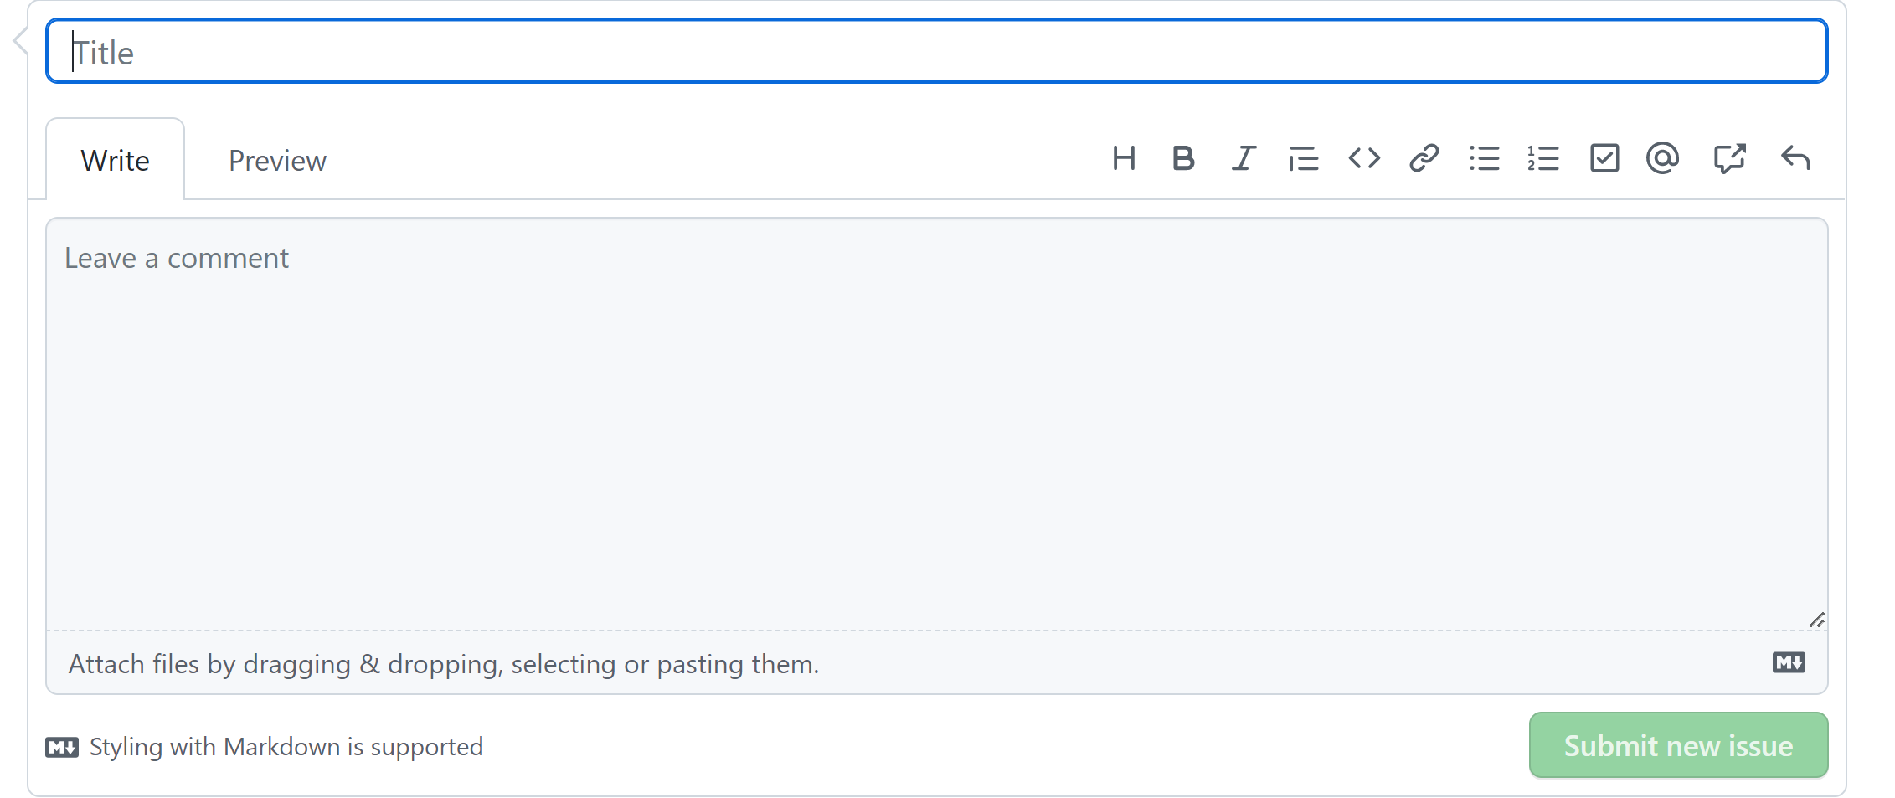
Contact
For other queries and engagement, reach out to:
re4afagri@gmail.com
https://github.com/giacfalk/RE4AFAGRI_platform

