Slide 1
Advanced Visual Computing
Lab 3: point clouds processing and registration
Andrea Giachetti University of Verona, Italy andrea.giachetti@univr.it

Slide 2
Open3D
Powerful library for 3d data processing
Can handle point clouds (another potential tool is pcl)
Available in python: pip install open3d
Let’s use in the python codes in the Lab3 archive
Documentation, tutorials and examples:
https://www.open3d.org/docs/latest/
We will focus on the registration pipelines
https://www.open3d.org/docs/latest/tutorial/pipelines/index.html

Slide 3
Depth images
Just to see how depth images are encoded
introduction_rgbd shows a file captured from depth camera and the basic processing to visualize point clouds using Open3d
The RGB-D image is acquired with a PrimeSenseCarmine camera (old device)
The focal length is 525 for both axes (fx=525, fy=525)and the principal point is (cx =319.5,cy=239.5)
Rgb and d are obviously already registered (but not all depths are valid)
We can extract a mesh from the point cloud as we have done in the stereo code (see example codes)

Slide 4
Point cloud registration
Remember:
Rigid registration 6DOF transform (translation+rotation)
Optimization problem to be solved given points correspondence
Typical approach for pre-registered clouds (local registration): ICP
Several variants and distances
Typical approach to get approximate registration: feature matching and robust optimization
Different features and robust estimators
Color information can help

Slide 5
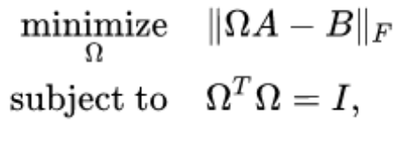




ICP
Iterative registration of point clouds
Nearest neighbor paring
Orthogonal procrustes problem solution
equivalent to finding the nearest orthogonal matrix to a given matrix
solving the closest orthogonal approximation problem
Solved with Singular Value Decomposition (SVD) that gives
We can write the code explicitly, without using open3D registration code, see
icp_ex.py

Slide 6
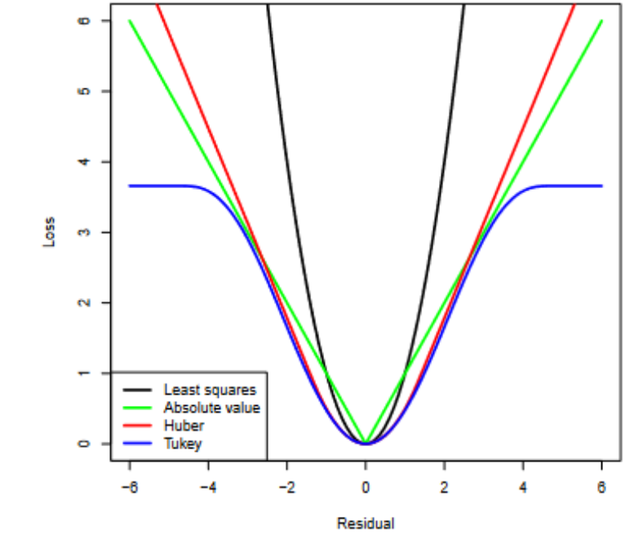
Open3D registration pipelines
See https://www.open3d.org/docs/release/tutorial/pipelines/index.html
ICP, comparing point to point and point to plane distances
icp_registration.py
Colored icp
colored_icp_registration.py
Robust ICP
robust_icp.py
RANSAC for global registration
registration_ransac.py
https://www.open3d.org/docs/release/tutorial/pipelines/global_registration.html
Robust ICP: different losses

Slide 7
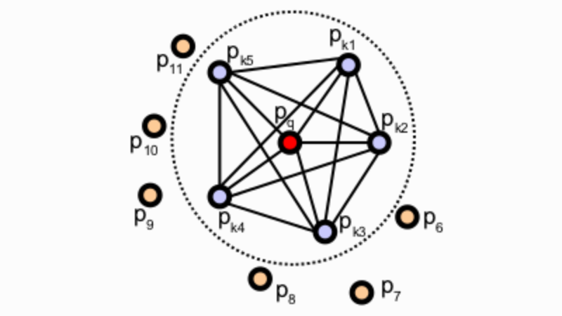
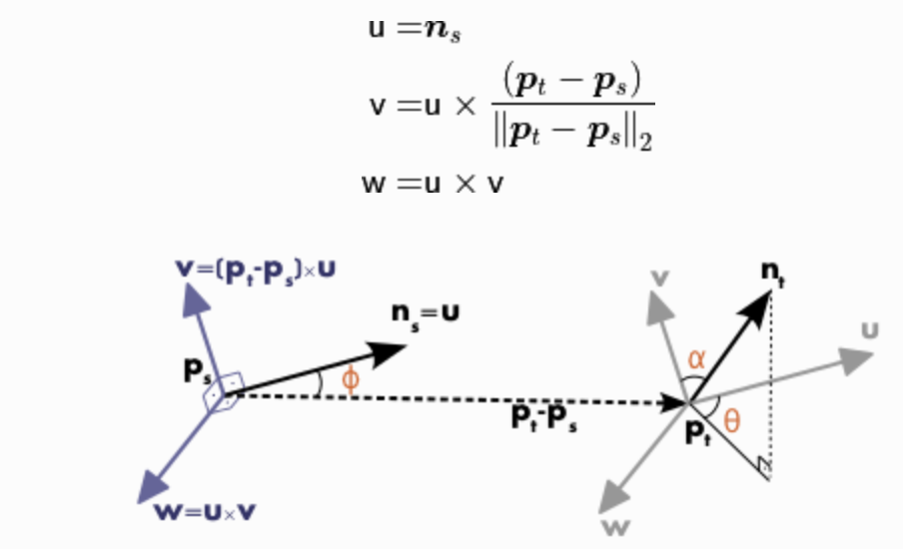
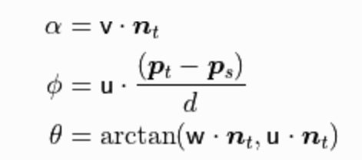
Global matching: feature detector/descriptor
FPFH (Fast Point Feature Histogram),
it attempts to capture as best as possible the sampled surface variations by taking into account all the interactions between the directions of the estimated normal
Point feature histogram: capture relationships between normals around the point
From PCL https://pcl.readthedocs.io/

Slide 8
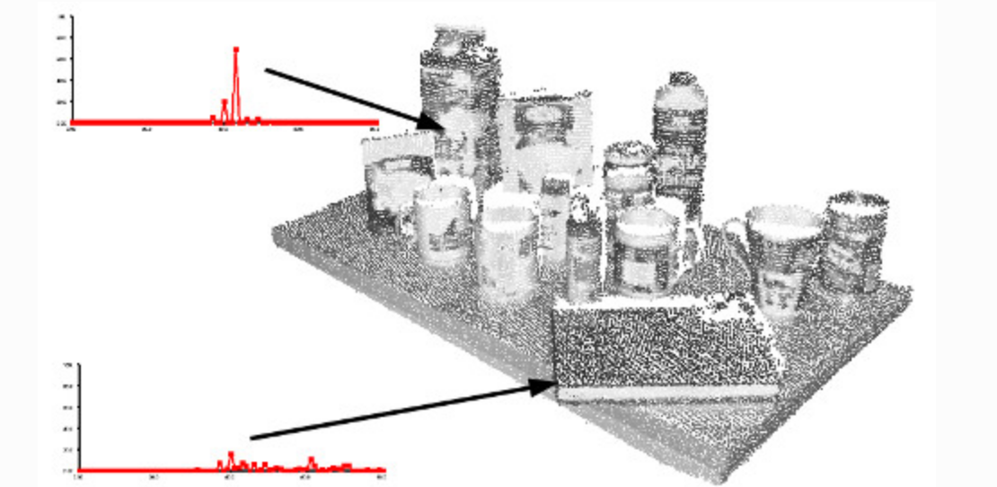
FPFH (Fast Point Feature Histogram),
From PCL https://pcl.readthedocs.io/

Slide 9
Homework
Consider the point clouds of the partial scans
Part1.ply
Part2.ply
Using the functions seen in the tutorial, try to
Estimate with feature-based robust matching the transform and refine with ICP
Create a merged, registered point cloud
(optional: mesh using Poisson using meshlab)

Slide 10
Lessons plan
No lesson on Tuesday, April 7
You can exploit the available room for working at the homework (or starting to work at the last homework, see next)
The course should end on May 14
And some of the 3 hours lessons will be reduced to 2 hours (possibly April 21/28, not sure, you will be informed)

Slide 11
Shape contest
Before the end of the course (currently planned on May 12) students are invited to
Create a shape (triangle mesh) that will be manufactured during the last lesson of the course
Using vision based pipeline and post processing (meshing, smoothing etc.)
Adding designed parts (Using Blender)
Preparing it for printing (we’ll see)
The winning shape will be printed and given to the author

