Slide 1
Advanced Visual Computing (Digital Design)
Lab 4: Photometric Stereo
Andrea Giachetti University of Verona, Italy andrea.giachetti@univr.it

Slide 2
Photometric Stereo
Let us see, practically, how it works
Active research here on this kind of images
Potential topic for projects (and internship/theses)
Lab 4 folder
Example synthetic and real datasets with
Code implementing simplest method (Lambertian)

Slide 3
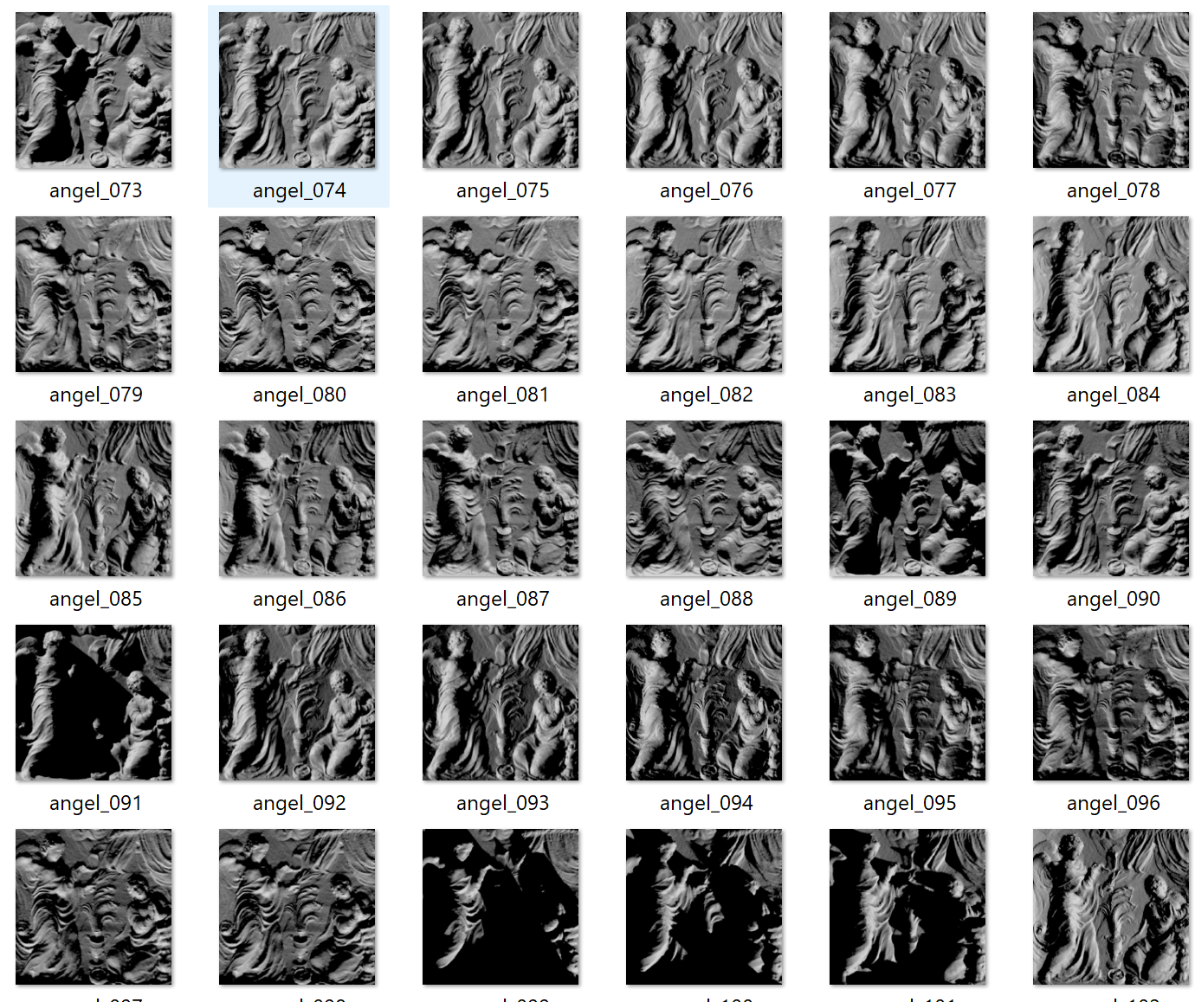
Multi-Light Image Capture
Calibrated: known light
Not obvious: which light model can we use?
In the practice we often (not correct) use a directional or point light model and estimate the related parameters (direction/position)

Slide 4
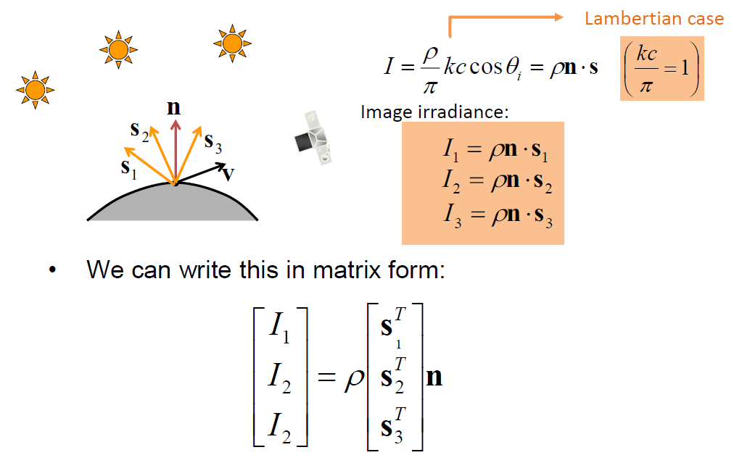
Lambertian photometric stereo
Simple technique but:
Calibration? How to know light directions?
If not Lambertian?
How to convert normals into depth maps?
Need to integrate

Slide 5
Example code
Run the example code:
It shows the normal map estimated with the basic method and the corresponding ground truth for the synthetic data
Are them similar?
How can we assess this quantitavely
What happens if we test with different materials?
How could we improve the result?
Also includes a tentative normal integration to obtain depth
Not too accurate. Why?
Better methods are available in the literature

Slide 6
Possible improvements
Trimming: remove highlights/shadows from the estimation
Separate color channels
Robust fitting:
Use robust kernels
Use Iteratively Reweighted Least Squares or other approaches

Slide 7
Homework: modify/evaluate
Estimate the mean angular error between estimated and true normals
Evaluate the average errors for all the materials and the overall mean
Try to improve the results and submit code/report with results

Slide 8
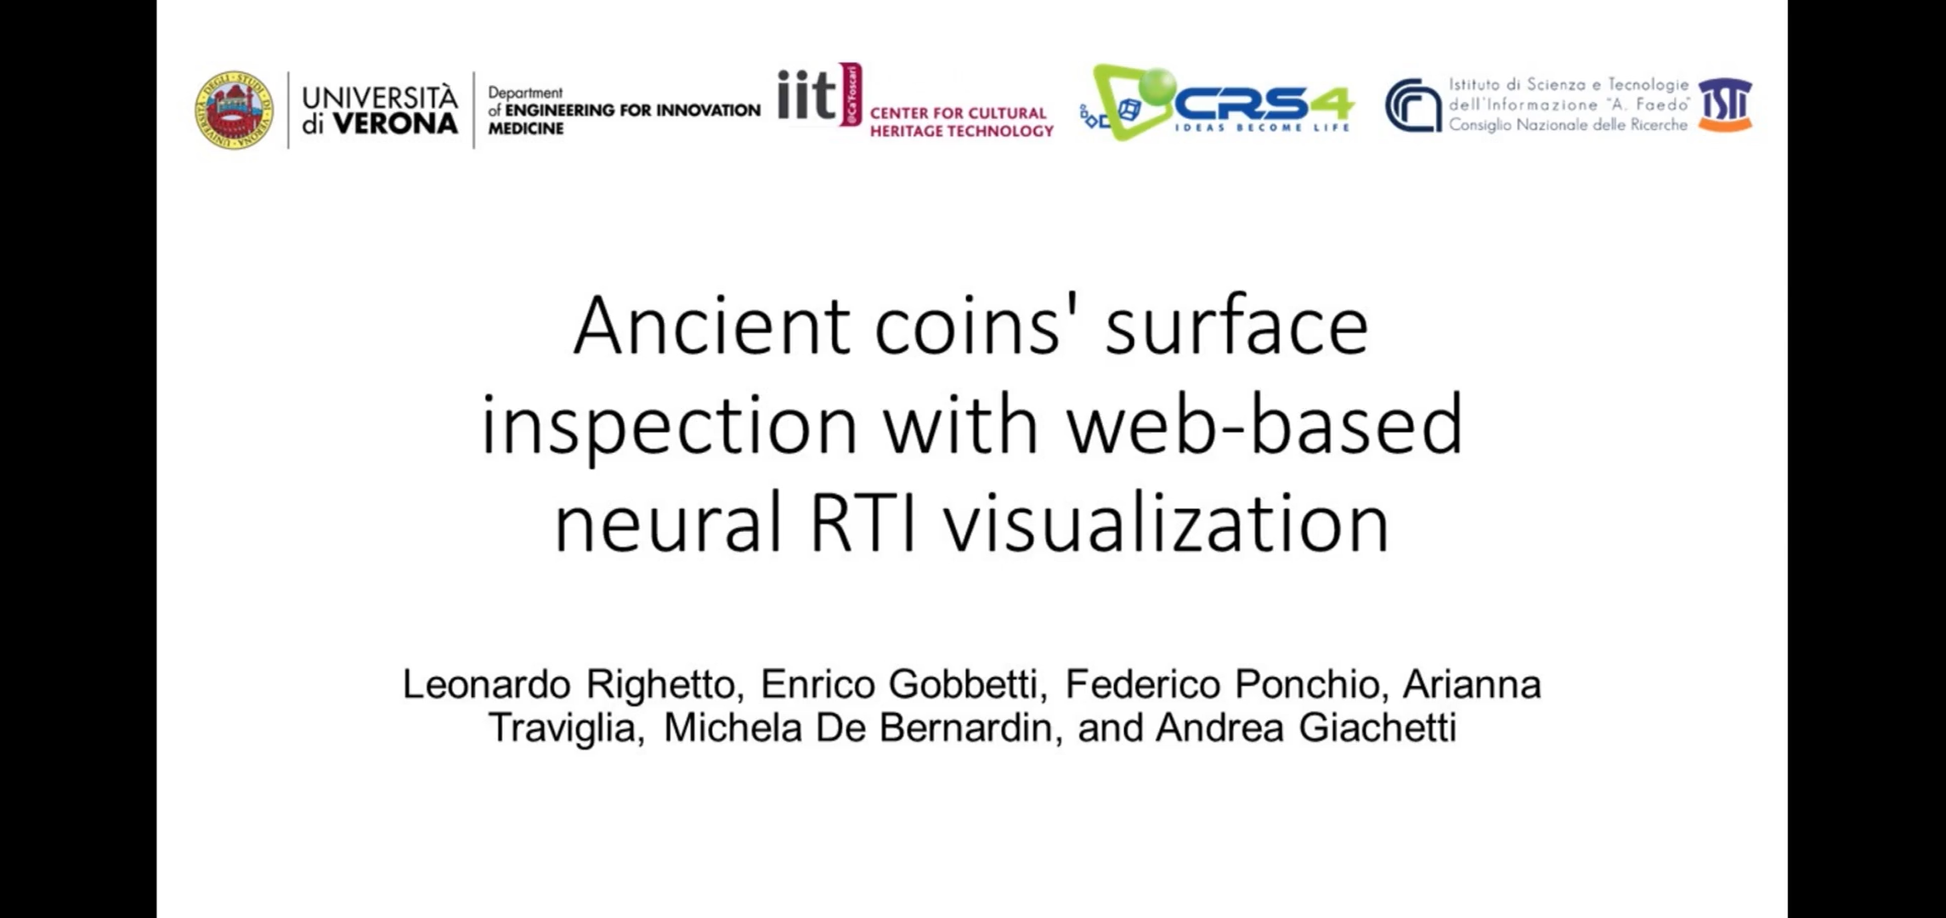
Reflectance Transformation Imaging

Slide 9
Potential theses/internships
Tests with novel data/polarized acquisitions
Inverse rendering tasks: shape, depth, shadow estimation

