Slide 1
Advanced Visual Computing
Lab 3
Andrea Giachetti University of Verona, Italy andrea.giachetti@univr.it

Slide 2
Depth Camera
introduction_rgbd shows a file captured from depth camera and the basic processing to visualize point clouds using Open3d
The RGB-D image is acquired with PrimeSenseCarmine cameras
The focal length is 525 for both axes (fx=525, fy=525)and the principal point is (cx =319.5,cy=239.5)

Slide 3
Open3D
Powerful library for 3d data processing
Can handle point clouds (other tool pcl)
Let’s see the registration pipelines demos
https://www.open3d.org/docs/latest/tutorial/pipelines/index.html
Code is included in the last Lab3 archive
Look at the examples and try to understand the different points

Slide 4
ICP
Iterative registration of point clouds
Nearest neighbor paring
Procrustes solution

Slide 5
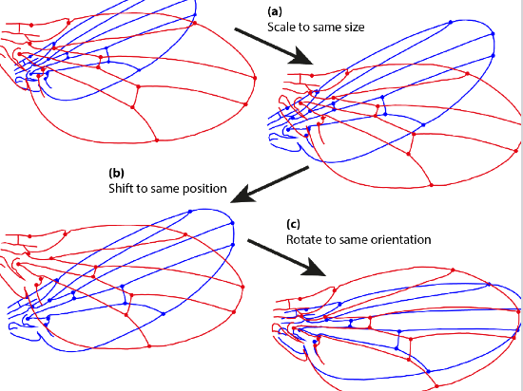
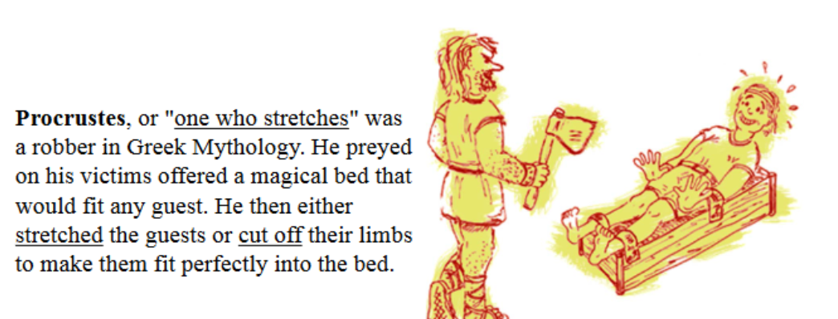
Procrustes analysis
Procrustes analysis
https://en.wikipedia.org/wiki/Procrustes_analysis
Steps
Scaling of both configurations to the same size;
Transposition to the same position of the center of gravity;
Rotation to the orientation that provides the minimum sum of squared distances between corresponding landmarks.

Slide 6
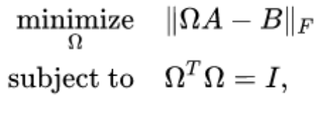
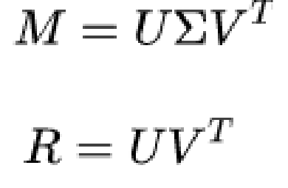
Procrustes analysis
Orthogonal procrustes problem
The solution is obtained with the singular value decomposition
See icp_ex.py

Slide 7
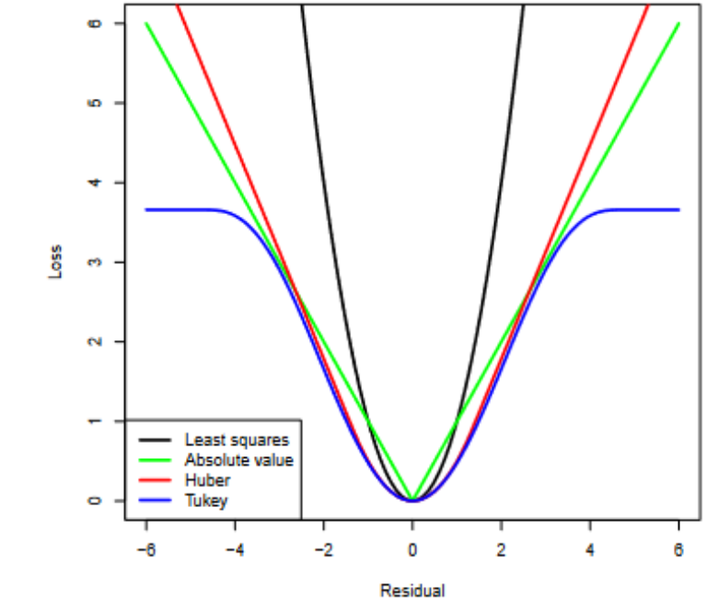
Open3D registration pipelines
See
ICP, comparing point to point and point to plane distances
icp_registration.py
Colored icp
colored_icp_registration.py
Robust ICP
robust_icp.py
RANSAC for global registration
registration_ransac.py
https://www.open3d.org/docs/release/tutorial/pipelines/global_registration.html
Robust ICP: different losses

Slide 8
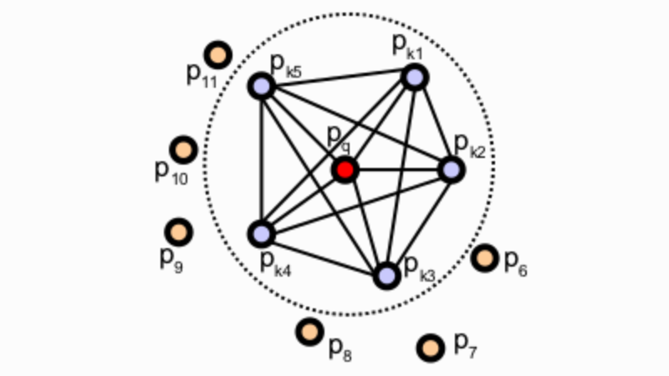
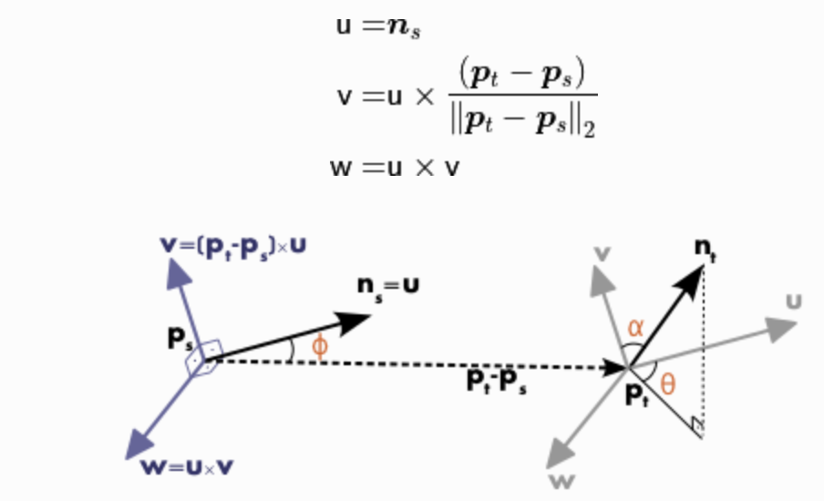
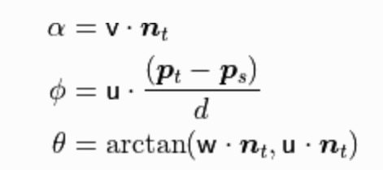
Feature detector/descriptor
FPFH (Fast Point Feature Histogram,
it attempts to capture as best as possible the sampled surface variations by taking into account all the interactions between the directions of the estimated normal
Point feature histogram: capture relationships between normals around the point
From PCL https://pcl.readthedocs.io/

Slide 9
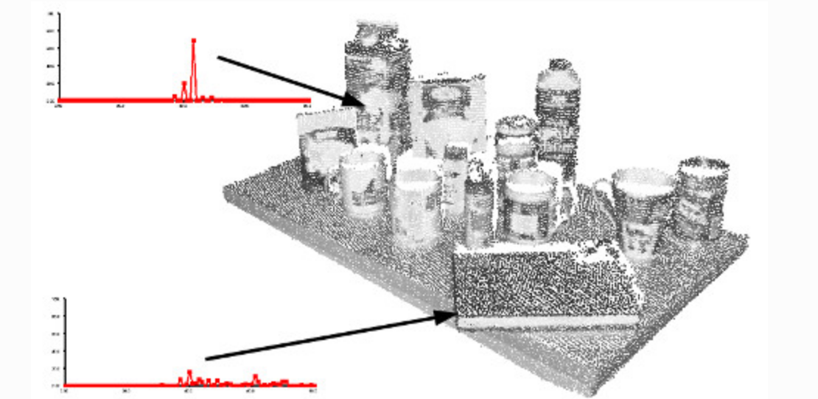
From PCL https://pcl.readthedocs.io/

Slide 10
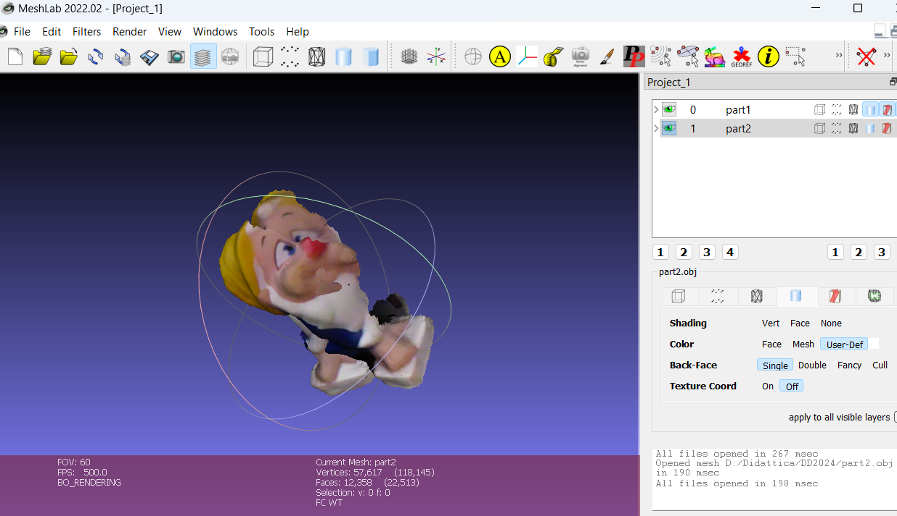
Meshlab
Easy to use tools for partial views registration and meshing
Use of point-based alignment and ICP

Slide 11
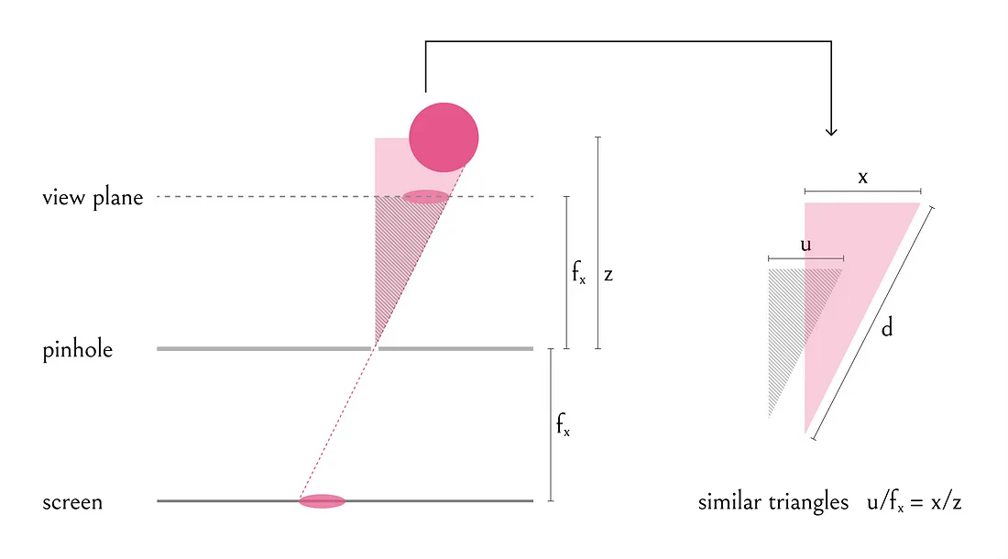
Homework 2
Create al 3D point cloud from the range scan the or stereo pair (e.g., starting from the stereo or depth code)
The formula to convert in 3D points is the classic formula of perspective projection (you can set the axis as you prefer)
Z=d
X=(i-cx)d/fx
Y=(y-cy)d/fy

Slide 12
Homework 2
If you use the range image, not all the pixels on the range image are the projection of a point on the 3D space! Check if there is a code for non valid depths (zeros or negative values). Which is the unit of the depth?
Create a mesh from the point cloud exploiting the known connectivity
Points are on a regular grid where the connectivity can be inherited from the pixel neighbourhood,
You need to triangulate the mesh in the right way!
Coherent triangle orientation
Consider noise/missing data: nearby pixels may not correspond to nearby points on the 3D cloud due to noise/errors in disparity or depth estimation
a “robust” strategy can be used (e.g., not connecting long edges)

Slide 13
How to save the mesh
Option 1
Complete the writing procedure of
def write_ply(fn, verts, colors):
verts = verts.reshape(-1, 3)
colors = colors.reshape(-1, 3)
verts = np.hstack([verts, colors])
with open(fn, 'wb') as f:
f.write((ply_header % dict(vert_num=len(verts))).encode('utf-8'))
np.savetxt(f, verts, fmt='%f %f %f %d %d %d ‘)
Adding the missing parts to save a mesh according to the template you can find in
https://en.wikipedia.org/wiki/PLY_(file_format)
Need to add a line in the header
element face (n.faces)
and lines with faces after the vertex list

Slide 14
How to save the mesh
However you can use the open3d functions as well
mesh = o3d.geometry.TriangleMesh()
…
mesh.vertices = o3d.utility.Vector3dVector(…) # put numpy arrays with coordinates
mesh.triangles = o3d.utility.Vector3iVector(…)
o3d.visualization.draw_geometries([mesh])
# Save the mesh to a .ply file
o3d.io.write_triangle_mesh("output_mesh.ply", mesh)
https://www.open3d.org/docs/latest/python_api/open3d.io.write_triangle_mesh.html

