Slide 1


Back-end web development
Part II
PHP introduction
(continuation)
Examples and source code available on
https://github.com/giachell/Big_data_course_FSE_2021
Fabio Giachelle
Corso FSE Big Data 2021

Slide 2
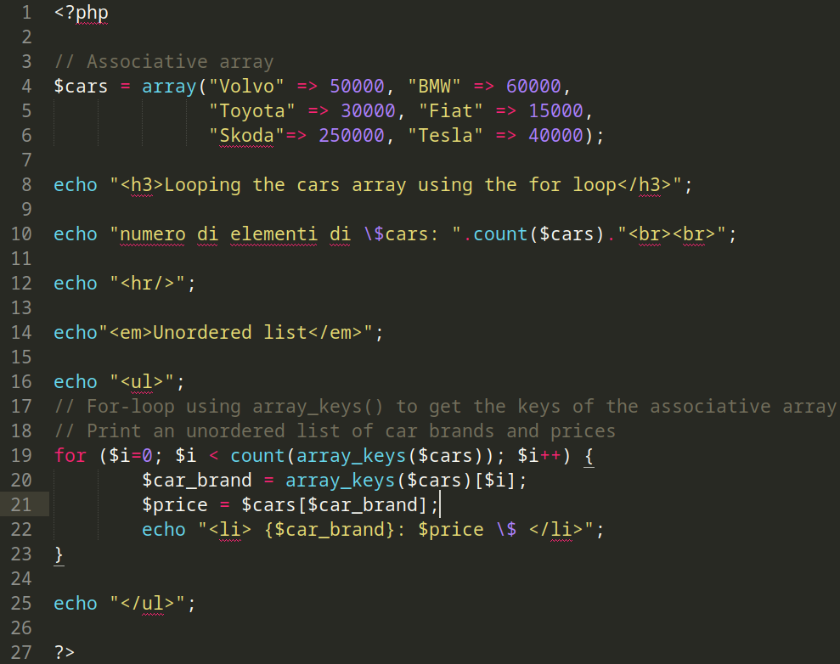
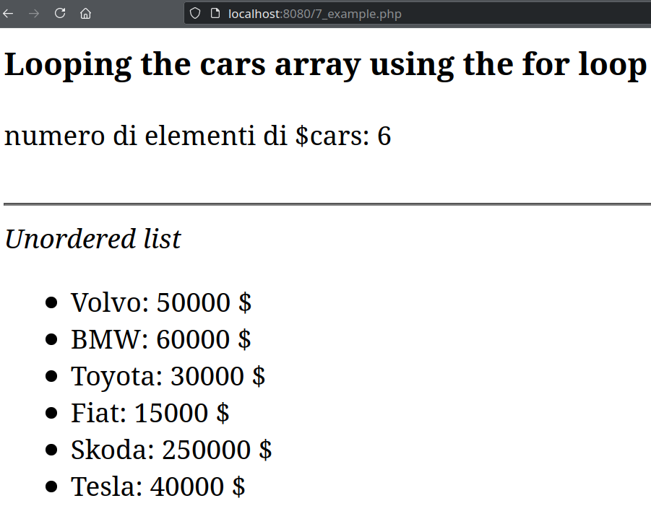
Back-end web development ∙ PHP Introduction
PHP example #7
PHP source code
HTML result in Firefox
Fabio Giachelle
Corso FSE Big Data 2021

Slide 3
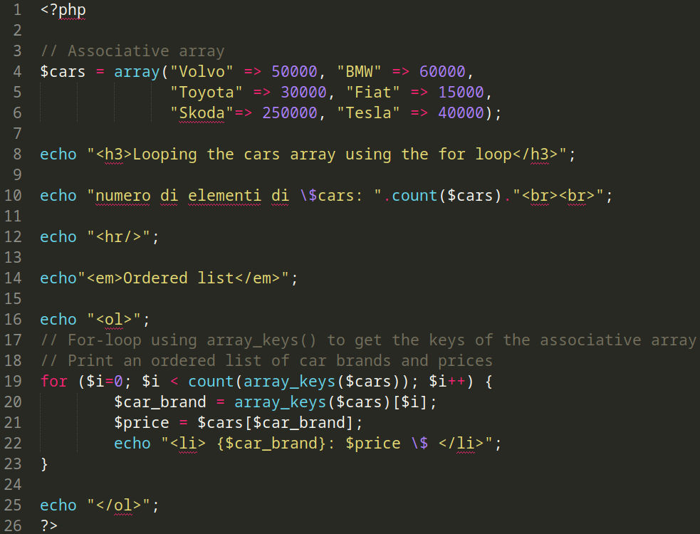
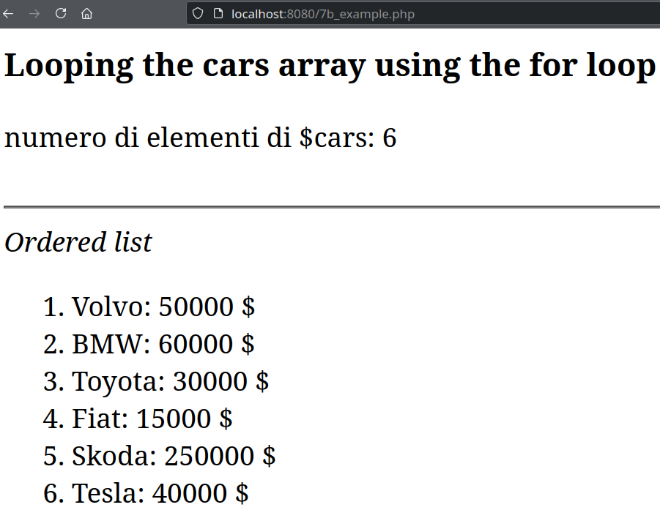
Back-end web development ∙ PHP Introduction
PHP example #7
PHP source code
HTML result in Firefox
Fabio Giachelle
Corso FSE Big Data 2021

Slide 4
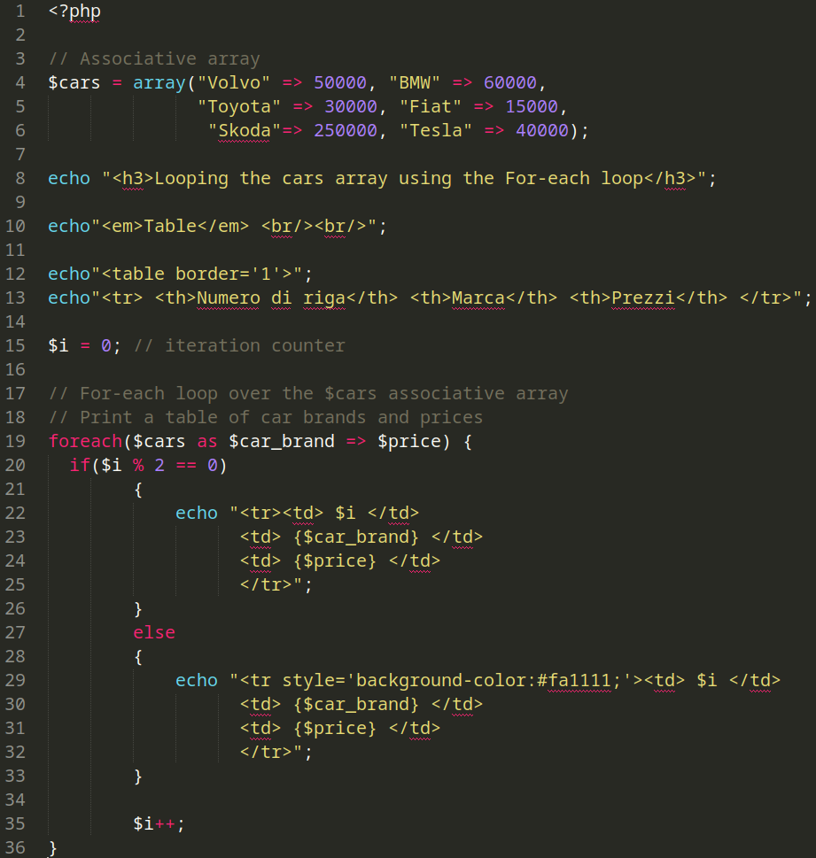
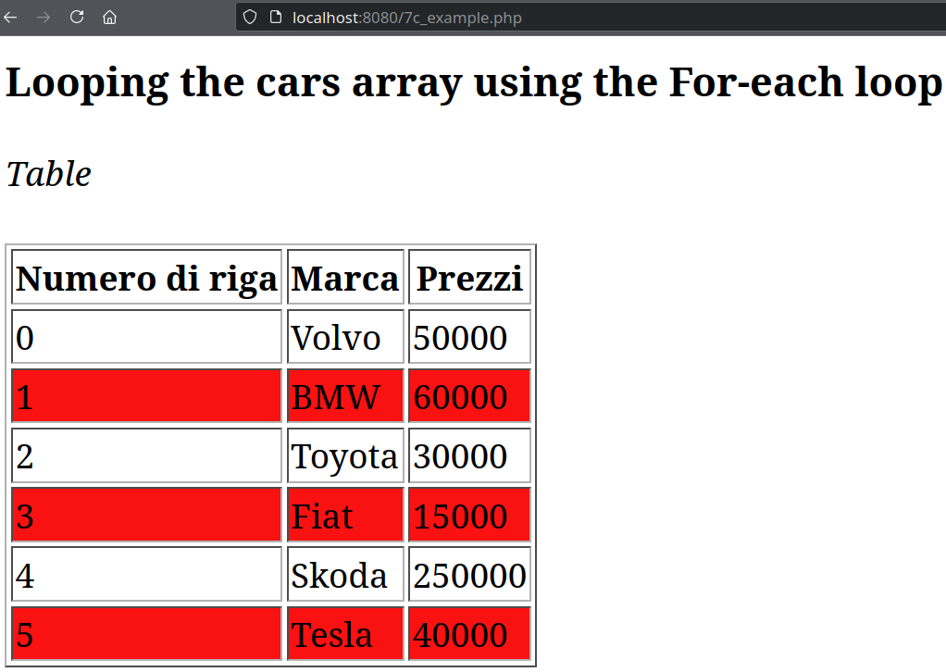
Back-end web development ∙ PHP Introduction
PHP example #7
PHP source code
HTML result in Firefox
Fabio Giachelle
Corso FSE Big Data 2021

Slide 5
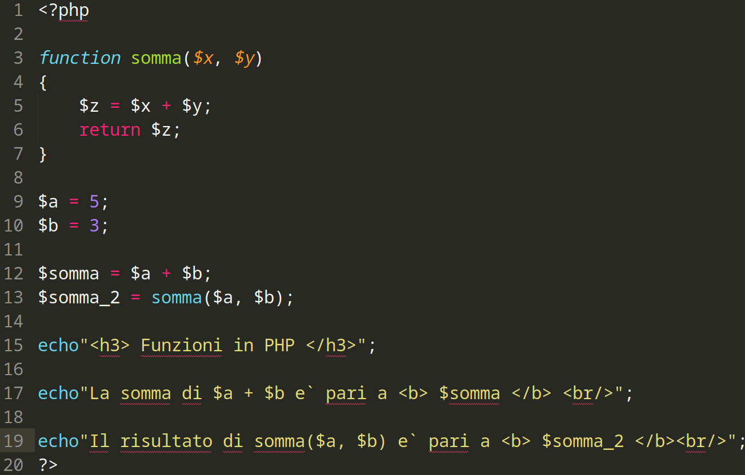
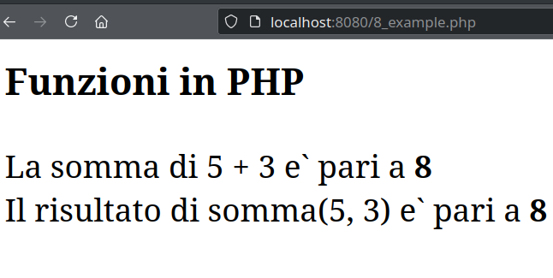
Back-end web development ∙ PHP Introduction
PHP example #8 (Functions)
PHP source code
HTML result in Firefox
Fabio Giachelle
Corso FSE Big Data 2021

Slide 6
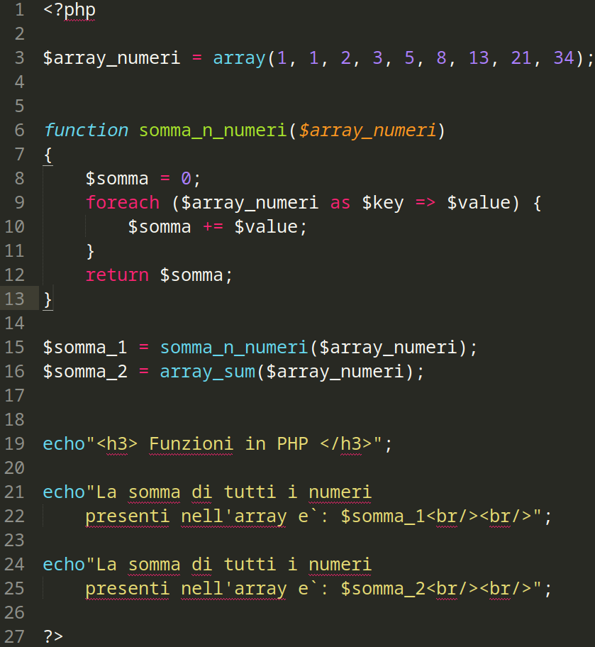
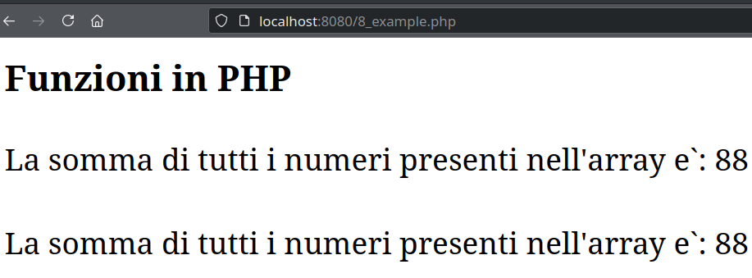
Back-end web development ∙ PHP Introduction
PHP example #9 (Functions)
PHP source code
HTML result in Firefox
Fabio Giachelle
Corso FSE Big Data 2021

Slide 7
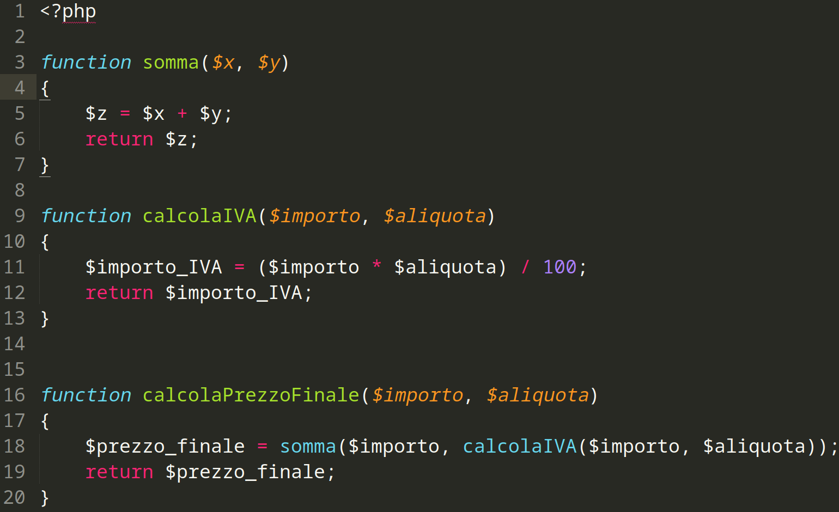
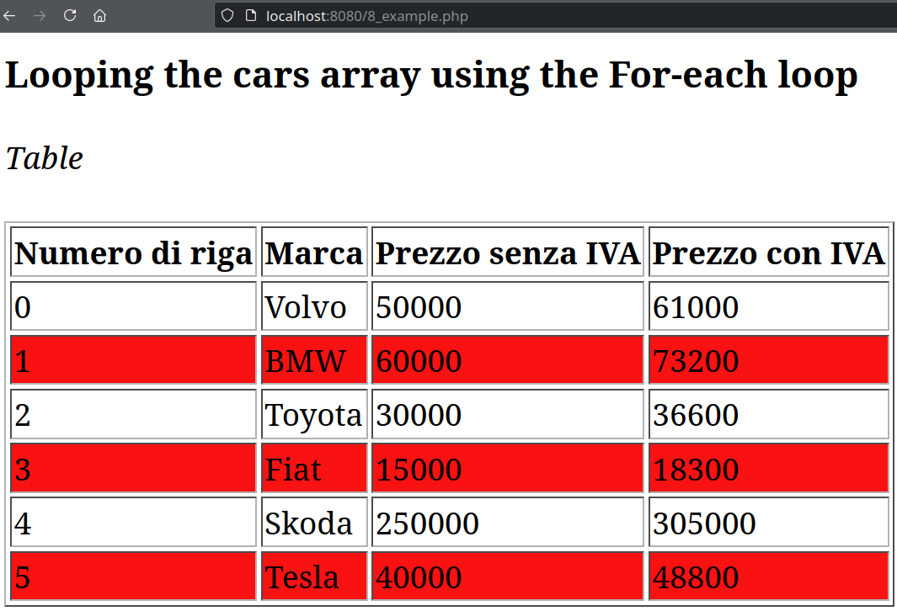
Back-end web development ∙ PHP Introduction
PHP example #10 (Functions)
PHP source code
HTML result in Firefox
…Full source code available on
Fabio Giachelle
Corso FSE Big Data 2021

Slide 8
Back-end web development
Part II
PHP & Forms
Examples and source code available on
https://github.com/giachell/Big_data_course_FSE_2021
Fabio Giachelle
Corso FSE Big Data 2021

Slide 9
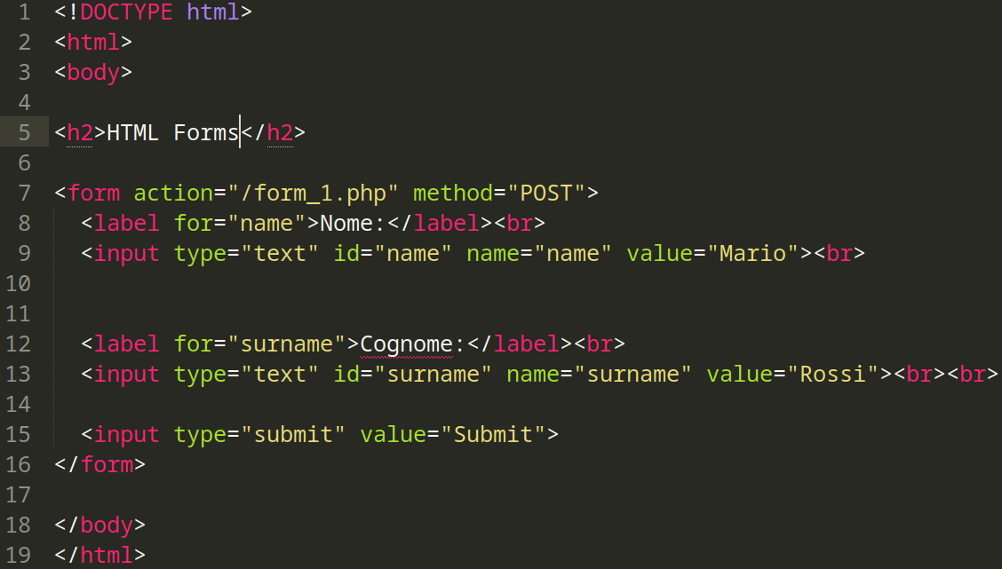
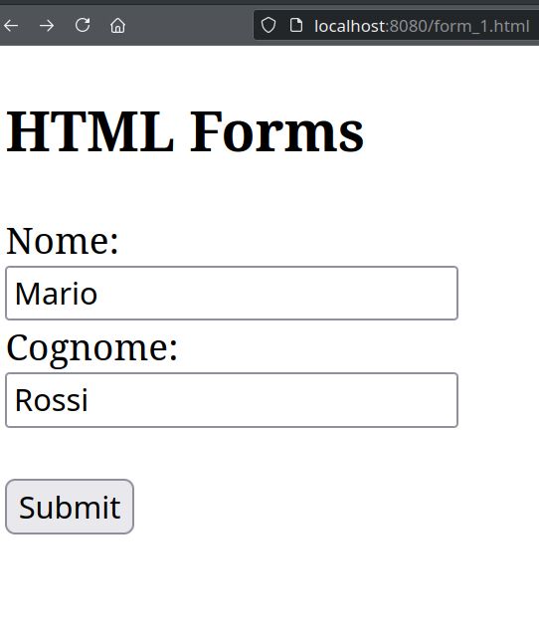
Back-end web development ∙ PHP & Forms
HTML Form #1
HTML result in Firefox
HTML source code
Fabio Giachelle
Corso FSE Big Data 2021

Slide 10
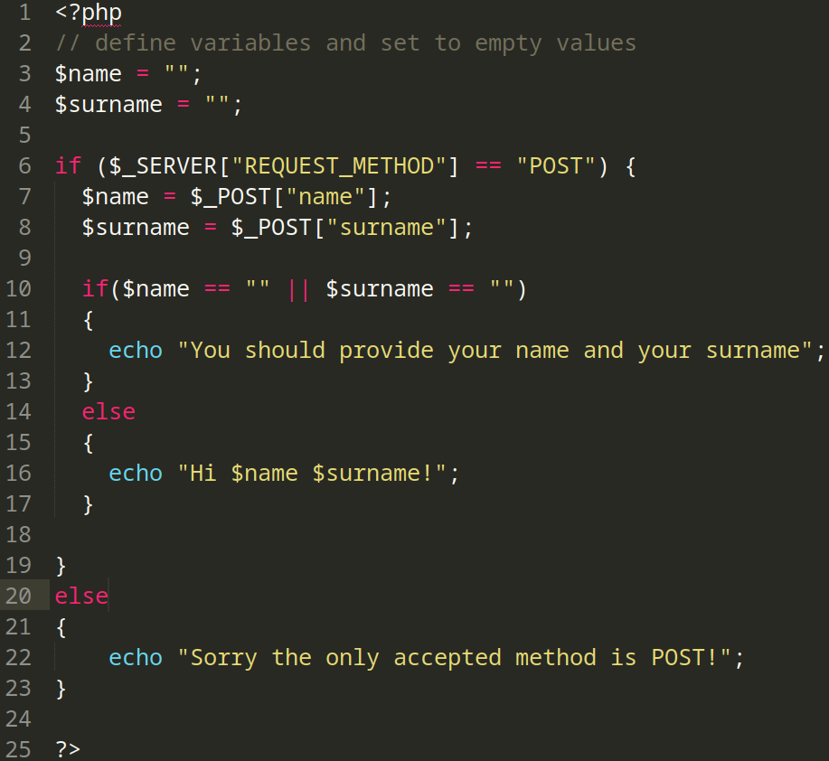
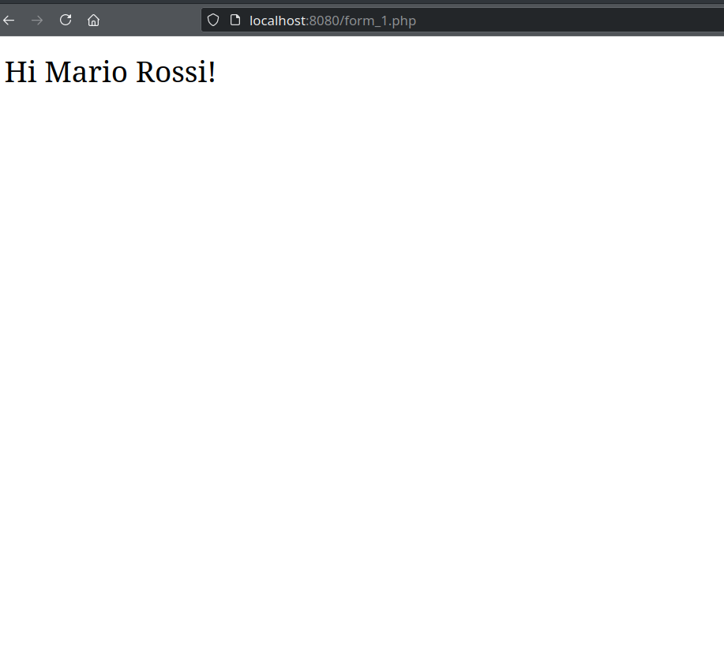
Back-end web development ∙ PHP & Forms
PHP Form #1
HTML result in Firefox
PHP source code
Fabio Giachelle
Corso FSE Big Data 2021

Slide 11
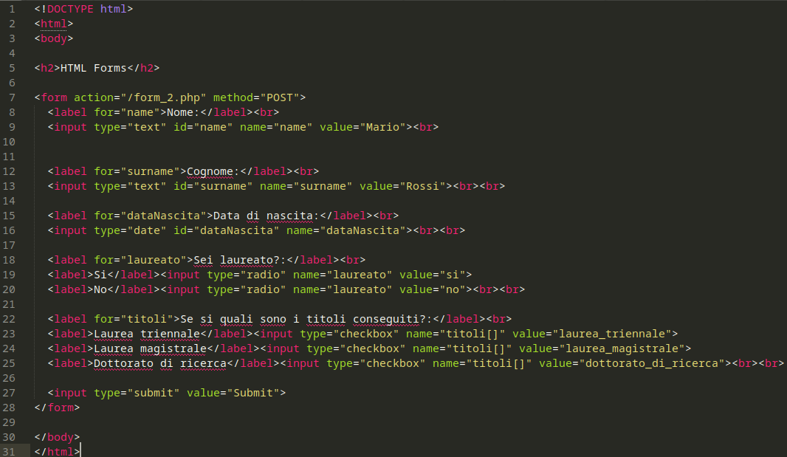
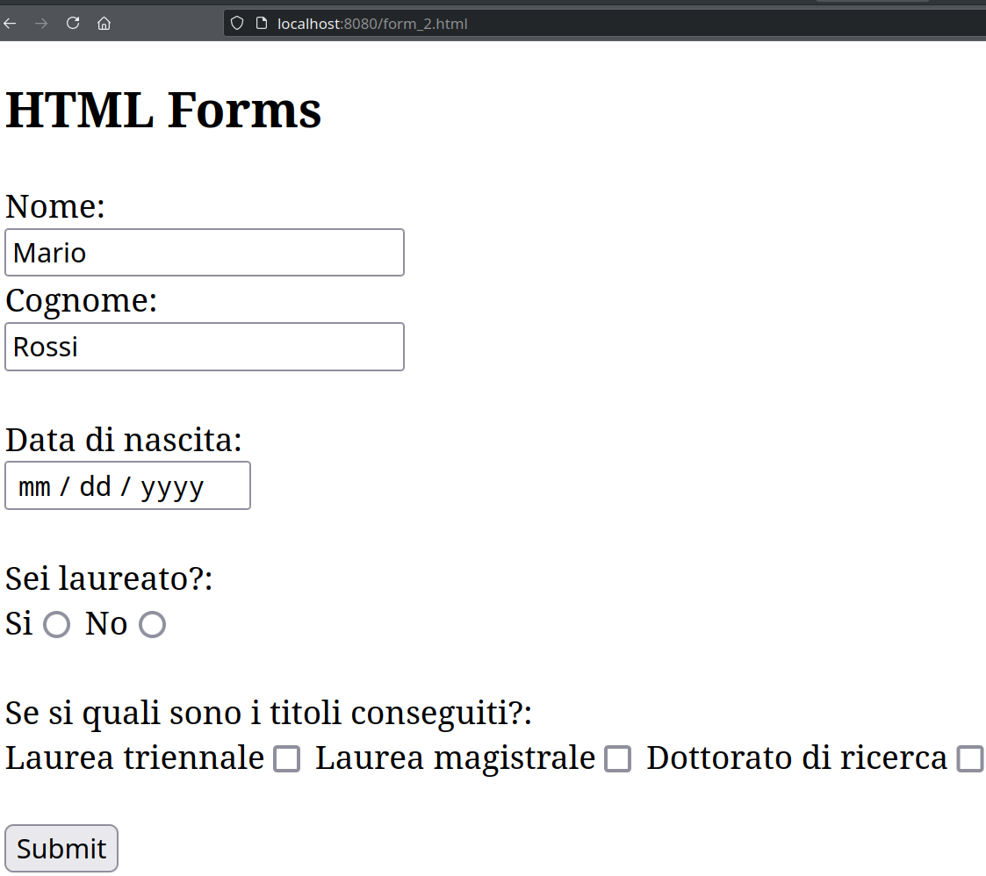
Back-end web development ∙ PHP & Forms
HTML Form #2
HTML result in Firefox
HTML source code
Fabio Giachelle
Corso FSE Big Data 2021

Slide 12
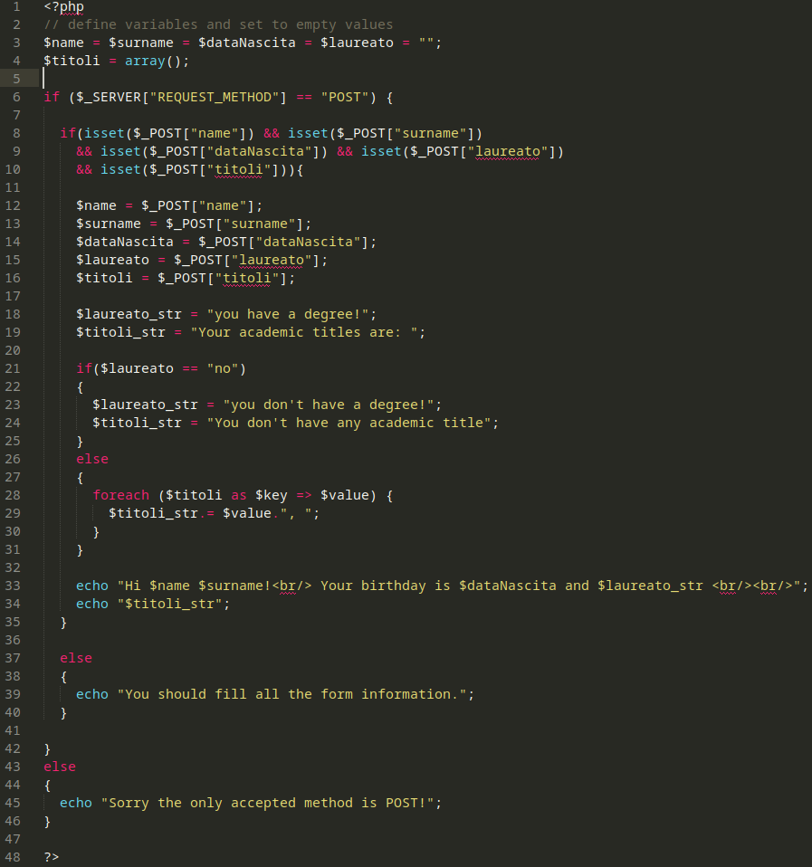
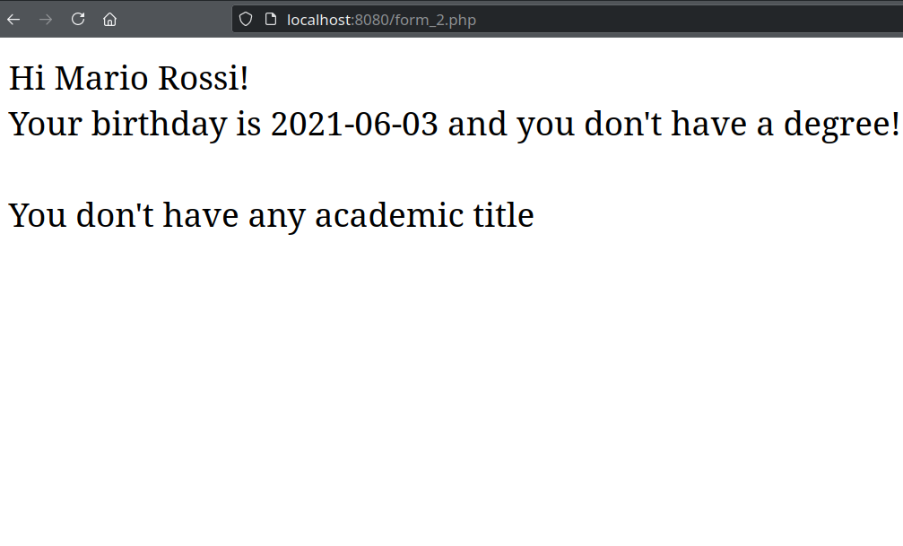
Back-end web development ∙ PHP & Forms
PHP Form #2
HTML result in Firefox
PHP source code
Fabio Giachelle
Corso FSE Big Data 2021

Slide 13
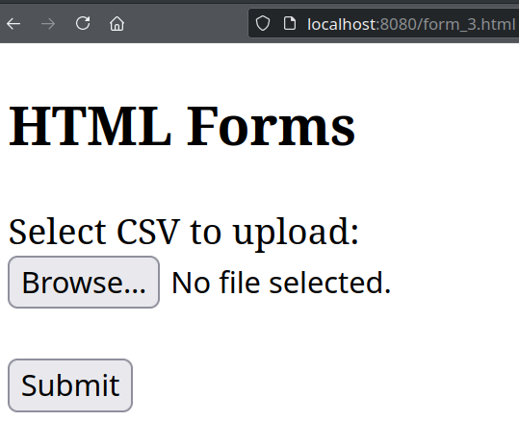
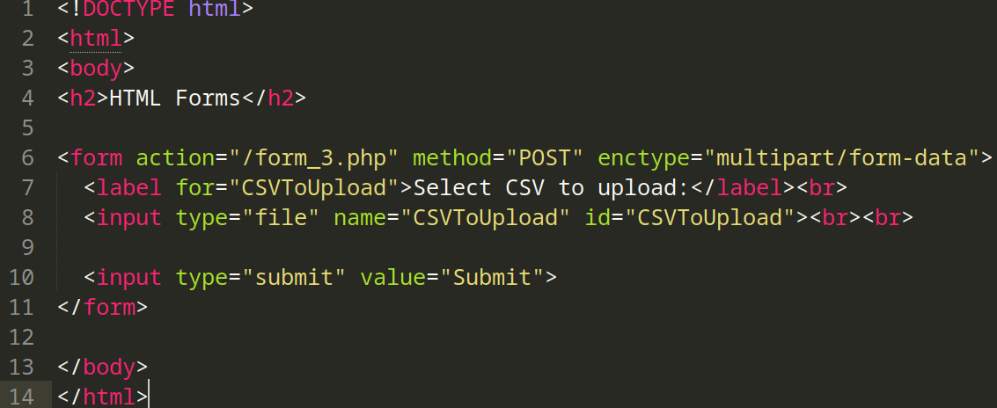
Back-end web development ∙ PHP & Forms
HTML Form #3 (upload)
HTML result in Firefox
HTML source code
Fabio Giachelle
Corso FSE Big Data 2021

Slide 14
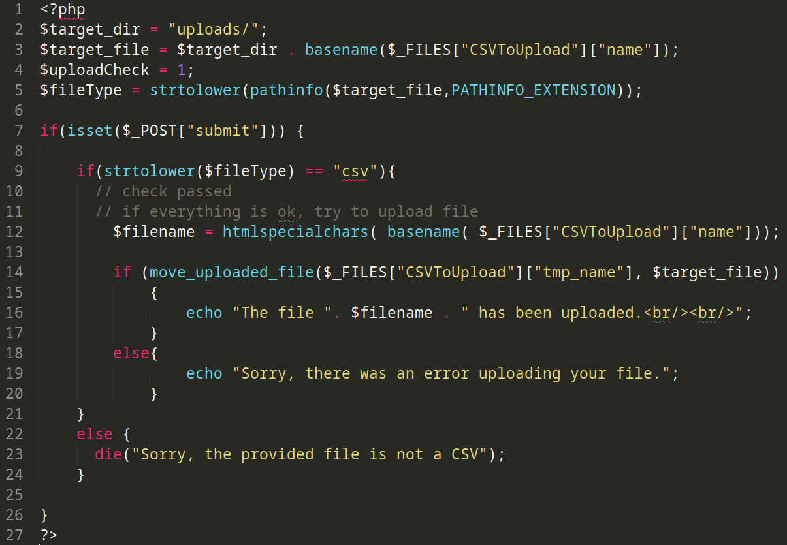
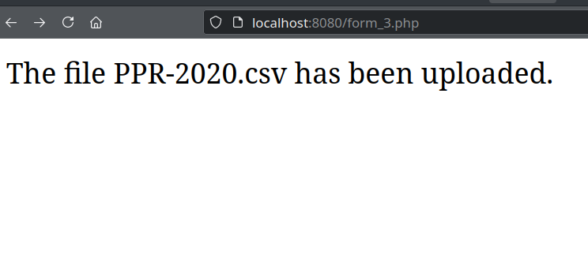
Back-end web development ∙ PHP & Forms
PHP Form #3 (upload)
HTML result in Firefox
PHP source code
Fabio Giachelle
Corso FSE Big Data 2021

Slide 15
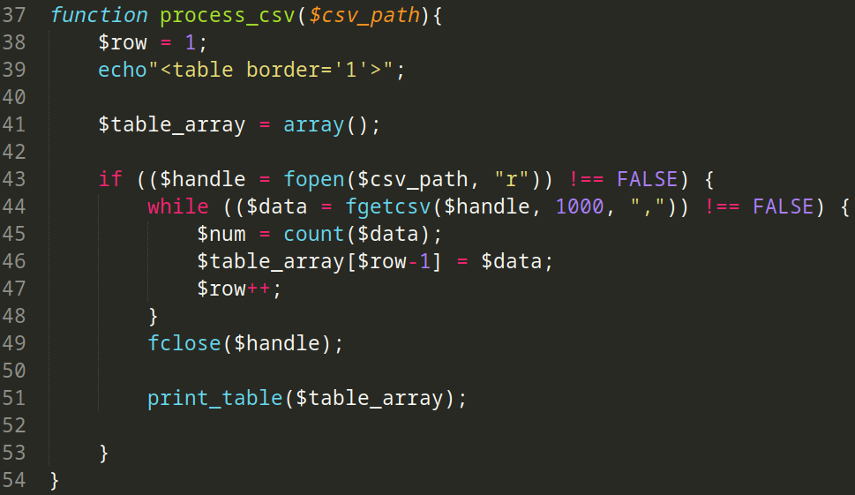
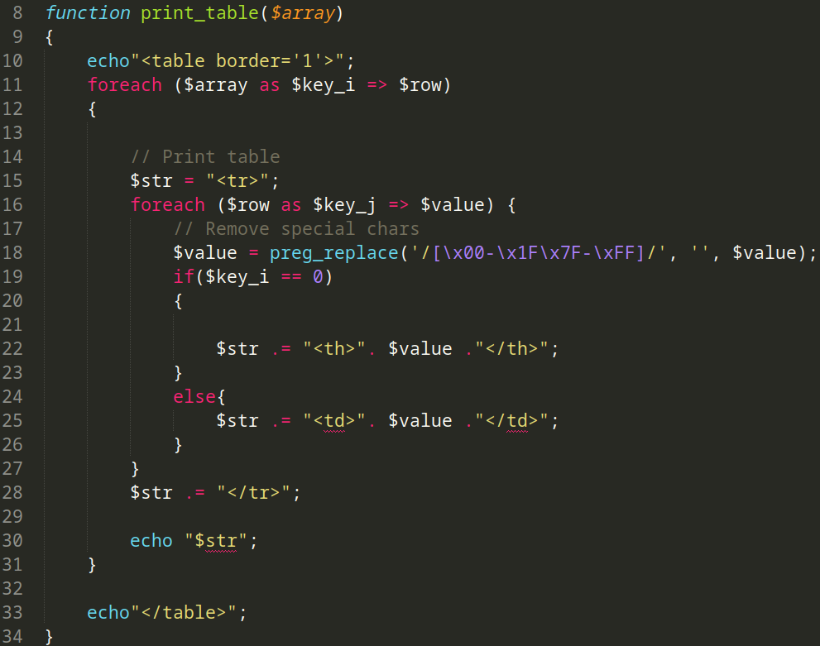
Back-end web development ∙ PHP & Forms
PHP Form #3 (CSV processing)
PHP source code
Fabio Giachelle
Corso FSE Big Data 2021

Slide 16
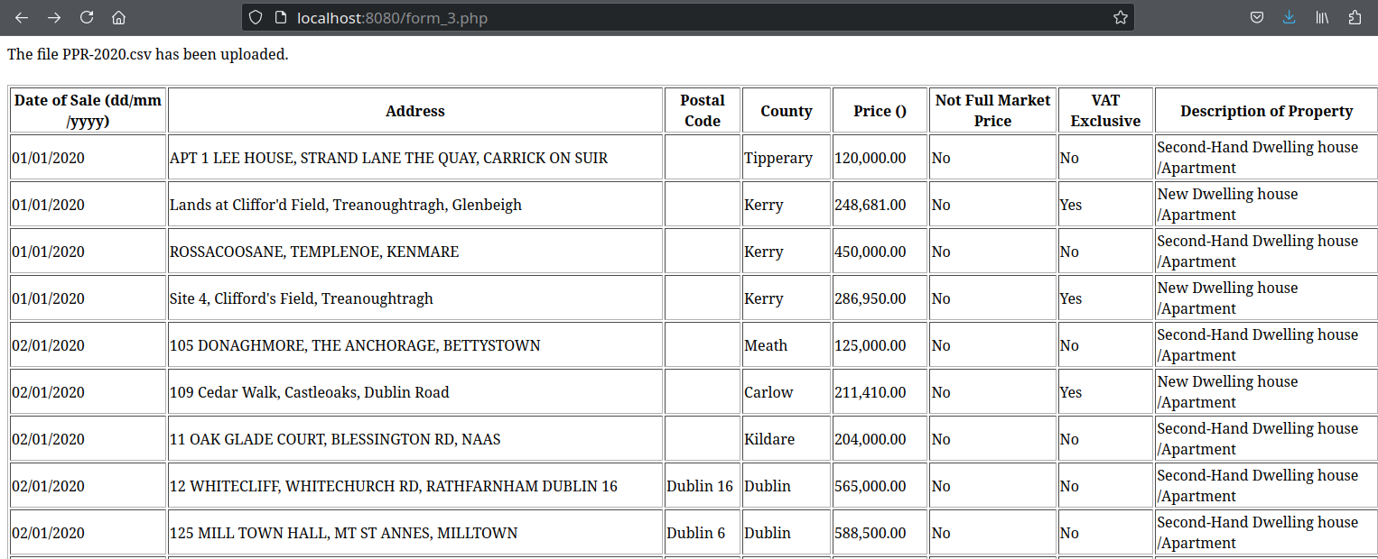
Back-end web development ∙ PHP & Forms
PHP Form #3 (CSV processing)
HTML result in Firefox
Fabio Giachelle
Corso FSE Big Data 2021

Slide 17
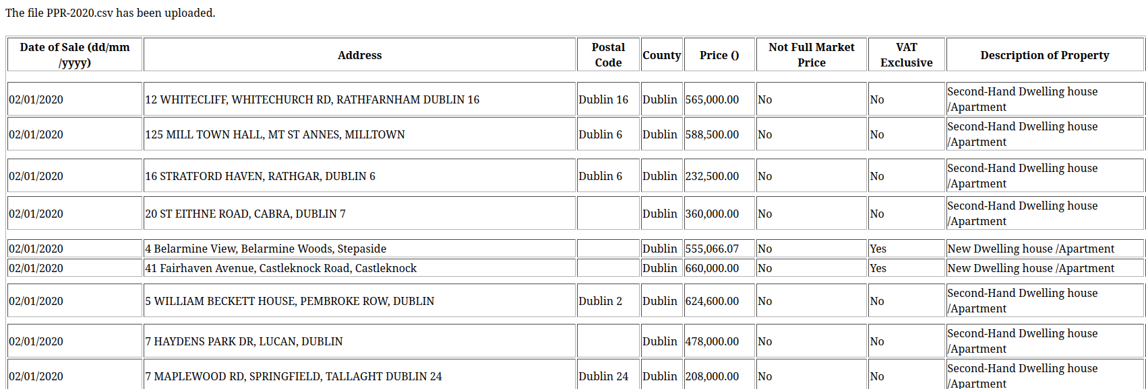
Back-end web development ∙ PHP & Forms
PHP Form #3b (CSV processing)
HTML result in Firefox
Print only the rows related to Dublin
Fabio Giachelle
Corso FSE Big Data 2021

Slide 18
Back-end web development
Part II
PHP & PostgreSQL
Examples and source code available on
https://github.com/giachell/Big_data_course_FSE_2021
Fabio Giachelle
Corso FSE Big Data 2021

Slide 19
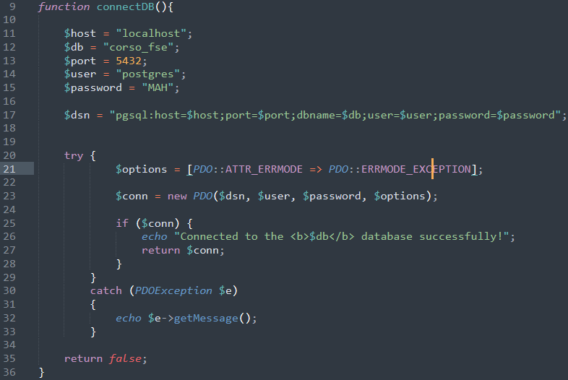
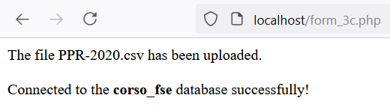
Back-end web development ∙ PHP & PostgreSQL
PHP Form #3c (connect DB)
PHP source code
HTML result in Firefox
Fabio Giachelle
Corso FSE Big Data 2021

Slide 20
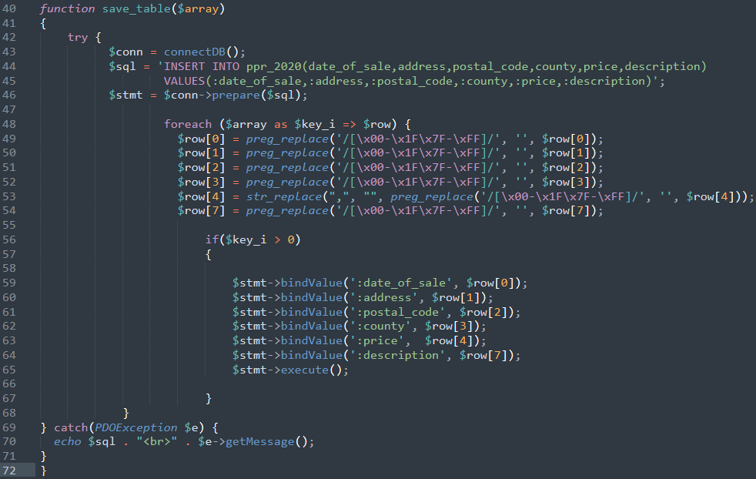
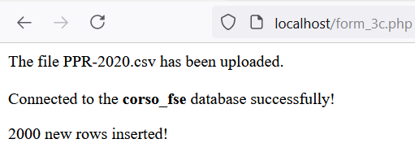
Back-end web development ∙ PHP & PostgreSQL
PHP Form #3c (save data into DB)
PHP source code
HTML result in Firefox
Fabio Giachelle
Corso FSE Big Data 2021

Slide 21
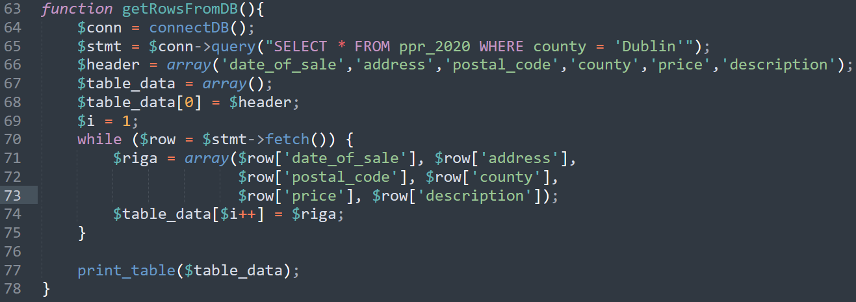
Back-end web development ∙ PHP & PostgreSQL
PHP Form #3d (get data from DB)
PHP source code
Fabio Giachelle
Corso FSE Big Data 2021

Slide 22
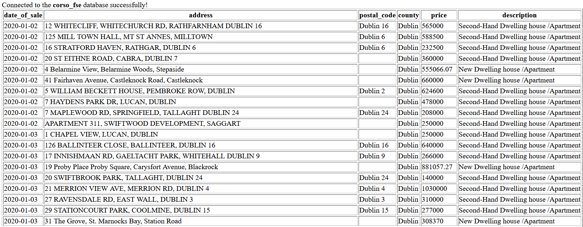
Back-end web development ∙ PHP & PostgreSQL
PHP Form #3d (get data from DB)
HTML result in Firefox
Fabio Giachelle
Corso FSE Big Data 2021

Slide 23

Back-end web development ∙ PHP & PostgreSQL
Thank you for your kind attention
Fabio Giachelle
Corso FSE Big Data 2021

