Slide 1
NiceTrip
Progetto Tecnologie Web - A.A. 2022 - 2023
Lorenzo Colletta
Giacobbi Domenico

Slide 2
Features
Sign up & Login
Post Managment
Profile Managment
Visualization and Follow
Settings
Feed
Notifications

Slide 3
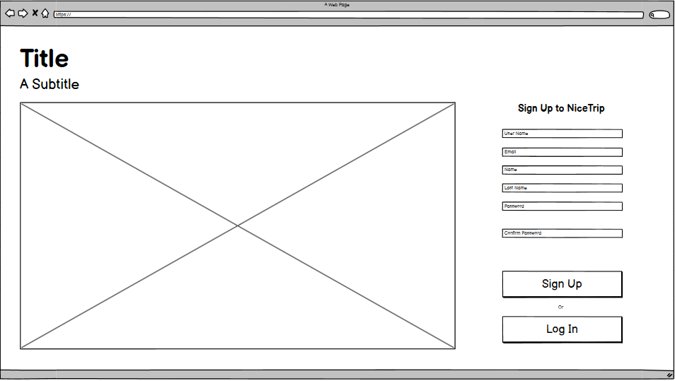
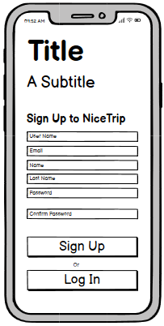
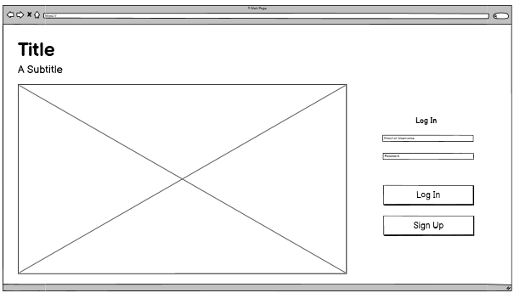
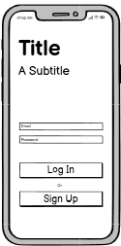
Sign up & Login
Post Managment
Profile Managment
Visualization and Follow
Settings
Feed
Notifications

Slide 4
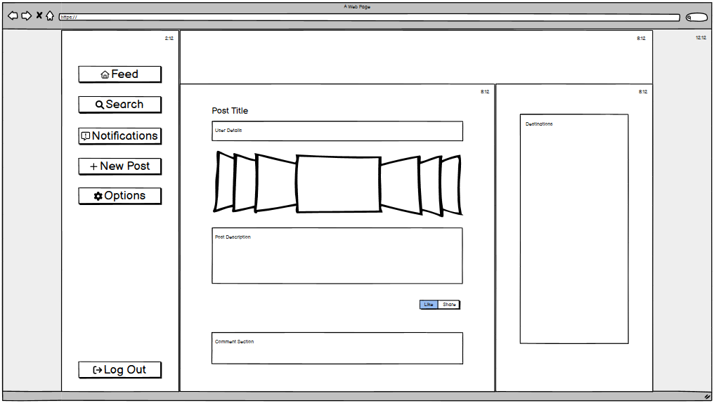
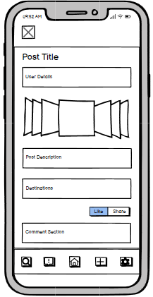
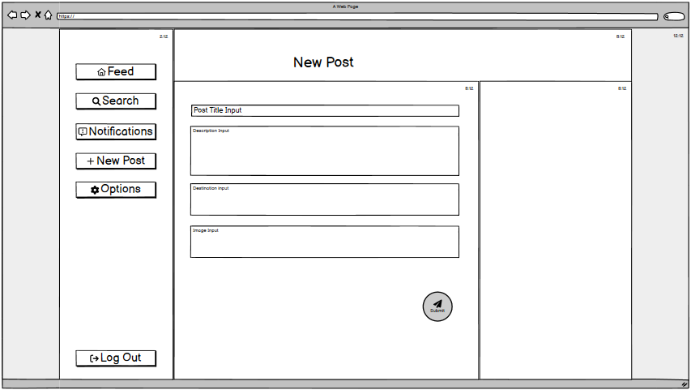
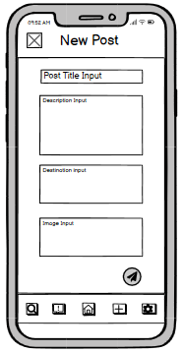
Sign up & Login
Post Managment
Profile Managment
Visualization and Follow
Settings
Feed
Notifications

Slide 5
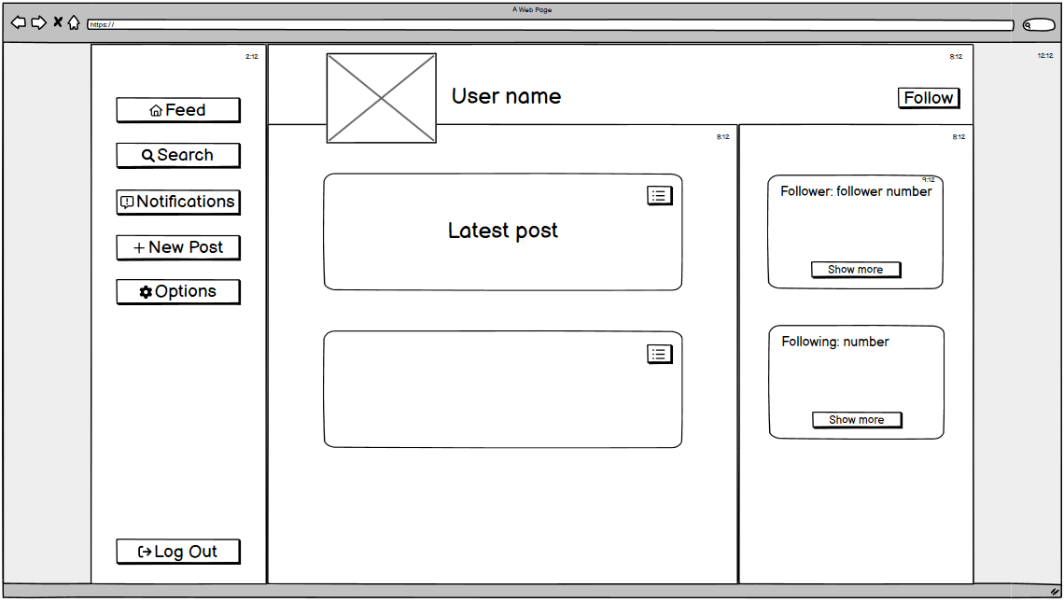
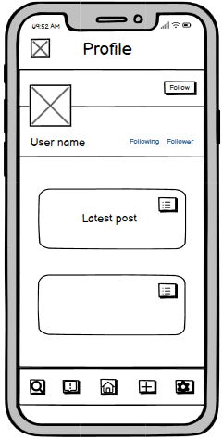
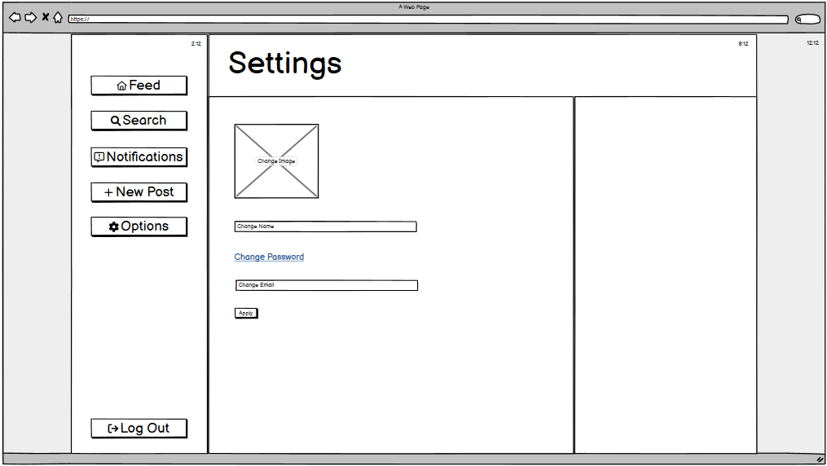
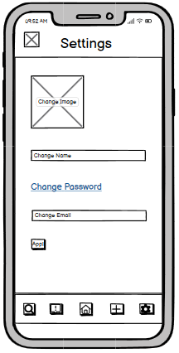
Sign up & Login
Post Managment
Profile Managment
Visualization and Follow
Settings
Feed
Notifications

Slide 6
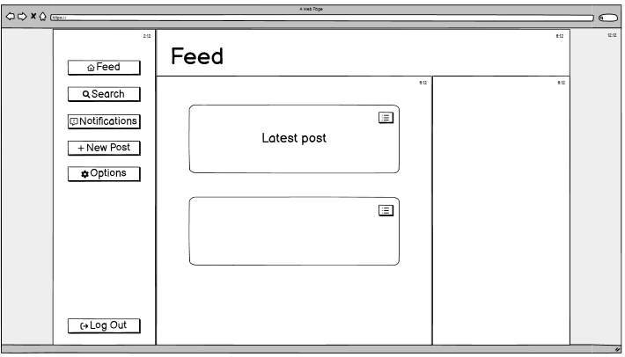
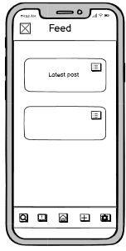
Sign up & Login
Post Managment
Profile Managment
Visualization and Follow
Settings
Feed
Notifications

Slide 7
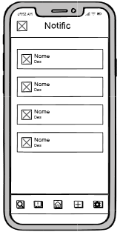
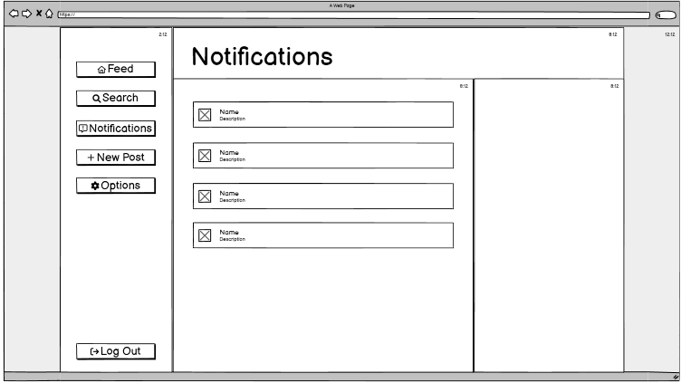
Sign up & Login
Post Managment
Profile Managment
Visualization and Follow
Settings
Feed
Notifications

Slide 8
Sign up & Login
Post Managment
Profile Managment
Visualization and Follow
Settings
Feed
Notifications
Security
Used Technologies

