Slide 1
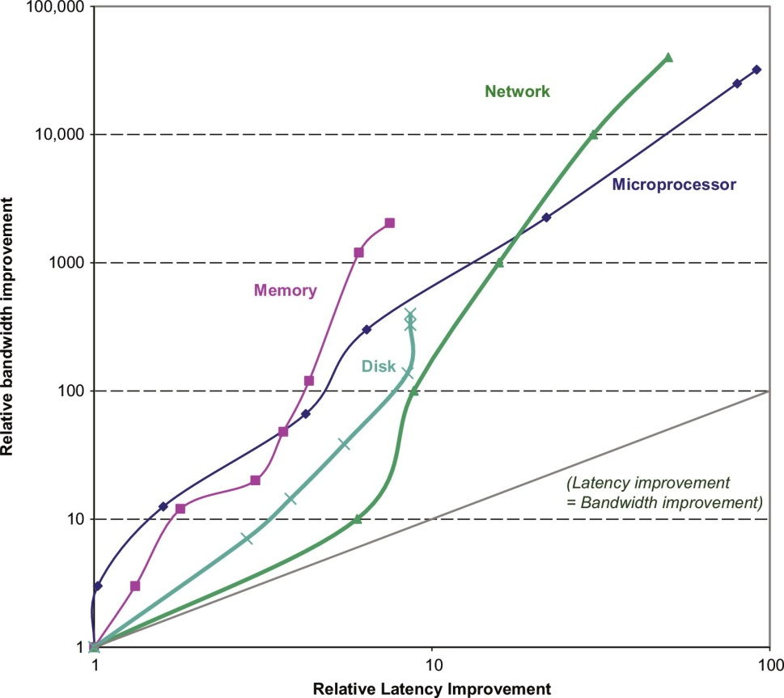
Why memory management matters
Hennessy, Patterson “Computer Architecture: A Quantitative Approach”

Slide 2
Introduction
CPU
Typical, simplified, CPU and system layout
  Non Uniform Memory Access
Core
Core
Core
Core
I-L1
D-L1
I-L1
D-L1
I-L1
D-L1
I-L1
D-L1
L2
L2
L3
Memory
CPU
CPU
Memory
interconnect
Memory
Memory
CPU
CPU

Slide 3
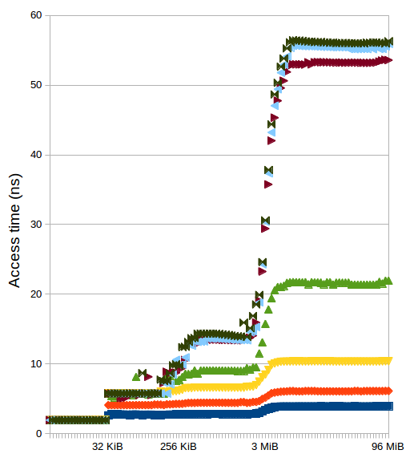
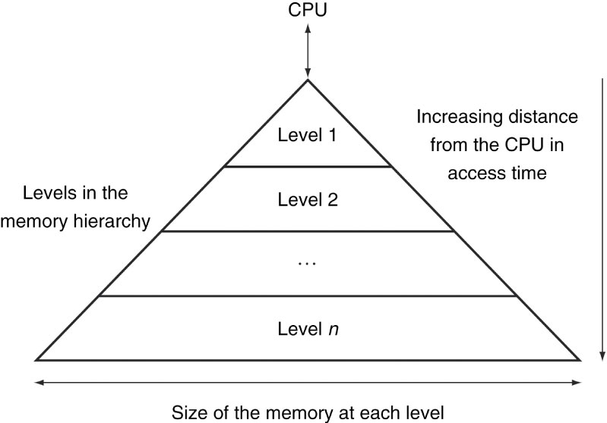
What's the ideal memory?
Memory technology | Typical access time | $ per GiB
SRAM | 0.5 ns – 2.5 ns | 500 – 1000
DRAM | 50 ns – 70 ns | 3 – 6
Magnetic disk | 5 ms – 20 ms | 0.01 – 0.02
Access time of SRAM, $/GiB and capacity of disk
The ideal situation can be approximated with a hierarchy of different memory types
3rd-level cache
memory
2nd-level cache
1st-level cache
Patterson, Hennessy “Computer Organization and Design: The Hardware/Software Interface”

Slide 4
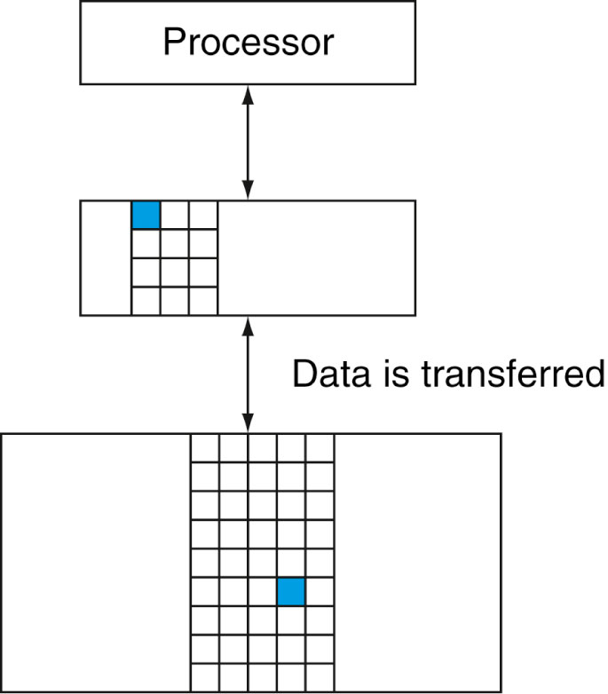
Hierarchy levels
The data is present in the highest level
  hit
  hit rate = hits / accesses
The data is not present in the highest level
  miss: data is looked for in the lower level
  miss penalty: the cost of getting the data
  likely causes stalls in the execution
Data is moved in blocks (cache lines)
Patterson, Hennessy “Computer Organization and Design: The Hardware/Software Interface”

Slide 5
Locality principle
int strlen(char const* str)
{
int len = 0;
while (*str++) ++len;
return len;
}
Data
  Multiple accesses to variable len
  Scanning of array str
Instructions
  Repetition of the instructions corresponding to the expressions *str++ e ++len
  Execution of consecutive instructions

Slide 6
Locality principle
In a limited time interval a program accesses only a small part of its whole address space
Temporal locality
  Memory locations recently accessed tend to be accessed again in the near future
    e.g. instructions and counters in a loop
Spatial locality
  Memory locations near those recently accessed tend to be accessed in the near future
    e.g. sequential access to instructions in a program or to data in an array
Hardware components like caches and pipelines are justified by the locality principle

Slide 7
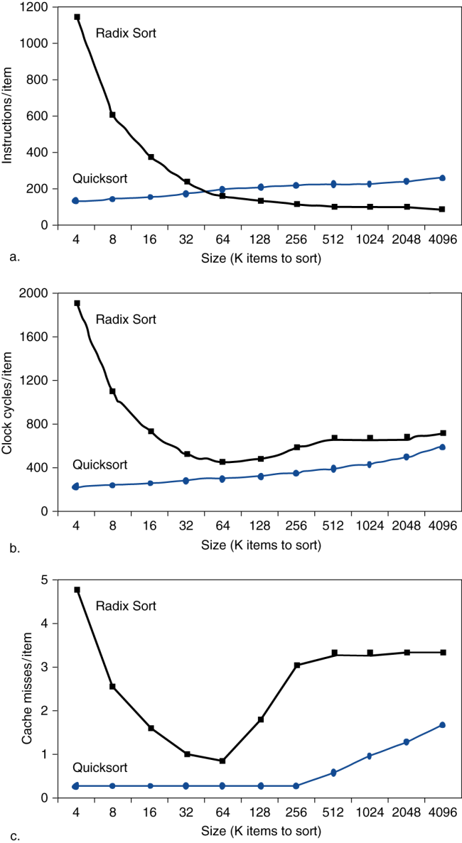
Cache effect
The efficiency of a program does not depend only on the computational complexity of an algorithm...
Be friendly to the cache
Patterson, Hennessy “Computer Organization and Design: The Hardware/Software Interface”

Slide 8
Size of a type
Determined statically (i.e. at compile time)
Queried with the sizeof operator
  returns multiples of sizeof(char), which by definition is 1
  typically a char is 1 byte, 8 bits
For primitive types
  on my laptop
Type | sizeof
bool | 1
char | 1
short | 2
int | 4
long | 8
long long | 8
float | 4
double | 8
long double | 16
void* | 8

Slide 9
Layout
Consider
struct S
{
char c1;
int n;
char c2;
};
static_assert(sizeof(S) == 12);
The size is influenced by alignment constraints
  the address of a variable of a certain type is typically a multiple of the size of that type
  e.g. an int can reside only at an address multiple of 4

Slide 10
Does it matter?
Try yourself, for example sorting a vector of structs with the same fields but different layouts
struct P
{
char c1;
int n;
char c2;
};
static_assert(sizeof(P) == 12);
struct P
{
int n;
char c1;
char c2;
};
static_assert(sizeof(P) == 8);
std::vector<P> v = …;
std::sort(v.begin(), v.end(), [](P const&, P const&) {…});

Slide 11
Cold data
Consider
struct S
{
int n;
float f;
double d;
};
static_assert(sizeof(S) == 16);
optimal layout
std::vector<S> v = …;
std::sort(v.begin(), v.end(), [](S const& l, S const& r) { return l.n < r.n; });
the order depends only on S::n
cache line (64 bytes)
Data is brought into the cache, but it's not used
  NB the “usefulness” depends on the specific operation

Slide 12
Does it matter?
Try yourself, for example sorting a vector of structs with a field of changing size which is not used
  EXTSIZE can be passed with -DEXTSIZE=nn to the compilation command
struct S
{
int n;
char ext[EXTSIZE]
};
std::vector<S> v = …;
std::sort(v.begin(), v.end(), [](S const& l, S const& r) { return l.n < r.n; });

Slide 13
Alternative design techniques
Externalize cold data from the data structure
Try yourself
using Ext = char[EXTSIZE];
struct Particle {
Vec position_;
Ext ext_;
void translate(Vec const& t) {
position_ += t;
}
};
using Ext = char[EXTSIZE];
struct ParticleExt { Ext ext; };
struct Particle {
Vec position_;
std::unique_ptr<ParticleExt> ext_;
void translate(Vec const& t) {
position_ += t;
}
};
using Particles = vector<Particle>;
void translate(Particles& ps, Vec const& t) {
for_each(ps.begin(), ps.end(),
[=](Particle& p) { p.translate(t); }
);
}
no impact on client code

Slide 14
Alternative design techniques
Structure of Arrays instead of Array of Structures
struct Particle {
Vec position;
Ext ext;
void translate(Vec const& t) {
position += t;
}
};
using Particles = std::vector<Particle>;
struct Particles {
std::vector<Vec> positions;
std::vector<Ext> exts;
};
void translate(Vec& position, Vec const& t) {
position += t;
}
Particle
Particle
Particle
Particle
Particle
Particle
Particle
Positions
Vec
Vec
Vec
Vec
Vec
Vec
Vec
Vec
Vec
Vec
Vec
Vec
Vec
Vec
Particles
Particles
Exts
Ext
Ext
Ext
Ext
Ext
Ext
Ext
Ext
Ext
Ext
Ext
Ext
Ext
Ext
The technique can be brought to the extreme, down to the primitive types

Slide 15
Alternative design techniques
Structure of Arrays
Try yourself
struct Particle {
Vec position;
Ext ext;
void translate(Vec const& t) {
position += t;
}
};
Particles v;
v[i].position;
struct Particles {
vector<Vec> positions;
vector<Ext> exts;
};
void translate(Vec& position, Vec const& t) {
position += t;
}
Particles v;
v.positions[i];
some impact on client code
void translate(Particles& ps, Vec const& t) {
std::for_each(ps.begin(), ps.end(),
[&](Particle& part) { part.translate(t); }
);
}
void translate(Particles& ps, Vec const& t) {
auto& positions = ps.positions;
std::for_each(positions.begin(), positions.end(),
[&](Vec& pos) { translate(pos, t); }
);
}

Slide 16
Hands-on
Inspect, build, run, measure, also through perf
  sort_packed.cpp
  sort_cold.cpp
  aos.cpp
  aos_impr.cpp
  soa.cpp

