Slide 1
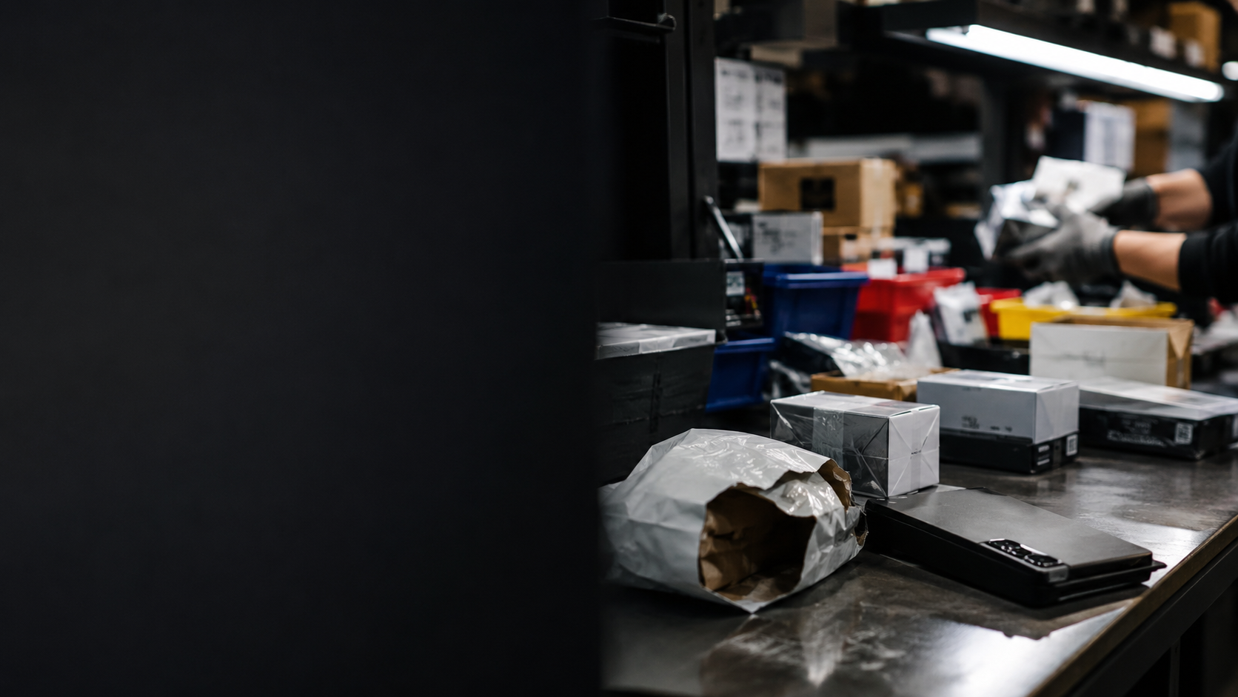
PROBLEM
Asia’s trade hub is still slowed by manual quality decisions
Hong Kong is a global gateway for high-value goods moving through Asia. But after containers and parcels enter warehouses, workers still inspect, classify and route exception-heavy items by hand.
13.7M TEUs
HK$10.9T
~60%
containers handled by HK in 2024
goods traded through HK in 2025
container throughput is transshipment
Current automation optimizes throughput
Port-Brain optimizes quality
•
Large systems: high-CapEx sorters, conveyors and warehouse rebuilds.
•
MicroSort: low-cost robotic cells that retrofit into dense logistics workstations.
•
Pain point: labor- and space-constrained teams need consistent first-pass triage for damaged, fragile, battery or high-value returns.
Sources: HK Marine Dept.; HKSAR C&SD; HKSAR Modern Logistics Action Plan

Slide 2
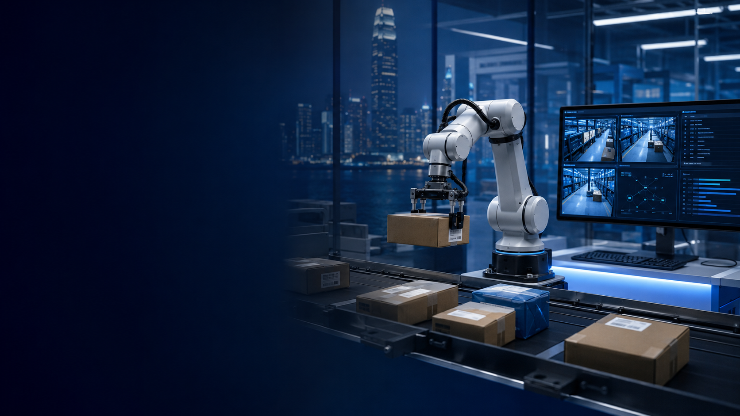
SOLUTION
Port-Brain MicroSort
A compact embodied-AI workstation for high-value logistics cells.
See
>
Decide
>
Act
>
Explain
camera
VLM + rules
robot policy
LLM log
•
Dashboard streams live robot operations: camera, action status, item history and exception queue.
•
LLM integration turns each action into an auditable explanation: what happened, why, and what a human should review.
•
MVP uses imitation-learned pick-and-place; roadmap adds predictive world models for safer fragile-goods handling.
Demo target: sort small parcels into Resell / Inspect / Manual Review bins

