Slide 1
NetworkNode
0
1
2
Loop 0
Loop 1
5
4
3

Slide 2
0
1
2
Loop 0
Loop 1
5
4
3

Slide 3
Topological object
quantity
0
1
2
Loop
X 2
Loop 0
Loop 1
LoopNode
X 6
LoopLink
X 8
5
4
3
X 7
NetworkLink

Slide 4
Loop 0
Loop 1
0
1
2
5
4
3

Slide 5
LoopLink 5->0
Loop 0
std::shared_ptr<Loop> loop;
std::shared_ptr<NetworkNode> source;
std::shared_ptr<NetworkNode> sink;
std::shared_ptr<NetworkLink> link;
NetworkNode 5
NetworkNode 0
NetworkLink 0->5

Slide 6
Physics
DislocationNetwork.h
DislocationNode.h
DislocationLoop.h
DislocationSegment.h
Geometry
SplineNode.h
SplineNode.h
Topology
LoopNode.h
Loop.h
NetworkLink.h
LoopNetwork.h
LoopLink.h

Slide 7
Topological Operations: LinkExpansion
0
6
1
2
5
4
3

Slide 8
Topological Operations: LinkExpansion
0
6
1
2
7
5
4
3

Slide 9
Dislocation Junction Formation
2
1
3
4

Slide 10
Dislocation Motion
Discrete events (junctions, node resdistribution)
= TOPOLOGICAL OPERATIONS
output

Slide 11
CURIOUSLY RECURSIVE TEMPLATE PATTERN
template<typename Derived>
struct A
{
A clone(){return static_cast<Derived*>(*this);}
};
struct B : public A<B>
{
};
B b1;
B b2=b1.clone();

Slide 12
x
unit sphere
centered at x
right-handed loop normal
Y_{n}=-R_{n}
P_{n+1}
P_{n}

Slide 13
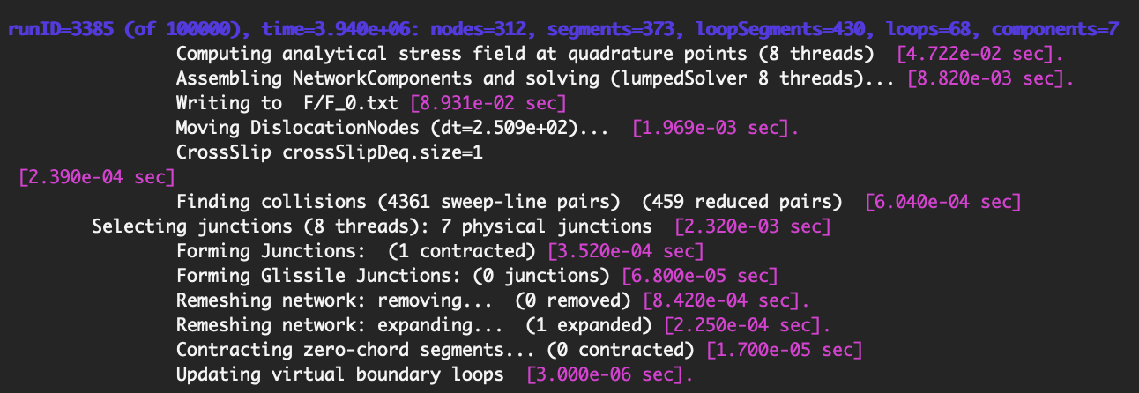
step #
time in code units
# of topological entities
motion
discrete events

Slide 14
.test()
.eval()
TestExpression<Derived>
TrialExpressionBase<Derived>
EvalExpression<Derived>
(testExpr,trialExpr)
BilinearForm
(testExpr,evalExpr)
LinearForm
(evalExpr,trialExpr)
LinearConstraint

